Slide 1
LEGAL MOBILIZATION… IN THE SHADOWS OF COURTS
The “politics of rights” (Scheingold)
A. Analyzes group/movement politics to mobilize rights → reconcile legal justice with social justice
Ex: same-sex marriage; gun rights; pro life/choice
B. Historic legal mobilization campaigns are episodic Most of time we are subjects “before” law -- Kafka
C. Capacities to mobilize reflect social inequalities,
different capacities (“resigned,” not duped)
D. In political contexts where rights traditions are
weak → few legal & social resources
Human rights activism by NGOs/lawyers →
aim to build rights culture, cut for and
against inequality

Slide 2
INDIVIDUAL LEGAL MOBILIZATION… IN THE SHADOWS OF COURTS
2. Zemans --“Legal mobilization”
A. Civil (and criminal) law is routinely mobilized by individual citizens in ordinary life
Defined as rights claiming; need not litigate (p.700)
B. Law enforced every day by ordinary legal subjects as well as officials – Laws R Us
Law empowers individuals in society – become “agents of state” p. 692 (we regulate each other)
Legal mobilization = “citizen participation” – “micro-politics” of citizen action (social movements = macro-politics)
Legal meaning is the water we fish swim in….
Notes:
There are these two young fish swimming along, and they happen to meet an older fish swimming the other way, who nods at them and says, "Morning, boys, how's the water?" And the two young fish swim on for a bit, and then eventually one of them looks over at the other and goes, "What the hell is water?"

Slide 3
INDIVIDUAL LEGAL MOBILIZATION… IN THE SHADOWS OF COURTS
C. Law’s power in social life as:
Practical knowledge
Ethical authority (want → entitlement)
Threat of state coercion
Actual coercive enforcement by state
D. Law constitutes citizen agents/subjects (697)
Shapes our interests, wants, expectations
Variable degrees of “legal/rights consciousness”
“Names” us and confers status/standing

Slide 4
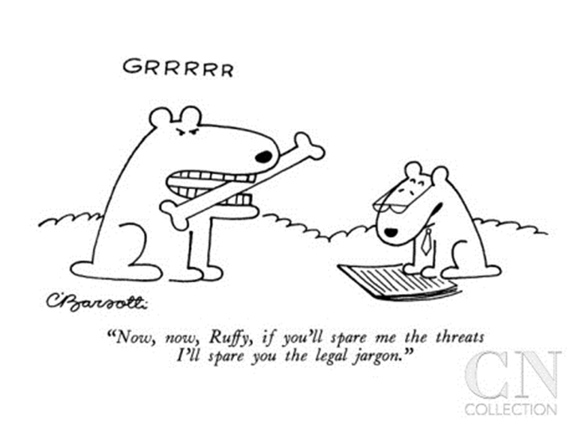
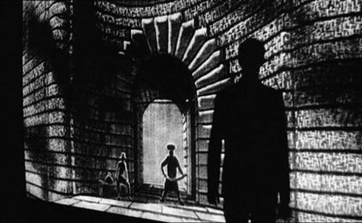
INDIVIDUAL LEGAL MOBILIZATION… IN THE SHADOWS OF COURTS

Slide 5
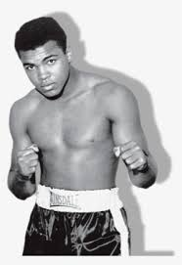
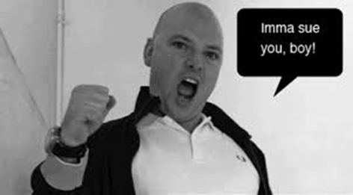
LEGAL MOBILIZATION… IN THE SHADOWS OF COURTS
E. Law’s power enables & constrains
Greatest when law goes unnoticed (water to fish)
F. Law is “all over” in our fragmented social system
G. Zemans – a bottom-up, democratic view of individual legal practice
Access & empowerment for ordinary people are
the measure of law’s performance

Slide 6
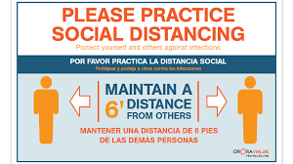
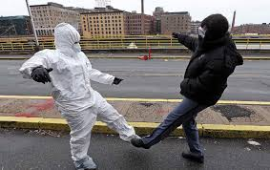
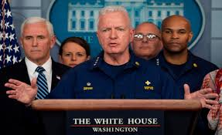
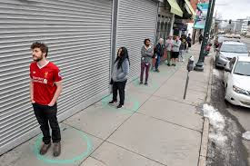
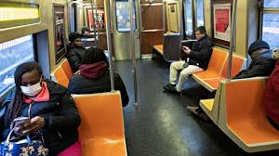
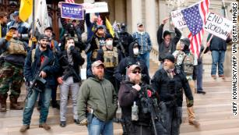
INDIVIDUAL LEGAL MOBILIZATION… IN THE TIME OF A PANDEMIC
Wide “range” of claims → claiming & disputing
Social Pressures for Distancing & Masking
We follow & enforce guidelines of officials
on each other (even if they don’t)

Slide 7
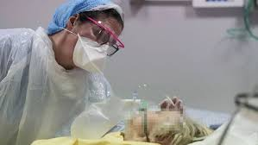
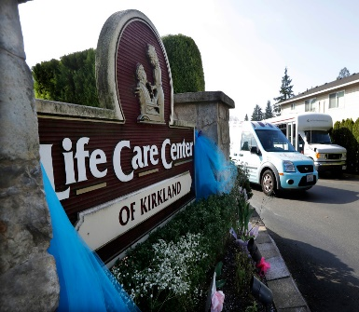
Legal Claiming in Time of Pandemic
NY Post: Lawsuits piling up across US amid coronavirus pandemic (!!)
Many types of legal claims, disputes and filings
Medical malpractice – for faulty treatment, for poor or side effects of drugs, wrongful death
Business neglect – nursing homes,
hospitals
Personal injury –negligent individuals infect others, employer negligence or pressure to work unsafely
Walmart Faces Lawsuit After Employee Dies from Virus

Slide 8
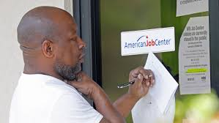
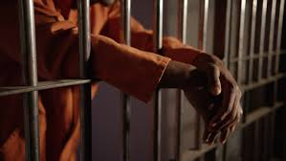
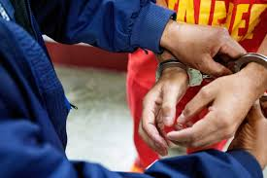
Unfair Business Employment Practices
Trader Joe’s Lawsuit Claims Employee Fired for Complaining About Lack of Gloves
Race/Sex Discrimination in Employee Termination,
Treatment
HHS Lawsuit Says LGBTQ Denied Care During Coronavirus Pandemic
Liability for Virus Infection in Prisons, ICE Detention
Texas Inmates Class Action Alleges Inadequate COVID-19 Protection
ICE Detainees Class Action Lawsuit Argues for Coronavirus Release

Slide 9
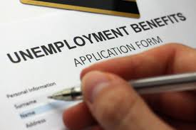
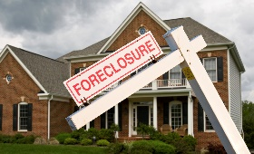
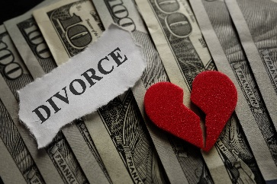
Products Liability claims
Inovio Sued Over False Coronavirus Vaccine Claims
Target Class Action Says Hand Sanitizer May Not Kill COVID-19
Unemployment Eligibility, Applications
Mortgage Loan Failure, Foreclosure
Divorce
Will COVID-19 lead to increased divorces?
Consumer Refund Claims (contracts)
U of Miami Class Action Lawsuit Requests Student COVID-19 Refunds

Slide 10
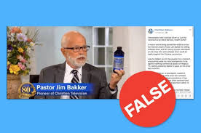
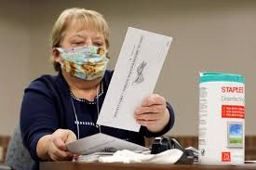
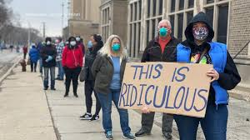
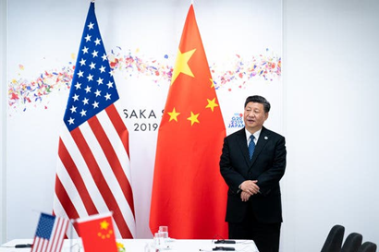
Libel
Televangelist Jim Bakker Faces Lawsuit After Selling Fake ‘Coronavirus Cure’
Voting Rights
Wisconsin Voters Call for No Witness Signatures During COVID-19
International Tort Liability
Will China Be Liable for Cornonavirus Pandemic?
Coronavirus Class Action Lawsuit Alleges
China Hid Virus News

Slide 11
LEGAL MOBILIZATION… IN THE SHADOWS OF COURTS
4. Citizen mobilization of law→ disputing practices
5 Stages of Disputing (Miller and Sarat)
(Experience of injury may lead to…)
A. Grievance (naming and blaming for harm)
B. Claim (pre-dispute)
C. Dispute (claim met with counter-claim)
D. Formalization (involve lawyer/police/mediator)
E. Resort to courts/state (adjudication)

Slide 12
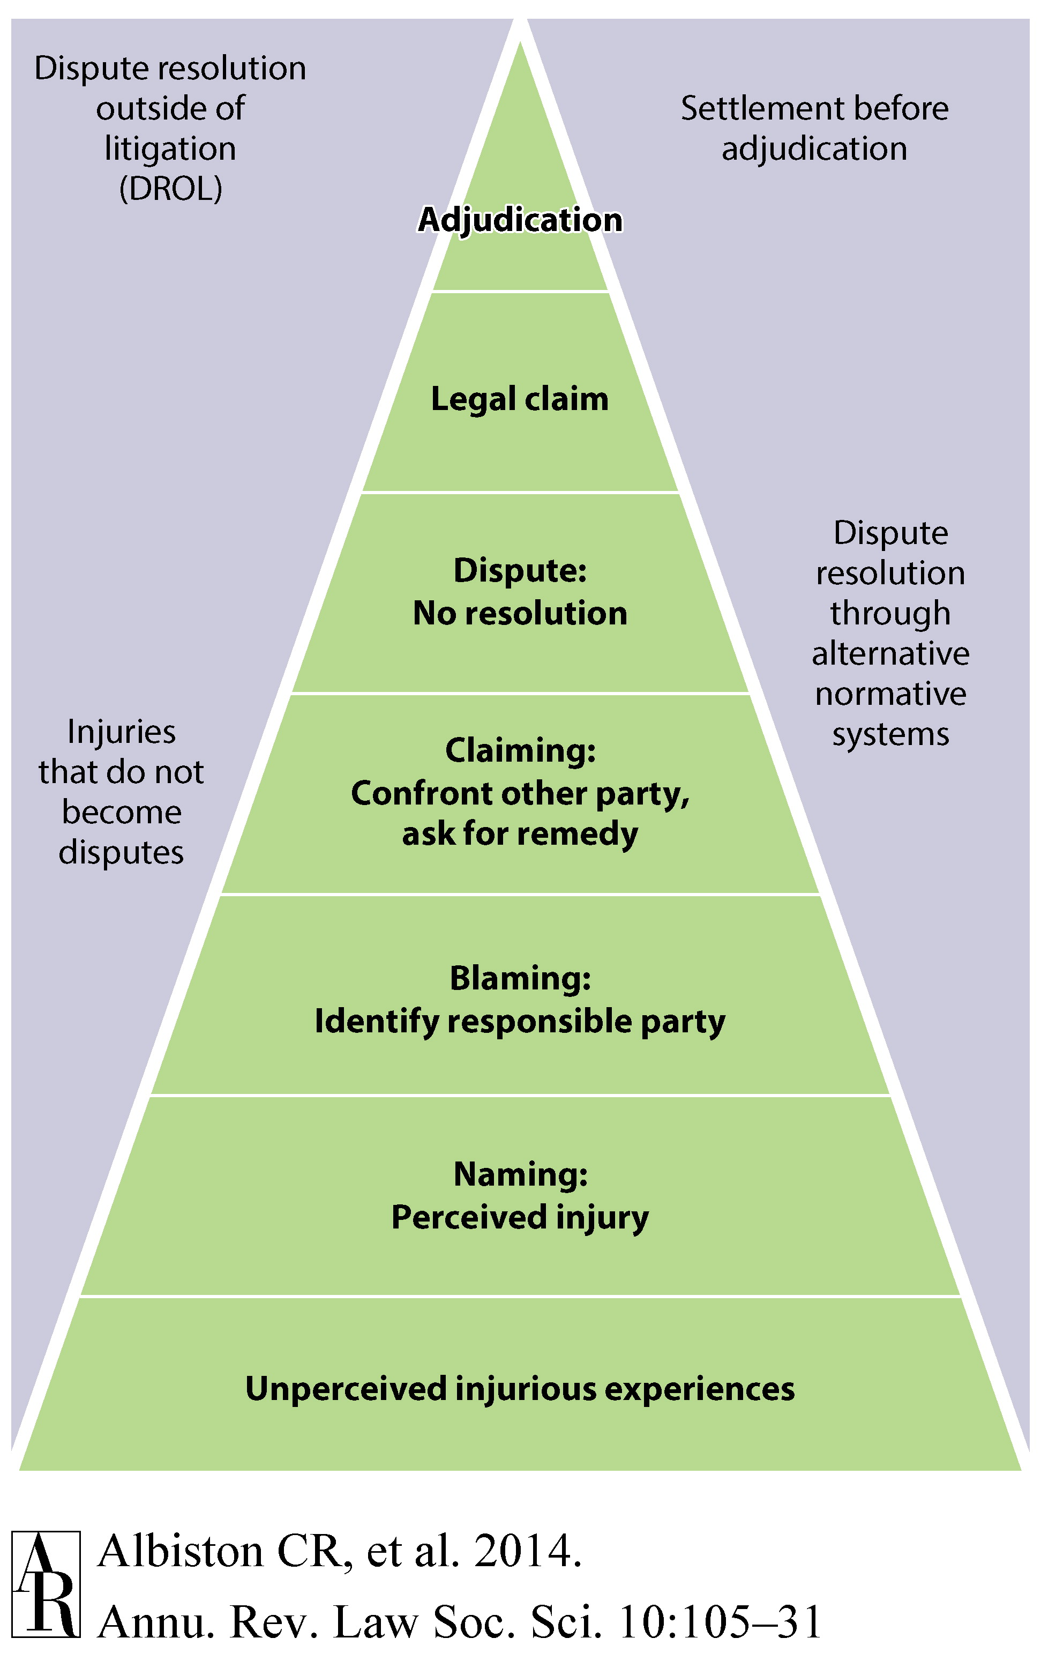

Slide 13
LEGAL MOBILIZATION… IN THE SHADOWS OF COURTS
5. “Shadow of courts” shapes action of disputants
A. Cost/risk of formalization encourages informal
disputing activity (in society, not state actors)
B. Different pyramid patterns – criminal, tort, discrimination, contract, divorce…disputes
C. Overall – Americans may be adversarial but are not litigious (as individuals)
The legal system and legal culture discourage formalization of claims and adjudication (formal litigation)

Slide 14
LEGAL MOBILIZATION… IN THE SHADOWS OF COURTS
6. Disputing studies: Why Do Many Victims “Lump It”
when harmed? Or lose if do make claims?
Law → opportunities. But need resources, power.
Key variables/factors that influence choices
A. Lack of knowledge of law, rights, legal process
B. Fear of risk -- money, time, stress, losing
C. Ability to pay lawyer/legal costs
“Single shot” vs. “repeat players”
Galanter – systemic bias toward haves w/ RPs
D. Individual social “status” – viewed as un/deserving, un/trustworthy by legal officials
E. Dependence on wrongdoer—people are reluctant to sue family, spouses, co-workers, employers

Slide 15
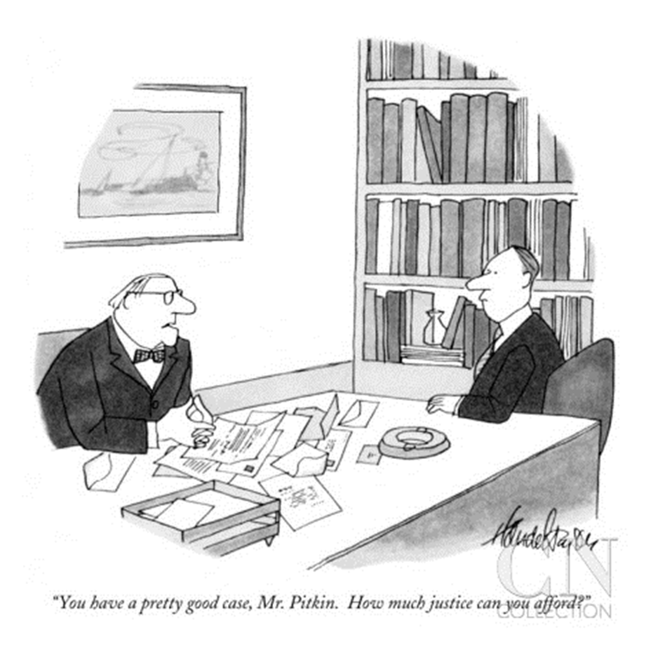
LEGAL MOBILIZATION… IN THE SHADOWS OF COURTS
Legal mobilization – formally equal access vs unequal
actual capacities for rights claiming (Zemans 693, 695)

Slide 16
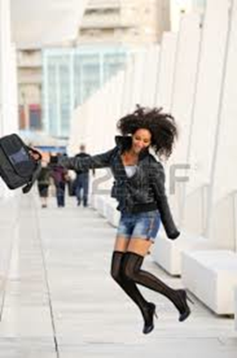
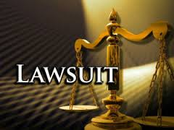
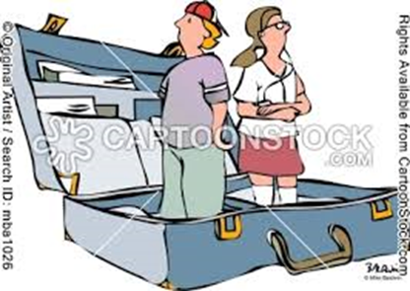
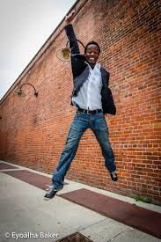
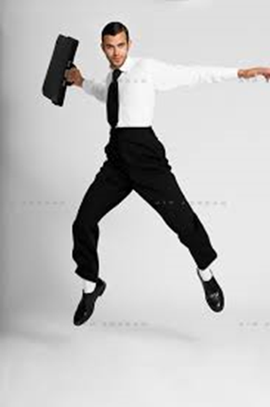
LEGAL MOBILIZATION… IN THE SHADOWS OF COURTS
Legal mobilization – formally equal access does not equal actual capacities for rights claiming (695)
VS

