Slide 1
LEGAL MOBILIZATION… IN THE SHADOWS OF COURTS
1. Zemans --“legal mobilization” by individuals
A. Defined as rights claiming, need not litigate (p.700, 692-3)
B. Law enforced everyday by ordinary legal subjects as well as officials – Laws R Us, as individuals….
C. As we mobilize law in relationships, law constructs us as legal subjects (our “perceptions of…interests,” expectations, wants, desires…) p. 697
Law “constitutes” our subjectivities and identities
D. We all are agents and subjects of law, but unequally so p. 693: “The Legal system can be considered quintessentially democratic, although not necessarily egalitarian if the competence and means to make use of…(law) is not equally distributed.”

Slide 2
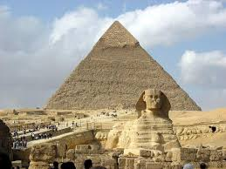
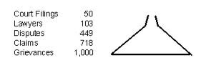
LEGAL MOBILIZATION… IN THE SHADOWS OF COURTS
2. As citizens mobilize law, claims → disputes
5 Stages (Miller and Sarat)
3. “Shadow of courts” shapes action of disputants
A. Cost/risk of formalization encourages informal
disputing activity (in society, not state actors)
B. Different pyramid patterns – criminal, tort, discrimination, contract, divorce…disputes
C. Overall – Americans as individuals may be adversarial but are not litigious

Slide 3
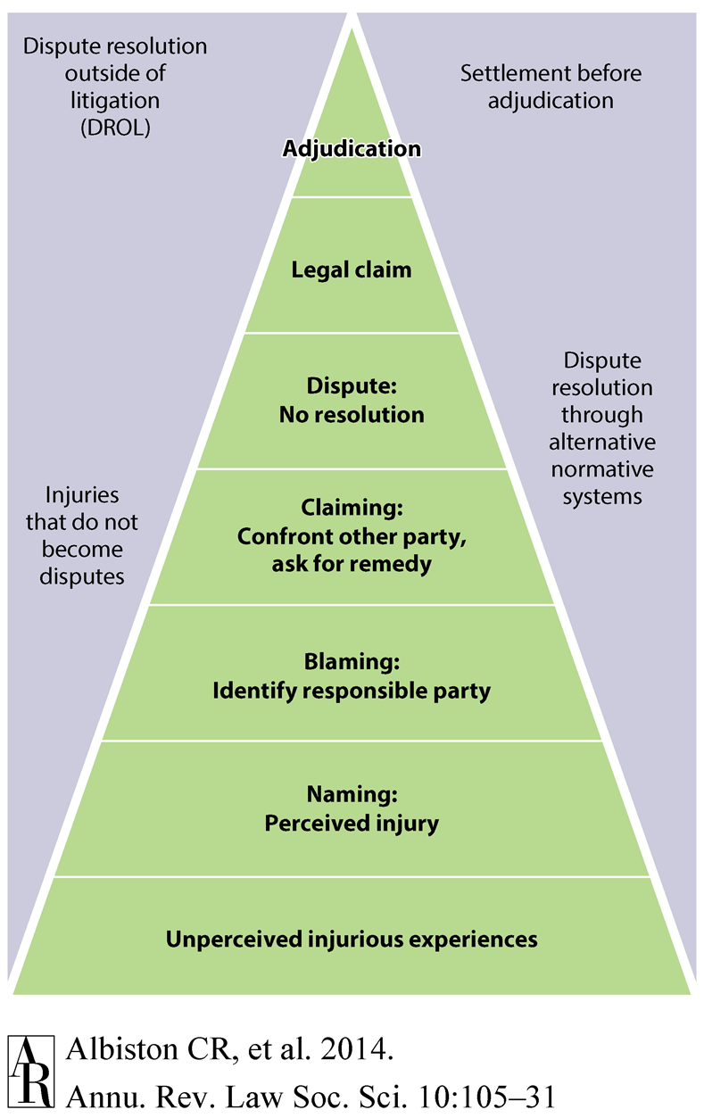
Formalization
Informal

Slide 4
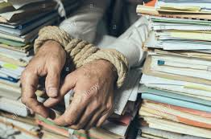
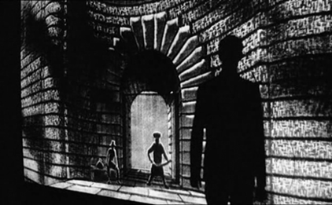
LEGAL MOBILIZATION… IN THE SHADOWS OF COURTS
Legal mobilization – formally equal access does not equal actual capacities for empowering rights claiming
VS

Slide 5
LEGAL MOBILIZATION… IN THE SHADOWS OF COURTS
4. Disputing studies: Why Do Many Victims “Lump It”
when harmed? Or lose if claim?
A. Lack of knowledge of law and in legal process
B. Fear of risk -- money, time, stress, losing
C. Ability to pay effective lawyer/legal costs
“Single shot” vs. “repeat players”
Galanter – systemic bias toward haves
D. Individual social “status” – viewed as un/deserving, un/trustworthy by legal officials
E. Dependence on wrongdoer—people are reluctant to sue family, spouses, co-workers, employers, gov’t administrators/regulators
F. Weak support network – family, friends, orgs

Slide 6
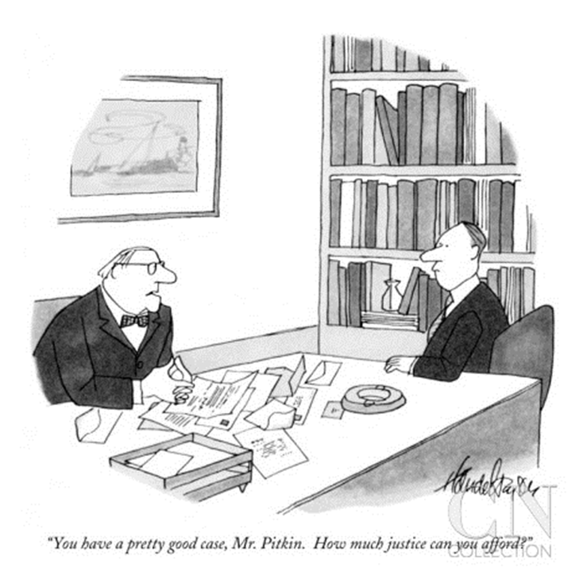
LEGAL MOBILIZATION… IN THE SHADOWS OF COURTS
Legal mobilization – formally equal access does not equal actual capacities for rights claiming

Slide 7
LEGAL MOBILIZATION… IN THE SHADOWS OF COURTS
A phone/camera can be a great equalizer for those who demand accountability….
Example: Darnella Frazier, the teen who filmed the killing of George Floyd and demanded accountability
Will see many examples of videos capturing excessive force by police during the second half of the course
Still, despite videos, very few charges and convictions….and limited evidence that police practices have changed

Slide 8
LEGAL MOBILIZATION… IN THE SHADOWS OF COURTS
How does pandemic crisis affect formalization of rights claims?
Job termination at shipyard for demanding safety appealed
NY: Fed Up Nurses File Lawsuits and Protest WH
Corporate America seeks legal protection from virus related lawsuits after lockdowns lift
Domestic violence cases surge amid stay-at-home orders

Slide 9
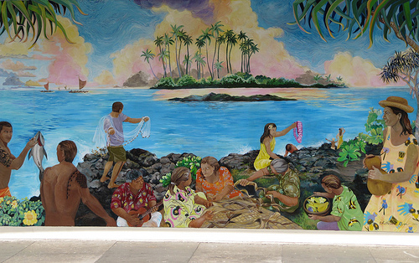
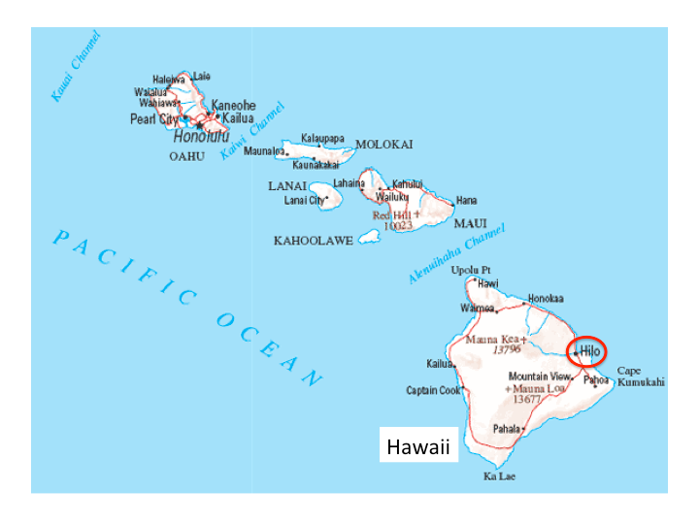
LEGAL MOBILIZATION… IN THE SHADOWS OF COURTS
4. Sally Engle Merry study of battered wives
A. Hilo, Hawaii – postcolonial historical context
Capitalism & rule of law → increased violence

Slide 10
LEGAL MOBILIZATION… IN THE SHADOWS OF COURTS
Merry – why/how do women decide to act & claim rights?
B. Abused women’s assertion of rights involves enacting new self, a new subjectivity (p. 345-9)
Subjectivity: Knowledge/viewpoint enacted from positions or roles in social relationships
Irony: “autonomous rights bearing individual” is a learned social role/performance
One of many subject positions or constructed identities of women (partner, mother, daughter, friend, Christian, etc)
Agency of subjects is constrained, contingent
Dependence on abuser is key constraint on making and formalizing claims (police)

Slide 11
LEGAL MOBILIZATION… IN THE SHADOWS OF COURTS
.
C. Transformation from wife/mother to rights- conscious claimant is “scary,” intimidating
D. What happens? Experiences vary.
E. Rights agency varies with context – support (or lack thereof) by family, women’s shelters, police, courts
F. Claimants must qualify as “good” victims (353-4)
Disciplined, reasonable, sober, cooperative
G. Some women empowered > increased agency and changed relationships (others not so much)
Experiences in law affect future actions

Slide 12
LEGAL MOBILIZATION… IN THE SHADOWS OF COURTS
.
H. Experience of Dora vs. Darlene (pp. 360-1)
I. Responses of men, husbands (to TRO, ATV, jail)
• Sometimes abusers change; mostly resist
• View formal claims by partners as betrayal, humiliation
• Lose rights, autonomy, control; law is alien force of state (like prison)
• Reverse gender identity (p.375?)
Women empowered, men emasculated
J. Relevance of class/wealth status – “good” victim, alternative resources/options

Slide 13
LEGAL MOBILIZATION… IN THE SHADOWS OF COURTS
.
K. Implications for (human) rights – implementation support structure matters on the ground
Individual subjects are not autonomous, free rights claimants, but are dependent and constrained by relational context → reluctant, lump it, at best mixed outcomes
Much like group based rights movements
Contingent on favorable context, resources, support structures and alliances
L. Does state violence remedy social violence ? Beyond punitive criminalization as remedy
Alternatives?

