Slide 1
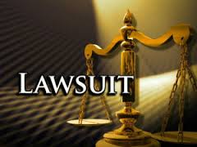
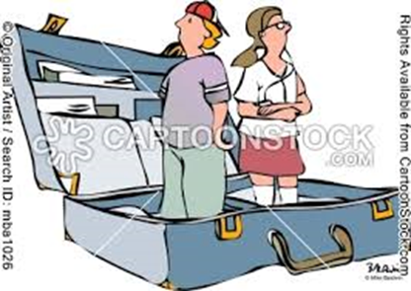
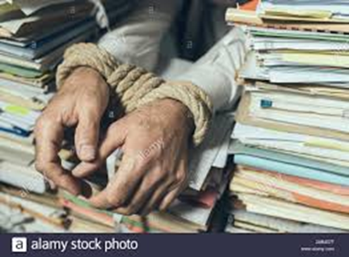
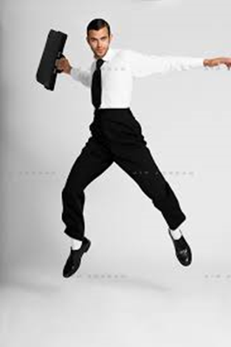
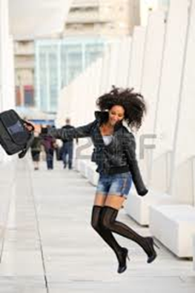
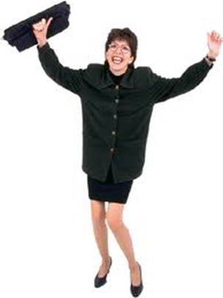
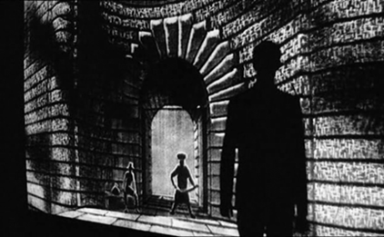
LEGAL MOBILIZATION… IN THE SHADOWS OF COURTS
Legal mobilization (Zemans)– formally equal access
vs. unequal capacities for empowering rights claiming

Slide 2
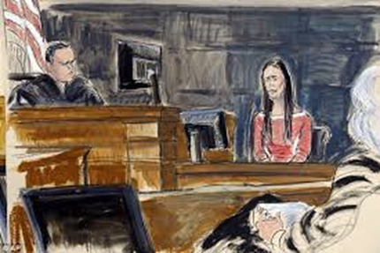
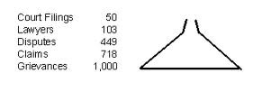
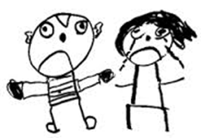
LEGAL MOBILIZATION… IN THE SHADOWS OF COURTS
2. Citizen mobilization of law > disputes
5 Stages (Miller and Sarat)
Merry – assertion of rights & mobilization of criminal law by abused women varies widely with key factors
A. Rights consciousness, knowledge, subjectivities
B. Past direct/indirect experiences with law
C. Dependence on abusers
D. Un/Supportive group network
E. Responses of state officials (police, judges, jury)
F. Claimant qualifies as “good,” disciplined victim

Slide 3
LEGAL MOBILIZATION… IN THE SHADOWS OF COURTS
Implications for assessing ordinary legal practice in US…
We increasingly hear the voices of those who perceive and fear the growth of an "adversary society”… a society of assertive, aggressive, rights-conscious, litigious people ready and eager to challenge each other and those in authority (Miller and Sarat, p. 53).
There is, of course, another view…which suggests we are, in fact, relatively uncontentious and even passive… Proponents of this view typically question the adequacy of existing political, social, and economic arrangements to achieve justice (Miller and Sarat, p. 53)

Slide 4
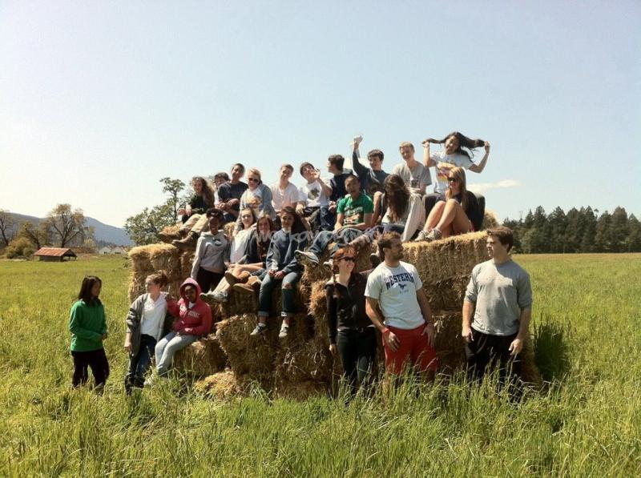
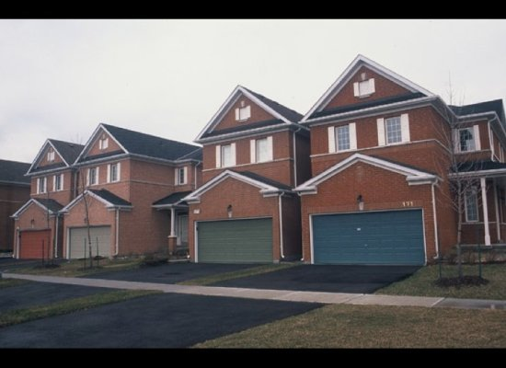
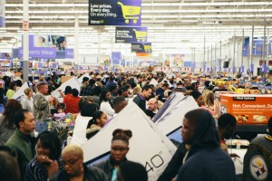
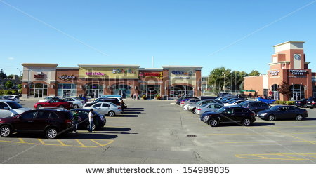
LEGAL MOBILIZATION… IN A COERCIVE COMMUNITY
Sander County changing
then (Blue Velvet)
vs. now

Slide 5
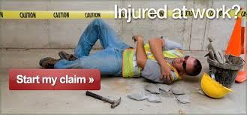
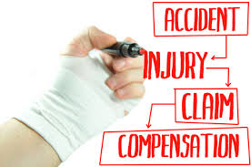
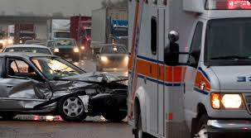
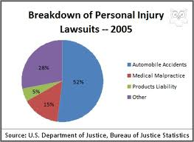
LEGAL MOBILIZATION/AVOIDANCE… IN A COERCIVE COMMUNITY
How do citizens deal w/ personal injuries (torts) in Sander Co.?
Most injured people lump it or settle tort claims…..

Slide 6
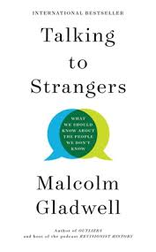
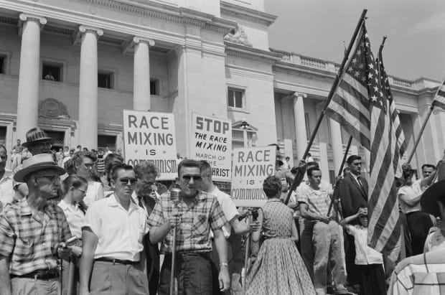
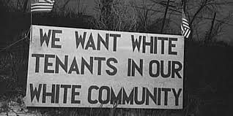
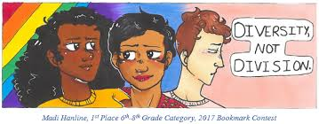
LEGAL MOBILIZATION/AVOIDANCE… IN A COERCIVE COMMUNITY
A. Why do injured persons avoid legal tort claims?
Insiders scorn litigants as “outsiders”
Who? New arrivals, racially different, low income
B. What is relationship of law and community?
i. “Avoidance” of rights mobilization enforces and expresses community
ii. Courts - site of contests between strangers (554)
Law constructs/connects/divides subjects (551)
Law reflects & enforces “social distance”

Slide 7
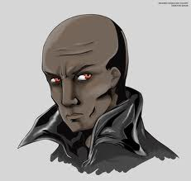
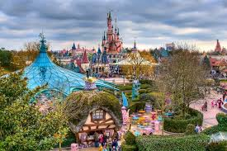
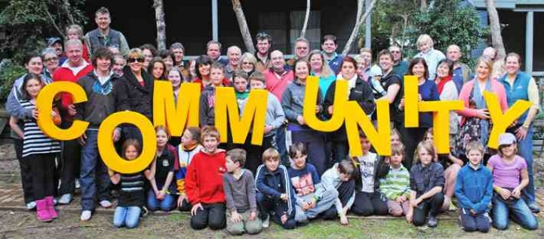
LEGAL MOBILIZATION/AVOIDANCE… IN A COERCIVE COMMUNITY
iii. Who enforces avoidance? (multiple actors)
External pressure → internalized (561)
iv. What is “community”? (Fantasy p. 580-81)
v. Allegory (p. 573) – need aliens for “unity” (579)
C. Engel two rival types of “Individualism”
Self reliance (promotes community)
Rights claiming (undermines community)

Slide 8
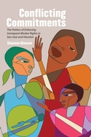
LEGAL MOBILIZATION/AVOIDANCE… IN A COERCIVE COMMUNITY
D. What do we know about outsiders?
i. Do outsiders really “litigate” disputes?
ii. Why might they sometimes “use” law?
iii. Paradox – they need law (572-3), but use of law reinforces their outsider status
iv. “Outsider” = multiple meanings, local myth of rights abuser vs. actual practice of low rights claiming
Community → normalizing discipline
Resistant or submissive subjectivity?
v. Engel does not provide much voice to
the “songs of others.” (Passive?)

Slide 9
LEGAL MOBILIZATION/AVOIDANCE… IN A COERCIVE COMMUNITY
E. Engel: Community pressures against rights mobilization
i. What of justice, of rights to remedy, of inclusionary legal promise?
ii. Are all persons equal under law?
iii. Rights – vary w/ image of deserving community member
Zemans’ ideal thwarted by all 6 factors discussed previously
Cp. Merry’s similar factors
Plus community stigma….
iv. Community –> unequal power for outsiders & among insiders (tavernkeeper)

Slide 10
LEGAL MOBILIZATION… IN THE SHADOWS OF LAW
Disputing studies: Why Do Victims “Lump It” or Lose?
A. Individual social “status” – viewed as “not good,” un/deserving, un/trustworthy by legal officials
Community stigma as “litigious” adds constraint
B. Dependence on wrongdoer—people are reluctant to sue family, neighbors, co-workers, employers, gov’t administrators/regulators (strangers sue)
C. Support network – family, friends, organizations
D. Lack of insider knowledge of law & legal process
E. Fear of risk -- money, time, stress, losing
F. Ability to pay effective lawyer/legal costs
“Single shot” vs. “repeat players”
Galanter – systemic bias toward haves

Slide 11
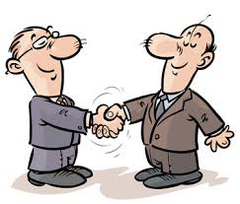
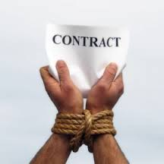
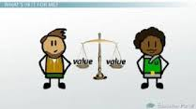
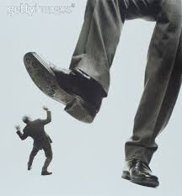
LEGAL MOBILIZATION/AVOIDANCE… AMIDST A COERCIVE COMMUNITY
2. Contract grievances & disputes
A. How different in practice? Why?
` B. Explanations:
Moral individuals “promise”→
preserve moral community
Power differentials of parties→
preserve social hierarchies

Slide 12
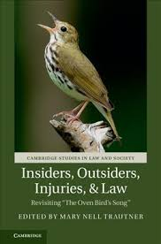
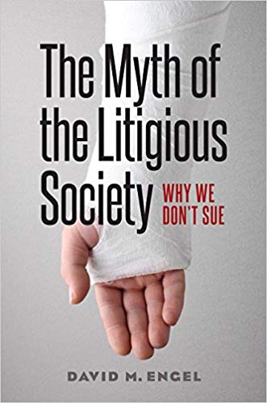
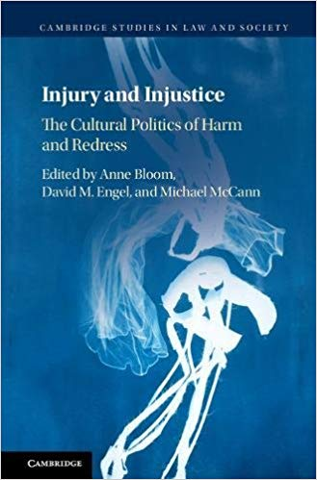
LEGAL MOBILIZATION/AVOIDANCE… AMIDST A COERCIVE COMMUNITY
3. Sander County – classic study of law in society

Slide 13
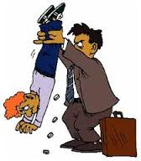
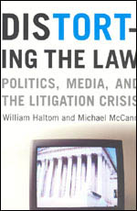
LEGAL MOBILIZATION/AVOIDANCE… AMIDST A COERCIVE COMMUNITY
3. Sander County – ideology & fears of decaying order
Is this anti-litigiousness confined to small communities
in transition about loss of customary past?
Next class: The “litigation crisis” and rights stigma as a national moral panic (or hegemonic practice) and reactionary “tort reform” movement

