Slide 1
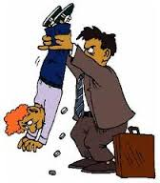
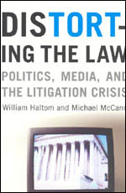
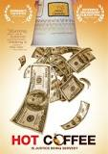
LEGAL MOBILIZATION/AVOIDANCE…
IN THE NATIONAL COMMUNITY
Engel: anti-litigiousness and anti-rights claiming is confined to small communities in transition about loss of past
McCann: it was a national phenomenon in 1970s→today
Tort reform movement aimed to make US into
Engel’s Sander County

Slide 2
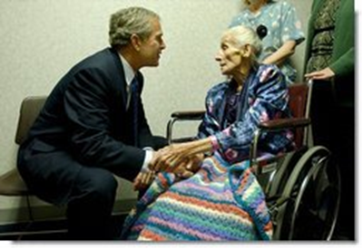
LEGAL MOBILIZATION/AVOIDANCE…
IN THE NATIONAL COMMUNITY
Health care costs rise for a lot of reasons…..And some of the costs are necessary. But there are some costs that are unnecessary as far as I'm concerned. And the problem of those unnecessary costs don't start in the waiting room, or the operating room, they're in the courtroom. (Applause.) We're a litigious society; everybody is suing, it seems like. There are too many lawsuits in America, and there are too many lawsuits filed against doctors and hospitals without merit. (Applause.)
President George W. Bush, Scranton, PA, 2003

Slide 3
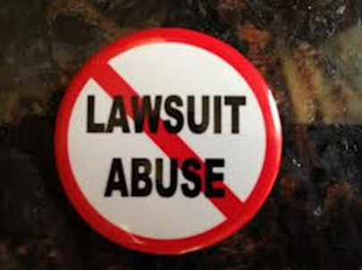
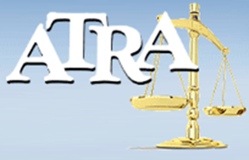
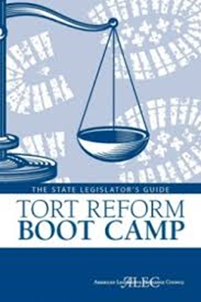

LEGAL MOBILIZATION/AVOIDANCE…
IN THE NATIONAL COMMUNITY
1."Tort Reform" Politics 1980s, pushed by Big Business, GOP
Classic conservative legal reform movement
A. Allegations - too many lawyers, claims, lawsuits, plaintiff wins, costs, rights
b. Reform proposals
-- Limit punitive damages
-- Losers should pay (deterrent)
-- Cap on noneconomic injuries
-- Federal over state standards

Slide 4
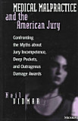
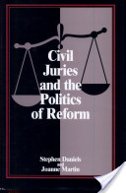
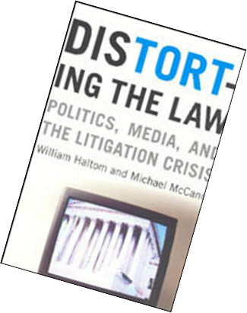
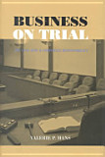
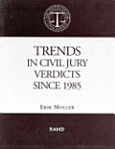
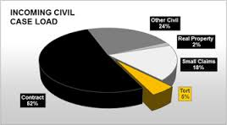
LEGAL MOBILIZATION/AVOIDANCE…
IN THE NATIONAL COMMUNITY
2. Empirical social scientists found little evidence of increase in personal injury litigation or epidemic of lawsuits in 1970s

Slide 5
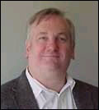
LEGAL MOBILIZATION/AVOIDANCE…
IN THE NATIONAL COMMUNITY

Slide 6
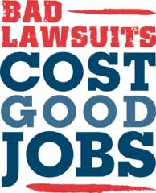
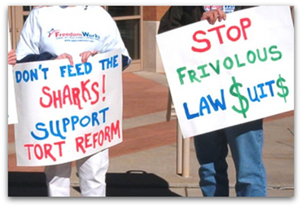
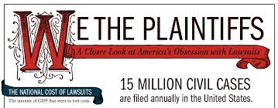

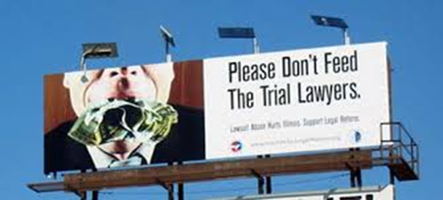
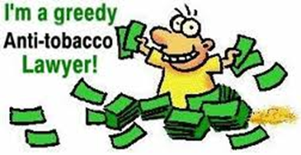

LEGAL MOBILIZATION/AVOIDANCE…
IN THE NATIONAL COMMUNITY
3. Reformers have little evidence, rely on anecdotes (tort tales & pop torts) that tap “common sense” folklore
A. Print ads, testimony, lobbying –
Instrumental reform advocacy
B. Focus on stigma of personal irresponsibility, greed

Slide 7
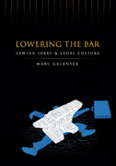
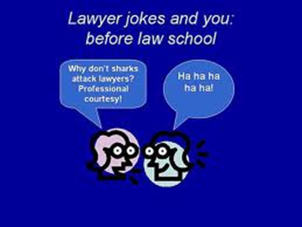
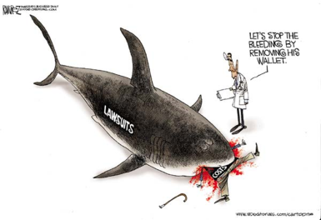
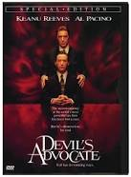
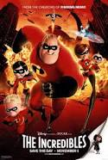
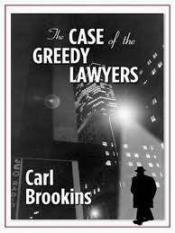
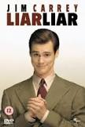
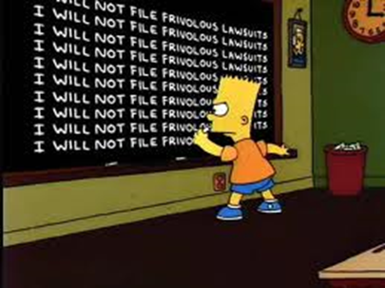
LEGAL MOBILIZATION/AVOIDANCE…
IN THE NATIONAL COMMUNITY
C. Mirrored in popular culture
  Lawyer jokes & cartoons
  Saturation of TV/movies/books stories of lawyers, trials, litigants
  Infotainment: "Trouble w/ Lawyers" (John Stossel)

Slide 8
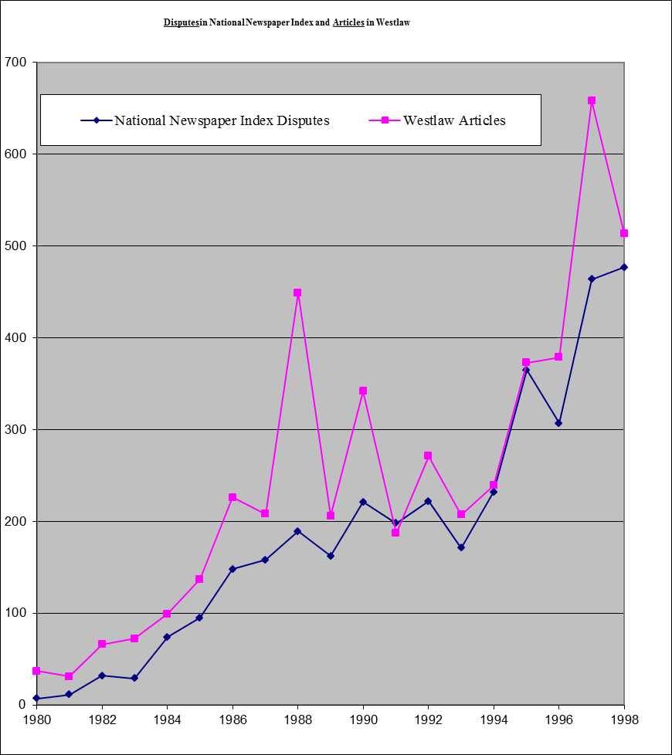
LEGAL MOBILIZATION/AVOIDANCE…
4. Mass Media News reporting on tort litigation 1980-2000
  Over-reported:
  A. Increases in # of tort stories over time (3800 arts)

Slide 9
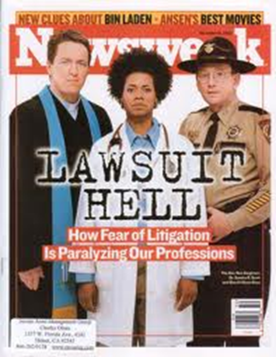
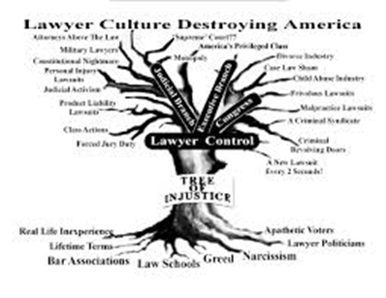
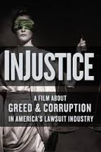
LEGAL MOBILIZATION/AVOIDANCE…
(Reports exaggerate/distort actual practice)
  B. Products Liability cases -- 90% of what is
  reported vs 4-5% of actual tort cases
  C. Wins by plaintiffs -- actual wins 35%; news > over 80% (most reporting is about filing)
  D. Large monetary awards -- 80% of articles about awards over median (dollars holler)
  E. Critics -- 2:1 cited over defenders of system
  F. Complaints about cost, greed (70%)

Slide 10
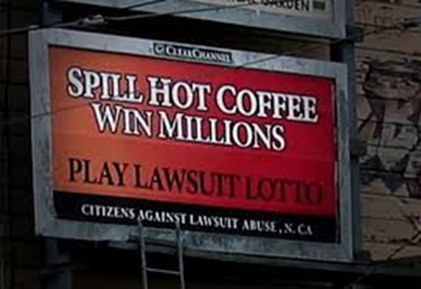
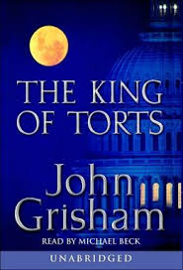
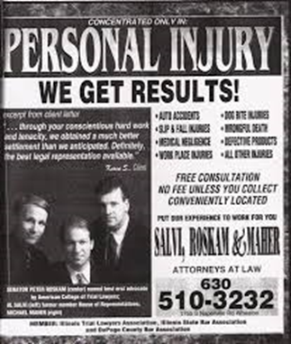
LEGAL MOBILIZATION/AVOIDANCE…
5. MacDonald’s Coffee Case: Real Injury→ Tort Tale
A. The Hot Coffee case video –
heroic trial lawyer counter-version
Adam Ruins the MacDonald’s Coffee Lawsuit
B. What the video gets right – facts of the case; media coverage discouraged plaintiffs, ridiculed lawyers
  New York Times Retrospective

Slide 11
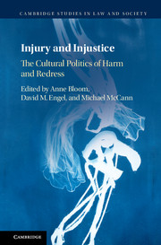
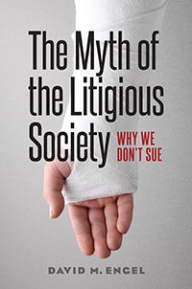
LEGAL MOBILIZATION/AVOIDANCE…
C. Beyond the video
i. Miss the role of corporate campaign,
media complicity & IR ideology
ii. Trial lawyers are part of the problem
iii. Tort system is inaccessible, inefficient
For ordinary people – as workers, consumers, resource-poor minorities
iv. Comparative legal study → US lacks consumer regulation, universal
health care (why must we sue
to get care?)

Slide 12
LEGAL MOBILIZATION/AVOIDANCE…
6. Anecdotal, cartoon knowledge of law shapes practice
A. Politics/policy -- what is/not reformed
B. Tort reform movement influenced legal knowledge (anti-rights) that we act on

Slide 13
LEGAL MOBILIZATION/AVOIDANCE…
We all live in Sander County….

