Slide 1
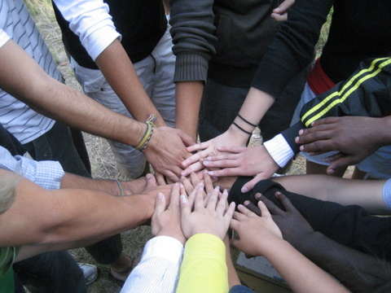
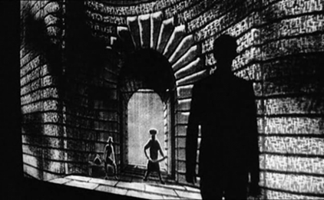
Law Is a Figment of Our Imagination….
Law’s words construct community, but law’s language is indeterminate, contested, unequally accessible, exclusionary
Our “myths” of law are contradictory – both encourage & discourage rights claiming, unequally
Enable us as legal actors, constrain us as subjects
B. Flawed law & failed communities → a challenge to build legal community where rights of all are respected and enacted

Slide 2
But Law is Real….Words “Trigger” Legal Violence
2. Robert Cover offers a theoretical challenge and framework
“Legal interpretation takes place in a field of pain and death.”
A. Law aspires to contain, deter, & remedy violence
B. But law’s power relies on violence - symbolic (words) and physical constraints
Hobbes: legal state violence creates order

Slide 3
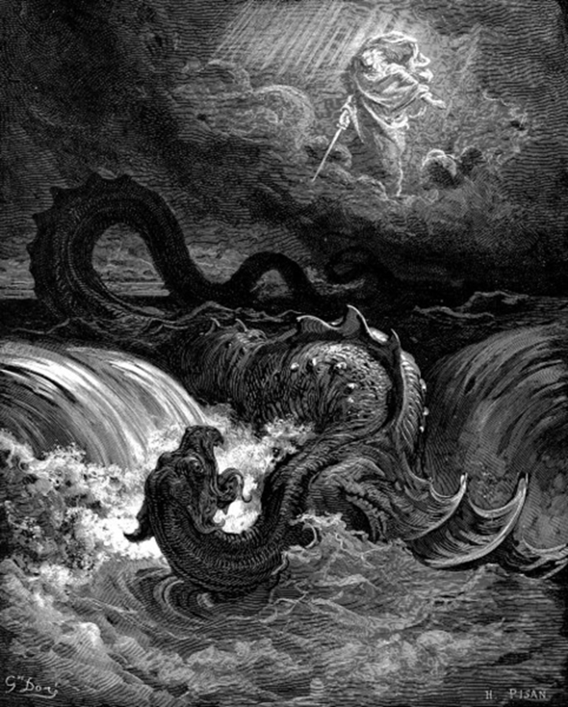
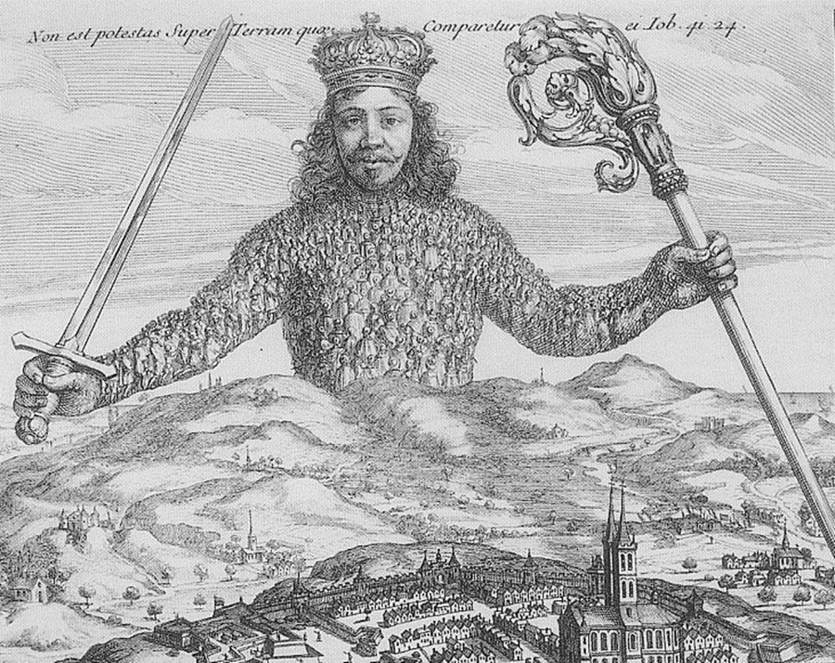
From Law’s Words to Legal Violence
Thomas Hobbes’s modern legal state, Leviathan 1651
"There is no power on earth to be
compared to him.” Job 41:24

Slide 4
From Law’s Words to Legal Violence
C. Law affirms/denies, creates/destroys
Merry: claiming rights may deter/punish violence against women by imposing legal violence on male abusers
Engel: insiders resent threat of legal violence
D. Citizen compliance with law – due to the power of words… or the threat/application of force?
Max Weber: legal state has monopoly on violence
E. But law aspires to discipline & limit violence of state legal officials (Thompson: law limits arbitrary, excessively violent governance”
Capt. Vere in Billy Budd)

Slide 5
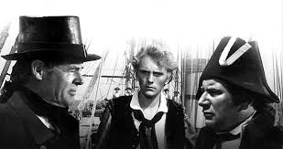
Melville: Billy Budd
Master At Arms Claggart: We must
serve the law, sir, or give up the right and privilege of service. It is only within that law that we may use our discretions of our rank……I am what I am, sir. And what the world has made me.
Captain Vere: The world? The world demands that behind every peacemaker there be the gun, the gallows, the jail. Do you think it will always be so?
Master At Arms Claggart: I have no reason not to, sir.
Captain Vere: But remember, Mr. Claggart, that even the man who wields the whip cannot defy the code we must obey and not be broken by it. That will be all.
Master At Arms Claggert: Aye, sir. With your permission, sir, is it still to be ten lashes?
.

Slide 6
From Law’s Words to Legal Violence
In the book/movie, the subjugated crew responds with disgust and anger
They witness the abuse of law’s violence
….and the empty words of justification by Captain Vere
The crew plots to kill or remove the bad cop, Claggart
Billy Budd reacts in anger, hitting and killing Claggart after he lies to frame BB
When Billy Budd is hanged for his violence and Claggart ”prevails,” the subjugated crew revolts
The ship divides and mutiny rules…until a distant threat of an external enemy arises and all unite again, if unhappily…`

Slide 7
From Law’s Words to Legal Violence
3. Cover: Law’s words “mask” law’s violence
A. Focus on formal legal arguments/words diverts from material, painful outcomes (words abstract from the “real,” trial vs punishment)
Legal abstractions “forget” real people
B. Fragmented “institutionalization” of law in practice separates words and violent deeds
C. Law’s focus on procedural limits to arbitrary violence distracts from systematic, routinized violence (e.g., mass incarceration)
Liberal law permits illiberal legal practices
Legal practices/rituals induce “forgetting” of symbolic and physical violence

Slide 8
From Law’s Words to Legal Violence
4. Focus on criminal justice – where physical and psychological violence are most evident
We will consider three sites of legal violence:
A. Police fight social violence w/ legal force
Violence of police in the street
Coercion in the station house
Political contestation (protests) over violence
Police enforce law, but are they limited by law?
B. Punishment – torture, prison, solitary confinement
C. Death Penalty -- the ultimate violence
Central Park Five – social & police violence

Slide 9
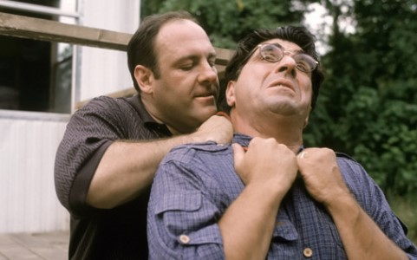
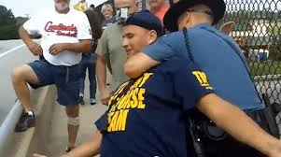
From Law’s Words to Legal Violence
5. Questions to and beyond Cover:
A) How does law’s violence differ from the violence it is supposed to deter, contain, remedy?
What makes law’s violence “better” or more acceptable than other types of violence?
Law’s violence should be more rational, measured,
constructive of community….but is it?
Does procedure really tame legal violence?

Slide 10
From Law’s Words to Legal Violence
Cover never defines “violence”
Violence = the use of physical force to cause injury, damage or death
1. swift, intense force: violence of storm.
2. rough or injurious physical force, action, or treatment
3. an unjust or unwarranted exertion of force or
power, as against rights or laws: to take over a
government by violence.
So is “legal violence” inherently legitimate
or just? A contradiction within law?
We need critical standards…

Slide 11
From Law’s Words to Legal Violence
B) How much violence is reasonable or excessive, both in individual cases and in aggregate?
Is Cover too comfortable w/ the “necessity” and ubiquity of law’s violence? (p. 1608)
i) Historical context of Cover – 1980s law & order politics, mass incarceration, “wars” on crime and abroad, accelerating punitiveness
ii) Is the US an overly punitive society? If so, why?
C. Who are the legitimate objects/subjects of violence?
i. Disproportionately poor people of color
ii. History of criminalizing race as “status crime”
Racial profiling is normal practice
iii. The “ghosts of slavery” haunt America still…(?)

Slide 12
From Law’s Words to Legal Violence
6. McCann: Legal violence is limited, measured force
i) Law’s words = reasoned, principled justification for and containment of violence
ii) Due Process exists to contest/review official violence for lawful justification
iii) Lawfulness relies on “economy of violence” – the least violence necessary to achieve end
Substantive as well as procedural constraints
iv) Law is most powerful when words need no violence to back them up
v) Excessive official violence undermines trust in law’s words → more violence
Legal officials can/do act unlawfully

Slide 13
From Law’s Words to Legal Violence
Hannah Arendt: "Violence can be justifiable, but it never will be legitimate ... Its justification loses in plausibility the farther its intended end recedes into the future. No one questions the use of violence in self-defense, because the danger is not only clear but also present, and the end justifying the means is immediate".
Violence (necessary force) vs. Power (relationship of trust)
Cover: Violence “kills” the meaning of words.
How can words justify violence if violence kills words?
**

Slide 14
From Law’s Words to Legal Violence
7. Three challenges for remedying excessive violence of law
1) Legality privileges procedural over substantive justice & fairness (impact ignored)
Few standards for proper amount of violence
2) Legality focuses on individual fairness, masking
institutionalized/systemic dimensions of state violence (profiling; punishment)
3) Obstacles to challenging legal abuse: legal rights mobilization to tame and remedy excessive violence is limited by deficient resource capacity of those subjected to violence (as individuals and as groups)
Racial & class repression permeate law’s violence

