Slide 1
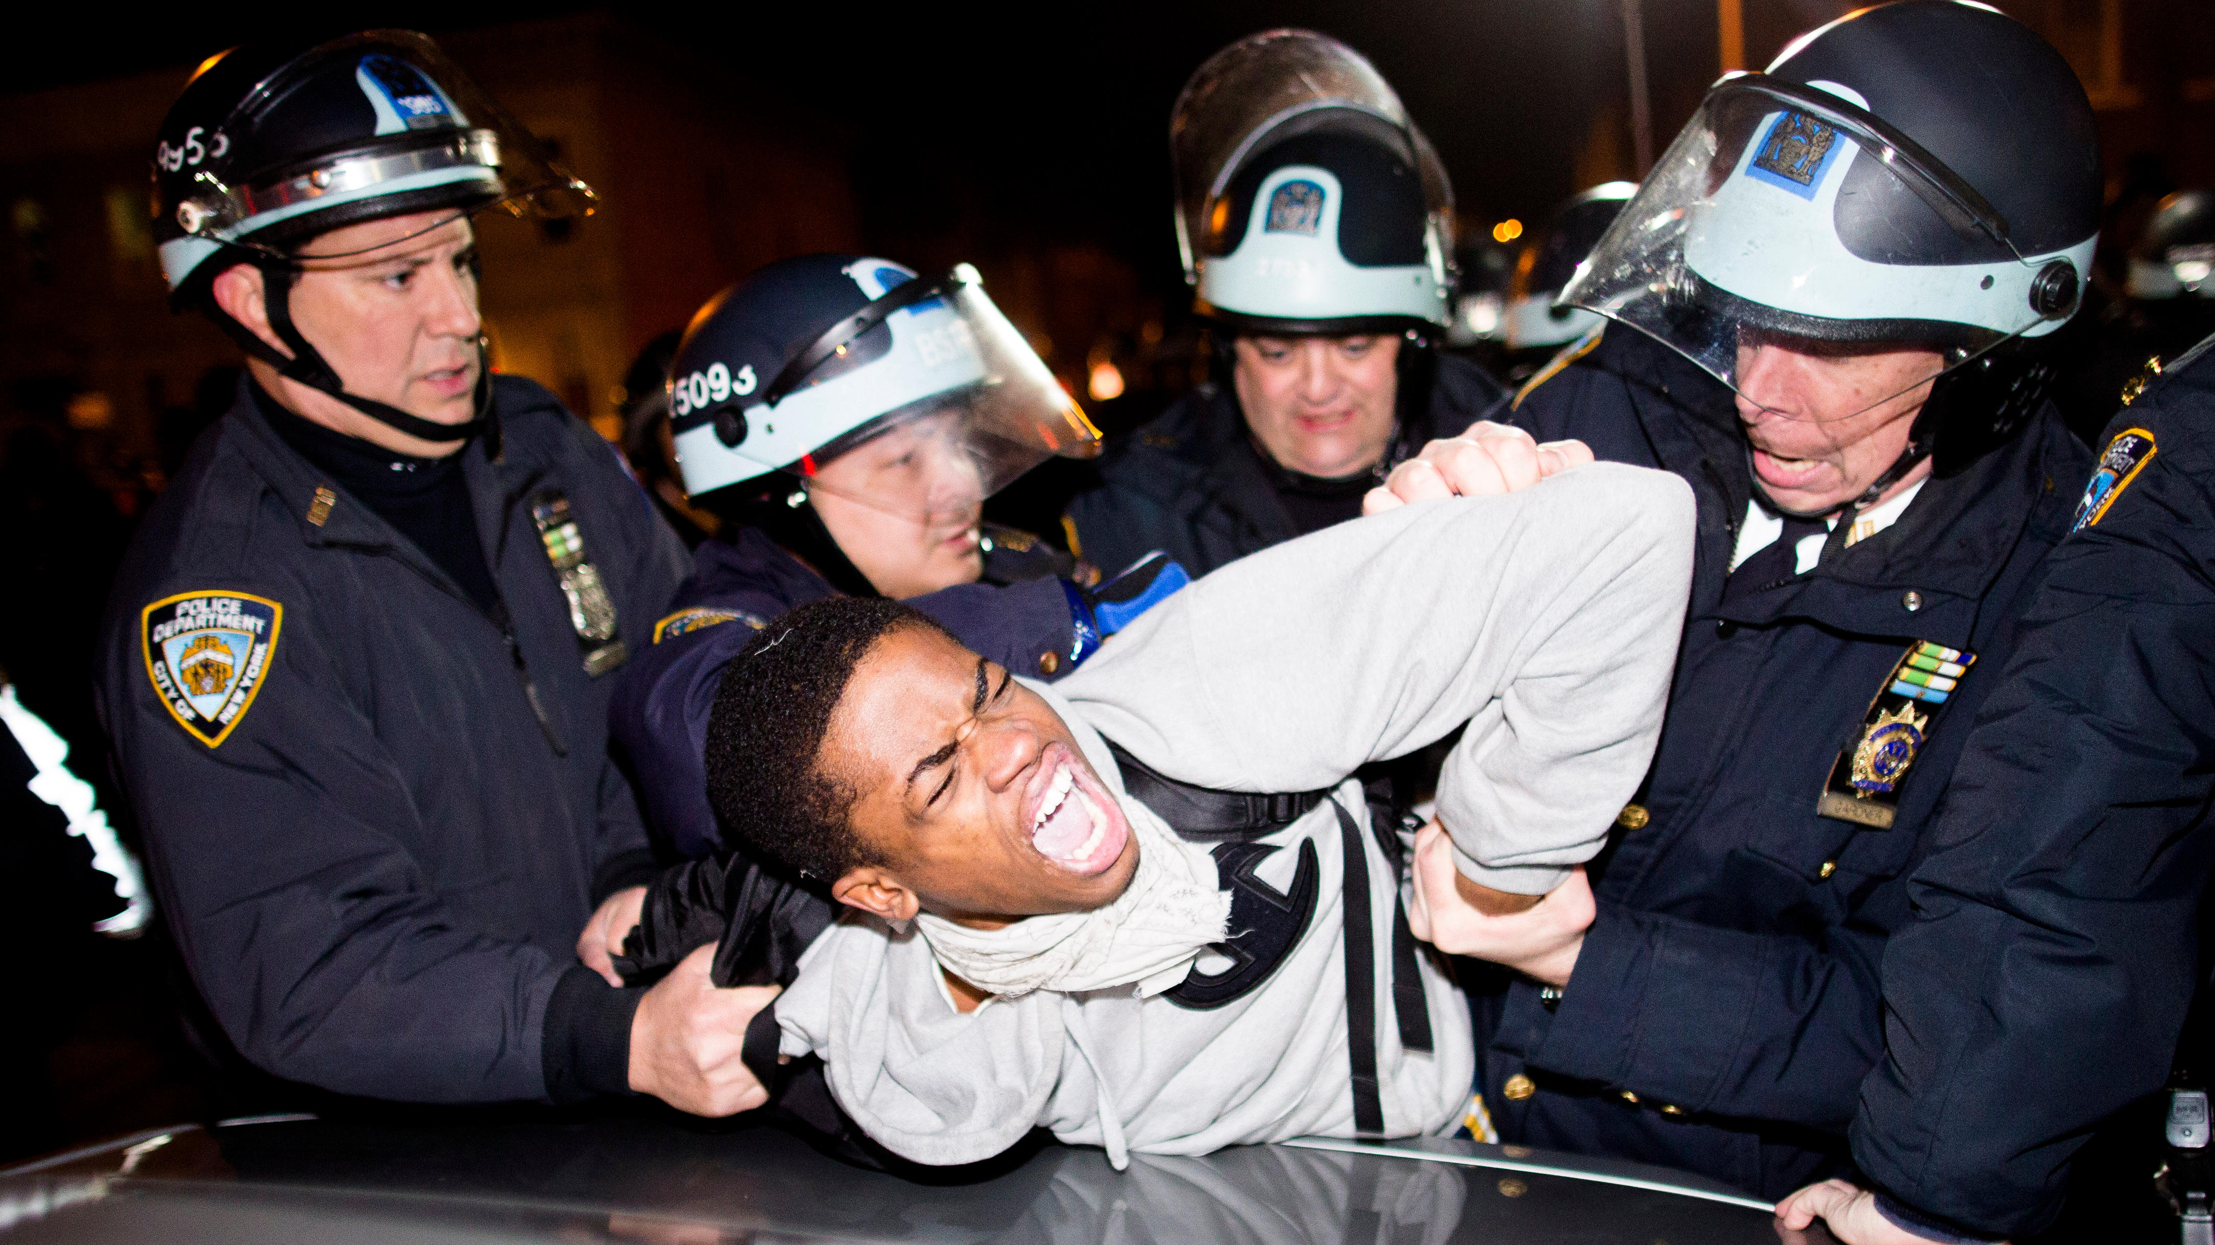
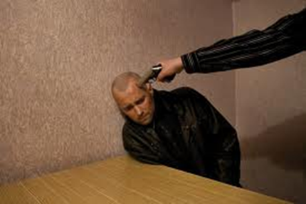
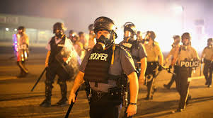
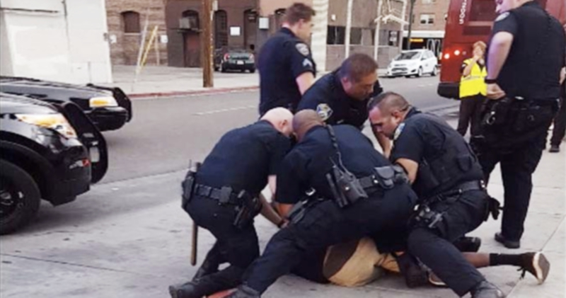
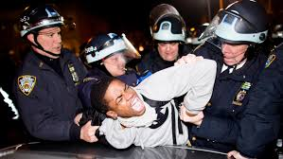
Law’s Violence: The Police
Cover: “Legal interpretation takes place on a field of pain and death…..”

Slide 2
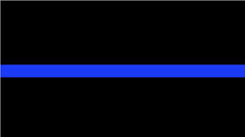
Law’s Violence: The Police
1.The Thin Blue Line –
The challenge for police……
Police must exercise some coercion/violence to enforce law
Police violence must be constrained. Least force necessary to serve legitimate ends (economy of violence)?
Justifiable claim of defense of self/others? Context matters.
Due process exists to demand legitimate reasons?
Is law’s violence “better” than illegal violence in society?
If law’s words fail to limit violence → loss of trust, more violence, more failed words...less police power

Slide 3
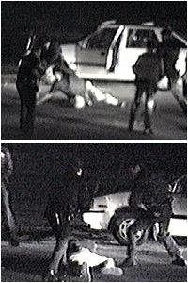
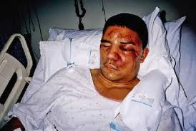
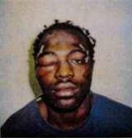
Law’s Violence: Police in the Street
2. Police Brutality
Rodney King
A. Police above the law? (Excessive? Brutal?)
B. Context-specific factors…matter?
C) Paradox of Extortionate Transactions
(Muir)

Slide 4
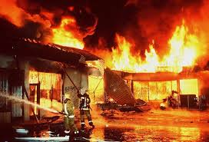
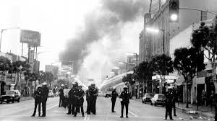
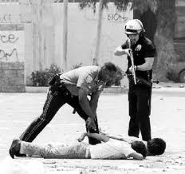
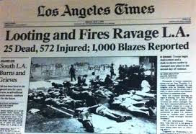
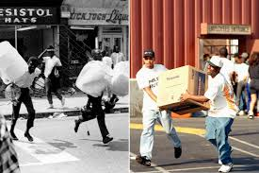
Law’s Violence: Police in the Street
D. Standards -- Defense of self/others?
Police effectiveness? Morality? Trust?
E. Three trials (State criminal trial; federal civil rights; civil personal injury lawsuit.)

Slide 5
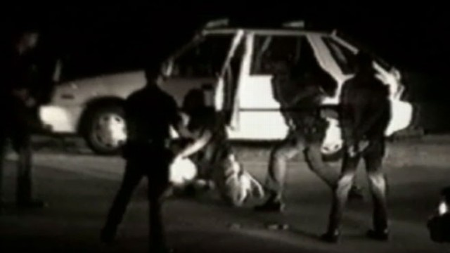
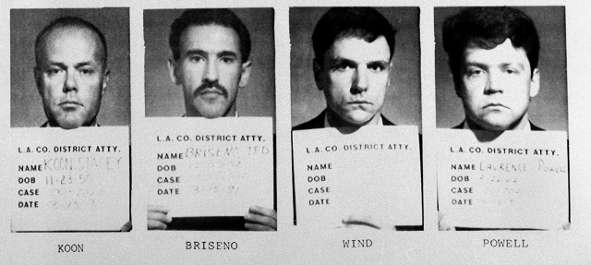
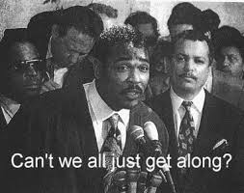
Law’s Violence: Police in the Street
F. Cycles of mistrust difficult
to break
Police abuse → lose trust,
legitimacy (power)

Slide 6
Law’s Violence: Police in the Street
3. Forms of routine police violence caught on camera
A. Alabama car chase and beating
B. Police yelling serious threats
C. Seattle jay walker
D. Albuquerque border incident
E. Routine Police Brutality
Excessive police force → media attention, lose power/trust in community

Slide 7
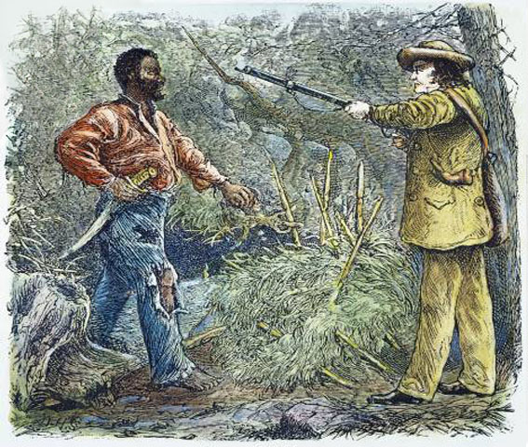
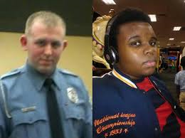
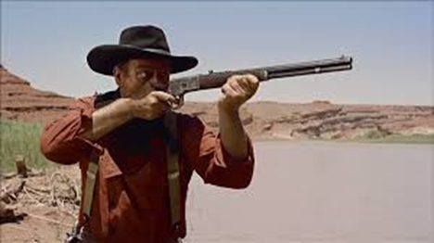
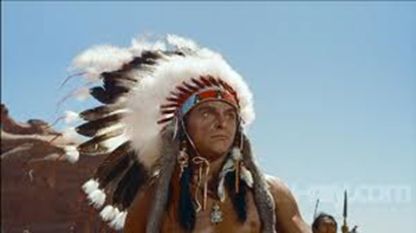
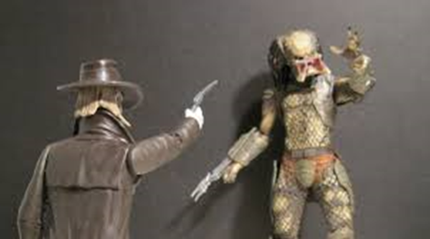
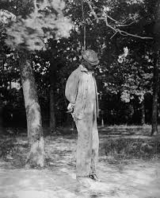
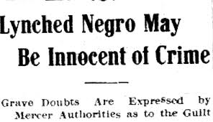
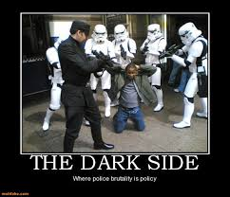
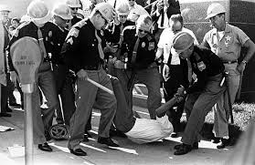
Law’s Violence: Settler Colonial Racial Legacy
4. History of racial vigilantism
Race is at center of concerns
about police violence today

Slide 8
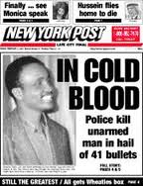
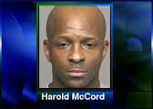
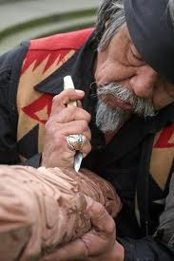
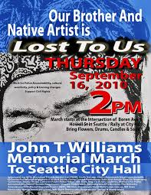
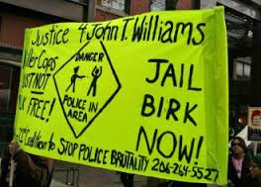
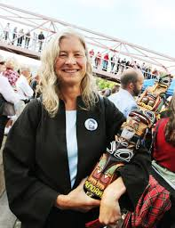
Law’s Violence: Police in the Street
5. How common (racial divide in opinion)?
Amadou Diallo (1999)
Springsteen, “41 Shots”
Harold McCord (2004)
John T. Williams (2010)
Seattle Seattle Police – investigation, charges by DOJ, public distrust

Slide 9
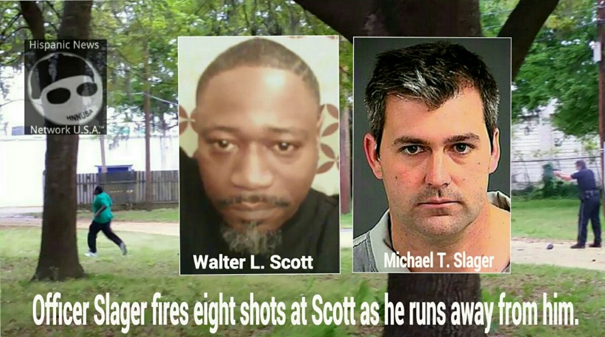
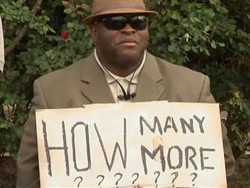
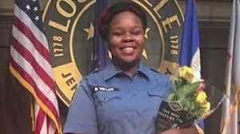
Law’s Violence: Police on Black Bodies
Well Known Recent Episodes:
Michael Brown (2014, Ferguson)
Ricardo Diaz-Zeferino
Eric Garner
Tamir Rice
Antonio Zambrano-Montes
Walter Scott, Freddie Gray, Sandra Bland,
Samuel Dubose, Laquan McDonald,
Alton Sterling, Philando Castile, Paul O’Neal
Breonna Taylor
Patrick Lyoya

Slide 10
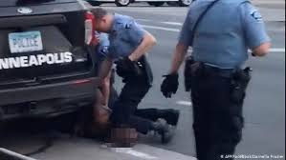
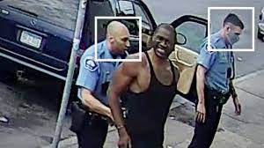
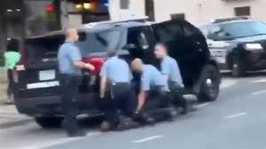
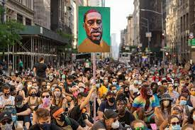
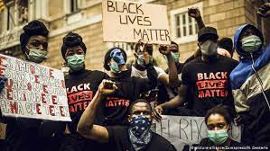
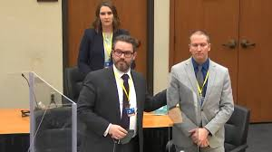
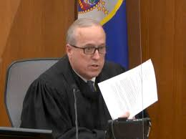
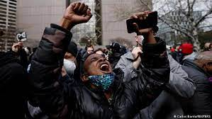
Police Violence to …. George Floyd

Slide 11
Law’s Violence: Police Killings
1136 people shot and killed in 2021; average of 3 per day
Only 15 days without police killing in 2021
Annual rate in US is consistent
2.5 times more Black persons and nearly 2 times more Hispanic persons killed than white persons relative to overall population (2015-22)
Black people killed are 1.3 times more likely to be unarmed than white persons
Most young (20-40 yrs old) males
More than 6 in days after Chauvin verdict – Ma’Khia Bryant (Brooklyn Center), Andrew Brown Jr. (N.C.)

Slide 12
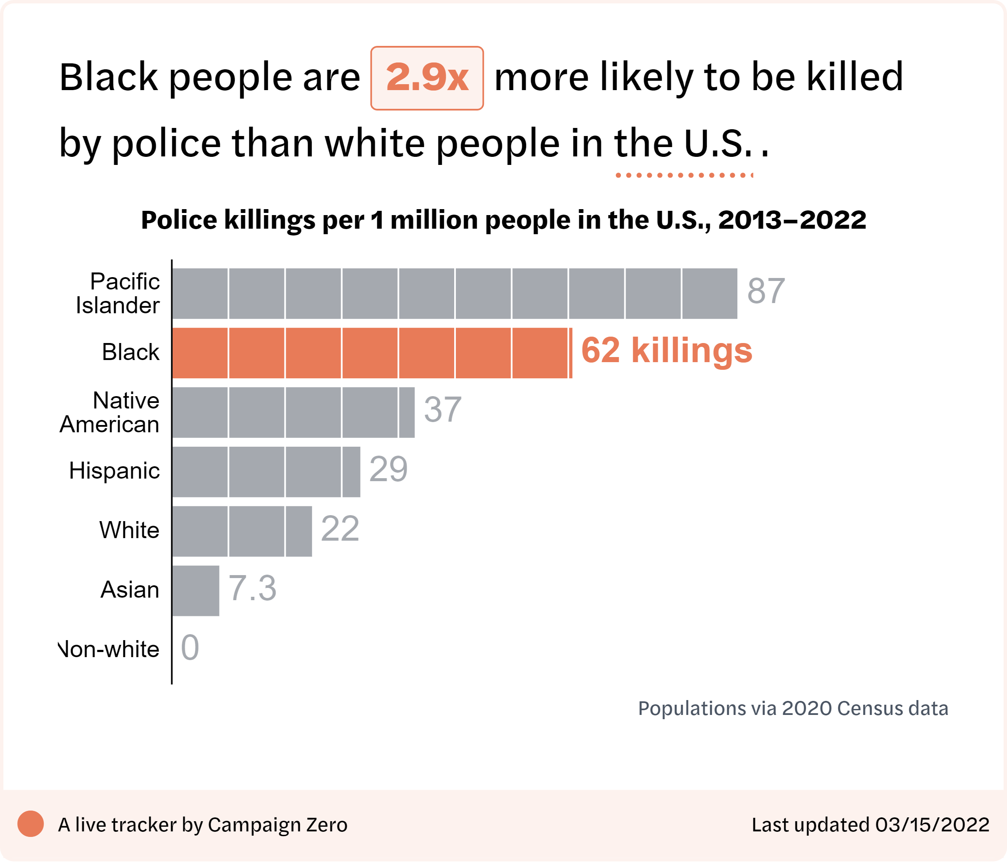
Law’s Violence: Police Killings Racialized Subjects

Slide 13
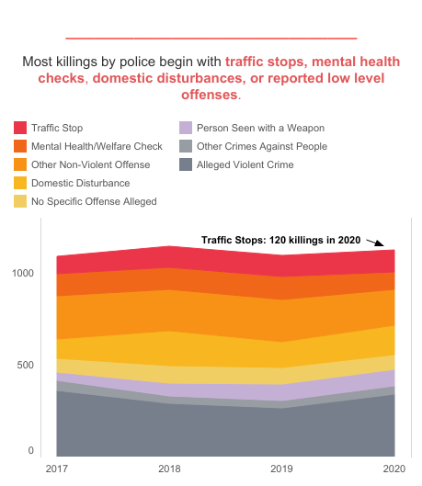
Law’s Violence: Police on Racialized Bodies

Slide 14
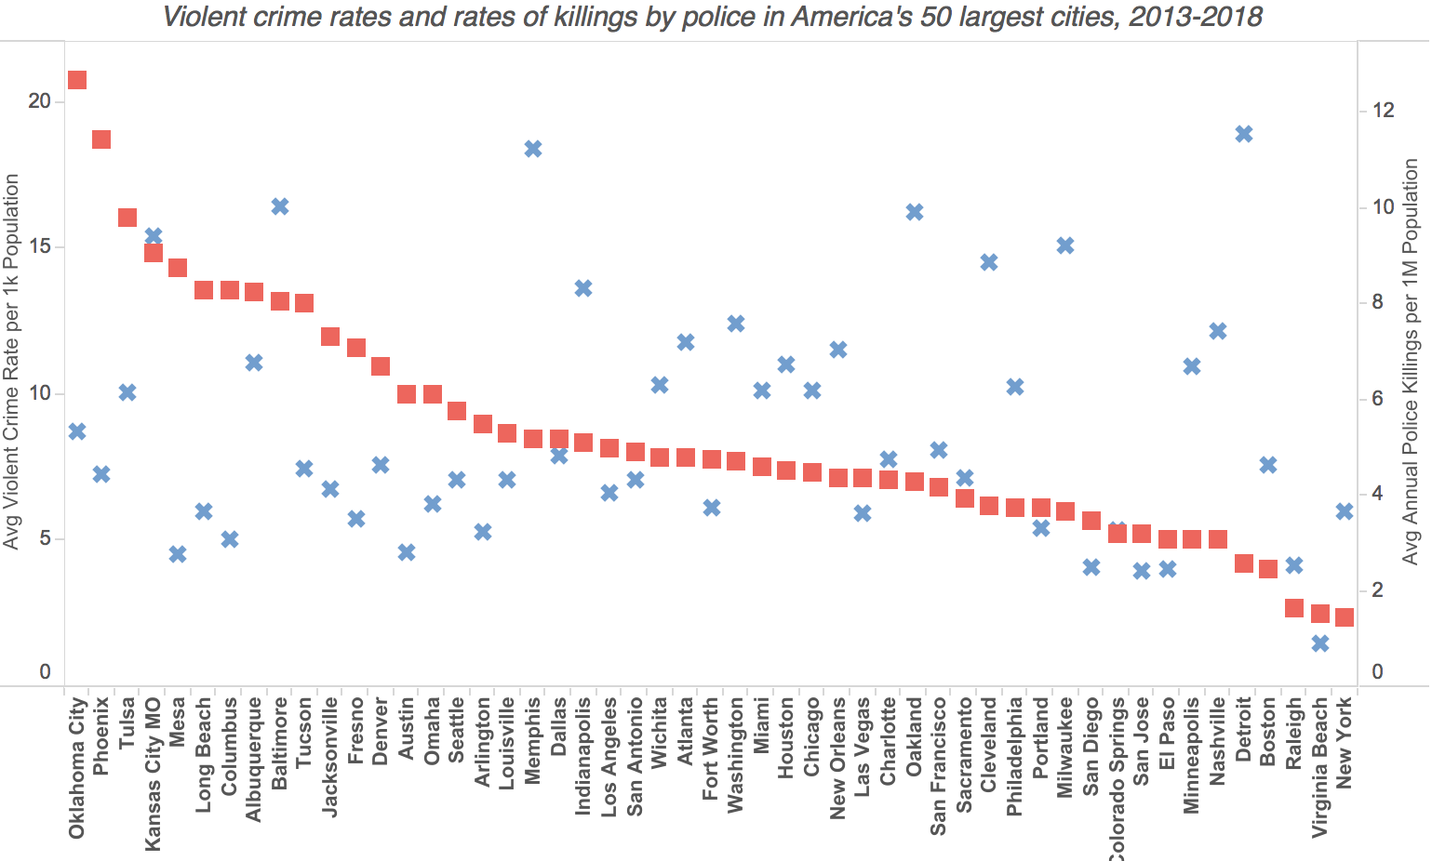
Law’s Violence: Police Killings
Police Killing Rates Violent Crime Rates

Slide 15
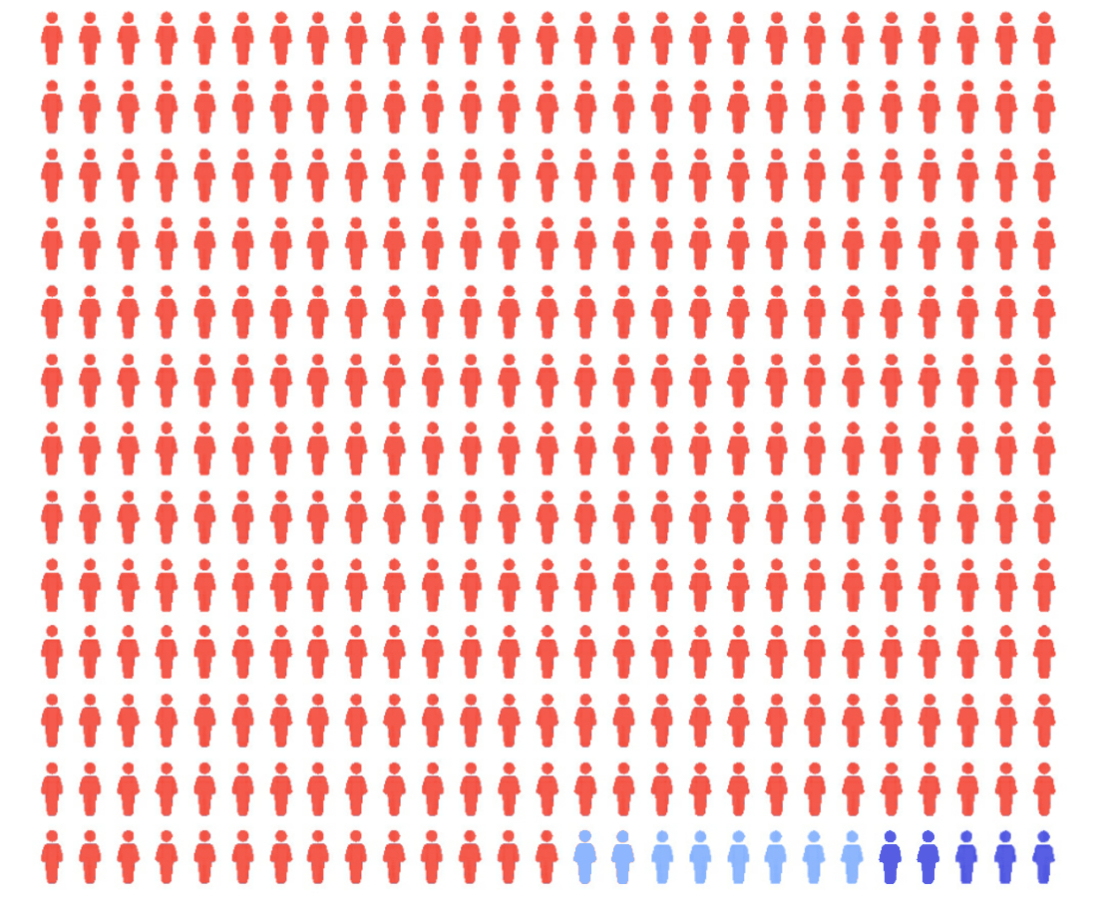
Law’s Violence: Police Killings
98.3% of killings by police 2013-2020 have not resulted in a criminal charge to the officer

Slide 16
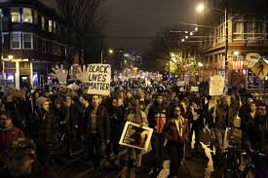
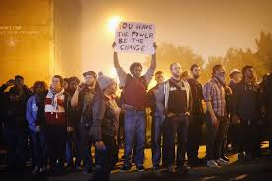
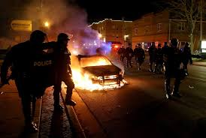
Law’s Violence: Police on Black Bodies
Signs and Symbols of Distrust

Slide 17
Law’s Violence: Policing Protest
Signs and Symbols of Distrust

Slide 18
Law’s Violence: Police in the Street
GENERAL PRINCIPLES OF LEGAL POLICING
Law requires the exercise of violence,
but excessive violence makes law illegal and ineffective.
Violence can be justified (legitimated) by persuasive legal accounting of danger to self & others, but violence also undermines the capacity for words to have meaning. (Cover)
Policing requires trust of the community, produced by the subordination of force to words – justice rules violence.
HENCE…Good law enforcement requires judgment, justification, economy of violence -- as does the reasoning of a good judge. A demanding ideal to build power of trust.
Cops must be “streetcorner politicians” (Muir) Paradoxes….

