Slide 1
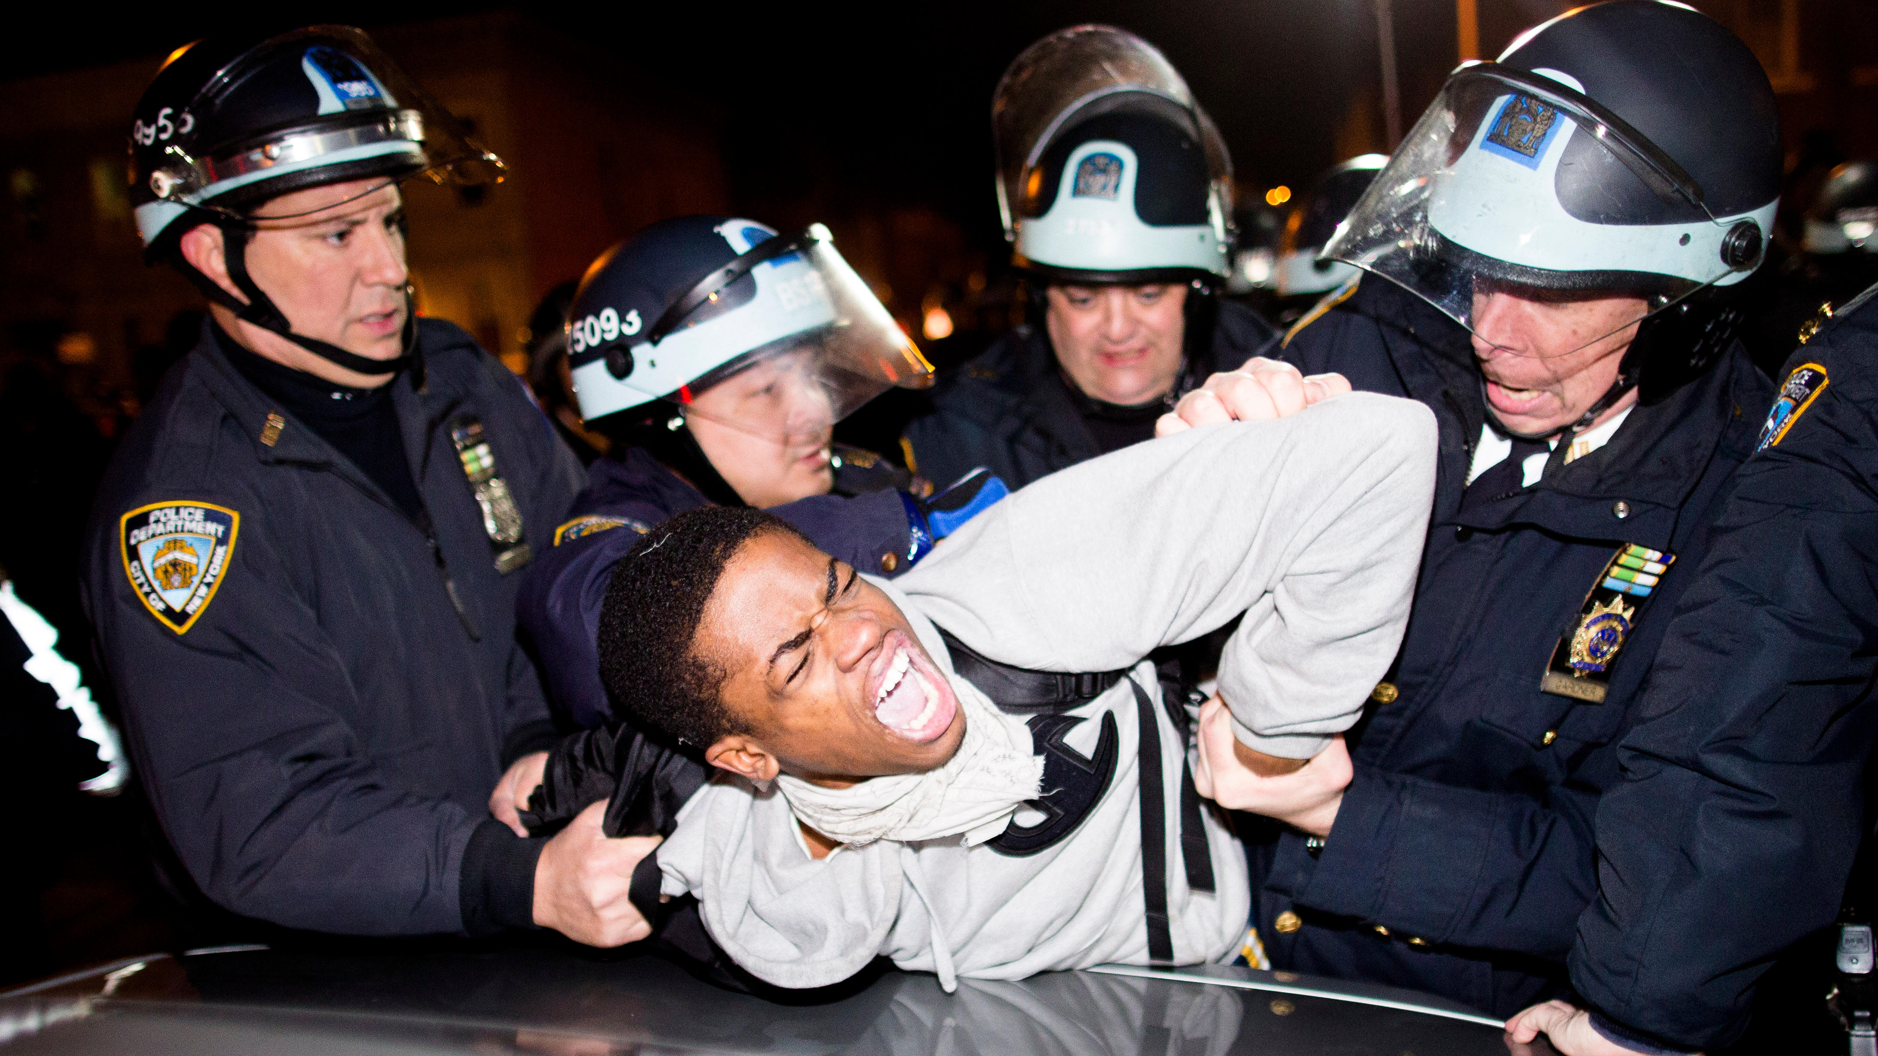
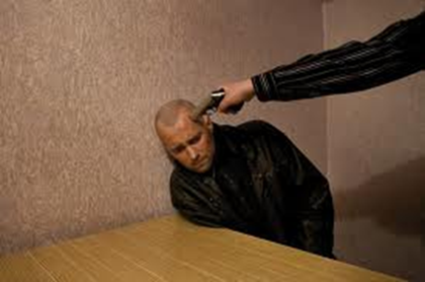
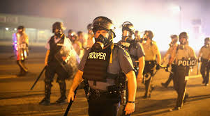
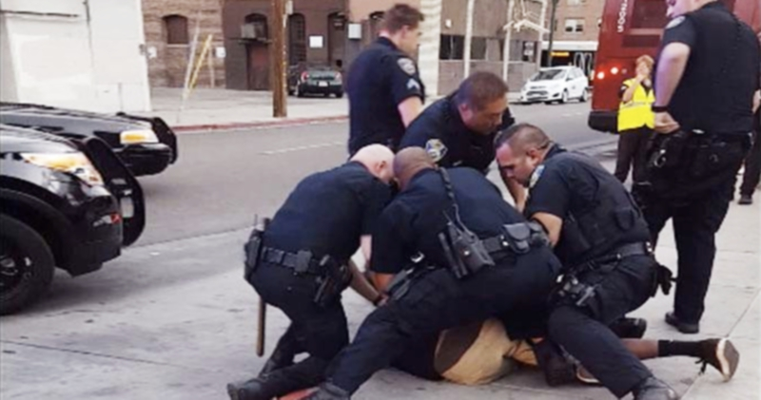
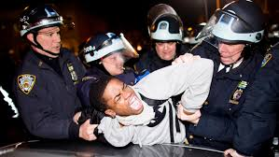
Law’s Violence: The Police
Cover: “Legal interpretation takes place on a field of pain and death…..”

Slide 2
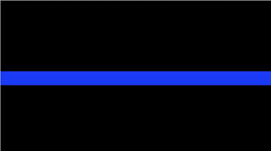
Law’s Violence: The Police
1.The Thin Blue Line –
The challenge for police……
Police must exercise violence to enforce law
Lawful police violence must be limited. Least necessary to serve legitimate ends (economy of violence)?
Justify by claim of defense of self/others? Context matters.
Due process exists to demand legitimate reasons (?)
Is law’s violence “better” than illegal violence in society?
If law’s words fail to limit violence → loss of trust, more violence, more failed words...less power

Slide 3
Law’s Violence: Police in the Street
Police killings – legitimate self defense? Excessive force (mistakes, fear)? Brutality (malicious)?
Was Chauven killing of Floyd…excessive or brutal?
Why do police use great, even deadly, force so often?
Cover: about the right amount of “terror”?
How do we judge the right amount in individual cases?
The “right” amount in the aggregate, systemically?
Different effects on different communities → variable types of answers to the questions
Today & Wednesday: will examine institutional (vs individual) factors that contribute to exercise of excessive force

Slide 4
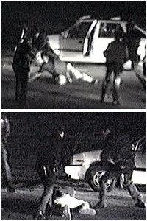
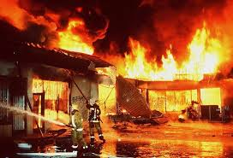
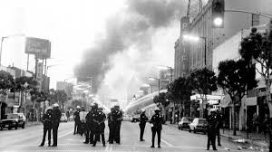
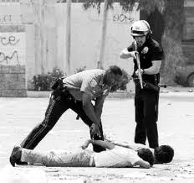
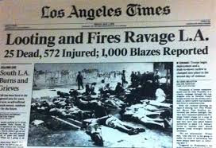
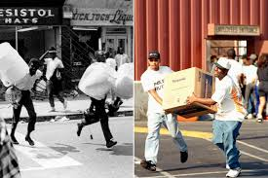
Law’s Violence: Police in the Street
Effects of excessive force → more violence,
distrust
Many most, police not trained for dealing with protests
& riots (NYT article, “Police Mishandled BLM..”)

Slide 5
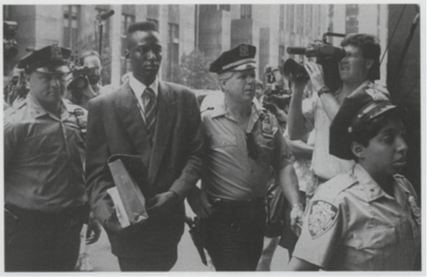
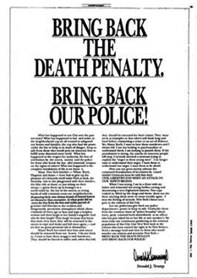
Above the Law
1.The Thin Blue Line
Which side are the police on in Central Park 5 case?
Context – panic about perception of crime, violence in society
Racial/class divide in NYC
Crime was horrific – symbolized public fears
Police under pressure – arrested, constructed story & timeline, held to it
Evidence – confessions (coerced), no DNA, stories conflicted
Prosecutors (Farstein)– ambitious, proceeded despite evidence
Suspects – teens did not understand, scared, no criminal backgrounds
Victim – Trisha Meili was “golden girl,” essence of “innocence”
Media – feeding frenzy of trying the suspects in print, public opinion
Trump – 4 ads, “Hate is what we need,” “they should suffer…death”
Public protests – black citizens divided, focused on lack of evidence
Poor legal representation ….Why did young men confess?
Suspects wrongly convicted, served 7-13 years. “Lives lost, taken”

Slide 6
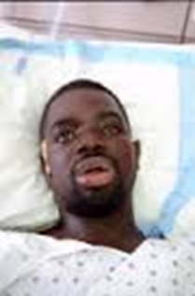
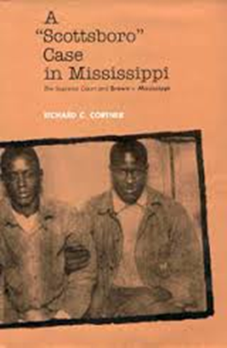
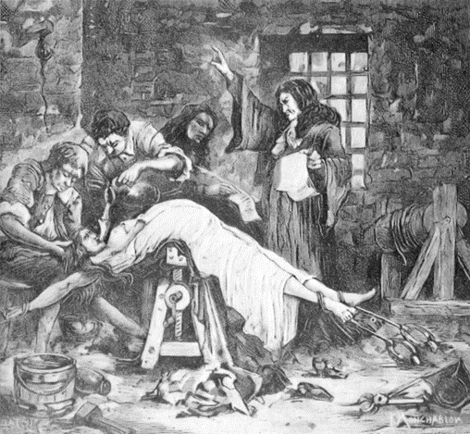
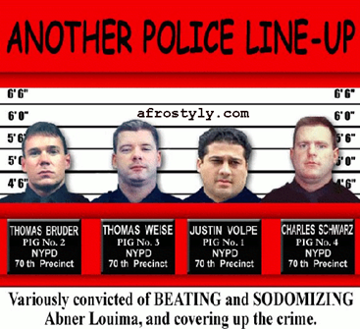
Law’s Violence: Police in the Station
Police Interrogation (in station)
A. Accusatorial logic of due process – 5thAmendment
B. Less visible site → potential for “3rd degree” abuse
Brown v. Mississippi (1936)
Abner Louima (NY 1999)
Central Park Five (1989)
Physical → psychological coercion

Slide 7
Law’s Violence: Police in the Station

Slide 8
Law’s Violence: Police in the Station
F. Historical impact of Miranda→ police resisted, then professionalized, increasing
effectiveness and prosecution rates
Irony: Miranda increased prosecutions, institutionalized plea bargaining, and legitimated outcomes by appearance of due process
G. But did Miranda end manipulation, deception, trickery? How “voluntary”?
Most (80%) suspects waive rights and incriminate selves
Interrogation as “confidence game”
Guilt, not innocence, is presumed. Innocent people most vulnerable…..

Slide 9
Law’s Violence: Police in the Station
H. Police skilled (Reid) at deception→ results
How police interrogation works
Ricky Joiner
I. Kassim on Central Park Jogger case of confessions
i. Police profile → presume guilt→ “the story”
ii. Innocents are naive, waive rights
iii. Claims of innocence “trigger” aggressive response, disbelief
iv. Police deception, manipulation can compel false confessions
v. False confessions difficult to discern
Most vulnerable are young, mentally unstable, intoxicated, and “innocent”

Slide 10
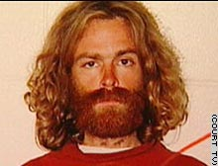
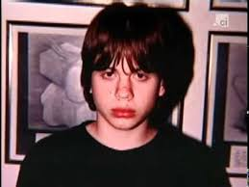
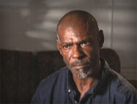
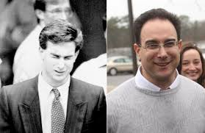
Law’s Violence: Police in the Station
J. Examples
Michael Crowe
Marty Tankleff Richard Tuite
Chicago: False Confession Central
Burden of Innocence – the lonely
Clyde Charles
K. Words as Lies & Coercion→ problem of “trust” again
Next lecture: why does law fail to contain force and govern by rules? Bad cops? Institutions? Politics? Us….

Slide 11
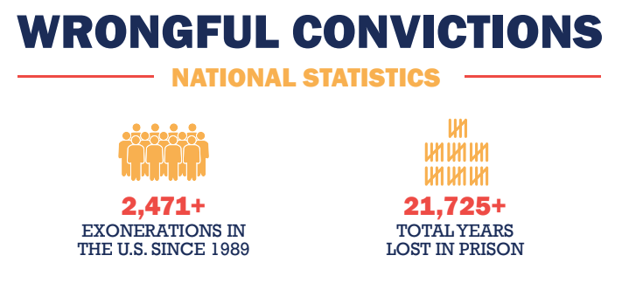
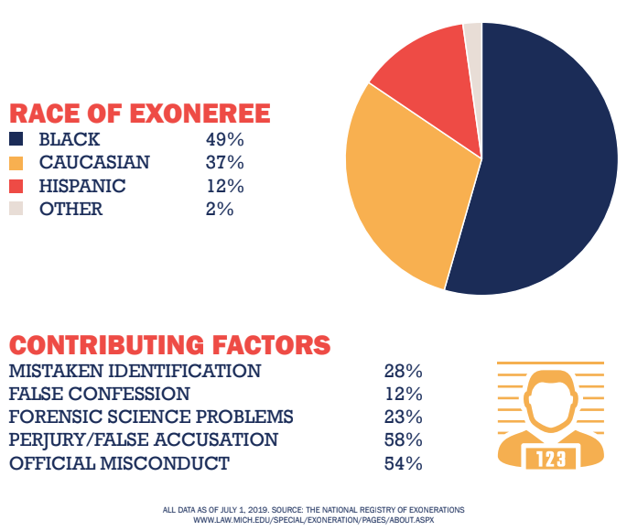
Not
All
That
Rare
More
Frequent
Are the
Routine
“Normal”
Over-
Convictions

Slide 12
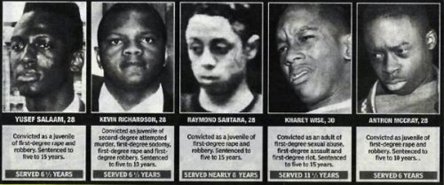
Central Park Five
Yusef Salaam, Kevin Richardson, Raymond Santana, Korey Wise, Antron McCray
Notes:
Kevin Richardson, Antron McCray, Raymond Santana, Korey Wise, Yusef Salaam at Innocence Project event 2019

Slide 13
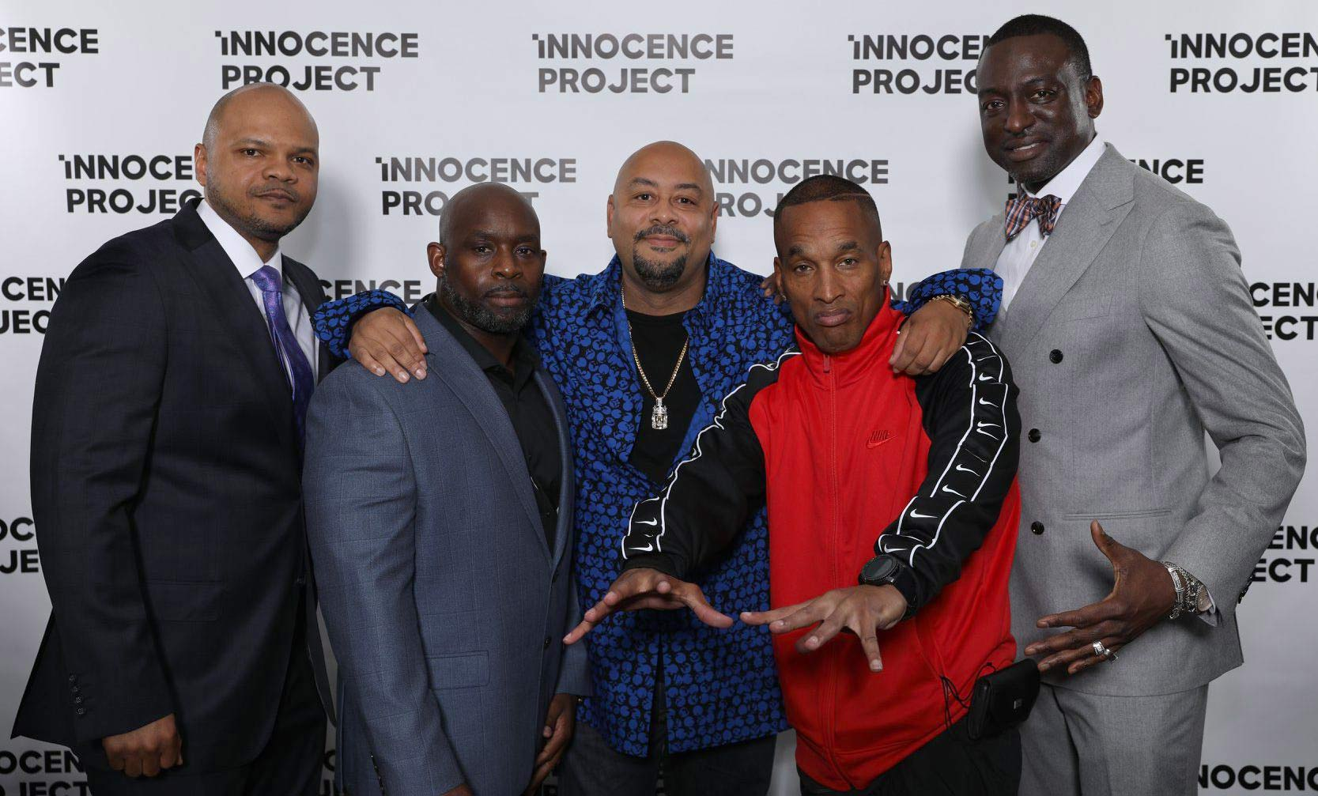
Central Park Five
Kevin Richardson, Antron McCray, Raymond Santana,
Korey Wise, Yusef Salaam
Notes:
Kevin Richardson, Antron McCray, Raymond Santana, Korey Wise, Yusef Salaam at Innocence Project event 2019

