Slide 1
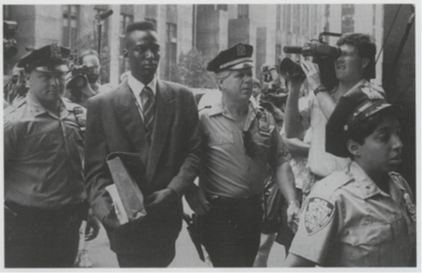
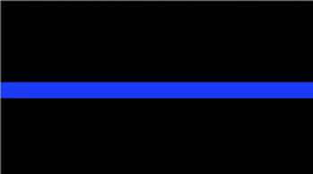
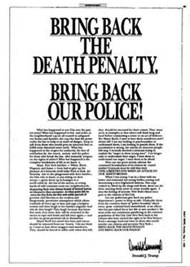
Above the Law
1.The Thin Blue Line
Which side are the police on in Central Park 5 case?
Police: responded to pressures of media, politicians, public, chief, prosecutor, Trump → found and charged “the monsters”
Used extreme coercion, duplicity, intimidation to extract confessions despite absence of material evidence (DNA, etc)
Suspects wrongly convicted, served 7-13 years.
Five “lives lost, taken” by denial of civil rights
Police miscarried justice, compounded criminal violence
Law’s words failed to deter and contain unlawful violence
The result was increased distrust, anger, protest in community
Prosecutor Fairstein and Trump defiantly insist were right

Slide 2
Above the Law
Why study excessive force/violence by police?
To understand the complex relationship between violence and law
Cover: law’s words require some violence
But… excessive violence/coercion undermine trust in the words→ reduce police power
B. To understand how & why legal officials abuse words and overuse violence → lose power
Reject “authoritarian personality” explanation Not individual psychology, not “bad apples”…
Social science → analysis of explanatory/causal
factors in the social/political context….
Claggart: “I am what the world has made me” We all are (unequally) part of the problem

Slide 3
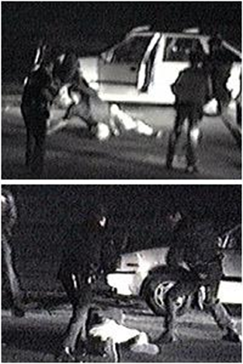
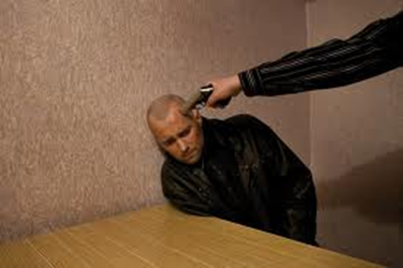
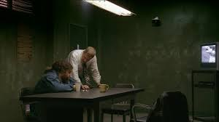
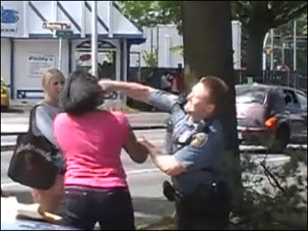
Law’s Violence at the Thin Blue Line
2. Context: Opportunities and Incentives
A. Situational factors – often not visible
1. Street -- only “outsiders” see violence, brutality
2. Station -- invisible to citizens
3. Police work is individual→
little supervision
4. Police have discretion, capacity
5. Force/fraud is easier

Slide 4
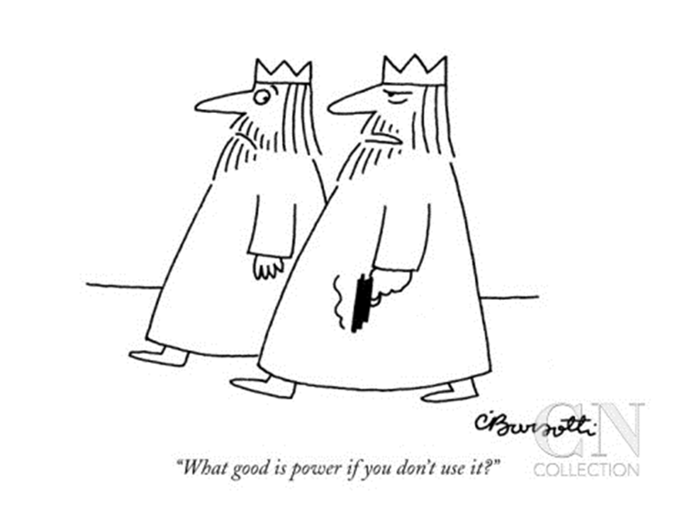
Law’s Violence at the Thin Blue Line

Slide 5
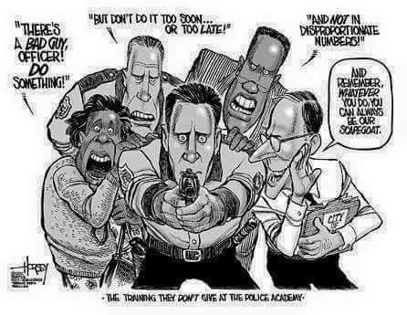
Law’s Violence at the Thin Blue Line
B. Relationship to broader community & politics
1. Public wants tough cops – inflated fears
2. Mass media is obsessed with street crime
3. Organized interests and “haves” want order
4. Politics of fear → “law & order” wins votes
5. Contradictory demands – force…but legality

Slide 6
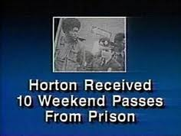
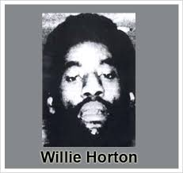
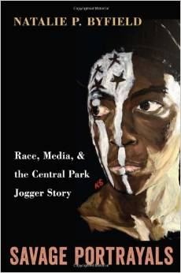
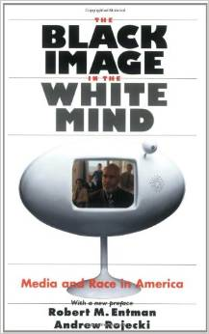
Law’s Violence at the Thin Blue Line
C. Racialized Crime Talk/Images
1. Politicians – GOP & Demos play “race card”
Willie Horton story
Bush ads
2. Media over-report black on white violence
3. Police act on racialized images &
implicit bias, trained to fear black
“super predators”
4. Trump revitalized race/crime link with
his law and order rhetoric
“

Slide 7
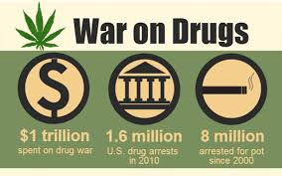
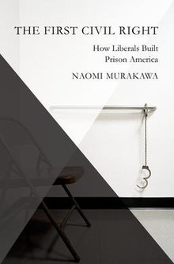
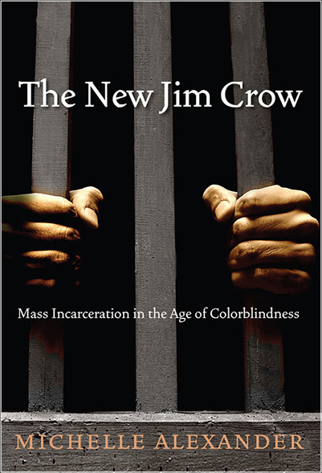
Law’s Violence at the Thin Blue Line
D. War on Drugs →New legal rules/precedents authorizing police discretion for aggressive searches and apprehension (M. Alexander)
Supreme Court: weakened procedural constraints, increased discretionary authority
Pretextual and consent searches…
Civil forfeiture incentives (money) Police could be more aggressive as long as followed procedure
4th Amend & Force: reasonableness standard
Legal procedure → empowered police
Procedure legitimated → immunity
about systemic targeting of poor, racialized, surplus populations
Law’s words masked rather than contain targeted violence (Cover)

Slide 8
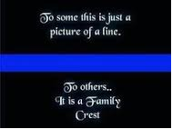
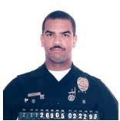
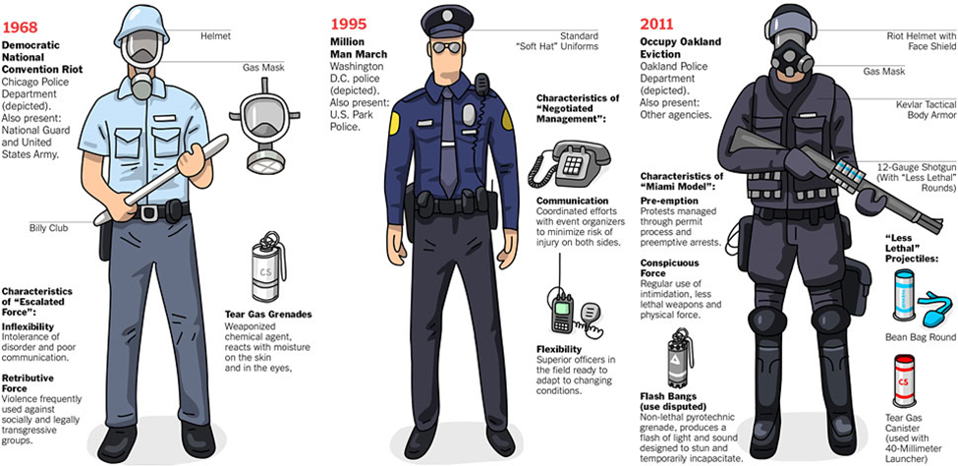
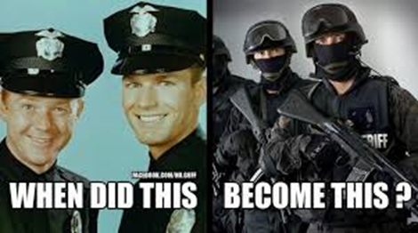
Law’s Violence at the Thin Blue Line
E. Police Culture -- insider norms (family) v. law
1. Moralistic lenses -- good insiders vs. outsiders
2. Vigilante tradition
3. Code of Silence mutes “rats”
Imprisoned cop’s story
Ex: LA CRASH unit
Us vs Them logic
4. Militarization of policing --“War” logic encourages using force on “enemies”

Slide 9
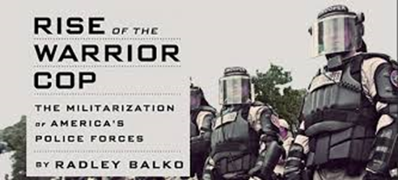
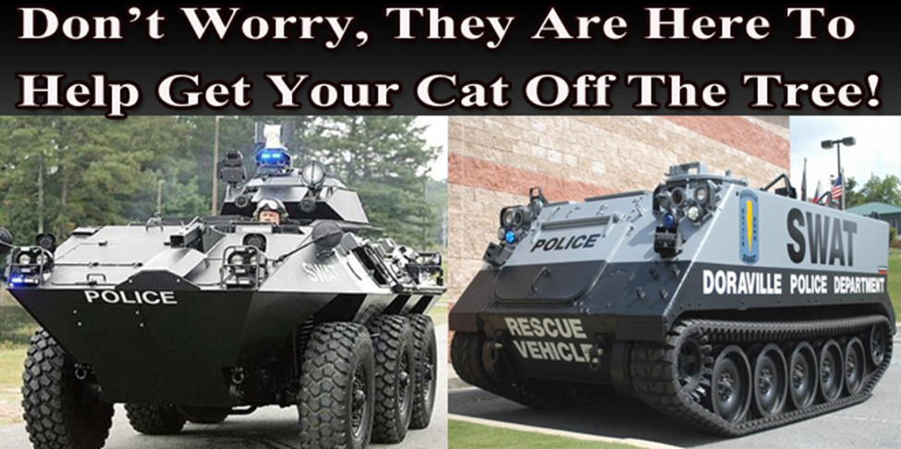
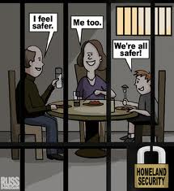
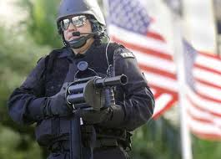
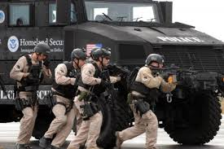
Law’s Violence at the Thin Blue Line
Militarization of Police
Militarization of Police #2
5. Coercive capacity/routines/training
6. Post 9/11 terror fears – magnifies all

Slide 10
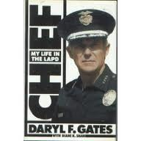
Law’s Violence at the Thin Blue Line
F. Internal police organization
1. Police chief -- norms, signals, system
2. Unit organization
3. Incentives > ends/means
4. Police unions amplify public need, support/insulate abusive force
G. Opportunity, Capacity, Reward→
“Order” by force over “law”
in enforcement
Citizens are part of “problem”

Slide 11
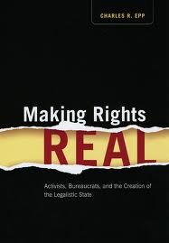
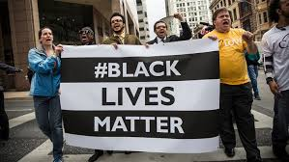
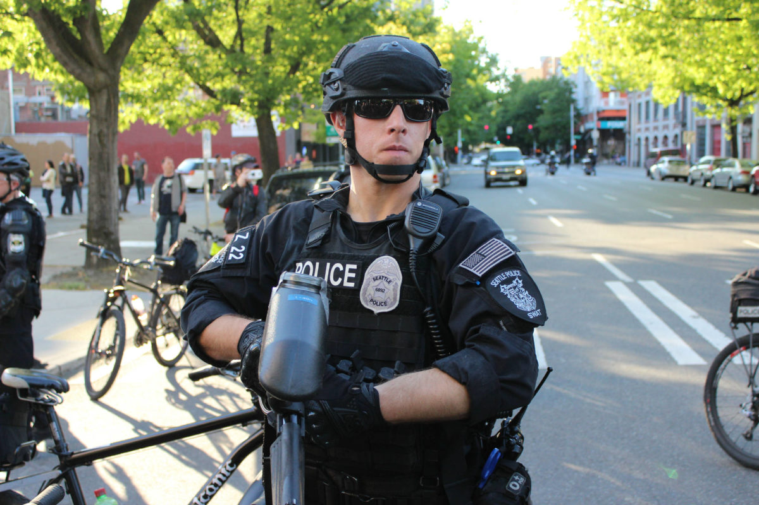
Law’s Violence at the Thin Blue Line
2. Weak remedies for Excessive Force/ Brutality
A. Citizen review boards
B. Citizen litigation→ “making rights real”
“Malice” must be proved – impossible
standard. Legalized impunity.
C. Dept of Justice investigation, pressure
D. Organized protest. Black Lives Matter.
DOJ: Seattle Police Are Complying
With Consent Decree (?)

Slide 12
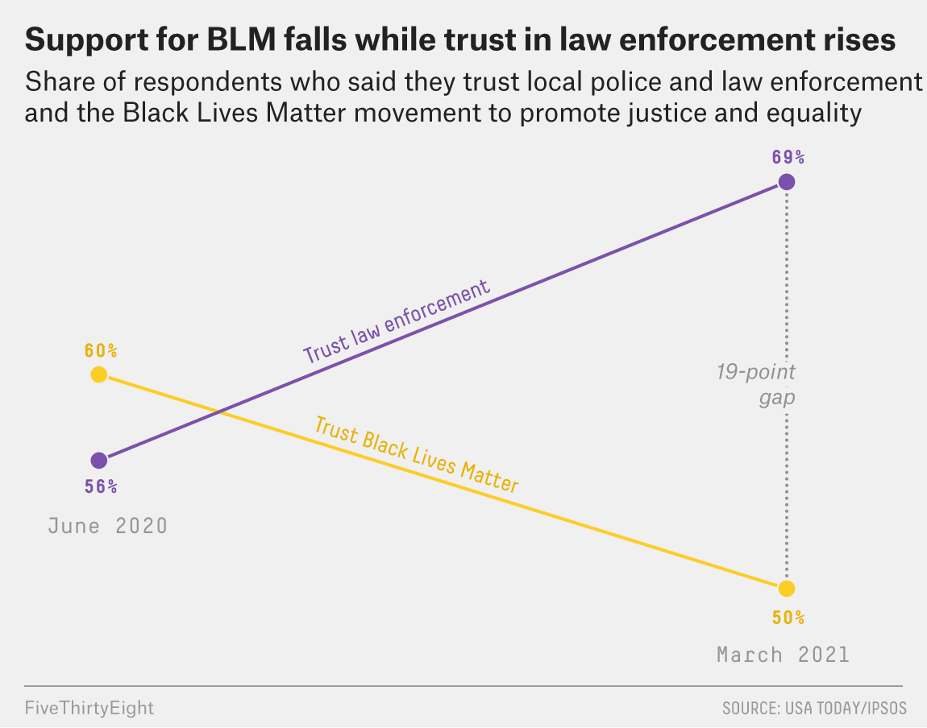
Policing Trust at the Thin Blue Line

Slide 13
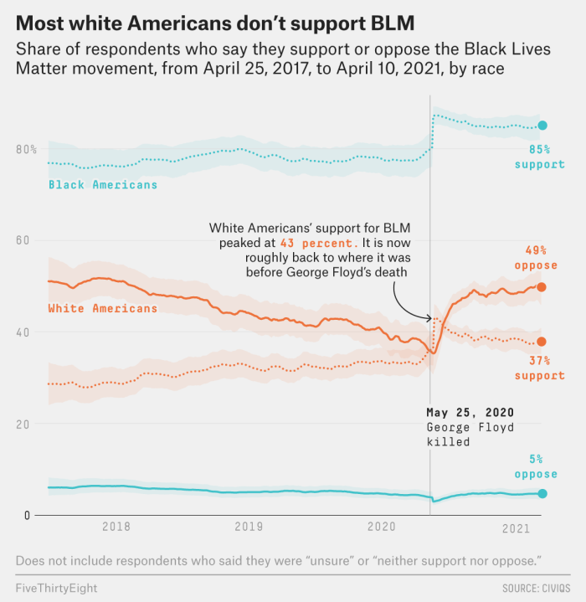
Policing Trust at the Thin Blue Line

Slide 14
Law’s Violence at the Thin Blue Line
The question is less why police rely on excessive force and deceit than why they do not more often…
Police are hired to protect property and persons of dominant groups in “community”
Ends often justify means….and those in power usually applaud
Order management of racialized underclass trumps liberal legality in hierarchical society

