Slide 1
The Context of Police Violence
Cover: “Legal interpretation takes place on a field of pain and death.”
Police must use force to protect citizen rights
But police violence can trample rights
Why do police sometimes exceed reasonable use of force and duplicity?
Complex mix of social and political forces contributed to rise of hyper-coercive policing (We all bear responsibility….)

Slide 2
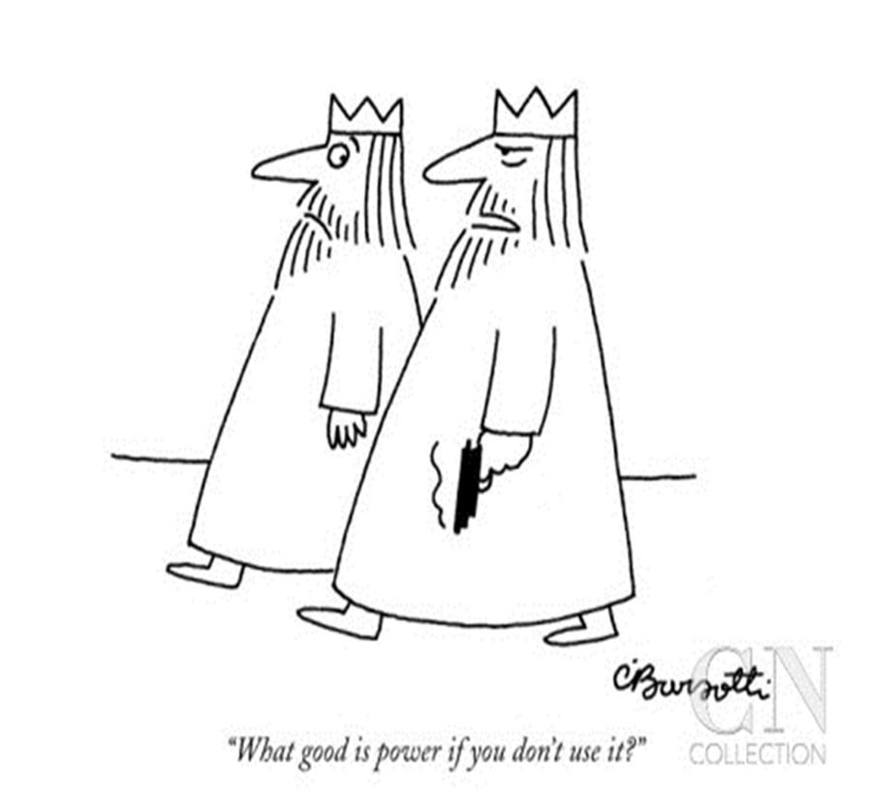
The Context of Police Violence

Slide 3
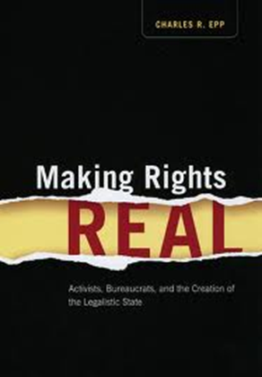
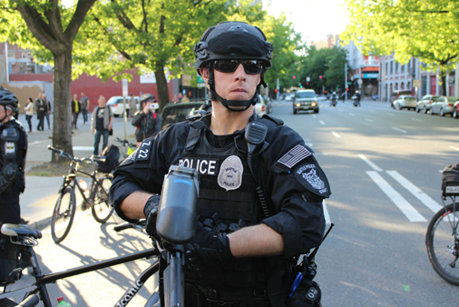
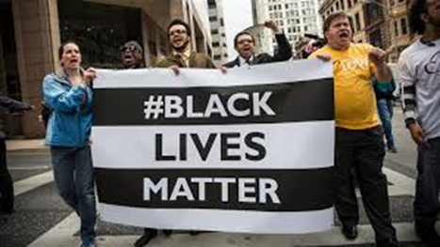
Law’s Violence at the Thin Blue Line
2. Weak remedies for Excessive Force/ Brutality
A. Citizen review boards
B. Citizen litigation→ “making rights real”
“Malice” must be proved – impossible
standard. Legalized impunity.
C. Dept of Justice investigation, pressure
D. Organized protest. Black Lives Matter.
DOJ: Seattle Police Are Complying
With Consent Decree (?)

Slide 4
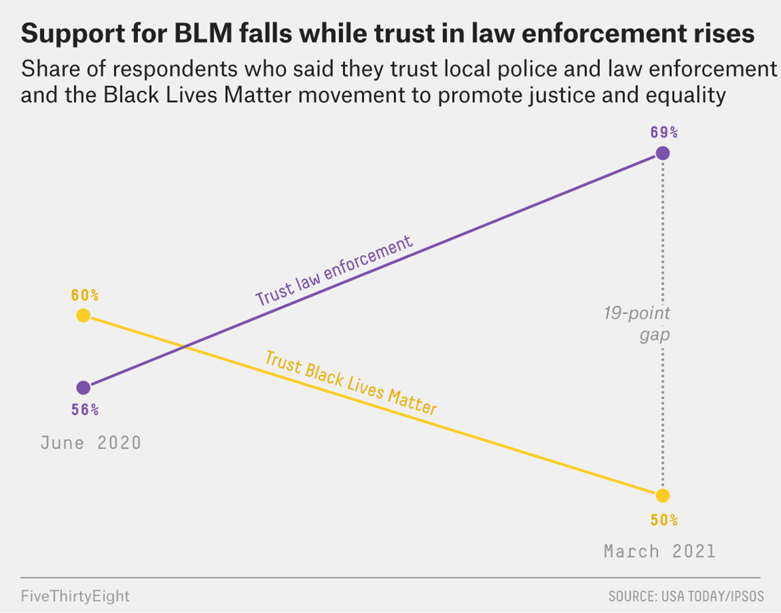
Law’s Violence at the Thin Blue Line

Slide 5
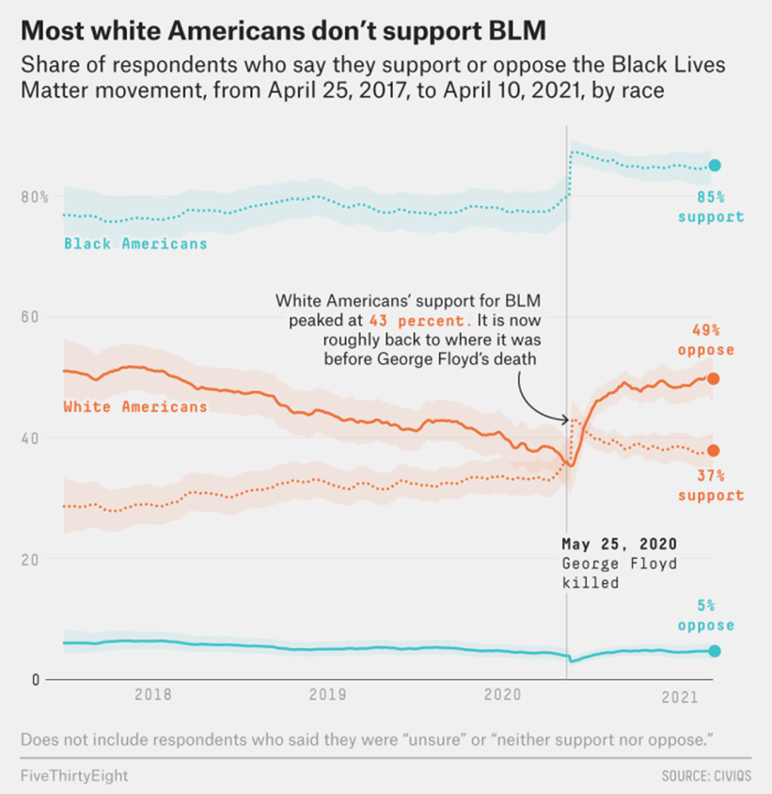
Law’s Violence at the Thin Blue Line

Slide 6
Law’s Violence at the Thin Blue Line
The question is less why police rely on excessive force and deceit so much than why they do not more often…
Police are hired to protect property and persons of dominant groups in “community”
Ends often justify means….and those in power usually applaud
Order management of racialized underclass trumps liberal legality in hierarchical society

Slide 7
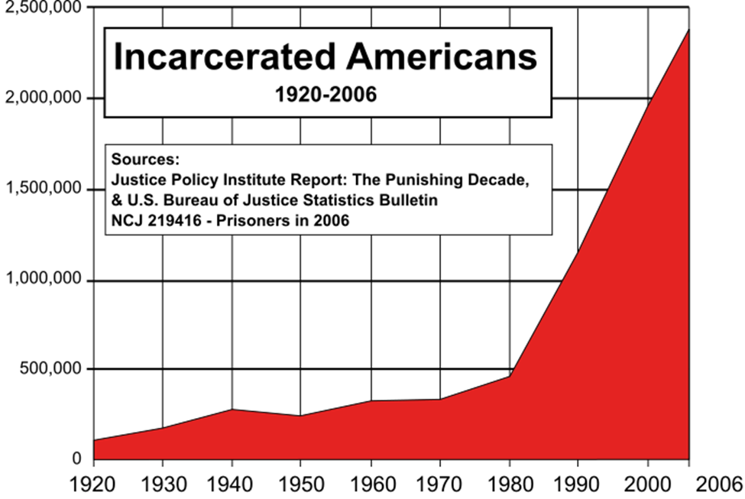
Beyond Police: State Violence Overall
1. Police Violence: Legal challenges individualize unlawful force; focus on arbitrary action & failed procedure. What about broad systemic violence?
Expanded powers/action by police → more in prison
2) Shift to the mass incarceration state
Notes:
2.4 million persons in prison. Grown by 500% in last 30 years. US has 5% of world population, but 25% of prisoners. In 2012, one in every 108 people in prison, and one in 28 children had parent behind bars.

Slide 8
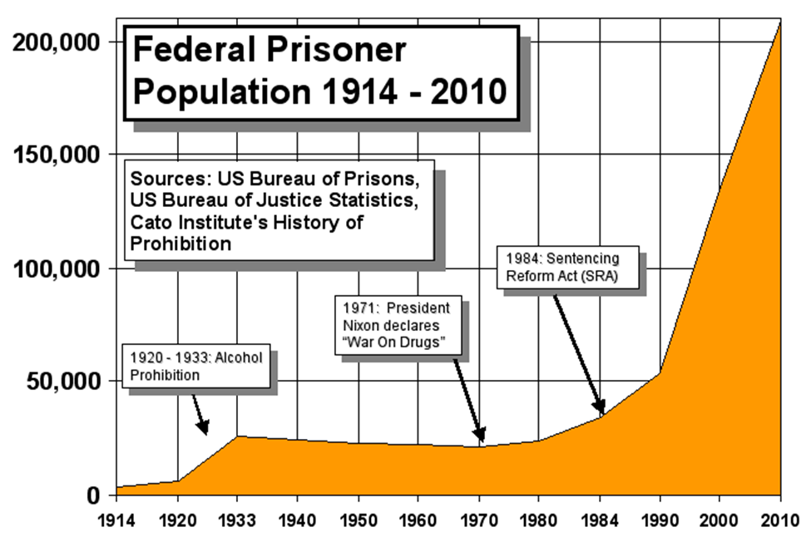
Beyond Police: State Violence Overall

Slide 9
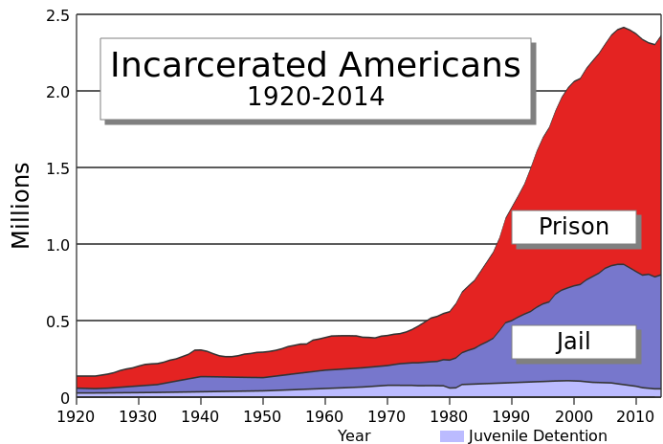
Beyond Police: State Violence Overall

Slide 10
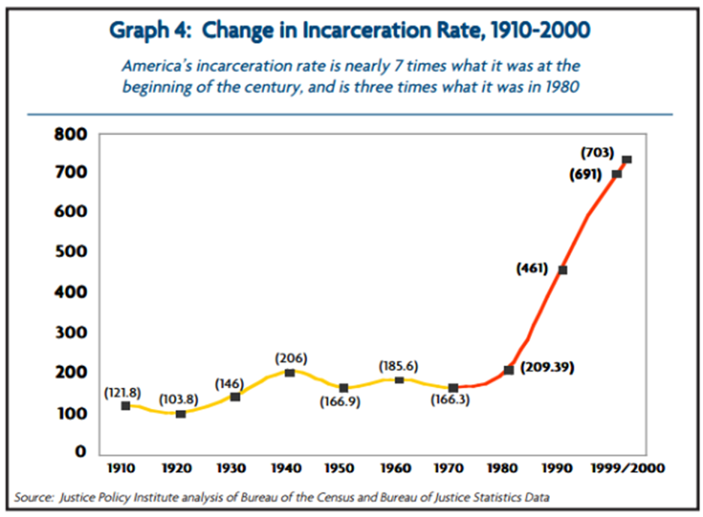
Beyond Police: State Violence Overall
Incarceration rate = # incarcerated per 100,000 residents over 17 yrs of age (1,000 by 2005-10)

Slide 11
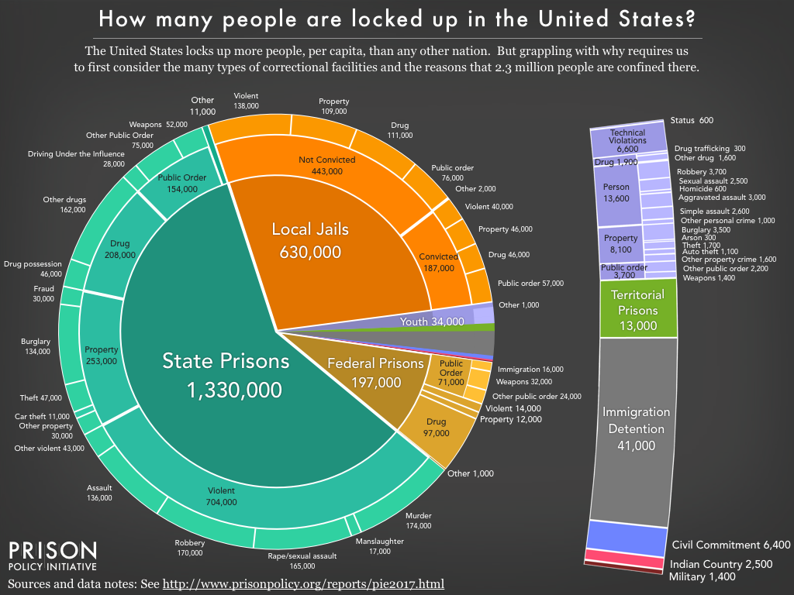
A Complex Map of Coercive Control: 2017

Slide 12
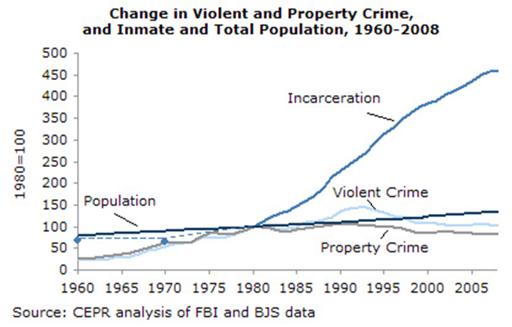
Beyond Police: State Violence Overall
Incarceration rate rises radically relative to rates of violent crime. (War on Drugs is key).

Slide 13
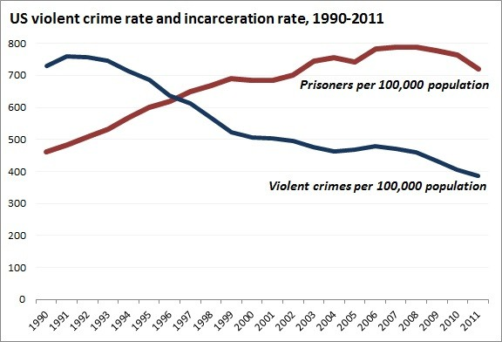
Beyond Police: State Violence Overall
Incarceration rate rises radically relative to rates of violent crime. (War on Drugs is key).

Slide 14
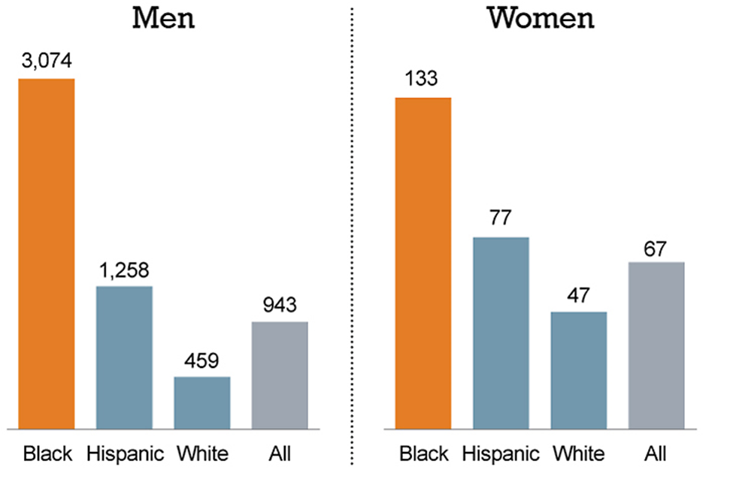
Beyond Police: State Violence Overall Race/Ethnicity/Gender incarceration per 100,000
Notes:
7 times as many blacks than whites per 100,000 population

Slide 15
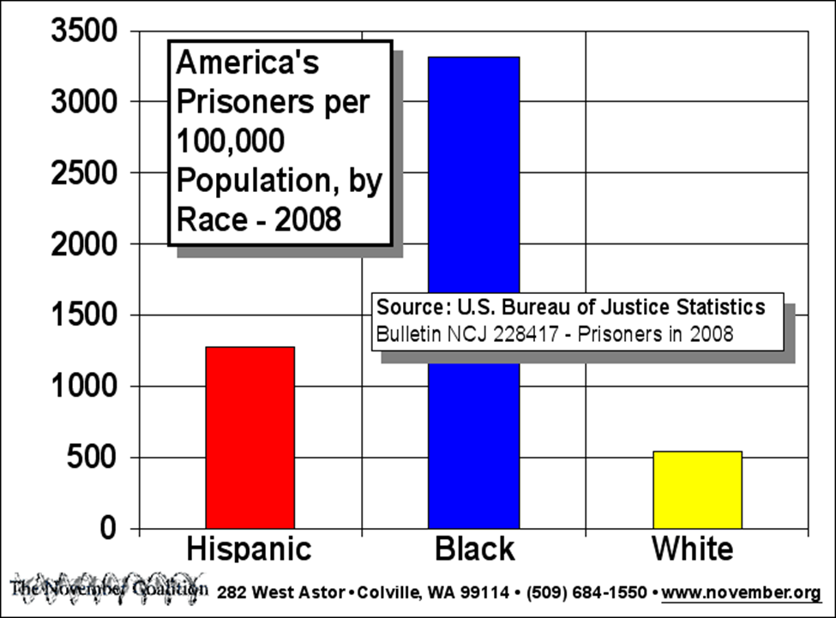
Beyond Police: State Violence Overall
Notes:
6.5 timex as many black persons as white persons per capita. 2.5 times as many Hispanic. Destruction of family units, fathers removed from children, no income. In 2007, 52% of prisoners were parents; 1.1 million fathers and 120,000 missing mothers., impacting 2.7 million children. 40% of all incarcerated parents are black.

Slide 16
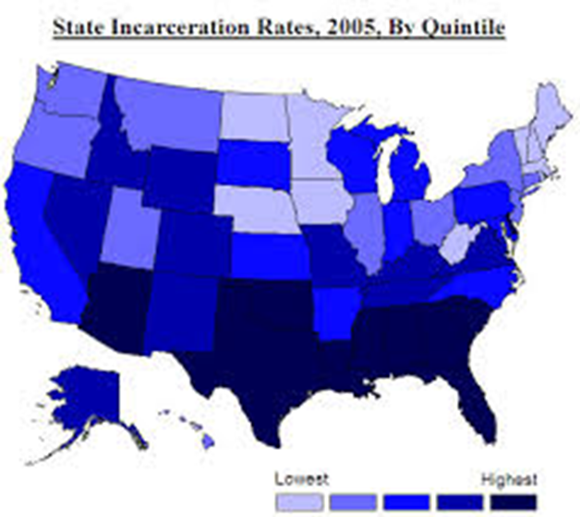
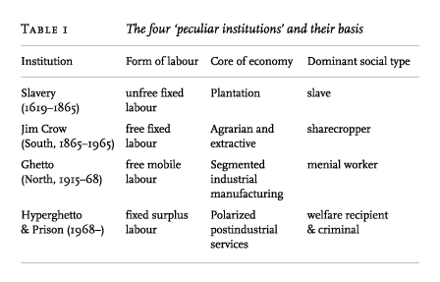
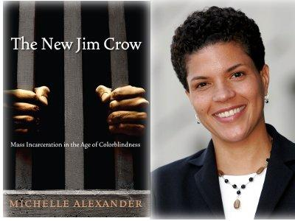
Beyond Police: State Violence Overall

Slide 17
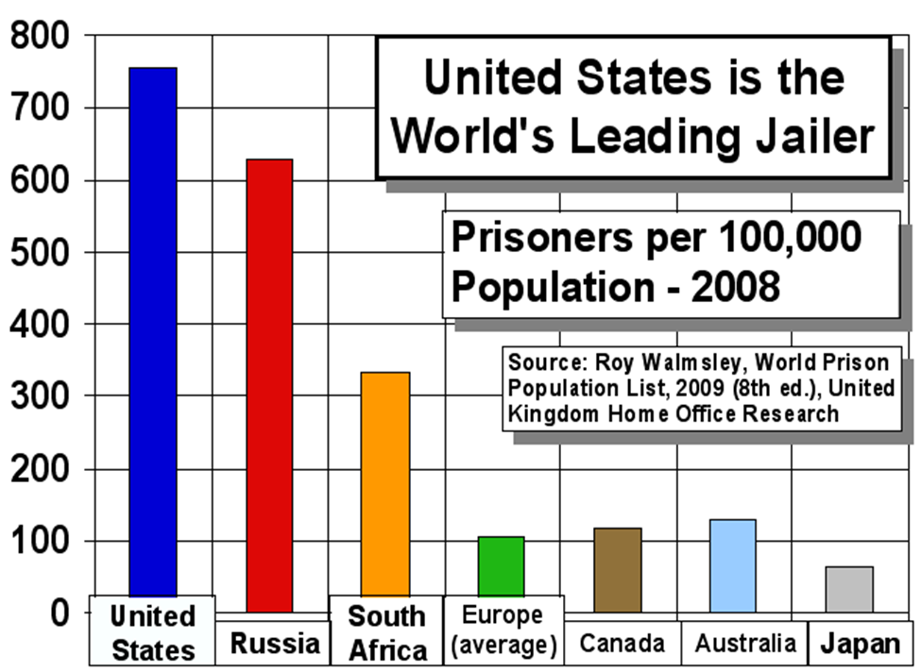
Beyond Police: State Violence Overall
Notes:
Compares rates of incarceration per 100,000 residents all ages.

Slide 18
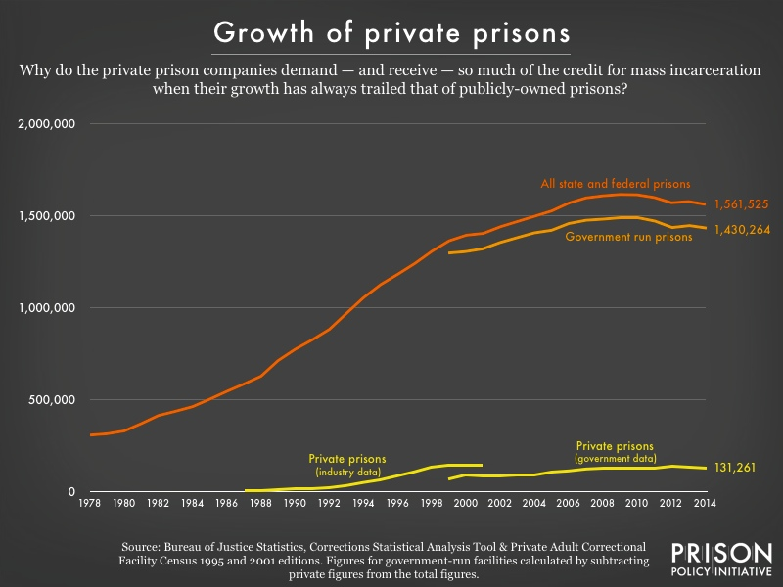
Beyond Police: State Violence Overall Private For-Profit Prisons: Parasites on the System (8% of incarcerated)
Notes:
7 times as many blacks than whites per 100,000 population. Several states, including WA, have limited or banned private prisons, including immigration detention facilities.

Slide 19
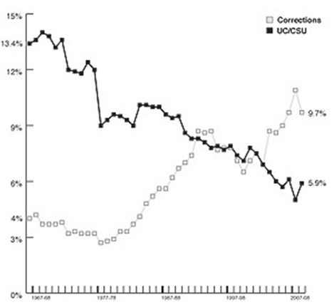
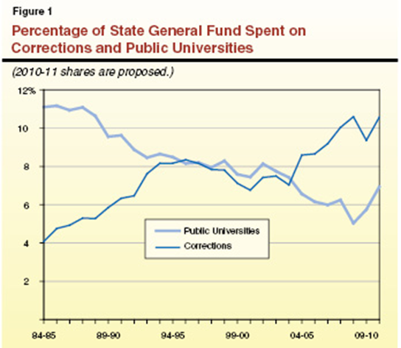
Beyond Police: State Violence Overall Paying for Prisons: Education vs. Corrections Expenditure Tradeoffs
Notes:
First graph: California university system expenditures (solid dark line) vs corrections (lighter line that starts on bottom) . Second graph is all universities vs. corrections.

Slide 20
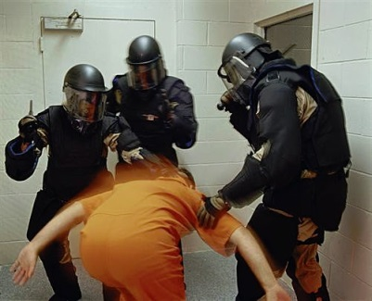
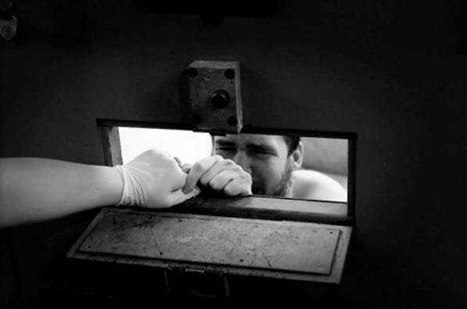
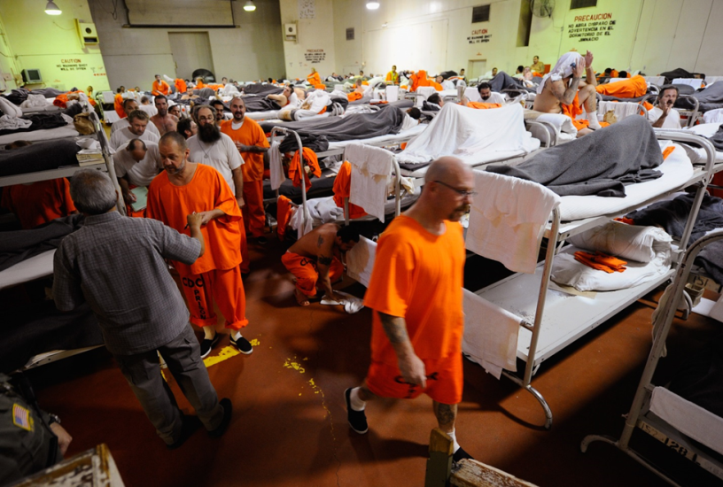
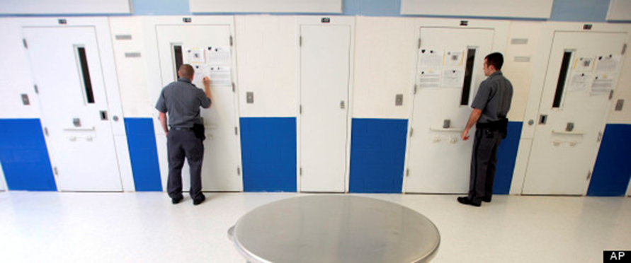
Beyond Police: State Violence Overall
A. Prison conditions in 1960s were brutal
B. Politics of rights advocacy for prisoners
C. 1980s Dramatic increase in imprisonment (highest in world)
D. Conditions of prison life are still brutal – violent, overcrowded, solitary confinement is common

Slide 21
Beyond Police: State Violence Overall
Deborah Davies documentary: prison is torture
Corrections Officer: “We cover up. Because we’re the good guys.”
US Press: very little attention
Adam Gopnik, New Yorker: More people in prison than in Gulag Archipelago under Stalin.
“The trouble with the Bill of Rights…is that it emphasizes procedures rather than principles.”
Prison makes people into “animals.”
CA overcrowding at 150% capacity → “needless suffering and death” → Brown v Plata 2011
Solitary Confinement 50,000 in US
`

Slide 22
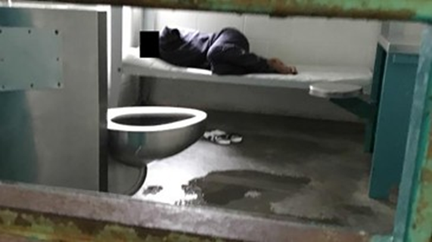
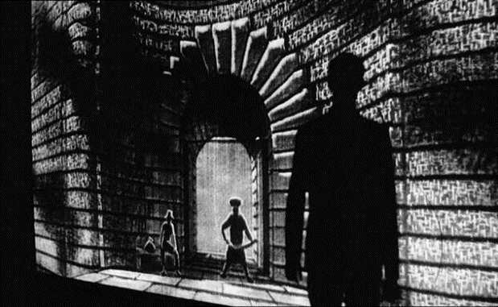
Beyond Police: State Violence Overall
Radically Unhealthy Conditions in Prisons/Jails
Prisoners have far greater health problems. People languish and die w/ little health care
Neglect, malpractice → painful deaths (S. Bland)
Exacerbated by COVID-19 – “hotspots”
Louisiana women’s prison: 156 of 194 infected
“No Sisters Left Behind”

Slide 23
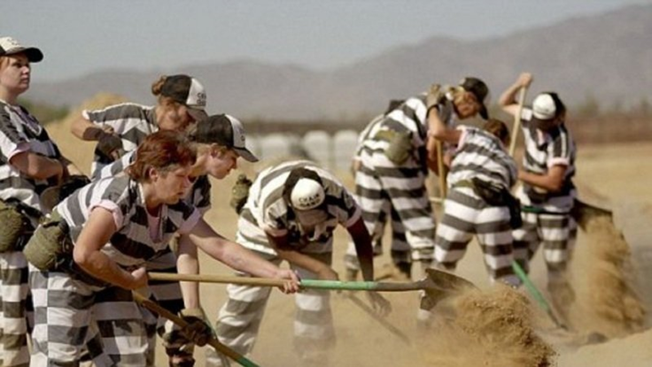
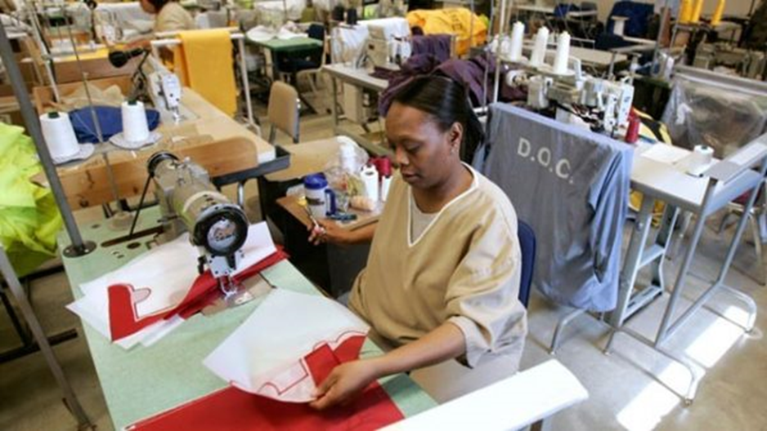
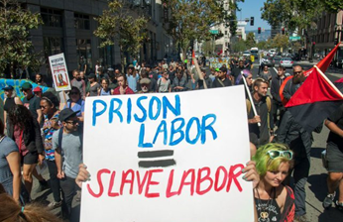
Beyond Police: State Violence Overall
Prison Labor – 1/3 (800,000) of incarcerated people work
for little to no pay ($.25-5/hr in states; $1.15 in fed prison)
Remnant of Jim Crow “convict leasing” – ghosts of slavery in present system
Much labor is “semi-voluntary,” some forced
Many prisoners hired out for big corporations
Make products for state institutions – license plates, office furniture (UW buys a lot)
2010-2020 – many strikes and protests → violence

Slide 24
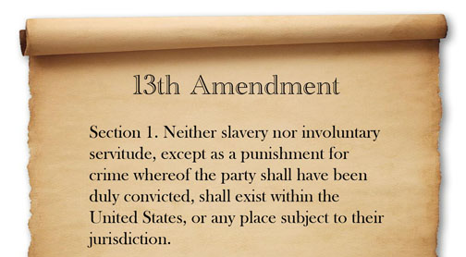
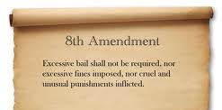
Beyond Police: State Violence Overall
E. Legal standards for violence of prison punishment and forced labor inherited from slavery (Dayan)
“The ghost of slavery….holds our prison system in its grip.”
Pelican Bay, CA: hunger strikes plus (Ashker) lawsuit → settlement in 2015 ending indefinite confinement

Slide 25
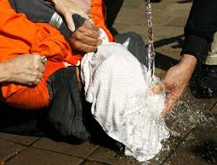
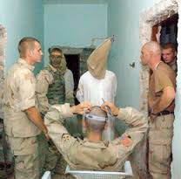
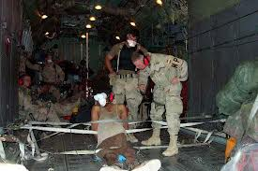
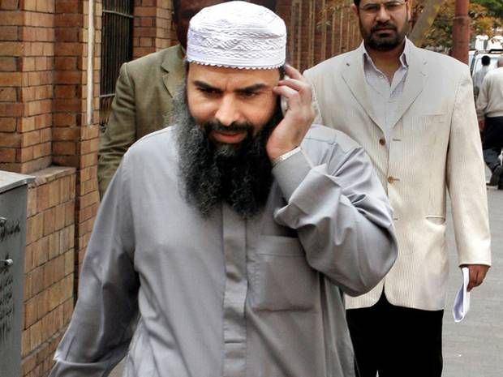
Beyond Police: State Violence Overall
3. Parallels & Links to War on Terror
(Davies, Dayan)
Enhanced interrogation/torture
Detainees w/o due process
Rendition – torture by proxy

Slide 26
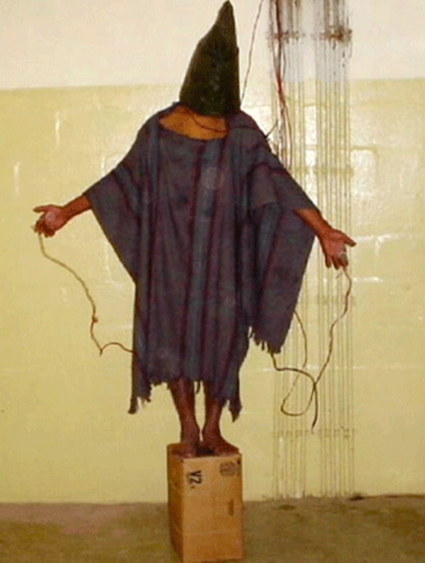
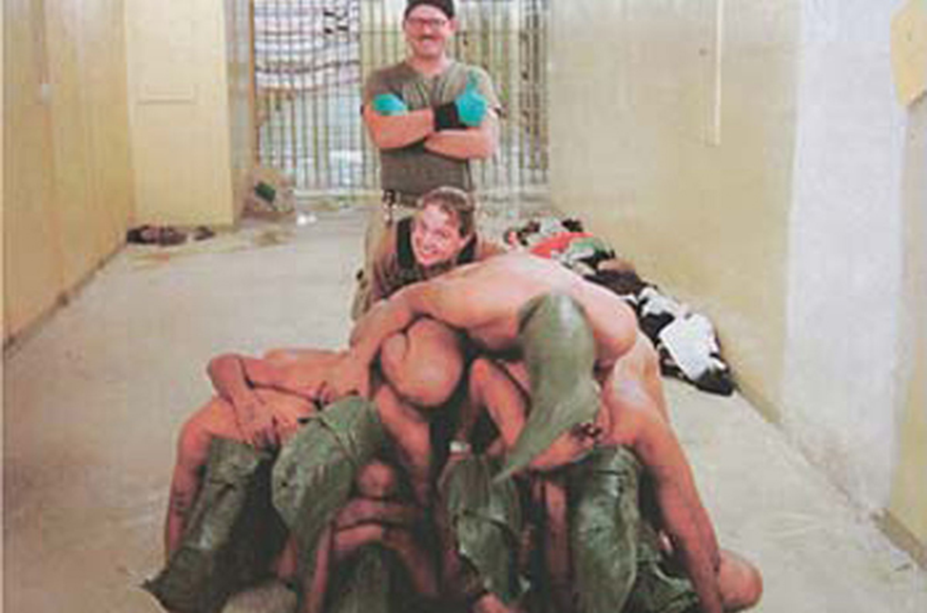
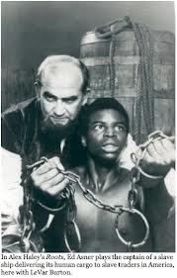
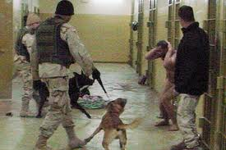
Beyond Police: State Violence Overall
3. Parallels & Links to War on Terror
a. Abuses of rights and law
Abu Ghraib abuses (Dayan)
https://www.youtube.com/watch?v=2oGh93UnxQg

Slide 27
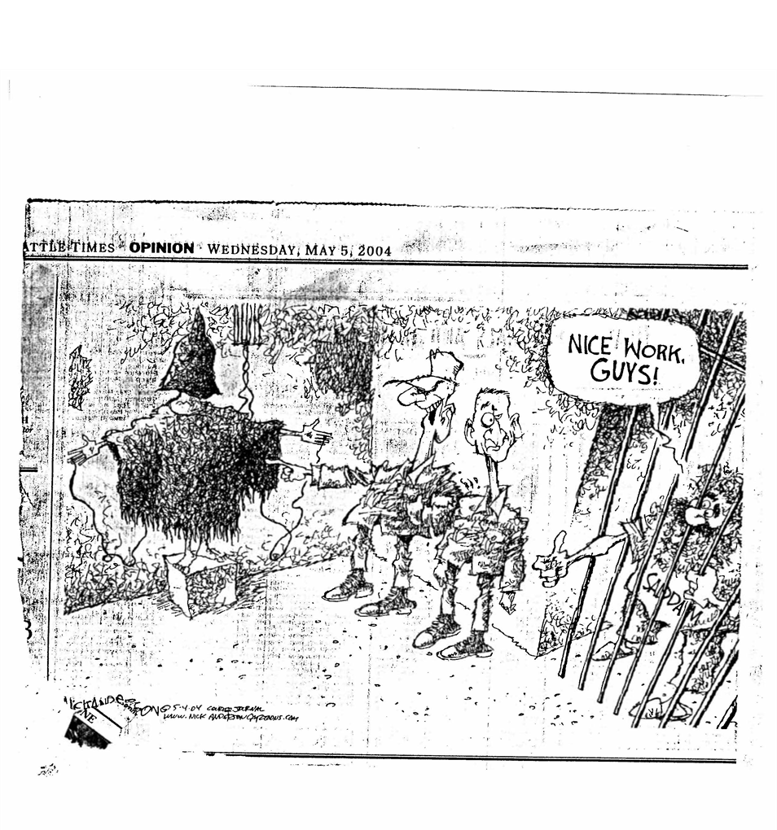
Beyond Police: State Violence Overall

Slide 28
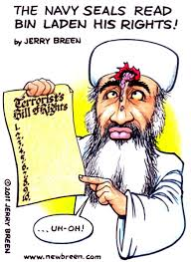
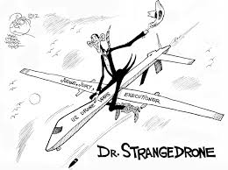
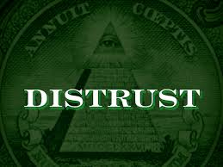
Beyond Police: State Violence Overall
6. US is out of compliance with international law and human rights conventions on most of these matters, not least US principles of rights (however contested)
Little economy of
violence→ force
lacking justice & trust

