Slide 1
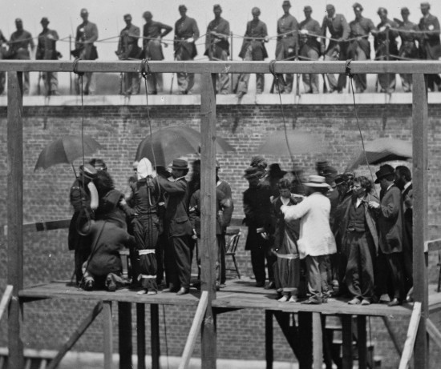
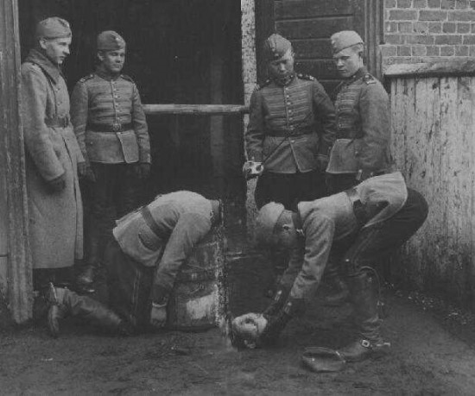
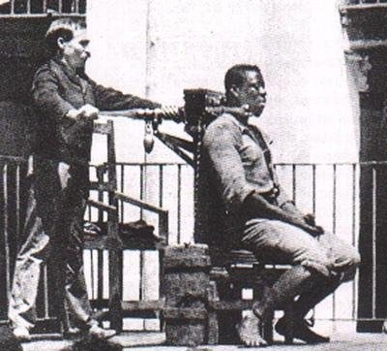
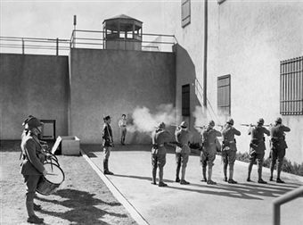
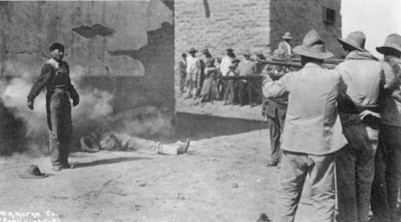
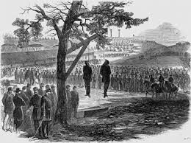
Legal Violence: State Killing
1. The Supremes on State Killing
8th Amend. Ban on Cruel & Unusual Punishment
“Disproportionate” or “barbaric”

Slide 2
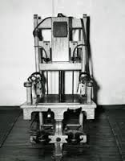
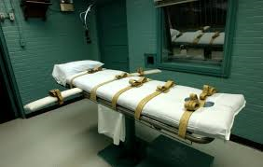
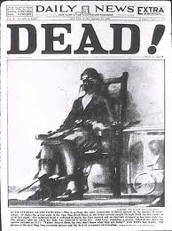
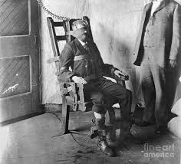
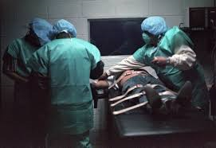
Legal Violence: State Killing
The Supremes: Judicialized State Killing is not a violation of the 8th Amend. Ban on Cruel & Unusual Punishment
Neither intrinsically disproportionate nor barbaric.
OK to kill, but don’t hurt…

Slide 3
Legal Violence: State Killing
2. Death penalty IS constitutional (never banned in US)
A. Pre-1970s – few procedural restrictions (despite racism)
B. Furman v. Georgia (1972) – death penalty w/o clear guidelines violates 14th Amendment due process and 8th Amendment (5:4)
“Uncontrolled discretion”–
Allows arbitrary & racist determinations of death;
Arbitrariness undercuts deterrent effect
C. 35 states created guidelines for state killing

Slide 4
Legal Violence: State Killing
D. Gregg v. Georgia (1976) (7:2)
1. Death penalty upheld w/ standards to guide
jury discretion about when/whom to kill
      a. Aggravating circumstances
      b. Mitigating circumstances
      c. Bifurcated Proceeding – guilt vs punishment
      d. Automatic appeal of death penalty cases
2. Retribution & deterrence are reasonable goals justifying death
Public opinion supports DP
3. Judiciary defers to states (federalism)

Slide 5
Legal Violence: State Killing
Aggravating Circumstances for Death Penalty: Washington State
  Law enforcement officer victim
  Defendant is a currently incarcerated or escaped
  Defendant in jail custody and convicted of felony
  Murder for hire (committed for money or value)
  Defendant hired someone else to commit murder
  Murder committed to advance position in a group
  Drive-by-shooting
  Victim was a judge, juror, former juror, witness, prosecutor, defense attorney, etc. OR Murder was related to exercise of victim’s official duties (murder on the job)
  Murder committed to conceal crime
  More than one victim & murder part of common scheme
  Murder committed in course of: robbery, rape, burglary, kidnapping, or arson
  Victim was news-reporter and murder was committed to obstruct reporter’s job
  At time of murder there was a restraining order out protecting victim that defendant knew about
  Domestic violence murder (in certain circumstances)

Slide 6
Legal Violence: State Killing
Mitigating Circumstances for Death Penalty: Washington State
  No significant criminal history
  Murder committed while defendant “under the influence of extreme mental disturbance”
  Victim consented to murder
  Defendant was an accomplice to murder only and role was minor
  Defendant acted under duress or domination
  Defendant’s capacity to appreciate wrongfulness of murder impaired by mental state (even though no intellectual disability)
  Defendant’s age calls for leniency
  Likelihood defendant poses a danger to others in future

Slide 7
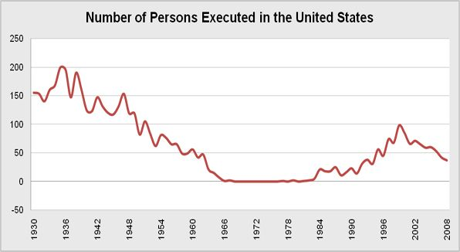
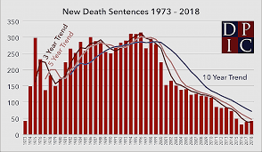
Legal Violence: State Killing
3. Death penalty today authorized in 24 states, not in 26 states
A. Since 1976, over 1546 executions
B. 32/yr in 1980s; 98 in 2000; 23 in 2017
C. Over 2,436 now on death row (1/2 in CA, FL, TX)
1930-1967 3,859 executions (2/3 in South)
1973 2018

Slide 8
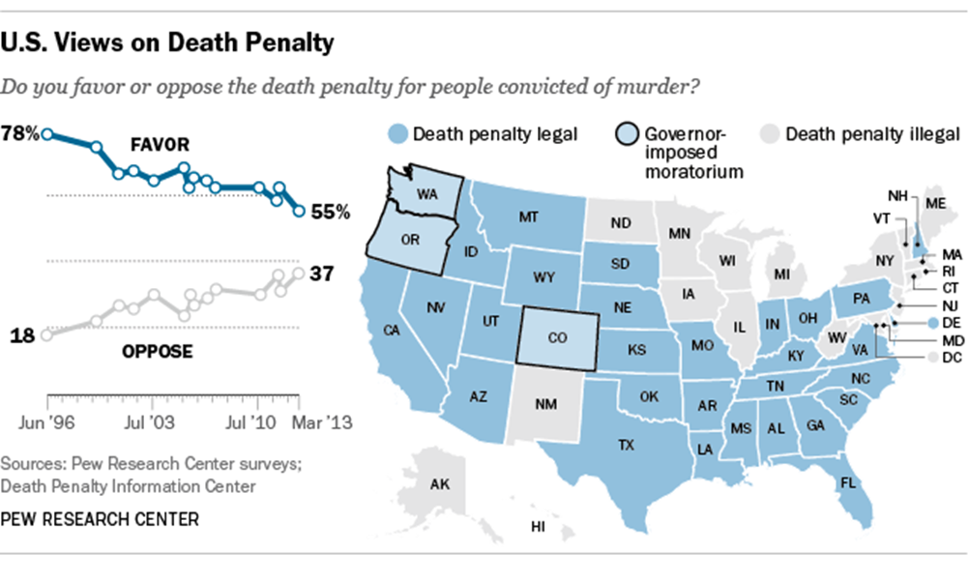
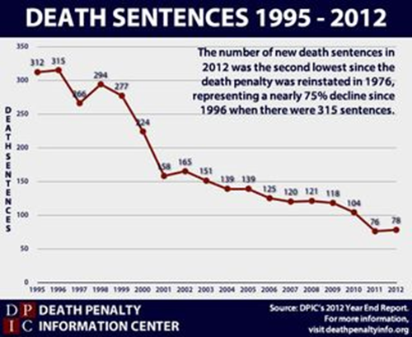
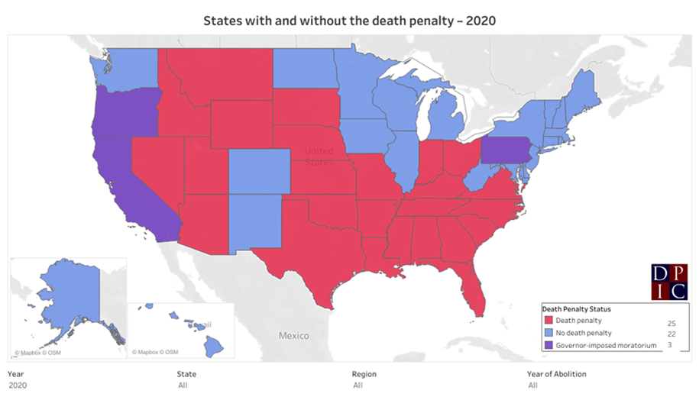
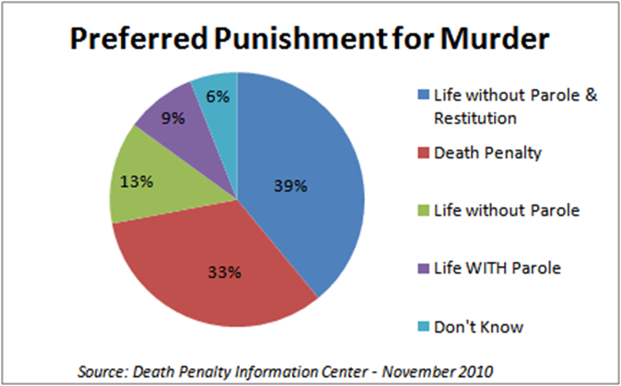
Legal Violence: State Killing
Trend toward
Abolition?

Slide 9
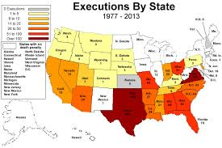
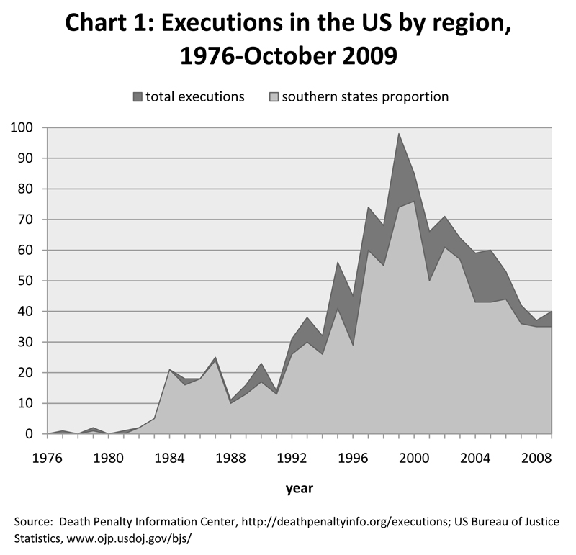
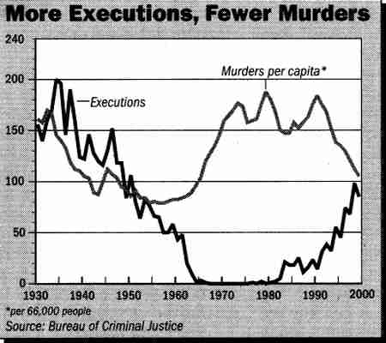
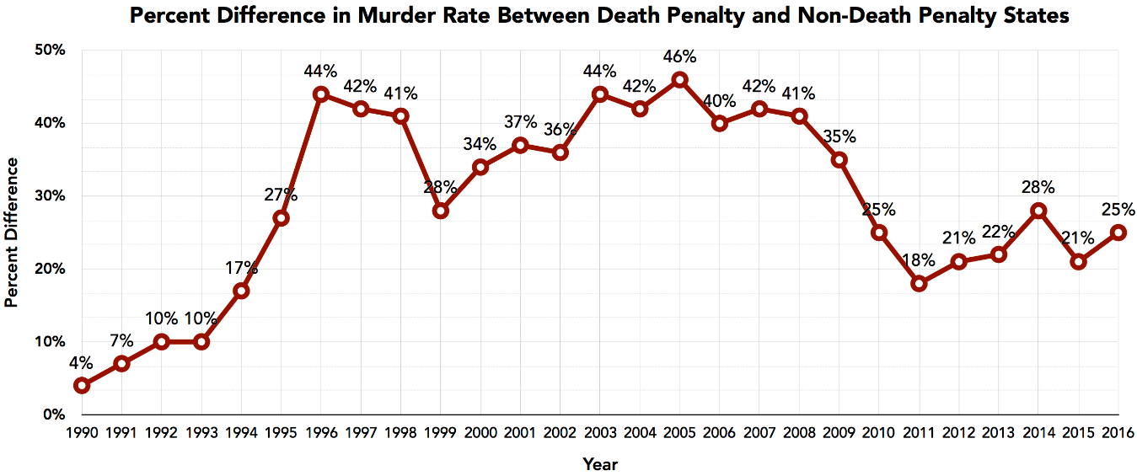
Legal Violence: States of Execution
D. TX, GA, FL, MO (OH, VA) lead in killing

Slide 10
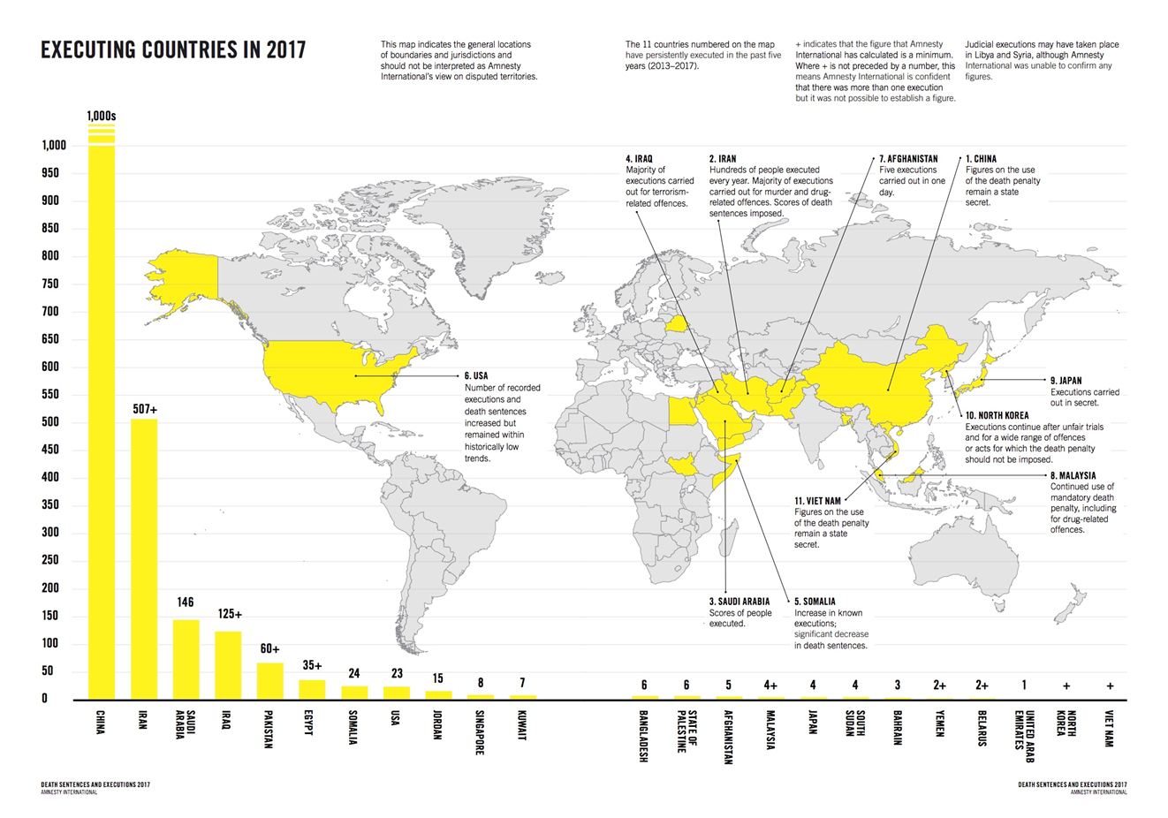
Legal Violence: State Killing

Slide 11
Legal Violence: State Killing
4. U.S. Supreme Court: Key to legitimating state killing
A. Has never ruled Death is unconstitutional per se
B. Focus on procedure of jury decision making
1. Furman/Gregg – bounded discretion in sentencing; bifurcated judgments for guilt and sentencing phases→ image of fairness
2. “Super due process” appeals until 1990s
3. Refinements for types of crimes (murder plus)
4. Who can be executed? (no low IQ, juveniles)
5. Techniques of state killing
Electrocution, hanging, lethal injection OK
C. SCOTUS – encourages disputing over process & techniques of death→ DP itself stronger?
D. No declared abolitionists on Court now (?)

