Slide 1
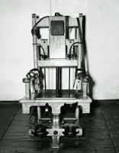
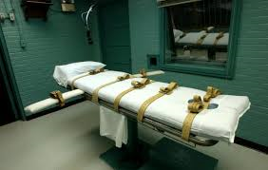
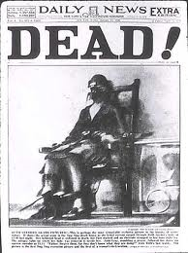
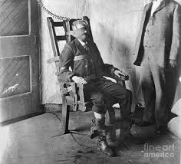
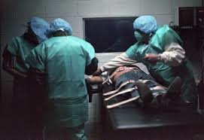
Legal Violence: Judicial State Killing
1. The Supremes on State Killing
8th Amend. Ban on Cruel & Unusual Punishment

Slide 2
Legal Violence: Judicial State Killing
4. U.S. Supreme Court: Key to legitimating state killing
A. Has never ruled Death is unconstitutional per se
B. Focus on procedure; substantive violence OK
1. Furman/Gregg – bounded discretion in sentencing; bifurcated judgments for guilt and sentencing phases→ image of fairness
2. “Super due process” appeals until 1990s
3. Refinements for types of crimes (murder plus)
4. Who can be executed? (no low IQ, juveniles)
5. Techniques & appearance of state killing
Electrocution, hanging, lethal injection OK
C. SCOTUS – encourages disputing over process & techniques of death→ DP more acceptable?
D. No declared abolitionists on Court now

Slide 3
Judicial State Killing: Capital Trials
“Because in capital punishment the
action or deed is extreme and
irrevocable, there is pressure placed on
the word
--
the interpretation that
establishes the legal justification for the
act....Not even the facade of civility,
wh
ere it exists, can obscure the violence
of a death sentence...A central task of
the legal interpreter is to attend to the
problematic aspects of the integration of
role, deed, and word, not only where
violence is lacking for meaning, but also
where meaning
is lacking for violence.”
Robert Cover, “Violence & the Word”

Slide 4
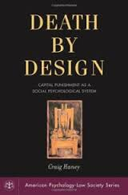
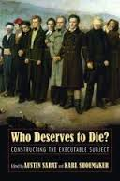
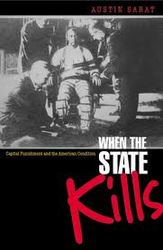
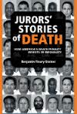
Judicial State Killing: Capital Trials

Slide 5
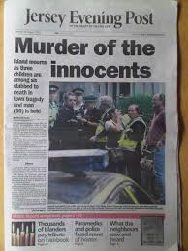
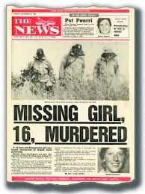
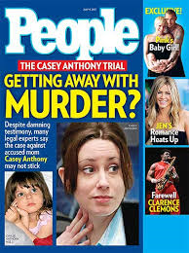
Judicial State Killing: Starts w/ Capital Trials
1. Capital Trials: Rituals of Forgetting
A. Cover/Sarat/Blackmun: Rituals of rational
responsibilization and irrational revenge
B. Trial begins in press – media obsession w/ crime primes juror knowledge, fear, scorn
i. Predators vs. innocent victims
ii. Individualizes victim & murderer
responsibility, demonizes latter
iii. Rumor level evidence circulates

Slide 6
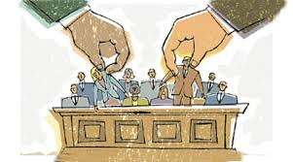
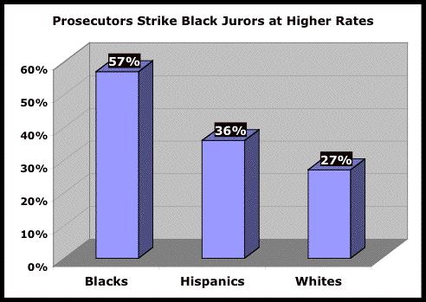
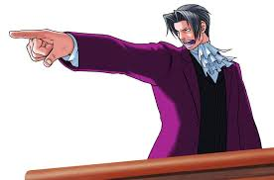
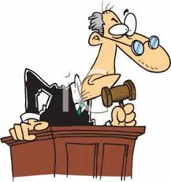
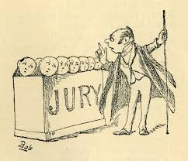
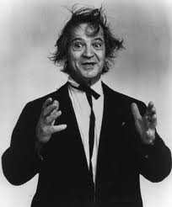
Judicial State Killing: Capital Trials
C. Trials rigged for prosecution
i. Voir dire screens jury, racial bias
ii. Prosecutors rule, focus on victims,
prepare jurors to be “hanging juries”
iii. Poor/unqualified legal defense
iv. Jury instructions obscure/confuse

Slide 7
Judicial State Killing: Capital Trials
D. Revenge over retribution
i) Victims’ rights movement drives action
ii) Individualizing > dehumanizes
iii) Sympathy & revenge for murdered….Is law’s violence different...?
iv. “Eye for an eye” is leading popular justification
(Jesus warned to reject this ethos)

Slide 8
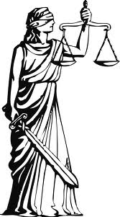
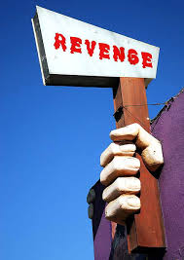
Judicial State Killing: Capital Trials
RETRIBUTION REVENGE
<--------------------------------------------------------->
Context of wrong act Violence to innocent
Perpetrator also victim Single/only victim
Limited Limitless, insatiable
Impersonal/public Personal/private
Rational, principled Emotion & pain
Generalizable Particularistic
Goal: Justice Goal: Closure
Inflating victim’s rights skews impartial legal process and reduces state responsibility for death.
“Eye for an eye” logic – is moral anger consistent with law’s demand for measured, proportional punishment?

Slide 9
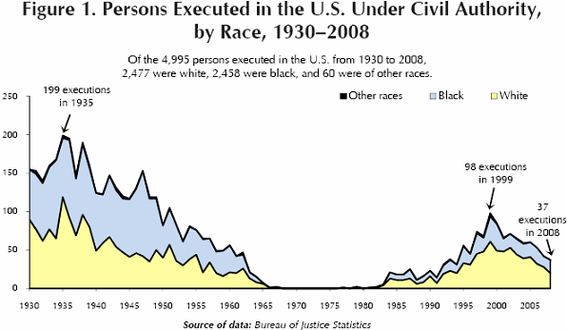
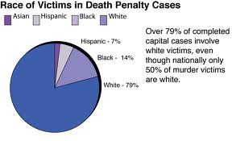
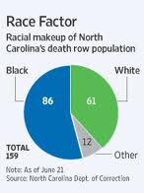
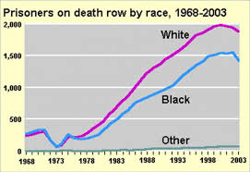
Judicial State Killing: Capital Trials
E. Race haunts processes
i. Southern legacy of lynching → executions
ii. Baldus – black on white victim violence

Slide 10
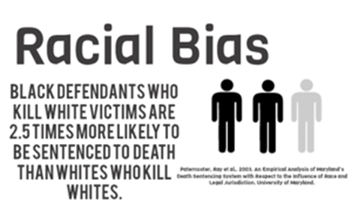
Judicial State Killing: Capital Trials
Race haunts processes
Persons Executed for Interracial Murders
300
White Def/ Black Def/
Black Victim White Victim
21

Slide 11
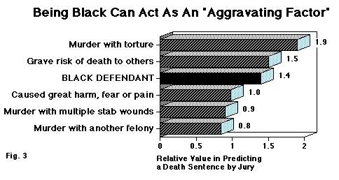
Judicial State Killing: Capital Trials
F. Individualistic bias of sentencing
i. McClesky v Kemp (1987) – challenges to disparate racial impact rejected (5:4 vote)
ii. Defense rarely addresses mitigating factors about murderer as victim or violence of execution
iii. Fleury-Steiner shows race bias on juries
iv. Rituals of responsibility, revenge, race converge
to “forget” violence against defendant

Slide 12
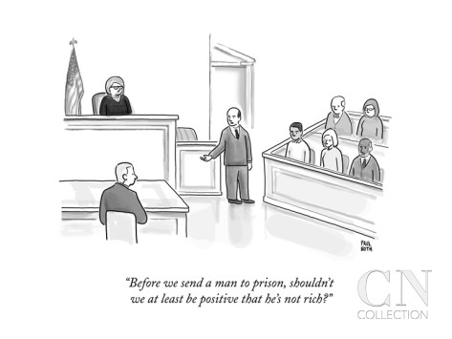
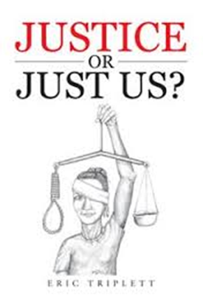
Judicial State Killing: Capital Trials
G. Haney: Supreme Ct. language about due process “robbed of truth-telling power.”
Outcomes – Innocents executed; systemic racial/class bias; arbitrariness of death “lottery”
Justice Blackmun reverses position on the “machinery of death” (Stevens too)
Cannot balance discretion and fairness

Slide 13
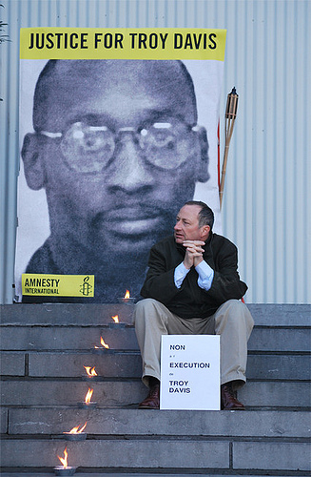
Judicial State Killing: Capital Trials
Troy Davis video (CNN)
https://www.youtube.com/watch?v=5SH4IpmJl6M
http://www.youtube.com/watch?v=683UAypf2NY

Slide 14
Judicial State Killing: Capital Trials
Troy Davis case illustrates the dubious dynamics of capital trials exposed by Haney (and Sarat)
Advance police-fed media coverage biased the jury; demonize accused, celebrated innocent victim
Experienced prosecutor vs inexperienced defense
Evidence tainted – 5 witnesses lied under pressure; accuser surely was the murderer; bad police work
(Eyewitness testimony singled biggest reason for errors)
Coles had gun, Davis did not; no DNA or material evidence
Race – black on white murder (& a police officer)
Prosecutors request death 2.5-1 for blacks. Why Davis over Coles?
Appeals dragged out but did not stop execution
Central Park 5 all over, but no movie exposure……
Human rights protests around the world – executed
September 21, 2011
1000 Maniacs “I’m Not the Man”

