Slide 1
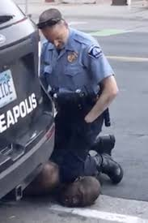
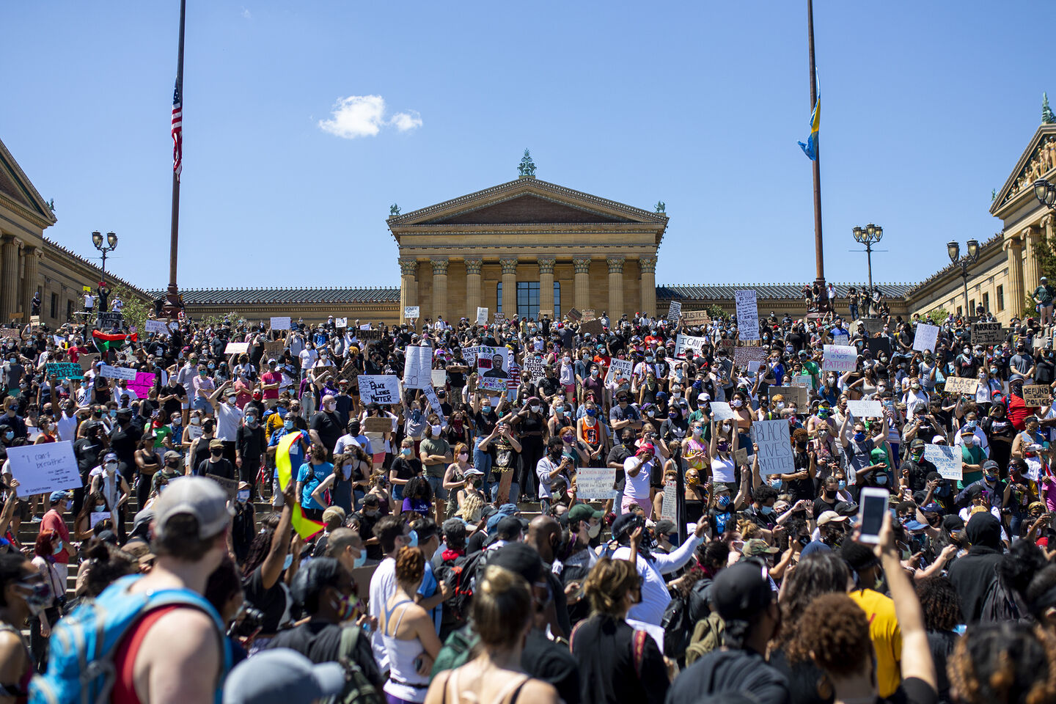
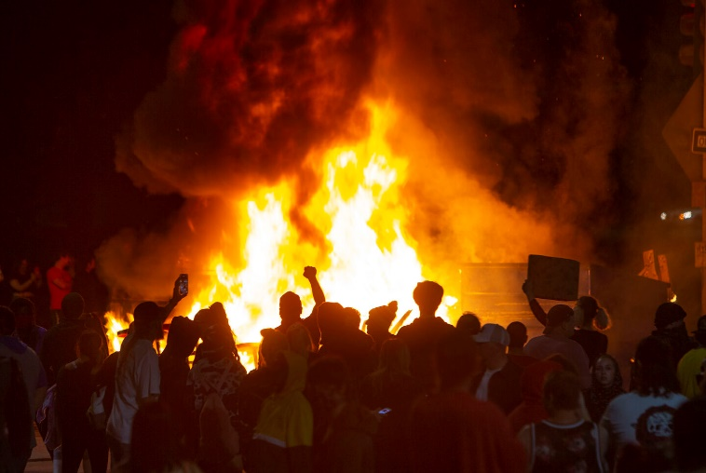
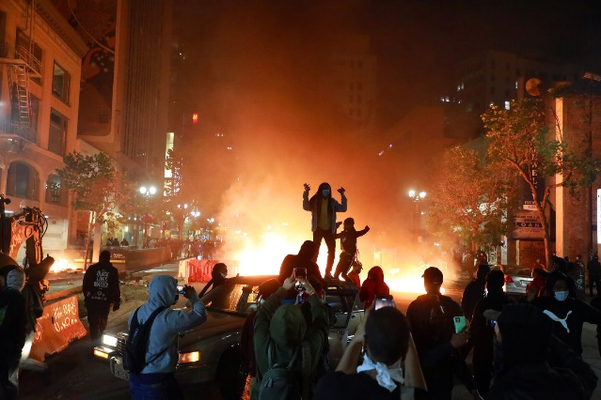
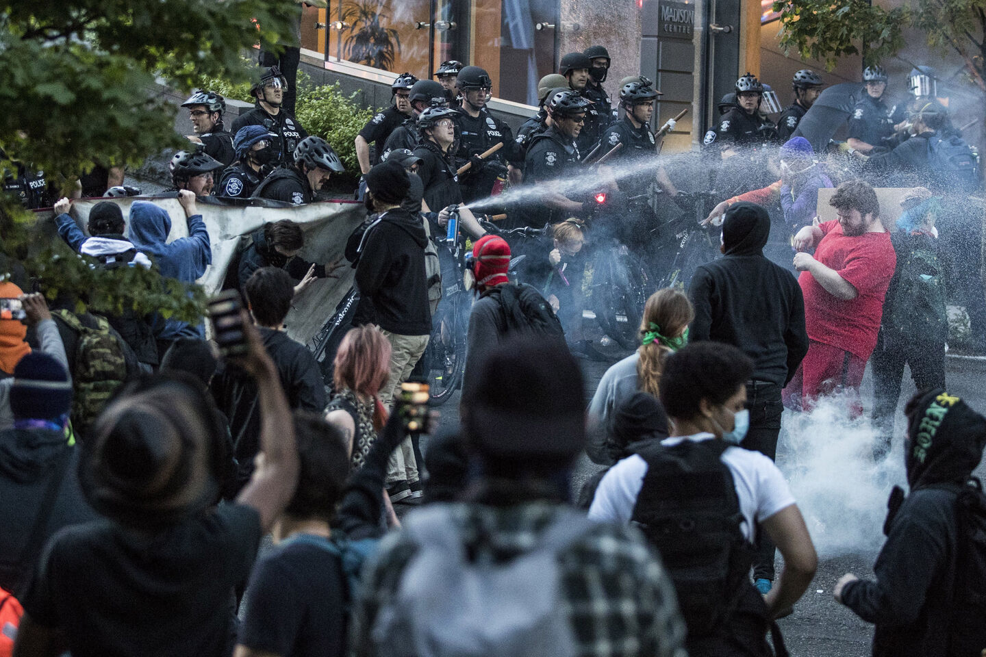
Excessive Force→Distrust→More Violence
NYT: Facing Protests Over Use of
Force, Police Respond with More Force

Slide 2
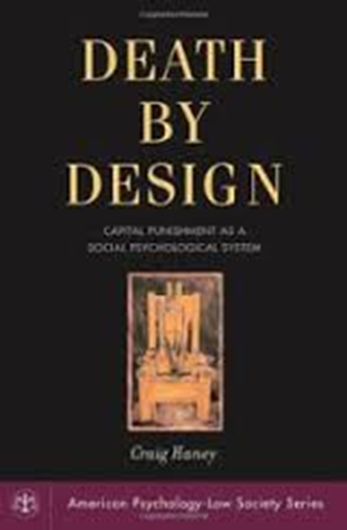
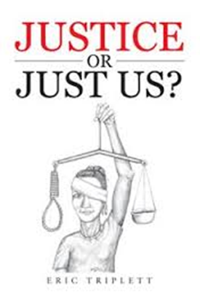
Judicial State Killing: Capital Trials
Haney on Capital Trials: Supreme Ct. language about
due process “robbed of truth-telling power.”
Outcomes –
1) Innocents executed
2) Arbitrariness of death lottery
3) Systematic class/race bias (McCleskey 1987)
Justice Blackmun reverses position: the “machinery ` of death” is inconsistent w/ law
(Stevens agrees later)
Cannot balance discretion and fairness
Public support for executions has
steadily declined

Slide 3
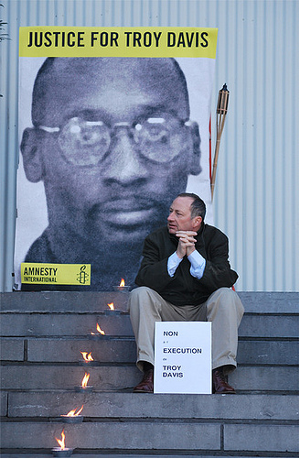
Judicial State Killing: Capital Trials
Troy Davis video (CNN)
https://www.youtube.com/watch?v=5SH4IpmJl6M
http://www.youtube.com/watch?v=683UAypf2NY

Slide 4
Judicial State Killing: Capital Trials
Troy Davis case illustrates the dubious dynamics of capital trials exposed by Haney (and Sarat)
Advance police-fed media coverage bias jury; demonize accused, celebrated innocent victim
Experienced prosecutor vs inexperienced defense
Evidence tainted – 5 witnesses lied under pressure; accuser was likely the murderer; bad police work
Eyewitness testimony often unreliable, wrong
Coles had gun, Davis did not; no DNA or material evidence
Race – black on white murder (& a police officer)
Prosecutors request death 2.5-1 for blacks. Why Davis over Coles?
Police/public revenge for cop killing drives process
Appeals dragged out but did not stop execution
7) CP5 all over, but no movie exposure……
8) Human rights protests around the world ignored
Executed September 21, 2011

Slide 5
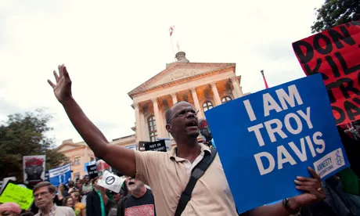
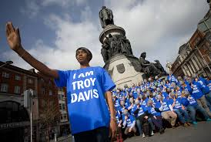
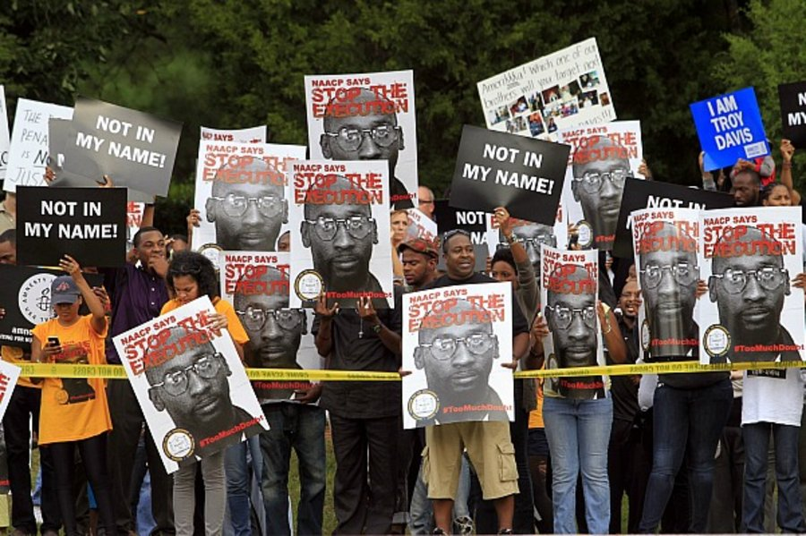
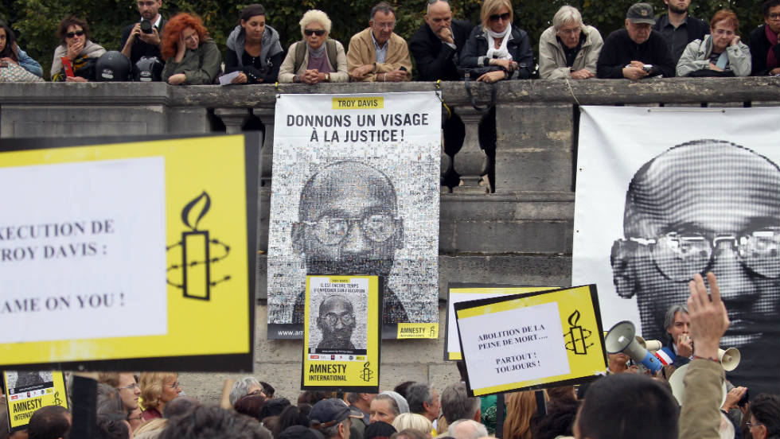
Judicial State Killing: Capital Trials

Slide 6
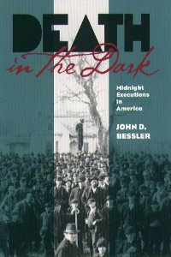
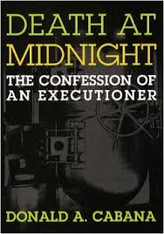
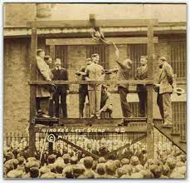
How the State Kills
6. Execution Rituals: More Systematic Forgetting
A. Legalism & bureaucracy (Cover) distance judge/jury who “trigger” execution
B. Executions used to be public spectacles
In early daylight, for people to see

Slide 7
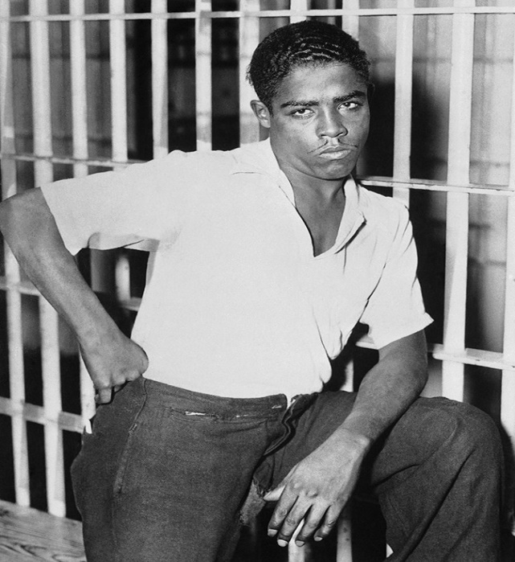
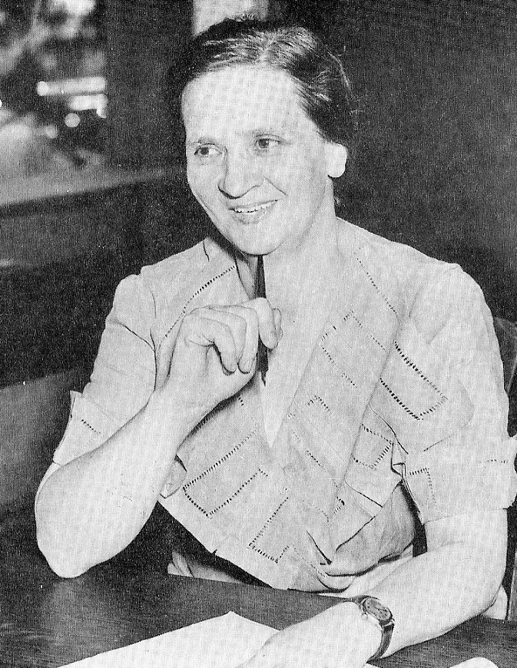
How the State Kills
Rainey Bethea -- last hanging
(Oklahoma,1936)
Rainey Bethea 2 weeks before hanging. Local sheriff Florence Thompson (right) was charged with seeing the public execution through.

Slide 8
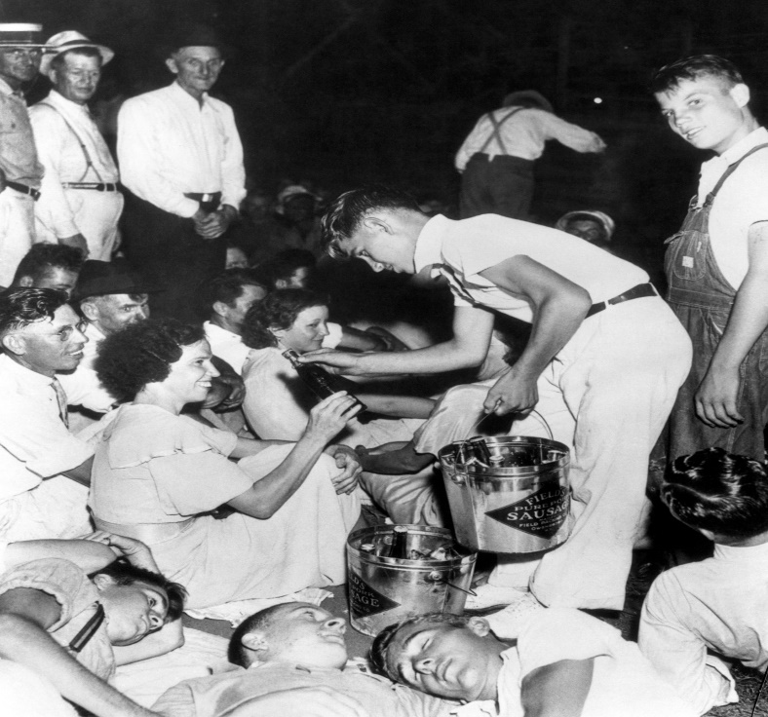
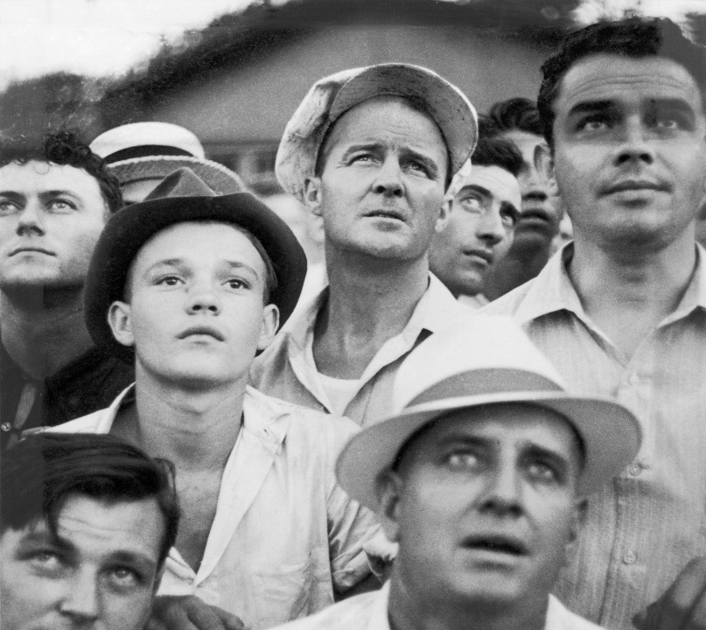
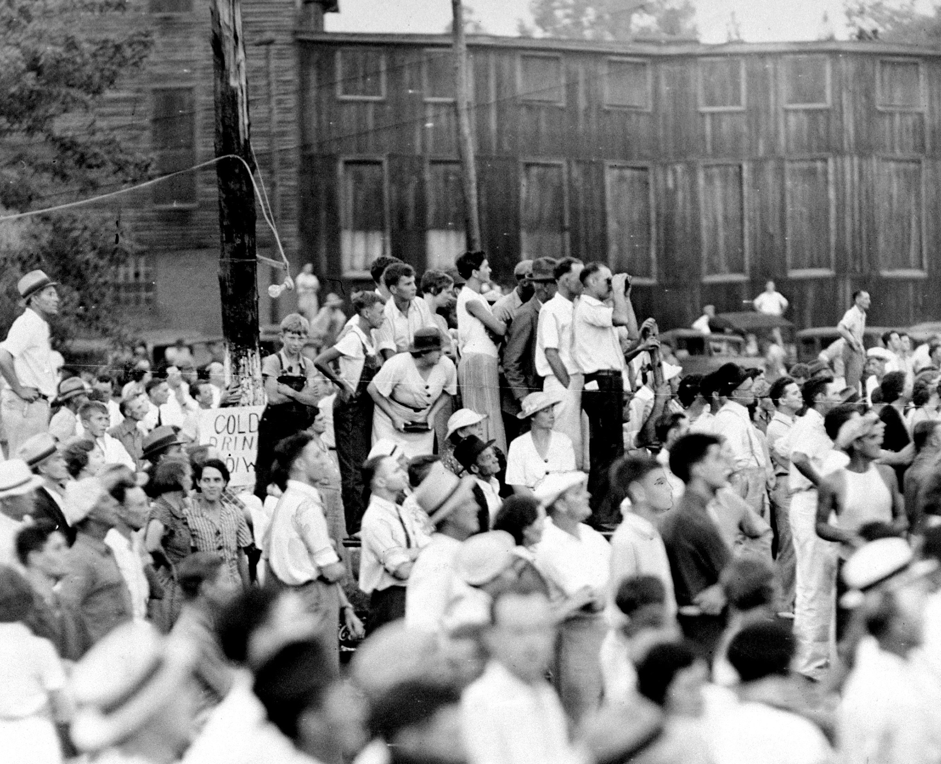
How the State Kills

Slide 9
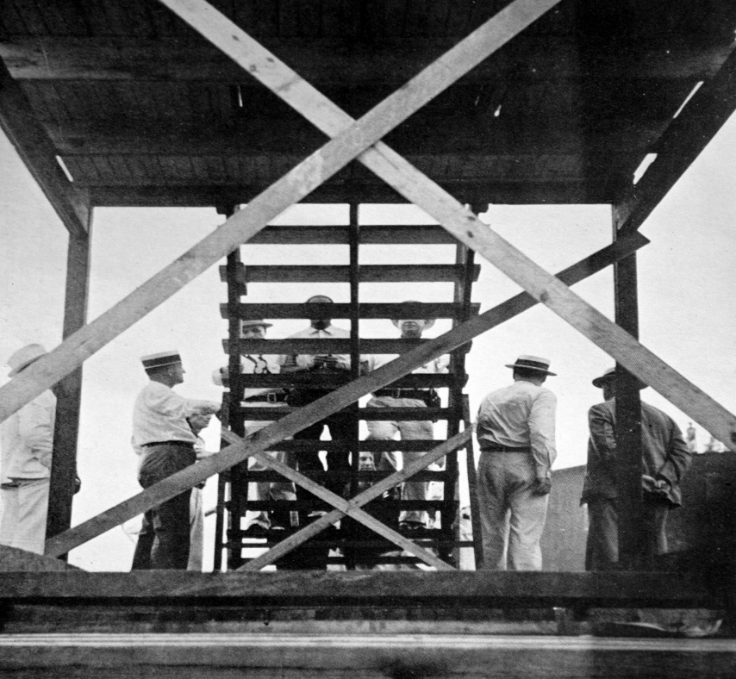
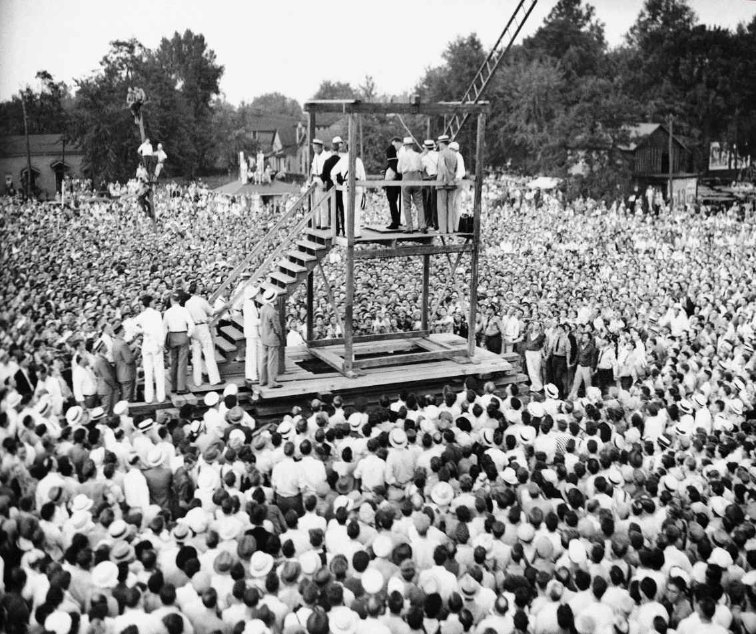
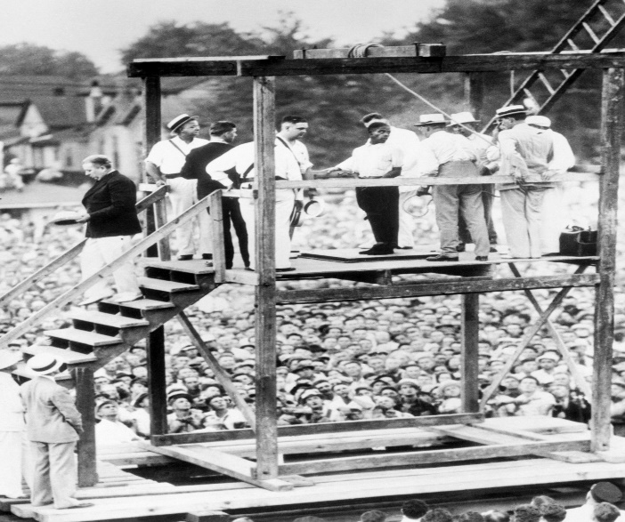
How the State Kills

Slide 10
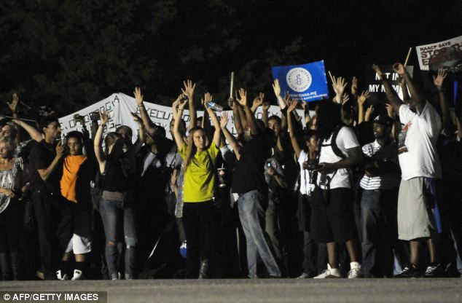
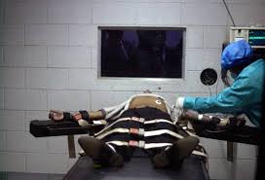
How the State Kills
C. State killing now is invisible, inaudible
i. Reversal: public trial, private execution
ii. Can this deter? Uplift us? Justify violence?
iii. Maybe televise executions?

Slide 11
How the State Kills
D. State can kill but must avoid hurting, torture…..
Technologies of death have evolved
“with standards of decency” →
Executions Since 1976 by Method Used
1366 Lethal Injection
163 Electrocution
11 Gas Chamber
3 Hanging
3 Firing Squad

Slide 12
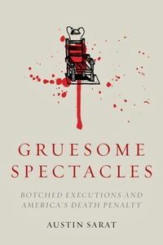
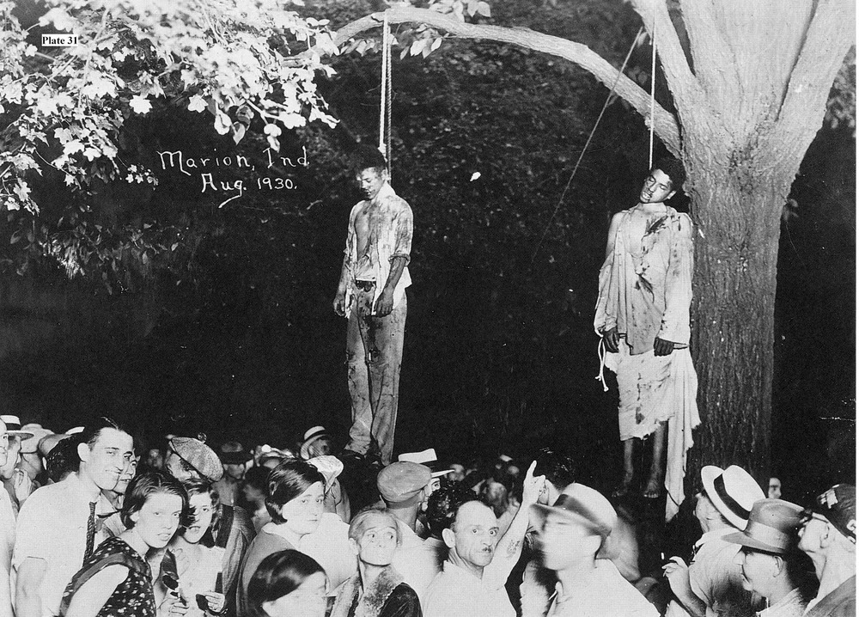
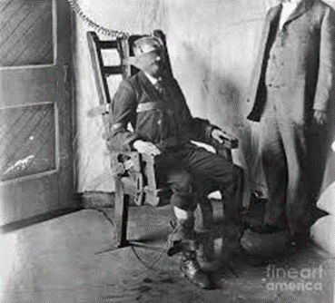
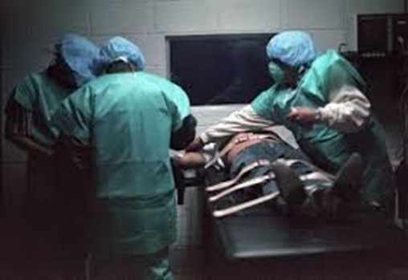
How the State Kills
D. State kills increasingly “softly,” humanely →
perception of painlessness (contested)
But symbolism arguably hides the
reality of painful death

Slide 13
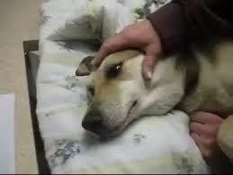
How the State Kills
1. Sarat:100 yrs: 3% executions “botched”
4% of legal injections botched→ least reliable
Law & culture → botches = aberrations
Technological progress will solve (?)
2. Symbolism: lethal injection like putting
sick pet “to sleep”
3. Blurs vengeful w/ humane
Death penalty is not really violent (?)
Does this legitimate or delude? (Cover)
Who is comforted? (Sarat: witnesses)

Slide 14
How the State Kills
4. Scalia in Callins – lowers bar to a lesser form of brutality
5. Baze v Rees (2008) - lethal injection ok
vs murder
6. Botched Lockett execution (2014)→ public concern Botched acts →question technologies, not killing
Sanjay Gupta on botched injection
Always a “better” way, but recently states have retreated to execution, hanging, firing squad

Slide 15
How the State Kills
7. Glossip v Gross, 2015
21 on death row filed civil rights lawsuit, 4 filed preliminary injunction staying executions & arguing method of execution violates 8th Amendment (Glossip, Cole, Grant, Warner)
Issue: Whether use of replacement drug midazolam in lethal injection violates 8th Amendment ban on cruel & unusual punishment
Supremes Holding: 5:4 finding that failed lethal injection was not cruel and unusual punishment
Key was failure to identify less painful method
Charles Warner autopsy → wrong protocols → Glossip execution postponed until corrected
2018: several executions delayed by drug dispute

Slide 16
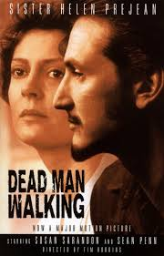
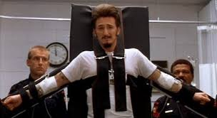
How the State Kills
7. Fantasy Killing on the Screen: Dead Man Walking
A romance of state killing and public morality
A. Moral anger = vengeance against violence
B. Passing reference to class/race biases
C. Ethos of individual responsibility
Helen humanizes & responsibilizes a “monster” P. relents, is redeemed; “truth makes you free”
Execution – more humane; forces to be “free”
http://www.youtube.com/watch?v=xQyYa3DBhNA
https://www.youtube.com/watch?v=jDFDpzWJj2s
DMW long ending
Death=apex of social control in
individualized disciplinary society
Reality is that state killing is premeditated, rational, coordinated, but unruly. Is it just?

Slide 17
Judicial State Killing
Death penalty is pinnacle of penal industrial complex,
the most violent modern constitutional republic
Incarcerate far more than past, most in the world
Punishment often is extreme, brutal, debilitating
Punishment focused on poor & people of color
Sets high benchmark for proportionality of lesser punishments…what is not permitted?
Punishment has taken resources from investment in education, health care, job training, opportunity
Innocence Movement challenges wrongful conviction, but not violence of punishment itself
Does law make us better? Live up to ideals? Limit systematic as well as arbitrary violence?
Commitments to equal rights – real, or a convenient, evasive or diversionary myth (Scheingold)?

Slide 18
Judicial State Killing
What does state killing express about, and make, us?
Exemplars of democratic law, free people?
Or angry, vengeful, punitive, class-enforcing (racist?) amnesiacs in cocoon of innocence?
“It is not permissible that the authors of
devastation should also be innocent. It is the innocence which constitutes the crime.”
― James Baldwin, The Fire Next Time

