Slide 1
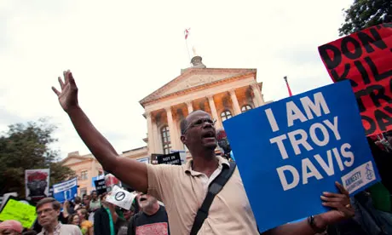
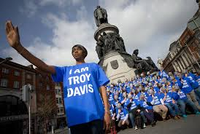
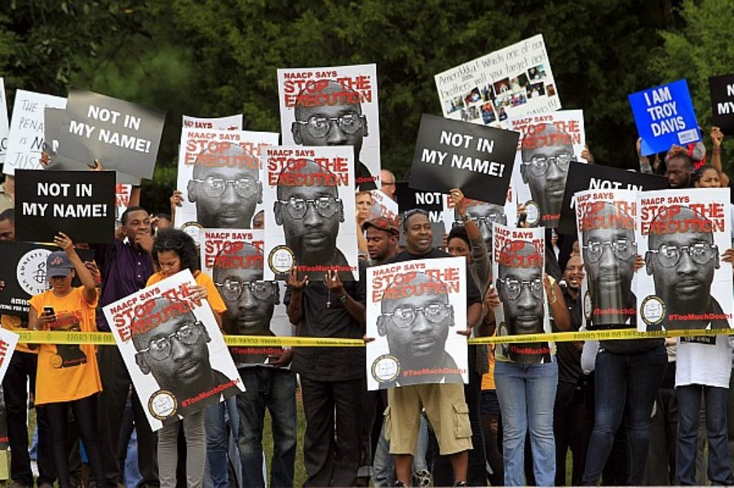
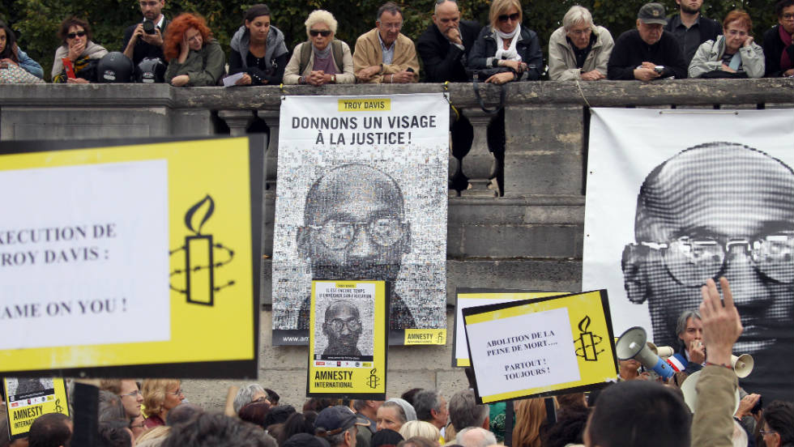
Judicial State Killing: Capital Trials

Slide 2
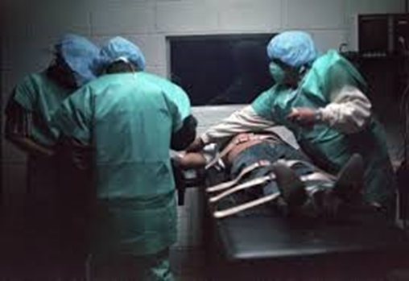
How the State Kills
6. Execution Rituals: More Systematic Forgetting
A. Legalism & bureaucracy (Cover) distance j Judge/jury who “trigger” execution
B. State killing now is invisible, inaudible
i. Reversal: public trial, private execution
ii. Can this deter? Uplift us? Justify violence?
C. Pseudo-medical rituals
serve to mask the
violence of executions w/
perception of painlessness

Slide 3
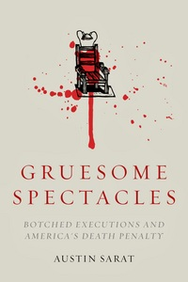

How the State Kills
7. Sarat:100 yrs: 3% executions “botched”; 4%
of legal injections botched→ least reliable
Law & culture → botches=aberrations
Technological progress will solve (?)
A. Symbolism: lethal injection like putting
sick pet “to sleep”
B. Blurs vengeful w/ humane
Does this legitimate or delude? (Cover)
Who is comforted? (Sarat: witnesses)
C. Scalia in Callins – lowers bar to lesser brutality
D. Baze v Rees (2008) - lethal injection ok vs murder
E. Botched Lockett execution (2014)→ public distrust Botched acts →question technologies, not killing
Sanjay Gupta on botched injection
Always a better way, but recently states have retreated to execution, hanging, firing squad

Slide 4
How the State Kills
8. Glossip v Gross, 2015
21 on death row file civil rights lawsuit, 4 filed preliminary injunction staying executions & arguing method of execution violates 8th Amendment (Glossip, Cole, Grant, Warner)
Issue: Whether use of untested replacement drug for midazolam in lethal injection violates 8th Amendment ban on cruel & unusual punishment
Supremes Holding: 5:4 finding that failed lethal injection was not cruel and unusual punishment
Key was failure to identify less painful method
Charles Warner autopsy → wrong protocols →Glossip execution postponed until corrected
2018: several executions delayed by drug dispute

Slide 5
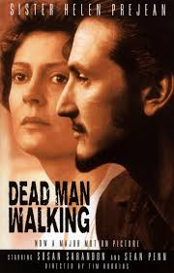
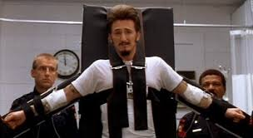
How the State Kills: More Fantasy
9. Fantasy Killing on the Screen: Dead Man Walking
A romance of state killing and public morality
A. Moral anger = vengeance against violence
B. Passing reference to class/race biases
C. Ethos of individual responsibility
Helen humanizes & responsibilizes “monster” P. relents, is redeemed; “truth makes you free”
Execution – more humane; forces to be “free”
http://www.youtube.com/watch?v=xQyYa3DBhNA
DMW long ending
Death=apex of social control in
individualized disciplinary society
Reality is that state killing is premeditated, rational, coordinated, but unruly. Is it just?

Slide 6
Judicial State Killing
Death penalty is pinnacle of violent penal industrial complex
Increasing police (700,000) and lethal military force
Incarcerate far more than past, most in the world
Punishment often is extreme, brutal, debilitating
Punishment focused on poor & people of color
Sets high benchmark for proportionality of lesser punishments…what is not permitted?
Punishment has taken resources from investment in education, health care, job training, opportunity
Innocence Movement challenges wrongful conviction, but not violence of death itself
Does law make us better? Live up to ideals? Limit systematic as well as arbitrary violence?
Commitments to equal rights – real, or a convenient, evasive or diversionary myth (Scheingold)?

Slide 7
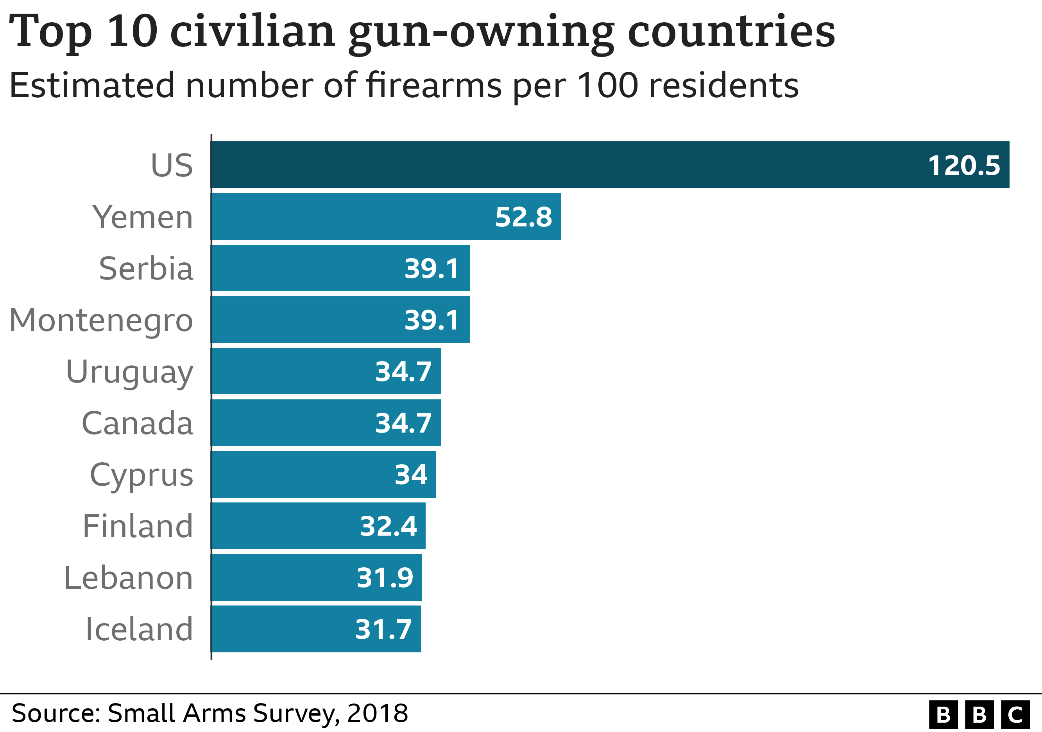
Ironic Relationships of Law & Violence
DC v. Heller (2008): 2nd Amendment guarantees individual rights to gun ownership→400,000,000 guns

Slide 8
Ironic Relationships of Law & Violence
Legal protection for guns → greater violence in society, which increases public demand for state violence

Slide 9
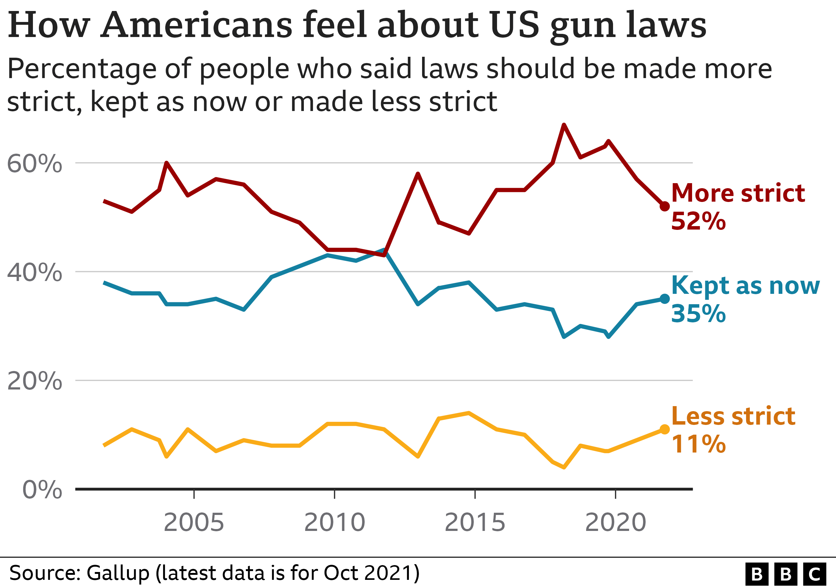
Ironic Relationships of Law &Violence

Slide 10
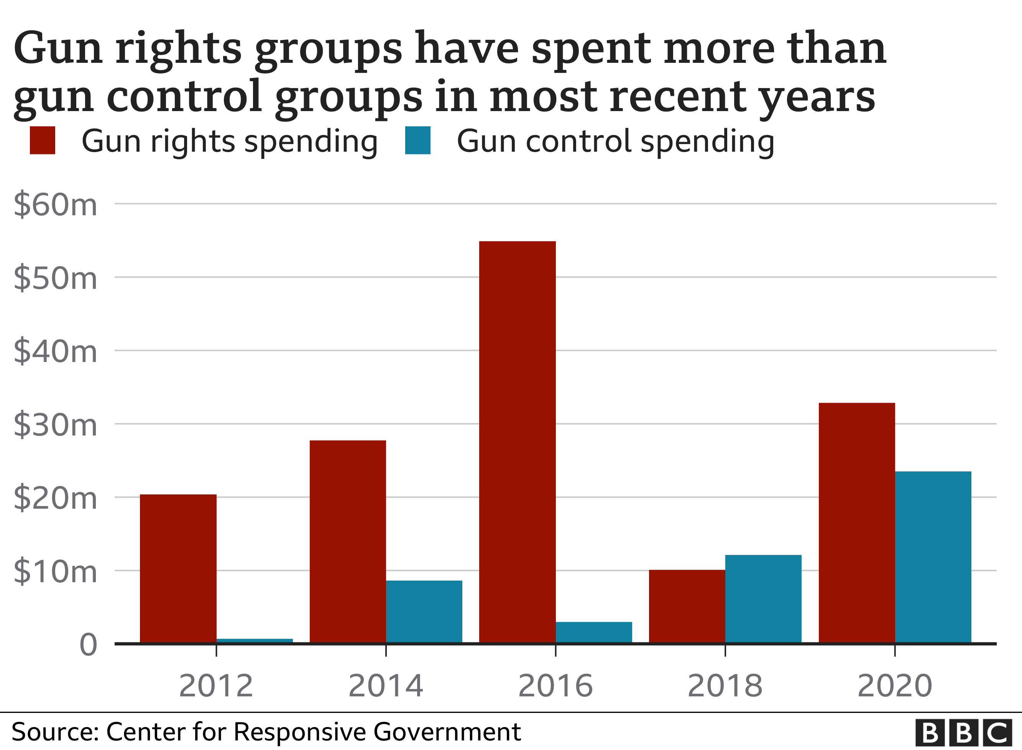
Ironic Relationships of Law & Violence
Legal protection for guns → greater violence in society, which increases public demand for state violence

Slide 11
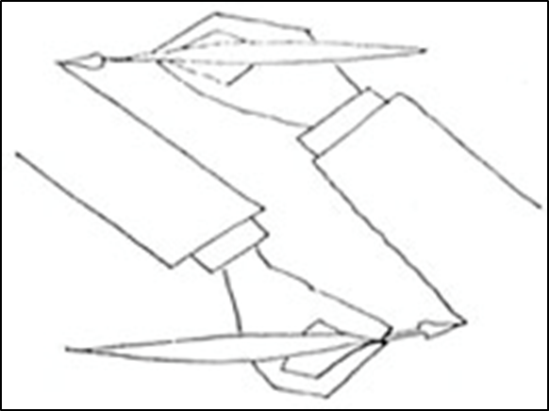
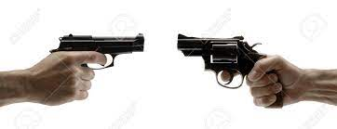
Ironies of Law and Violence
Public support for state killing has declined, but support for tough cops and extreme punishment, for punitive state, continues…even after George Floyd
Law and society are mutually constitutive
Social violence and legal violence are interrelated

Slide 12
Judicial State Killing
What does state killing/violence express about, and make, us?
Exemplars of democratic law, free people?
Or angry, vengeful, punitive, class-enforcing (racist?) amnesiacs in cocoon of innocence?
“It is not permissible that the authors of
devastation should also be innocent. It is the innocence which constitutes the crime.”
― James Baldwin, The Fire Next Time
Is it possible to reduce both types of violence?

Slide 13
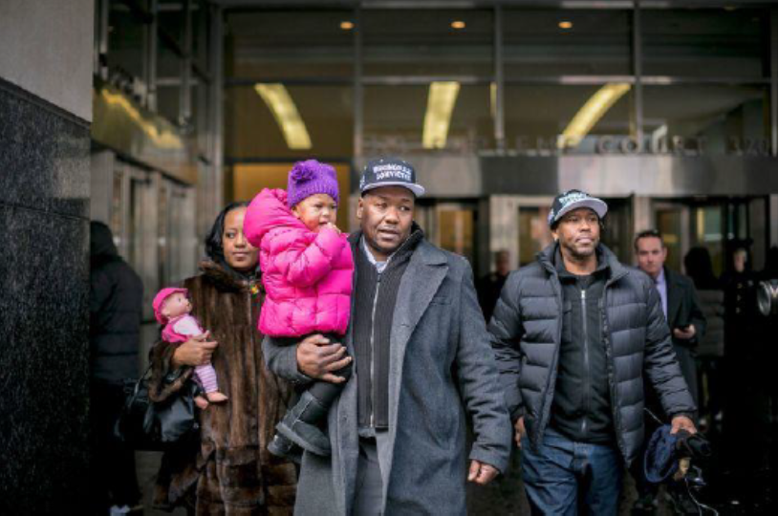
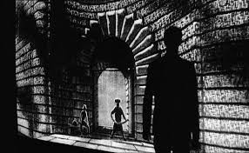
Epilogue…..
Why and how is rule of law worth defending and upholding, when law is generally produced by and for the “haves” over the “have nots” in society?
How do we understand the gap between promise and practice of law?
Derrick Hamilton, exonerated, 2015

Slide 14
Epilogue…..
The rhetoric and rules of a society are something a great deal more than sham. In the same moment they may modify, in profound ways, the behavior of the powerful, and mystify the powerless. They may disguise the true realities of power, but, at the same time, they may curb that power and check its intrusions. And it is often from within that rhetoric that a radical critique of the practice of the society is developed.
E. P. Thompson, Whigs & Hunters (1975)

Slide 15
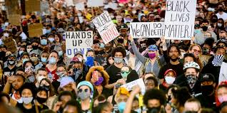
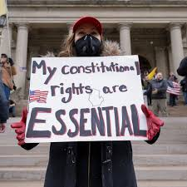
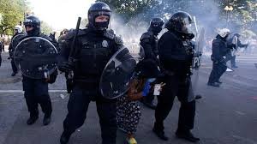
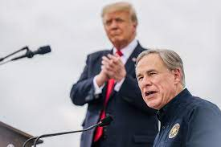
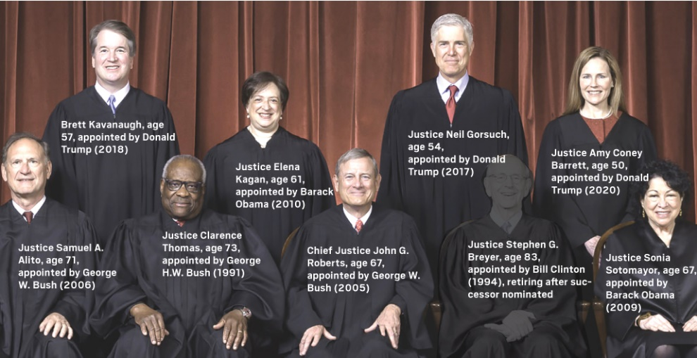
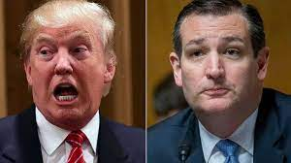
The Current Polarization…..
VS

Slide 16
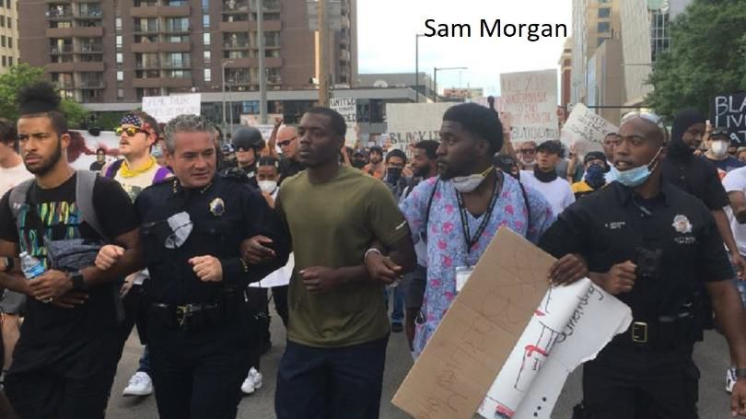
Epilogue…..Will It Ever Happen?

