Slide 1
M&A Tax
Class 4

Slide 2
Limitation on Tax Attributes

Slide 3
C Corporation tax attributes
Net operating losses (“NOLs”)
R&D credits
Foreign tax credits
Other tax credits

Slide 4
Section 172 Limitation
Pre-2018 NOLs: May be carried forward up to 20 tax. May not be carried back.
Post-2017 NOLs: May be carried forward indefinitely. May not be carried back. May only be used to offset up to 80% of taxable income.
Post-2018 Pre-2021 NOLs: may be carried back 5 tax years.
Tax credits may be carried back 1 year and carried forward 20 years.

Slide 5
Section 382: Overview
Section 382 generally provides that, after an ”ownership change,” the amount of a “loss corporation’s” taxable income for any post-change year that may be offset by pre- change losses cannot exceed the “Section 382 limitation” for that year.
An ownership change is a greater than 50% increase in ownership by “5% shareholders” during a “testing period,” which is generally three years. A change in ownership % by a shareholder is called an “ownership shift”
Ownership is tracked by value not vote. Thus, the analysis must consider the differing values between different classes of stock.
In determining the 50% increase, you compare the lowest percentage owned at any time over the testing period for each 5% shareholder and groups of public shareholders with their ownership on the testing date.

Slide 6
Section 382: Overview
A loss corporation is any corporation that has certain tax attributes, including NOL or capital loss carryforwards and net built-in losses.
The Section 382 limitation also applies to Section 163(j) interest deductions carryforward.
Section 383 has similar rules limiting utilization of tax credits
Most states follow Section 382 rules with some variation.
What tax attributes are subject to a Section 382 and 383 limitations?
Pre-ownership change tax attributes. If the ownership change occurs during a tax year, pro-rate the tax attributes generated in the tax year.

Slide 7
Purpose of Section 382
To provide an objective standard governing the availability of NOLs which can be abused through trafficking of losses, allowing taxpayers that did not incur the loss to utilize the loss.

Slide 8
Determining if there is a Section 382 limitation
Is the corporation a loss corporation?
Loss corporation is a corporation that is entitled to use an NOL carryforward or one of the tax attributes in Section 383.
Determine the testing date:
A date on which an “ownership shift” occurs.
Determine testing period:
A three-year rolling period (look back three years from the testing date).

Slide 9
Determining if there is a Section 382 limitation
Determine the company’s 5% shareholders
Determine the company’s public shareholder groups.
Determine the % ownership interest change by each 5% shareholder at the close of the testing date throughout the testing period.
Determine the % ownership interest change by each “public group” of non-5% shareholders.
The aggregate % change in ownership interest of each 5% shareholder and each public group during the testing period is the ownership shift % on the testing date.

Slide 10
Determining 5% shareholders
A 5% shareholder is an individual shareholder (or group of individuals) that holds, directly or indirectly, at least 5% of the stock of the corporation at any time during the testing period. Treas. Reg. 1.382-2T(g)(1).
You would need a stock ledger that has recorded all issuances and transfers of the company’s equity.
Section 318 attribution rules apply: the stock ledger may not be enough to identify all 5% shareholders.
There may be “higher tier” shifts for shareholders that are pass-through entities.
Loss corporation has a duty to inquire about higher tier shareholders.

Slide 11
Determining 5% shareholders
Actual knowledge trumps all. Best to have a stock ledger and cap tables directly from the company.
For US public companies: taxpayers may rely on SEC Schedules 13D and 13G filings (and other similar public filings) to determine which shareholders are direct 5% shareholders on any date. Similarly, if the 5% shareholder is an SEC registered entity, taxpayer may rely on that shareholder’s SEC filings in determining if there are higher tier 5% shareholders. Treas. Reg. 1.382-2T(k)(1)(i).
For private companies, taxpayers could rely on Section 409A valuations, which companies are required to obtain on an annual basis if they issue stock options.

Slide 12
Determining 5% shareholders
A loss corporation can generally rely on a written statement made by a first tier or higher tier shareholder to establish the extent to which changes in ownership of the entity making the statement have occurred. Statement must be signed under penalty of perjury by an officer, director, or similar person on behalf of the entity. Treas. Reg. 1.382-2T(k)(1)(ii).
Note: the written statement cannot be relied upon if taxpayer knows it is false.
If a 5% shareholder’s ownership percentage is reduced below 5%, the taxpayer can treat the shares owner immediately after the reduction as continuously owned by the 5% shareholder for the remainder of the testing period that includes the day the interest dropped below 5%. Treas. Reg. 1.382-2T(g)(5)(i)(B). This shareholder is treated as its own public group. Alternatively, the taxpayer can “tier down” the shareholder to join a lower tier public group.

Slide 13
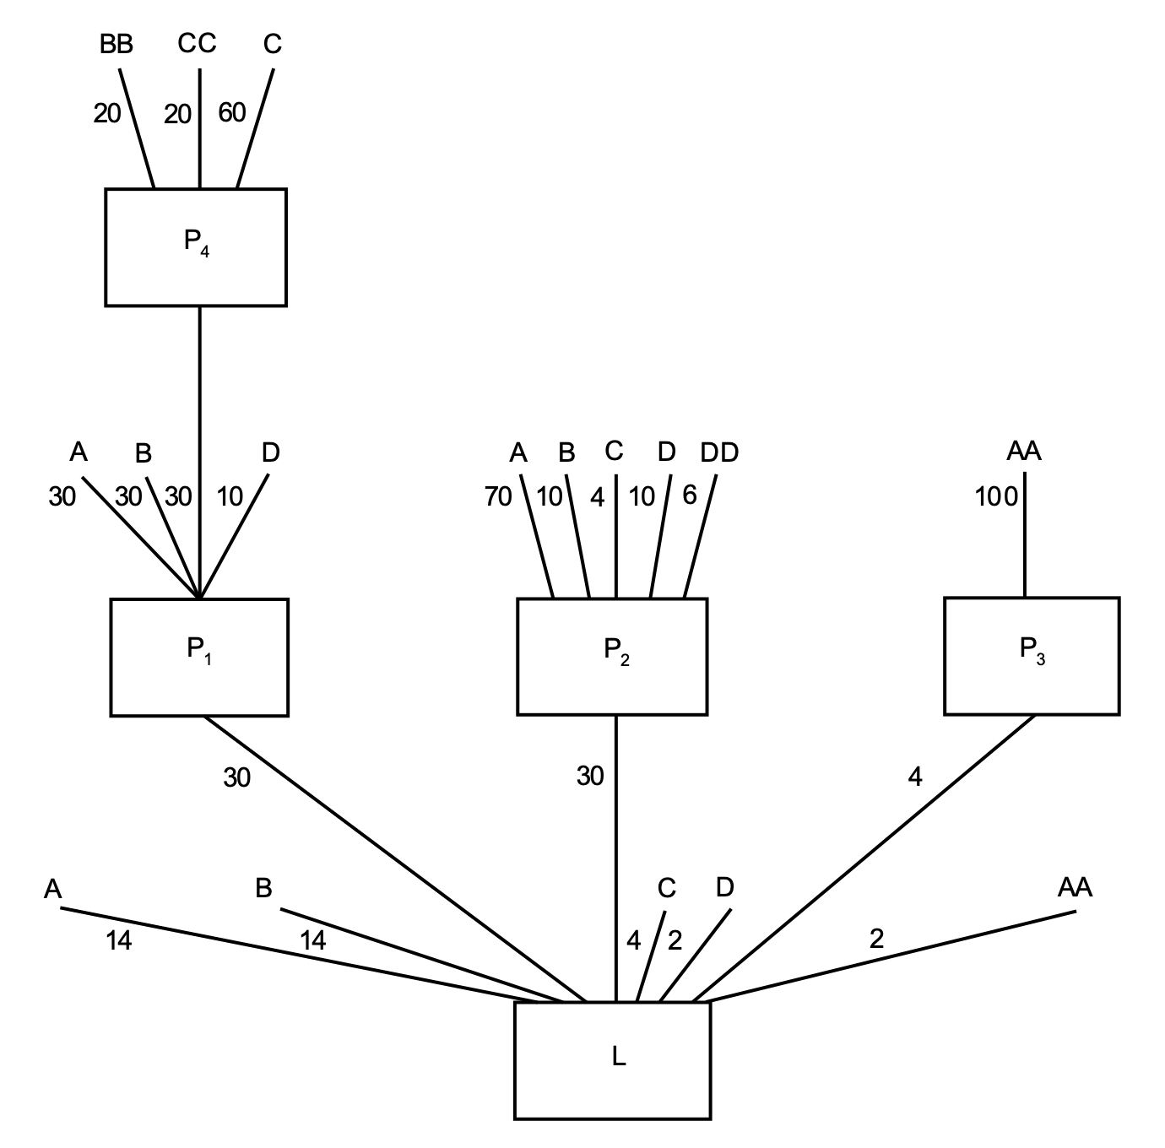
Who are the 5% shareholders?

Slide 14
Who are the 5% shareholders?
Identify the 5% shareholders of P4. Are these shareholders 5% shareholders of P1 or L?
Identify the 5% shareholders of P1, P2, and P3. Are these shareholders 5% shareholders of L?
Identify the 5% shareholders of L.
How much of L does C actually own? Would L have actual knowledge of C’s higher tier ownership?

Slide 15
Determining 5% shareholders
A loss corporation can generally rely on a written statement made by a first tier or higher tier shareholder to establish the extent to which changes in ownership of the entity making the statement have occurred. Statement must be signed under penalty of perjury by an officer, director, or similar person on behalf of the entity. Treas. Reg. 1.382-2T(k)(1)(ii).
Note: the written statement cannot be relied upon if taxpayer knows it is false.

Slide 16
Rules on public groups
Determine the company’s public shareholder groups.
Under the aggregation rules, all individuals owning less than 5% of LossCo during the entire testing period is assigned to a public group.
Public shareholder groups are treated as 5% shareholders for purposes of determining whether there is an ownership change. Section 382(g)(4)(A); Treas. Reg. 1.382-2T(j)(1)(i)
A public group consists of individual shareholders that are grouped together under either of the aggregation or segregation rules. Temp. Reg. § 1.382-2T(g)(1)(ii–iv).
Generally, we do not care if public group shareholders actually have an increase/decrease in their ownership percentage (e.g., you do not need to track transactions between public group shareholders.

Slide 17
Rules around public groups
Public group aggregation rules start at the highest tier entity. All <5% direct shareholders of that entity are aggregated into a public group.
Example: Highest tier entity (TopCo) owns 50% of a loss corporation. TopCo has a 20% shareholder and a bunch of <5% shareholders. The <5% shareholders are aggregated into one 40% public group that is treated as a 5% shareholder.
If there is a higher tier public group that owns less than 5% of LossCo, then the public group is treated as a public group in the tier below.

Slide 18
Example Question: how should we classify each shareholder?
<5% SH
<5% SH
Corp H
G
<5% SH
30%
60%
10%
D
<5% SH
Corp E
Corp F
15%
85%
30%
70%
A
Corp B
Partnership C
<5% SH
20%
10%
20%
50%
LossCo

Slide 19
Example Question: how should we classify each shareholder?
A: 20.0%
B Shareholder Group: 10.0%
E Shareholder Group: 6.0%
G: 8.4%
F Shareholder Group: 5.6%
Lossco Shareholder Group: 50.0%
Total 100.0%

Slide 20
Segregation rules for public groups
Certain transactions require you split existing public groups, thus effectively creating a new 5% shareholder.
Equity structure shifts
Section 1032 transactions
What is a 1032 transaction?
Redemptions and similar transactions
Deemed acquisition of stock under the option attribution rule
Issuance of stock rights.

Slide 21
Segregation rules for public groups
Exceptions to the segregation rules for 1032 transactions:
Small issuance exception:
Under this exception, each class of stock may issue up to 10% of the aggregate number or value of that class of stock at the beginning of the calendar year. Alternatively, the taxpayer may apply the small issuance exception on a corporation wide basis based on the company’s total equity value. This includes stock issued to 5% shareholders in the same issuance.
If the small issuance exception applies, the entire issuance is aggregated with the existing public groups.
Cash issuance exception:
If the stock issuance does not fall under the small issuance exception, it may fall under the cash issuance exception if the stock is issued solely for cash.
If the cash issuance exception applies, half of the issuance is aggregated with the existing public groups.

Slide 22
Example: Ownership Shift Analysis

Slide 23
Section 382 limitation Ordering Rules
The annual Section 382 limitation ”frees-up” tax attributes that are otherwise restricted under Section 382 and 383. The Section 382 limitation is cumulative and carries over to subsequent tax years.
If there are tax attributes subject to multiple ownership changes, the most restrictive annual Section 382 limitation applies.
Order in which tax attributes free-up:
Capital losses
Section 163(j) limitation (proposed regulations)
NOL carryforwards
Tax credits

Slide 24
Determining Annual 382 Limitation
A Section 382 limitation generally equals the sum of:
The FMV of the loss corporation multiplied by the applicable federal long-term tax exempt rate, plus
Recognized built-in gains in the first five years post ownership change, plus
Any unused limitation from the prior tax year, less
Redemptions and other corporate contractions, less
Disqualified capital contributions, less
Substantial non-business assets.
COBE Rule: if the loss corporation does not continue the business enterprise of the old loss corporation at all times during the two-year period beginning on the ownership change date, then the 382 limitation for post change years is $0.

Slide 25
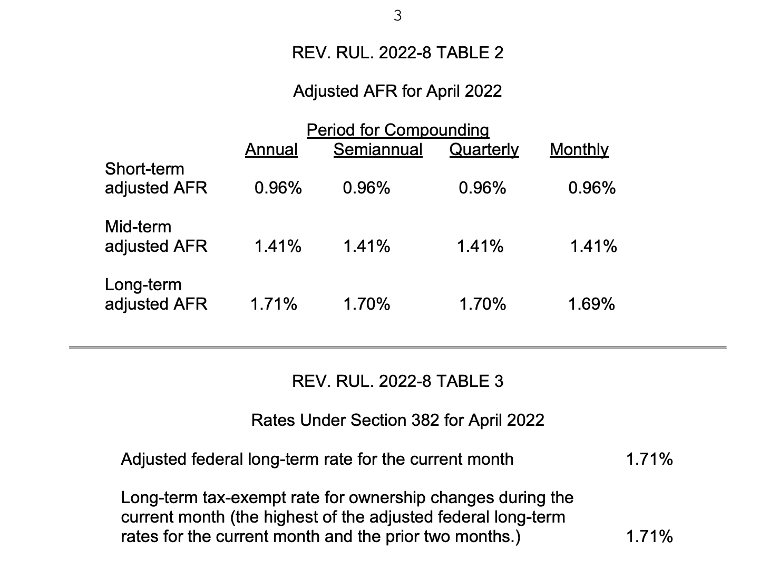
Applicable Federal Rate
April 2022 AFR: 1.71%

Slide 26
Annual Base Limitation
A Corp had an ownership change on 4/30/2022. A Corp has $200,000 of NOL carryovers from pre-2018 tax years and $200,000 of NOL carryovers from post-2018 tax years. In 2022, A Corp generated $300,000 of NOLs. A Corp’s FMV is $1M at the time of the ownership change.
What is the base 382 limitation of A Corp (annual limitation without considering adjustments)?
Will any of A Corp’s NOLs expire unutilized?

Slide 27
Determining Annual 382 Limitation
A Section 382 limitation generally equals the sum of:
The FMV of the loss corporation multiplied by the applicable federal long-term tax exempt rate, plus
Recognized built-in gains in the first five years post ownership change, plus
Any unused limitation from the prior tax year, less
Redemptions and other corporate contractions, less
Disqualified capital contributions, less
Substantial non-business assets.

Slide 28
RBIG/RBIL Adjustment
If LossCo has a net unrealized built-in gain (NUBIG) at the time of the ownership change, the Section 382 limitation generally can be increased to the extent of any recognized built-in gains (RBIGs). Section 382(h)(1)(A)
Conversely, if LossCo has a net unrealized built-in loss (NUBIL) at the time of the ownership change, any RBILs are treated as pre-change losses subject to Section 382 limitation. Section 382(h)(1)(B).
Why do we have the RBIG/RBIL rules?

Slide 29
What is an RBIG/RBIL?
RBIGs and RBILs are generally income, gains, deductions, and losses that are ”built-in” as of the change date and taken into account by LossCo during the 5 year period beginning on the change date (recognition period). Section 382(h)(7)(A).
Gain or loss recognized during the recognition period on the disposition of any asset held by LossCo before the change date (FMV over basis).

Slide 30
NUBIG/NUBIL Threshold
NUBIG/NUBIL generally equals the difference between aggregate FMV of assets and adjusted basis immediately before an ownership change, with adjustments for pre-change built-in items.
Threshold: Lesser of 15% of FMV of corporation’s assets or $10,000,000.
If the NUBIG/NUBIL does not meet this threshold, then the amount is $0.
In determining the threshold, cash, cash-like items, and marketable securities generally don’t count (basis and FMV do not substantially differ).

Slide 31
Notice 2003-65
Pending the issuance of final regulations, taxpayers can continue to rely on the two safe harbors in Notice 2003-65 to identify recognized built-in items.
Section 338 Approach
Increases Section 382 limitation by recognized built-in gains from “deemed” amortization of certain assets.
Section 1374 approach
Narrower approach with limited items of RBIG and RBIL

Slide 32
Section 338 Approach
Preferred approach by most taxpayers in a NUBIG position.
This approach treats RBIG/RBIL items as if there was a hypothetical Section 338 election to purchase 100% of LossCo’s stock.
Recall Section 338 election fiction:
New LossCo acquires all of the assets of Old LossCo in a taxable transaction (FMV basis in assets).
If LossCo has increased in value, there may be additional amortization deductions you could take.

Slide 33
Section 338 Approach
This approach treats RBIG/RBIL items as if there was a hypothetical Section 338 election to purchase 100% of LossCo’s stock.
Recall Section 338 election fiction:
New LossCo acquires all of the assets of Old LossCo in a taxable transaction (FMV basis in assets).
If LossCo has increased in value, there may be additional amortization deductions you could take.
This approach allows taxpayer to treat any “forgone” depreciation or amortization deduction on assets during the recognition period is treated as RBIG/RBIL. In other words, taxpayer may get the RBIG/RBIL even if no assets are disposed of.

Slide 34
Section 338 Approach
Taxpayer only get the “forgone” depreciation and amortization deductions.
LossCo had an ownership change while holding intangible property with basis of $100 and FMV of $300. LossCo’s original basis in the intangible property was $200, but it had already taken $100 of amortization deductions.
How much RBIG would LossCo get on the intangible asset (assuming they meet the NUBIG threshold).

Slide 35
Section 338 Approach: Example
LossCo was purchased by Buyer for $10 million in April 2022. LossCo has the following assets: $1M cash, $3M in inventory, $3M in fixed assets ($5M tax basis). What is the annual limitation of LossCo after taking into account RBIG?
Would this answer change if tax basis in fixed assets was $4M?

Slide 36
Determining Annual 382 Limitation
A Section 382 limitation generally equals the sum of:
The FMV of the loss corporation multiplied by the applicable federal long-term tax exempt rate, plus
Recognized built-in gains in the first five years post ownership change, plus
Any unused limitation from the prior tax year, less
Redemptions and other corporate contractions, less
Disqualified capital contributions, less
Substantial non-business assets.

Slide 37
Corporate contractions
The value of LossCo is reduced if a redemption or other corporate contraction occurs in connection with the ownership change. Section 382(e)(2).
In connection with an acquisition LossCo redeems out a minority shareholder. The value of LossCo must be reduced by the value of the minority shareholder’s equity for Section 382 purposes.
Corporate contraction is not defined. An example would be a “bootstrap acquisition”:
Acquisition is financed by indebtedness incurred by Target. Note, this may apply if Target is a guarantor (particularly if it is the sole guarantor) of the debt or if Target is expected to be the source of repayment of the debt. Facts and circumstances.

Slide 38
Determining Annual 382 Limitation
A Section 382 limitation generally equals the sum of:
The FMV of the loss corporation multiplied by the applicable federal long-term tax exempt rate, plus
Recognized built-in gains in the first five years post ownership change, plus
Any unused limitation from the prior tax year, less
Redemptions and other corporate contractions, less
Disqualified capital contributions, less
Substantial non-business assets.

Slide 39
Capital Contributions
Capital contributions are not taken into account if it was received as part of a plan of which the principal purpose is to avoid or increase a 382 limitation. Section 382(l)(1)(A).
Capital contributions made within 2 years prior to the ownership change date is presumed to be as part of a plan to avoid or increase 382 limitation. This presumption is rebuttable. Section 382(l)(1)(B).
Notice 2008-78: IRS issued guidance stating that starting in 2008 the 2 year presumption essentially no longer applies. The presumption is reversed.

Slide 40
Determining Annual 382 Limitation
A Section 382 limitation generally equals the sum of:
The FMV of the loss corporation multiplied by the applicable federal long-term tax exempt rate, plus
Recognized built-in gains in the first five years post ownership change, plus
Any unused limitation from the prior tax year, less
Redemptions and other corporate contractions, less
Disqualified capital contributions, less
Substantial non-business assets.

Slide 41
Substantial non-business assets
LossCo is required to reduce the value of its stock if it has “substantial” nonbusiness assets immediately after an ownership change. Section 382(l)(4)(A).
Nonbusiness assets = assets held for investment (e.g., cash, marketable stock or securities, etc.)
Assets that are held as an ”integral part of the conduct of a trade or business” are not treated as nonbusiness assets. For examples, investment assets or cash for bank reserve requirements.
Note: subsidiary stock is not counted in determining nonbusiness assets, instead the parent is deemed to own its proportional share of subsidiary assets.

Slide 42
Substantial non-business assets
“Substantial” nonbusiness assets = at least 1/3 of your assets are nonbusiness assets. The amount of nonbusiness assets is measured immediately after the ownership change.
If LossCo has substantial non-business assets, then the value of LossCo’s stock is reduced by the exess of:
The FMV of the nonbusiness assets divided by
The amount of liabilities allocable to the nonbusiness assets. (Section 382(l)(4)(A).
The amount of allocable liabilities is based on the ratio of the FMV of the nonbusiness assets to the FMV of all the asset of LossCo.
The amount of substantial nonbusiness assets reduction is determined immediately before the ownership change.

Slide 43
Treas. Reg. 1.382-7
On September 9, 2019 the Treasury and IRS issued Proposed Regulations regarding items of income and deduction that are treated as built-in gains and losses under Section 382
The proposed regulations are prospective and would apply to determinations of NUBIG or NUBIL and of RBIG or RBIL for section 382 ownership changes occurring after the date the Proposed Regulations are adopted as final regulations.
The Proposed Regulations reject the 338 approach from Notice 2003-65 and would adopt a modified version of the 1374 approach from that notice.

Slide 44
Calculation of Section 382 limitation: Example
On 6/15/2021, Buyer purchases Target for $100M. Target was formed on 3/31/2016 and tax attribute schedule is as follows:
2016: $2M NOLs
2017: $5M NOLs
2018: $10M NOLs, $300k R&D credits
2019: $15M NOLs, $500K R&D credits
2020: $30M NOLs, $1M R&D credits
6/15/2021: $20M NOLs, $200K R&D credits
Target’s balance sheet: $20M of cash, $10M accounts receivable, $10M inventory, $5M patent, $10M of liabilities. Assume tax basis = FMV.
Target’s original tax basis in the patent was $10.8M.
What is the annual limitation? Will any of the tax attributes expire unused?

Slide 45
Calculation of Section 382 limitation: Example
Note: A Section 382 analysis should be performed prior to making a Section 338 election to understand the cost-benefit of making the election.
Note: State NOLs generally follow the same Section 382 rules. Nonetheless, there are some deviations, and you should always check to see how states apply the rules.

Slide 46
Section 382 in Consolidated Group context
A consolidated group generally determines its taxable income or loss on a consolidated basis.
A consolidated net operating loss refers to the consolidated group’s excess of deductions over gross income. Treas. Reg. 1.1502-21(e).
This is usually calculated by aggregating the members’ separate taxable income or loss items. Treas. Reg. 1.1502-11.
In addition to Section 382, consolidated NOL deductions are subject to the separate return limitation year (SRLY) limitation.

Slide 47
SRLY Limitation: Overview
The SRLY rules limit the use of a member's NOLs that arise in a separate return limitation year (SRLY) of that member. See Treas. Reg. § 1.1502-1(f) (definition of SRLY)
The SRLY rules can apply to carryforwards and carrybacks of NOLs, capital losses, Section 163(j) carryovers, certain credits, and other attributes (e.g., built-in losses). See e.g., Treas. Reg. §§ 1.1502-3(c), -4(f), -15 and -22.
In general, the SRLY limitation is the corporation's cumulative contribution to consolidated taxable income of the group. See Treas. Reg. § 1.1502- 21(c)(1)(i).

Slide 48
SRLY Limitation: Overview
The SRLY limitation applies in addition to other limitations, including those imposed by Sections 269, 382, 383, and 384, subject to the “overlap rule” in Treas. Reg. §1.1502-21(g) (discussed below).
The SRLY and Consolidated Section 382 limitations must be calculated independently, and the lower limitation applies.

Slide 49
SRLY Limitation: Overview
The SRLY rules only limit the use of a member's NOLs that arise in a "SRLY" of that member.
Definition of “SRLY” (Treas. Reg. §1.1502-1(f)(1) and (e))
In general, a SRLY is any taxable year for which a member corporation (or predecessor) either filed a separate return or filed with another group (i.e., a separate return year, or SRY)
A member includes a successor corporation if the predecessor transferred its assets in (1) a transaction to which Section 381 applies (e.g., Section 332 liquidation, tax-free merger) or (2) in certain carryover basis transactions which occur after January 1, 1997. See Treas. Reg. § 1.1502-1(f)(4)

Slide 50
SRLY Limitation Amount
SRLY NOLs attributable to a SRLY member may be used by the group only to the extent of the cumulative contribution to consolidated taxable income of the SRLY member (or SRLY subgroup)
The SRLY member’s losses and deductions while in the consolidated group are taken into account if actually absorbed by the group.
Contribution to consolidated taxable income determined by taking into account only items of income, gain, deduction and loss of the SRLY member.

Slide 51
Overlap Rule
If a corporation has an ownership change that occurs within 6 months before becoming the member of a USFIT consolidated group, then Section 382 limitation trumps. If not, then both SRLY and 382 applies.

Slide 52
Reading Purchase Agreements

Slide 53
What to review in a purchase agreement
Preamble: understand stated Buyer and Seller intentions. Are there other parties involved?
Sometimes the preamble may state the intended tax treatment of the transaction. It also may state that the purchase agreement should be treated as a plan of reorganization.
Definitions: Tax, Tax Return, Tax Benefits, Holdbacks and escrows, etc.
Transaction Language / Closing: helps to understand the basis mechanics of the transaction, how purchase price is calculated, what the adjustments would be to purchase price, holdbacks, etc. Also helps to

Slide 54
What to review in a purchase agreement
Representations and warranties: Tax matters
Ensure that the reps and warranties are catered towards the business and structure of Target.
Ensure that issues discovered during due diligence are covered under this section.
Review disclosure schedules to understand what Seller is “carving out.”
Tax Matters:
There should be separate section that just covers who is responsible for tax returns, tax contests, amendments to tax returns, VDAs, etc.
It may also contain unique tax terms, such as payment for tax attributes, gross-ups, Section 338 election, etc.

Slide 55
What to review in a purchase agreement
Conditions to close
Scan to see if there are any tax conditions to close. Usually it would be withholding related (e.g., FIRPTA certification).
Indemnification:
Usually tax representations are warranties are “fundamental” and/or have a different set of rules governing the indemnification mechanism.
Typically survival should extent to expiration of SOLs.
No basket or cap.

