Slide 1
Word Building Tools
Greek and Latin Components

Slide 2
Outline
Words & Ideas,
Chapters 2 and 3
Greek components
Latin components

Slide 3
Greek Components
Words & Ideas, Chapter 2

Slide 4
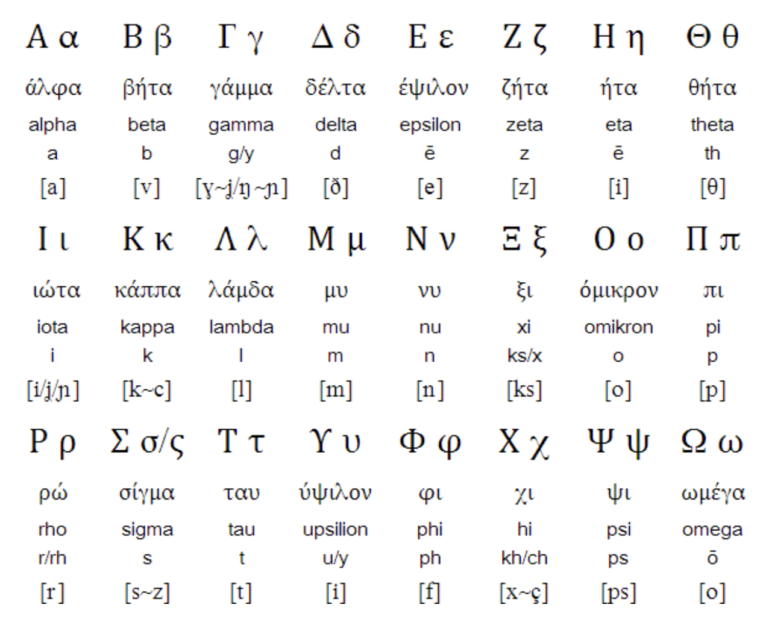
The Greek Alphabet

Slide 5
Greek Bases, Nouns
Greek Base | English Combining Form | Meaning | English Derivative
-archia | -archy | rule by | gynarchy
-archos | -arch | ruler | monarch
-kratia | -cracy | rule by, ruling body of | democracy
-kratēs | -crat | supporter of rule by, member of a ruling body | democrat

Slide 6
Greek Bases, Nouns cont’d
Greek Base | English Combining Form | Meaning | English Derivative
-patheia | -pathy | feeling | telepathy
-philia | -philia | love of | neophilia
-philos | -phile | lover of | cinephile
-phobos | -phobe | one who fears | arachnophobe

Slide 7
Greek Bases, Adjectives
Greek Adjective | English Base | Meaning | English Derivative
heteros | heter- | other | heterosexual
hieros | hier- | holy | hieroglyphics
holos | hol- | whole | holism
homos | hom- | same | homosexual
homoios | home- | similar, same | homeopath

Slide 8
Greek Bases, Adverb
Greek Adverb | English Combining Form | Meaning | English Derivative
eu | eu- | well, favorable | eulogy

Slide 9
Greek Bases, Verbs
Greek Verb | English Base | Meaning | English Derivative(s)
akouein | acou- | hear | acoustic
legein | log- lect- | say | epilogue dialect
opsesthai | opt- | see | optic, synoptic
skeptesthai | skept- | look at | skeptical
skopein | scop- | look at | periscope

Slide 10
Greek Prefixes
Prefix a-, an-, “not, without” | English Base | Meaning of Base | English Derivative
a- | mnes- | remember | amnesia
an- (before vowels and “h”) | osm- | smell | anosmia

Slide 11
Greek Prefixes cont’d
Prefix anti-, ant-, “instead of, against, in opposition to, opposite” | English Base | Meaning of Base | English Derivative
anti- | path- | feeling | antipathy
ant- (before vowels and “h”) | agon- | struggle | antagonism

Slide 12
Greek Prefixes cont’d
Prefix ec-, ex-, “ out, from, off” | English Base | Meaning of Base | English Derivative
ec- | stas- | cause to stand | ecstasy
ex- (before vowels and “h”) | od- | road | exodus

Slide 13
Noun-forming Suffixes, General
Suffix | English Base | Meaning of Base | English Derivative
-ot | idi- | own, personal | idiot
 | patri- | father | patriot

Slide 14
Greek Noun-forming Suffixes, Abstract
Suffix | English Base | Meaning of Base | English Derivative
-ism | ostrac- | potsherd (pottery fragment) | ostracism
 | barbar- | foreign, barbarian | barbarism
 | social- | companion, ally, associate | socialism
Notes:
Add a slide about the ostracism process in ancient Greece

Slide 15
Greek Noun-forming Suffixes, Agent
Suffix | English Base | Meaning of Base | English Derivative
-ist | cycl- | circle | cyclist
 | dogmat- | opinion, decree | dogmatist
 | hedon- | pleasure | hedonist
Notes:
Add a slide about the ostracism process in ancient Greece

Slide 16
Greek Adjective-forming Suffixes
Suffix | English Base | Meaning of Base | English Derivative
-ac | cardi- | heart | cardiac
 | Dionysi- | Dionysus/Dionysia | Dionysiac
Notes:
Put in a slide after about Dionysus and the gods, you can say that we will talk more about the gods and mythology on Thursday and for the next three lessons

Slide 17
Greek Verb-forming Suffixes
Suffix | English Base | Meaning of Base | English Derivative
-ize | synchron- | “together” (prefix) + “time” | synchronize
 | ostrac- | “potsherd” (pottery fragment) | ostracize
 | agon- | struggle | agonize
Notes:
Add a slide about the ostracism process in ancient Greece

Slide 18
Exercises and Review of Chapter 2

Slide 19
Latin Components
Words & Ideas, Chapter 3

Slide 20
The Latin Alphabet

Slide 21
Latin Bases, Nouns
Latin Noun | English Base | Meaning | English Derivative
aqua | aqu- | water | aquarium, aqueduct
ius, iuris | jur- | right, law | jurist, jurisprudent
tempus, temporis | tempor- | time | temporary, temporization
vir | vir- | man | virile, virilization

Slide 22
Latin Bases, Verbs
Latin Verb | English Base | Meaning | English Derivative
cedere | -ced | go | intercede
ius, iuris | -ceed | right, law | proceed
tempus, temporis | cess- | time | recession

Slide 23
Latin Bases, Verbs cont’d
Latin Verb | English Base | Meaning | English Derivative
mittere | -mit | send | remit
ius, iuris | mitt- | right, law | intermittent
tempus, temporis | miss- | time | missile

Slide 24
Latin Prefixes
Prefix | English Base | Meaning | English Derivative
ante- “before” | ced- | go | antecedent
circum- “around, about” | navig- | sail | circumnavigate
contra- “against” | dict- | say | contradict
de- “down, away from” | ject- | throw | dejected

Slide 25
Latin Suffixes, General
Suffix | English Base | Meaning of Base | English Derivative
-ane | meth- | wine | methane
-ine | can- | dog | canine
-ment *forms nouns from verbs | frag- | break | fragment

Slide 26
Latin Suffixes, Abstract
Suffix | English Base | Meaning of Base | English Derivative
-ation | declar- | explain, reveal | declaration
-ion | un- | one | union
-tion | erup- | burst forth | eruption

Slide 27
Latin Suffixes, Agent
Suffix | English Base | Meaning of Base | English Derivative
-and | gradu- | step, degree | graduand
-end | rever- | respect | reverend
-arian | veget- | grow, be fresh | vegetarian
-ian | phonetic- | sound | phonetician

Slide 28
Latin Suffixes, Locative
Suffix | English Base | Meaning of Base | English Derivative
-orium | audit- | hear | auditorium
-ory | dormit- | sleep | dormitory

Slide 29
Latin Suffixes, Diminutive
Suffix | English Base | Meaning of Base | English Derivative
-el | mors- | bite | morsel
-il | penc- | brush | pencil
-ule | caps- | box | capsule

Slide 30
Latin Adjective-forming Suffixes
Suffix | English Base | Meaning of Base | English Derivative
-ible | leg- | read | legible
-ant | radi- | beaming | radiant
-ic | civ- | citizen | civic

Slide 31
Latin Verb-forming Suffixes
Suffix | English Base | Meaning of Base | English Derivative
-ate | navig- | sail | navigate
-ify | pac- | peace | pacify
-esce | conval- | thoroughly be well | convalesce

Slide 32
Latin Expressions
Chapter 3, pp. 63–65

Slide 33
Exercises and Review of Chapter 3

Slide 34
What’s Next
Mythology
Read Words & Ideas, Chapter 4, pp. 75-84

