Slide 1
Mythology Pt. 2
Words & Ideas, Chapter 4, pp. 85–95

Slide 2
Outline
Heroes
The Trojan War
What does it mean to be a “hero”?
The Wanderings of Odysseus
Word Study

Slide 3
Heroes
Ancient Greek v. Modern concepts of what makes someone a “hero”
What is the significance of ancient Greek heroes? Why are these people important to study?
Heracles/Hercules and Theseus

Slide 4
Heracles/Hercules
Zeus slept with the woman Alcmene and fathered Heracles
Hera (Zeus’s wife) was jealous and wanted to destroy the child
Hera sent serpents to kill Hercules, but he kills the serpents
He has superhuman strength (that of a demigod)
Hera drives Heracles to madness and he murders his wife and children
When he regains his sanity, he is mortified about what he had done
To be purified from his bloodguilt, he must serve his cousin Eurystheus for 12 years (12 labors of Heracles)
Died after completing these (and many others)
Apotheosis, he became a god

Slide 5
12 Labors of Heracles
The Nemean Lion
The Hydra of Lerna
The Deer of Keryneia
The Erymanthian Boar
The Augean Stables
The Stymphalian Birds
7. The Cretan Bull
8. The Horses of Diomedes
9. The Belt of the Amazons
10. Geryon
11. The Apples of the Hesperides
12. Cerberus (Greek Kerberos)

Slide 6
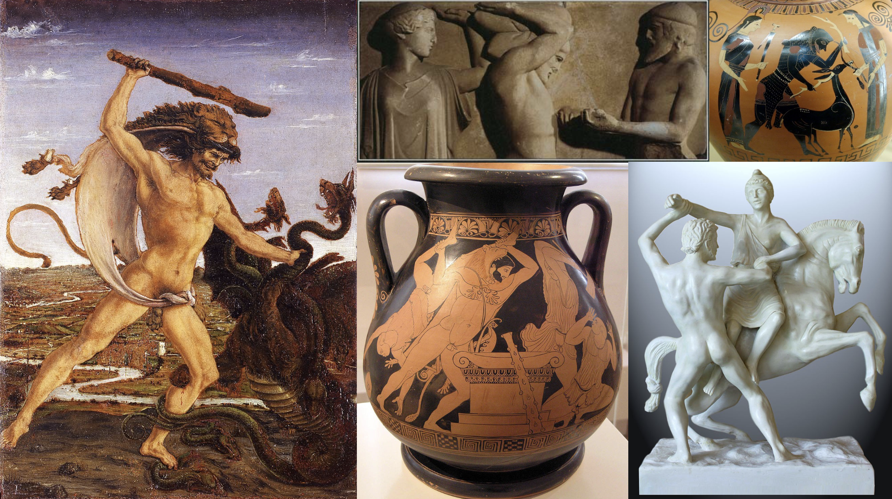

Slide 7
Theseus
Athenian by birth, son of the King of Athens
Defeated the Minotaur (man-eating monster that was half-man and half-bull)
Ariadne and her ball of string
Encounters with Sinis and Procrustes
Re-caught the Cretan Bull and sacrificed it to Apollo

Slide 8
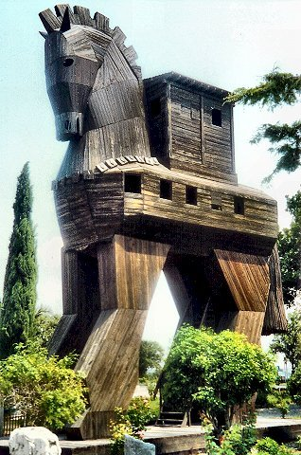
The Trojan War
A 10 year war between the Greeks and the Trojans
Zeus, Athena, Hera, and Aphrodite
Paris, Menelaus, and Priam
Achilles and Odysseus
The Trojan Horse

Slide 9
Greek Heroes of the War
Agamemnon
Older brother of Menelaus
Fought and survived the war
Killed by his wife Clytemnestra (and her paramour Aegisthus)
Achilles
Swift of feet
Most famous hero of the war
Son of Peleus (a mortal) and Thetis (a sea-nymph)
Only vulnerable at a small place on his heel
Killed in the last year of the war

Slide 10
Greek Heroes of the War cont’d
Ajax
Best fighter after Achilles
Competed for Achilles’ armor
Very muscular and strong
Odysseus
Awarded Achilles’ armor
Not very strong physically, but had a strong mind
Trojan horse
Odyssey

Slide 11
Greek Heroes of the War cont’d
Nestor
Oldest of the Greek heroes at Troy
King of Pylos
Always a source of wise advice
Stentor
Herald at the Trojan war
Voice said to be as loud as 50 men

Slide 12
Trojan Heroes of the War
Hector
Son of King Priam, brother to Paris
Great fighter, great man
Killed by Achilles shortly before the sack of Troy
Aeneas
Hero of Troy and of Rome
HE DID NOT found Rome

Slide 13
Trojan Heroes of the War cont’d
Anchises
Father of Aeneas
Survived because Aeneas carried him on his back after the siege of Troy
Cassandra
Daughter of King Priam
Prophet of Apollo
No one would believe her
Taken back with Agamemnon
Killed by Clytemnestra

Slide 14
Word Study: The Trojan War
Judgment of Paris
Helen of Troy
Trojan horse
Achilles’ heel
Stentor, Nestor, Odysseus, Hector, Cassandra, Aeneas
Work like a Trojan
“epic”, epos, ancient word for heroic poetry

Slide 15
The Hero in Epic
Heroes strove to win kleos (glory, fame) so that their names would be remembered in songs
Wealth, power, etc. are incidental: glory is the big prize to be gained
They value this glory so much that they considered a glorious death in battle to be beautiful and well worth the sacrifice of their life
Human life is short but epic (poetry) is forever
The central theme of Iliad illustrates this
Achilles is given the unique choice of two fates: either dying young with immortal glory or living to old age in ignominy
Achilles prefers dying young if it guarantees that a captive audience of undergrads will have to learn about him 3,000 years later!

Slide 16
Physical Strength vs. Mental Skill
Raw physical might was typical of heroes (e.g., Heracles, Achilles)
Some were notable for their cunning intelligence
Odysseus: he devised the Trojan horse which allowed the Greeks to sack the city
He frequently crafted lies to outwit his enemies
While his mendacious cunning earned him glory and success, it was not without criticism from other heroes
Iliad 9.312–13, Achilles tells Odysseus: “For hateful in my eyes as the gates of Hades is that man who hides one thing in his mind and says another.” —trans. Loeb

Slide 17
Shame Culture in Homeric Greece
Homeric Greece was a shame-culture
Appearances and what others thought of one was a chief motivator for a hero’s actions
As honor was so highly valued, to be dishonored was terrible
Achilles’ wrath when Agamemnon disrespects him by unilaterally seizing the honor-prize the Greeks had awarded him
The death of Ajax the Greater is also a good example

Slide 18
What is important to remember?
Greek heroes lived long ago in the mythical past
They generally were involved with supernatural phenomena and/or were descended from the gods
They principally struggled in life to gain glory
One’s heroic status was not dependent on moral behavior
Later generations worshipped them and believed that dead heroes could provide assistance to their worshippers
The Homeric ideal of the Hero remained in Greek consciousness but later generations also redefined what it meant to be a hero

Slide 19
The Wanderings of Odysseus
Odyssey, another epic poem, Odysseus’ journey home after the Trojan war
It took him 10 years to get back to his wife Penelope
Cyclops, Polyphemus
Circe
Sirens, half woman, half bird, sang so sweetly that any sailor who heard them was compelled to stay and listen entranced forever
Lotus-eaters (but not the plant)
Scylla and Charybdis
Returning home and killing all the suitors

Slide 20
Word Study: Odysseus
Circe
Cyclopean
Lotus-eaters
Mentor
Penelope
Siren
Scylla and Charybdis

Slide 21
What’s next?
Final mythology lesson :(
Read Words & Ideas, Chapter 4, pp. 95–103
Homework 2 assigned on Tuesday (7/11)

