Slide 1
Mythology Pt. 3
Words & Ideas, Chapter 4, pp. 95–103

Slide 2
Outline
Oedipus and His Family
Lineage
Gods and Mortals
Women in Mythology
Word Study (Review of Chapters 1–3)

Slide 3
Where are we?

Slide 4
Oedipus and His Family
“the extreme example of an undeserving victim of Fate”
Delphi, Apollo, the Pythia
Laius, King of Thebes
Oedipus and the prophecy
Sphinx’s riddle
Sphinx: woman’s head, eagle’s wings, and the body of a lion
“What is it that goes on four legs in the morning, on two legs in the middle of the day, and on three legs in the evening?”
Oedipus marrying Jocasta
Plague on Thebes
Prophecies being fulfilled

Slide 5
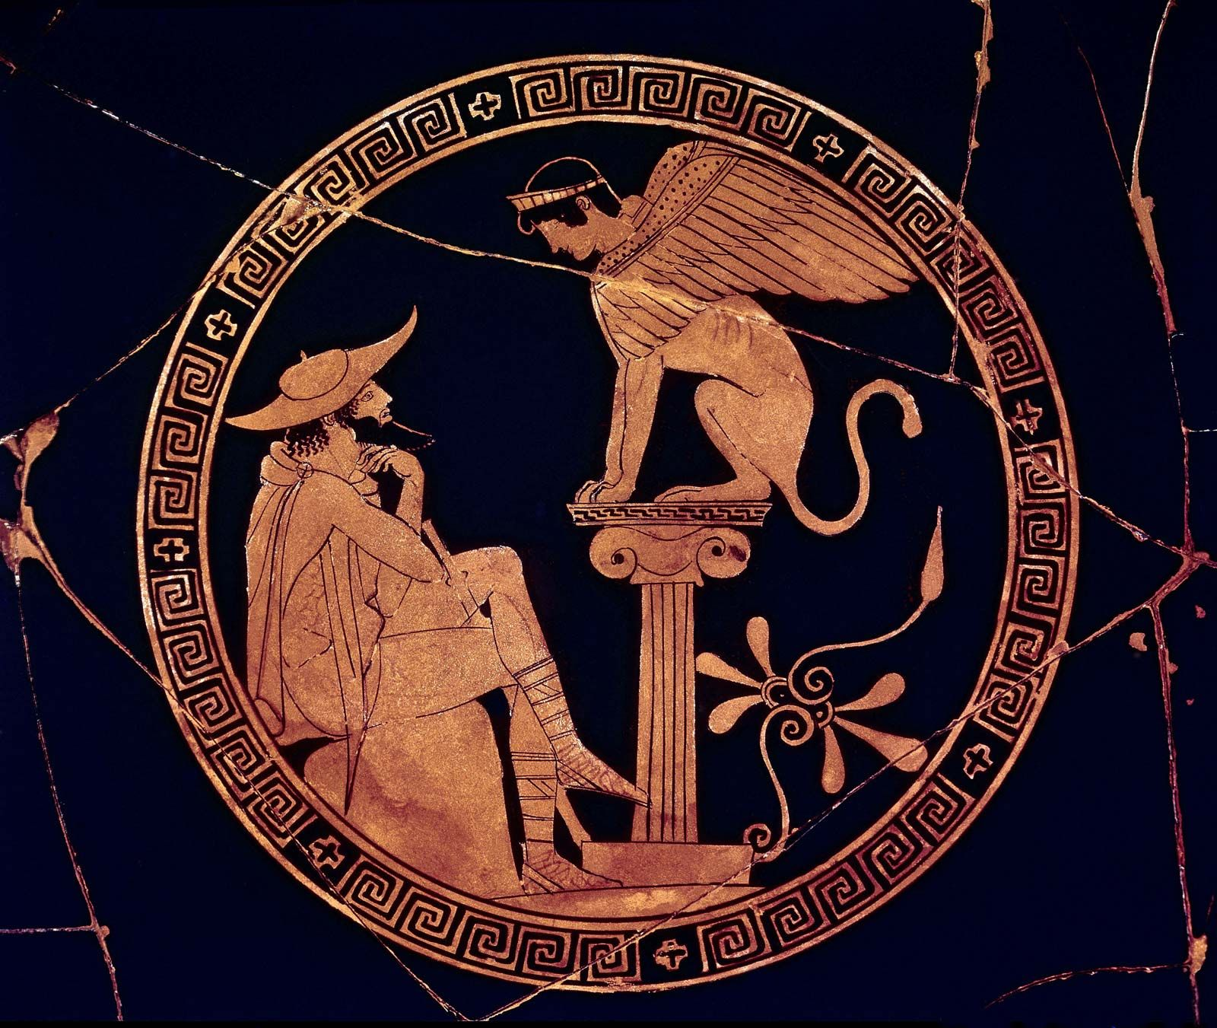
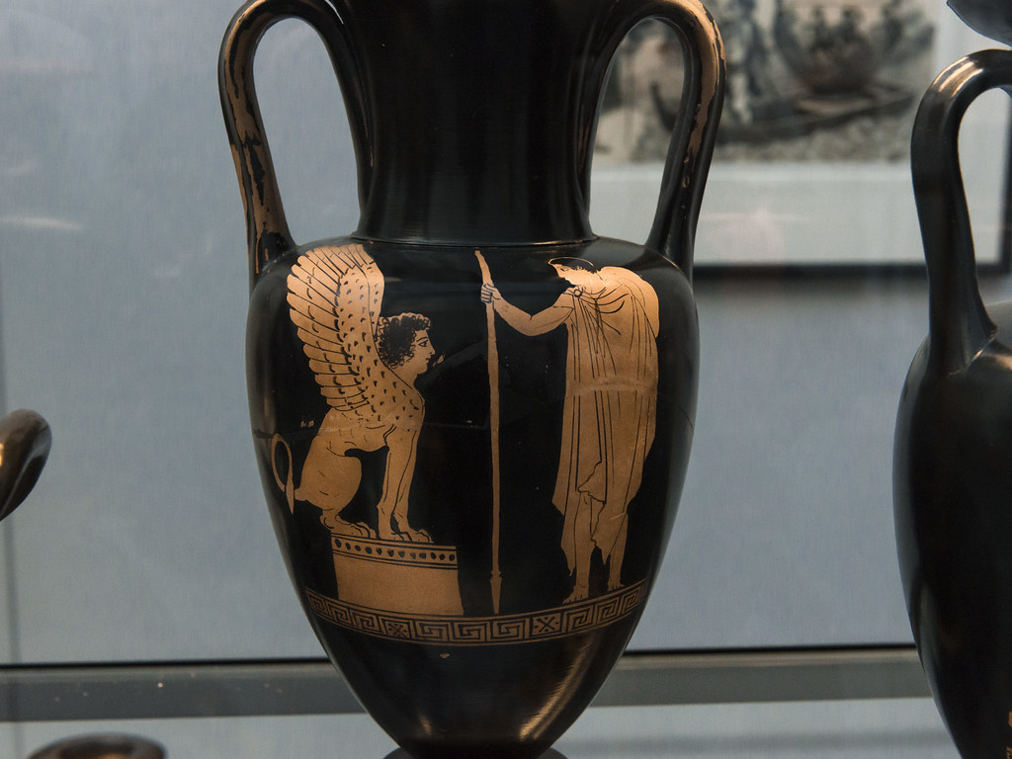
Oedipus and His Family

Slide 6
Mythology and Fate
“one of the main points of the myth is that you cannot escape your destiny no matter how hard you try.”
Was Oedipus blameless? Does his punishment seem fair?
Freud, the Oedipus complex

Slide 7
Eteocles and Polynices
Oedipus had two sons, Eteocles and Polynices
Who was to rule after Oedipus exiled himself?
Creon (Jocasta’s brother), rule in alternation starting with Eteocles
The Seven Against Thebes
Civil war
Brother fights against brother

Slide 8
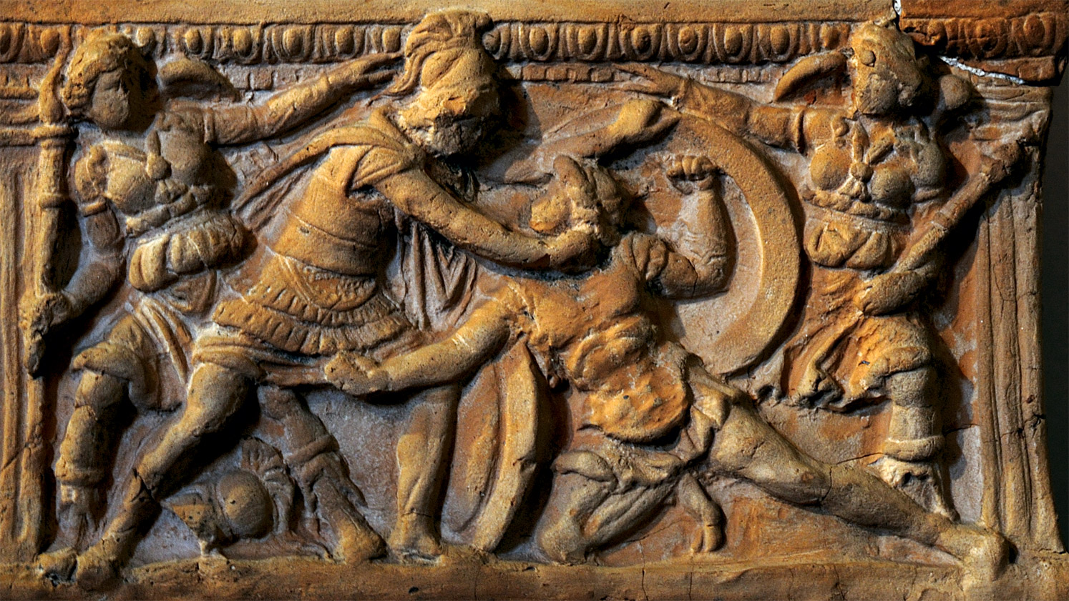
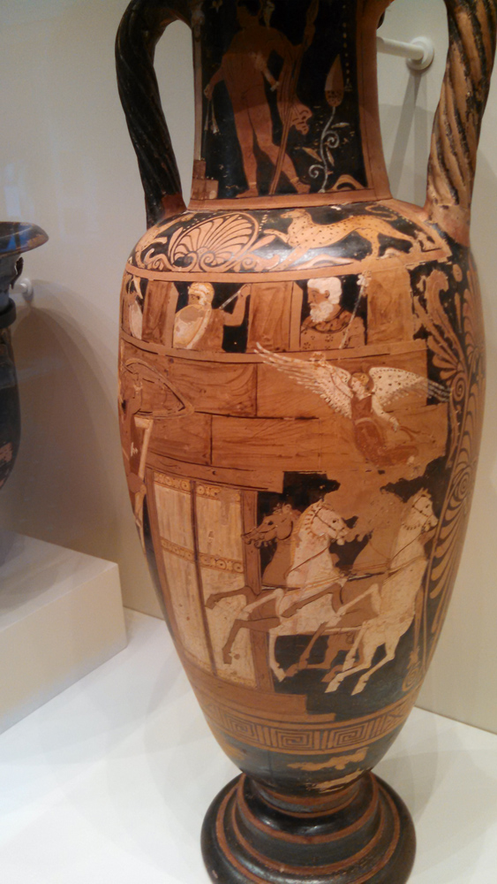
Eteocles and Polynices

Slide 9
Antigone and Ismene
Two daughters of Oedipus, Antigone and Ismene
Creon now being the ruler of Thebes
Eteocles being buried, Polynices being left to rot on the battlefield
Antigone trying to honor her brother with a proper burial and sentenced to death by Creon (walled up in a cave)
Perhaps comparable to a martyr
Haemon, Antigone’s fiancé, finding Antigone committed suicide and then did so out of grief
Eurydice, Haemon’s mother, committed suicide too because she was distraught by the death of her son

Slide 10
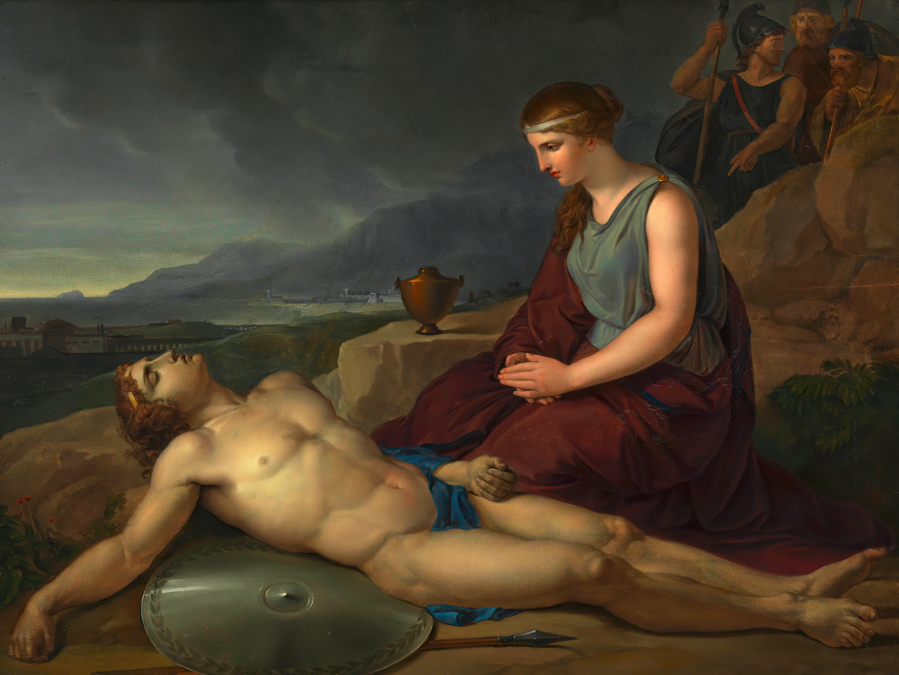
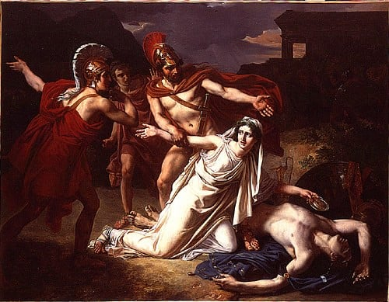
Antigone and Ismene

Slide 11
Women in Mythology
Stories of women in Greco-Roman mythology enforced patriarchal gender norms
Women were frequently depicted as dangerous because of their beauty: Helen, Aphrodite, Circe
They were also depicted as wanton, lustful women who want men too much: Clytemnestra, Circe, Medea, Pandora
Sometimes these categories overlap!
#NotAllWomen – some women were prized as virtuous and good: Athena, Penelope, Daphne, Persephone, Eurydice
Sometimes tragedy still befalls these women, but sometimes not!

Slide 12
Women and Abduction
Excerpt from the Homeric Hymn to Demeter
“She [Persephone] was filled with a sense of wonder and she reached out with both hands
To take hold of the pretty plaything. And the earth, full of roads leading ever which way, opened up under her.
It happened on the Plain of Nysa. There it was that the Lord who receives many guests made his lunge.
He was riding on a chariot drawn by immortal horses. The son of Kronos. The one known by many names.
He seized her against her will, put her on his golden chariot,
20 And drove away as she wept. She cried with a piercing voice,
calling upon her father [Zeus], the son of Kronos, the highest and the best.
But not one of the immortal ones, or human mortals,
heard her voice. Not even the olive trees which bear their splendid harvest.”

Slide 13
Scorned Women in Mythology
Ariadne, Dido, Medea, Scylla, etc.
The general theme of the story is usually the same:
A young woman falls in love with a man; she betrays her family for him, only for him to leave her stranded. She transforms into a vengeful “monster” and/or “woman scorned”

Slide 14
Gods and Mortals, Relationships
Arachne and Athena
Arachne was a mortal women who was famous for her weaving
She challenged Athena to a competition
Arachne was indeed a great weaver, but was unable to bear Athena’s anger and she hanged herself
Athena turned Arachne into a spider
Midas and Dionysus
Midas was king in Phrygia (modern day Turkey)
Dionysus was travelling to India, one of his companions got lost
Midas treated the companion well and brought him back to Dionysus
In return, Midas asked to have the “golden touch”
He soon regretted it, Dionysus advised to wash his hand in a river (Pactolus)
Daphne and Apollo
Eros was angry with Apollo and made him fall in love with Daphne
She was already set on staying a virgin and hunting, but Eros shot her with an arrow
Apollo pursues Daphne
Daphne prays to Gaia, Gaia turns her into a laurel tree
Apollo makes laurel his sacred tree

Slide 15
Next Time
This was our last mythology lesson ☹
On to History!
Read Words & Ideas, Chapter 9 (pp. 227–238), stop reading at "Source Passages”
Homework 2 assigned, due Thursday by 11:59pm PST

