Slide 1
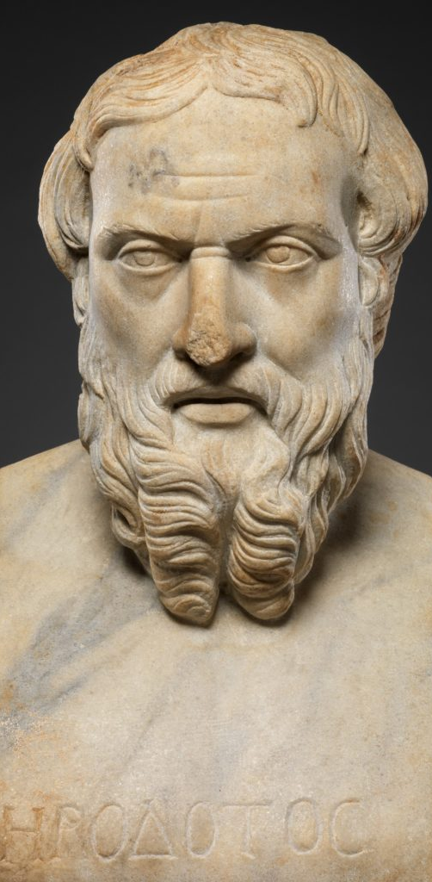
History Pt. 1
Words & Ideas, Chapter 9,
pp. 227–238

Slide 2
Outline
What is History?
Methodology and Tools of History
Recording Time
Greek and Roman Historians
Word Study and Exercises

Slide 3
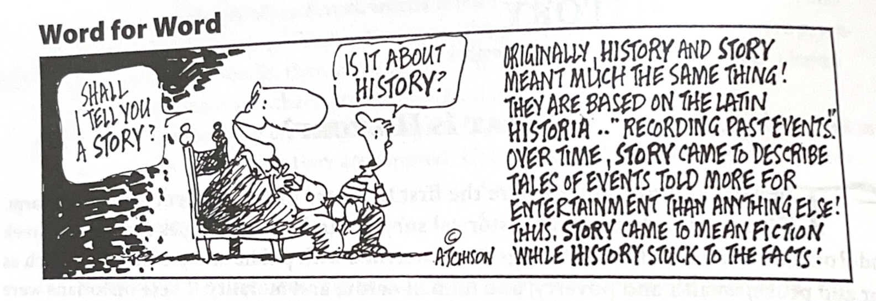
What is History?
ἱστορία (Greek) meaning “a learning by inquiry, inquiry”
historia (Latin) meaning “a narrative of past events, story, history”

Slide 4
Dictionary Time!
quaerere, quaesitum (verb)
in- + quaerere, quaesitum (verb)
vestigium (noun)
agere, actum (verb)
curare, curatum (verb)
dare, datum (verb)

Slide 5
Methodology and Tools of History
What kinds of evidence do we have?
Primary sources | Secondary sources
Evidence that is from the actual place/location and time period Ex. Wall paintings | Evidence that researches and interprets primary sources Ex. Article about wall paintings

Slide 6
Primary Sources, Literature
Sometimes ancient copies are found on papyrus
Usually passed down through manuscripts, what survives depends on later generations
Fiction: epic poetry, lyric poetry, tragedy, comedy, novels, etc.
Non-Fiction: history, biography, oratory, philosophy, manuals
Only wealthy people were educated

Slide 7
Primary Sources, Literature cont’d
Contracts, wills, and private letters are other sources
Epigraphy, the study of inscriptions made on durable materials (for example, marble)
Laws, edicts, decrees
Temple records
State records
Graffiti
Epitaphs (inscriptions on gravestones)

Slide 8
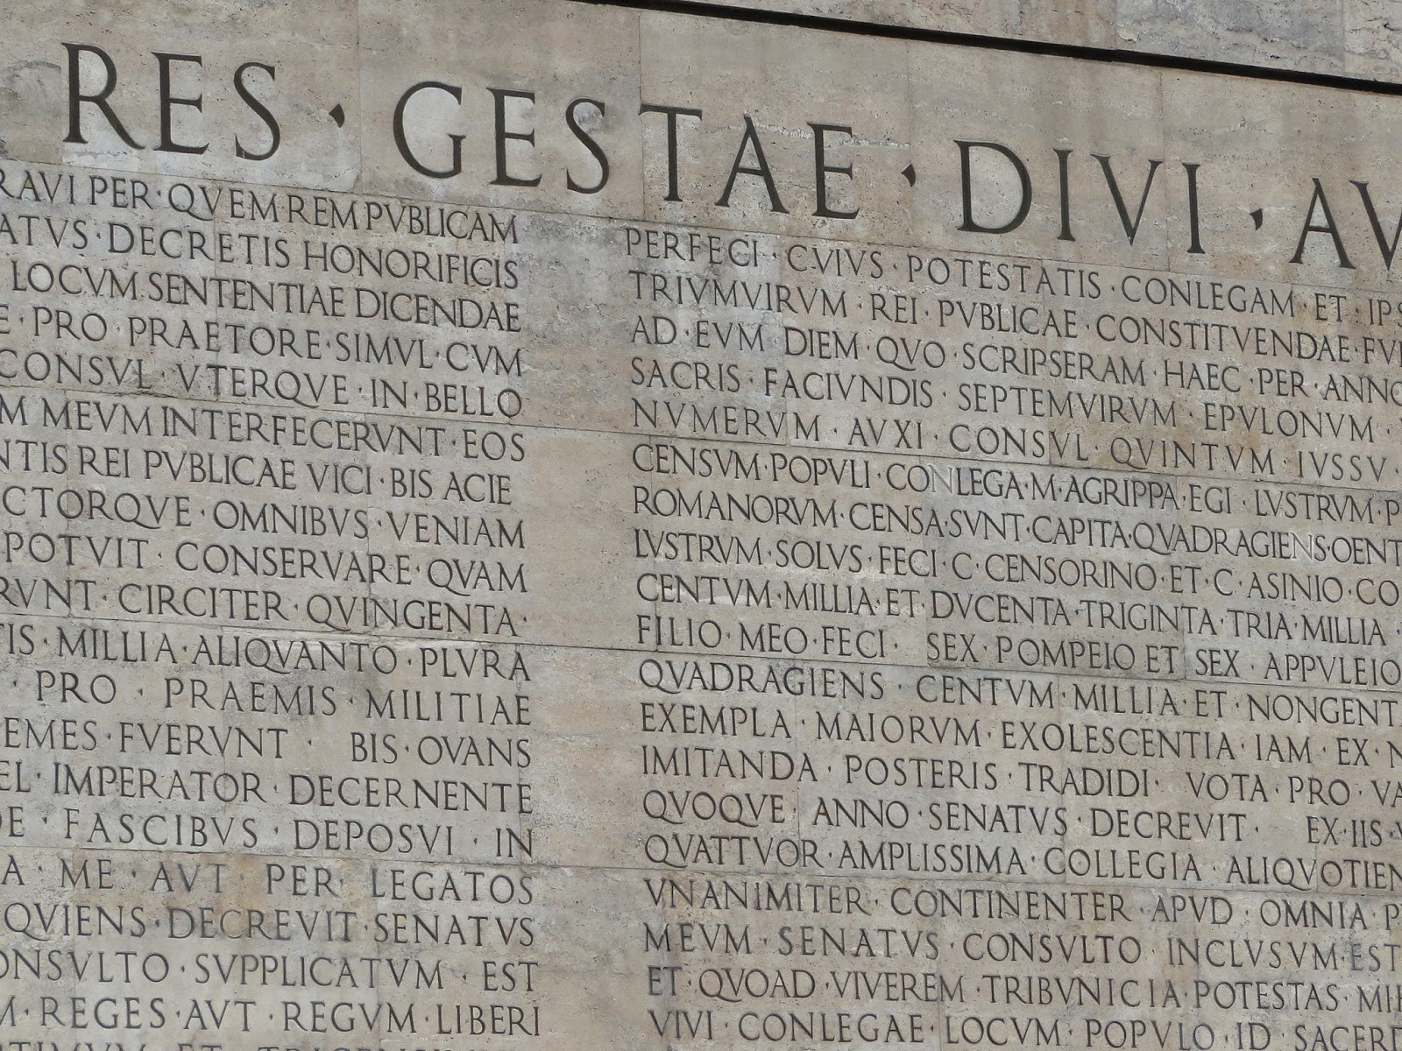
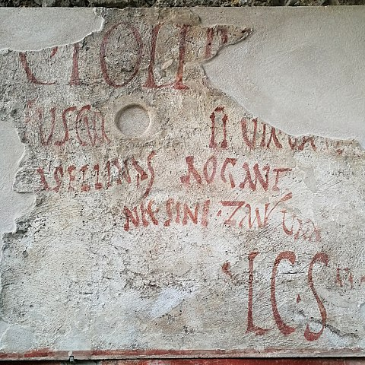
Inscription of Augustus’ Res Gestae
Graffiti in Pompeii

Slide 9
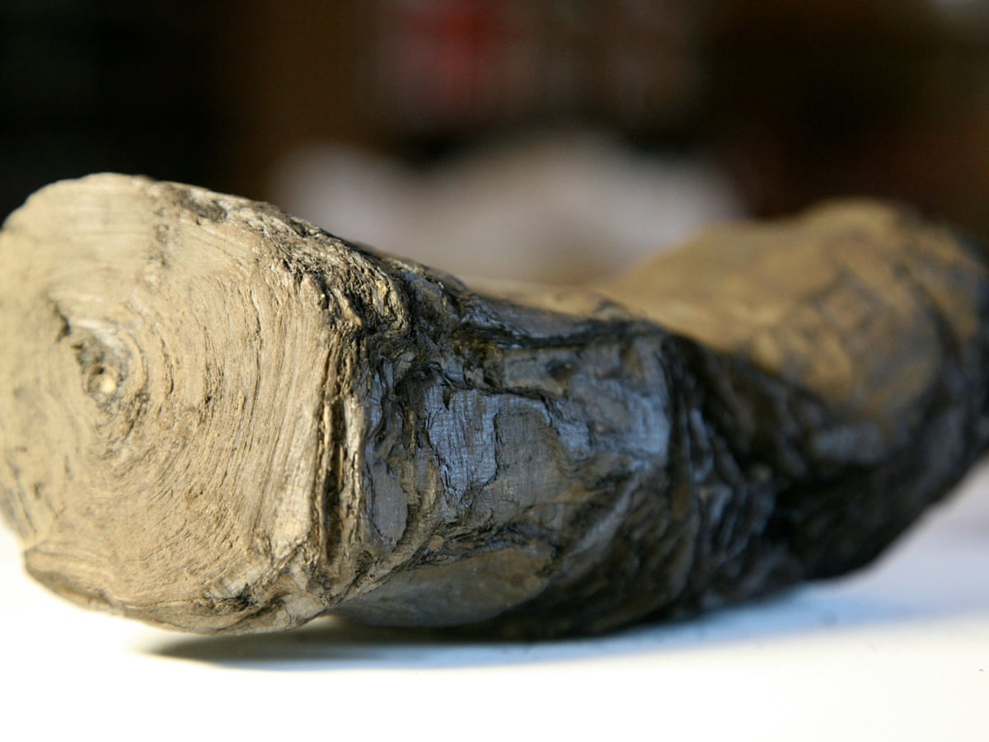
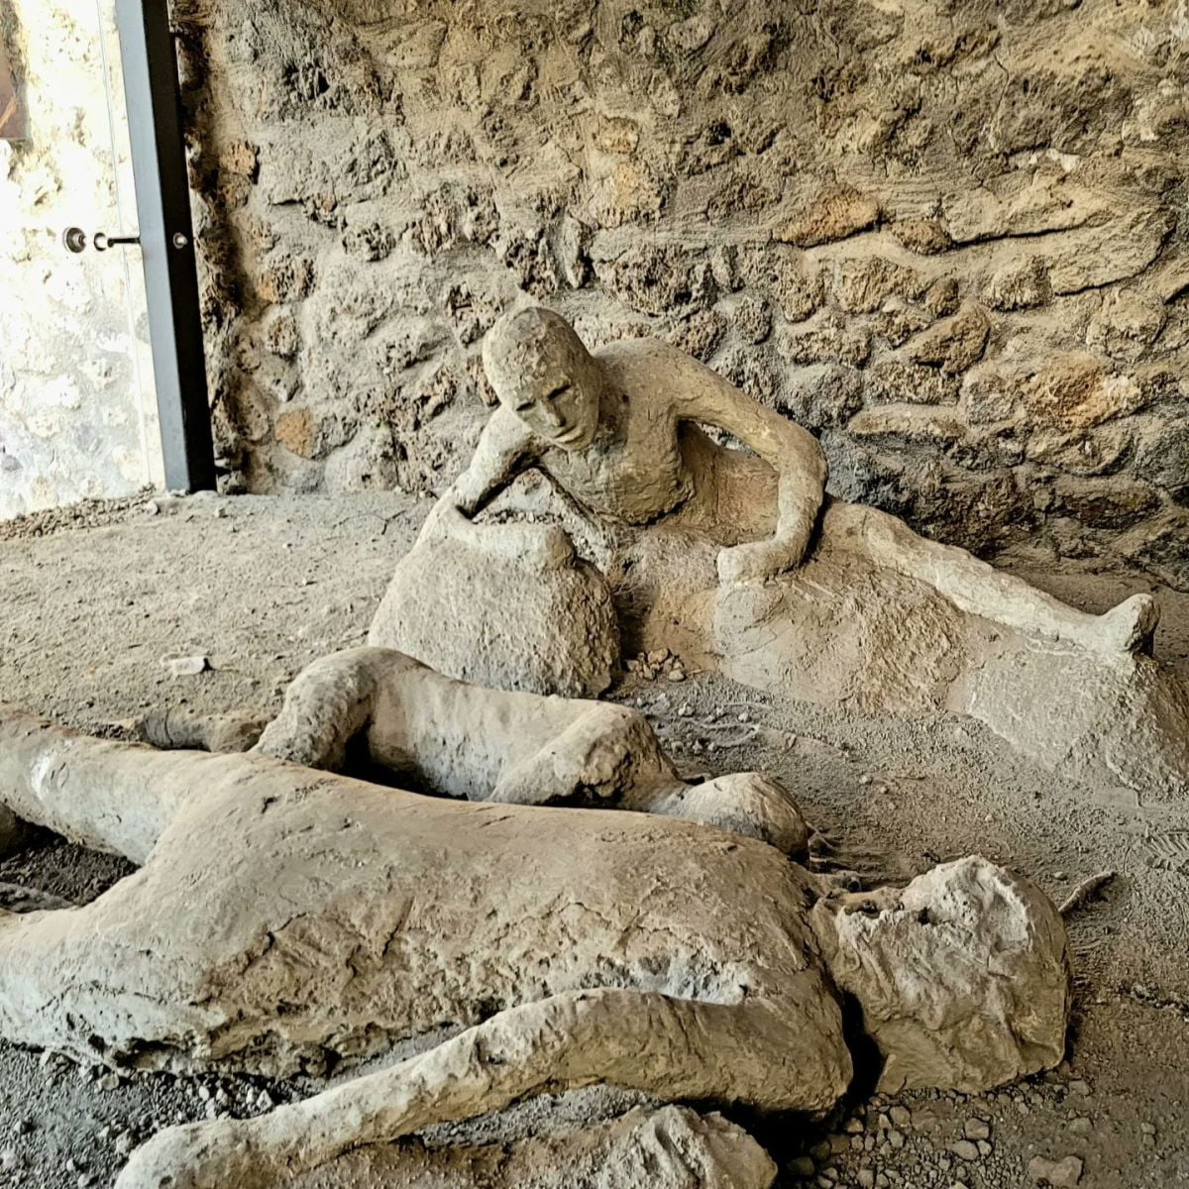
Primary Sources, Material Evidence
Pompeii
Mount Vesuvius erupted in 79 CE and buried Pompeii under ash and pumice, things are well preserved where they were (for the most part)
Materials that usually decay were preserved such as papyri and wall paintings

Slide 10
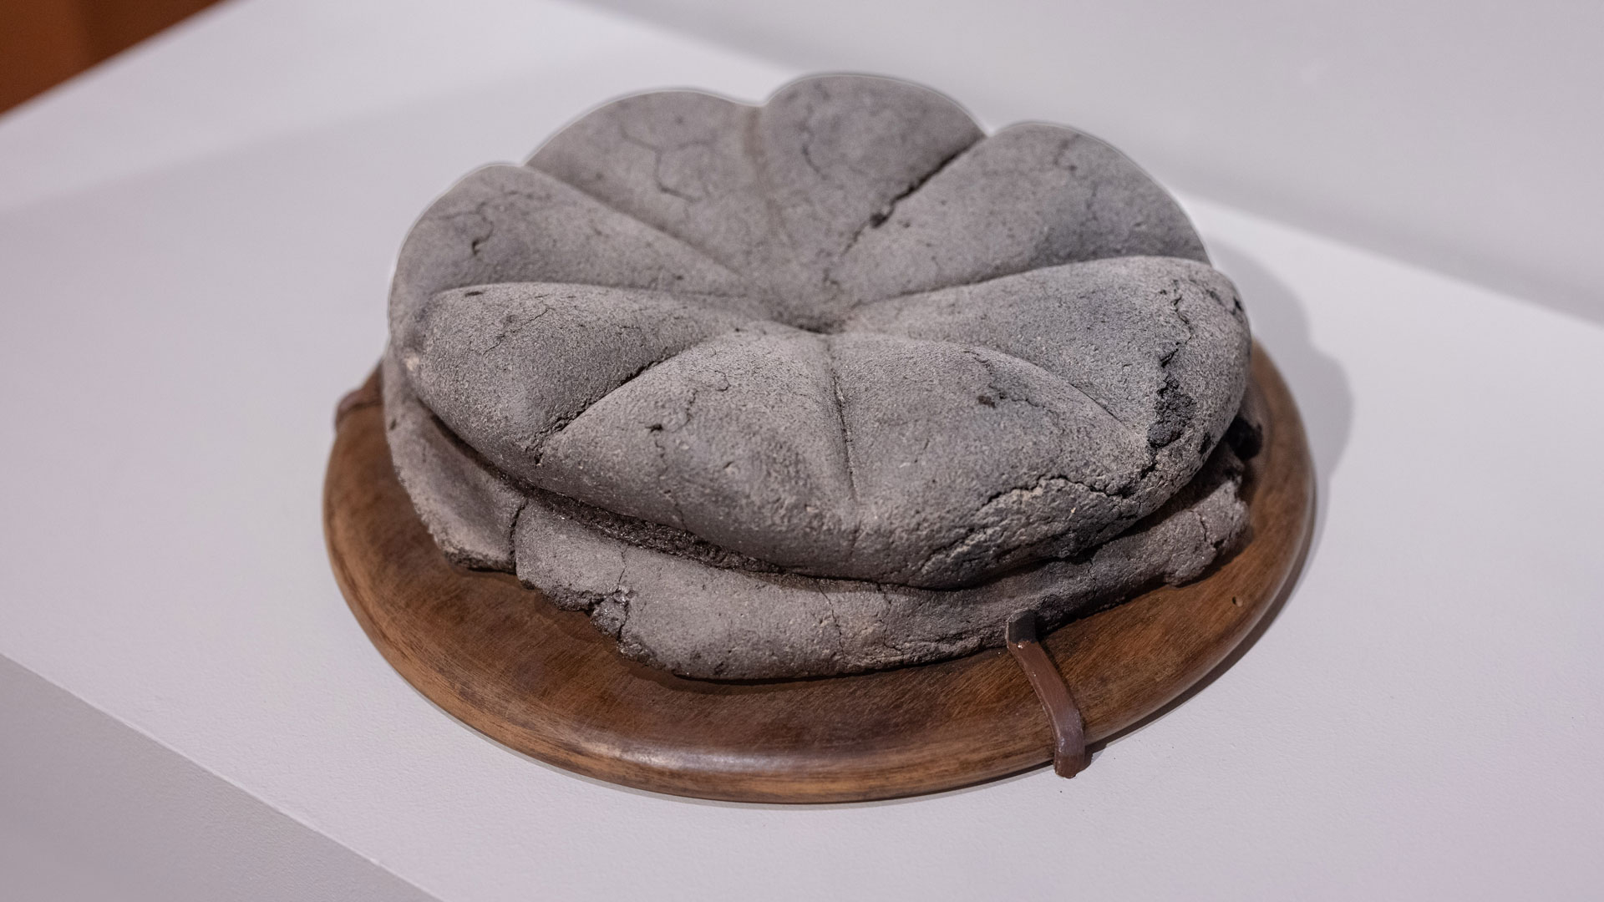
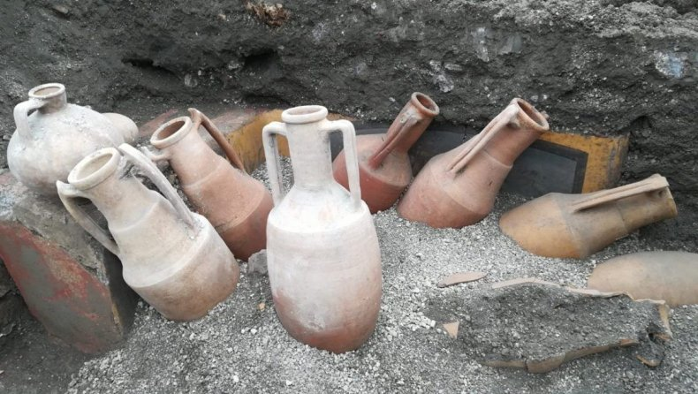
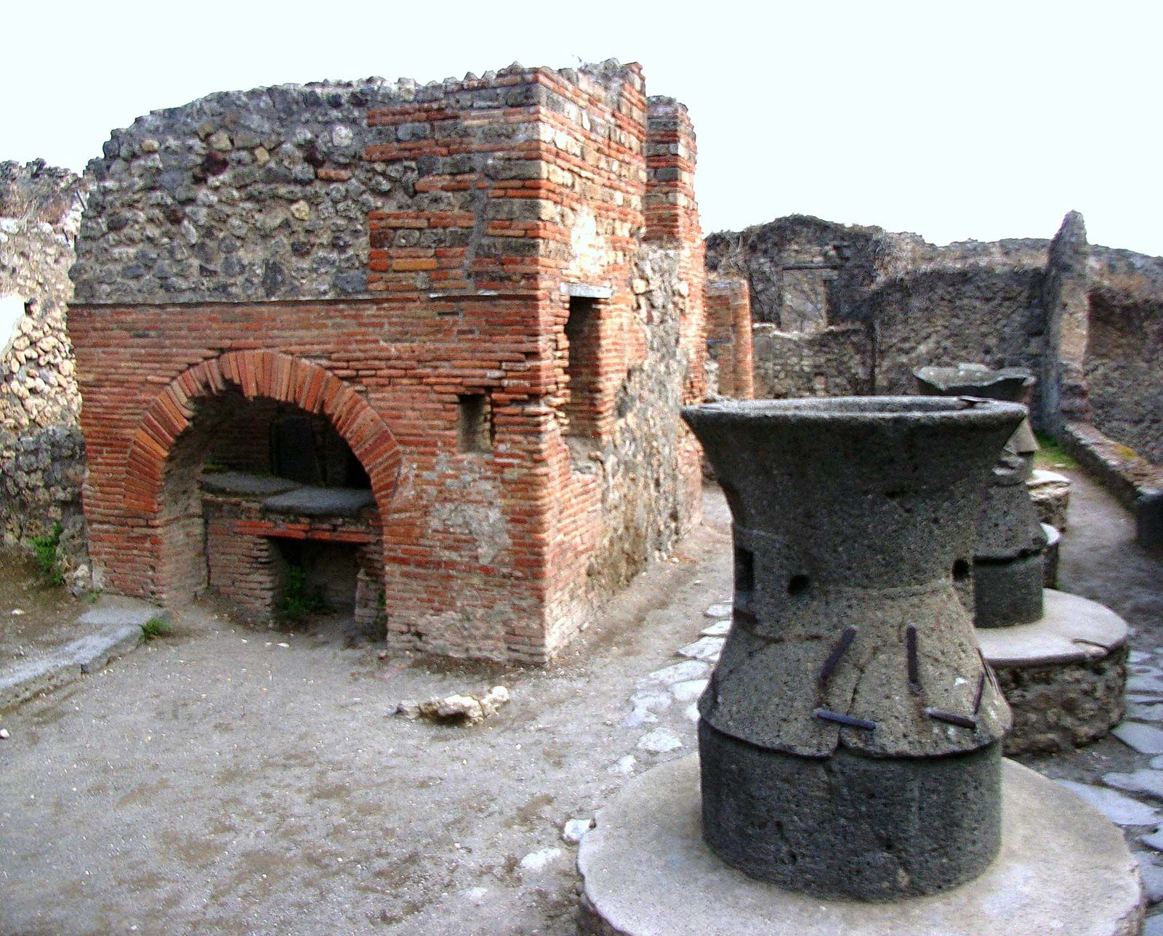
Material Evidence from Pompeii
bread
pots
bakery

Slide 11
Recording Time
Ancient calendars and timekeeping were usually based on natural cycles
Egyptians were the first to use a solar calendar
The Babylonians, Greeks, and Chinese used a lunar calendar
Based on a lunar month of 29 or 30 days
Lunar calendars cannot keep pace accurately with the seasons, must be corrected with intercalary days or months
The Roman year began in March and consisted of 10 months

Slide 12
The Roman Calendar
1. March (the month of Mars, when campaigning season began)
2. April
3. May (Maia)
4. June (Juno)
5. Quintilis (“five”)
6. Sextilis (“six”)
7. September (septem, “seven”)
8. October (octo, “eight”)
9. November (novem, “nine”)
10. December (decem, “ten”)

Slide 13
The Roman Calendar as we know it
1. January (Janus)
2. February (Februa, purification)
3. March
4. April
5. May
6. June
7. July (Julius Caesar)
8. August (Augustus)
9. September
10. October
11. November
12. December

Slide 14
Greek Historians

Slide 15
Herodotus
Born c. 484 BCE in Halicarnassus (one of many Greek cities in Asia Minor)
“Father of History”
Histories
Mostly covered the Persian Wars (490-470 BCE)
Genealogy and geography
Wide scope and immense detail
Is he accurate?

Slide 16
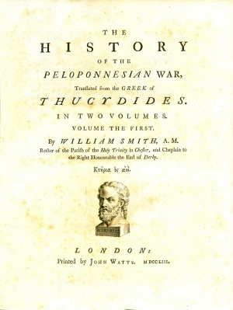
Thucydides
Born c. 464 BCE, Athenian citizen
Peloponnesian War, Athens v. Sparta (431-401 BCE)
Firsthand knowledge and military experience
War and politics
His work is unfinished, breaks off in the middle of his account in 411 BCE

Slide 17
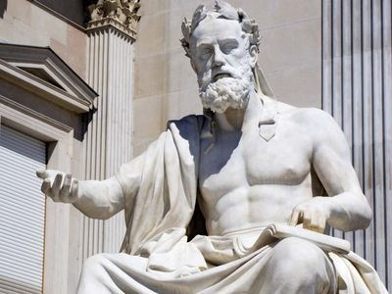
Xenophon
c. 430-356 BCE, Athens
Student of Socrates
Military and politics
Hellenika, history of Greece from 411-362 BCE
Picks up where Thucydides’ History breaks off and covers the end of the Peloponnesian War and its aftermath

Slide 18
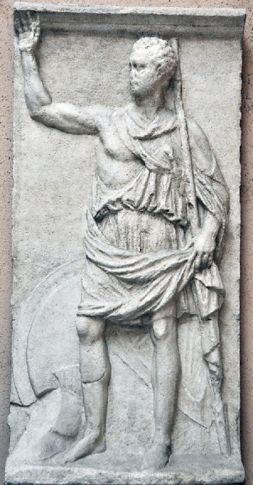
Polybius
c. 200-118 BCE
Aristocrat and politician
Banished from Greece and lived in Rome
Travelled to Africa
Writing for a Greek audience but included Roman methods
Histories, cover rise of Rome’s power from 264-146 BCE

Slide 19
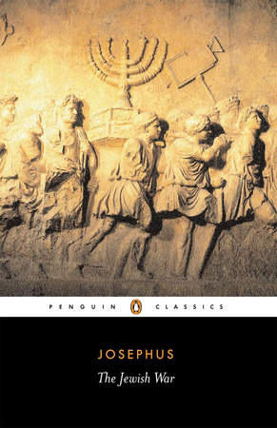
Flavius Josephus
Born c. 37 CE, sent to Rome as an ambassador
Educated in the Rabbinical tradition
Became a leader in the revolt against the Roman government
Captured, but pardoned
History of the Jewish War and Jewish Antiquities (a history of the Jewish people from Adam up to his own days)

Slide 20
Roman Historians

Slide 21
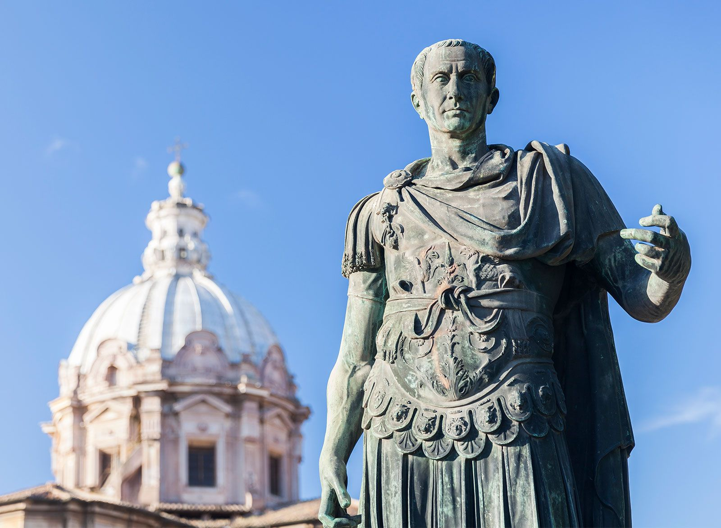
Caesar
Gaius Julius Caesar, c.100-44 BCE
Conquest of Gaul and powerful politician
Civil war, defeated the forces led by Pompey, made perpetual dictator
Assassinated by Brutus and Cassius (Republican party)
Wrote a record of the civil war, third person
Meant to glorify his accomplishments to the Roman people

Slide 22
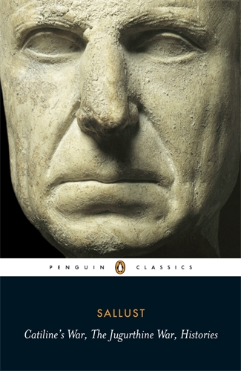
Sallust
Gaius Sallustius Crispus, c. 86-34 BCE
Roman senator and supporter of Caesar
Conspiracy of Catiline (an attempted revolution that took place in 63 BCE)
Jugarthine War (111-105 BCE)
Dramatic, effective, skillful depiction of character
Histories (78-67 BCE), fragmented

Slide 23
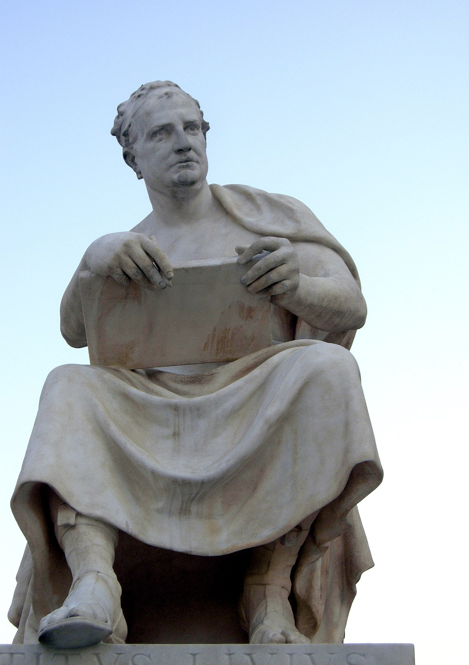
Livy
Titus Livius, c. 59 BCE - 17 CE
Not involved in political or military life
Lived through the civil wars that followed Julius Caesar’s assassination and battles between Augustus and Mark Antony
From the Foundation of the City (Ab Urbe Condita)
142 books, late Republic and Civil Wars
Rome’s history
Summarizing multiple accounts

Slide 24
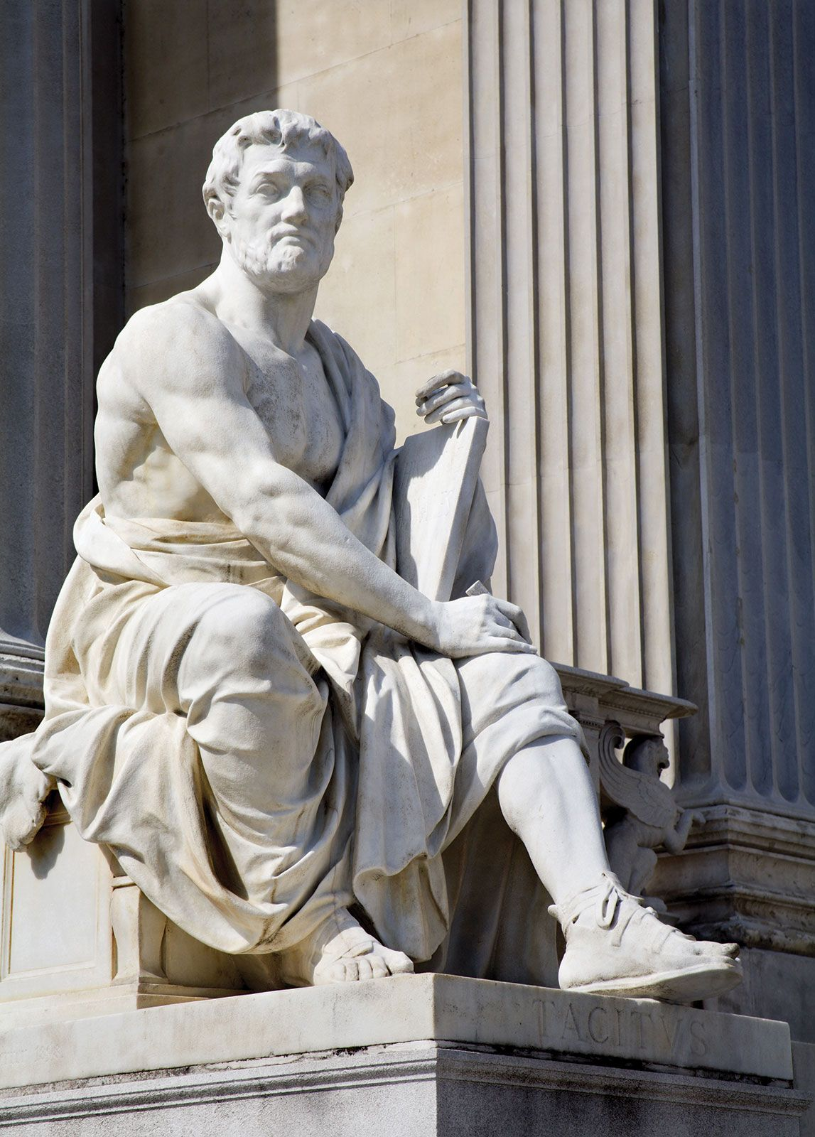
Tacitus
Cornelius Tacitus, c. 56-120 CE
Senator and celebrated lawyer
Dialogue on Orators and Agricola, biographies
Germania, monograph of customs of people in Germany
Histories, civil wars after the death of Nero and the reign of the Flavian emperors (68-96 CE)
Annals, cover the period of the early Empire, from the death of Augustus to Nero
Concerned with accuracy, consulted the works of previous writers

Slide 25
Word Study and Exercises
Words & Ideas, Chapter 9, pp. 230, 232, 234

Slide 26
What’s Next
History Pt. 2
Read Words & Ideas, Chapter 9, pp. 238–249

