Slide 1
History Pt. 2
Words & Ideas, Chapter 9, pp. 238–249

Slide 2
Outline
Review of authors/historians
Timeline
Source passages
How to read the text using critical analysis
Modern day history lessons
Word study

Slide 3
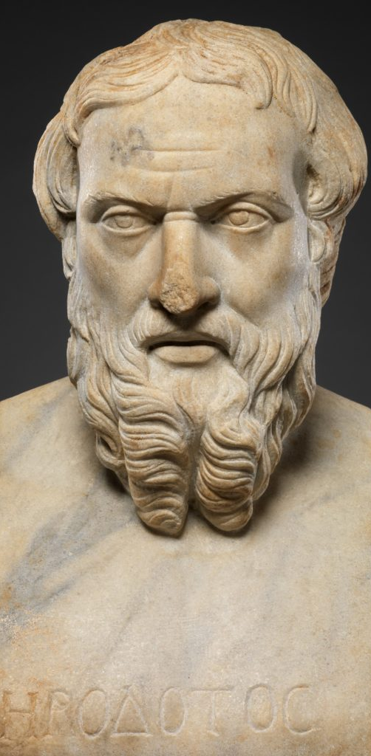
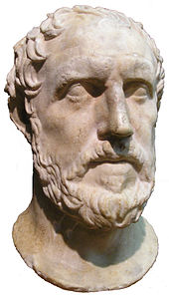
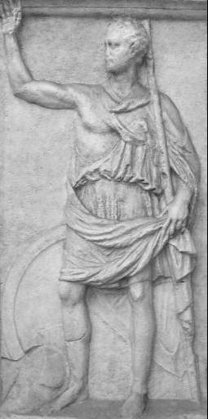
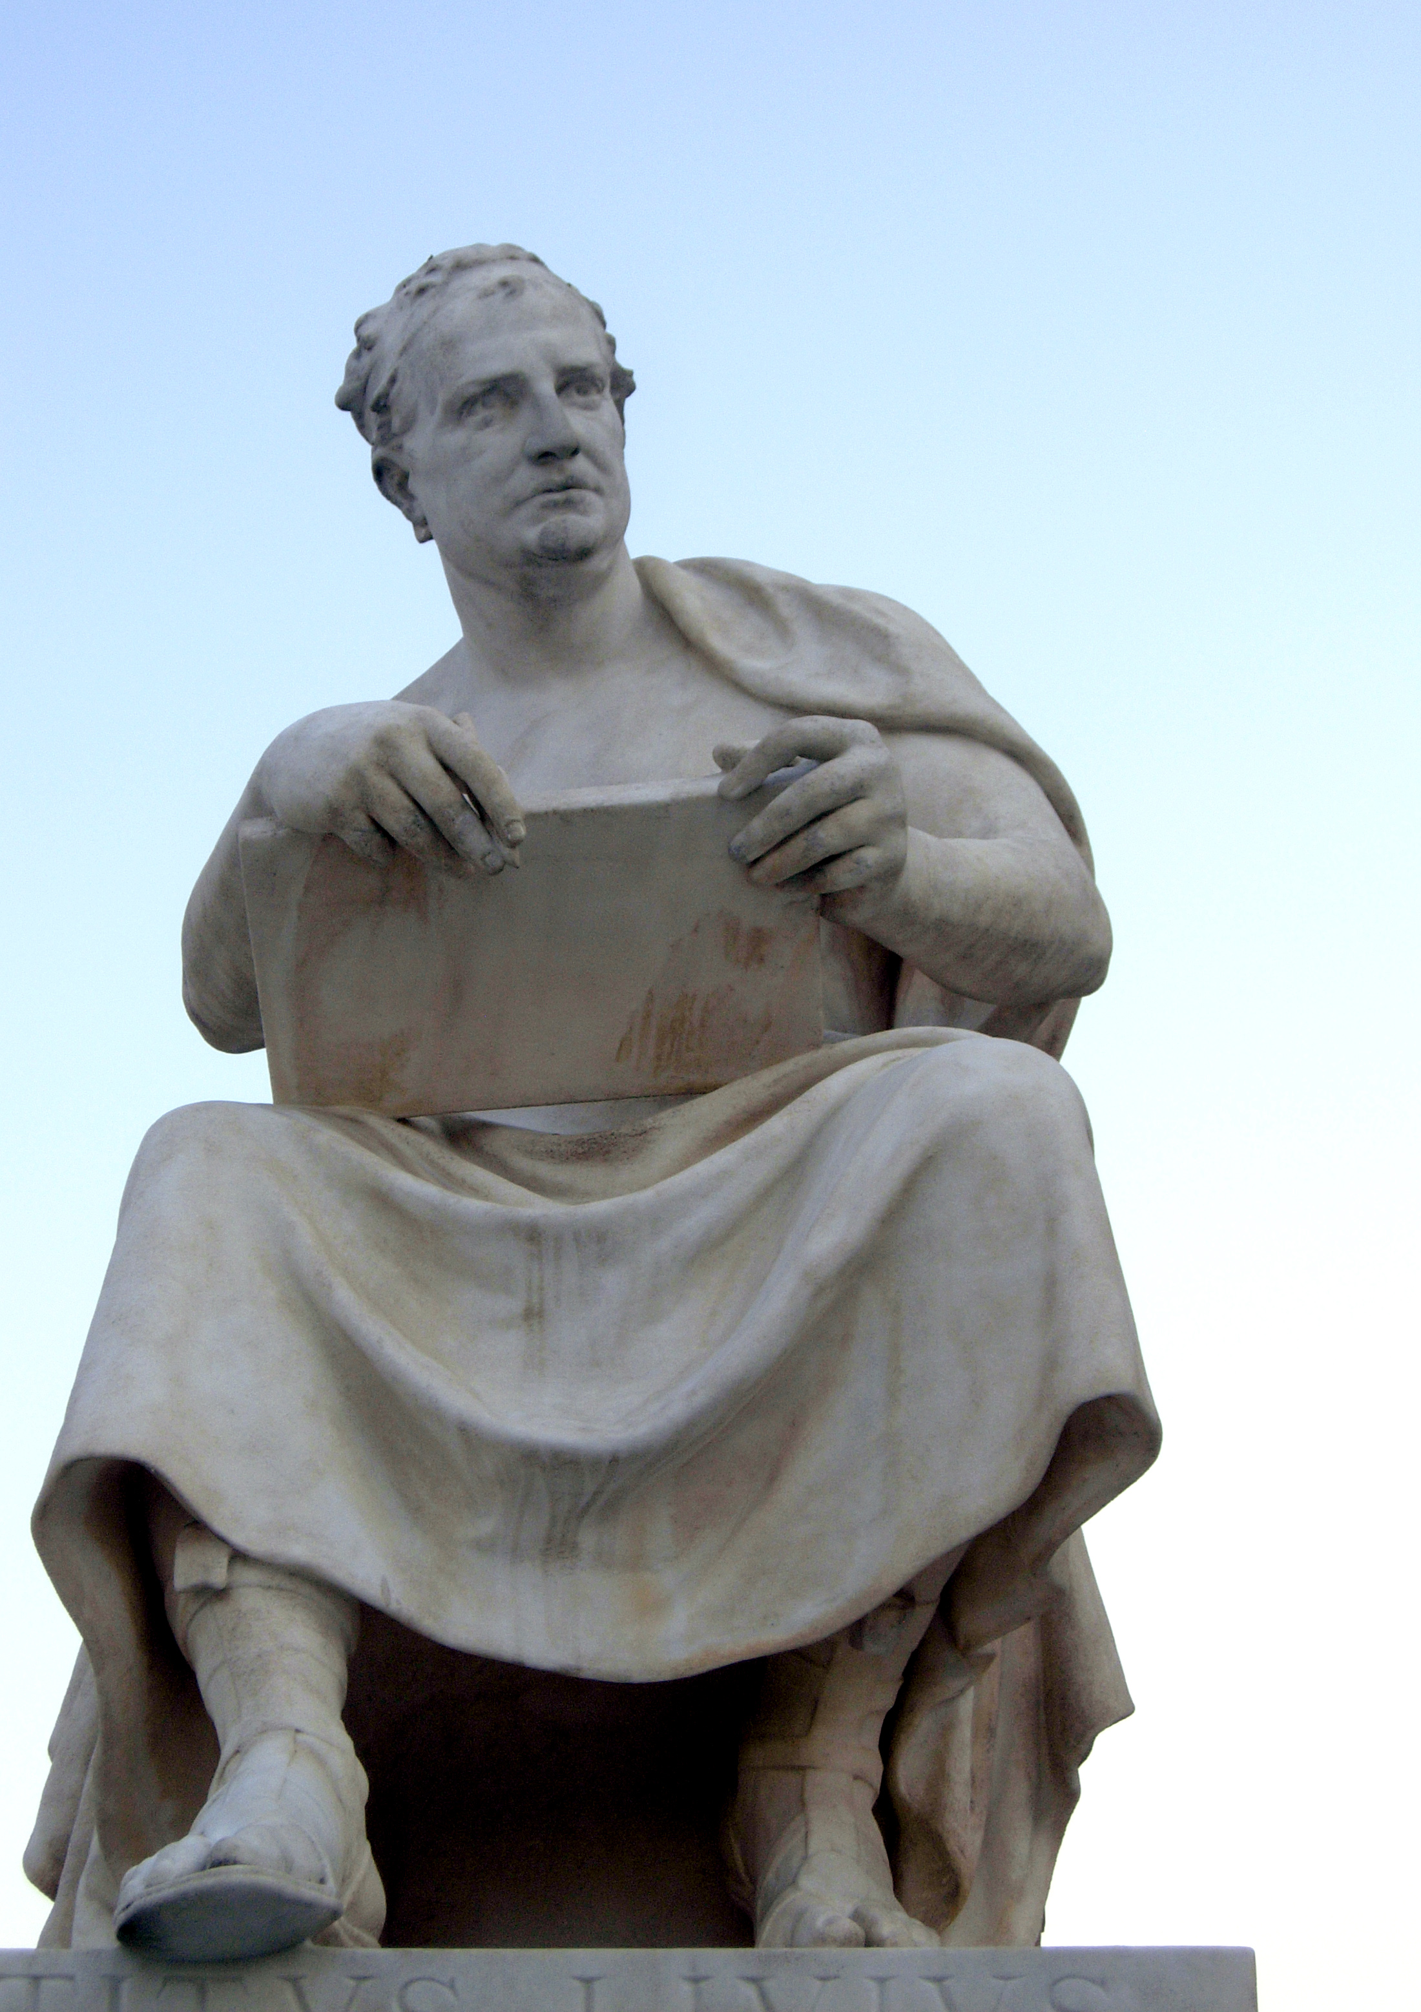
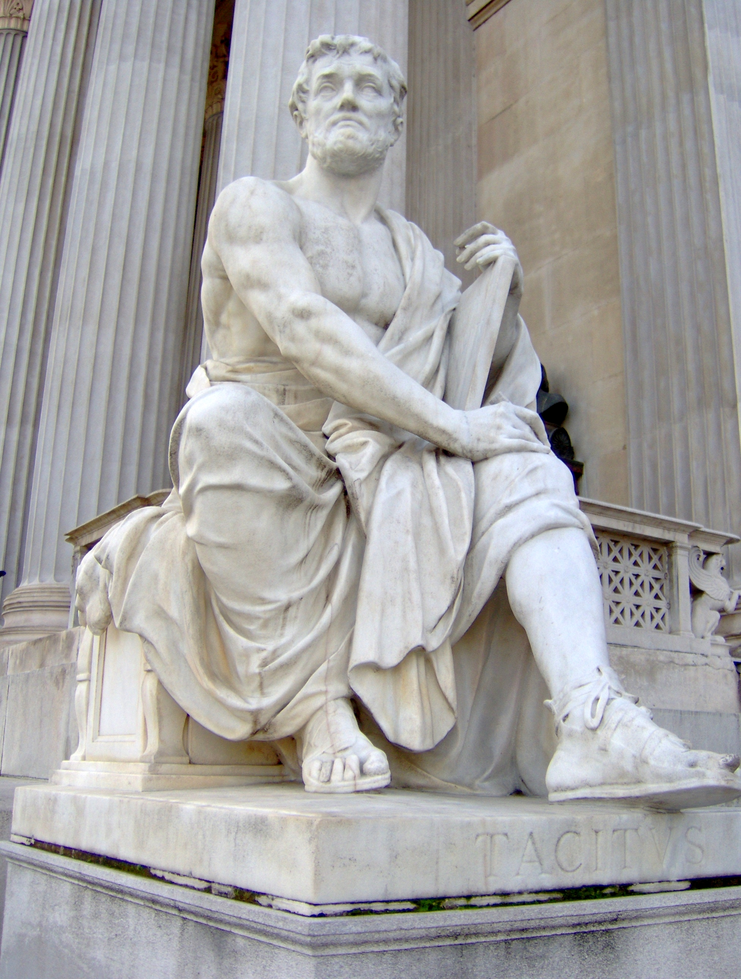
Review of Authors/Historians
Herodotus, Thucydides, Polybius, Livy, Tacitus
Source passages are all from the preface of their works

Slide 4
Timeline
c. 484 BCE
c. 464 BCE
c. 200 BCE
c. 59 BCE
c. 56 CE

Slide 5
What should we be looking for?
Who, what, where, when, why
Are they writing contemporaneously? Past? Distant Past?
What is the motivation/reason for their writings?
Are they using sources? What are they? Do they cite them?
Do they display bias? Personal opinions?
Personal connection to their text
Do they connect their work to others? And if so, what is the relationship between the works?

Slide 6
Herodotus, Histories preface 1.5.3
Record of the research of Herodotus of Halicarnassus
Great and marvelous achievements of Greeks and non-Greeks
Persians and Phoenicians
State things as they are
Speak about the man who was the first to commit wrongs against the Greeks

Slide 7
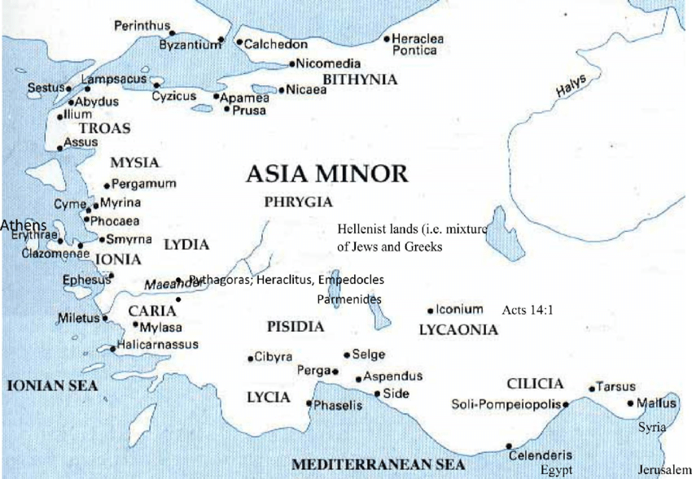
Herodotus cont’d
From Halicarnassus
Interested in a non-Greek point of view
Trying to be unbiased and state the “facts”
Personal opinion and judgement

Slide 8
Thucydides, The Peloponnesian War 1.21–22
Very personal, but affirms his account is more accurate and authentic than others
Critical of past works on the subject, but does not call them out
His account should be trusted because he did a vast amount of research
Discredits other methods of historiography
Separates mythology from history (entertainment aspect)
Knowing his audience
Stating the value of his work now and in the future

Slide 9
Polybius, Histories 3.31.2–4, 7–8, 11–13
“... Knowledge of the past [is] good but not essential” but then it is essential because no one knows the future
Difficult to determine each person’s policy and truth is often obscure
According to Polybius, what should writers and readers of history pay attention to?
Narrative, questions asked, who was there, what followed
Educational value
What use is history in the future?

Slide 10
Livy, From the Foundation of the City preface 6–7, 9–10
Collection of accounts on the events before the city of Rome was founded
Clearly states his opinion
What should people consider?
How people lived, values, which individuals and what skills established and increased Rome’s power
Explaining why it is beneficial to study history
Learning from your past to have a successful future
A guide to how to be a successful country, leader, etc.

Slide 11
Tacitus, Annals 1.1
Acknowledgment from past writers, positive
False accounts because of fear under the period of Tiberius, Gaius, Claudius, and Nero
Future accounts were further influenced by the hatred of the previous times
Describing things as neutral and unbiased (to his best abilities) as there is no place for anger or partiality in history

Slide 12
Modern Day History Lessons
Are there any connections between how history is written and taught today to how it was recorded during antiquity?
Bias, personal opinion, judgment, which groups of people, events, places, etc.
“The Problem of Bias in US History Textbooks and Curriculum” – School of Education, American University

Slide 13
There’s always room for improvement!
Practice your critical thinking and analysis skills!
Know your author and their sources
Be aware of the language (note specific terms and phrases)
What is being said? What is being left out?
Ambiguity can be a choice
Read and re-read
Research the topic for yourself
Ask others or see what other people have to say or have said

Slide 14
Word Breakdown
Autobiography
auto- “self” (autos, from Greek)
bio- “life” (bios, from Greek)
-graphy “art or method of writing” (combining form)

Slide 15
Word Breakdown
Historian
histor- “expert” (histor, from Greek)
-ian (noun-forming suffix, agent function)

Slide 16
Word Breakdown
Memory
memor- “mindful of” (memor, from Latin)
-y (noun-forming suffix, abstract function)

Slide 17
What’s Next
Greek law and politics
Read Words & Ideas, Ch. 6, pp. 145–151

