Slide 1
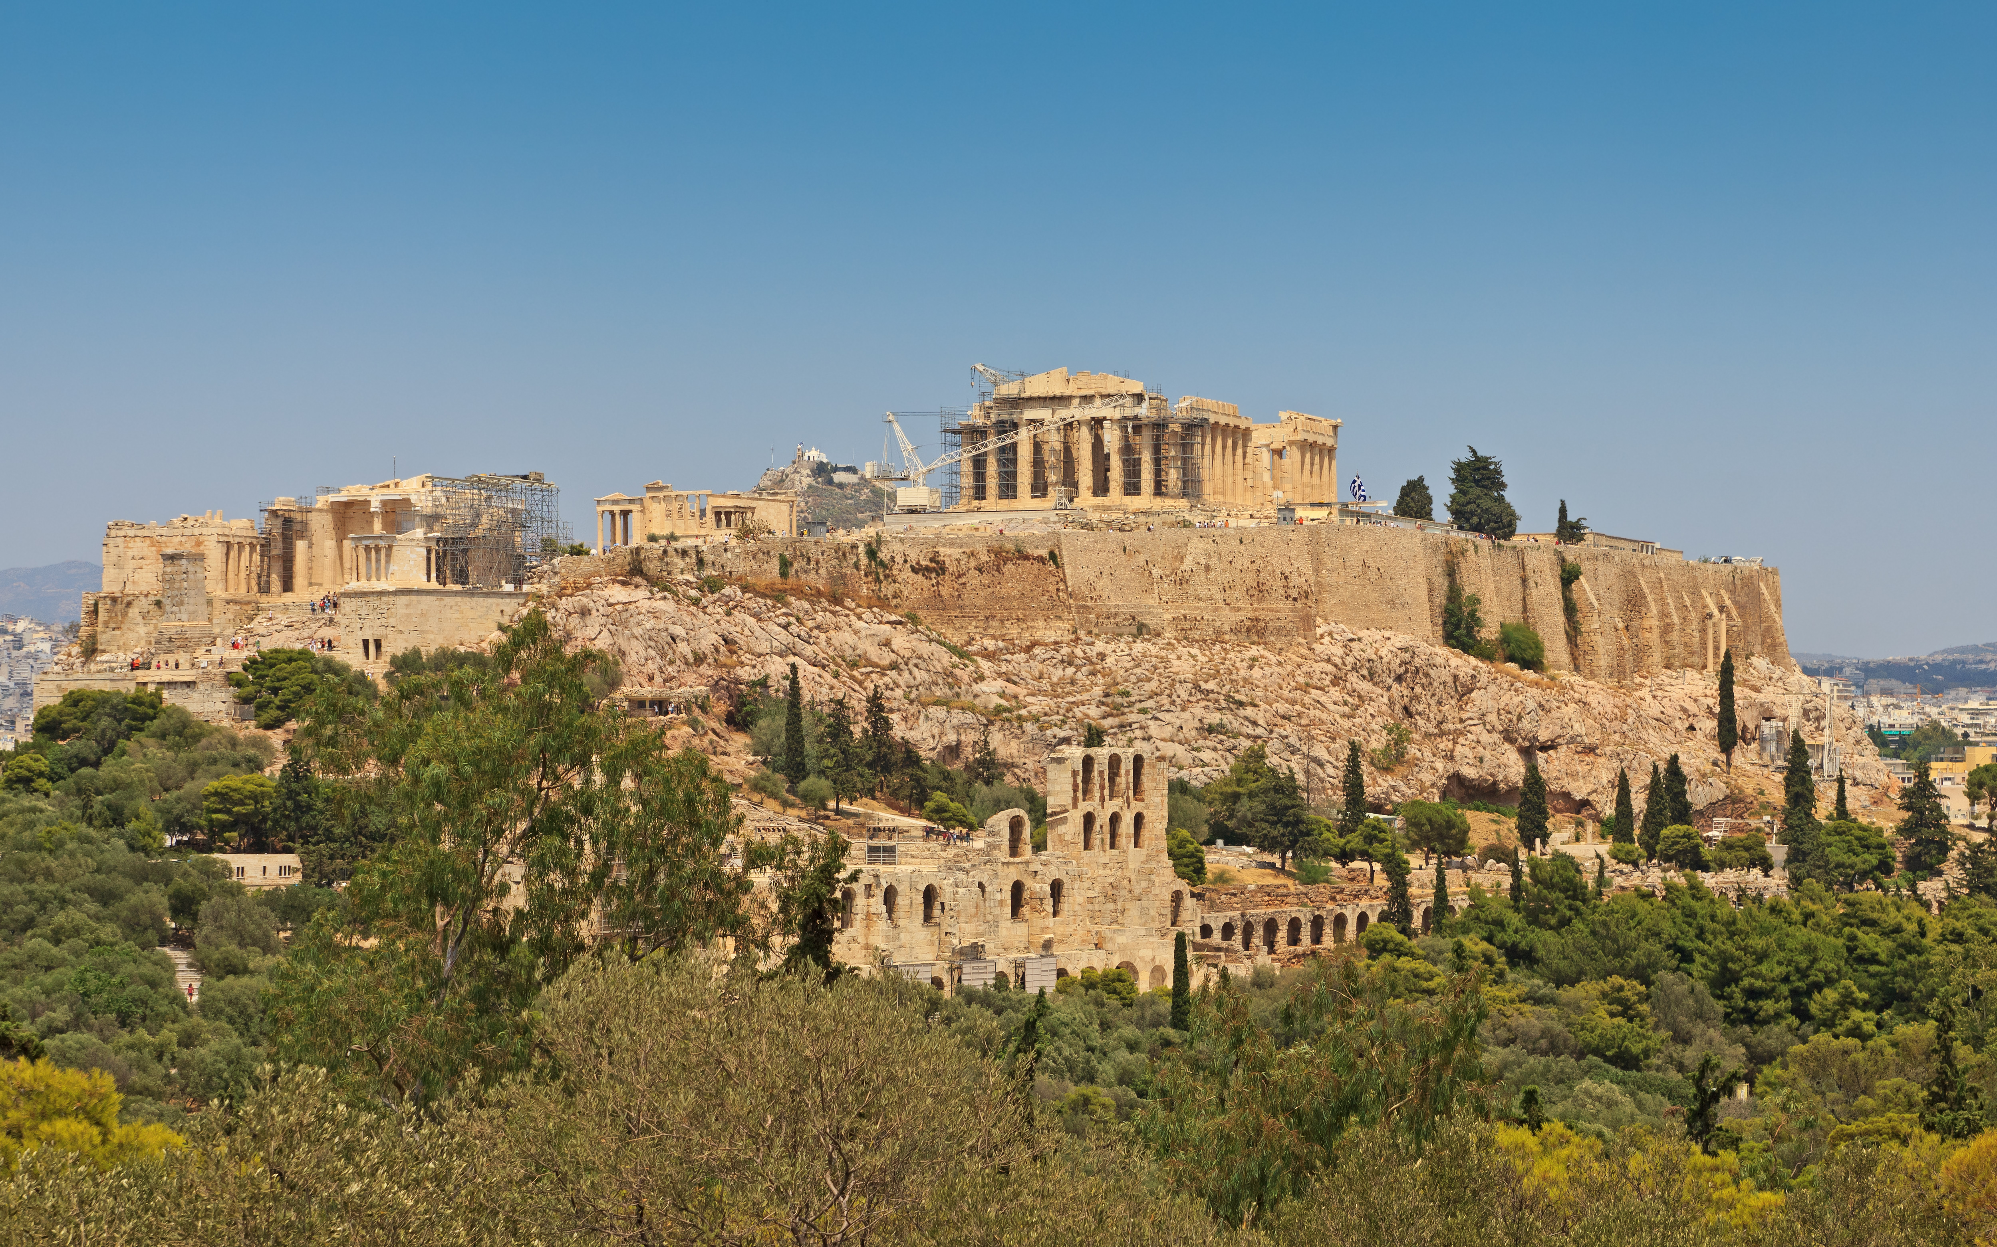
Greek Law and Politics
Words & Ideas, Chapter 6, pp. 145–151

Slide 2
Outline
The Greek Polis
Latin Words for “City”
Monarchy and Related Forms
Democracy
Word Study

Slide 3
The Greek Polis
politic, politico, politics, political, politician, politicize, polity
polit– (base)
politēs, “citizen”
police, policy
polis (“city”), “citadel”

Slide 4
The Greek Polis cont’d
astu (“town”)
distinct area from the rest of the city (polis)
acro– (“high”) +
polis (“city”)
acropolis (“high city”)
A citadel is a fortified hill-top

Slide 5
The Greek Polis cont’d
The Greeks also used the word polis to mean “the body of citizens”
This meaning is demonstrated by Homer’s description of two cities (poleis), one at peace and the other at war (Iliad 18.490-540)
Cities are described in terms of their social structures: the family, the legal system, and the army
Athens and Athenians
The polis was not necessarily dependent its fortified citadel
In times of danger the people in the area around a fortified hill-top would congregate there and co-operate in the defense of their position

Slide 6
The Greek Polis, Aristotle
Man is a “political animal” and society came into being for a natural purpose: human beings need to form communities in order to survive
Human beings by nature tend to live in cities
The basic unit of society is the family, which fulfills basic needs, making the polis a matter of necessity
War among Greek city-states and larger forces
Autonomy and political freedom
Political diversity

Slide 7
Latin Words for “City”
urban, urbane, urbanity, urbanize, urbanization
urbs, “stronghold, a walled town, city”
*consider Romulus and Remus
civic, civics, civil, civilian, civility, civilization, civilize, citadel, citizen, city
civis, “citizen”
*civitas, referred to the state as constituted by its citizens (more abstract than civis)

Slide 8
Monarchy and Related Forms
mon + archy = monarchy
“single” + “rule by”
olig + archy = oligarchy
“few” + “beginning,” “rule”
In English, a monarch is a general, constitutional term referring to a state traditionally ruled by one person (king, queen, or emperor)
In Greek, monarchy refers to a variety of different types of rulers (kings, tyrants, and other despots)

Slide 9
Monarchy in Ancient Greece
In early times the king was probably advised by a council of elders (Greek boulē, Latin senatus)
Aristocrats, nobles (derived from noscere, “to know”; old Latin form gnoscere, from the base gno- of Greek gignoskein, “to begin to know)
Assembly of the people in the early monarchies, ekklesia
But unlikely that they had any power
Homer example, Iliad 2.84-392

Slide 10
Monarchy in Ancient Greece cont’d
In Archaic and Classical periods, the monarchy was not strong in Greece
Invasion of the Macedonians, Alexander the Great defeated the Persian Empire, a stronger monarchy arose and used many of the characteristics of the Persian type -> Hellenistic monarchy
Hellenistic monarchy influenced the Roman imperial system of government and later European monarchies
Crown (Latin corona) and diadem (Greek diadema)
Prince (Latin princeps, “leader”) and Duke (Latin dux, “leader”)
Count (Latin comes, “companion”)

Slide 11
Monarchy in Ancient Greece cont’d
Greek kings often claimed to rule by virtue of the fact that they were descended from kings or elected to the position
Sometimes these monarchies were overthrown by revolutionary leaders, tyrants
Wealthy through trade, change in military tactics, socio-economic changes
Tyranny was usually revolutionary and unconstitutional
Tyrants in ancient Greece were not necessarily all tyrannical in the English sense of the word
Some were quite moderate and even popular
The rule of Peisistratus in Athens

Slide 12
Democracy
democracy, democratic, democrat
demos (“the people”) + kratos (“power, dominion”)
demokratia (“popular government, power in the hands of the people”)
*In English, democracy means “state practicing government by the people, direct or representative”

Slide 13
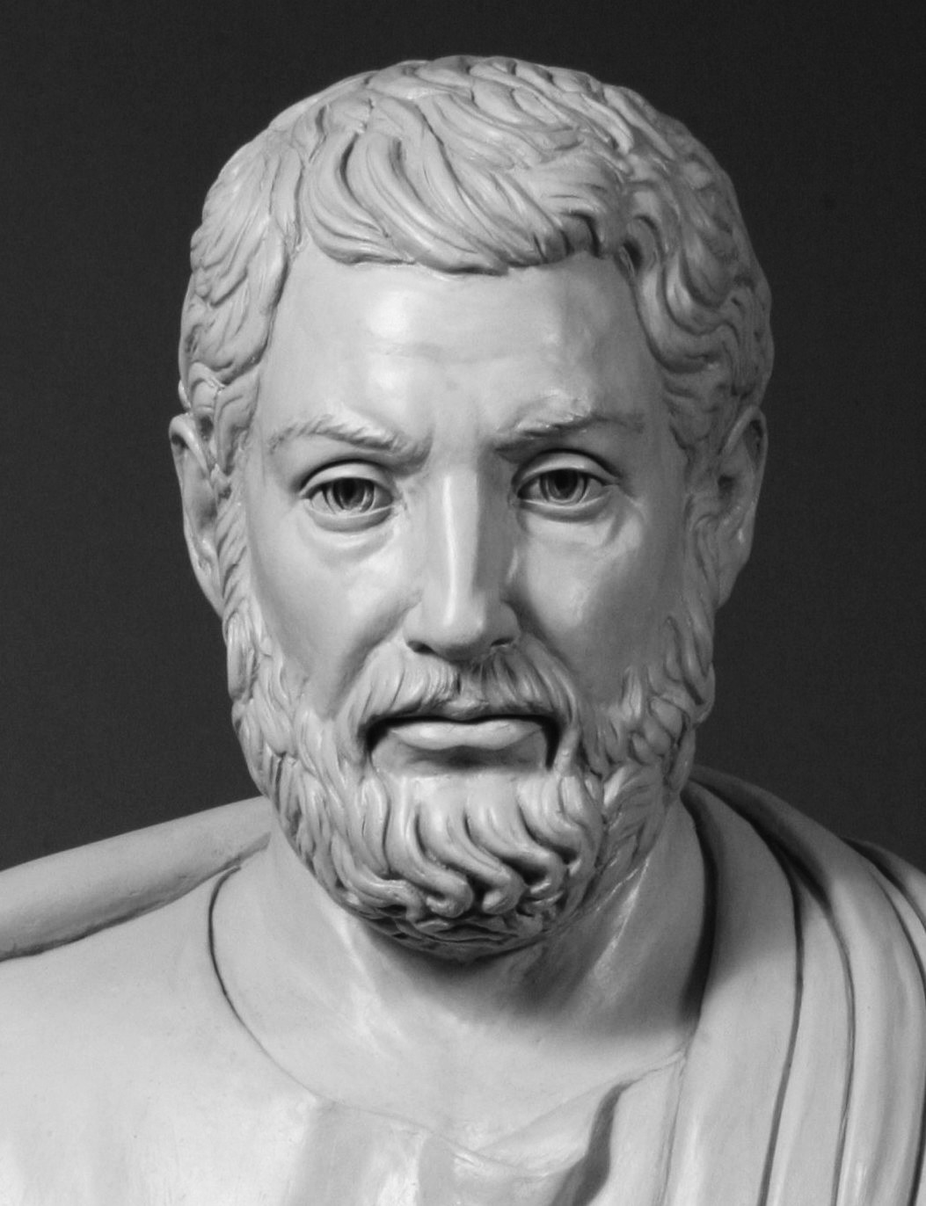
Athenian Democracy
Arose when Hippias, the last tyrant, was expelled from Athens in 510 BCE
Athenian aristocrat, Cleisthenes, introduced a new system of government in a bid to obtain popular support for himself

Slide 14
Main Features of Athenian Democracy
The redistribution of the citizens of Athens into artificial rather than ethnic tribes
The election of councilors by lot
The short term of office for political leaders
The sovereignty of the ekklesia (“popular assembly”)
The payment of political officers
Cleisthenes is also said to have introduced the practice into Athenian politics whereby the assembly could ostracize unpopular citizens from Athens for a period of ten years (ostracism)

Slide 15
Some Notes on Democracy
Despite the fact that democracy is now widely considered to be one of the most desirable constitutions, it was very unusual in Greek and Roman times
The wealthy, educated class was preferable to a radical democracy
Art of public speaking, rhetorica technē
Critics of democracy believed people could be easily influenced by this art
Most ambitious politicians diligently studied this art
Thucydides, History of the Peloponnesian War

Slide 16
Word Study
regent
reg-, Latin base from verb regere (“to rule”)
-ent, noun-forming suffix, agent function
acrophobe
acr-, Greek base, “high” (akros)
-phobe, English combining form, “one who fears” -phobos
senile
sen-, Latin base, “old” (senex)
-ile, adjective-forming suffix
demography
demo-, Greek base, “people” (demos)
-graphy, English combining form (-graphia)

Slide 17
What’s Next
Roman law and politics
Words & Ideas, Chapter 6, pp. 151-168
Homework 2 due by 8:30 (A), 9:30 (B) on Canvas

