Slide 1
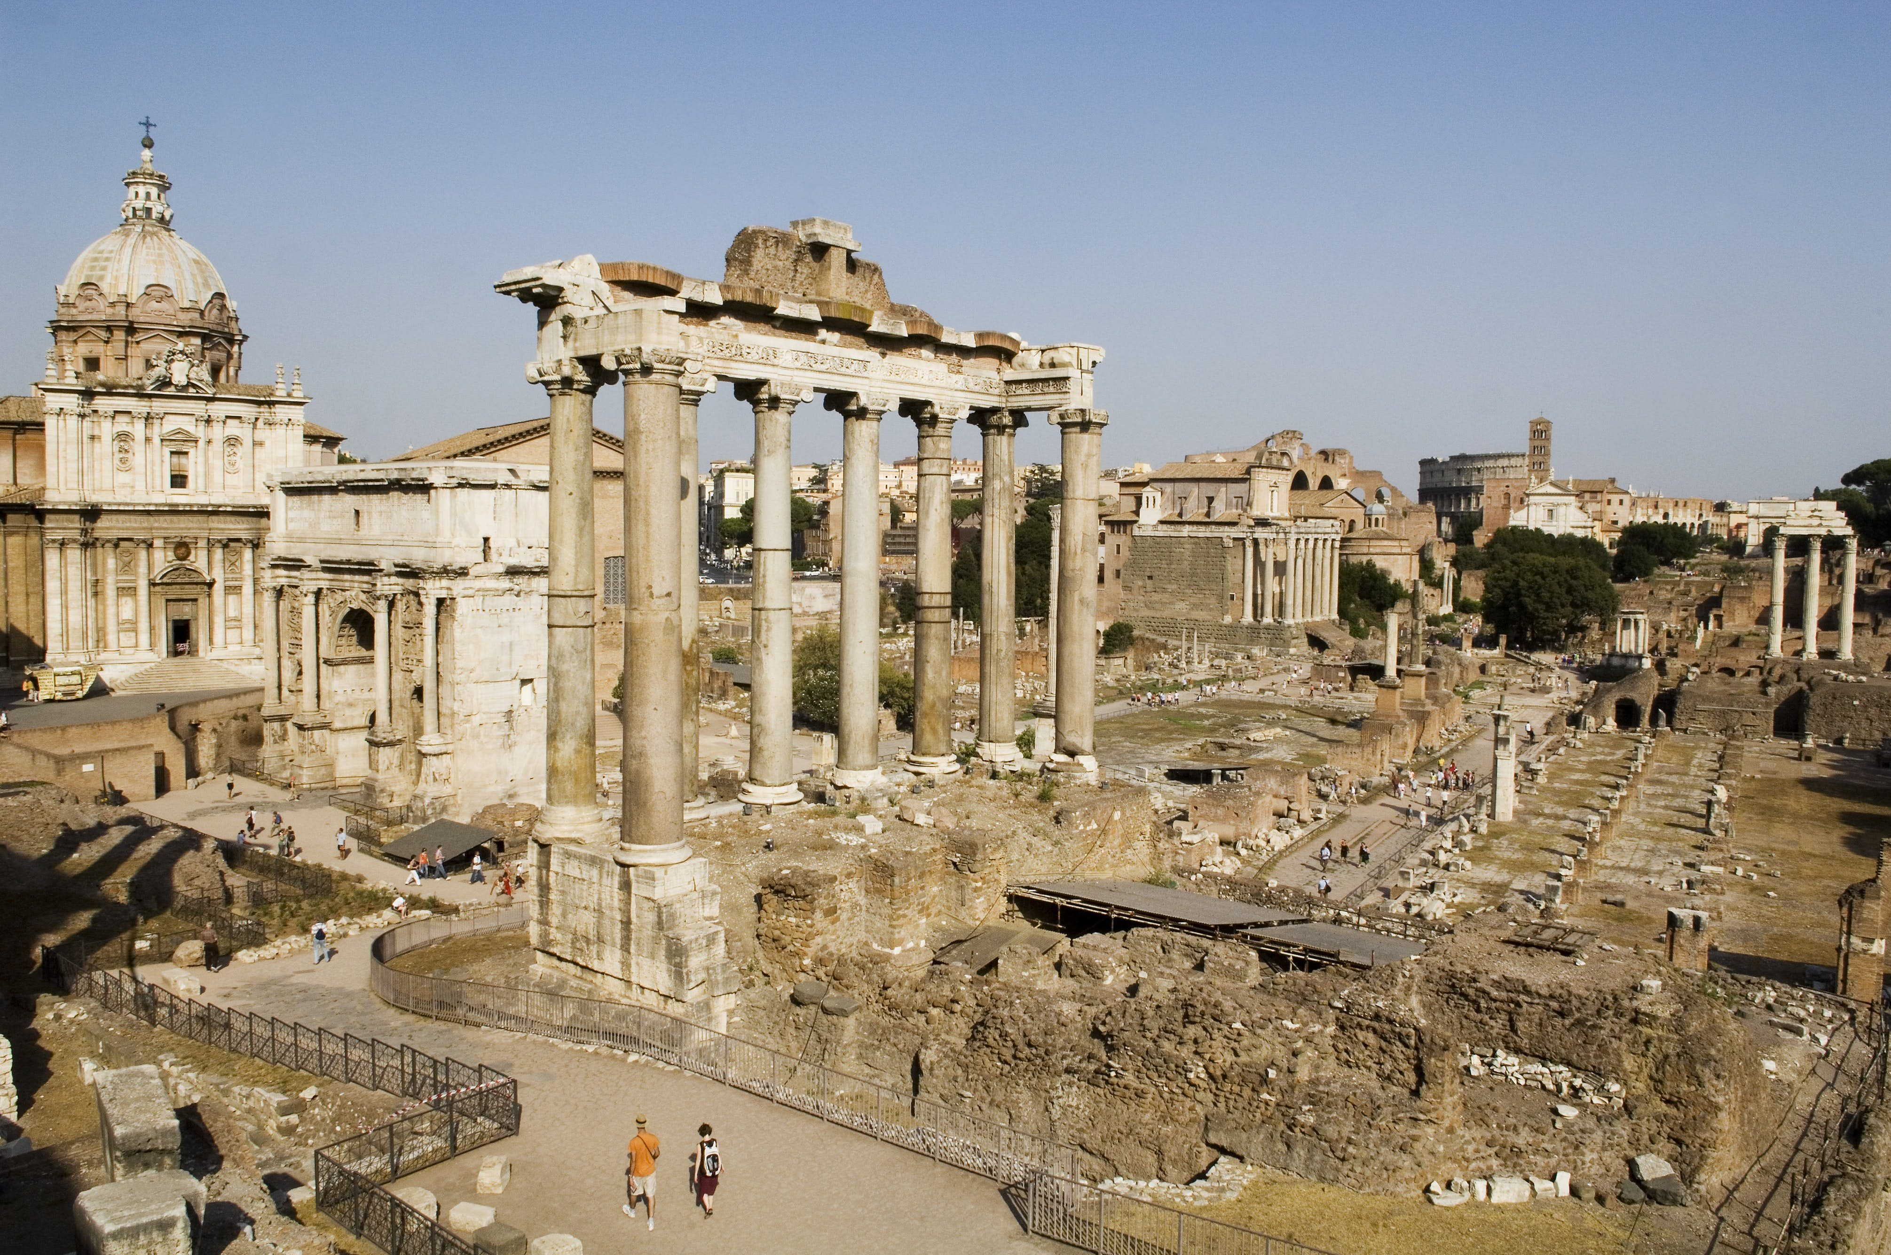
Roman Law and Politics
Words & Ideas, Chapter 6, pp. 151–168

Slide 2
Outline
Foundation Myths and the Founding of Rome
The Roman Republic
The Roman Class Structure
The Roman Empire
Roman Law
Latin Derivatives in Legal Vocabulary
Latin Legal Phrases
Word Study

Slide 3
Foundation Myth: Aeneas
Virgil’s Aeneid (book 2 covers the destruction of Troy)
Aenas: Trojan prince who fought in the Trojan War, but flees
Son of Venus and Anchises
Travelled to Italy and founded the city Lavinium (named after his second wife Lavinia)
Son is Ascanius/Iulus
  Julian family traces their lineage back to Aeneas (and therefore Venus
  Founds Alba Longa
  Eventually descendants will found Rome

Slide 4
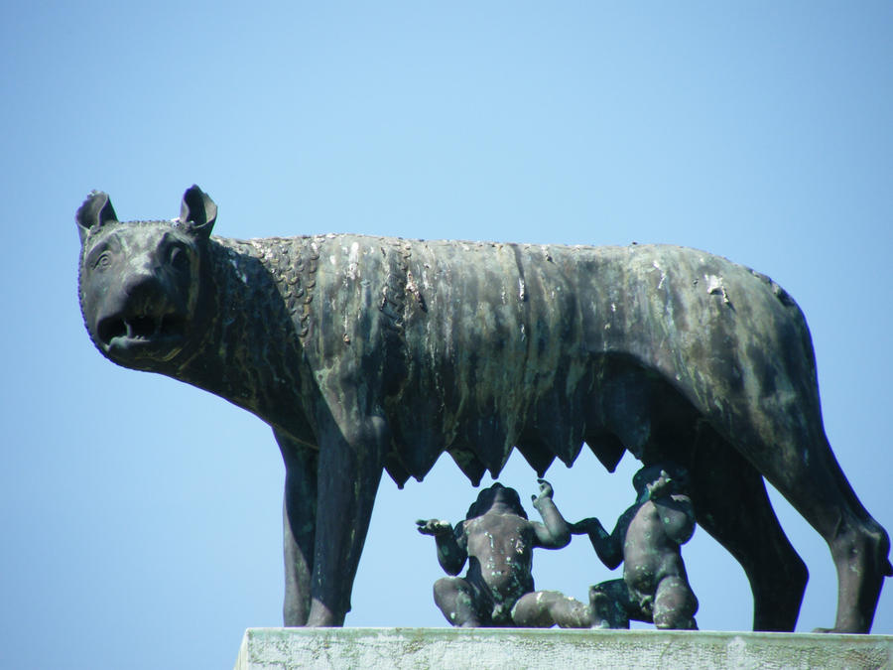
Foundation Myth: Romulus and Remus
Romulus and Remus
  Twin sons of Rhea Silvia (Vestal Virgin) and Mars
  Aeneas’ descendants
  Exposed as infants, but nurtured by a she-wolf (lupa)
  They overthrow their bad uncle Amulius and reinstate Numitor, their grandfather as king of Alba Longa

Slide 5
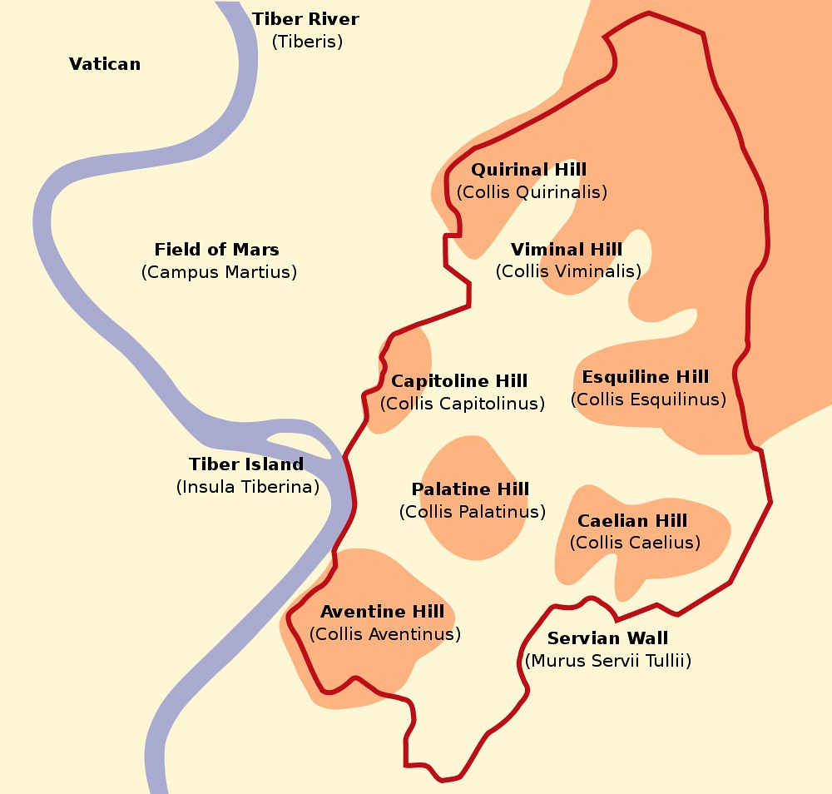
Founding of Rome and the 7 Hills
Romulus and Remus decide to establish a city, but disagree on where to locate it
  Romulus — Palatine
  Remus — Aventine Hill
Romulus kills Remus because of a conflict over an omen, becomes the first king
Legendary founding date for Rome: April 21, 753 BCE
  But! Earlier settlement and burials exist
Romulus = little Rome, (diminutive form) so he must have been named after Rome and not the other way around

Slide 6
The Roman Republic
The Romans first referred to their system of government as a “Republic” (res publica, “the affairs, or property, of the people” but literally “the public thing”)
  Modern term means “a form of government in which the people or their elected representatives possess the supreme power” and is virtually synonymous with “representative democracy”
Value of libertas (“freedom”) in Roman democracy
Libertas in Rome meant the freedom of the wealthy, political classes to compete for political office without the domination of a monarch

Slide 7
The Roman Republic cont’d
Libertas was to secure this political freedom that the kings had been driven out of Rome (an event traditionally dated to 510 BCE)
  Tarquinius Superbus was the last of the 7 kings
  The king’s son Sextus Tarquinius assaults Lucretia
  She kills herself after telling her father and brothers
  Event leads to overthrow the monarchy
Lucius Junius Brutus founds the Republic and becomes one of the first consuls in 509 BCE
  Visit to the Oracle at Delphi prophesies Brutus’ consulship
  His descendant Brutus is one of Julius Caesar’s assassins
  Note: 509 BCE coincides with the start of Athenian democracy under Kleisthenes

Slide 8

The Roman Republic cont’d
Roman Republic was a mixed constitution consisting of executive magistrates, an advisory Senate drawn from the wealthy citizens, and popular assemblies
Aimed at achieving a balance of the competing elements in the state

Slide 9
Roman Magistracies
Magistracies were contested by the patricians (“founding fathers” of the state)
*Senior magistracies: consuls, praetors, and censors
  Consuls: executive power over the army
  Praetors: administer the law
  Censors: take census, review citizen body, award contracts
**Junior magistracies: quaestors, aediles, and tribunes
  Quaestors: administer the finances of the Republic
  Aediles: administer the city, roads, temples
  (Plebeian) Tribunes: veto legislation, convene Senate, help citizen
* Elected by the assembly of citizens in centuries
** Elected by the assembly of citizens by tribes

Slide 10
Roman Magistracies cont’d
The executive power (imperium) of the magistrates was symbolized by the fasces (a bundle of sticks containing an axe)
  Consuls were awarded 12 fasces
Dictators were appointed during times of political emergency and given 24 fasces
  Appointed for 6 months
  From dico (“to speak”)
  In the Roman context, the word did not always have these negative associations: the word simply referred to the person elected into the office of dictator

Slide 11
The Roman Class Structure
Classified the population according to a wealth requirement
Comitia centuriata (“assembled by centuries”) elected the highest officials (like consuls), declared war, enacted laws
Comitia tributa, citizens assembling in tribes
Majority vote by 193 centuries, centuries are assigned unequally among Roman citizens based on how much property they had
The richest people get 80 centuries (=votes) + second richest people get 18 centuries (=votes); proletarians only get 1 century (=vote)
Voting starts from the wealthiest centuries, so they always get their way

Slide 12
The Roman Senate
The Senate was very powerful
It was made up of ex-magistrates
Discussed and decided all issues of foreign and domestic policy
Did not have legislative authority (they could not enact laws)
However, it was responsible for discussing and drafting the laws to be proposed to the assembly
It was the Roman deliberative body of state

Slide 13
Who was a citizen in Rome?
Enslaved people were not citizens, but joined the citizen body when they were freed
Women could be citizens but could not vote
As the territory grew, there was constant tension about citizenship with the allies (by 100 BCE, allies were 2/3 of the army)
Even when people outside of Rome received the right to vote, there is a geographical barrier because of direct democracy

Slide 14
The Roman Empire
The Roman army (exercitus) was superior to any other with the Mediterranean basin
Established control over Italy by means of colonies (coloniae), treaties (foedera), free tributary states (municipia), and the client-patron relationship (clientia) with other tribes
After many wars against rival powers in the Mediterranean (Carthage, the Hellenistic kingdoms, and developing nations such as Gaul, Britain, and Germany), Rome came to power

Slide 15
The Roman Empire cont’d
Julius Caesar (100-44 BCE), popular leader, politician, etc.
  Leads military campaigns in Gaul (58-50 BCE)
  Writes De Bello Gallico, with annual updates
First Triumvirate
  Unofficial political alliance between 3 men (tri + vir)
  Julius Caesar, Pompey, Crassus
JC enters Italy with army and starts civil war with Pompey
  Crosses the Rubicon River in 49 BCE (alea iacta est, “the die is cast”)
  Battle of Pharsalus in 48 BCE, victory for Caesar
  Pompey flees to Egypt, but is beheaded
JC is appointed dictator for life (dictator perpetuus) in 45 BCE
Assassinated in 44 BCE on the Ides of March (15th)

Slide 16
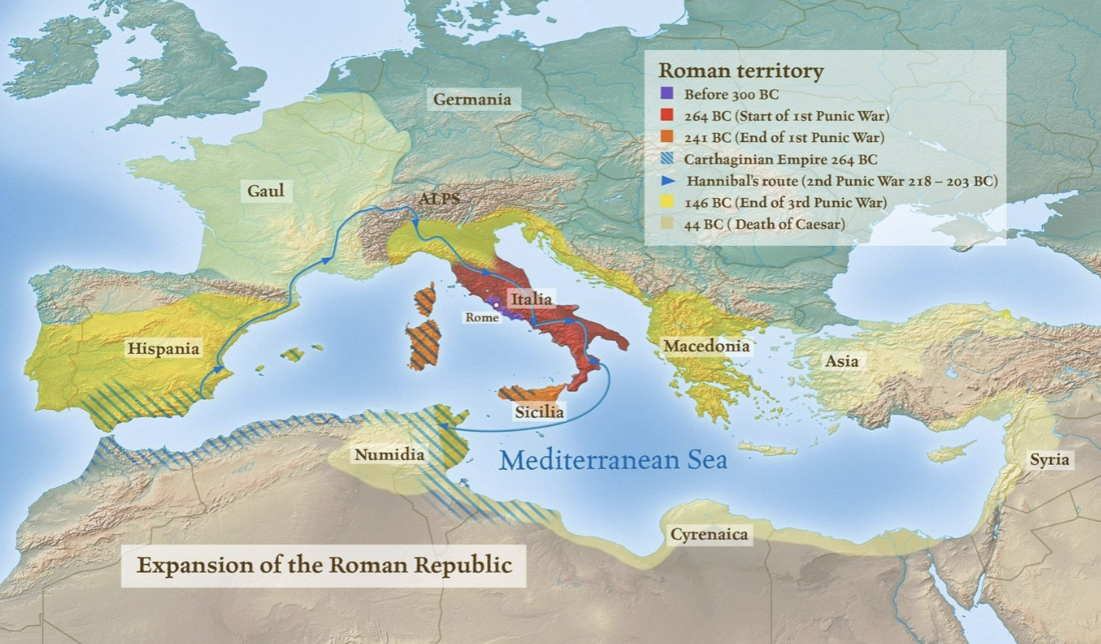

Slide 17
The Roman Empire cont’d
Second Triumvirate
  Octavian (Augustus), Mark Antony (supporter of JC), Lepidus
  Hunt down Caesar’s assassins
Civil war breaks out between Antony and Octavian
Octavian defeats Antony and Cleopatra at the Battle of Actium in 31 BCE
Octavian becomes the first emperor of Rome
Began the Principate (princeps “first-citizen) and opted for a dyarchy (system of government where the power is shared between the Senate and the emperor)
Granted the title Augustus (“the majestic one”) by the Senate in 27 BCE

Slide 18
The Golden Age of Rome
Augustus (27 BCE-14 CE)
Promises a “Golden Age” or Rome (pax Romana)
Promotes himself as the restorer of traditional Roman values
  Moral legislation that leads him to exile his daughter Julia
Claims that he restored the Republic
Sponsors literature, Vergil writes for Augustus
Transforms the physical city with extensive temple restoration program and construction
  Suetonius says that Augustus “Found Rome a city of bricks and left it a city of marble”
  Forum of Augustus and Temple to Mars Ultor (“the avenger”)

Slide 19
Roman Law
Latin word for law is lex (the base of the extended form is leg-), which in its general sense refers to a “contract, a set form of words, a binding agreement” and can specifically denote “a law that has been passed by an authoritative body”
Augustus as princeps
Reign of Emperor Justinian (527-565 CE), the great legal code, the Corpus Iuris Civilis, was compiled
  Purpose was to preserve the law for posterity and also to assist the education of law students
Corpus Iuris Civilis consisted of four main sections
  The Digests or Pandects
  The Institutes (first principles in the law)
  The Codex (imperial statutes)
  The Novellae Constitutiones (Justinian’s new legislation)
Roman law was largely eclipsed by the laws of the Germanic kingdoms of Western Europe during the sixth to eleventh centuries
Revitalization of Roman laws occurred in the eleventh century

Slide 20
Latin Derivatives in Legal Vocabulary pp. 160-162
Latin Legal Phrases
pp. 163-164
Word Study!

Slide 21
What’s Next
Commerce and economics
Words & Ideas, Chapter 7, pp. 169–189

