Slide 1
Commerce and Economics
Words & Ideas, Chapter 7, pp. 169–189

Slide 2
Outline
Ancient Economic Theories
Agriculture in the Ancient World
Financial Systems
Greek Trade and Transport
Roman Trade and Transport
The Role of Slavery in the Greek and Roman Economies
The Role of Technology in the Greek and Roman Economies
Word Study

Slide 3
Ancient Economic Theories
Economics is concerned with the scarcity of resources available to a community and how these resources are allocated
Farming
Hesiod, Works and Days
Oikos (“house”)
Each household—family, enslaved people, land, animals, other property—aimed to be self sufficient
Under the master (“despotes”)
Definitions of price, money, sales, and loans in Roman law
Laws of supply and demand
Agriculture!!
ager, “field,” “land”
cultura, “cultivation,” “tillage,” “care”

Slide 4
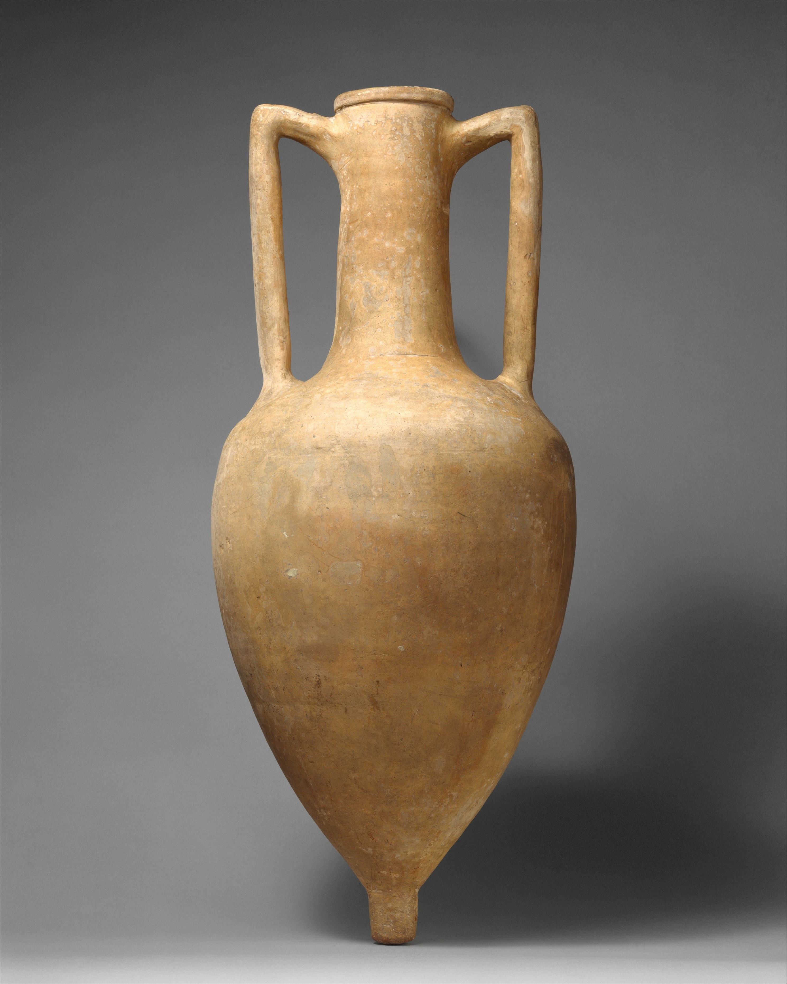
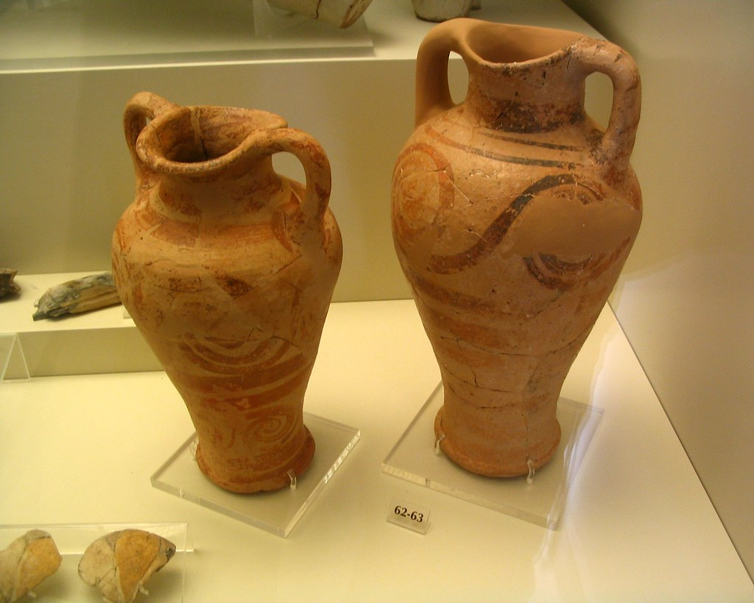
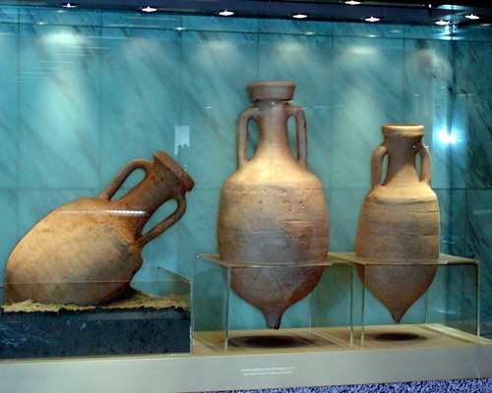
Greek Agriculture
Concentrated mainly on the cultivation of barley, grapes (wine), and olives (olive oil)
Grain had to be imported
This is because there was bad soil and arable land (though probably this was at least a little bit of an exaggeration)
All of these products would have been stored and transported in amphorae (sg. amphora)

Slide 5
Roman Agriculture
Small, but brought up by wealthy people
Animal and slave labor
Grain mills and ores (in mining) were designed to be driven by oxen or donkeys
Large estates worked by slave labor
Land regulations for citizens was ignored
The grain law (lex frumentaria)
Regulated by the Senate, though essentially a private market
Limited amount of grain supplied to Roman citizens at a fixed price
Most of the grain was imported from Egypt and Africa
Water was brought to the city by aqueducts such as the Aqua Appia (“Appian Aqueduct”)

Slide 6
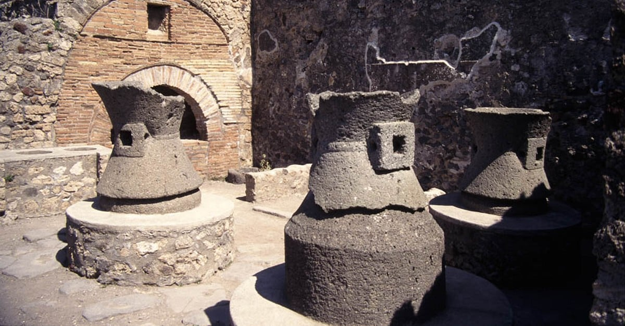
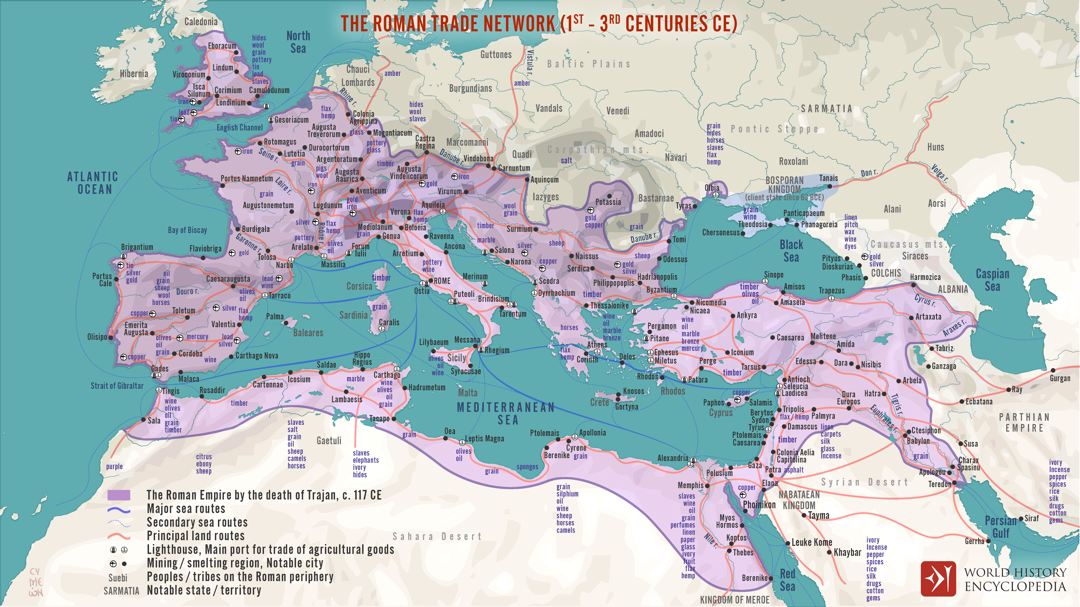
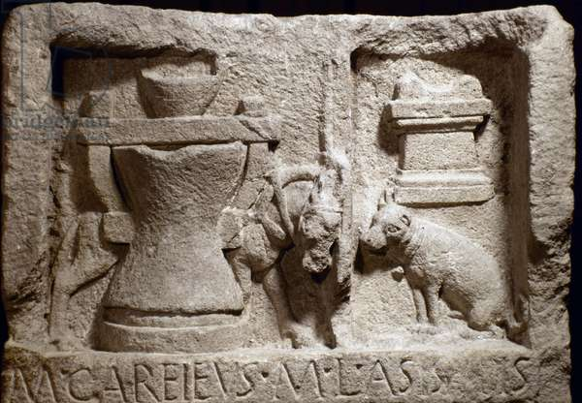
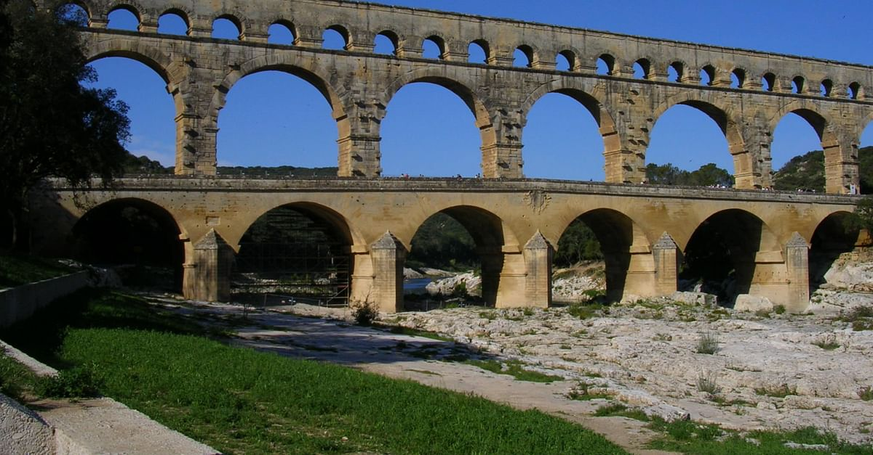
Grain mill
Map of the Roman trade network and aqueduct

Slide 7
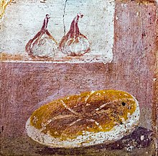
Roman Agriculture cont’d
The price of grain was gradually reduced in Rome until eventually it was distributed for free
Restrictions
Julius Caesar only allowed 150,000 citizens to receive the grain free
Feeding scheme in the first and second centuries
Purpose was to increase the birth rate with a view to the eventual conscription of young men into the army

Slide 8
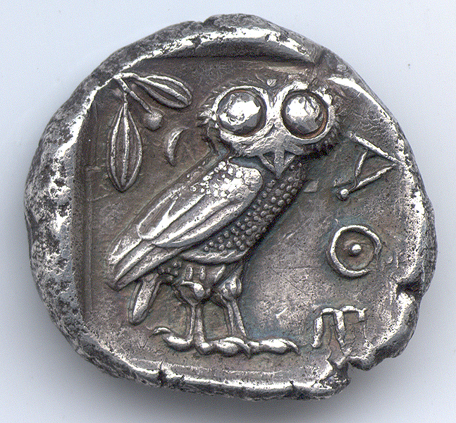
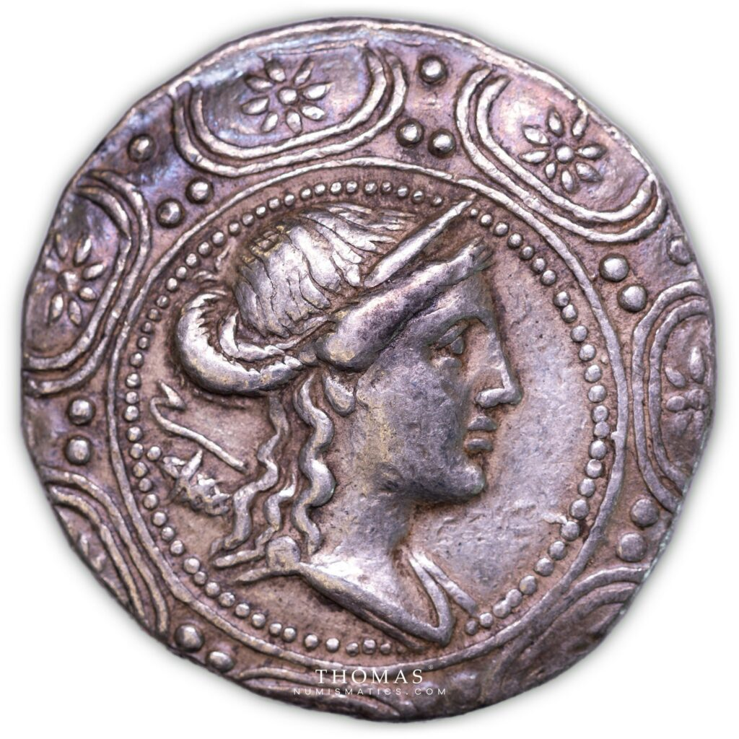
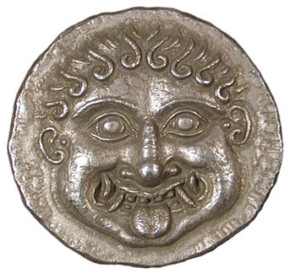
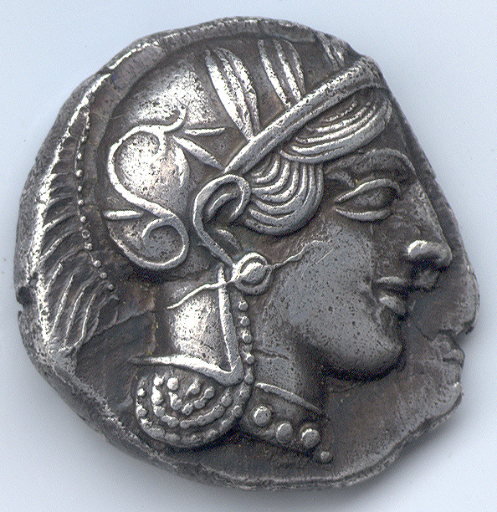
Greek Money and Coinage
Greek words for money
Talent (“balance”), obol (“spit” or “nail”), 6 nails making a handful (drachmē)
550 BCE, the practice of striking coins was established
The study of coins sheds light on social, political, and economic conditions
Differing values
Banking systems, private banks

Slide 9
Roman Money and Coinage
Roman words for money
pecunia (“money”)
litrae (“measuring scales”)
aes (“bronze”), aes rude (“rough bronze”), aes signatum (“marked bronze”), asses (“bronze coins”), denarius (“silver coin”), sesterius (“sesterce”), aureus (“gold”)
Coins were originally made from copper and were introduced into Italy from Sicily
Roman coins can also give important information about the provinces of the Roman empire
The writing on these coins often advertised the policy of the Senate, politicians, and emperors

Slide 10
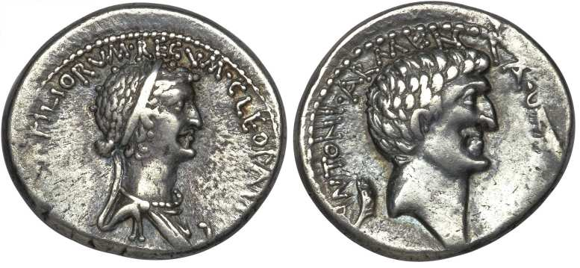
Cleopatra VII of Egypt (obverse) and Antony (reverse)
“Queen Cleopatra, new goddess” and “Antony, ruler and triumvir”

Slide 11
Roman Treasury and the Imperial Fisc
Subject nations paid tribute (tributum) to the Roman empire
Paid into the treasury (aerarium, “a place for bronze”)
Orginally administers by the quaestors with assistance of the scribes (scribae)
Praestors were later replaced by the prefects (praefecti)
Later, tribute was kept in the imperial fisc in each province that was managed by the procurators (procuratores) and fiscal advocates (advocati)

Slide 12
Roman Business
Public works of Rome were undertaken by the publicani (“contractors”)
Public contracts
Awarded by the censor
For provisions for the army, religious ceremonies, public buildings, etc.
Clubs
Originally religious in character, but later became political
collegia (college), scholae (schools)
patroni (patrons)

Slide 13
Greek Trade and Transport
Strength of the Athenian fleet
Trade was necessary due to the poor land conditions
Athens controlled the sea and certain imports such as timber and grain were essential and had to be protected
Africa, Carthage, Egypt
Controlled (or attempted to control) other marketplaces

Slide 14
Roman Trade and Transport
Trade was more limited in the Roman empire
Most trade consisted of the movement of raw materials and foodstuffs and this was often undertaken by the imperial government
pax Romana
Via Appia (“Appian Way”) 312 BCE, Via Flamina (“Flaminian Way”) 268 BCE, Via Aemilia (“Aemilian Way”) 187 BCE
Sea transport by freight
Major trade commodities, p. 181

Slide 15
Enslavement in Greece
Sources of enslavement: warfare, debt, inheriting parent(s)’ status
Athens: early on outlawed to enslave other citizens for debt
In Attica, enslaved to free ratio is estimated to be 1:4
In Athens, mining silver was done exclusively by enslaved people, and it was hard, brutal work
Sparta: helots, whole indigenous groups of people enslaved

Slide 16
Enslavement in Rome
Sources same as in Greece
At the end of the Republic enslaved:free was estimated to be 1:3
High presence of enslaved people in the country at villas
Manumission (“freeing” of enslaved people) was more prominent in Rome
Freed people became citizens with limited rights, their children were full citizens
Freed people became clients, former enslavers became patrons

Slide 17
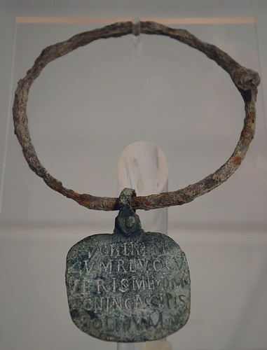
Zoninus Collar
The Zoninus Collar was an iron neck ring with an inscribed bronze tag (date: 4th or 5th c. CE)
Fugi, tene me.
Cum revoc(a)v-
eris me d(omino) m(eo)
Zonino, accipis
solidum.
I have run away; hold me. When you have
brought me back to my master Zoninus, you will
receive a gold coin.

Slide 18
Word Study
Review word study lists found in this chapter
Reference chapters 2 and 3
Practice, practice, practice!

Slide 19
What’s Next
Medicine
Read Words & Ideas, Chapter 5 (pp. 105–127) *stop reading at “Medical Terminology”
Quiz 2 on Tuesday, 11/14

