Slide 1
Medicine Pt. 2 Words & Ideas, Chapter 5, pp. 127–143

Slide 2
Outline
Medical Humor
Medical Terminology
Key Words Derived From Greek
Key Words Derived From Latin
Ancient Healing
Ancient Magic

Slide 3
Medical Humor
“The Laughter Lover” (Philogelos)
Recorded some jokes and anecdotes that circulated in antiquity
Described as “sick humor”
Reflect Hippocrates’ belief that “the doctor should have at his disposal a certain ready wit since a gloomy disposition is repugnant to the healthy and the sick”
Only a few are obscene or scatological, the tone of others can be described as skeptical, cynical, or disrespectful
Which may be attributable to the lack of confidence that some patients had in the medical profession

Slide 4
Medical Terminology
90% of medical vocabulary in English comes from Greek/Latin
There is a whole UW course about this! (Classics 205)
Some medical combining forms
ectomy = “surgical removal of” (ec ‘out’ + tom ‘cut’ + y noun suffix)
emia = “condition of the blood”
itis = “inflammation of”
oma = “tumor arising in or composed of”
pathy = “disease of” or “treatment of a disease”
Psychopathy vs hydropathy or homeopathy
Notes:
Atom (a + tom) a – not, tom – to cut, not cuttable, not dividable, the base unit of a chemical
Haima for blood in Greek

Slide 5
Medical Terminology cont’d
It helps to have a common language of knowledge and understanding among doctors and scientists
Medical terminology also helps simplify medical language
Ex. electroencephalograph “a medical instrument used for measuring brain waves”
electro + en + cephal + graph and the combining vowel “o”
Ensures precision of meaning
Complex, phobia, allergy
Formation of medical words examples (Greek and Latin)

Slide 6
Key Words Derived From Greek Suffixes and Combining Forms
Base | Combining Form | Word
append- (“appendix”) | -ectomy “surgical removal of” | appendectomy
tonsill- (“tonsil”) |  | tonsillectomy
leuk- (“white”) | -emia “condition of the blood”; occasionally, “congestion of blood in” | leukemia
septic- (“decay”) |  | septicemia

Slide 7
Key Words Derived From Greek Bases
Base | Word | Meaning
arthr- “joint, articulation” | arthritis | inflammation of joint
dendr- “tree”, “tree-like structure” | dendrologist | one who studies trees
nephr- “kidney” | nephrolith | kidney stone
phleb- “vein” | phlebectomy | surgical removal of a vein

Slide 8
Key Words Derived From Latin
Word | Meaning | Sample Use of Word
atrium (from atrium, the central courtyard of a Roman house) | one of the two upper chambers of the heart | atrium of the heart
cerebral (from cerebrum, “brain”) | relating to the brain | cerebral palsy
jugular (from jugulum, “collarbone,” “throat,” jugum “yoke”) | relating to the collarbone or throat | jugular vein
lateral (from latus, “side”) | at, towards or from the side | lateral movement

Slide 9
Ancient Healing
Steps to be cured from sickness:
1. Travel to an Asclepion
2. Make appropriate offerings and sacrifices to the god
*Votive offerings: body parts made out or clay or metal that represent the ailing body part (from Latin votum “vow”)
3. Sleep in a special dormitory (abaton) with sacred snakes
4. Tell dreams to priests in the morning to find out treatment
5. If you’re lucky, Asclepius will visit you in your dream and heal you

Slide 10
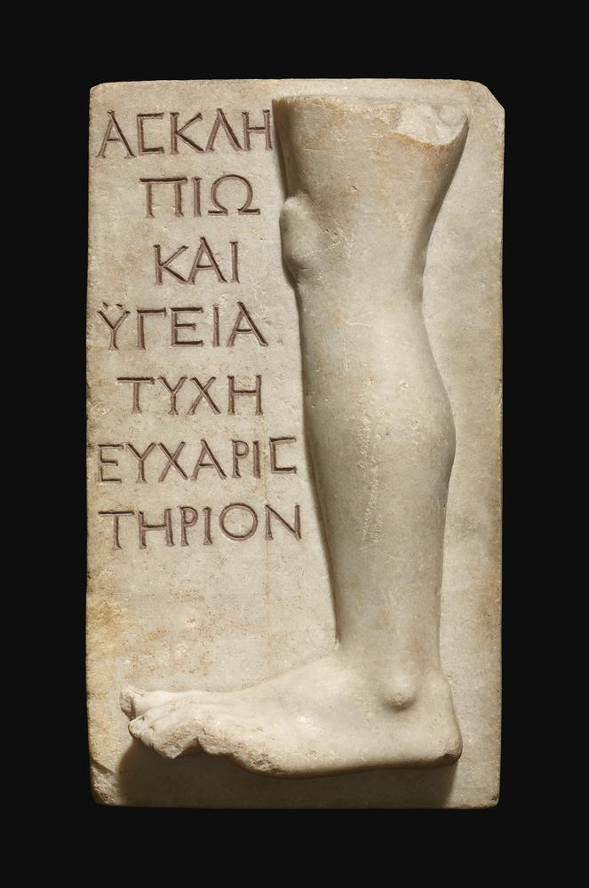
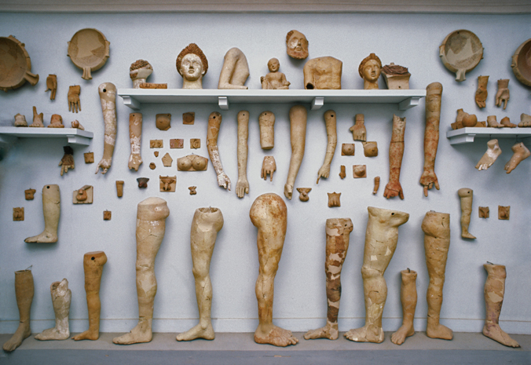
“An offering of thanks
(eucharisterion) to Asclepius,
Health, and Fortune”
Terracotta votive offerings

Slide 11
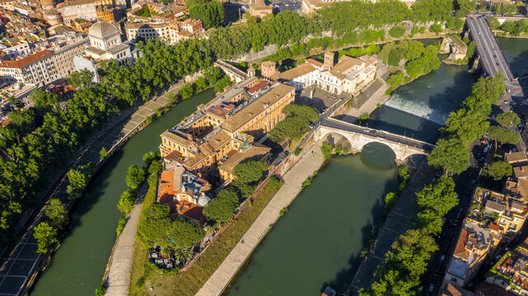
Temple to Asclepius on Tiber Island in Rome
Plague in Rome in 293 BCE
Romans consult Sibylline Books (a collection of verses that are supposed to predict the future)
Travel to Epidaurus and obtain statue of Asclepius
Roman process of evocatio “calling out”
The god turns into a snake on the ship
The snake slithers out into Tiber River in Rome
Romans establish temple to the god in that spot
There is a hospital in that location today

Slide 12
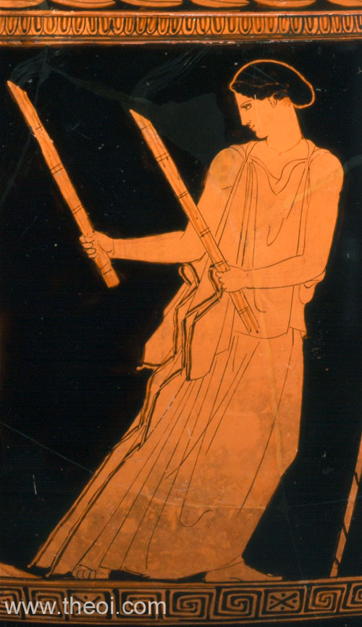
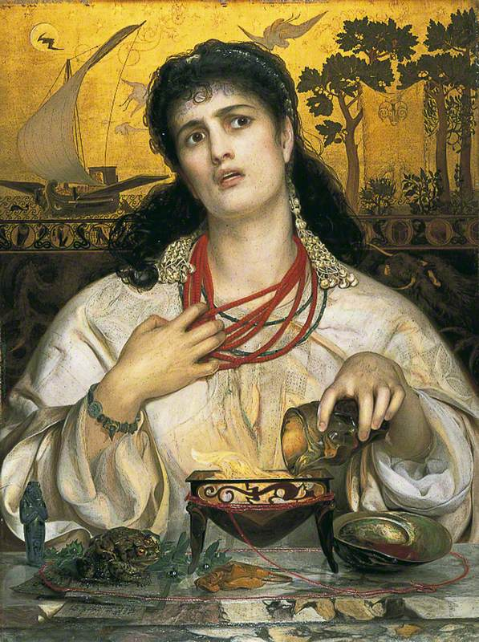
Ancient Magic
Magic was practiced widely in Greece and Rome
Hecate is the goddess of magic
In ancient literature, magical practitioners are usually women
Examples: Circe and Medea
Circe: Turns Odysseus’ men into pigs but also guides him to the underworld
Medea: Uses magic to help Greek hero Jason
Notes:
Medea (left) and circe (right) holding magic wands to turn men into pigs

Slide 13
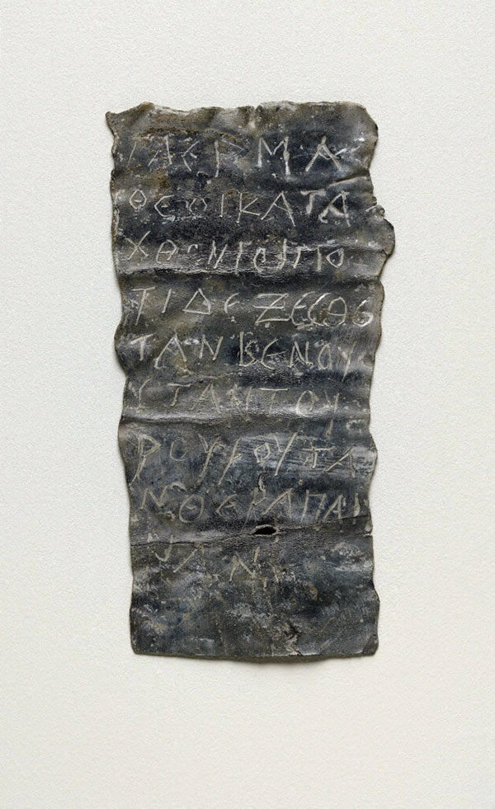
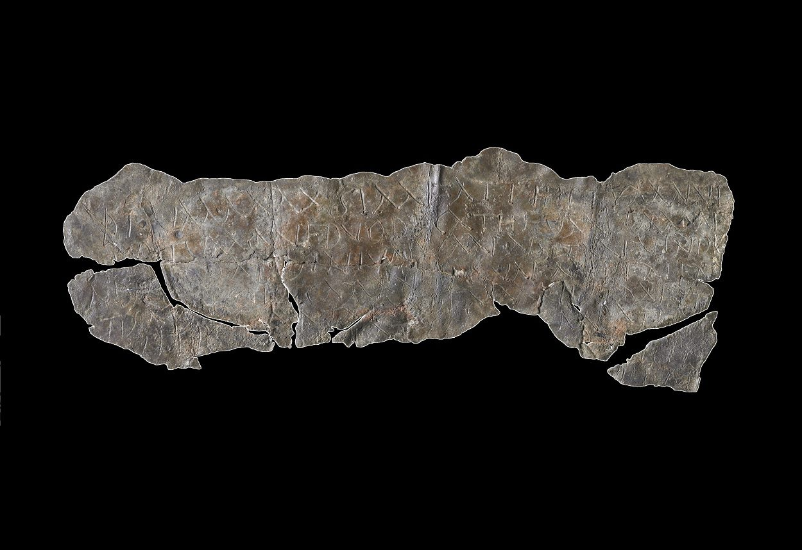
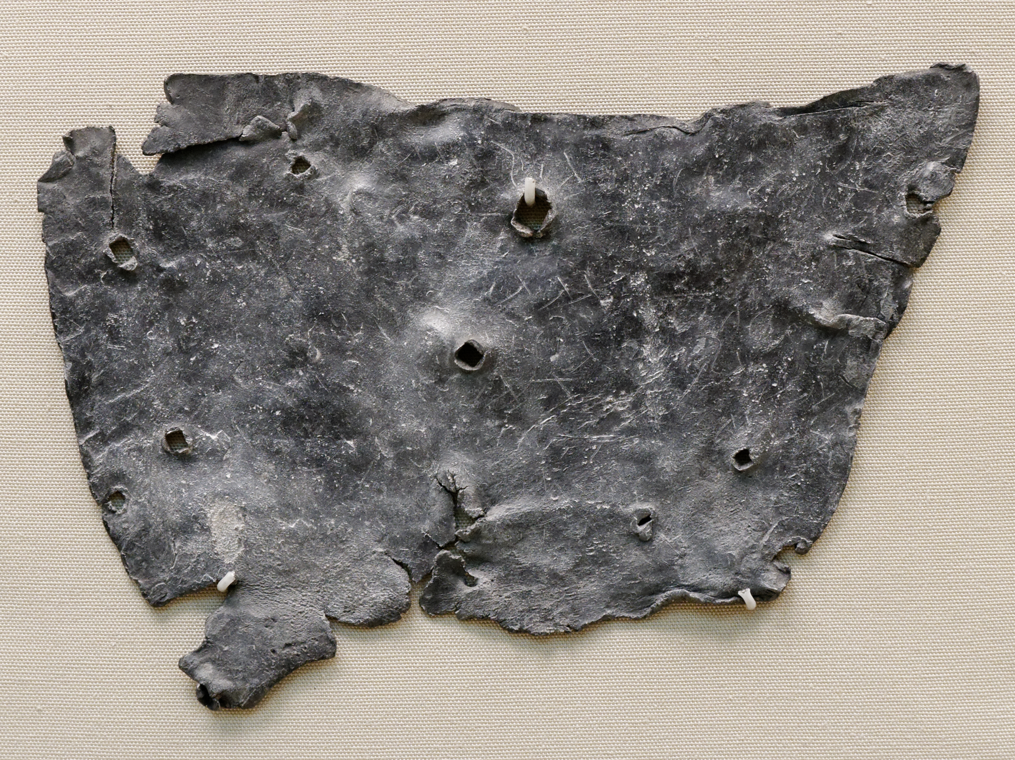
Curse Tablets
Curse tablets were a popular form of magic in the ancient world
Greek: katadesmoi
Latin: defixiones
Both related to the words for “binding”
Love, judicial, competitive, legal, and commercial uses
Notes:
Καταδέω – to bind up, defixiones – to fasten down (de)

Slide 14
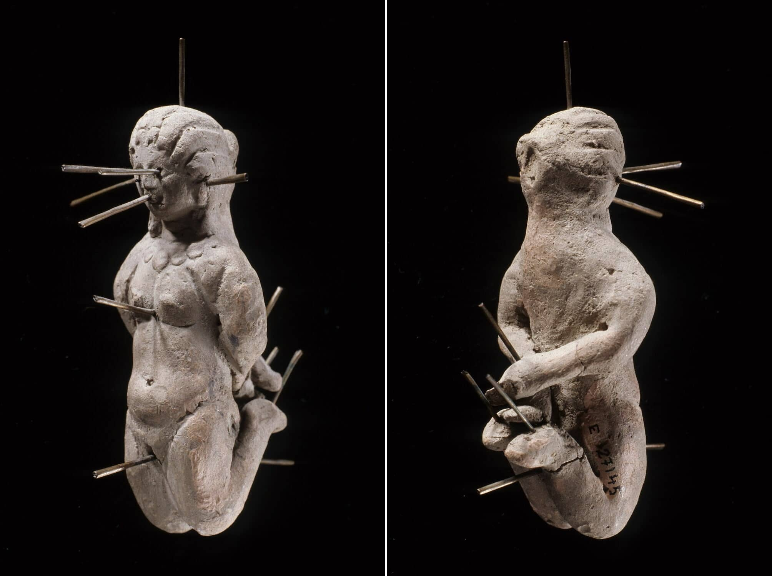
Curse Tablets cont’d
Used formulaic language to bind the victim
Written on lead tablets, nailed shut, and deposited in a well or grave
Some spells called for the victim’s hair/nails or dolls
Name of the victim would be scrambled
Ex: GAIUS = SUIAG
Louvre Doll
Found in a vase with a curse tablet

Slide 15
Erotic Curse Tablets at Hero Shrine in Nemea
“I turn Euboula (feminine name) away from Aineas (=Aeneas): from his face, from his eyes, from his mouth, from his chest, from his soul, from his belly, from his erect penis, from his anus, from all his body. I turn Euboula away from Aineas.”
*Ambiguity → is the unknown author interested in Euboula or Aineas?

Slide 16
Sample of Curse Tablets from Roman Britain
“I curse Tretia Maria and her life and mind and memory and liver and lungs mixed up together, and her words, thoughts and memory; thus may she be unable to speak what things are concealed, nor be able.” (translation: British Museum)
“Solinus to the goddess Sulis Minerva. I give to your divinity and majesty [my] bathing tunic and cloak. Do not allow sleep or health to him who has done me wrong, whether slave or free unless he reveals himself and brings those goods to your temple.”

Slide 17
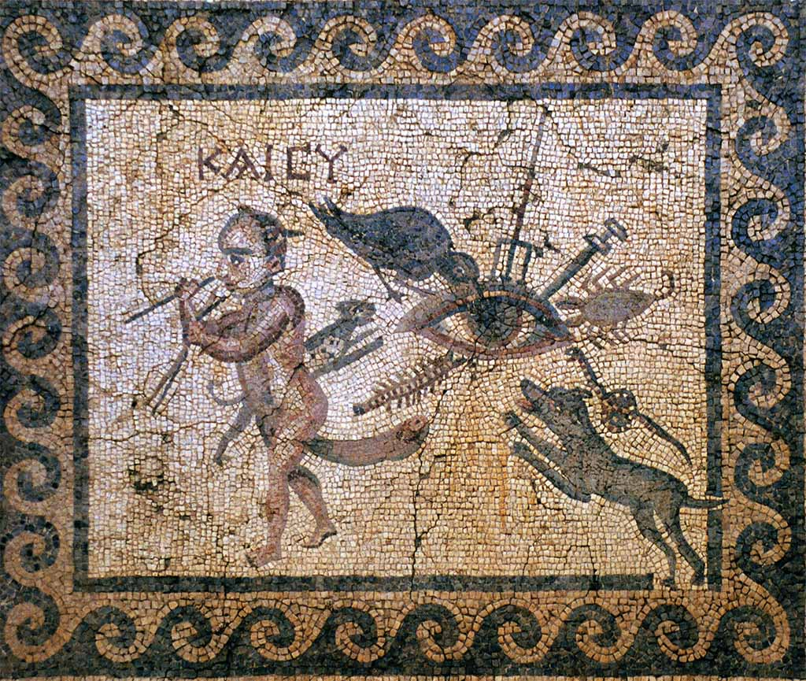
Amulets
Roman boys and girls wore amulets to ward off the evil eye and curses
Fear of the “evil eye” related to envy
Latin invidere “to look at (with malice)”, gives English “Envy”
Apotropaia: “things that turn away”
Symbols that ward off the evil eye

Slide 18
Make your own curse tablet activity!

Slide 19
What’s Next
Philosophy
Words & Ideas, Chapter 8, pp. 191–206

