Slide 1
Philosophy Words & Ideas, Chapter 8, pp. 191–206

Slide 2
Outline
Overview
Greek Philosophy
The Pre-Socratic Philosophers
Socrates
More Philosophers
Arete
Video and Activity

Slide 3
Overview
Philosophy
phil + o + soph + y
“love” + CV + “wisdom” + suffix
Universal, transhistorical questions
What is the best way to live?
What is the root of happiness?
What is justice?
What is the ideal state?

Slide 4
Greek Philosophy
Inquiry is essential to Greek philosophy
But also a fundamental inquiry of psychology
Nature and origin of the universe
Nature of man and ethics
Logos
Knowledge
Aspects of Greek Philosophy
Speculative and scientific inquiry
Practical application
Critical philosophy

Slide 5
The Pre-Socratic Philosophers
Pre-Socratic = before Socrates
Often referred to as “natural philosophers”
Interested in the natural world and how it looked
Tried to develop systems to describe nature’s fundamental laws
Looked beyond supernatural to reason
Pre-Socratic philosophers:
Pythagoras
Democritus
The Sophists

Slide 6
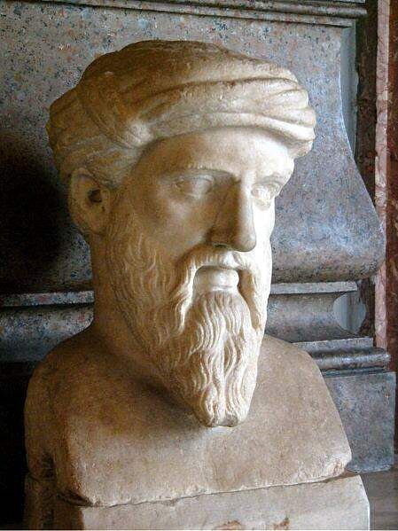
Pythagoras
Pythagoras of Samos, c. 570–495 BCE
Philosophy as a brotherhood and way of life
Pythagorean theorem and music
Immortality and transmigration of souls → vegetarianism
Universe was a living creature
Each individual contained a fragment of the divine whole that was trapped in the physical body

Slide 7
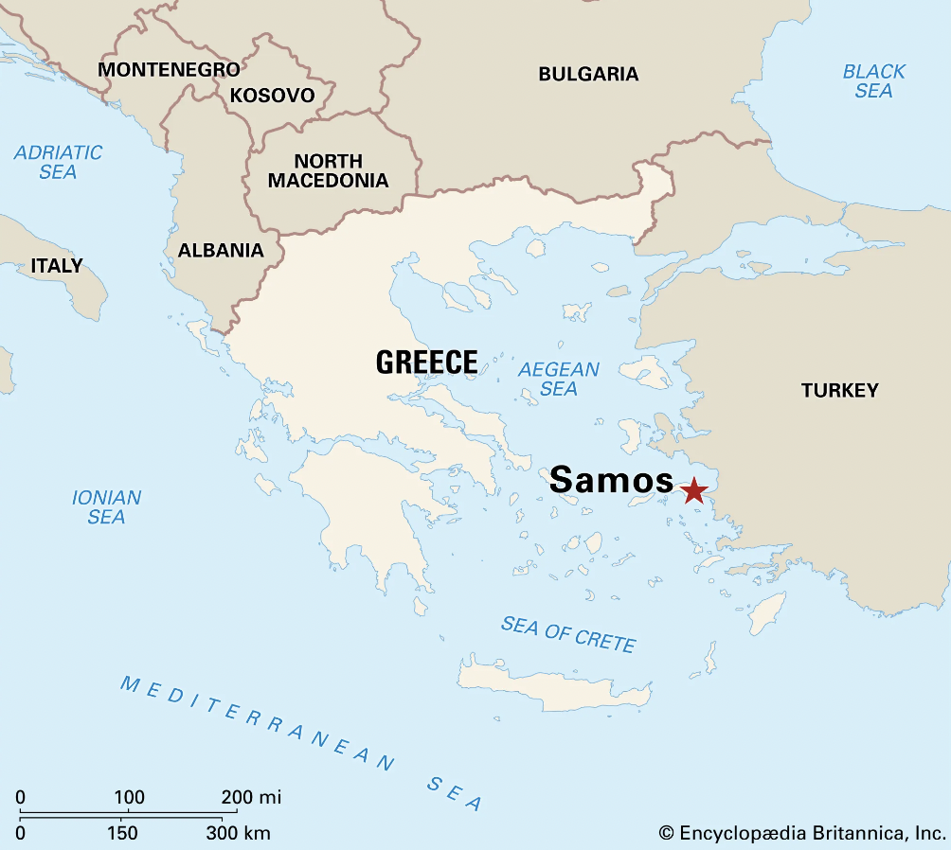

Slide 8
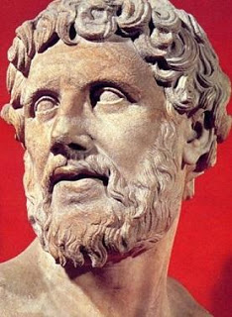
Democritus
c. 460–370 BCE
Atomic theory
Claimed the world consisted of atoms and particles
All in a constant state of motion
Different sizes
Chance combinations in varying densities make various forms of matter
a “not” + tom “to cut”

Slide 9
The Sophists
5th century BCE
Sophist: specific kind of teacher who travelled teaching skills for public life (such as rhetoric)
sophisticate, sophisticated
Taught arete (“excellence” or “virtue” for a fee)
Believed that perception is relative, no absolute justice or right or wrong
Skeptical about the possibility of absolute knowledge or truth
Criticized by Socrates
Some regarded them as immoral and subversive
Often maligned for making a weaker argument appear stronger

Slide 10
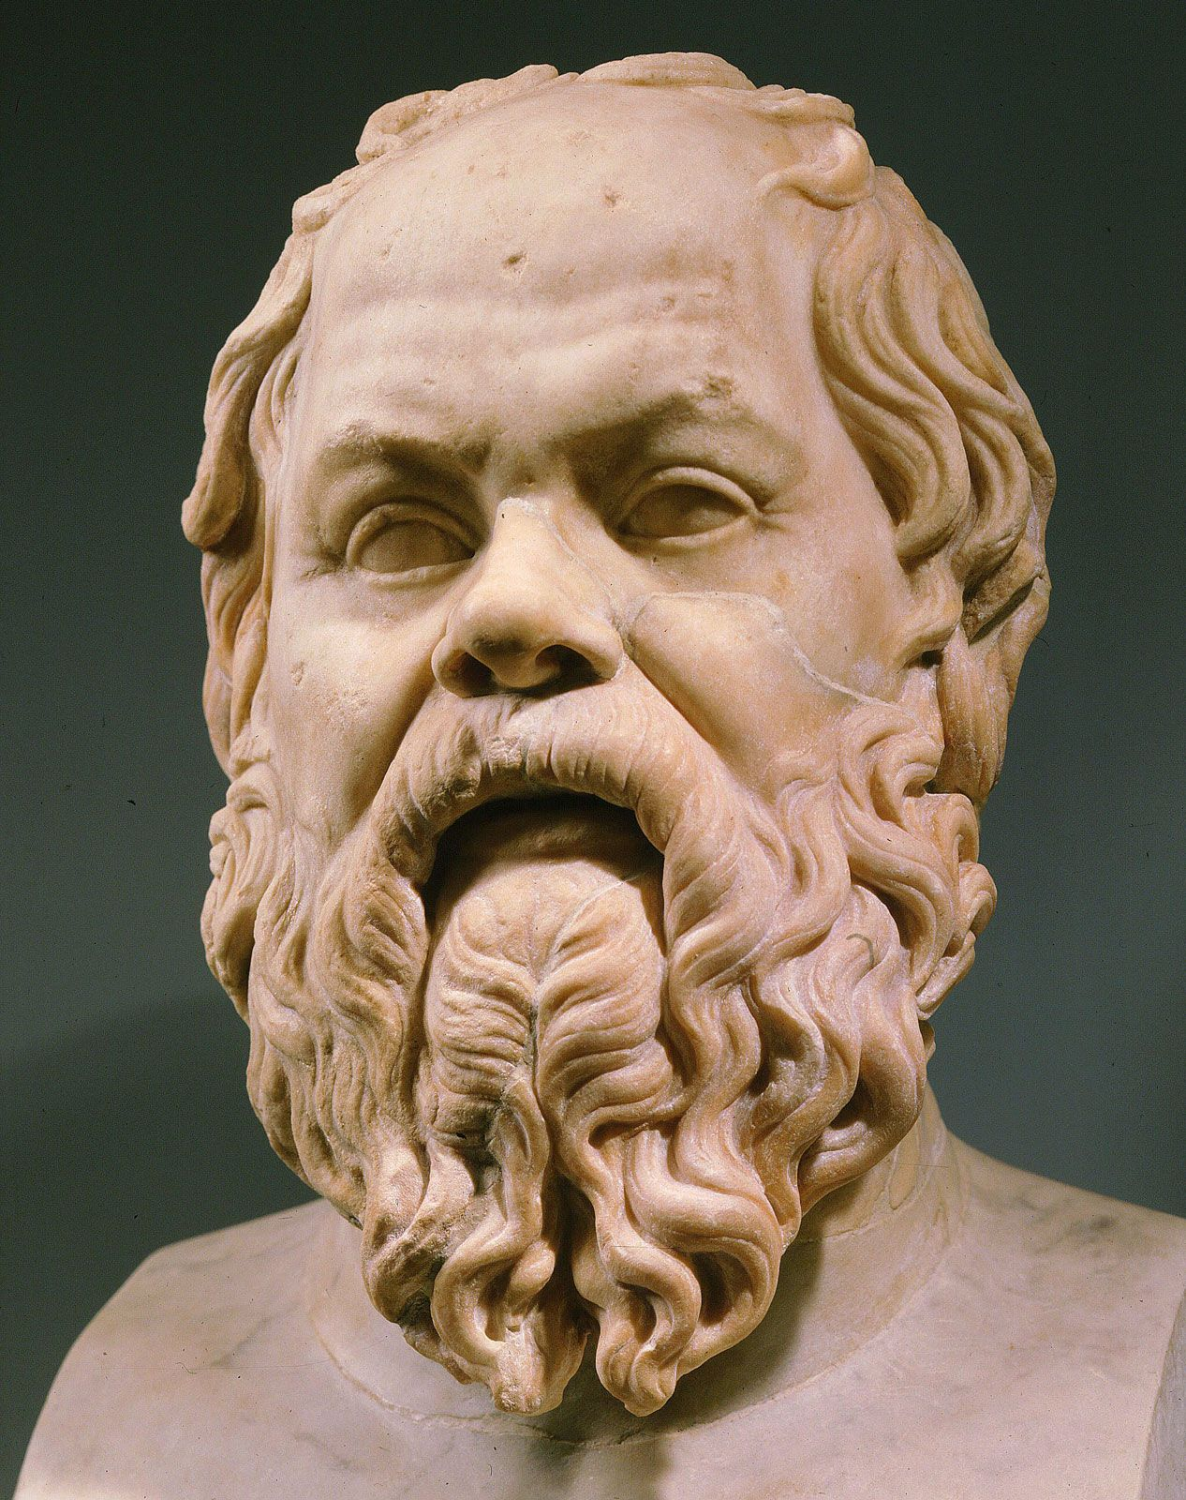
Socrates
469–399 BCE
Life and thoughts only known through writings of others (Plato, Xenophon)
Taught in public spaces: gyms, agora, outside
Wisdom is awareness of one’s own ignorance
Dialectic method (Socratic method): involves asking questions and using rules and models of reasoning to come to conclusions
“The unexamined life is not worth living” (Apology 38a)
Sentenced to death for impiety and corrupting the youth in 399 BCE
See Plato’s Apology
The trial of Socrates and Socrates’ defense speech

Slide 11
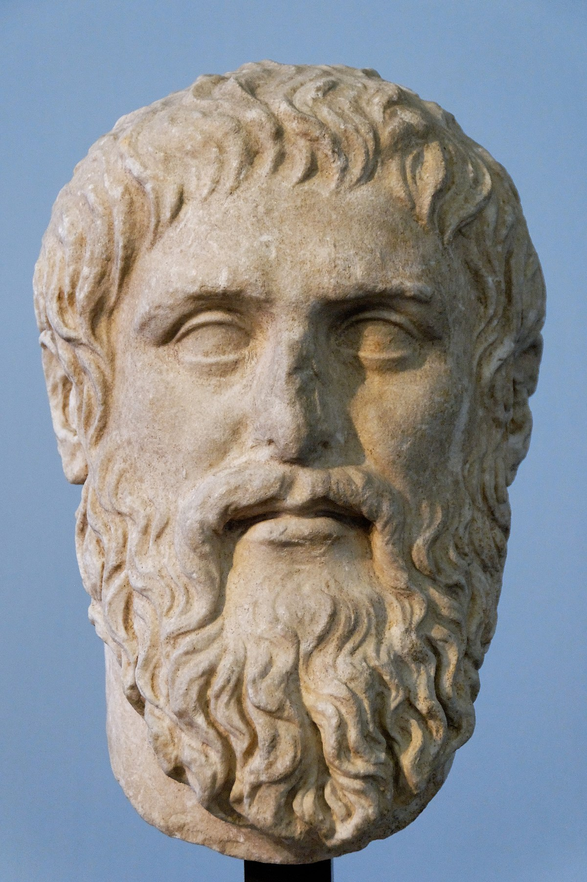
Plato
429–347 BCE
Pupil of Socrates
We know Socrates’ ideas through Plato’s writing
Platonic dialogues include Plato’s own ideas too though
Founded the Academy: first establishment of higher education in Greek and Roman world
Outlines that the ideal government is led by a philosopher-king in his Republic
Theory of Forms:
Sense perception is unreliable, and when we perceive a thing, we see only part of the whole picture
The perfect reality that underlies what we perceive is the true “form”

Slide 12
The Allegory of the Cave (Republic, Book 7)
Allegory: a story with a deeper meaning “speaking otherwise”
Imagine prisoners chained up in a cave watching shadows on a wall
A prisoner gets free and sees the real objects (not just the shadows)
Other prisoners are hostile towards this idea
Demonstrates that things in the physical world are flawed reflections of ideal forms
Shadows = physical world in our perception
Real objects = intelligible world that we can only access in our minds

Slide 13
Plato’s Symposium
Sym “together” + pos “to drink” + ium
Drinking party for elite men
Conversation on the nature of Love “eros” between various Greeks
Aristophanes, a comic poet, gives an etiology of sexual desire
Humans originally had 4 arms, 4 legs, two heads, etc.
Children of the Sun (man/man), Earth (woman/woman), and Moon (man/woman)
Cut in half by Zeus, with a future threat of cutting humans in half yet again (leaving one leg, etc.)

Slide 14
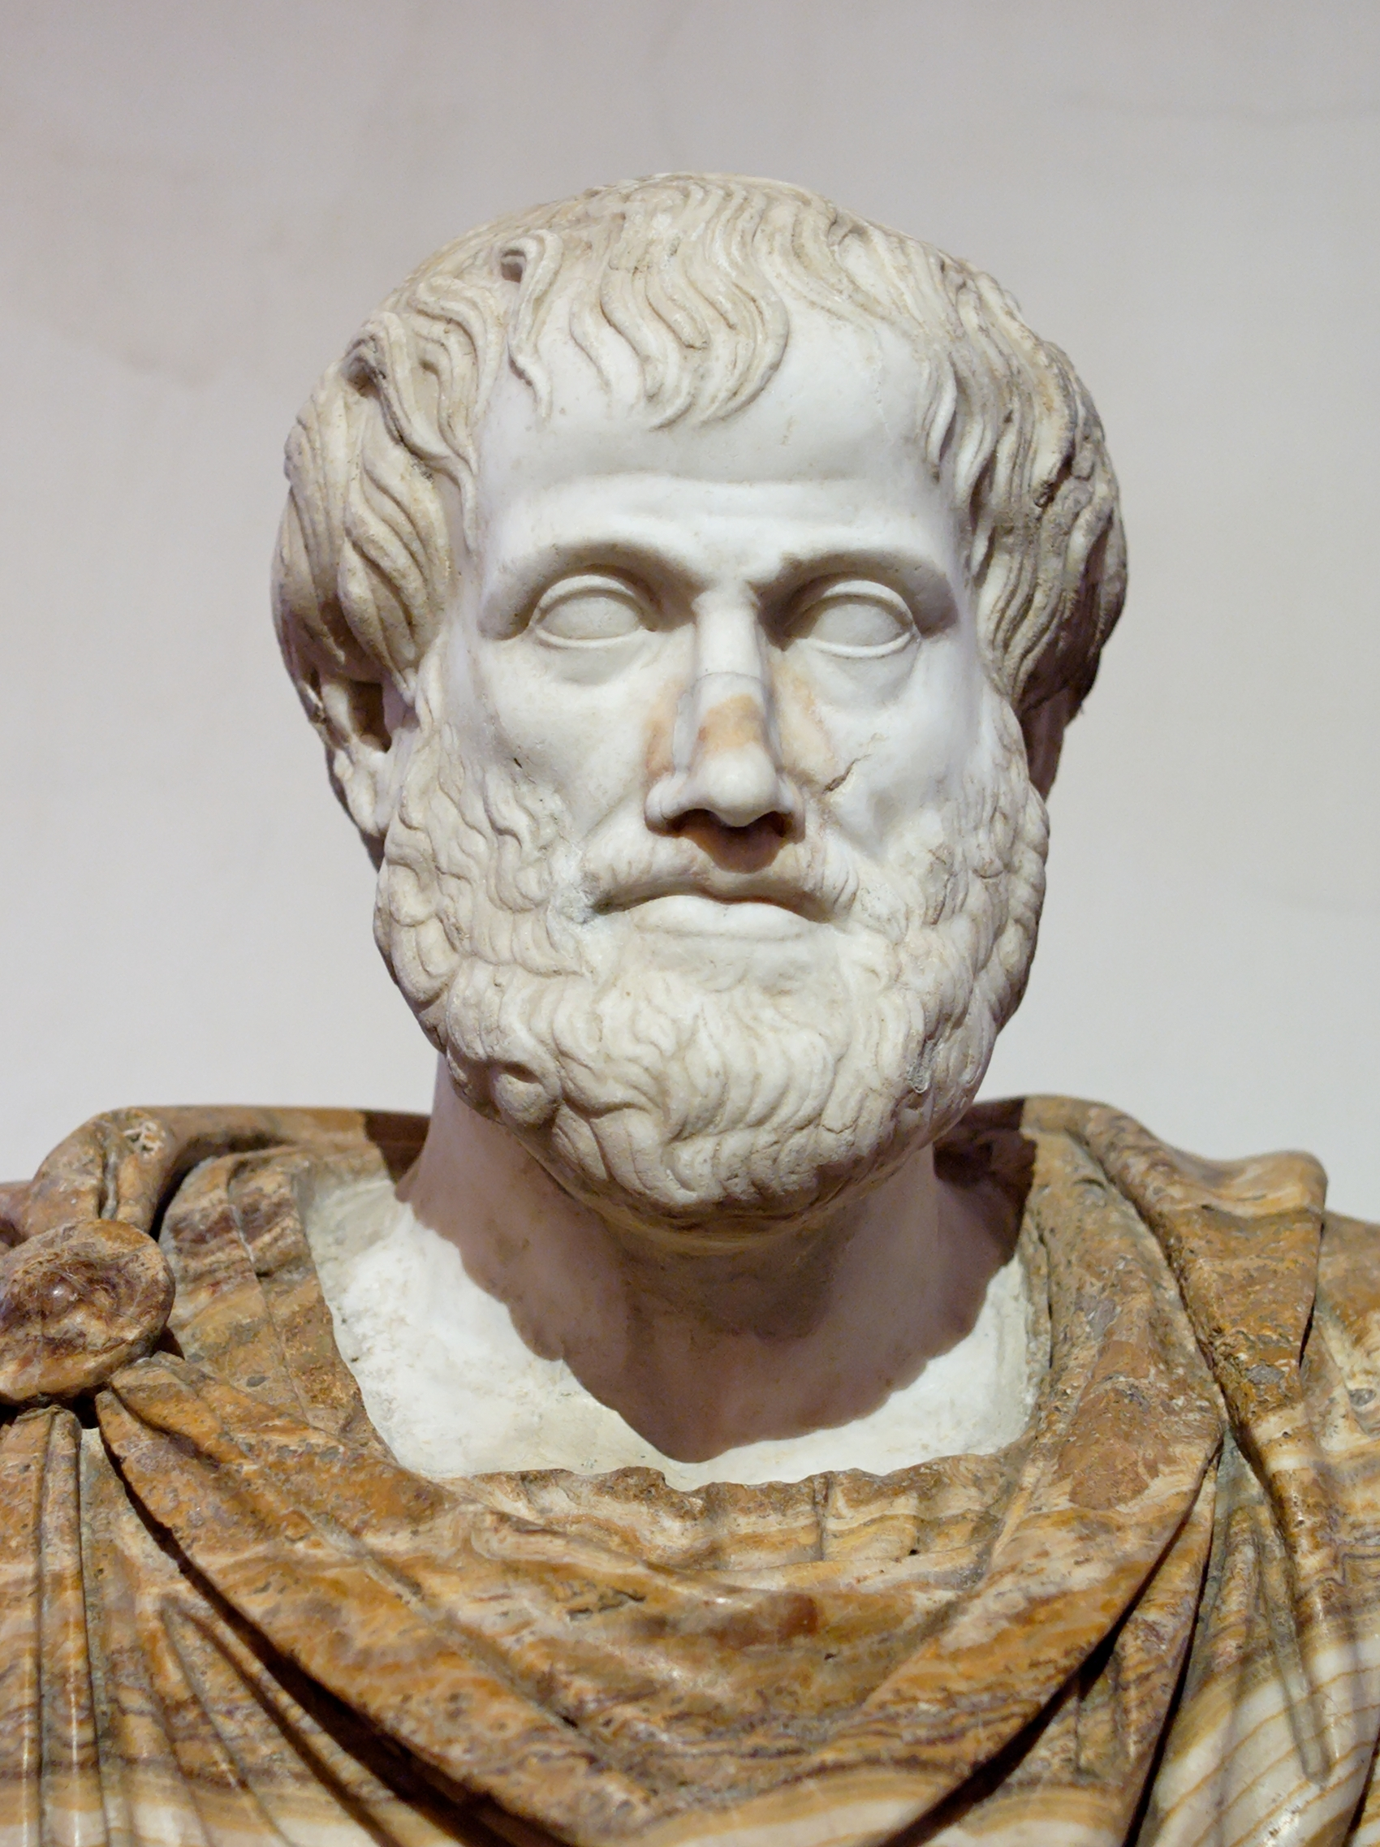
Aristotle
384–322 BCE
Pupil of Plato, succeeded him as head of the Academy
Tutor to Alexander the Great
Founded his own school called the Lyceum
Wrote about a range of intellectual interests
Literary criticism, biology, political studies, logic
Believed in the power of the human mind to perceive the basic nature of objective reality when assisted by:
Precise observations of natural phenomena
System of deductive logic

Slide 15
The Epicureans
Founded by Epicurus (341–270 BCE)
Continuation of atom theory: a soul is made of atoms and dissolves upon death (no afterlife)
No need to fear death?
Gods exist (and are made of atoms) but are not concerned with human affairs
Aim to avoid fear and anxiety (apatheia)
Advocates withdrawal from public affairs
Very popular reception in Rome
Lucretius (c. 99–55 BCE): Roman who wrote On the Nature of Things (De Rerum Natura), a didactic poem about Epicureanism
Many prominent Romans were likely Epicureans (e.g. Julius Caesar, Vergil, etc.)

Slide 16
The Stoics
Founded by Zeno (c. 333–262 BCE)
Name comes from the Stoa (covered colonnade) where Zeno taught in the Athenian agora
Everything happens in accordance with fate
Goal = happiness, achieved through avoidance of mental disturbances and excesses of emotion
Passions subject to control by reason
Involvement in public life for both personal and common good
English usage: a person who can endure pain or hardship without showing their feelings or complaining

Slide 17
The Cynics
Founded by Diogenes (412–323 BCE)
Supreme importance of individual freedom and self-sufficiency
Rejects social conventions
Despised pleasure, instead opted for an ascetic life
Derived from Greek word kyon (“dog”)
English usage: a person who believes that people are motivated purely by self-interest rather than acting for honorable or unselfish reasons

Slide 18
Arete
“courage” according to Homer
Generally, it meant “skill or efficiency at a particular job”
Sophists, teaching “efficiency”, not “virtue”
Arete anthropine, “human virtue”

Slide 19
Word Study Exercises

Slide 20
What’s Next
Psychology
Words & Ideas, Chapter 8, pp. 206–226

