Slide 1
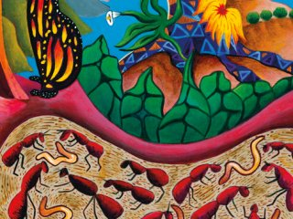
Environmental and heath impacts of herbicides in rhizosphere and human gut microbiomes
Indigenizing the Scientific Discourse

Slide 2

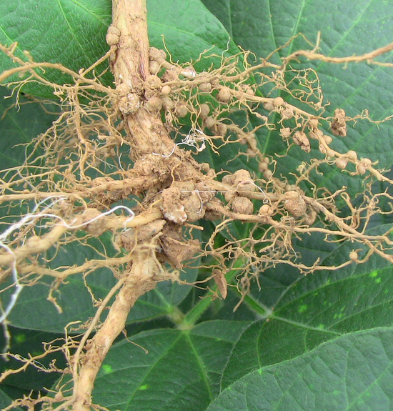
Guts and roots have large surface areas, with microvilli and folds or root hairs in some parts. Both roots and guts are structured, non-homogenous habitats with pH, nutrient, water, and oxygen differential levels or gradients. Gradients would favor colonization [sic] by distinct bacteria that are more successful in some root or gut regions. In consequence, the multiple microhabitats that exist in roots and guts contribute to high species richness.
  - Shamayim T. Ramírez-Puebla, et al. (2012)
Notes:
Decolonizing Note: A more appropriate term would be “co-inhabitation” rather than “colonization” which avoids the anthropomorphic qualities of the latter term.

Slide 3
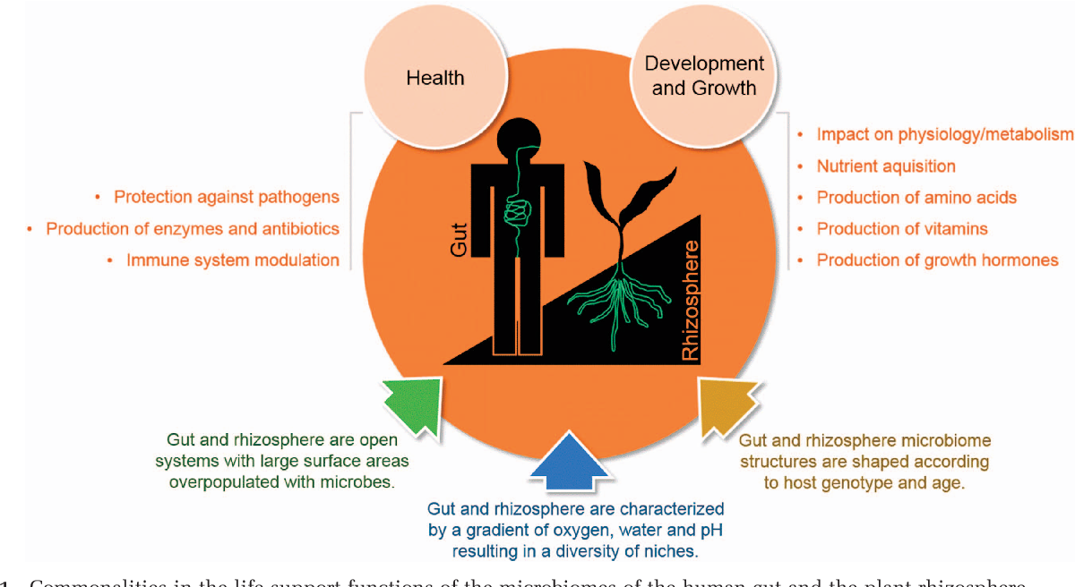
Commonalities
…root microbiome[s] might assemble by core ecological principles similar to those shaping the mammalian microbiome in which core phylum level enterotypes provide broad metabolic potential combined with modest…host genotype-dependent associations. (Ramirez-Puebla 2012:2)
Notes:
Explanatory note: Core phylum level enterotypes. Enterotypes are a classification of living organisms based on its bacteriological ecosystem in the gut microbiome. The discovery of three human enterotypes was announced in the April 2011 issue of Nature by Peer Bork and his associates. Taxonomic levels include kingdom [sic], phylum or division, class, order, family, genus, species.

Slide 4
Commonalities of Rhizosphere and Human Gut Microbiomes
Per Ramirez-Puebla et al. (2012:1-5)
Soil and Gut are Living Systems
ENVIRONMENTAL AND MATERNAL ACQUISITION
Back-ups & ‘Minorities’ matter
FUNCTIONAL REDUNDANCY AND ROLE OF MINORITIES
Nurturing Bugs Welcome
GUT AND ROOT BACTERIA ENHANCE THE METABOLIC CAPACITIES OF THEIR HOSTS
The Interactiive Common
SIMILAR BACTERIUM-HOST INTERACTIONS IN GUTS AND ROOTS
Bugs help us evolve & adapt
EVOLUTIONARY PATHWAYS
Shared Outcomes
Gut and root microbiotas significantly impact health, development, and fitness of their respective hosts.
Notes:
Ramirez-Puebla (2012: 2):
In a few cases, microorganisms can be transferred vertically from mother to progenies. Endophytes present in plant seeds may subsequently colonize the roots and the rhizosphere. Enterobacter asburiae, found in maize kernels, is able to exit the roots and colonize the rhizosphere after the plant has established (61). Other seed bacteria do the same (54, 62). Animals can also acquire their gut micro- biota from their mothers after being born, but there are cases of paternal transmission of symbionts, as in malaria vectors.

Slide 5
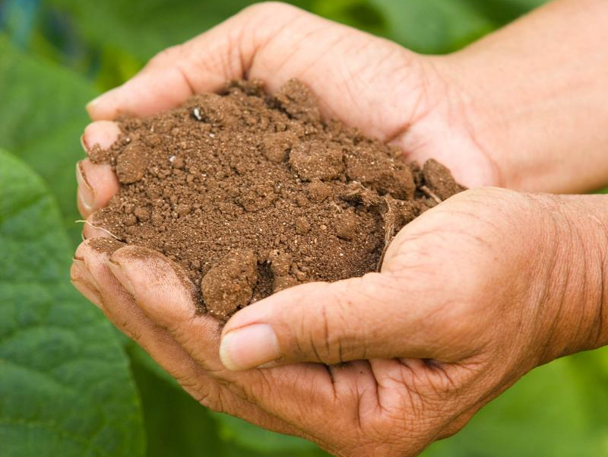
Gut and root microbiotas significantly impact health, development, and fitness of their respective hosts.
  Ramirez-Puebla, et al. (2012:5)

Slide 6
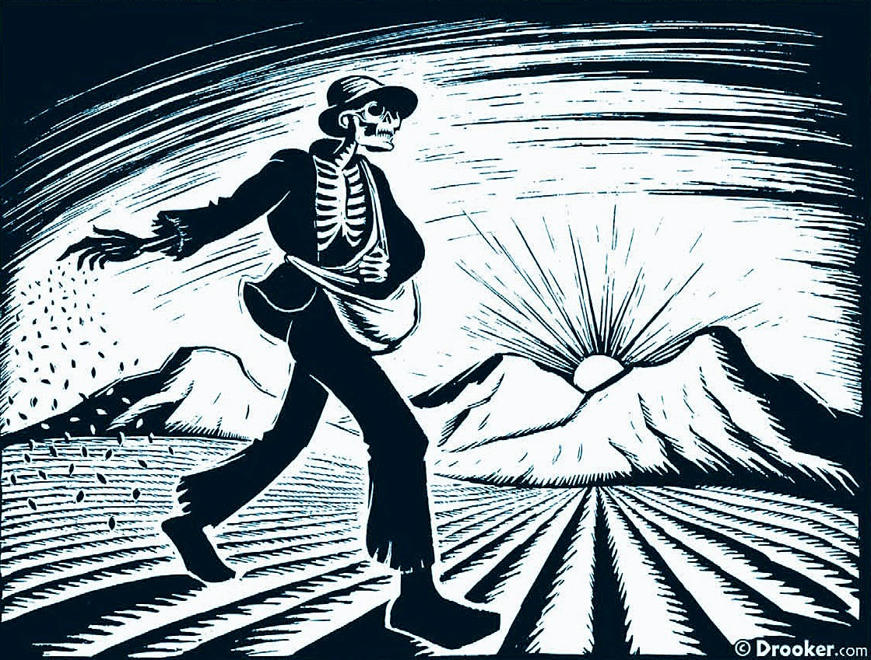
Environmental and health effects of the herbicide glyphosate
Van Bruggen et al. 2018
Glyphosate and its degradation product AMPA have accumulated in the environment.
Chronic low dose effects on animals and humans have been documented recently.
Shifts in microbial community composition in soil, plants and animal guts resulted.
Glyphosate and antibiotic resistance have arisen in fungi and bacteria in parallel.
Glyphosate may serve as one of the drivers for antibiotic resistance.

Slide 7

The risk science of glyphosate
The herbicide glyphosate…has been used extensively in the past 40 years, under the assumption that side effects were minimal. …in recent years, concerns have increased worldwide about the potential wide ranging direct and indirect health effects of the large scale use of glyphosate. In 2015, the World Health Organization reclassified glyphosate as probably carcinogenic to humans.
Notes:
A decolonizing note about the graphic image: What is wrong with this widely-used meme? My take is that it ignores the disproportionate risk structures and processes of environmental racism and other forms of disparate impact targetting BIPOC populations. It makes it seem as of risk is a game of chance (of throwing the die) and a matter of personal freedom to take risks.
The EJM has a slogan that addresses this racist/neoliberal construct: “We do not have the complexion for protection.” The meme (and indeed a lot of scientific discourse) also obscures the role of governmental and corporate collusion in fomenting the dominant economistic metrics for assessing risk and their roles as prime forces underlying the structural violence that produces environmental racism and other forms of disparate (and involuntary) exposure to risk.

Slide 8
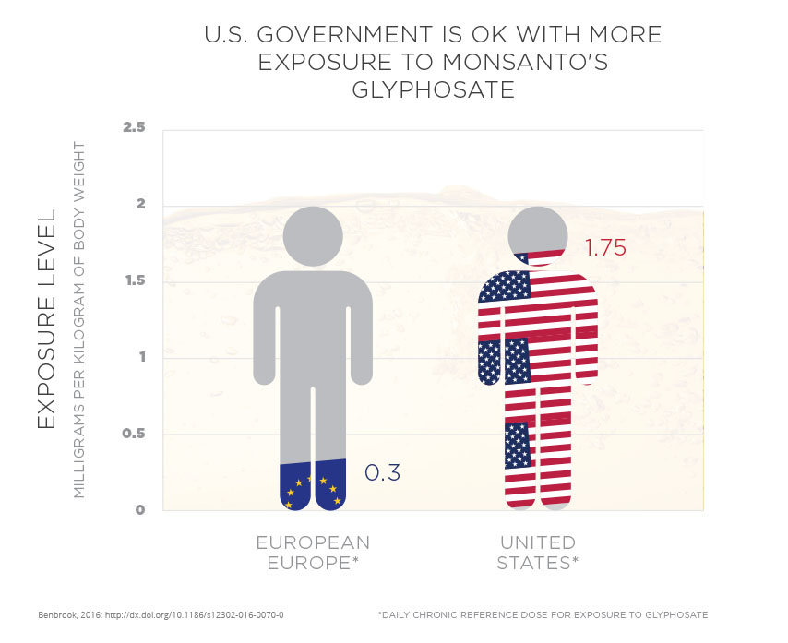

Slide 9
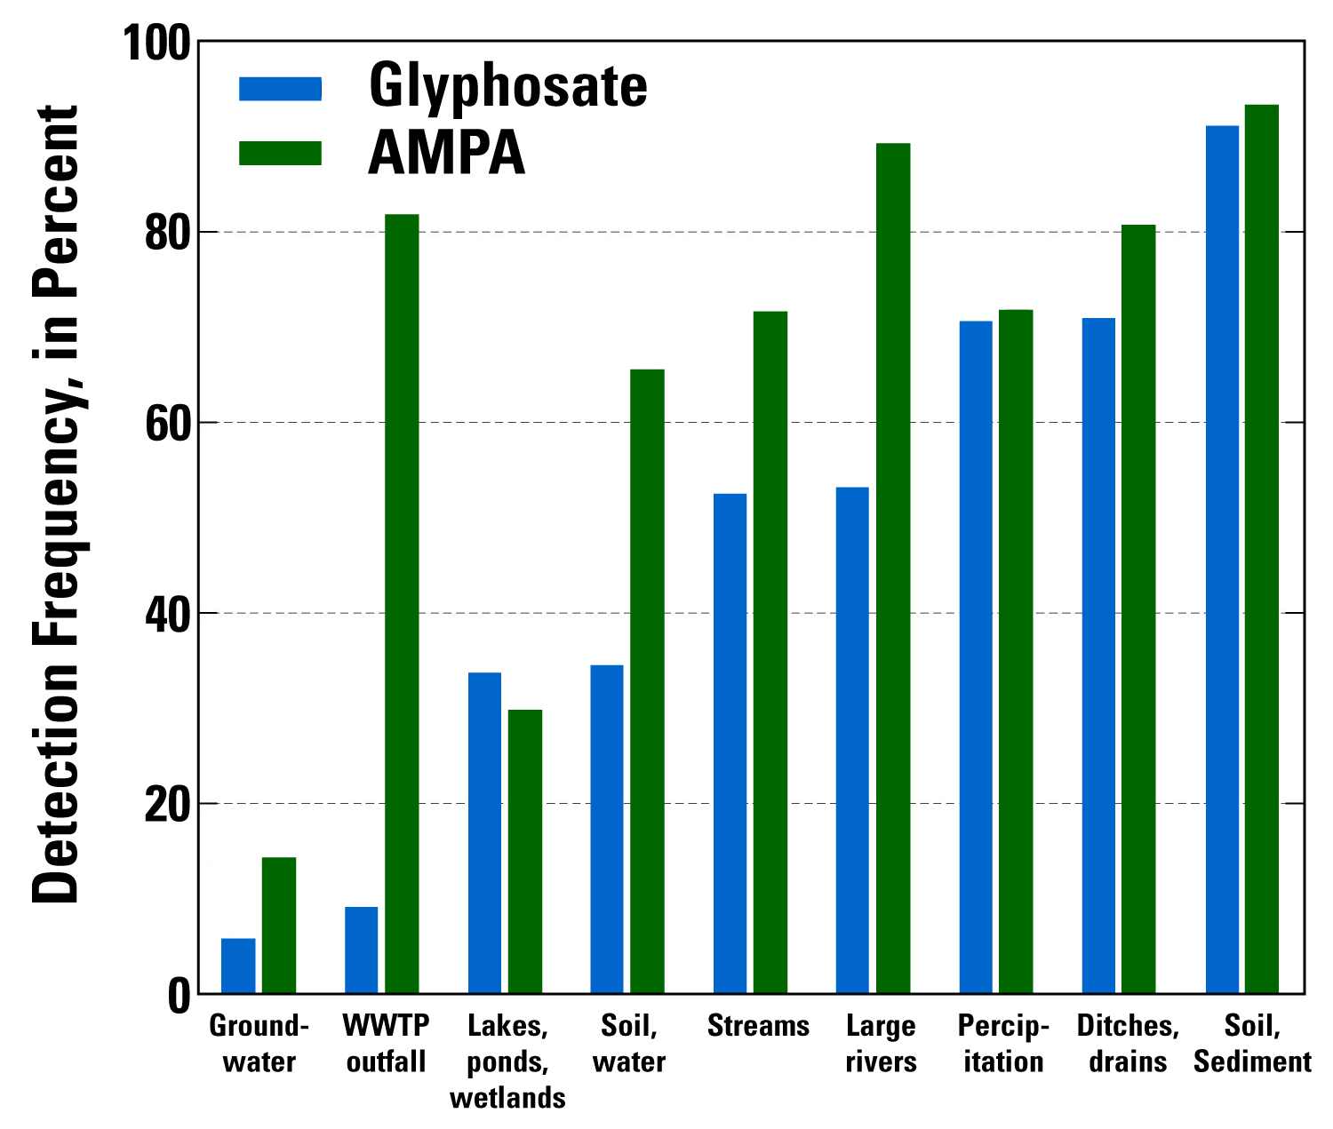
The problem of AMPA
Soil is the foundation of human health. Restoring the organic matter it needs for fertility and a balanced system of functions involves treating soil as more than an aggregation of chemicals, whether mineral or organic. It means recognizing soil as a truly living system.
Notes:
Source of chart: US Geological Survey at: https://toxics.usgs.gov/highlights/2014-04-23-glyphosate_2014.html.

Slide 10
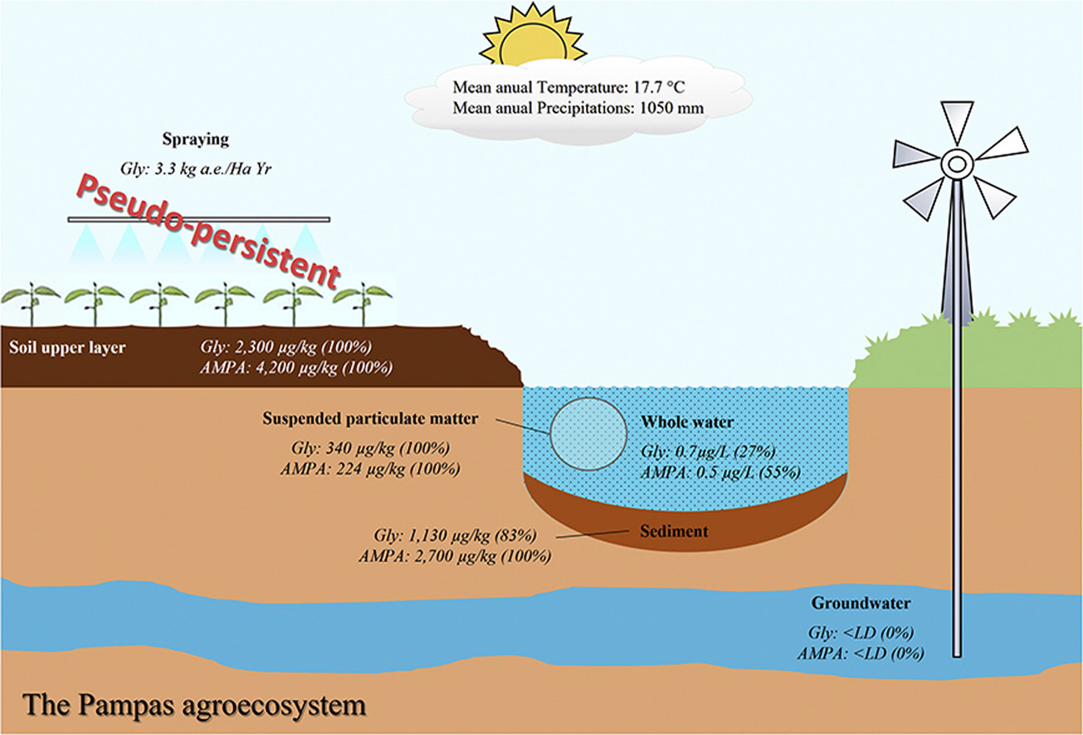
The problem of AMPA
…scientific literature on the movement and residues of glyphosate and its breakdown product aminomethyl phosphonic acid (AMPA) in soil and water reveals their toxicity to macro- and micro-organisms, effects on microbial compositions and potential indirect effects on plant, animal and human health. (255)

Slide 11
USGS Findings
Glyphosate and, or AMPA were detected commonly in surface waters (59 percent of 470 sites), and infrequently in groundwater or soil water (8.4 percent of 820 sites).
Glyphosate was detected in more than 50 percent of soil and sediment samples, and water samples from ditches and drains, precipitation, large rivers, and streams.
Glyphosate was detected in less than 40 percent of water samples from lakes, ponds, wetlands.

Slide 12
USGS Findings
AMPA was detected more frequently than glyphosate in all environmental settings except lakes, ponds, and wetlands.
AMPA was detected in more than 80 percent of wastewater treatment plant samples; while glyphosate was detected in only about 10 percent of those samples.
Data from nine surface-water sites sampled repeatedly indicate that glyphosate and AMPA detection frequency, median concentrations, and loads are higher late in the study period (2006-2010) than early (2001-2005).

Slide 13
The problem of cumulative effects
…the acute toxic effects of glyphosate and AMPA on mammals are low, there are animal data raising the possibility of health effects associated with chronic, ultra-low doses related to accumulation of these compounds in the environment.
  -Van Bruggen et al, 2018: 255.

Slide 14
Other major impacts of glyphosate
Intensive glyphosate use has led to the selection of glyphosate-resistant weeds and microorganisms.
Shifts in microbial compositions due to selective pressure by glyphosate may have contributed to the proliferation of plant and animal pathogens.
Research on a link between glyphosate and antibiotic resistance is still scarce but we hypothesize that the selection pressure for glyphosate- resistance in bacteria could lead to shifts in microbiome composition and increases in antibiotic resistance to clinically important antimicrobial agents.
    Van Bruggen et al, 2018: 255.

Slide 15
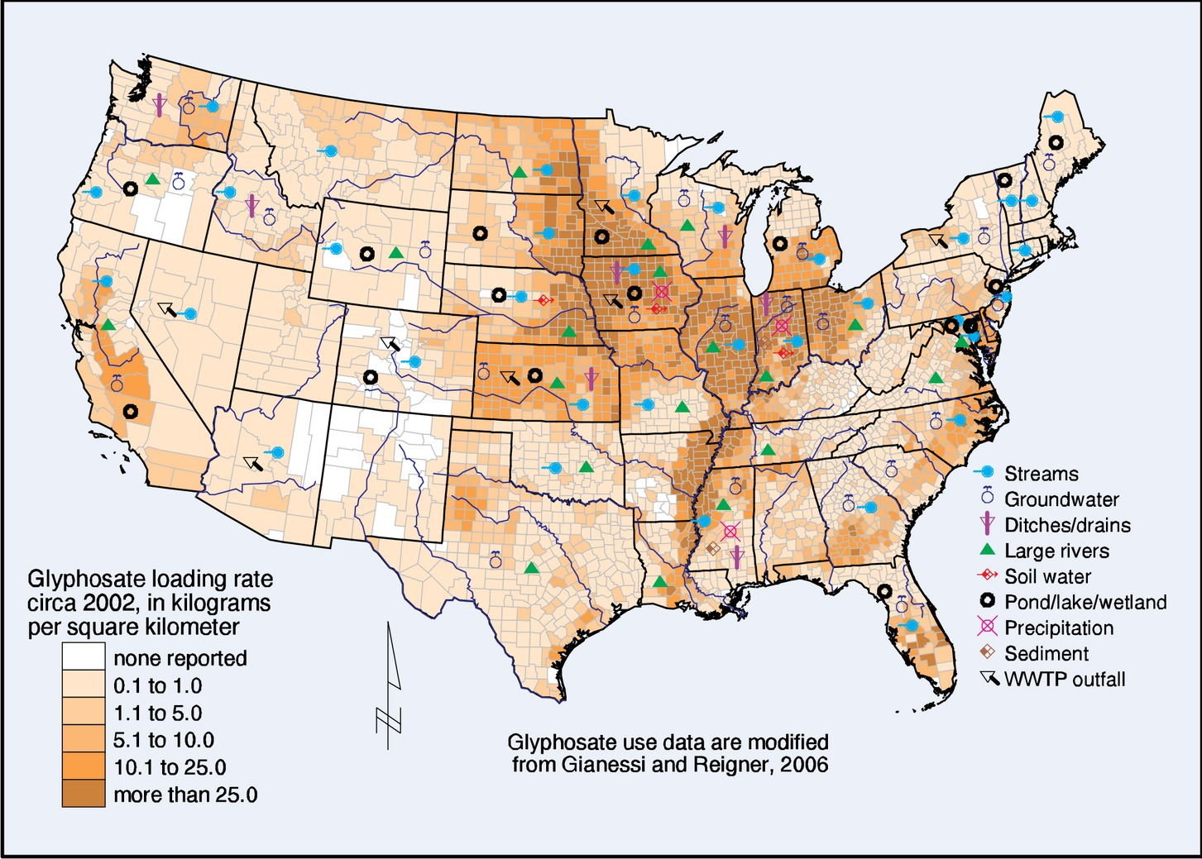
We recommend interdisciplinary research on the associations between low level chronic glyphosate exposure, distortions in microbial communities, expansion of antibiotic resistance and the emergence of animal, human and plant diseases.
    - Van Bruggen et al, 2018: 255.
Notes:
Figure. Nahua soil taxonomy (after Williams, 1994).

Slide 16
Other concepts in Mexica soil classification
Atocpan = tierra gruesa y fertil (Molina, 1571)
Atoctlalli = alluvial soil, moist, fertile land; translated as "suerte de tierra”
Cuemitl = land under cultivation, tierra labrada
Cuenchihua = to work the soil; to work the land (molina, 1571)
Elemiqui = to cultivate the soil (Simeon, 1996)
Ixmolonia = to loosen the soil (Molina, 1571)
Mo:le:hua = to break up soil (Kartunnen, 1992)
Tezoquitli = a parcel of land heavy in minerals, rocky soil (Santa Barbara Tamasolco, 1593)
Tlalli = the earth, land, soil
Tlalmoyahua = to loosen the soil (Molina, 1571)
Tlamomolonia = to work land, to aerate the soil (Karttunen, 1992)
Teotlamomolonia = sacred worked land (Tezozomoc)
Teocuemitl = sacred land under cultivation (Tezozomoc)
Alonso de Molina. Franciscan priest and grammarian. Dictionary of Nahuatl language (1571)

Slide 17
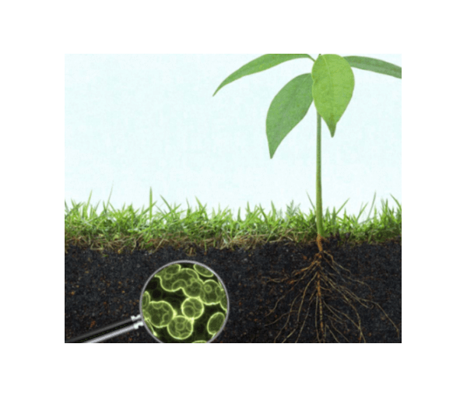
Effects on plants
Glyphosate is toxic to monocotyledonous plants (such as grasses) and dicotyledonous plants (most broad leaf plants). Uptake and translocation of glyphosate in plants is enhanced by surfactants in the formulated product. (258)

Slide 18
Effects on plants
Glyphosate and its breakdown product AMPA inhibit antioxidant enzyme activities and induce the accumulation of reactive oxygen species (ROS) that induce physiological dysfunction and cell damage. (258)
Notes:
Technical note: Reactive oxygen species (ROS) are chemically reactive chemical species containing oxygen. Examples include peroxides, superoxide, hydroxyl radical, singlet oxygen, and alpha-oxygen. The reduction of molecular oxygen (O2) produces superoxide (•O−2), which is the precursor of most other reactive oxygen species. Basically, all pathways to oxidation are known to damage cells.

Slide 19
Effects on plants
Glyphosate and AMPA decrease photosynthesis through different mechanisms: glyphosate increases chlorophyll degradation, while AMPA disturbs chlorophyll biosynthesis. Both enhanced chlorophyll degradation and reduced biosynthesis result in yellowing and necrosis of foliage. (258)

Slide 20
Effects on plants
Plants treated with glyphosate do not produce secondary aromatic compounds, including antimicrobial phytoalexins that defend plants against pathogens. Consequently, glyphosate treated plants frequently die from infection by root pathogens that are universally present in soil. (258)

Slide 21
Effects on plants
Even sublethal glyphosate concentrations in plants, for example from residues in soil or water, diminish plant resistance to pathogens.
In addition to reduced plant resistance, indirect effects of glyphosate and AMPA on plant health are possible through changes in the endophytic and rhizosphere microbiome.
(258)
Notes:
Technical note: Endophytes are organisms, often fungi and bacteria, that live between living plant cells. The reference to endophytic is to the habitat of these organisms in the interstitial spaces between larger cells.

Slide 22
Effects on plants
Besides a reduction in plant resistance as a result of changes in microbial composition after glyphosate use, attraction of plant pathogens to the roots of glyphosate-resistant plants can be enhanced by increased exudation of carbohydrates and amino acids from roots of glyphosate treated plants
(258)
Notes:
Technical note: Endophytes are organisms, often fungi and bacteria, that live between living plant cells. The reference to endophytic is to the habitat of these organisms in the interstitial spaces between larger cells.

Slide 23
Effects on plants
In reaction to the glyphosate-resistance problem, farmers have in- creased the dosage and frequency of glyphosate use even further (Benbrook, 2012), and companies producing glyphosate-resistant crops added genes for resistance to other herbicides, 2,4-D and dicamba, in those crops
(258)
Notes:
Technical note: Endophytes are organisms, often fungi and bacteria, that live between living plant cells. The reference to endophytic is to the habitat of these organisms in the interstitial spaces between larger cells.

Slide 24
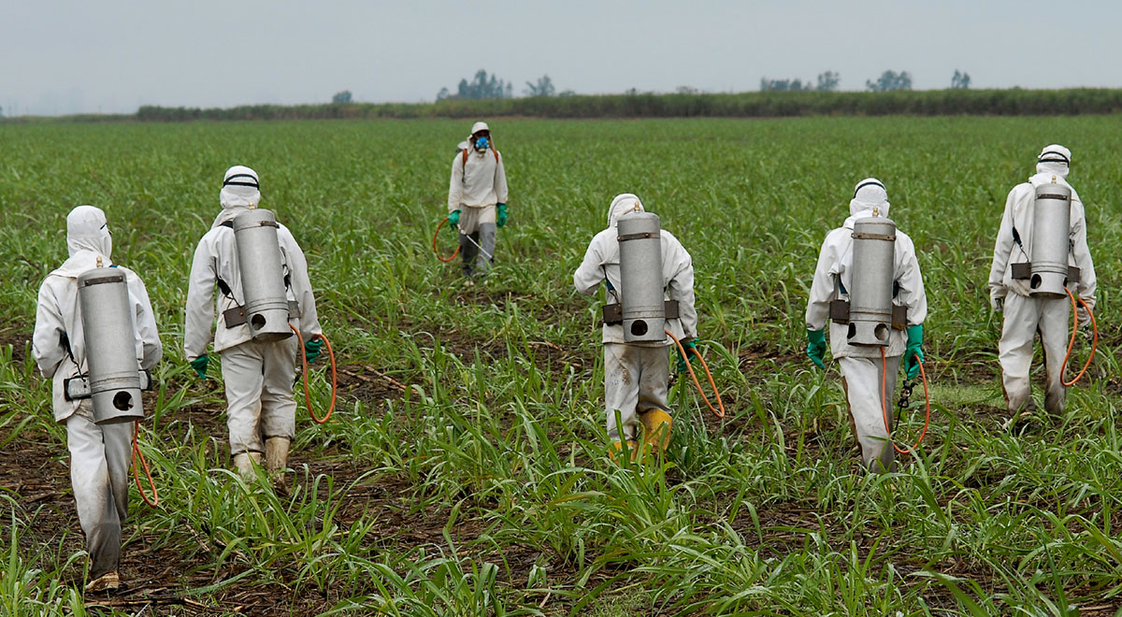
Effects on plants
Another agricultural problem that has arisen in response to intensive glyphosate use is the widespread appearance of glyphosate-resistant weed species
(258)

Slide 25
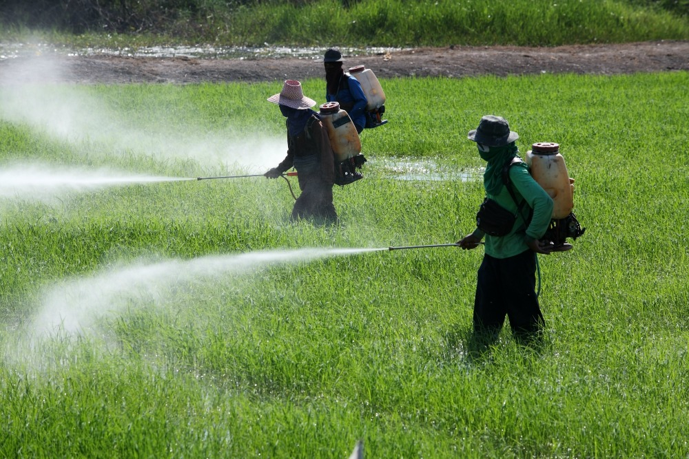
Effects on plants
However, weeds with multiple herbicide resistance at multiple sites of action will likely emerge soon after the widespread use of these herbicides (Bell et al., 2013). This may then lead to an additional increase in herbicide use and additional unintended side effects (Landrigan and Benbrook, 2015).
(258)

Slide 26
Glyphosate effects on animals

Slide 27
Effects on animals
Repeated application of glyphosate at relatively low doses (5 mg kg− 1) negatively affected fertility in male rats, while a single application had a negative fertility effect at a high dose (500 mg kg− 1) only. (260)

Slide 28
Effects on animals
Again, similar to glyphosate effects on terrestrial animals, chronic exposure of gold fish (Carassius auratus) to moderately low levels of glyphosate (34 mg l− 1) disturbed the metabolism in various tissues, led to overproduction of ROS and oxidative stress (Li et al., 2017). The final result was severe renal injury. (260)

Slide 29
Effects on animals
In addition to these direct effects on aquatic animals, glyphosate can affect the interactions between fish and their pathogens or parasites. Exposure of silver catfish (Rhamdia quelen) to sublethal concentrations of glyphosate (.73 mg 1⁻¹) decreased immune cell responses and increased susceptibility to the pathogen Aeromonas hydrophila, resulting in a decrease in the survival rate. (260)

Slide 30
Effects on Microorganisms
The shikimate pathway is present not only in plants but also in fungi and bacteria, rendering many taxa of microorganisms sensitive to glyphosate. However, not all organisms with the shikimate pathway are sensitive to glyphosate.
Notes:
Technical note: The shikimate pathway (shikimic acid pathway) is a seven-step metabolic pathway used by bacteria, archaea, fungi, algae, some protozoans, and plants for the biosynthesis of folates and aromatic amino acids (phenylalanine, tyrosine, and tryptophan).

Slide 31
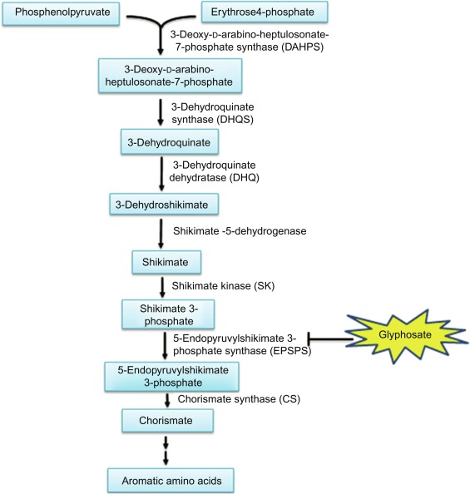
Shikamate Pathway and Glyphosate

Slide 32
Effects on Microorganisms
In studies comparing soil treated with glyphosate with untreated control soil, microbial communities seemed to recover from short term glyphosate treatment … with only minor or no effect on global microbial structure, biomass or activity, probably due to the great diversity and compensatory ability of microorganisms in soil. (261)

Slide 33
Effects on Microorganisms
Newman et al. (2016) showed that the phospholipid fatty acid composition in the rhizospheres of Roundup-ready® corn and soybeans changed as a result of long term (3 yr) glyphosate treatment at the recommended dose. (261)
Notes:
Technical note: Phospholipids are major components of the plasma membrane, the outermost layer of animal cells. Like fats, they are composed of fatty acid chains attached to a glycerol backbone. Unlike triglycerides, which have three fatty acids, phospholipids have two fatty acids that help form a diacylglycerol.

Slide 34
Effects on Microorganisms
The modes of action in aquatic microorganisms are similar to those in terrestrial plants and microorganisms: glyphosate affects synthesis of aromatic amino acids, the production of chlorophyll, photosynthesis and respiration. (261)

Slide 35
Effects on Microorganisms
Autotrophic microorganisms are vital to marine and freshwater ecosystems, because they form the base of food chains. Photosynthesis, cell densities and growth rates of three microalgae were diminished by exposure to a typical application rate of glyphosate (0.21 mg POEA l− 1). (261)
Notes:
Technical note: Autotrophic = self-nurturing. Humans and other animals are heterotrophic (other nurturing).

Slide 36
Antibiotic resistance and glyphosate

Slide 37
Conclusions
Due to the almost exponential increase in glyphosate use and the slow decomposition of glyphosate and its breakdown product AMPA in soil, water and sediment, the accumulation of glyphosate in the environment, plant products and animal organs has become quite worrisome. (263)

Slide 38
Conclusions
Although the acute toxic effects of glyphosate on fish and mammals are low, the formulated products often are more toxic than glyphosate itself, and concerns have emerged about chronic effects of the formulated products on human and animal diseases, in particular various forms of cancer and mental disorders. (263)

Slide 39
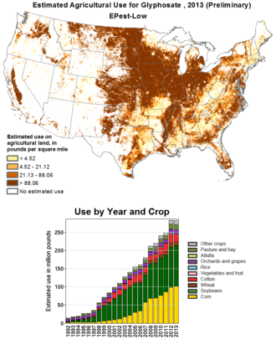

Slide 40
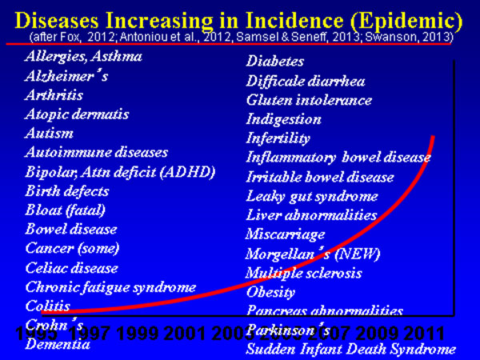
Red curve represents glyphosate use

Slide 41
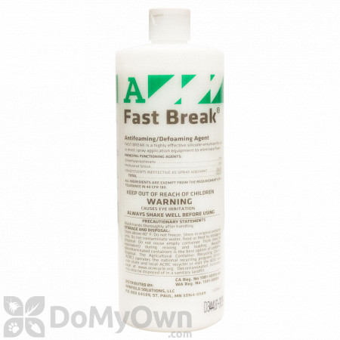
Critique
The work by Van Bruggen, et al. could have addressed the role and effects of the adjuvants like surfactants (little is known because these remain largely under corporate control as “proprietary interests.”
What about farm worker exposure and risks?
What are the alternatives?
Policy implications? What about the “Precautionary Principle”?

