Slide 1
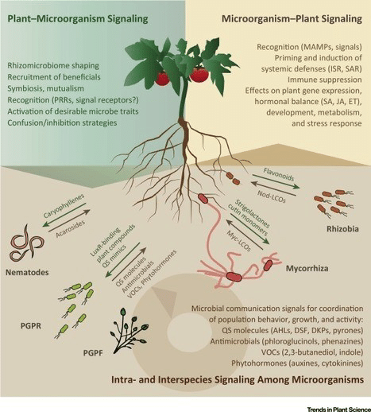
Conceptualizing the rhizosphere
Berendsen, et al.
The diversity of microbes associated with plant roots is enormous, in the order of tens of thousands of species. This complex plant-associated microbial community, also referred to as the second genome of the plant, is crucial for plant health.
There is evidence that upon pathogen or insect attack, plants are able to recruit protective microorganisms, and enhance microbial activity to suppress pathogens in the rhizosphere .

Slide 2
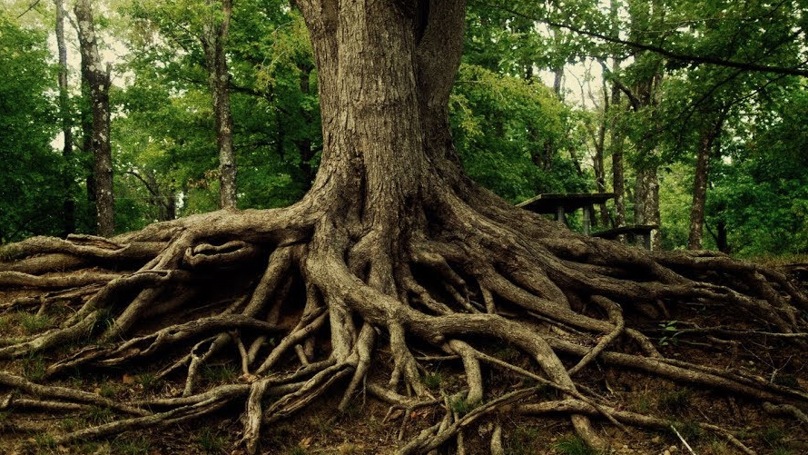
The rhizosphere microbiome
The rhizosphere, which is the narrow zone of soil that is influenced by root secretions, can contain up to 1011 microbial cells per gram root and more than 30,000 prokaryotic species. The collective genome of this microbial community is much larger than that of the plant and is also referred to as the plant’s second genome (p. 478).
Notes:
Prokaryotic. Typically, a unicellular organism defined by absence of cell nucleus or organelles. Foremost forms are bacteria.

Slide 3
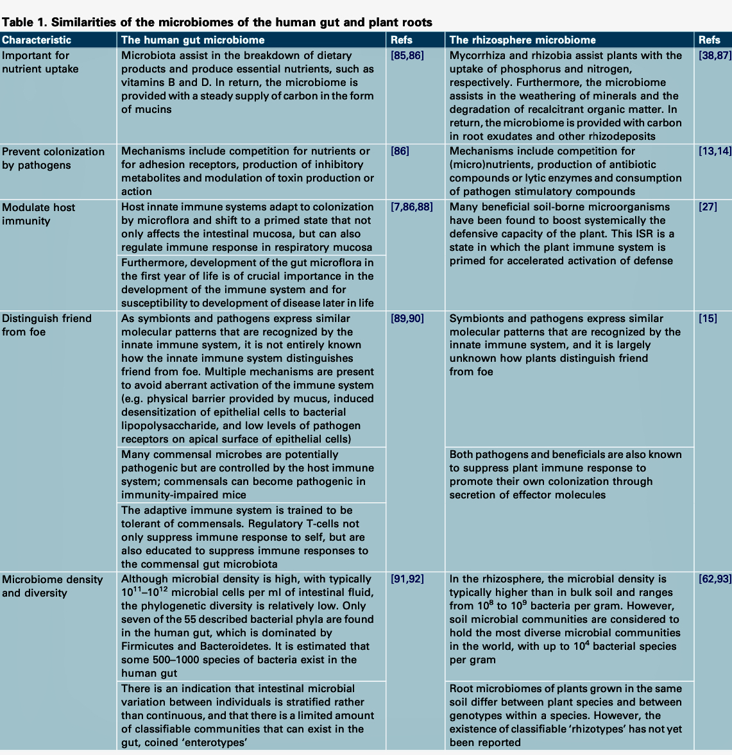
Human and rootzone microbiome similarities
In humans, the effects of intestinal microbial communities on health are becoming increasingly apparent. Similar functions can be ascribed to microbial communities in the human gut and plant rhizosphere (478).

Slide 4
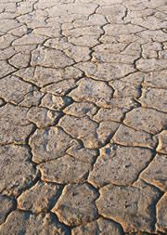
Starved soils
The impact of the root microbiome on plant health is evidenced most clearly in disease-suppressive soils.
The microflora of most soils is starved.
Note: Why are so many soils “starved”? Has this always been the case? How is settler colonialism implicated?

Slide 5
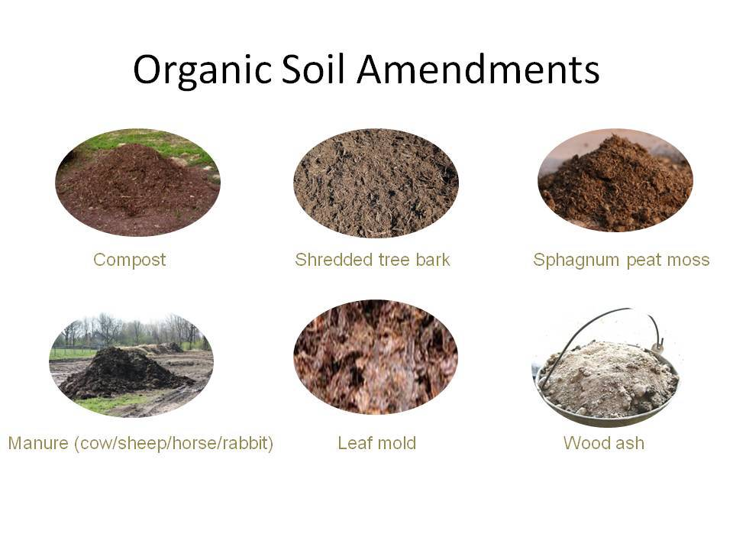
Healing is possible
Organic amendments can stimulate the activity of microbial populations in a conducive soil, resulting in enhanced general disease suppressiveness (478)

Slide 6
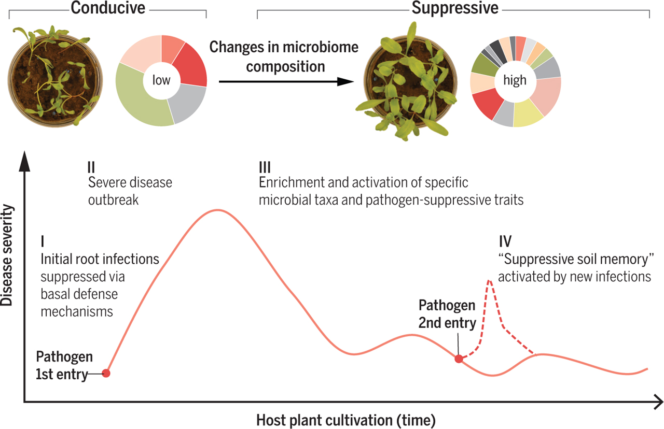
Suppressiveness across soil types
Some soils retain their disease suppressiveness for prolonged periods and persist even when soils are left bare, whereas other soils develop suppressiveness only after monoculture of a crop for several years. Induction of suppressiveness by itself is remarkable, because for most plant species, successive monocultures will lead to a build-up of specialized plant pathogens [Note: which with GMOs can cause harmful cumulative effects]. (479)

Slide 7
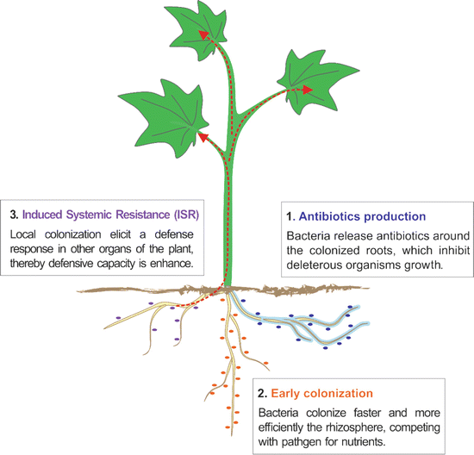
Direct effects on deleterious microbes in the rhizosphere
In addition to, many beneficial soil-borne microorganisms have been found to boost the defensive capacity in above- ground parts of the plant [15]. This induced systemic resistance (ISR) is a state in which the immune system of the plant is primed for accelerated activation of defense.
Note: Primed implies “memory.”
Notes:
Notes on diagram: Several rhizobacteria trigger the salicylic acid (SA)-dependent SAR pathway by producing SA at the root surface whereas other rhizobacteria trigger different signaling pathway independent of SA.
This medication is used on the skin to treat common skin and foot (plantar) warts. Salicylic acid helps cause the wart to gradually peel off. This medication is also used to help remove corns and calluses. This product should not be used on the face or on moles, birthmarks, warts with hair growing from them, or genital/anal warts.
Salicylic acid is a keratolytic. It belongs to the same class of drugs as aspirin (salicylates). It works by increasing the amount of moisture in the skin and dissolving the substance that causes the skin cells to stick together. This makes it easier to shed the skin cells. Warts are caused by a virus. Salicylic acid does not affect the virus.

Slide 8
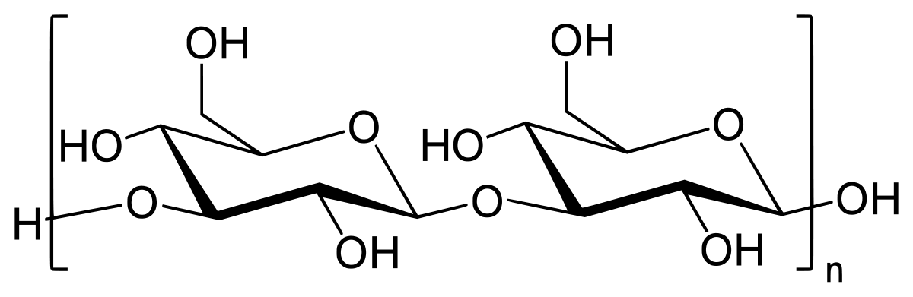
Induction of ISR in Arabidopsis (Arabidopsis thaliana, thale cress) by the plant growth-promoting rhizobacterium Pseudomonas fluorescens is well studied. Locally in roots, [the rhizobacterium]…is able to suppress flagellin-triggered immune responses via apoplastic secretion of one or more low-molecular-weight molecules. (480)
An immune signaling cascade is initiated systemically that confers resistance against a broad spectrum of pathogens and even insects.
The ISR primes accelerated defense-related gene expression and increased deposition of callose at the site of pathogen entry.
Plant growth-promoting rhizobacteria, beneficial fungi such as mycorrhizal fungi, Trichoderma spp. and other fungal biocontrol agents have also been found to induce ISR.
Mycorrhizal fungi can also form a connecting network between plants that can convey a resistance-inducing signal to neighboring plants
Notes:
Notes on terminology:
Induced systemic response (ISR).
Arabidopsis thaliana (thale cress, mouse-ear cress) is a small flowering plant native to Eurasia and Africa.
Pseudomonas simiae WCS417, a widely-studied bacterium that protects plants against pathogenic microbes through a diversity of mechanisms including competition for nutrients, production of antibiotics, and stimulation of the host immune system, a phenomenon called induced systemic resistance (ISR).
Callose is a plant polysaccharide. Its production is due to the glucan synthase-like gene (GLS) in various places within a plant. It is produced to act as a temporary cell wall in response to stimuli such as stress or damage.
Plant growth-promoting rhizobacteria (PGPR).

Slide 9
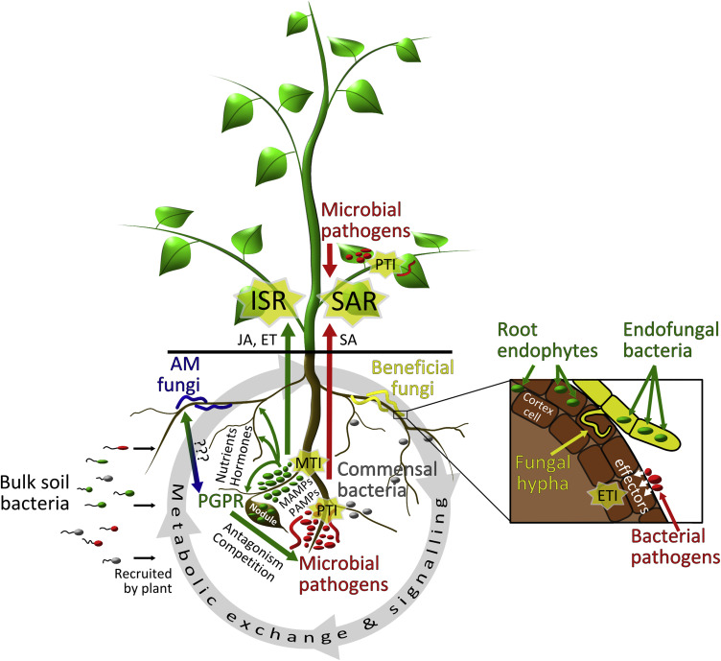
Microbiome complexity
Identification of microorganisms responsible for disease suppressiveness has relied mainly on cultivation-dependent techniques.
Neither the number nor the exclusive presence of microbial taxa could be related to disease suppressiveness.
Instead, the relative abundance of several taxa was found to correspond to disease suppressiveness. (480)
Note: In other words, diversity is the key to resilience.
Notes:
Note on diagram: The mutualistic endofungal bacterium Rhizobium radiobacter signals an effector-triggered immunity (ETI) as the second layer immune system.
SAR – Systemic acquired resistance

Slide 10
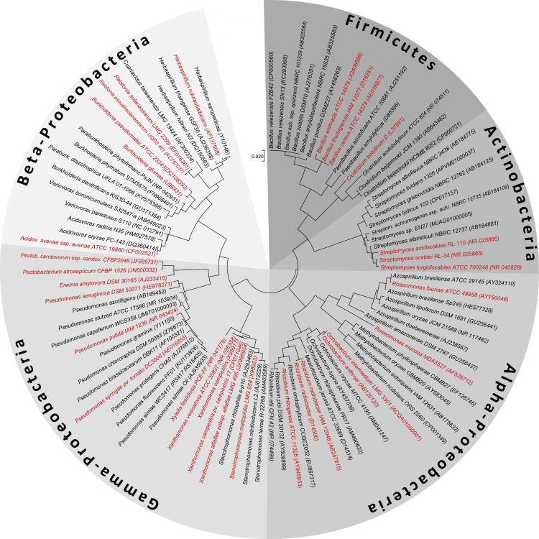
The Key is Diversity
It was concluded that disease suppressiveness in the R. solani suppressive soil could not be attributed to a single taxon, but that it was brought about by a consortium of microorganisms. (480)

Slide 11
Although specific microorganisms are able to protect the plant either directly or indirectly against pathogens, their efficacy is largely influenced by the rest of the microbial community. (480)
Pathogen-suppressing microorganisms could be present in sufficiently high numbers to have a significant effect.
Microorganisms regarded as commensals, because they neither harm nor benefit the plant directly, can compete effectively with the pathogen-suppressing biocontrol bacteria.
Biocontrol bacteria may also act synergistically on each other, as seemingly non-antagonistic bacterial strains can become antagonistic when grown together with other specific strains.
It can be argued that all the active microorganisms affect each other in one way or another, albeit indirectly…it is the total microbiome that affect[s] plant health

Slide 12
Plants also influence the rhizosphere
Plants actively shape their root microbiome
The microflora of most soils is carbon starved.
Because plants secrete up to 40% of their photosynthates into the rhizosphere, the microbial population densities in the rhizosphere are much higher than in the surrounding bulk soil. (481)

Slide 13
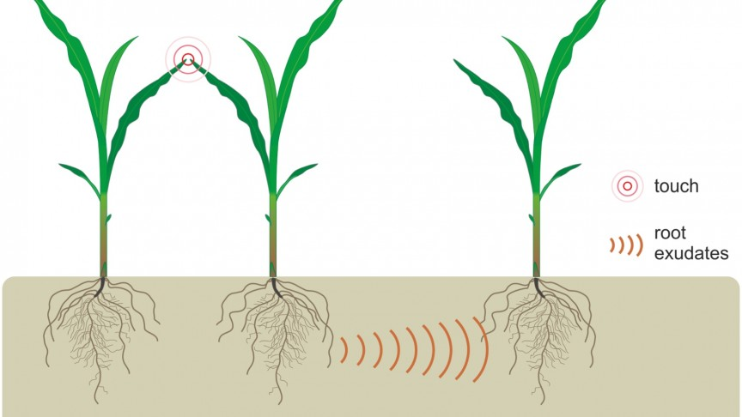
Roots signal alerts and beckon specific companions
Plant roots select for specific microorganisms to prosper in the rhizosphere.
Soil type is an important driver of the microbial community composition in the rhizosphere
Microbial communities in the rhizospheres of different plant species growing on the same soil are also often different.
Plants are able to shape the composition of the microbiome in their rhizosphere. (481)
Notes:
Critical Note: The issue of soil types as a variable is left unaddressed. What do they mean by soil types? Only two references suggests a paucity of studies, especially those addressing agroecological processes and models.

Slide 14
Plant effects in the root zone
Plants can determine the composition of the root microbiome by active secretion of compounds that specifically stimulate or repress members of the microbial community.
How? The exudates produced by seed, seedlings and roots of tomato, cucumber and sweet pepper are predominantly organic acids with citric acid, succinic acid and malic acid being the most common.
The ability of rhizobacterial strains to grow in vitro on citric acid as the sole carbon source appears to correlate with their root-colonizing ability. This indicates that plant species can select bacteria through the production of specific root exudates. (482)

Slide 15
Quorum sensing
Cell-to-cell communication
Plant-associated bacteria produce and utilize AHLs to signal to each other and to regulate their gene expression
AHLs affect root development and elicit ISR, further highlighting the importance of AHLs in cross-kingdom signaling in the rhizosphere.
Plants can produce compounds that stimulate or repress QS-regulated responses in bacteria.
Notes:
Technical Notes:
Lactone is very important to processes that support metabolism in the rhizosphere. For e.g., cyclic carboxylic esters which are energy transmitters in the form of diffusible N-acyl-homoserine lactones (AHLs) lactones are important to:
Hydrolysis
Reduction
Aminolysis
Polymerization
Michael reaction

Slide 16
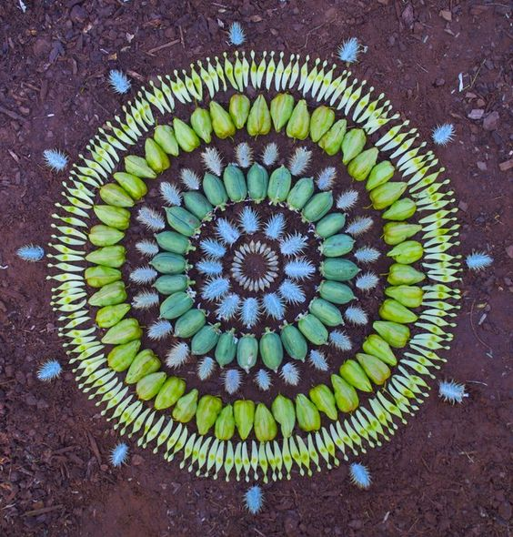
Plant genotype and soil type shape microbiome composition
Evidence suggests that differences between plant genotypes in a single gene can have a significant impact on the rhizosphere microbiome.
A study of bacterial rhizosphere communities in two different soils on three cultivars of potato…detected 2432 operational taxonomic units in the potato rhizosphere, of which 40% had a site-specific abundance.
These results underline not only the importance of the soil in determining rhizosphere communities, but also that some microbes have a particular affinity for certain plant genotypes. (482)
Notes:
Critical note: Still no elaboration of soil types, e.g., sandy loam, gravelly loam, clay dominant, etc.

Slide 17
The root microbiome to the rescue
The microbiome changes upon defense activation and plants develop what we can call immunological memory, just like mammals.
Plants (through root exudation) recruit beneficial microbes. (See Fig.3, 483)

Slide 18
Activation of beneficials
The association of the pathogenic fungus G. graminis var. tritici with wheat roots strongly altered gene expression of the biocontrol bacterium P. fluorescens Pf29Arp
Results imply that, upon pathogen attack, the plant launches a systemic response that can stimulate the antifungal activity of the rhizosphere microflora.
Notes:
Note: Many of these results were obtained using inoculation protocols involving biocontrol bacterium.

Slide 19
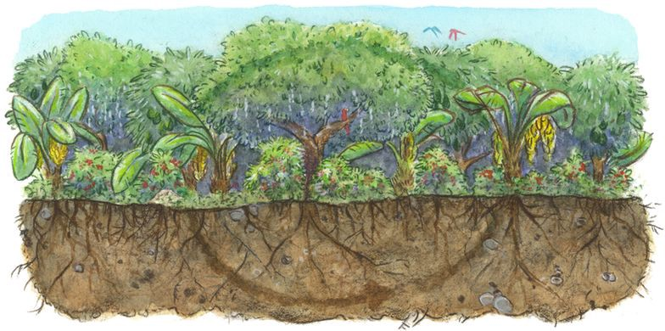
Critique
The authors never clarify which soil types are being considered.
They did not control for companion plants and focused only on the crop specific to the experiments.
Plant communication is obviously important, and the authors advance understanding of the role of AHL (energy transmitters) and other metabolic agents, but they do not address how agro-biodiversity itself – involving multiple alleles of the same species (e.g., corn) – might affect signaling and recruiting.

Slide 20
Decolonial implications and questions
If plants shape the rhizosphere, then what is the role of cultural selection practices in Indigenous agroecosystems where the quality of the crop is not reduced to a simple farm-gate end product?
“Induction of suppressiveness by itself is remarkable, because for most plant species, successive monocultures will lead to a build-up of specialized plant pathogens.” Q: Is this an endorsement?
Many studies suggest GMOs, combined with agro-industrial chemicals like glyphosate, can cause harmful cumulative effects to the rhizosphere and human gut microbiomes alike.

Slide 21

Do plants have “agency”?
Plants respond to nutrient deficiency by altering root morphology, recruiting the help of microorganisms and changing the chemical environment of the rhizosphere.
The ability to respond to environmental conditions is a central quality in anthropological definitions of human agency and action. Given this criterion, it seems that plants do have a sort of agency.
Is subjectivity the difference? Human subjectivity (and its active constituents including cultural norms and values, ideologies, belief systems, symbolic language) is clearly implicated in our understanding of human agency.
Do plants have an analog of subjectivity or is their chemical signaling an a priori predisposition?

