Slide 1
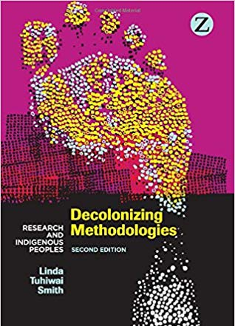
Linda T. Smith
Decolonizing methodologies
25 Indigenous Projects

Slide 2
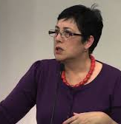
Linda Tuhiwai Smith
Professor of indigenous education at the University of Waikato in Hamilton, New Zealand.
Affiliated with Ngāti Awa and Ngāti Porou, Māori
Inspired a wave of indigenous-led critiques of academic power and proposals for indigenized methodological interventions.

Slide 3
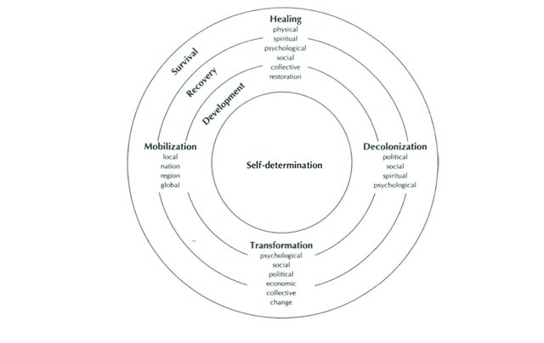
Decolonizing methodologies

Slide 4
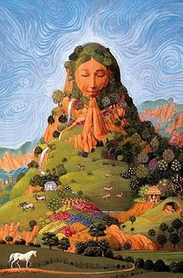
The ecology of/as being
To Smith’s self-determination model, I wish to add the human relationship to local and global environments. This epistemic relationality includes more-than-human beings all of whom are involved in the co-production of this knowledge.
The ecology of being intersects with all the forces in the circle including knowledge and practices in development, recovery, and survival. This unity of transformative change agency is embodied in mass mobilization of the movement, and hence advances a wide range of decolonization projects in a place-based manner always linked to other local nodes in a global network.

Slide 5
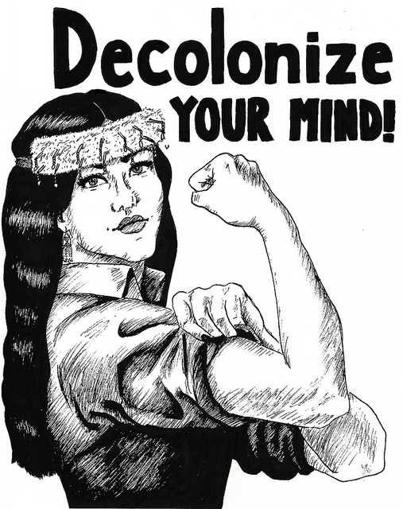
Smith’s decolonizing projects
The acts of reclaiming, reformulating and reconstituting indigenous cultures and languages have required the mounting of an ambitious research program, one that is very strategic in its purpose and activities and relentless in its pursuit of social justice. Within the program are a number of very distinct projects. Themes such as cultural survival, self-determination, healing, restoration and social justice are engaging indigenous researchers and communities in a diverse array of projects.

Slide 6
The 25 projects
1 Claiming
2 Testimonies (testimonio)
3 Story telling
4 Celebrating survival – survivance
5 Remembering

Slide 7
1. Claiming
Colonialism has reduced indigenous peoples to making claims and assertions about our rights and dues. It is an approach that has a certain noisiness to it. Indigenous peoples, however, have transformed claiming into an interesting and dynamic process.
Intensive research projects are deployed as evidence before tribunals, courts, agencies, and other decision-making contexts.
Claiming serves to give TEK and IK legitimacy as knowledge claims.

Slide 8
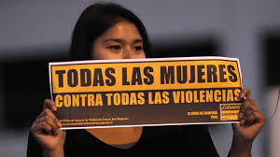
2. Testimonies (testimonios)
Testimonies intersect with claiming because they are a means through which oral evidence is presented to a particular type of audience. A testimony is also a form through which the voice of a ‘witness’ is accorded space and protection. It can be constructed as a monologue and as a public performance.
Notes:
Testimonio is more familiar to Latin American contexts as a narrative of collective memory: it has become one of a number of literary methods for making sense of histories, of voices and representation, and of the political narrative of oppression. (241)

Slide 9
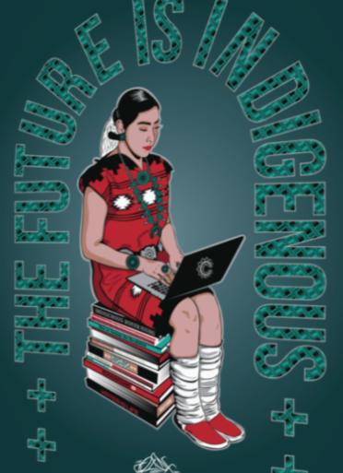
3. Story-telling
Story telling, oral histories, the perspectives of elders and of women have become an integral part of all indigenous research. These new stories contribute to a collective story in which every indigenous person has a place. For many indigenous writers, stories are ways of passing down the beliefs and values of a culture in the hope that the new generations will treasure them and pass the story down further.

Slide 10
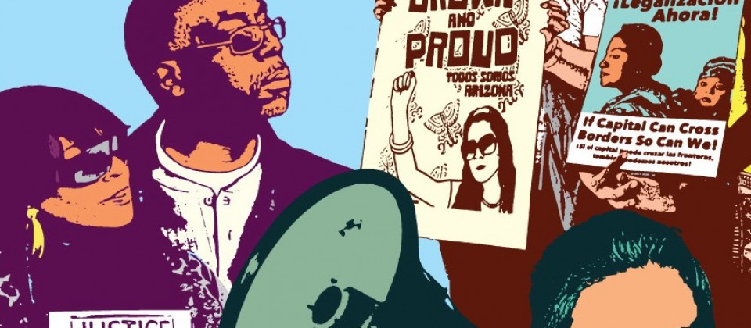
4. Celebrating survival – survivance
Non-indigenous research has been intent on documenting the demise and cultural assimilation of indigenous peoples. Instead it is possible to celebrate survival, or what Gerald Vizenor has called ‘survivance’ – survival and resistance
Peña: A beautiful example of this is the return of the “milpa diet” (heritage cuisine) as central aspects of the Indigenous seed and food sovereignty movements.

Slide 11
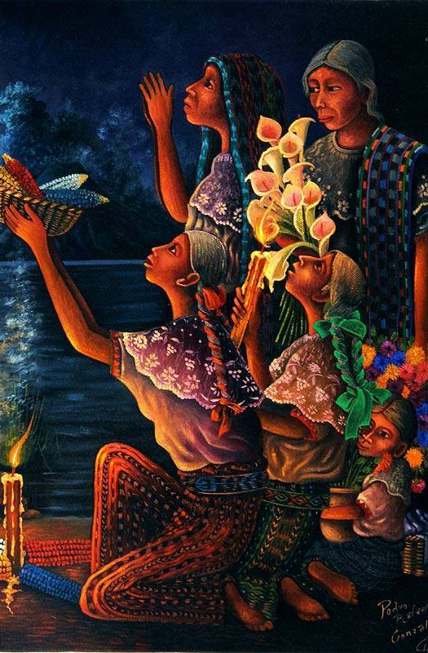
5. Remembering
…the remembering of a painful past, re-membering in terms of connecting bodies with place and experience, and importantly, people’s responses to that pain.
…collectively indigenous communities can talk through the history of traumatic events…
Notes:
This directly addresses erasure and silencing as settler colonial practices of domination.
Recall the readings from Mexican-Origin Foods, Foodways, and Social Movements book; for e.g., in the chapter by Sylvia Patricia Solis, the author notes how her body carries the memory of generations of pain, and of a history of being landless. But in the end her body is also the site of re-membering -- it is the sense of becoming aware of her body as place, as carrying the healing memory of place connections.

Slide 12
Smith, Decolonizing methodologies
6 Indigenizing and indigenist processes
7 Intervening
8 Revitalizing and regenerating
9 Connecting
10 Reading

Slide 13
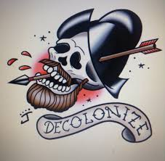
6. Indigenizing and indigenist processes
…a centering in consciousness of the landscapes, images, languages, themes, metaphors and stories of the indigenous world, and the disconnecting of many of the cultural ties between the settler society and its metropolitan homeland.

Slide 14
7. Intervening
Intervening takes action research to mean literally the process of being proactive and of becoming involved as an interested worker for change. Intervention-based projects are usually designed around making structural and cultural changes.
This can happen in Indigenous or settler colonial settings and institutions as needed. Interventionist research is a form of claiming or reframing of truth and legitimation of knowledge claims. It seeks to transform law and policy.
Notes:
Intervention is often used against indigenous communities – for example, as an excuse to invade and occupy territories under the pretense of saving or rescuing an indigenous community.
The indigenous intervening project carries with it some working principles. For example, the community itself invites the project in and sets out its parameters. The various departments and agencies involved in such a project are also expected to be willing to change themselves in some way – to redirect policy, design new programs or train staff differently. Intervening is thus directed at changing institutions that deal with indigenous peoples, and not at changing indigenous peoples to fit the structures.

Slide 15
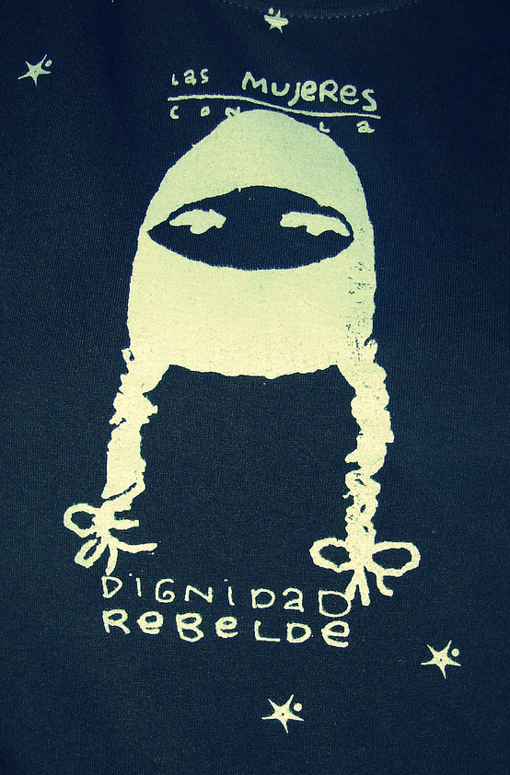
8. Revitalizing and regenerating
Indigenous languages, their arts and their cultural practices are in various states of crisis. Many indigenous languages are officially ‘dead’, with fewer than a hundred speakers. Others are in the last stages before what is described by linguists as ‘language death’. Revitalization initiatives in languages encompass education, broadcasting, publishing and community-based programs.
Regeneration is for many of us a preferred term for revitalization.

Slide 16
9. Connecting
Connectedness positions individuals in sets of relationships with other people and with the environment.
Many indigenous creation stories link people through genealogy to the land, to stars and other places in the universe, to birds and fish, animals, insects and plants.
Connecting is related to issues of identity and place, to spiritual relationships and community well-being.

Slide 17
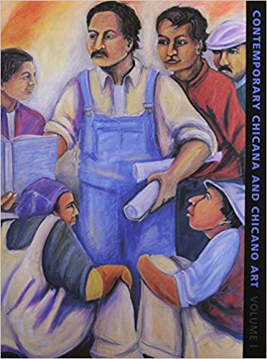
10. Reading
Critical rereading of Western history and the indigenous presence in the making of that history.
These origin stories are deconstructed accounts of the West, its history through the eyes of indigenous and colonized peoples.

Slide 18
Smith, Decolonizing methodologies
11 Writing and theory making
12 Representing
13 Gendering
14 Envisioning
15 Reframing

Slide 19
11. Writing and theory making
Indigenous people are writing and theory making.
In a localized context…writing is employed in a variety of imaginative, critical, and also quite functional ways.
The boundaries of poetry, plays, song writing, fiction and non-fiction are blurred as indigenous writers seek to use language in ways that capture the messages, nuances and flavour of indigenous lives.
Notes:
Interdisciplinarity + intersectionality + interculturality

Slide 20
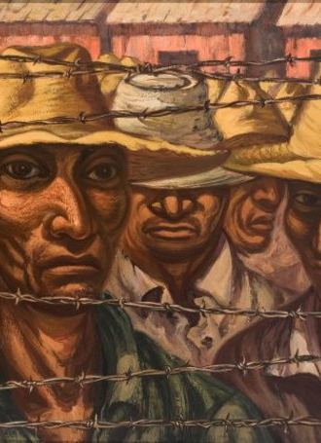
12. Representing
Indigenous communities have struggled since colonization to be able to exercise what is viewed as a fundamental right, that is to represent ourselves. The representing project spans both the notion of representation as a political concept and representation as a form of voice and expression.
Peña: The second point can be recast as a politics of enunciation rather than representation.

Slide 21
13. Gendering
Gendering indigenous debates, whether they are related to the politics of self-determination or the politics of the family, is concerned with issues arising from the relations between indigenous men and women that have come about through colonialism.
This also involves going beyond the binary to embracing and enunciating two-spirit knowledge, belief, practices, and experiences.
Notes:
Women across many different indigenous societies claim an entirely different relationship, one embedded in beliefs about the land and the universe, about the spiritual significance of women, and about the collective endeavours that were required in the organization of society.

Slide 22
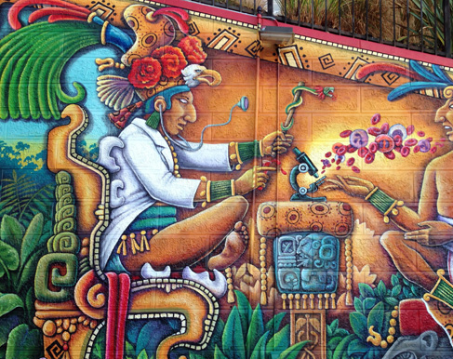
14. Envisioning
…imagine a future, [in which we] rise above present-day situations which are generally depressing, dream a new dream and set a new vision.
The power of indigenous peoples to change their own lives and set new directions, despite their impoverished and oppressed conditions, speaks to the politics of survivance.

Slide 23
15. Reframing
Reframing is about taking much greater control over the ways in which indigenous issues and social problems are discussed and handled. Reframing occurs in other contexts where indigenous people resist being boxed and labelled according to categories which do not fit. This is particularly pertinent in relation to various development programs, government and non-government.

Slide 24
Smith, Decolonizing methodologies
16 Restoring
17 Returning
18 Democratizing and indigenist governance
19 Networking
20 Naming

Slide 25
16. Restoring
‘The main question, which has not been addressed by government, is the legitimacy or otherwise of the assumption that white domination of Aboriginal people is in itself a concept of justice.’
Restoring well-being – spiritually, emotionally, physically and materially – has involved social workers and health workers in a range of initiatives …

Slide 26
17. Returning
This project intersects with that of claiming. It involves the returning of lands, rivers and mountains to their indigenous owners. It involves the repatriation of artefacts, remains and other cultural materials stolen or removed and taken overseas.
Peña: This should include biopiracy bans and edicts against any form of biocultural appropriation for commercial gain.

Slide 27
18. Democratizing and indigenist governance
Democratizing in indigenous terms is a process of extending participation outwards through reinstating indigenous principles of collectivity and public debate without necessarily recreating a parliamentary or senatorial style of government.
It means that indigenous nations and communities have to develop twenty-first-century governance approaches that are embedded in an indigenous value system and geared to meet contemporary social challenges

Slide 28
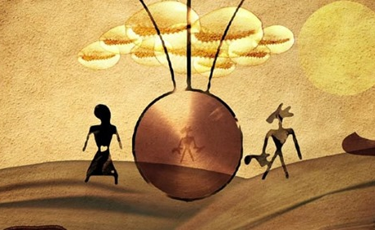
19. Networking
Networking has become an efficient medium for stimulating information flows, educating people quickly about issues and creating extensive international talking circles. Building networks is about building knowledge and data bases which are based on the principles of relationships and connections.
Networking is a way of making contacts between marginalized communities…a process which indigenous peoples have used effectively to build relationships and disseminate knowledge and information.

Slide 29
20. Naming
This project takes its name from Brazilian educator Paulo Freire whose saying, ‘name the word, name the world’ (which was about literacy programs), has been applied in the indigenous context to literally rename the landscape.
Naming applies to other things as well. It is about retaining as much control over meanings as possible. By ‘naming the world’ people name their realities.
Notes:
Recall my idea and discussion of noisy toponyms.

Slide 30
Smith, Decolonizing methodologies
21 Protecting
22 Creating
23 Negotiating
24 Discovering the beauty of our knowledge
25 Sharing

Slide 31
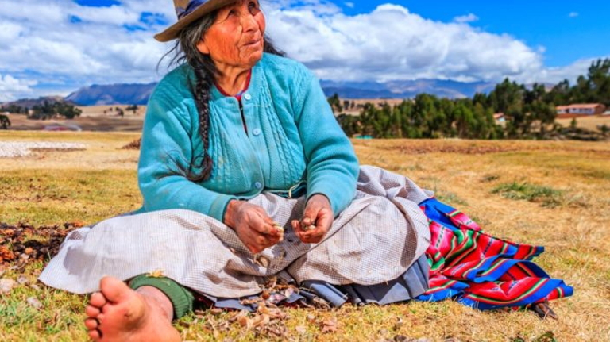
21. Protecting
This project is multi-faceted. It is concerned with protecting peoples, communities, languages, customs and beliefs, art and ideas, natural resources and the things indigenous peoples produce.
It can be as real as land and as abstract as a belief about the spiritual essence of the land.
The need to protect a way of life, a language and the right to make our own history is a deep need linked to the survival of indigenous peoples.

Slide 32
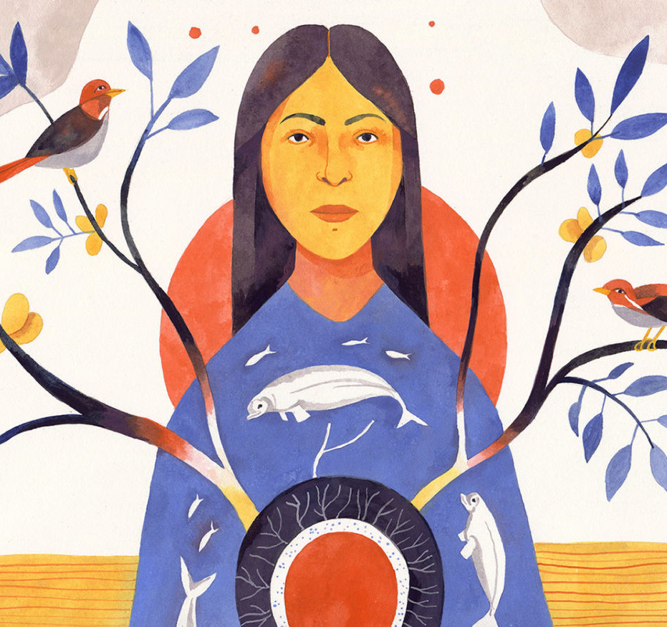
22. Creating
The project of creating is about transcending the basic survival mode through using a resource or capability that every indigenous community has retained throughout colonization – the ability to create and be creative.
Indigenous communities also have something to offer the non-indigenous world. Communities are the ones who know the answers to their own problems.
Notes:
For e.g.: TEK is constantly integrated into environmental protection programs and practices.

Slide 33
23. Negotiating
Negotiating is about thinking and acting strategically. It is about recognizing and working towards long-term goals.
Negotiations are also about respect, self-respect and respect for the opposition. Indigenous rules of negotiation usually contain both rituals of respect and protocols for discussion.
The contemporary negotiation project is related to self-determination…for e.g., over their own territories.

Slide 34
24. Discovering the beauty of our knowledge
This project is about discovering our own indigenous knowledge and Western science and technology and making our knowledge systems work for indigenous development.
The development of ethno-science and the application of science to matters that interest indigenous peoples, such as environmental and resource management or biodiversity, offer some new possibilities for indigenous people to engage with the sciences they find most relevant.
Notes:
Photo: Aboriginal man setting fire in the bush country, Australia. Courtesy of Wunambal Gaambera Aboriginal Corporation/Russell Ord.
URL: https://ensia.com/features/indigenous-knowledge-wildfires-australia/.

Slide 35
25. Sharing
The final project discussed here is about sharing knowledge between indigenous peoples, around networks and across the world of indigenous peoples. Sharing contains views about knowledge being a collective benefit and knowledge being a form of resistance.
Sharing is a responsibility of research.
Notes:
There are ethics to sharing and the act of sharing must not violate principles of confidentiality, anonymity, shared ownership, Indigenous autonomy, and respect for sacred knowledge which includes knowledge that is not to be shared beyond certain groups, etc.

