Slide 1
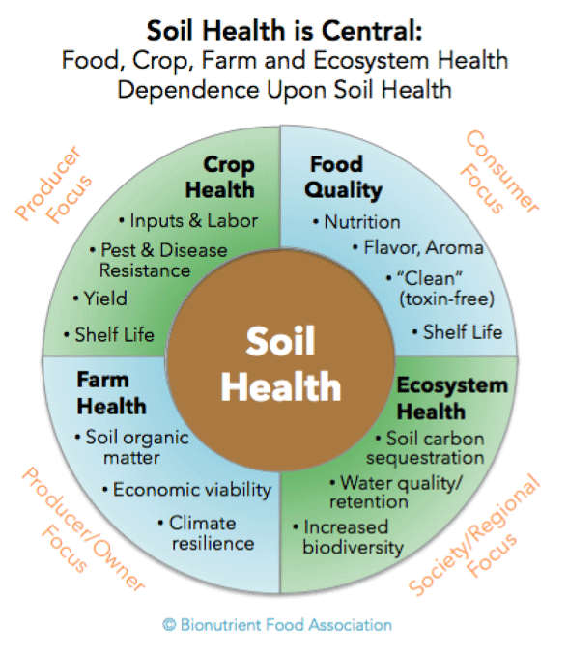
ANTH 488 Agroecology
Decolonizing the Rhizosphere and Gut Microbiomes
UNIVERSITY OF WASHINGTON
Summer B Term (July 22-August 20, 2021)
Professor Devon G. Peña

Slide 2
Sacred Landscapes. Deep histories
Sisnaajini (Black-Belted Mountain) – Sacred Mountain of the Diné, Home of Changing Woman, a.k.a. Thought Woman
The San Luis Valley in Southcentral Colorado is Nuchu-Dinè-Tewa-Genizarx Ancestral Territory

Slide 3
The Upper Rio Grande Watershed

Slide 4
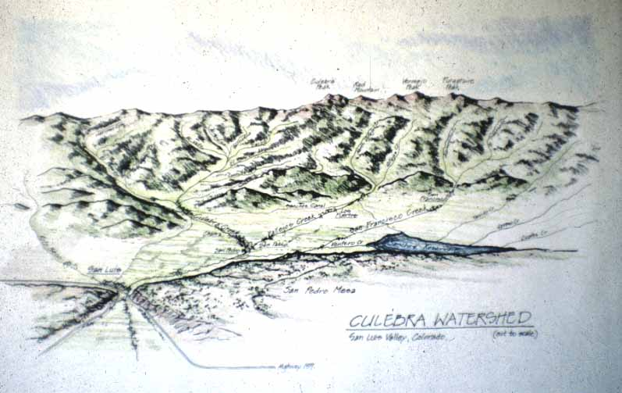
The Culebra watershed of the Sangre de Cristo Land Grant

Slide 6
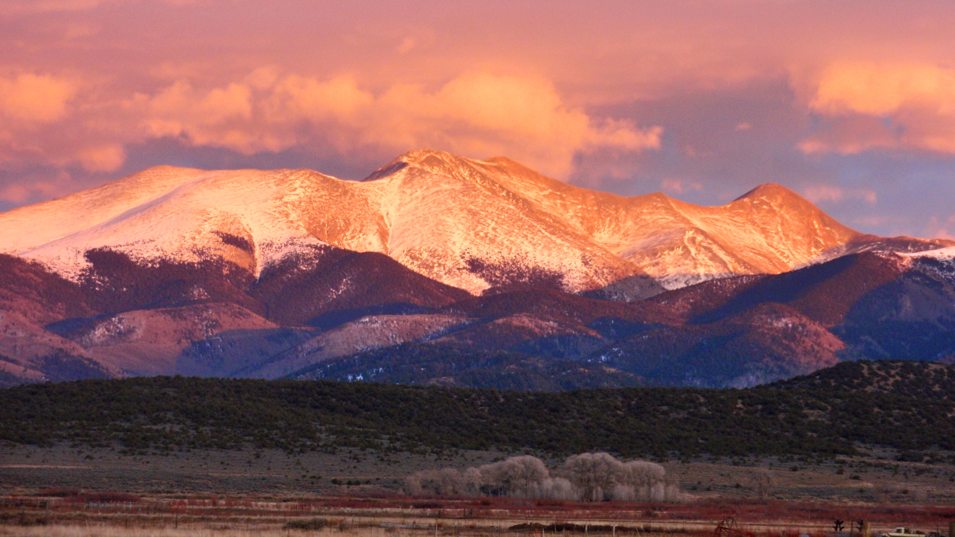
Sierra de la Culebra, 14,053 ft. Heart of the 80,000 acre
common land ejido of the Sangre de Cristo Land Grant

Slide 7
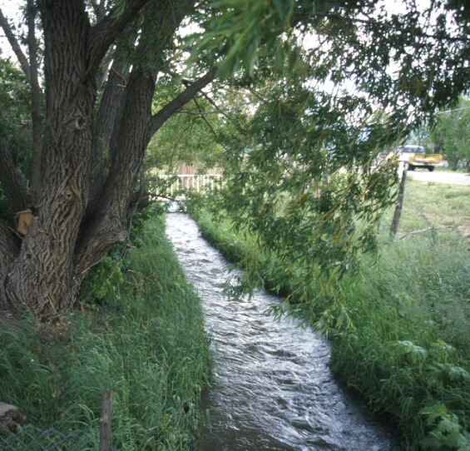
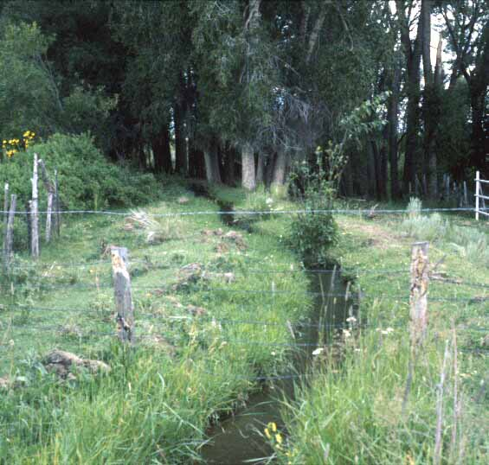
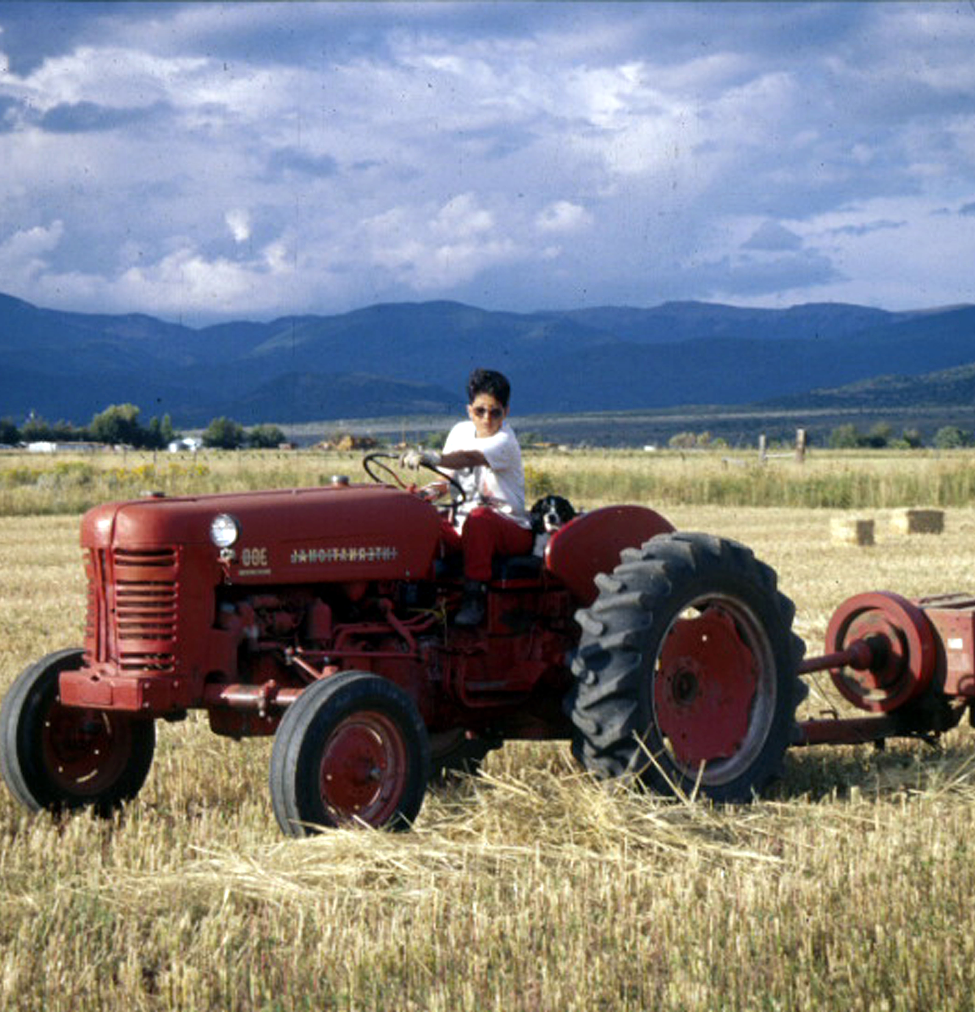
Acequia · as-Saquiya

Slide 8
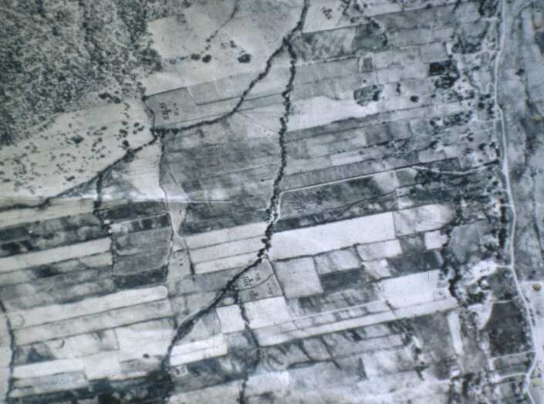
Extensiones or ‘vara strips’. Riparian long-lots
La Sierra Common. 80,000 acres; the largest working common lands in the world

Slide 9
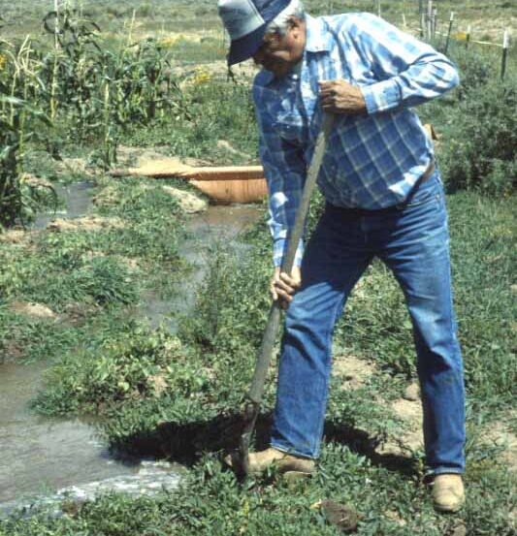
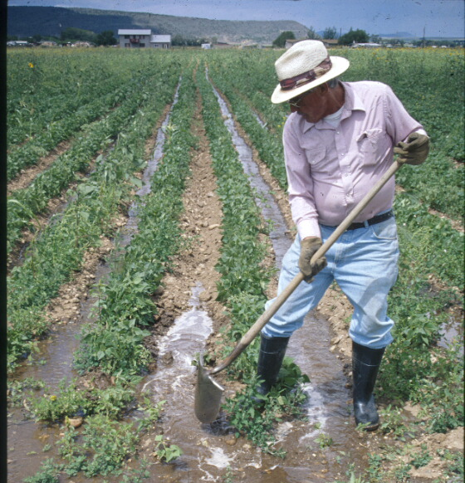

Slide 10
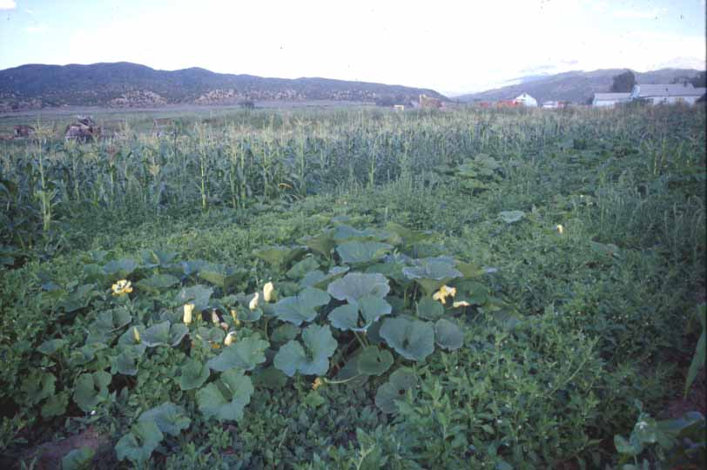
Milpa por acequia en
maiz de concho-calabasita-haba

Slide 11
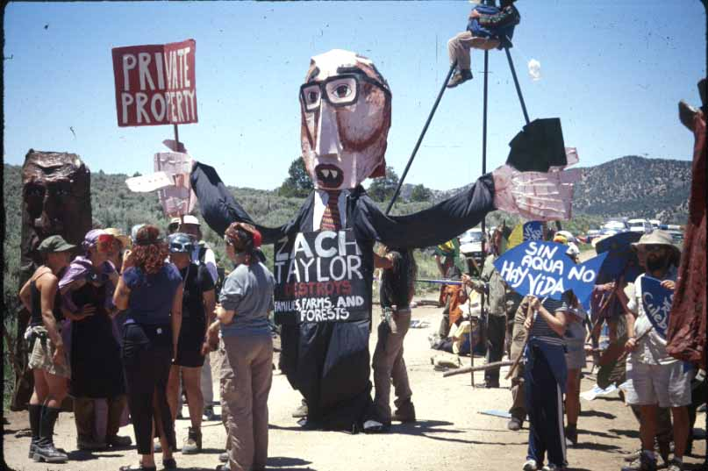
1995-2000: Second wave of industrial-scale logging on La Sierra was met by intense opposition bringing local ranchers and farmers together with radical environmentalists from groups like Earth First!, Greenpeace, and Ancient First Rescue.

Slide 12
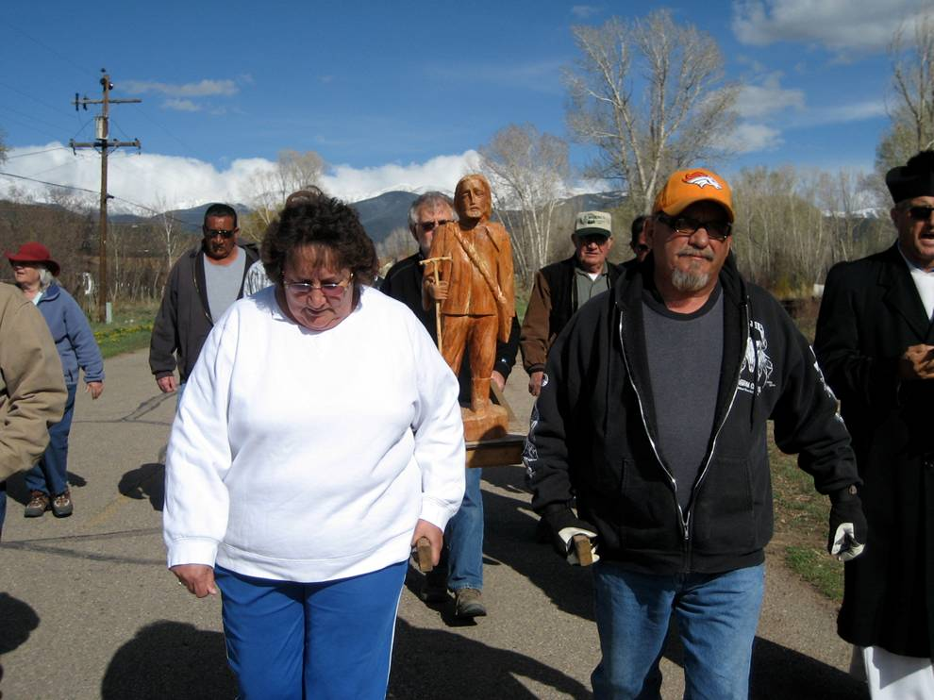
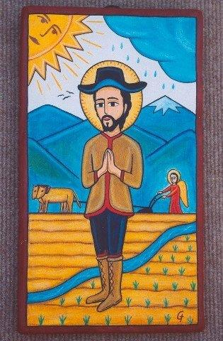
San Isidro Labrador, patron saint of the farmer. Feast Day Celebration takes place on May 15.

Slide 13
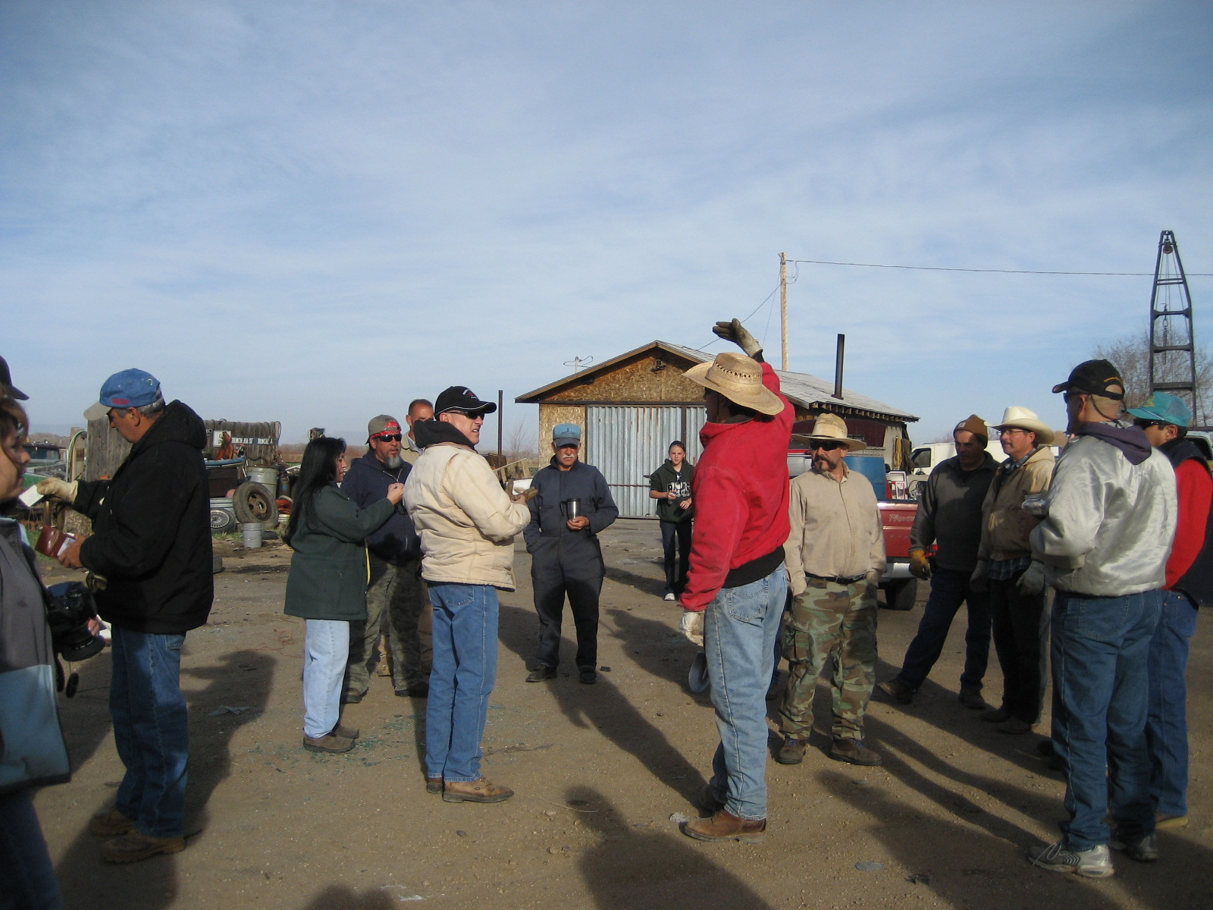
The annual springtime ditch cleaning. Saca y limpieza de acequia.

Slide 14
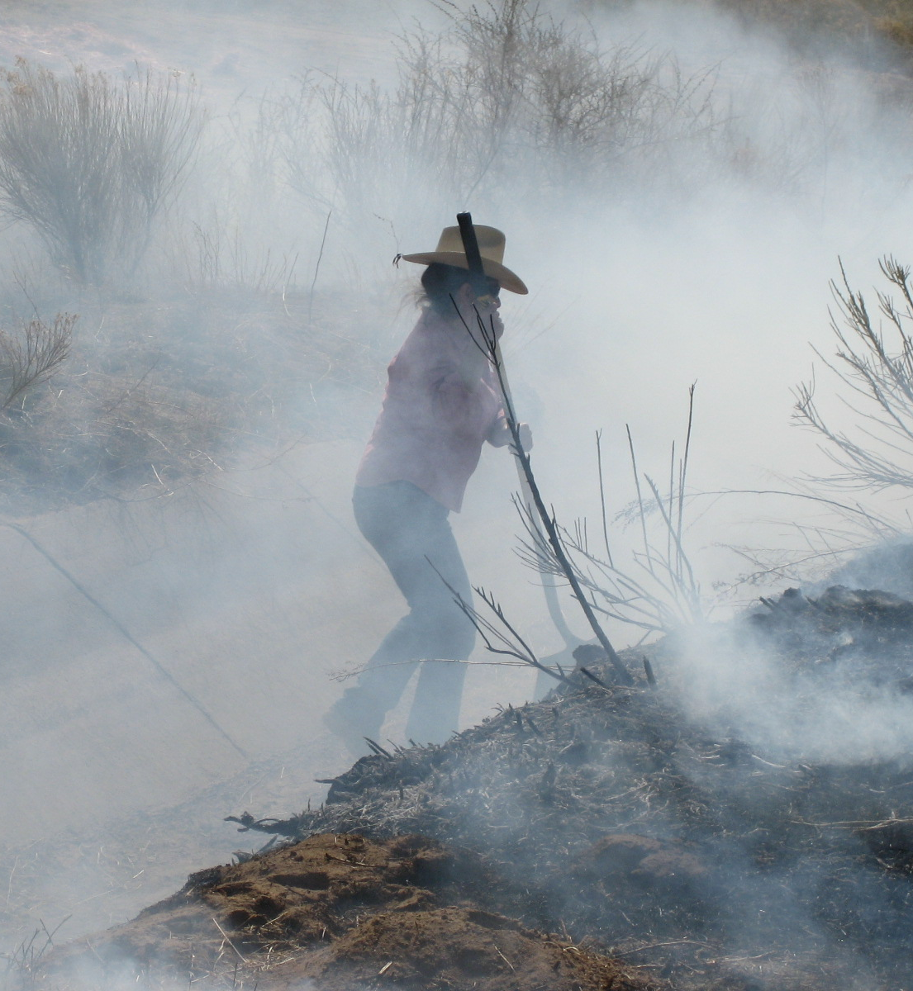
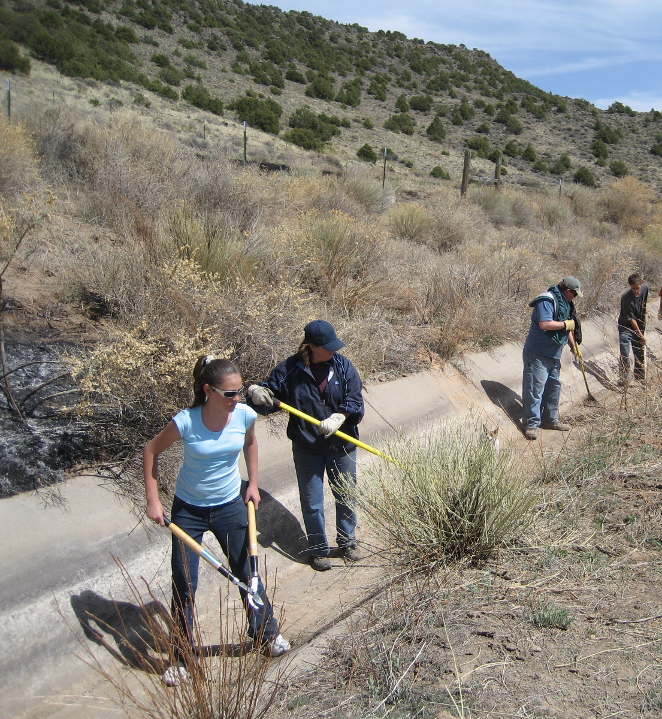

Slide 15
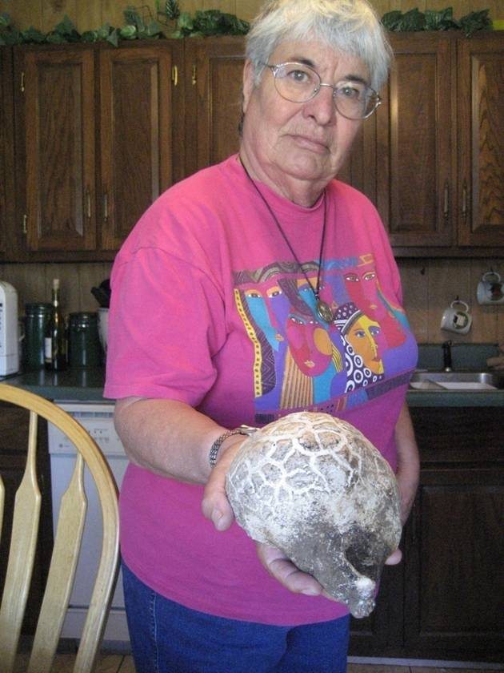
Sister Teresa Jaramillo

Slide 16
Acequia ecosystem services

Slide 17
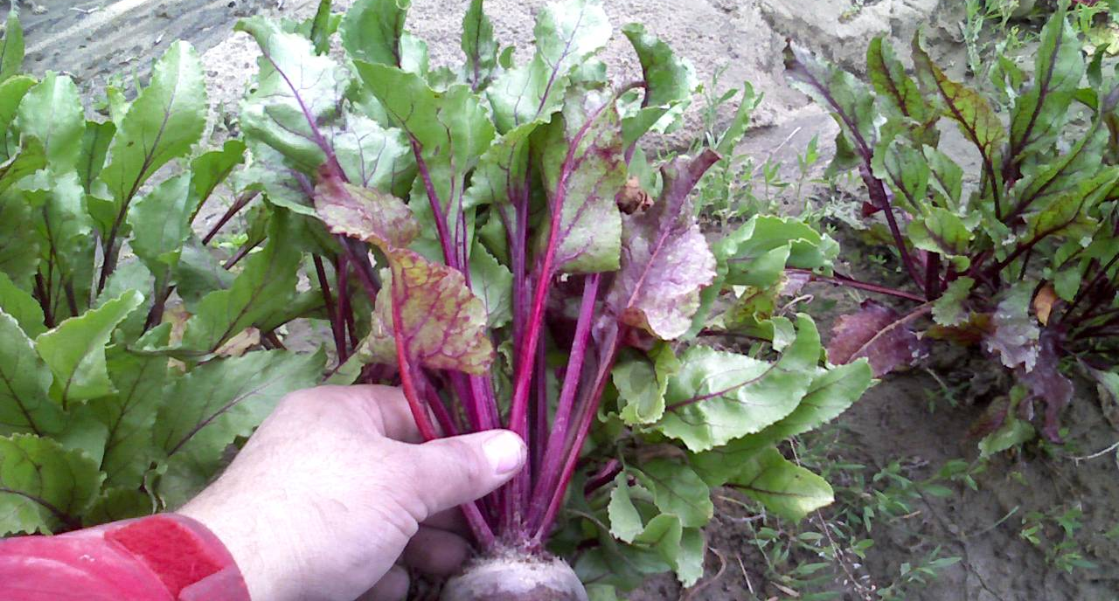
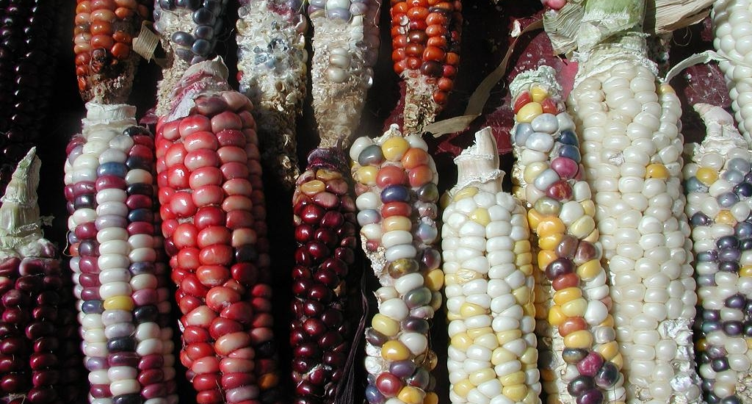
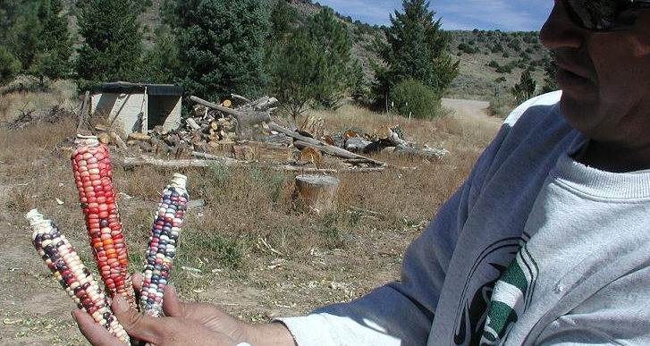

Slide 18
Semilla sagrada | Sacred seed

Slide 19
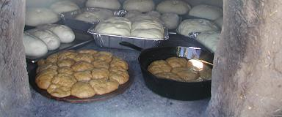
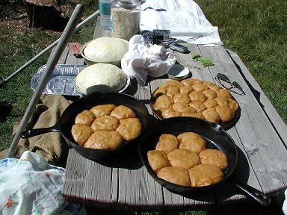
Pan de horno from Las Comadres de San Luis

Slide 20
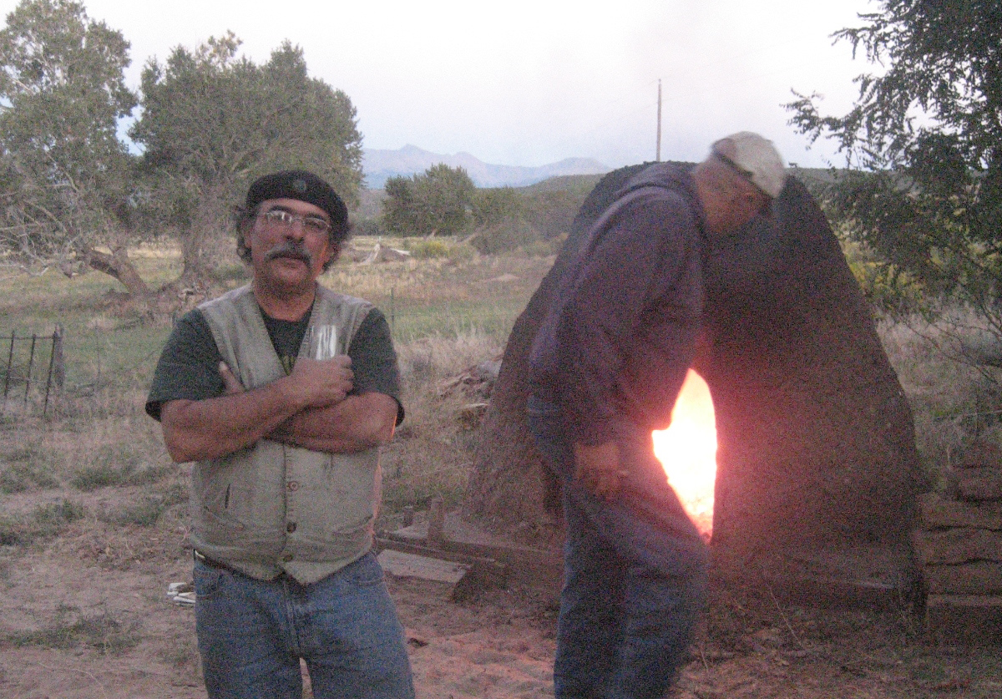
Not just slow food, but deep food

Slide 21
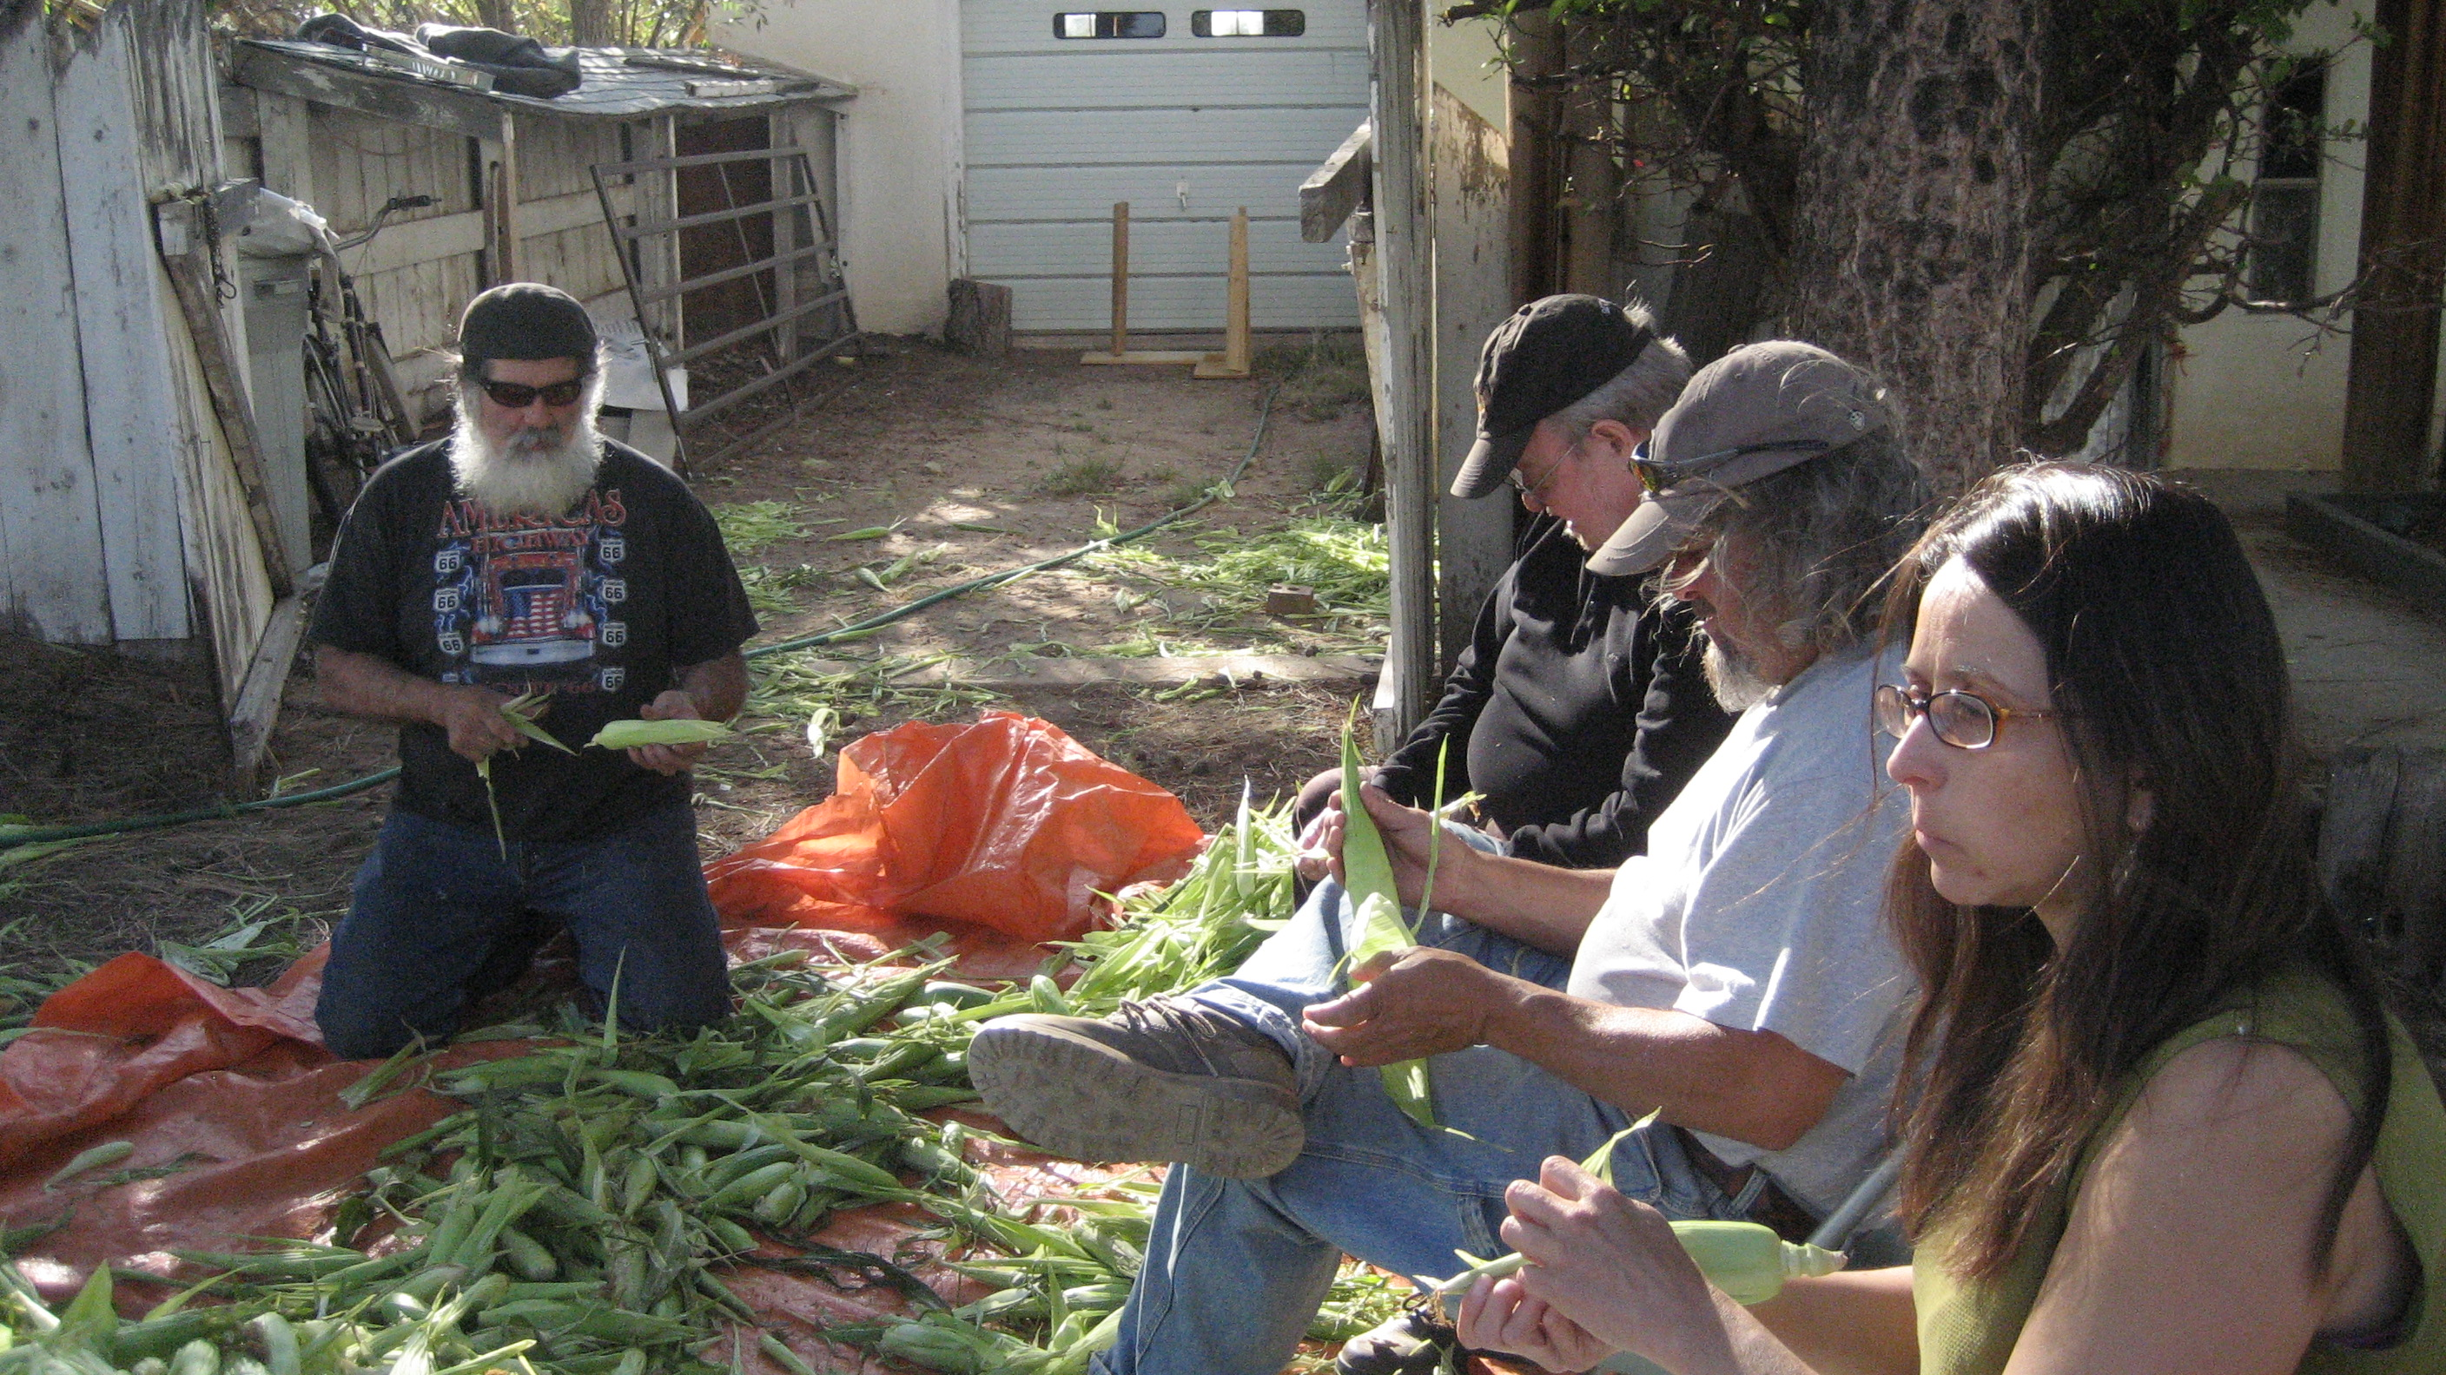

Slide 22
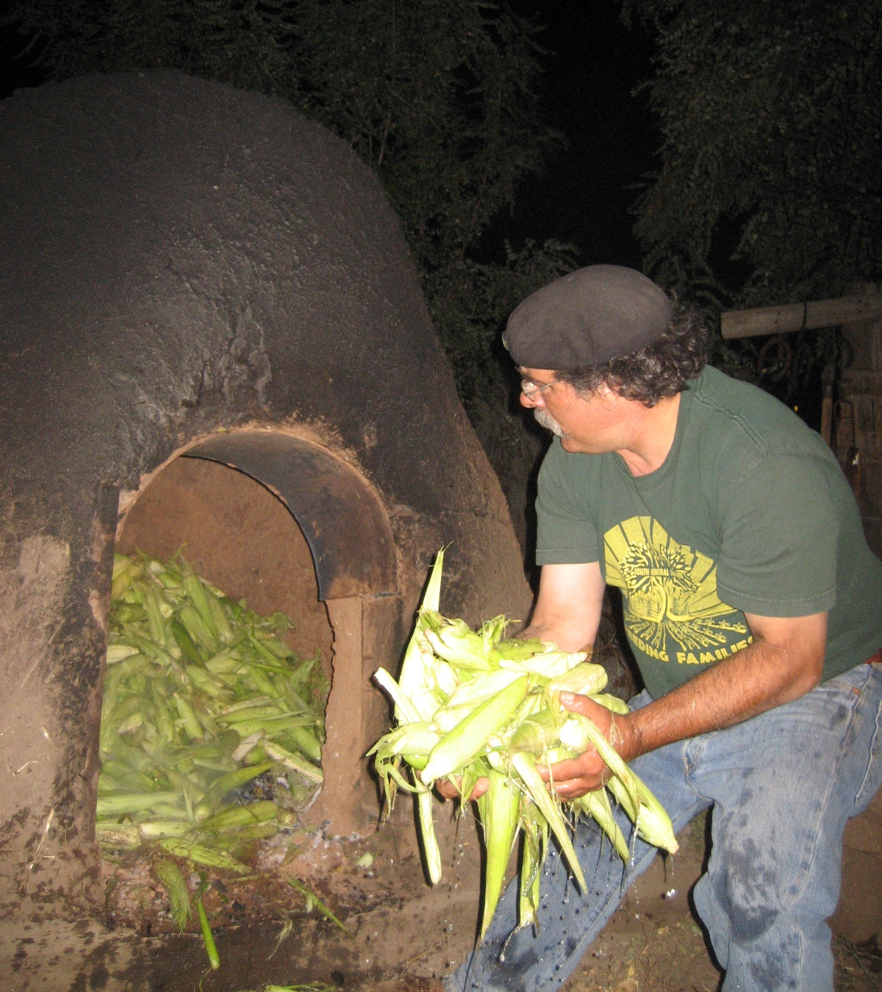
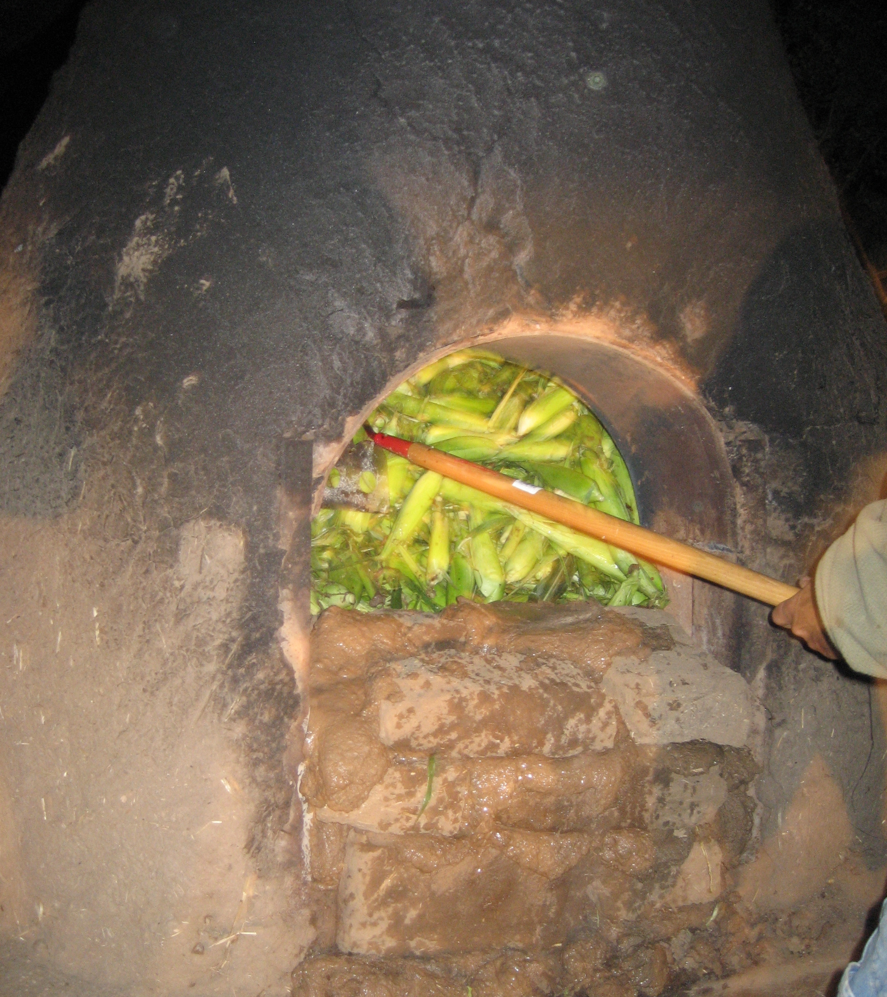

Slide 23
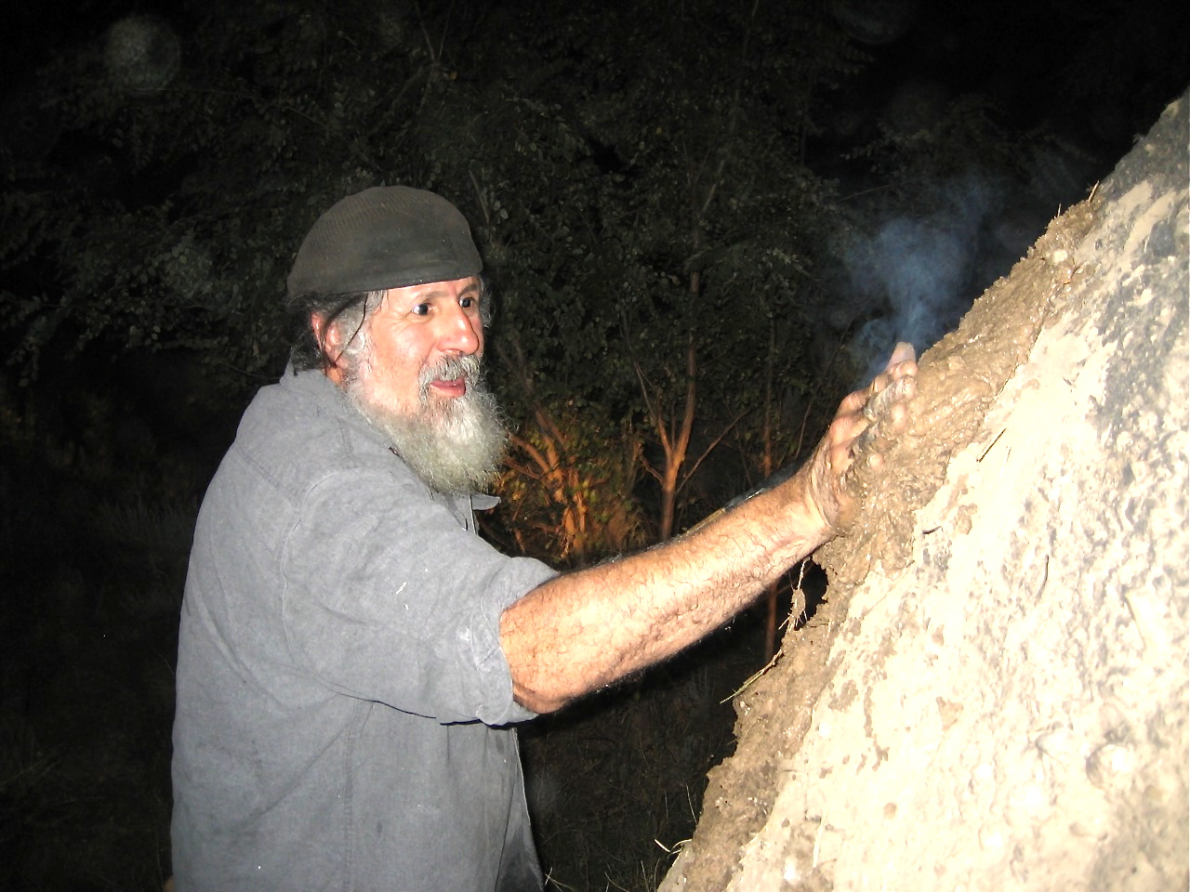

Slide 24
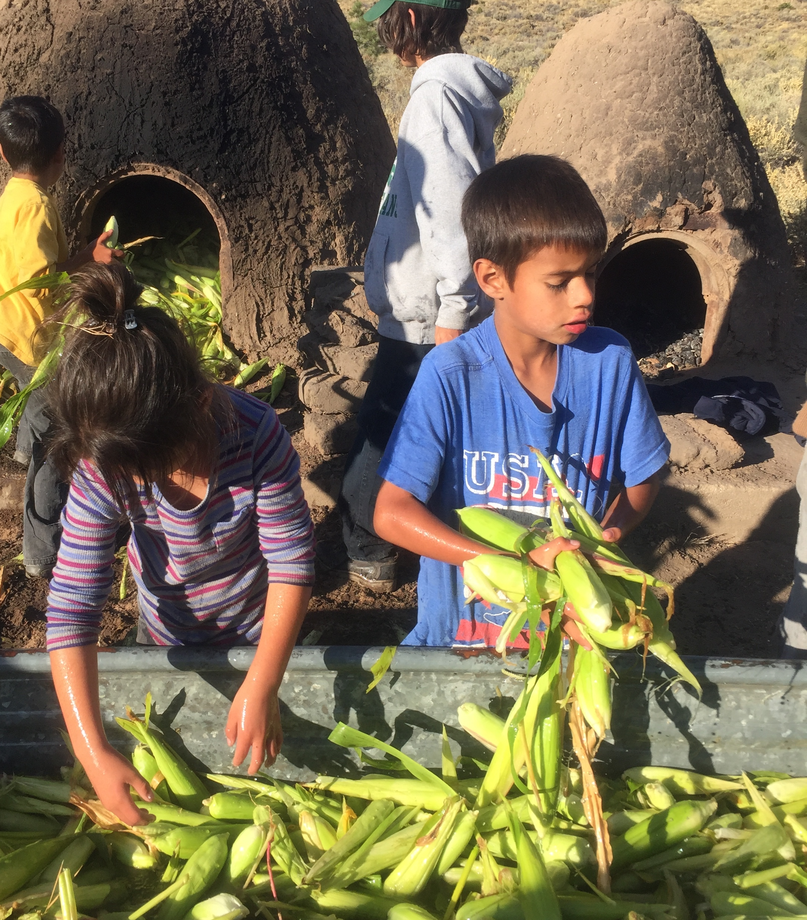
Three generations work the annual horneada.
Corpus A. Gallegos Ranches, San Luis, CO. Sept. 2015.

Slide 25
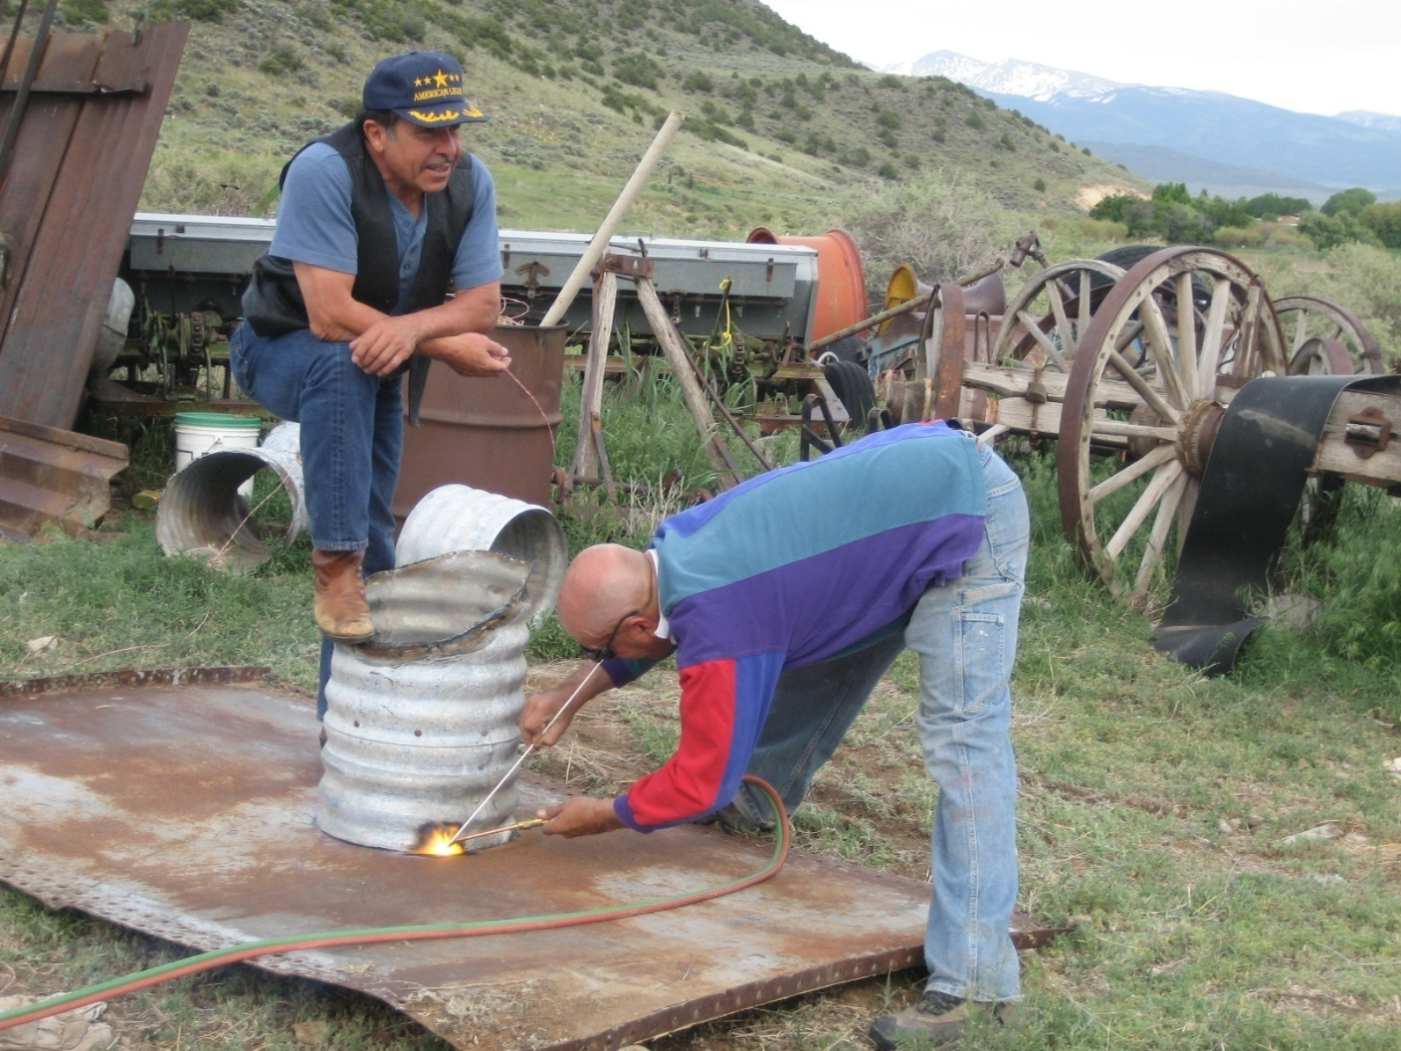
Cooperative labor: marginality as inventive force

Slide 26
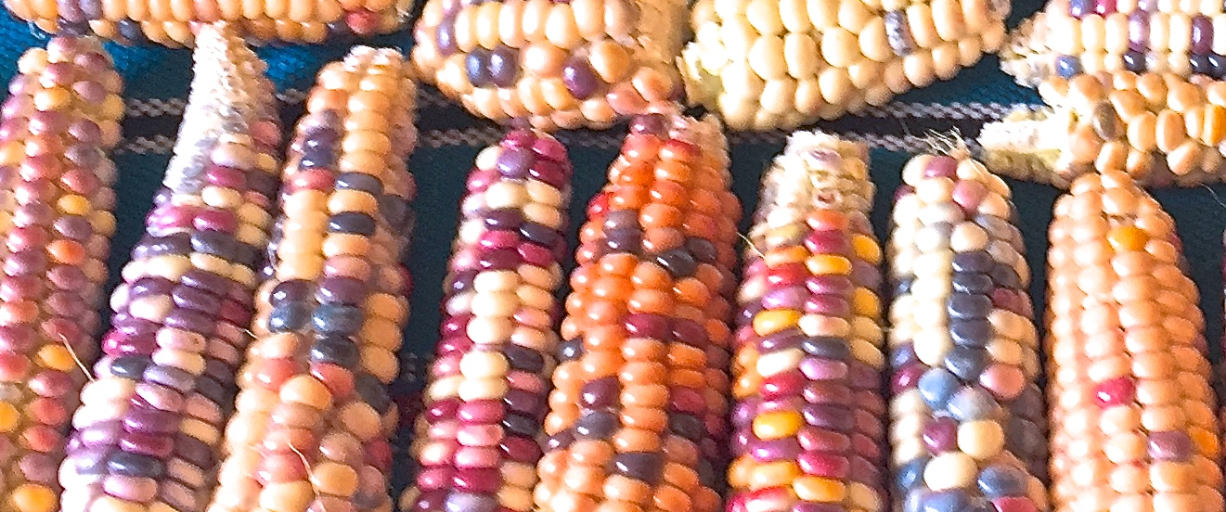
Deep Seeds

Slide 27
Maíz de concho (Zea mays clibanus, culebrana)

Slide 28
Our landrace Zuñi red flint, which is a native place-based high altitude and short season variety

Slide 29
Resurgence and Survivance of Indigenous Agroecology
What is agroecology? It is the Indigenous knowledge of farming in the context of local ecosystems. It is the ethnoscience of resilient agriculture.
The study of farms in ecological and bioregional context including biophysical, cultural, economic, political and social subsystems understood in an interdisciplinary form.
“The Farm does not end at the edge of the field.” - Miguel Altieri

Slide 30
Principles of Agroecology
1. Sense of place: Agroecology recognizes sense of place as a factor in the co-evolution of culture and nature in the adaptation of agroecosystems to the physical and biological nuances of localities (ontological principle). 2. Local knowledge (a.k.a. TEK): Agroecology values the preservation of local indigenous knowledge over the imposition of universal mechanistic knowledge and recognizes the sustainability of traditional agroecosystems (epistemological principle). 3. Polycultures: Agroecology privileges the production strategies of traditional polycultures over modern monocultures as a way to correct inequities in agricultural research and extension services (ethical principle).

Slide 31
4. Local self-management: Agroecology empowers traditional farmers by favoring local self- management of the natural conditions of production and promoting local control of political economic institutions (policy principle). 5. Ecosystemic principle: Agroecology views the farm from a biological or ecosystemic perspective and eschews mechanistic or industrial models of productivity and efficiency. The fundamental principle of agroecology, seemingly paradoxical, is that the farming system is above all a human artifact and yet the farm does not end at the edge of the crop field. The farm is itself an ecosystem and exists within a larger ecosystemic (watershed or bioregional) context.
Principles of Agroecology

Slide 32
6. Multiple systems: Agroecology emphasizes the fact that farms are embedded in multiple systems: physical, biological, socioeconomic, and cultural. All these systems are interconnected and their interactions must be understood for a farm to evolve in a sustainable manner (see handout). 7. Assessment strategy: Agroecology provides a specific set of criteria for assessing the sustainability of a farming system that includes the following values: crop diversity, temporal permanence, isolation, stability, genetic diversity, human control, and natural pest control (see handout).
Principles of Agroecology

Slide 33
8. Principle of mimicry: Agroecology seeks to protect traditional farming systems because they involve strategies that mimic nature’s own diversity. A traditional farming systems is characterized by: genetic diversity in plant species; complex trophic relationships among crops, weeds, insects, and pathogens; relatively closed nutrient cycles with many crop nutrient requirements supplied by rotations, fallow, or manure; year-round vegetative cover of soil; efficient use of water, sunlight, and soil; low risk of complete loss of crops due to diversity; high level of production stability due to compensation by the various components when one component fails.
Principles of Agroecology

Slide 34
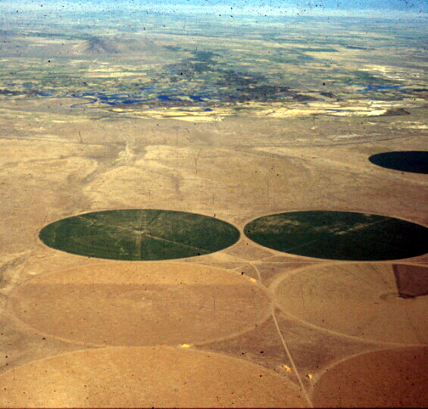
Polka-dot monoculture uniformity. Center—pivot sprinkler operations in the San Luis Valley, CO.
Acequia biocultural diversity. The huerto familiar, home kitchen garden at Corpus Gallegos Ranches, San Luis, CO. Photos by Devon G. Peña

Slide 35
Heritage Cuisines The return of the “milpa diet.”
Genes, food, culture, and the body. “We are what our ancestors ate.” Epigenetics. The gut microbiome.
The importance of heritage cuisine to health and well-being. Food is our medicine and the milpa and kitchen garden our pharmacopeia.
Heritage cuisine and ethnic identity.
The importance of soil biodynamics to the nutrient density of our crops.
The role of companion plants, intercropping and polycultures, rotations, fallow, and other cultural practices that sustain resilience.
Spiritual practices and material culture associated with heritage cuisines

Slide 36
Chicos fresh out of the oven

Slide 37
Chicos & bolita beans being cleaned for cooking.

Slide 38
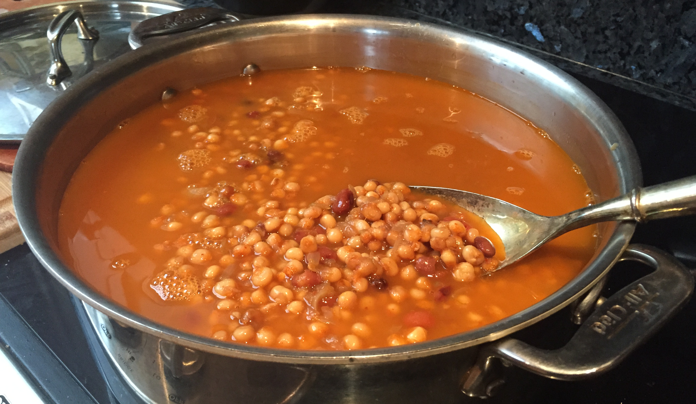
Caldo de chicos del horno con frijol de bolita
Prepared in our adobe ovens with wood ash means this corn is fully nixtamalized.
Notes:
Nixtamalization. A process for preparing corn invented by Mesoamericans thousands of years ago that optimizes the nutritional value and bioavailability of nutrients for the human digestive system. See: https://www.sciencedirect.com/topics/food-science/nixtamalization.

Slide 39
The Acequia Institute

Slide 40
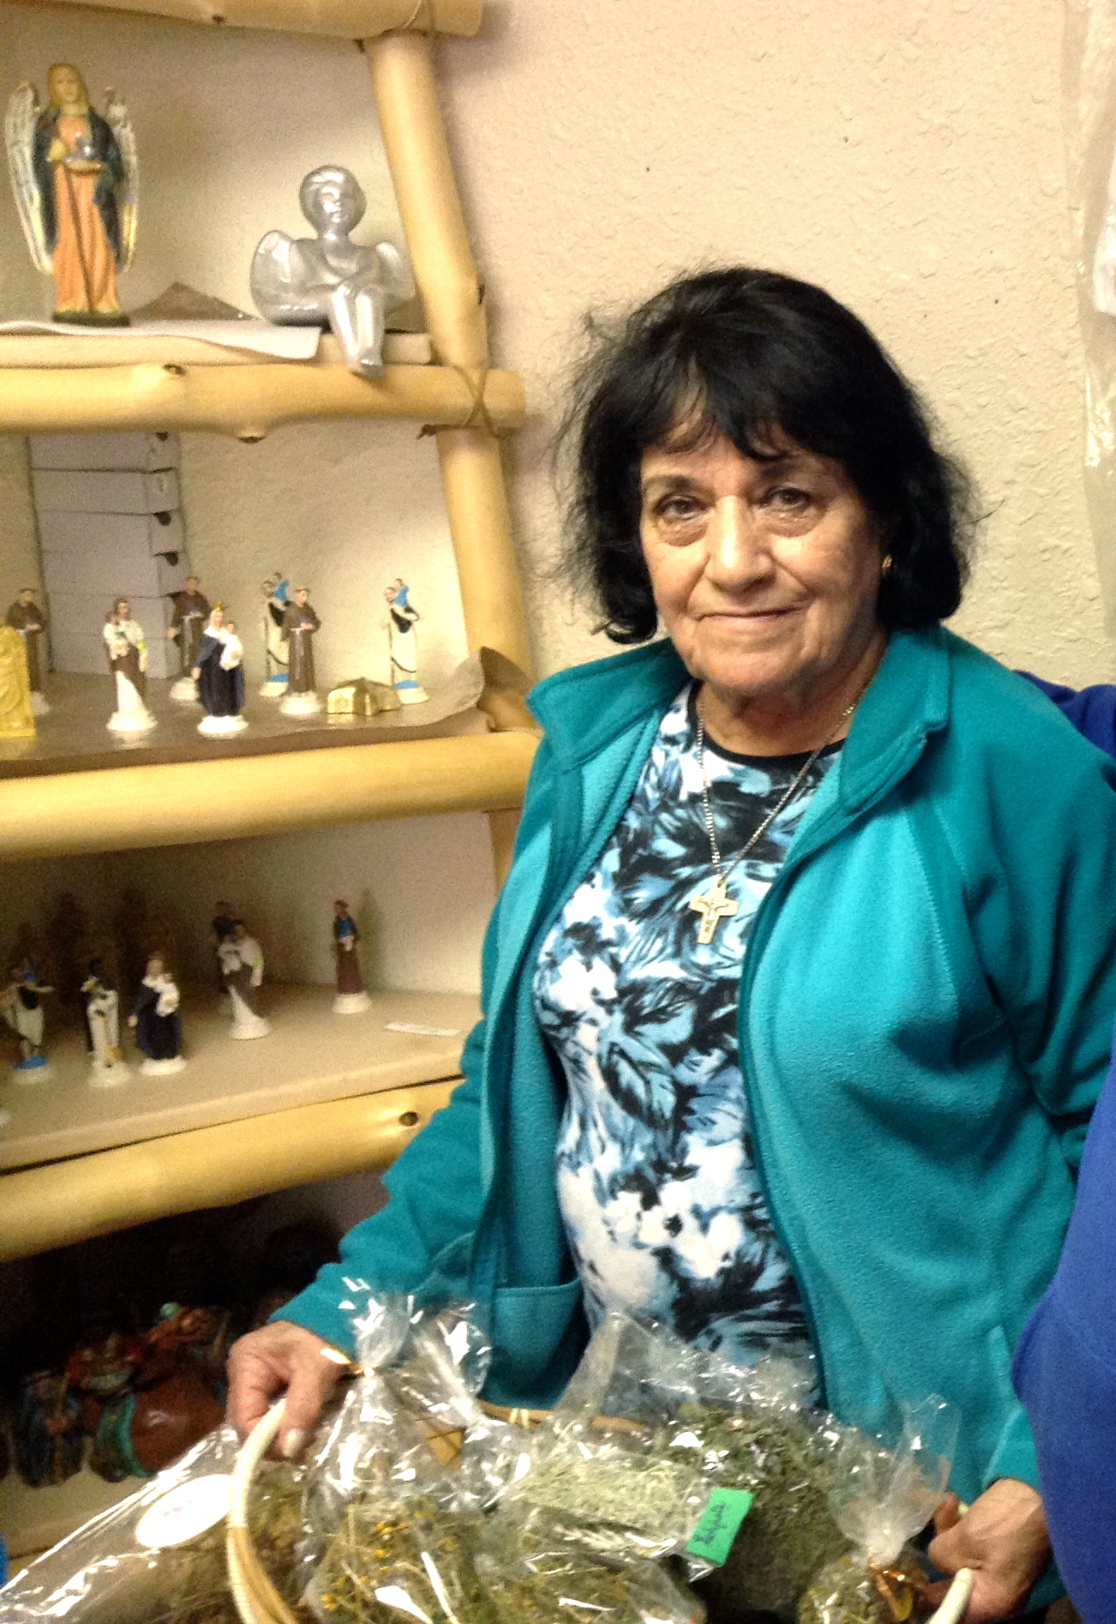
Ethnobotany
Our esteemed colleague Maestra Teresa Vigil serves as one of our Indigenous elder mentors and field instructors. We often spend a week in the classroom and field as she shared knowledge of local traditions of curanderas, doulas, parteras and other practitioners of community-based nursing and care-giving labor. The field trips introduce students to the watershed of the Sangre de Cristo land grant. Students included UW groups and local high school students studying with the Move Mountains project for at-risk youth.

Slide 41
Connecting with local students

Slide 42
Building local economy
2015 UW summer field school students built this adobe brick and mud plaster oven or horno under the tutelage of master artisan, Cornelio Arellano. The site is a Chicana-P'urhépecha acequia farm in San Luis, CO.

Slide 43
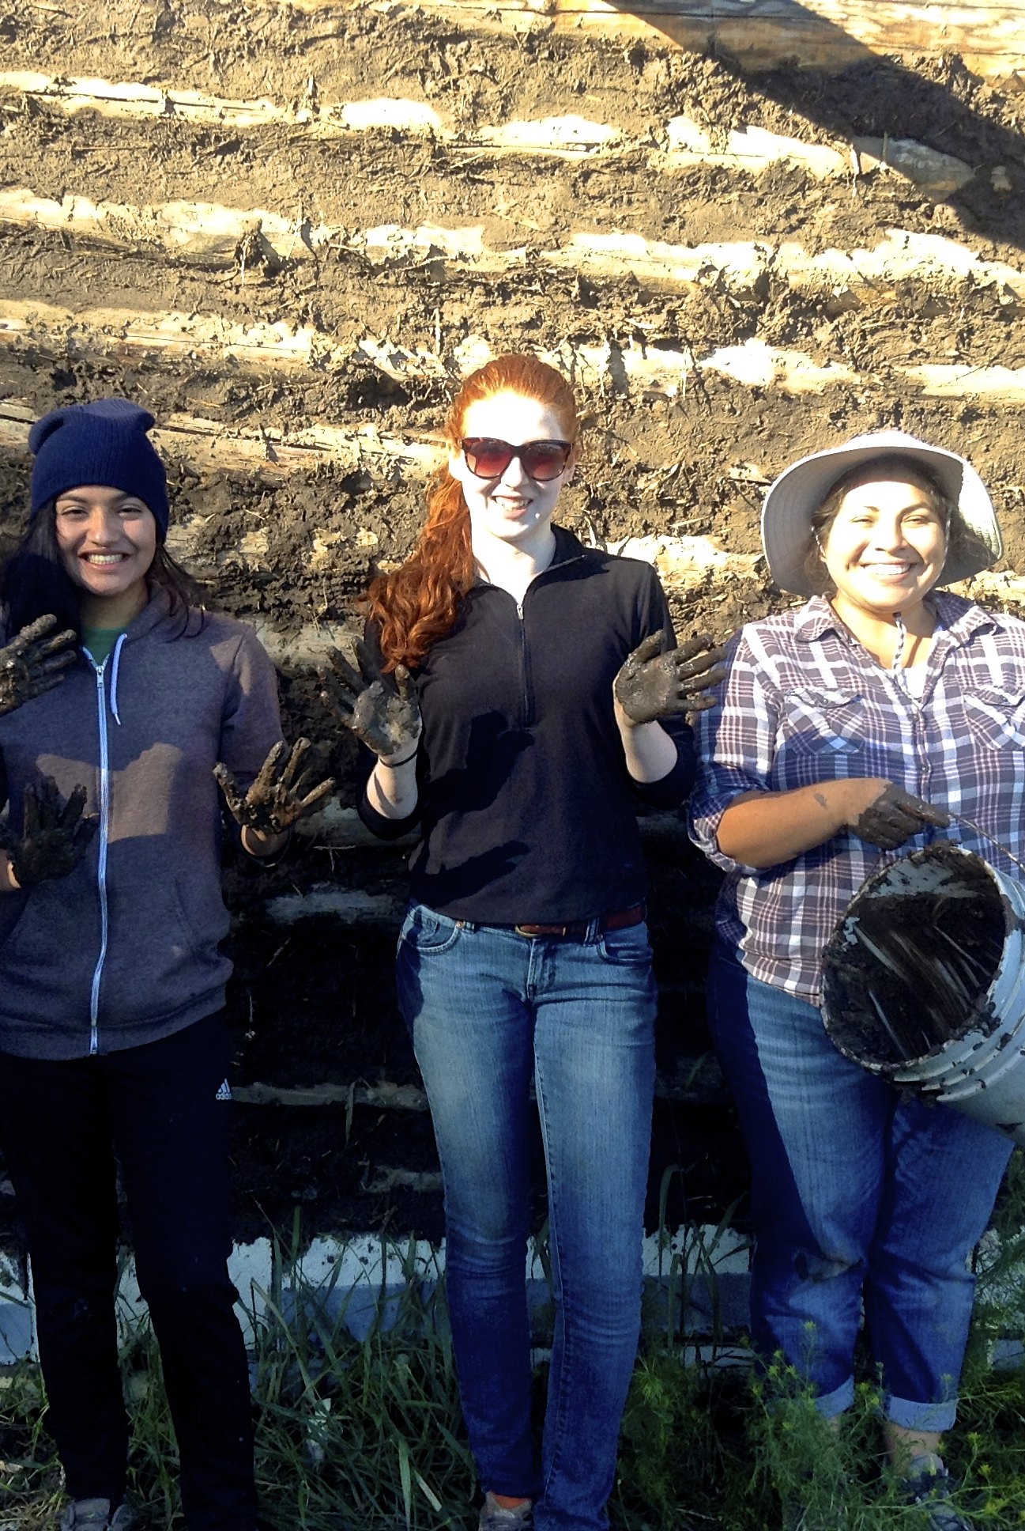
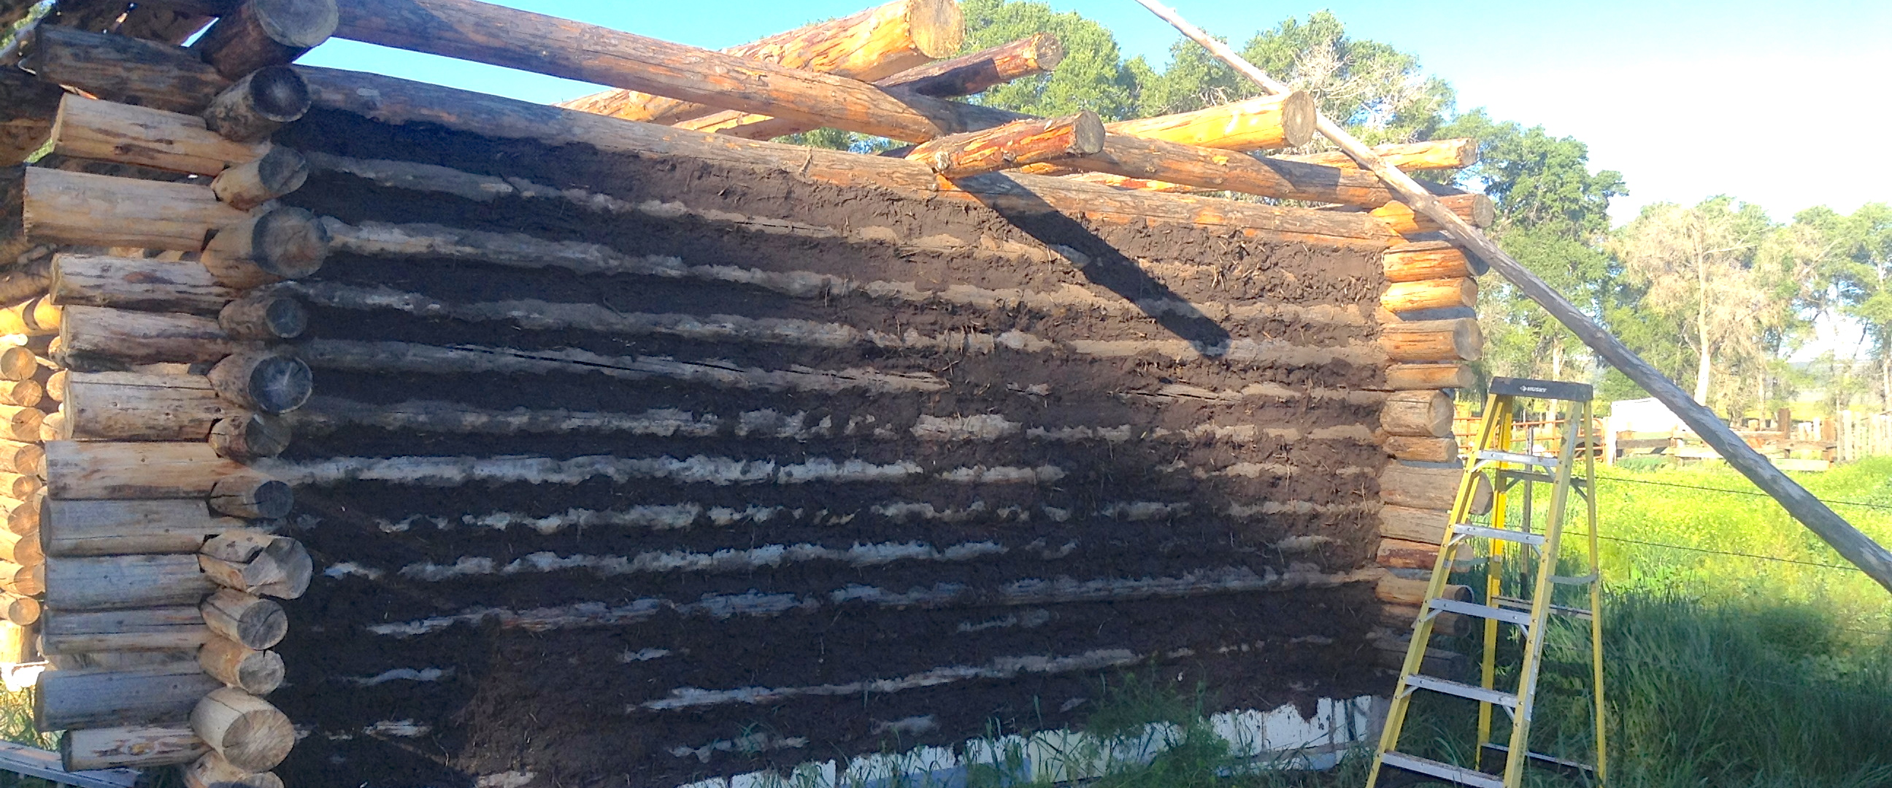
Building local economy – la dispensa

Slide 44
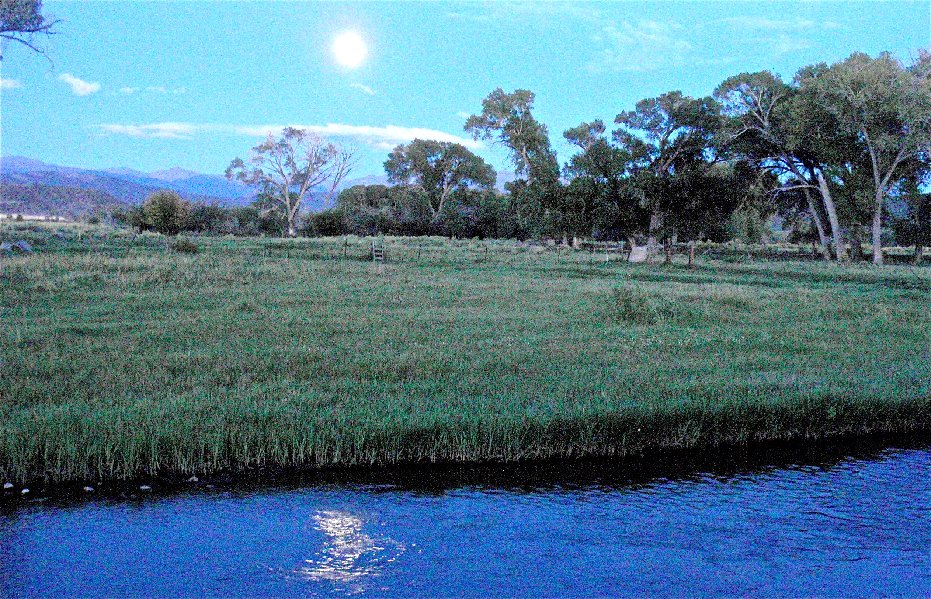
Culebra River ecological restoration

