Slide 1
Maiz Concho for Chicos del horno A local, slow, and deep food

Slide 2
Cultural Ecological History of Maíz Concho for Chicos del Horno ZEA MAYS CLIBANUS CULEBRANA
The 8 principal Vavilov centers of origin. 1 = Mesoamerica

Slide 3
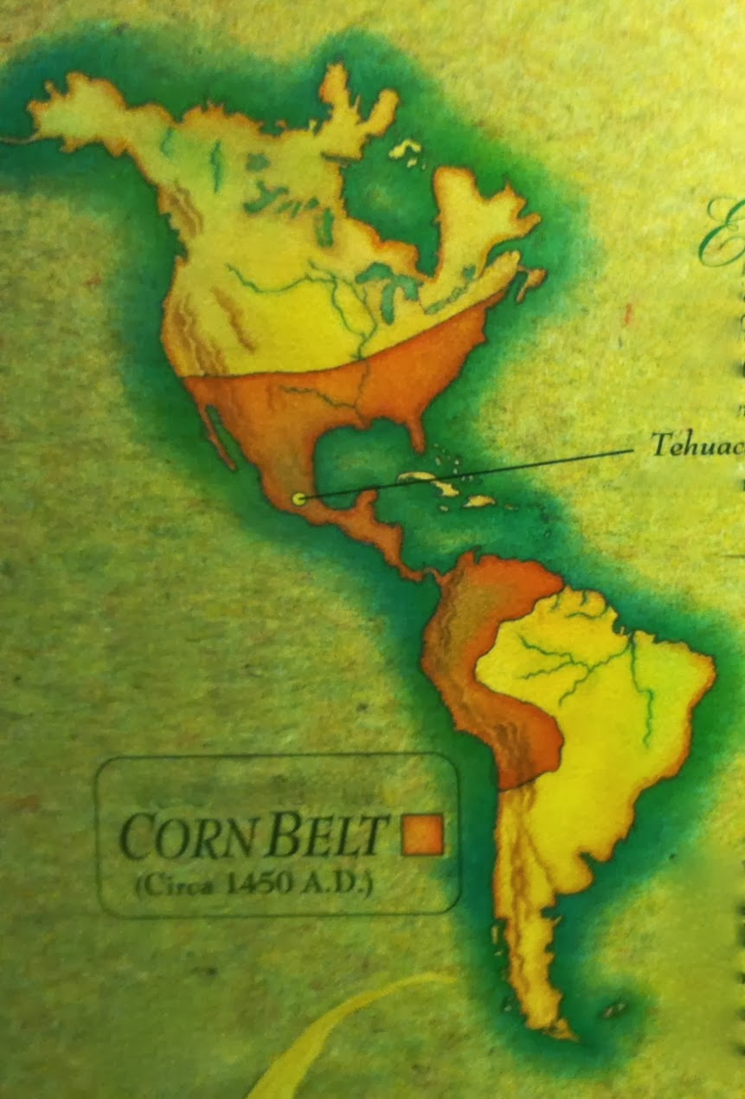
Franja del Maíz The Corn Belt a.k.a. Corn Corridor

Slide 4
Dispersion of varieties from Centers of Origin

Slide 5
Centers of Origin and Diversification of Maize
Costilla County Concho

Slide 6
Origin of maize (Zea mays spp.)
Domesticated in central and southern Mexico from a wild grass relative known in Nahuátl nomenclature as teosinte, which has been interpreted to mean “Grain of the Gods”.
Some species of teosinte are distinct from maize both genetically and taxonomically, and they appear not to have played any role in the origin of maize.
However, one form of teosinte, known as Zea mays ssp. Diploperenis; parviglumis, is widely regarded as the direct ancestor of the cultigen.

Slide 7
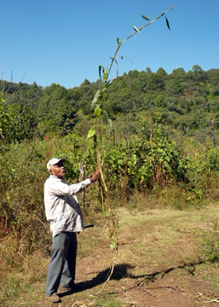
Teosinte diversity: Zea diploperennis, a.k.a. “madre del maíz” – a wild variety from the Mixteca region of Oaxaca

Slide 8
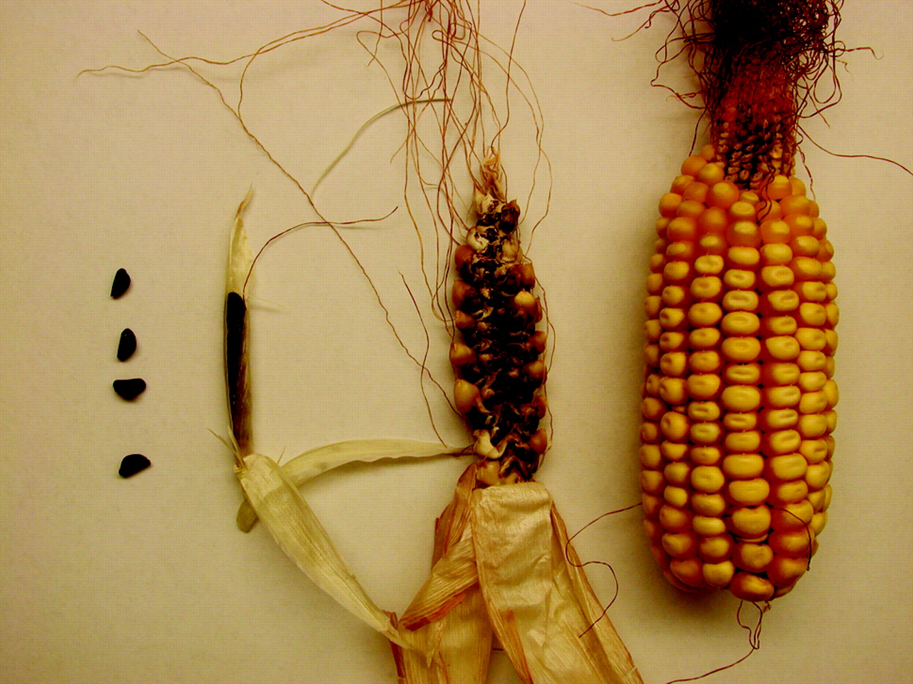
Teosinte Teosinte Madre del maíz Cacachuacintle
seed infructescence infructescence land race

Slide 9
Agroecology of corn
Mexico has more than 60 distinct “land races” (native heirloom varieties) of maize.
The cultural selection and other adaptive practices of indigenous farmers over the past 7-10,000 years has produced an incredible variety of corn land races in Mexico, distributed among the six principal subclasses of Zea mays:
Dent
Flint
Flour
Popcorn
Sweet
Pod

Slide 10
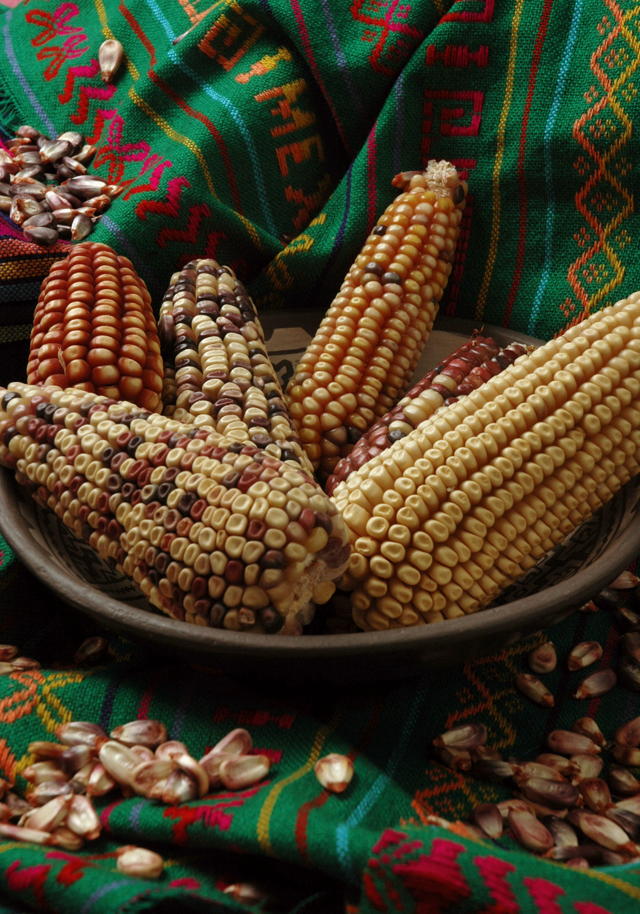
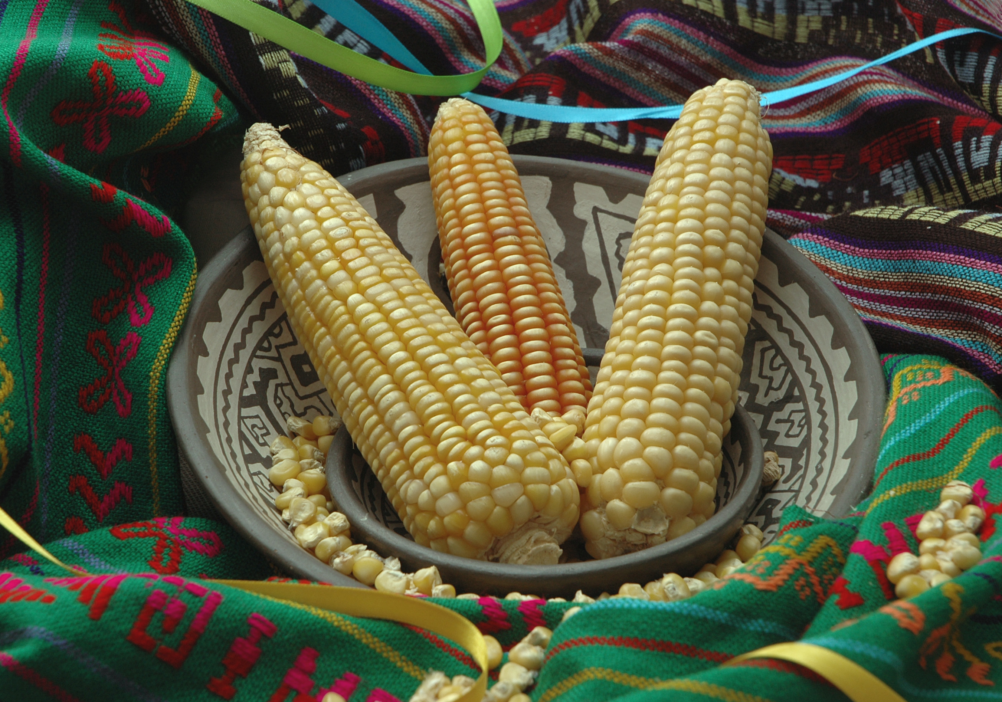
The CIMMYT collection
Amarillo de Sonora (flint)
Conico Norteño (dent)

Slide 11
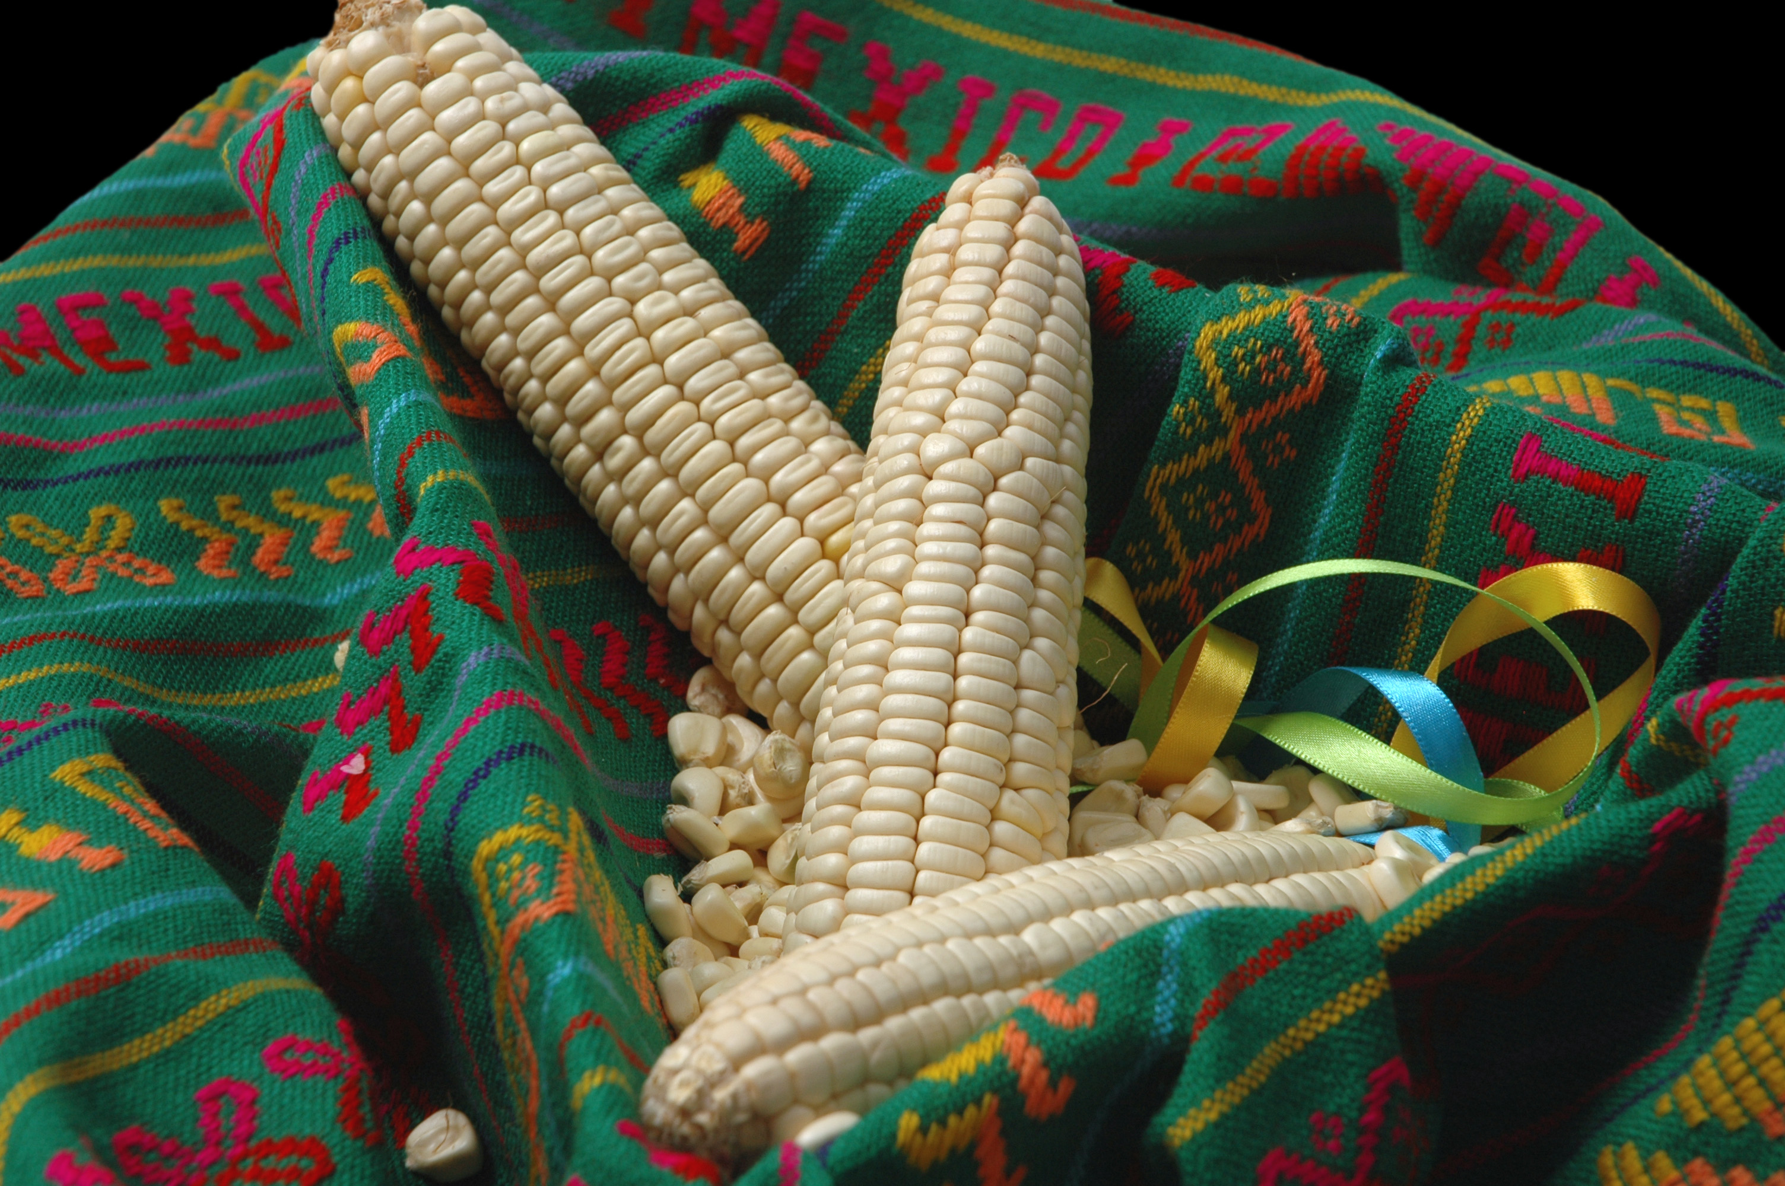
Blandito de Sonora (flour)

Slide 12
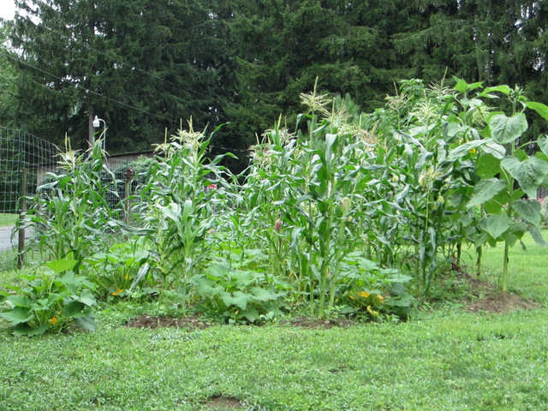
Agroecology
Maize traditionally grown as part of a complex mix of annual and perennial polyculture intercropping patterns centered on the famous “Three Sisters” companion plants – corn, bean, squash (and pumpkin).

Slide 13
Ethnobiology
Indigenous peoples use every part of the maize plant for food, medicine, ceremony, and mulch and composts.
Corn silk is used used as a medicinal tea.
The nixtamalization of corn masa (flour) liberates vital nutrients inc. B vitamins, amino acids, anti-cancer and anti-inflammatory phytochemicals for uptake by the body.

Slide 14
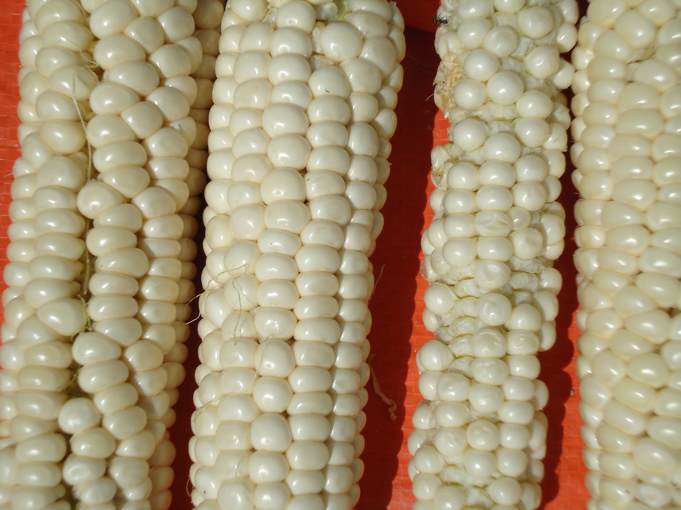
Maíz de concho (Zea Mays clibanus culebrana). A white floury-flint land race of the Upper Rio Grande

Slide 15
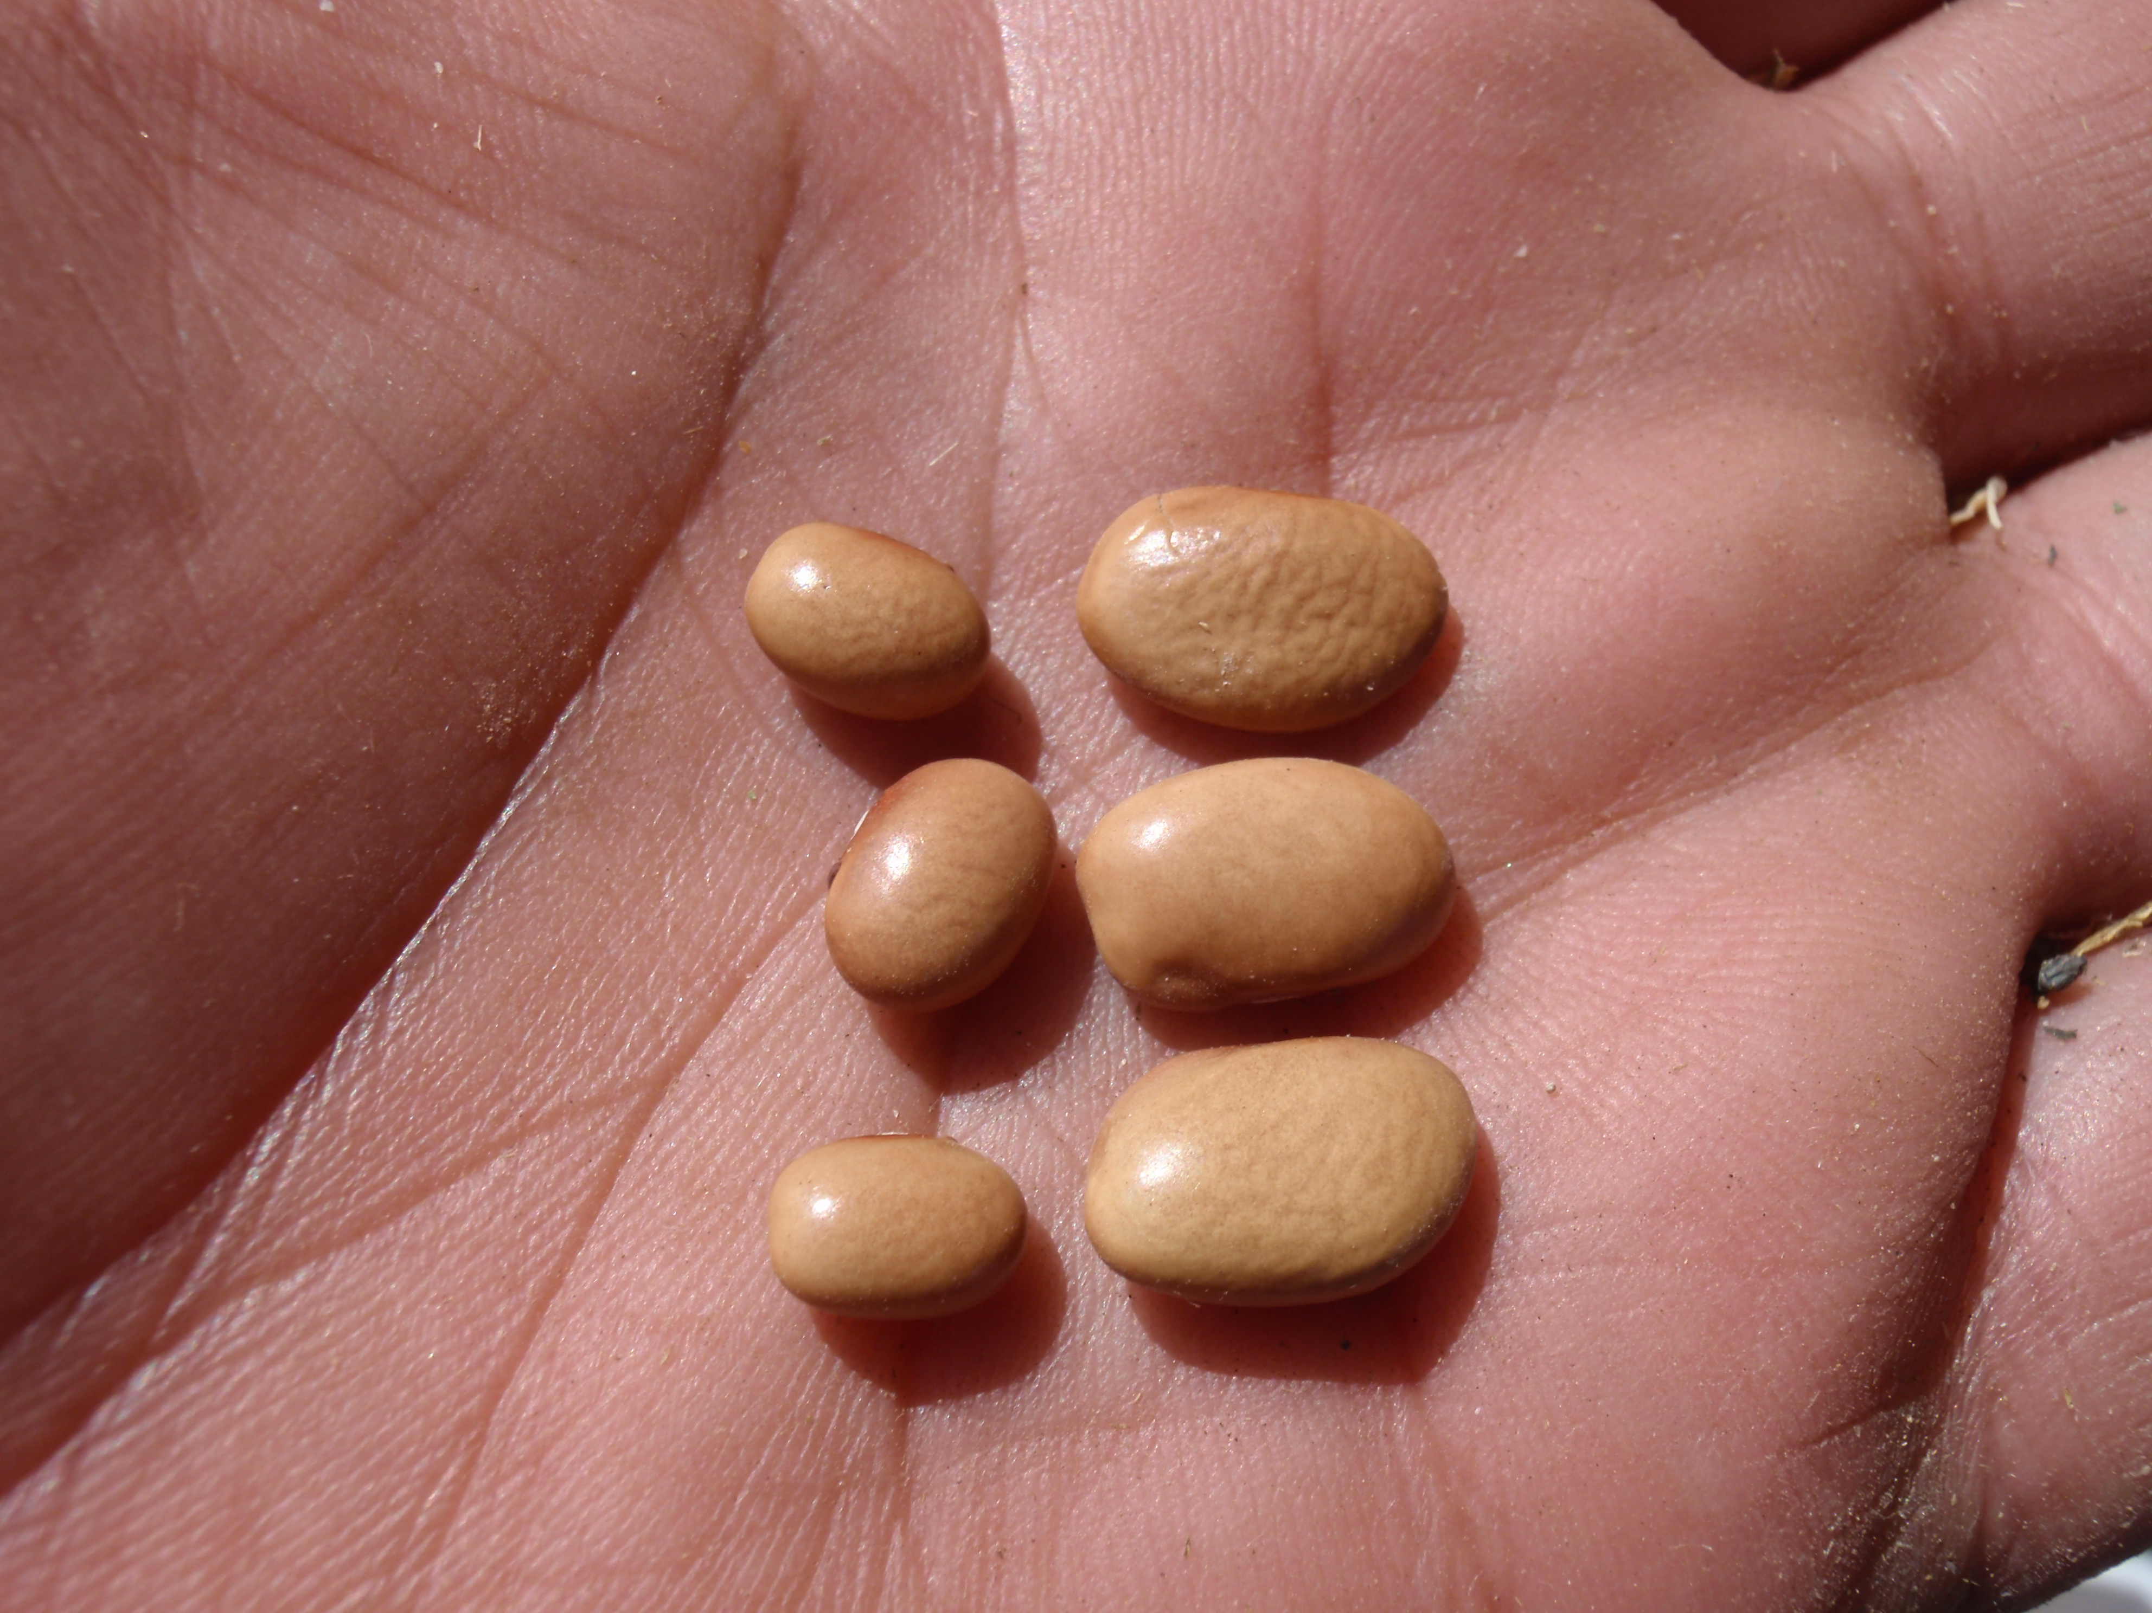
Heirloom Bolita bean restoration.
Go to: Bolita Bean Wars

Slide 16
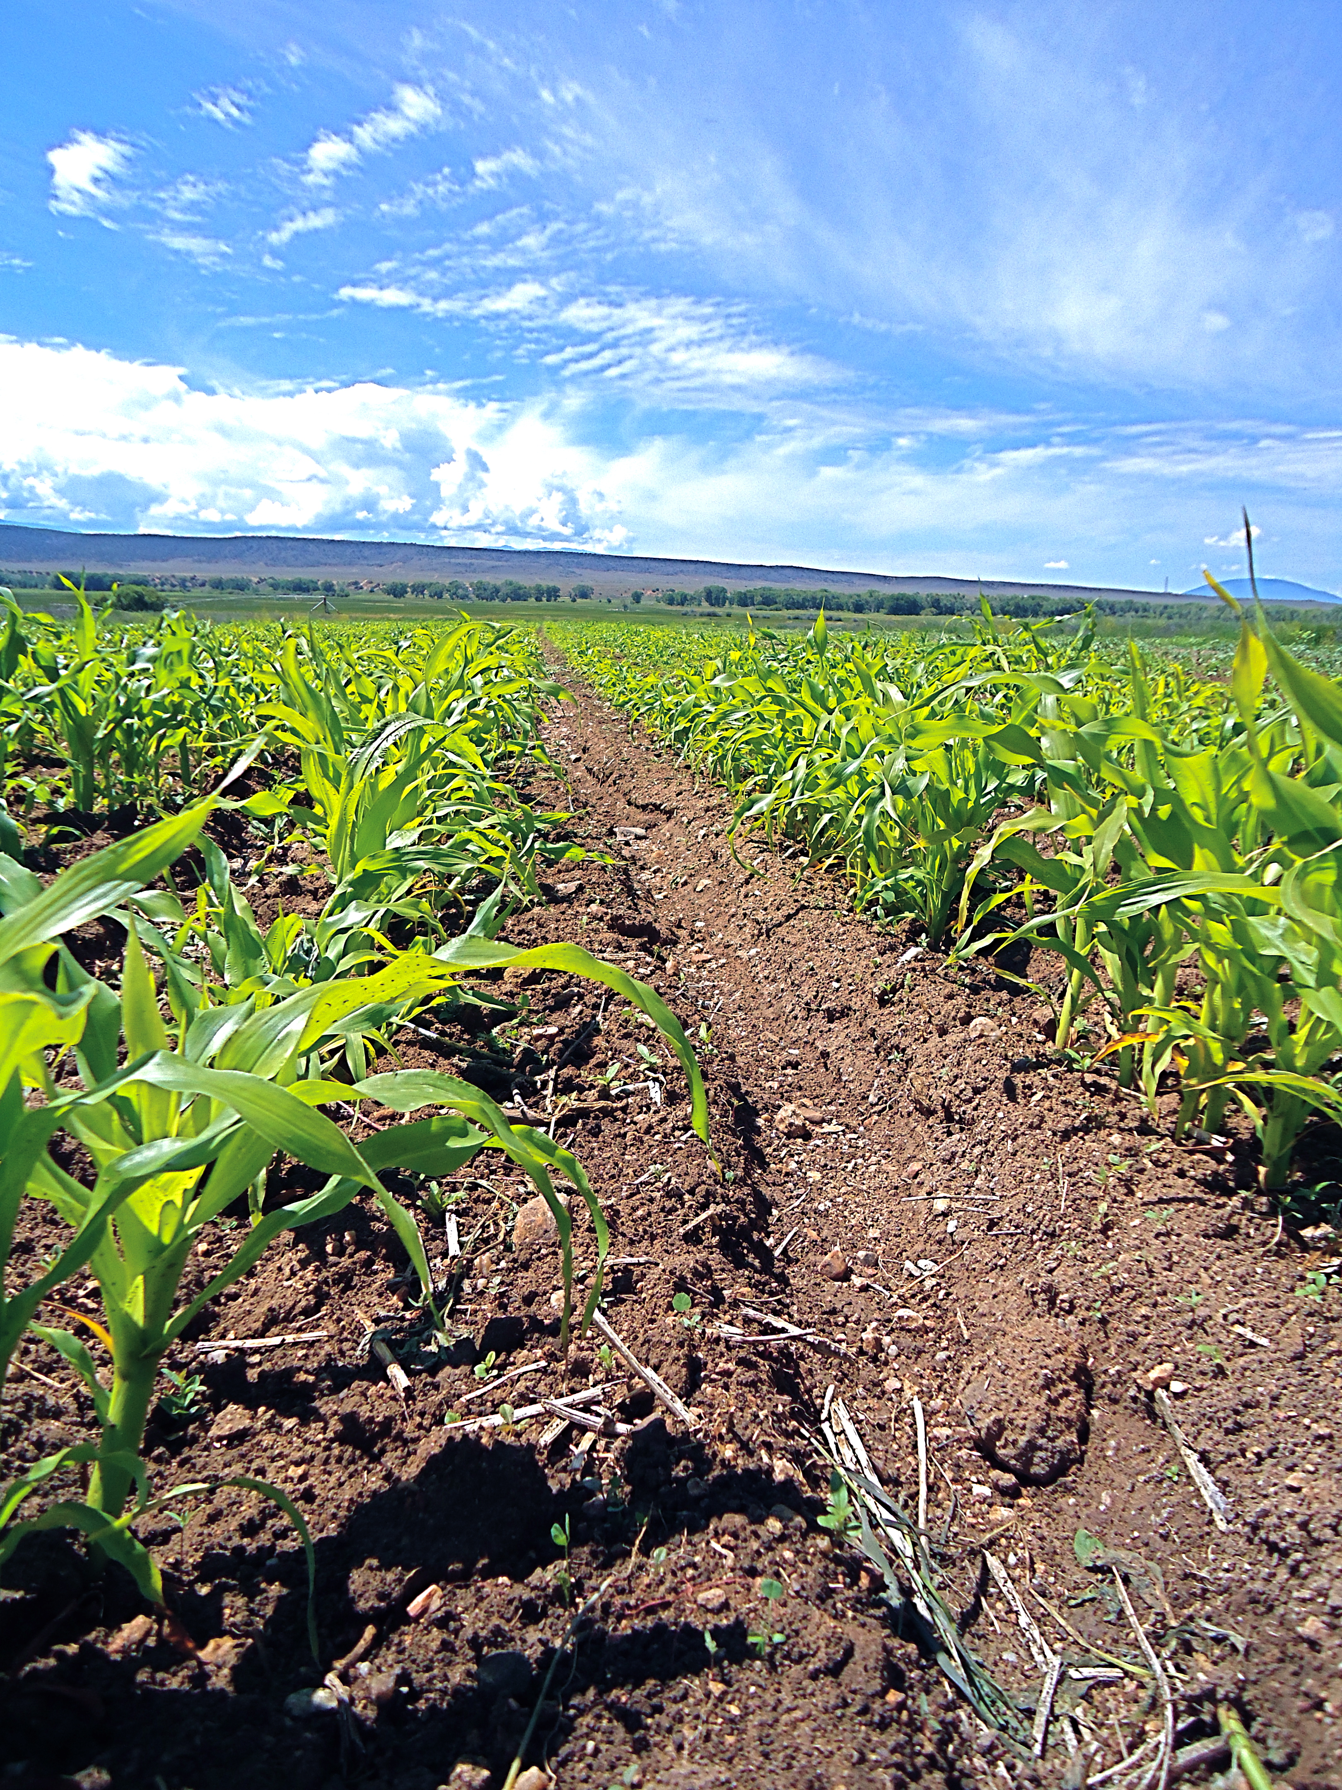

Slide 17
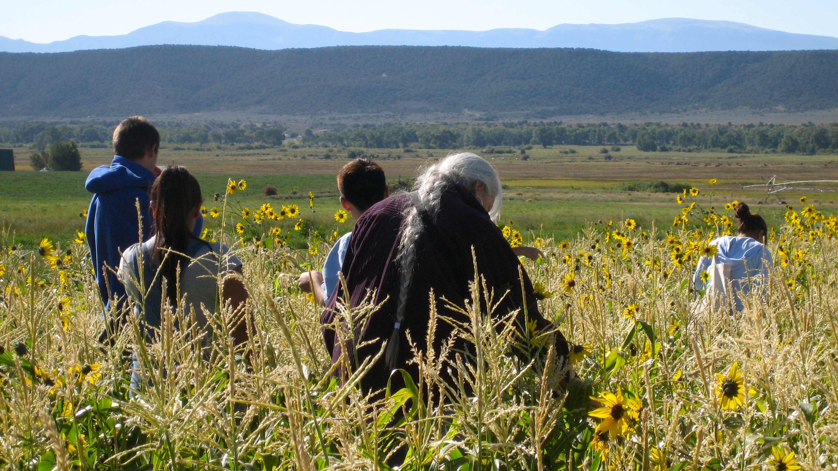
Harvesting maize at the Acequia Institute milpa.

Slide 18
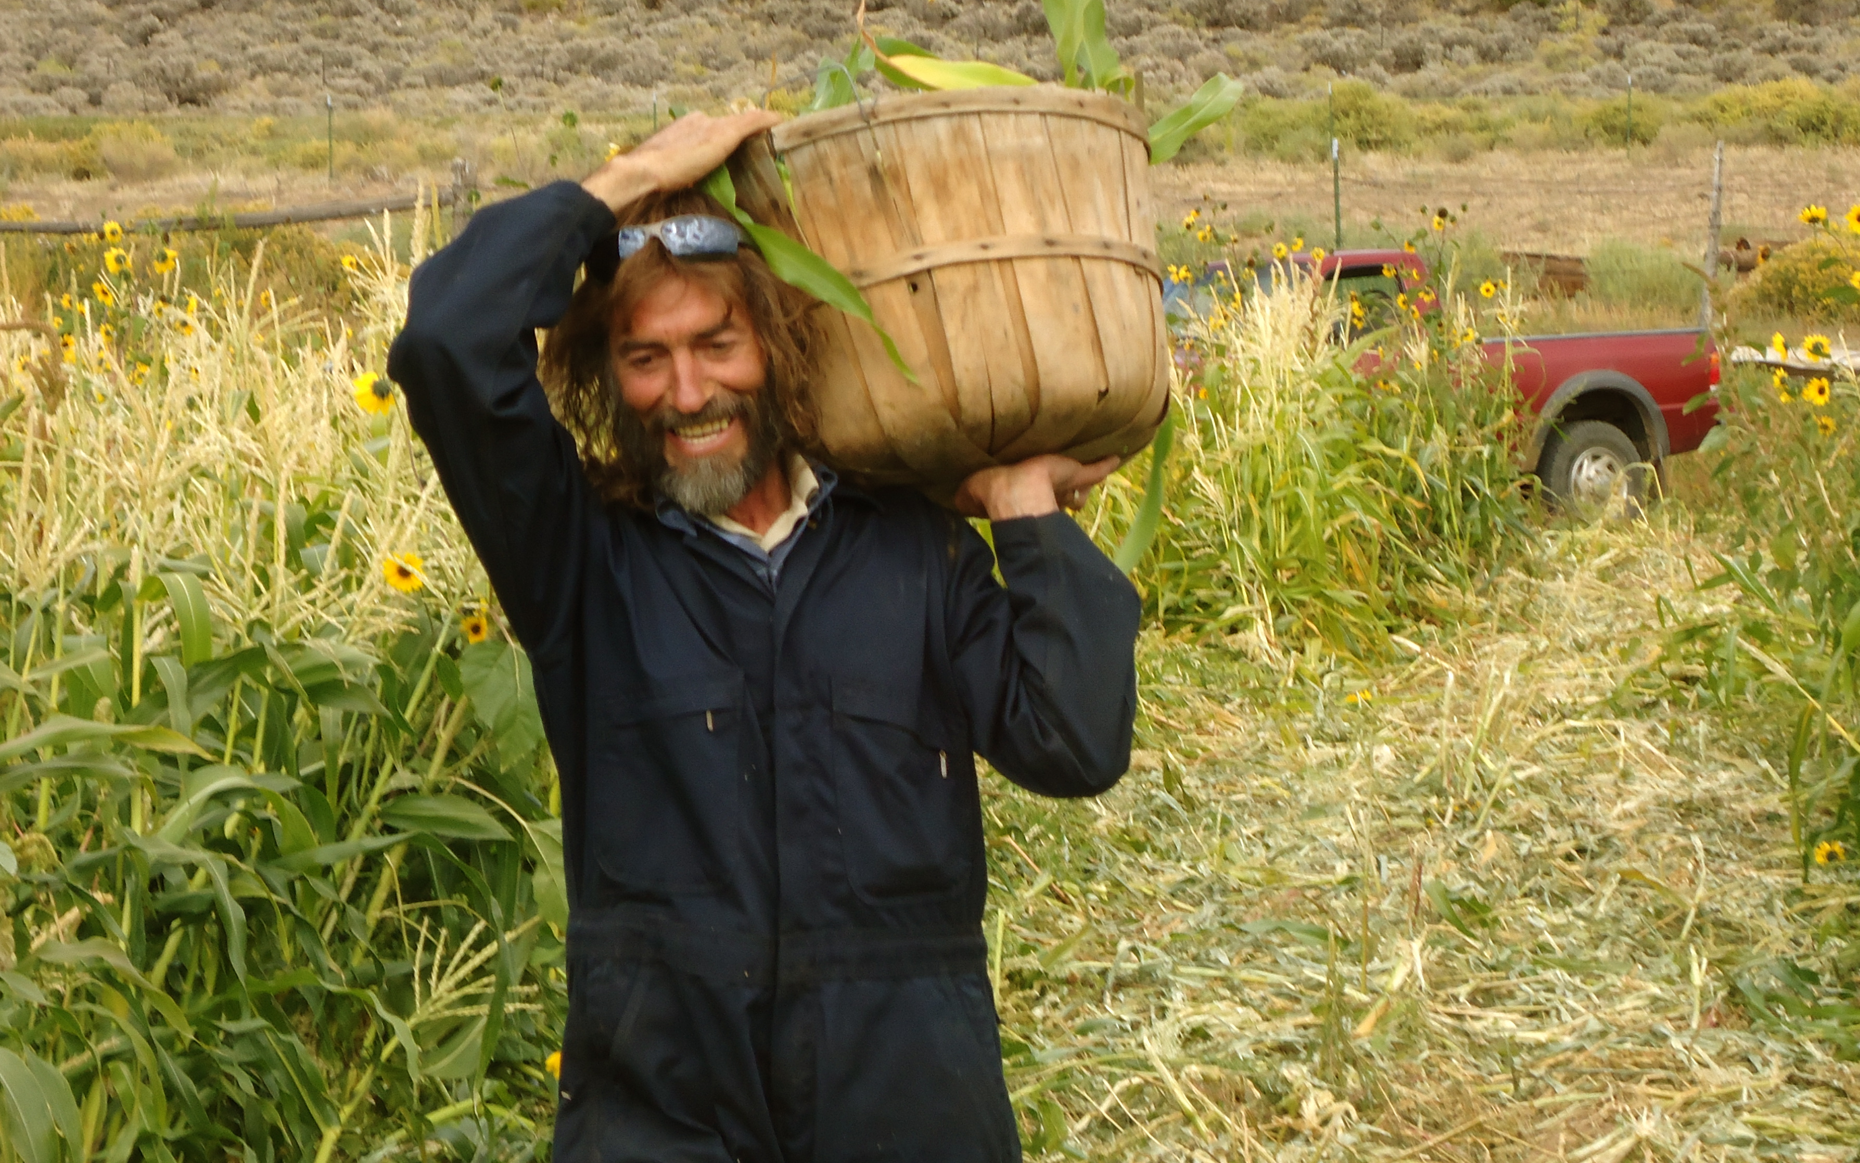

Slide 19
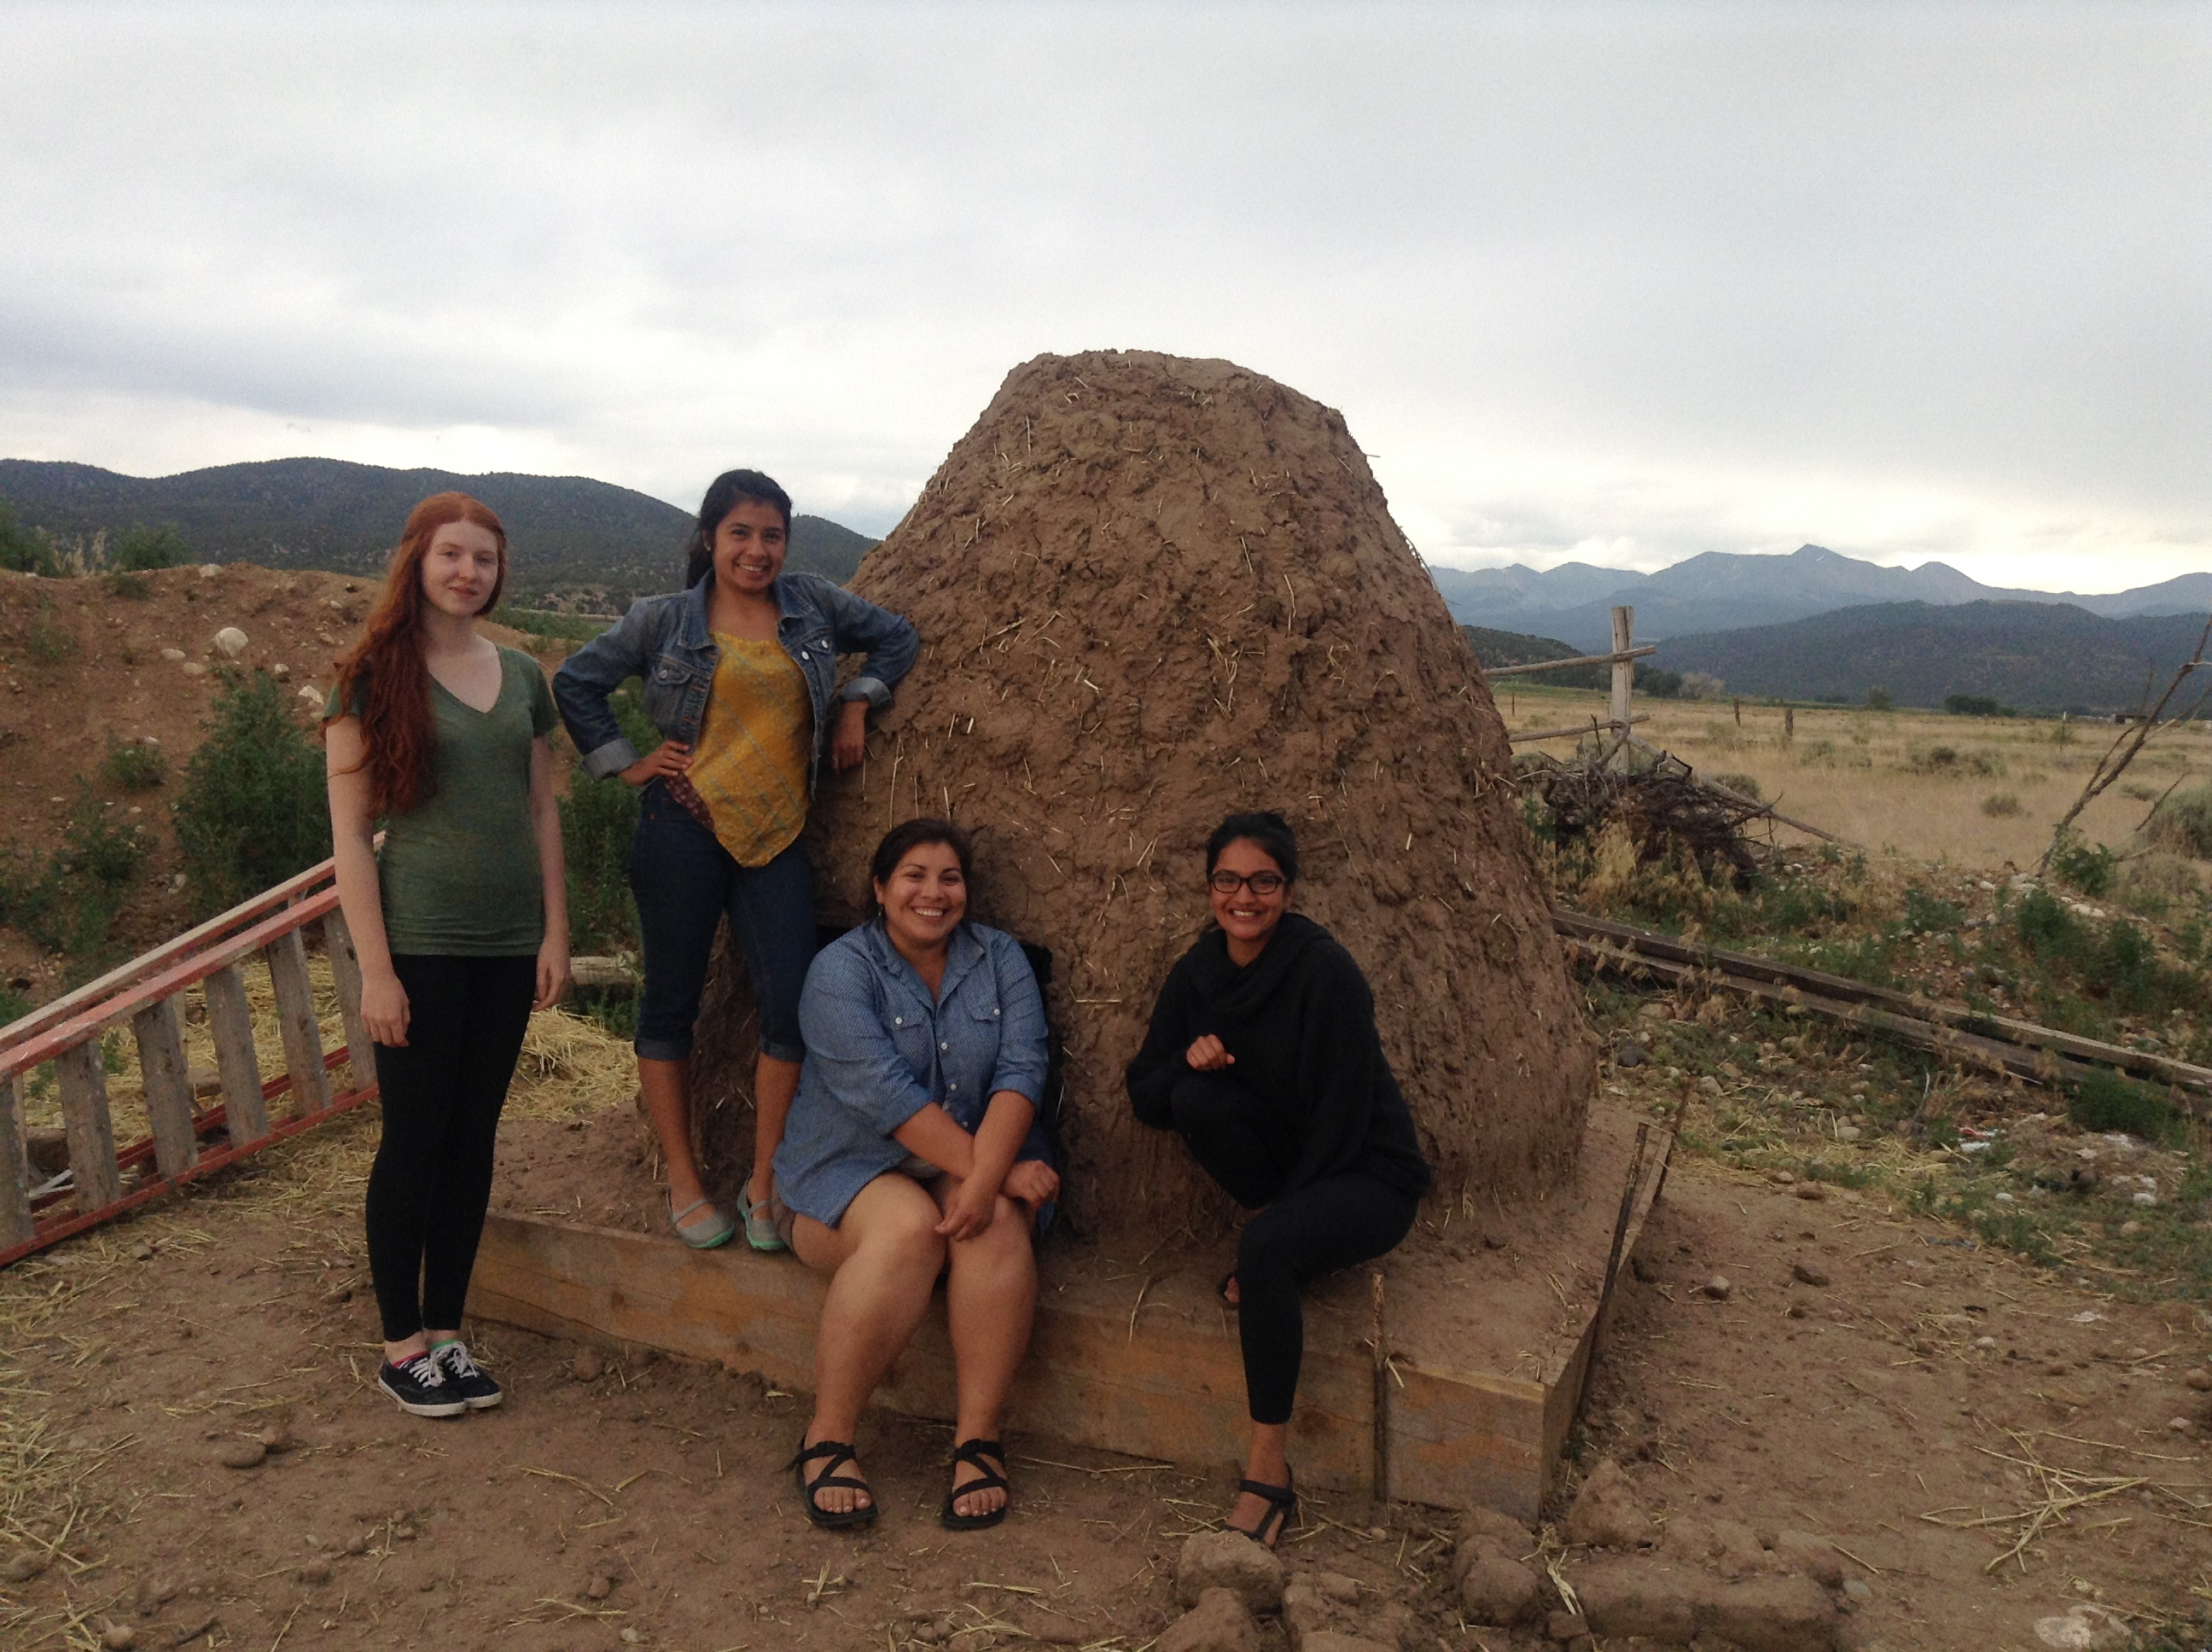
First you have to build the oven

Slide 20
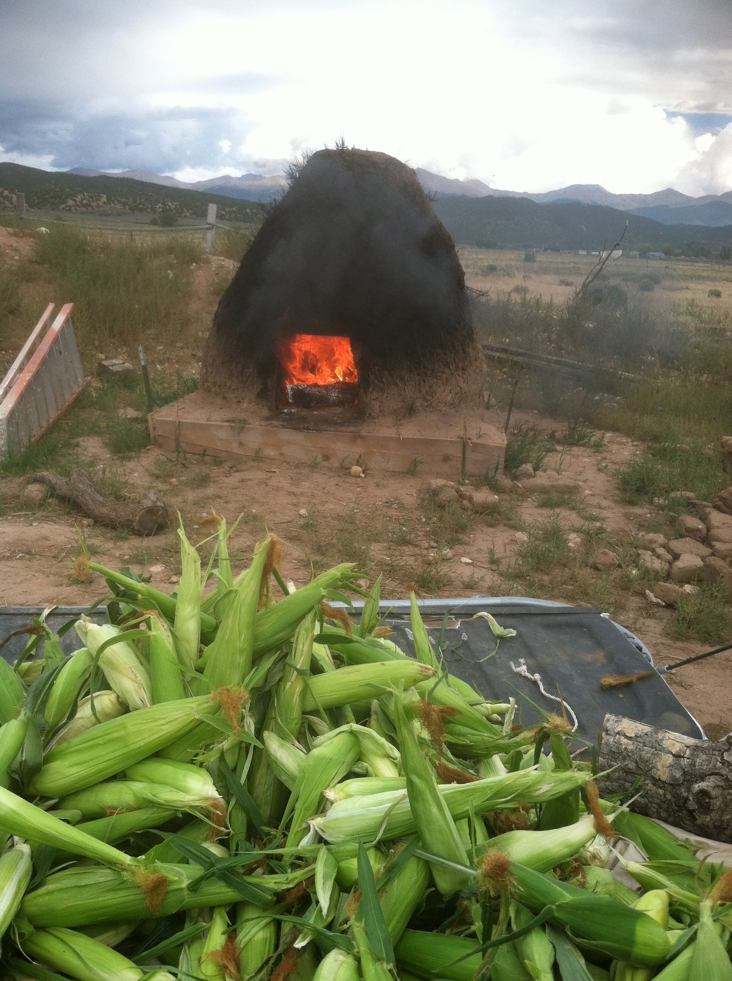

Slide 21
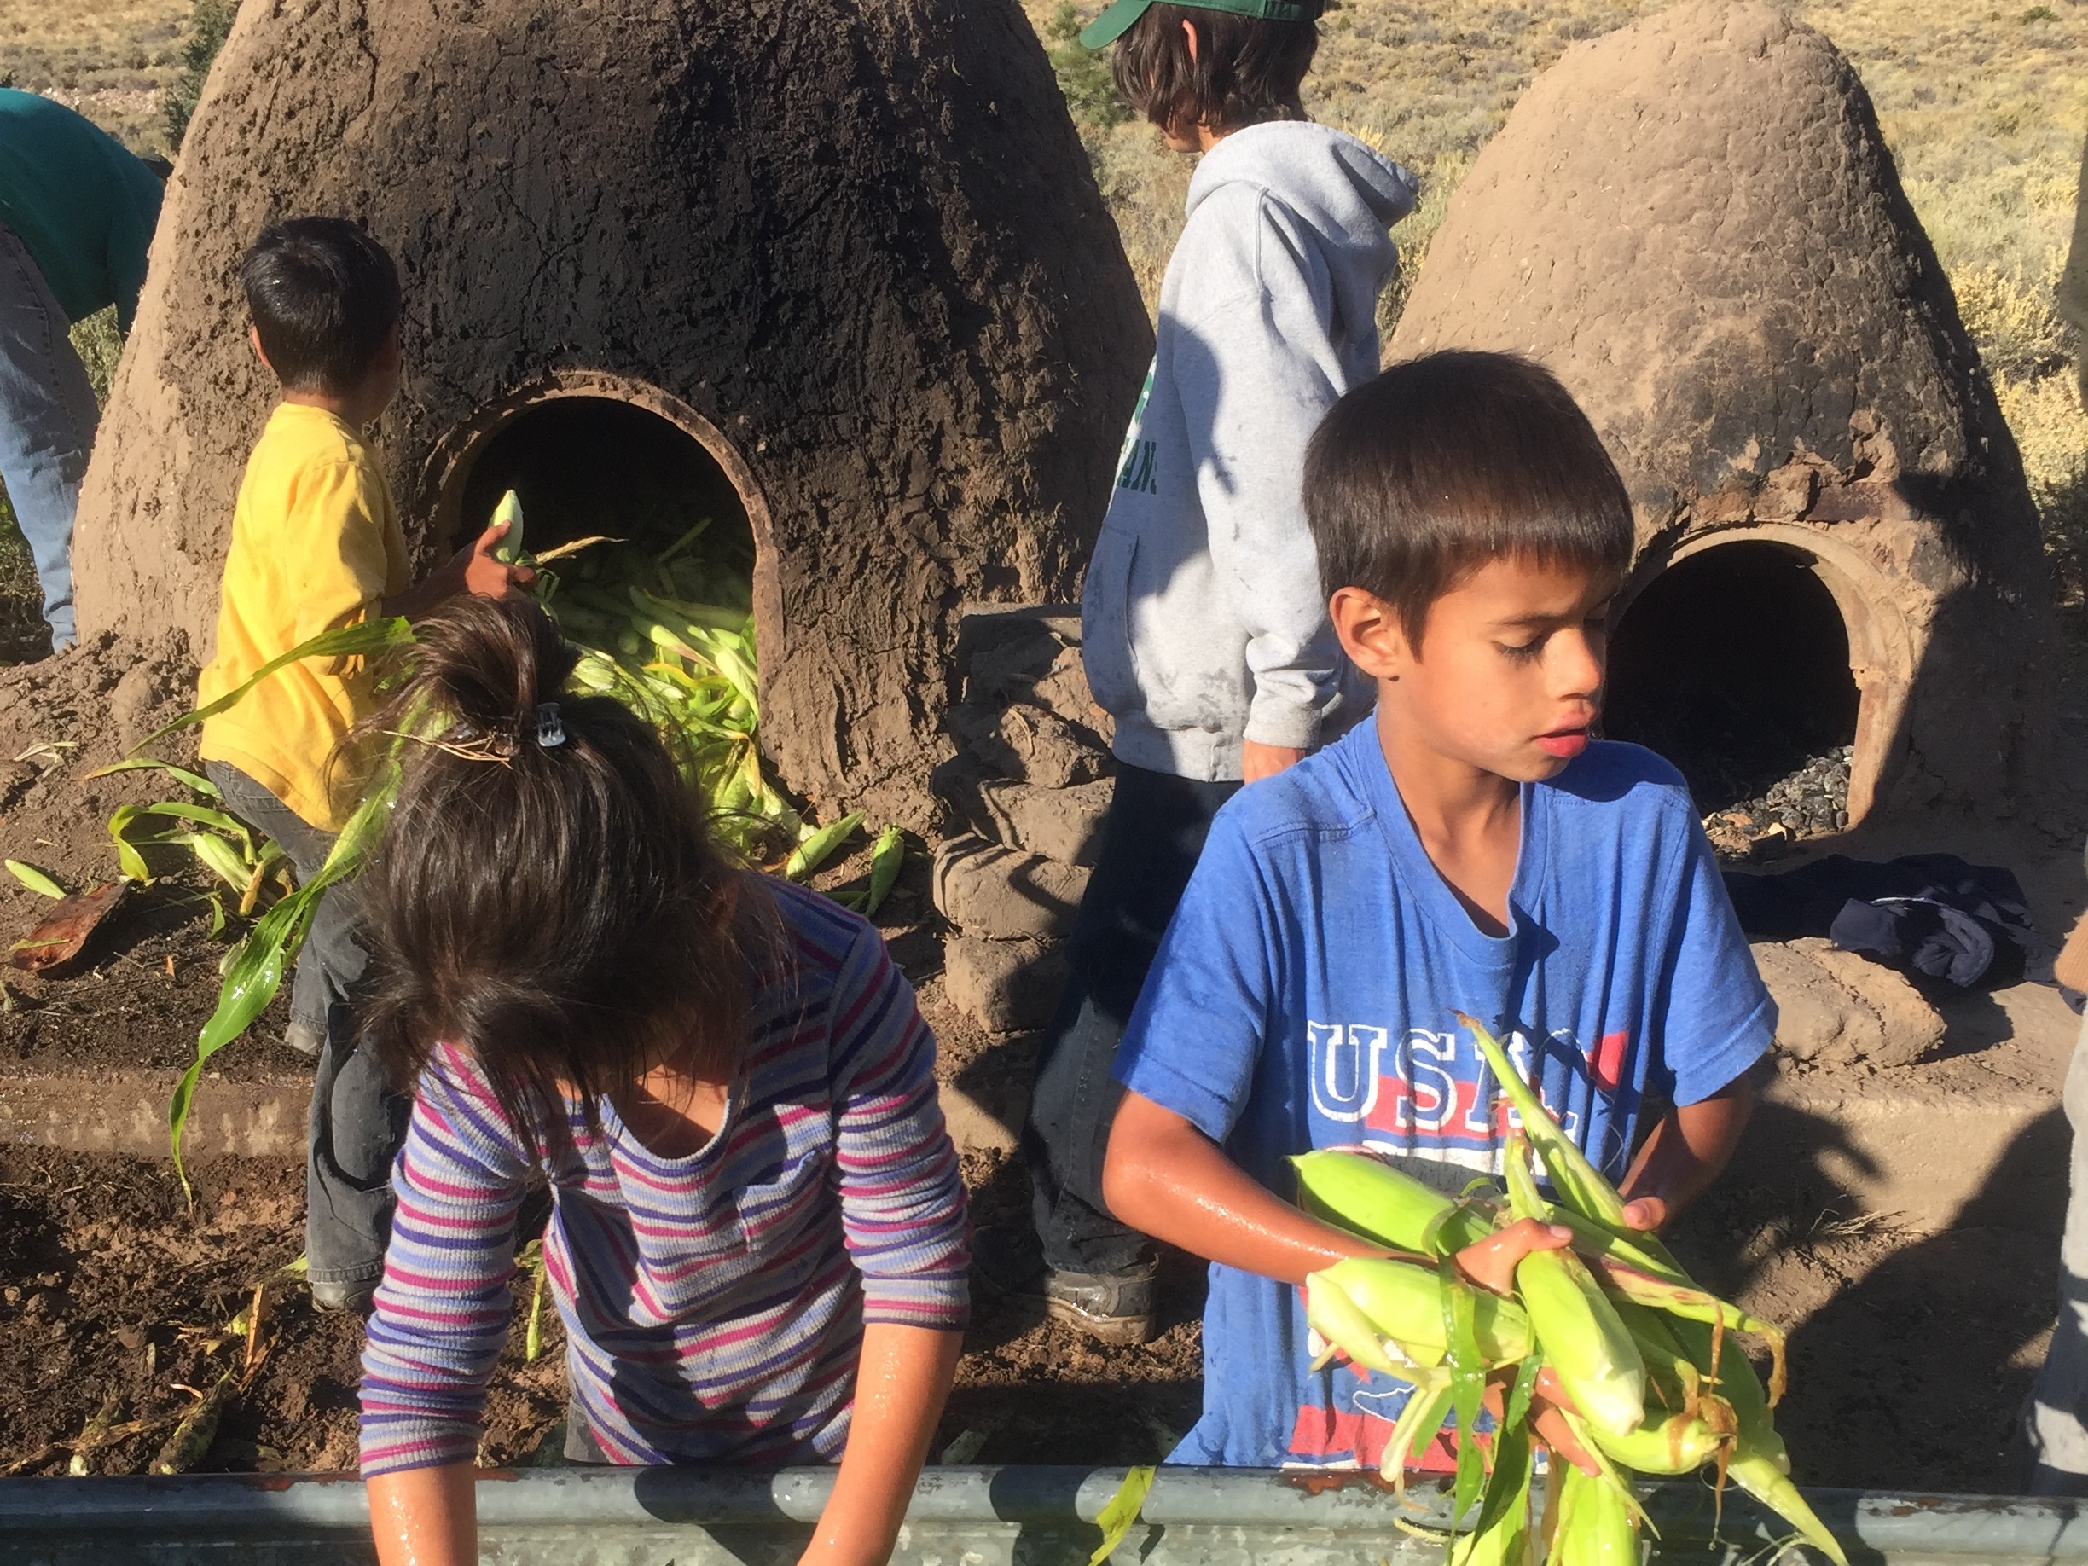
Three generations work the annual horneada. Corpus A. Gallegos Ranches, San Luis, CO. Sept. 2015.
Notes:
Photo by Devon G. Peña.

Slide 22
Air-drying the chicos under the sun

Slide 23
Summary of production of chicos
There are 17 steps, all highly labor intensive, involved in the artisan production of chicos:
planting
irrigating
cultivating
harvesting

Slide 24
stripping corn husks to promote even cooking and prevent scorching,
soaking the corn in water prior to cooking,
building the fire (preferably with a combination of cedar and piñon),
feeding the corn into the horno,
sealing the door and rear vent and checking and plugging the oven for leaks
We recently (2010) started to skip this step, on the advice of another local mentor, and have found that leaving all the husks intact produces fewer losses from burned kernels and cores and also saves time and labor costs.

Slide 25
steaming the crop overnight in the sealed horno,
removing the steamed corn from the horno,
stripping the remaining husks from the steamed corn,
laying out the corn on drying racks for 3-5 days to dry under the sun,
stripping the kernels from the cobs (a process called desgranando),
cleaning the chicos on a windy day or in front of a fan, and
packaging the chicos for sales or storing them for future use.
The epitome of local, slow, and deep food.

Slide 26
Chicos, fresh out of the horno

Slide 27
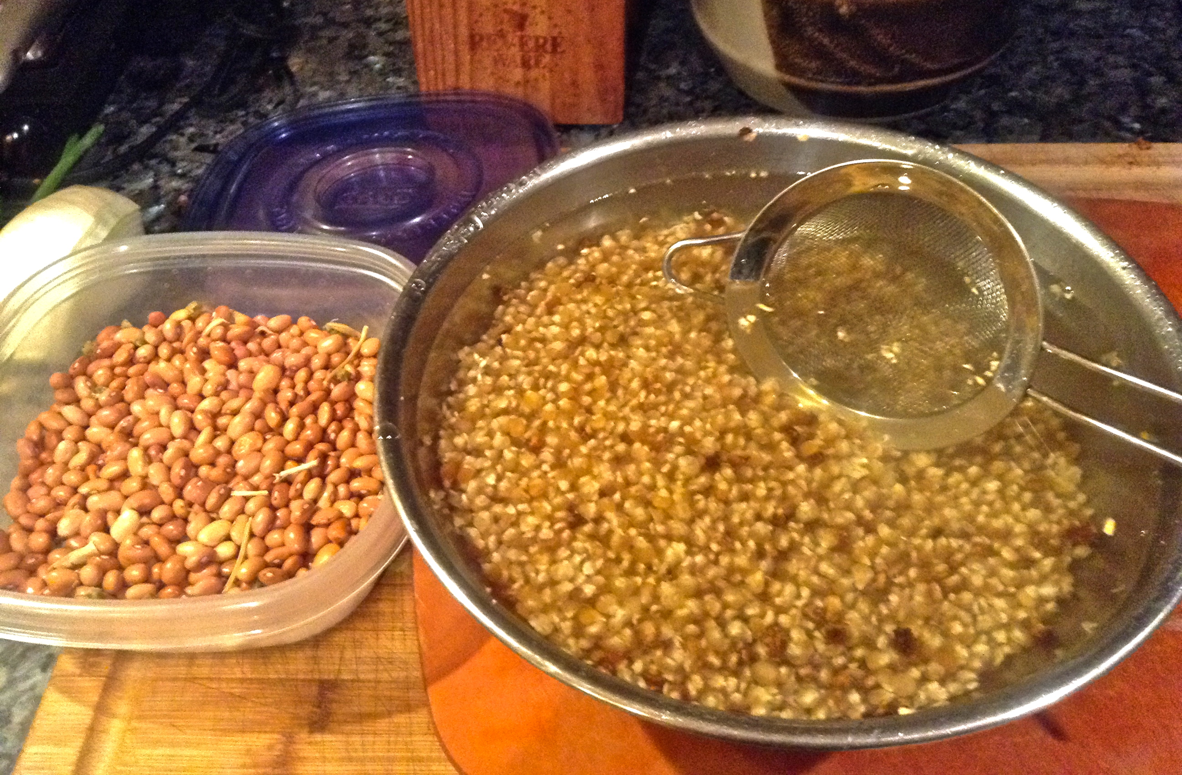
Cleaning the maíz de concho and bolita beans

Slide 28
1. Caramelize onions (15-20 minutes) 2. Add roasted corn 3. Add water to cover corn and bring to soft boil 4. Add bolitas 5. Season: red chili powder, garlic powder, salt, and pepper

Slide 29
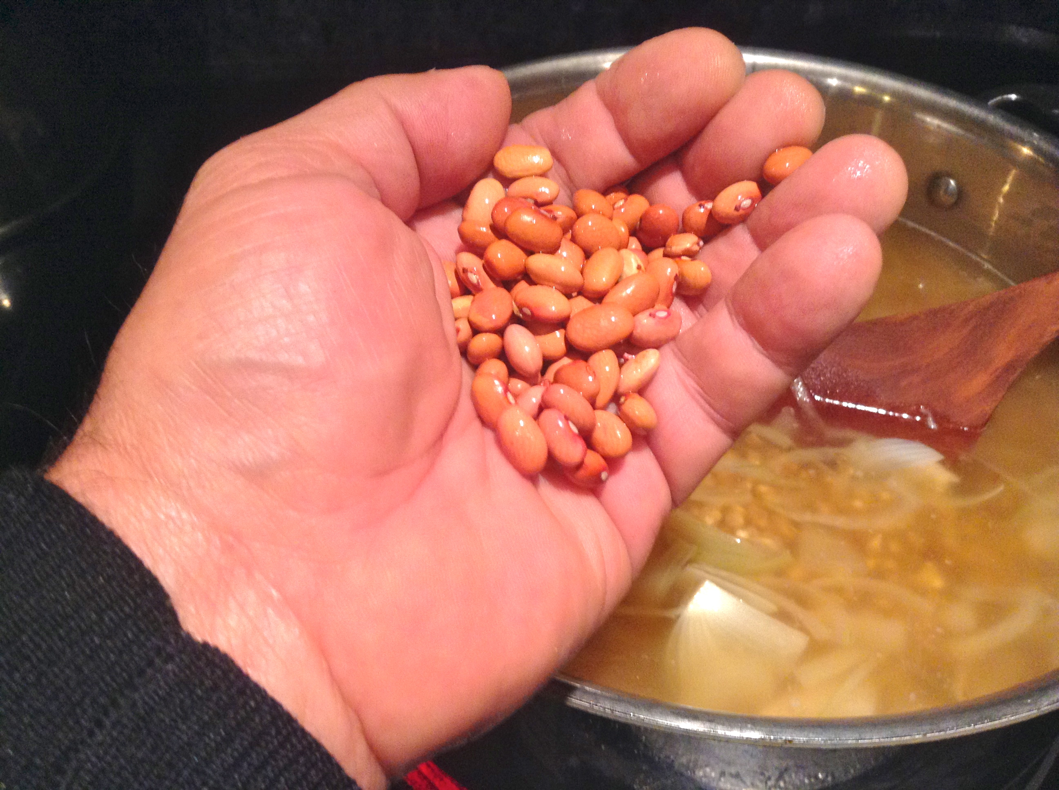
Adding bolitas to chicos and vegetable stock

Slide 30
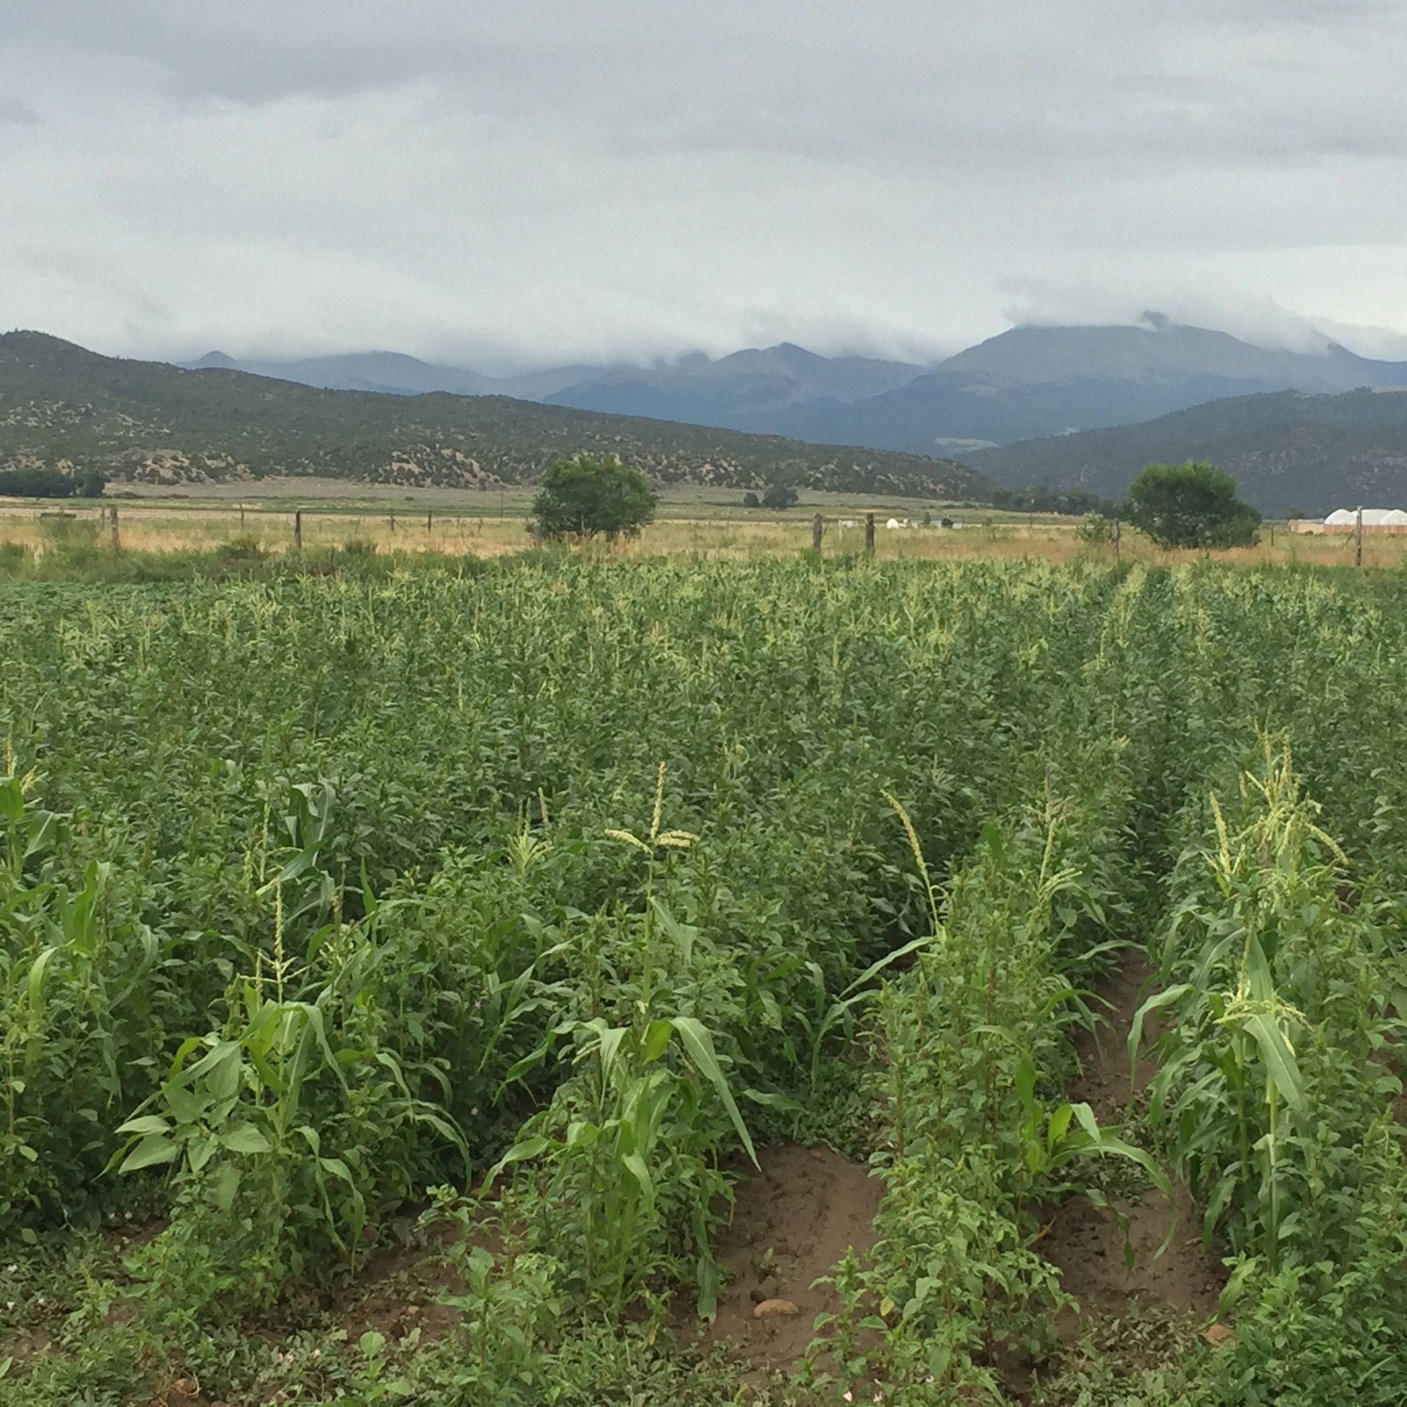
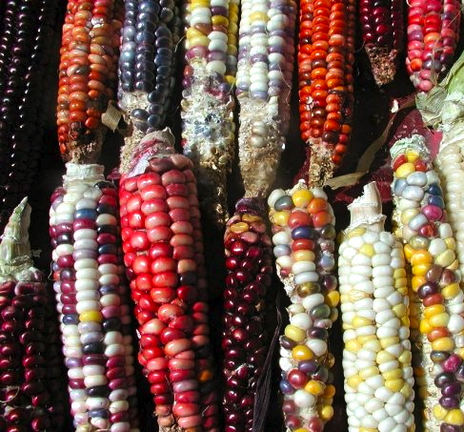
Diversity is the key to resilience

Slide 31
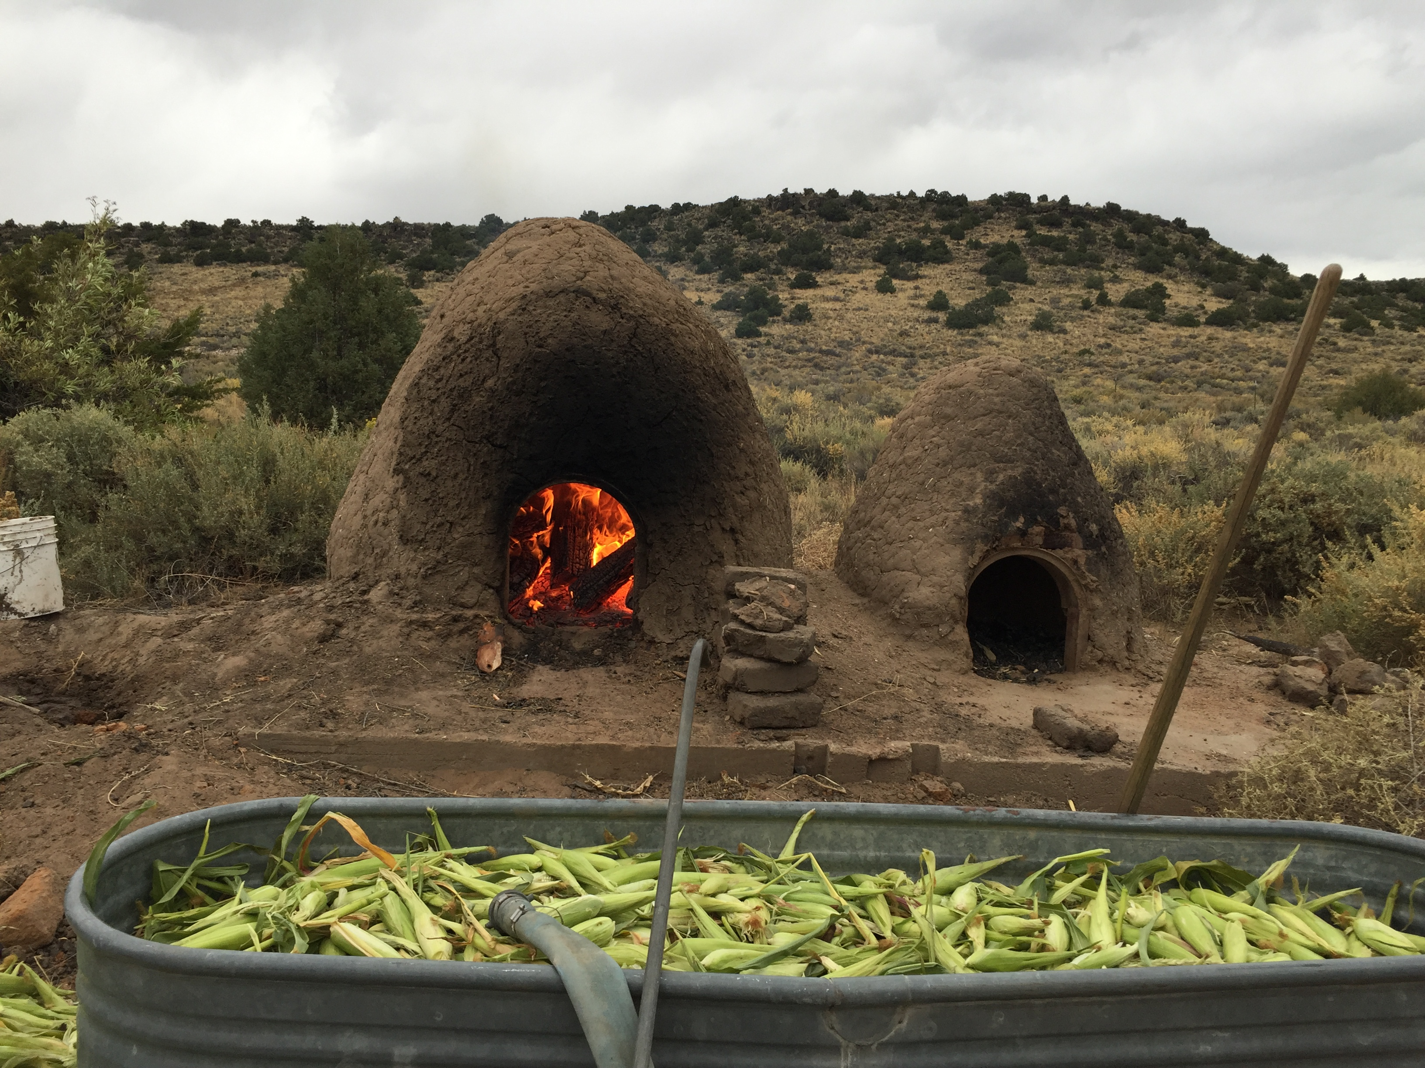
Return to heritage cuisines
Nixtamalization makes all the amino acids and B series vitamins in corn available for absorption by the human digestive system.
Notes:
The Ca, K, Mg, Fe, and Zn content of lime and wood ashes showed lime to be high in Ca content while wood ash contained more K and about 71% of the Ca content of lime. Both contained relatively high levels of Mg, Fe and Zn, but more so in the wood ashes.
Effect of Lime and Wood Ash on the Nixtamalization of Maize and Tortilla Chemical and Nutritional Characteristics
María Renée Pappa, Patricia Palacios Palomo, Ricardo Bressani
Published in Plant foods for human nutrition 2010
DOI:10.1007/s11130-010-0162-8

Slide 32
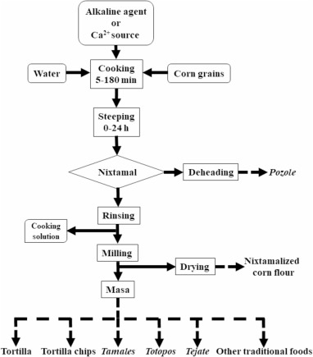
Nixtamalization

Slide 33
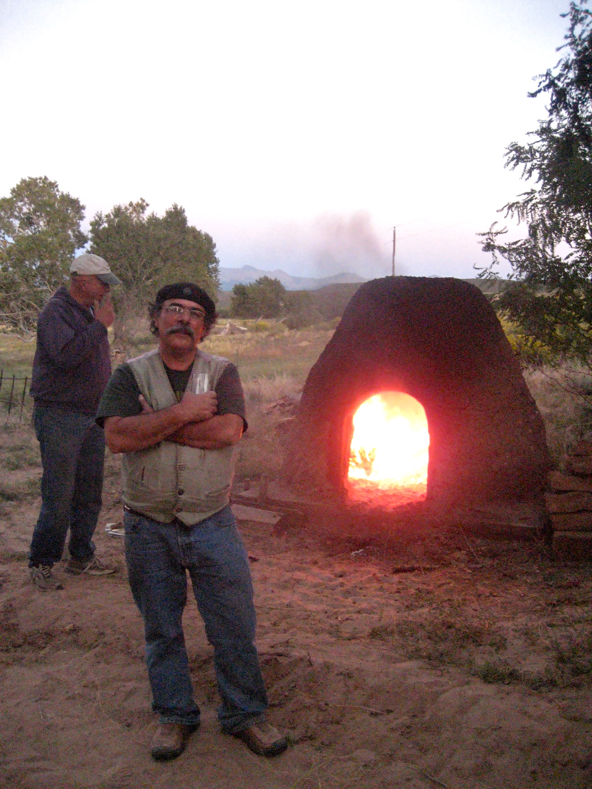
Preparing the fire for our annual adobe oven roast of heirloom corn to make chicos del horno. The preferred fuel wood is a combination of cedar at the start to bring up heat and then finished with piñon pine for the smoky flavor.

Slide 34
Our partners

