Slide 1
Mythology Pt.1
Words & Ideas, Chapter 4, pp. 75–84

Slide 2
Outline
What is mythology? Why is it important to study?
The Creation of the World
Gods and Goddesses
The Underworld
Word Study

Slide 3
What is mythology?
+
=
mythos | logos | mythology
“story” or “tale” | “word,” “explanation,” or “study” | study of stories

Slide 4


The Creation of the World
Chaos
Ge/Gaia
Uranus
Fertilized Earth
kosmos “order,” “world,” or “universe”

Slide 5
Theogony
theos (“gods”) + gony (“birth”) = theogony (“birth of the gods”)
Hesiod, Theogony (c. 700 BCE)
Gaia and Uranus give birth to the Titans, including Kronos
Kronos castrates Uranus and rules in his place
Kronos then marries Rhea (his sister) and she gives birth to Zeus
Kronos eats/swallows the children he has with Rhea
Zeus escapes to Crete (later deposes Kronos)

Slide 6
Theogony cont’d
Demeter, Hades, Hera, Hestia, Poseidon, and Zeus
Kronos eats/swallows every child but Zeus
Zeus escapes to Crete
Zeus deposes Kronos and tricks him to throw up his siblings
Zeus marries Hera (his sister) and becomes the new ruler of the cosmos

Slide 7
The Olympians
p. 79, list of the 16 Olympians (12 main ones)
Greek/Roman names
Significance

Slide 8
Terms for talking about the Greek gods
Attribute
Associated tokens often used to identify a god in art
Epithets
Descriptive phrases that describe the god; used often in literature sometimes by themselves, without the god’s name

Slide 9
Attributes and Epithets
Zeus/Jupiter (Greek/Roman)
  Attributes: thunderbolt, throne, eagle, oak tree, scepter
  Epithets: father of gods and men, son of Kronos, cloud-gatherer
Hera/Juno
  Attributes: peacock, scepter, throne
  Epithets: cow-eyed, Argive
Poseidon/Neptune
  Attributes: trident, marine life, older with beard
  Epithets: earth-shaker
Aphrodite/Venus
  Attributes: nude, doves, often showed with son (Eros/Cupid)
  Epithets: laughter-loving

Slide 10
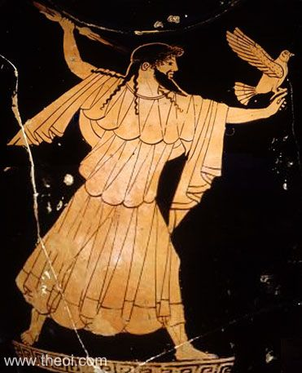
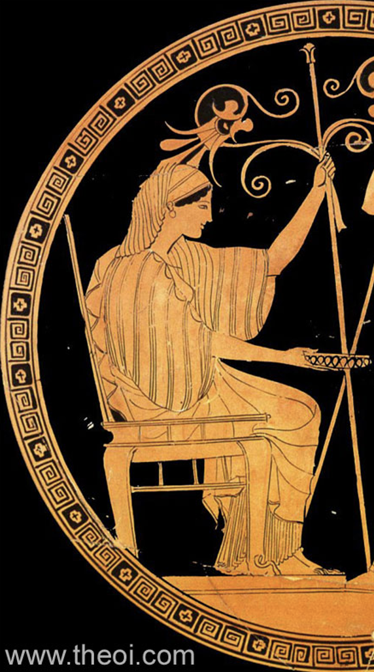
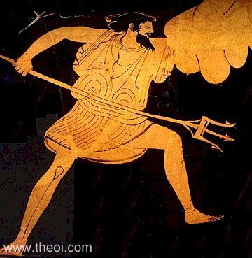
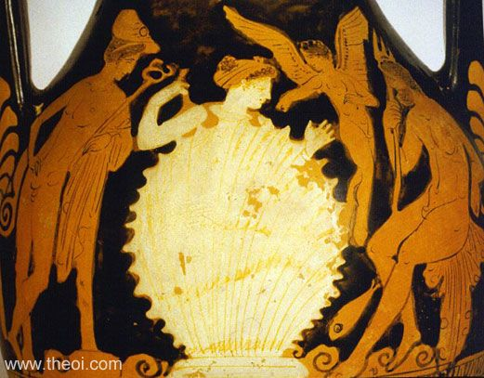
Attributes and Epithets
Zeus/Jupiter
Aphrodite/Venus
Hera/Juno
Poseidon/Neptune

Slide 11
Attributes and Epithets cont’d
Eros/Cupid(Greek/Roman)
  Attributes: bow and arrow
  Epithets: beautiful, limb-loosening
Ares/Mars
  Attributes: armor, weapons, often with Aphrodite/Venus
  Epithets: man-slaughtering, brazen
Athena/Athene/Minerva
  Attributes: aegis (goat skin shield/cloak used to protect people), owl, woman in armor
  Epithets: Pallas, Parthenos, daughter of Zeus, patron goddess of Athens
Hephaestus/Hephaistos/Vulcan
  Attributes: hammer and anvil, tongs
  Epithets: smith, the lame god

Slide 12
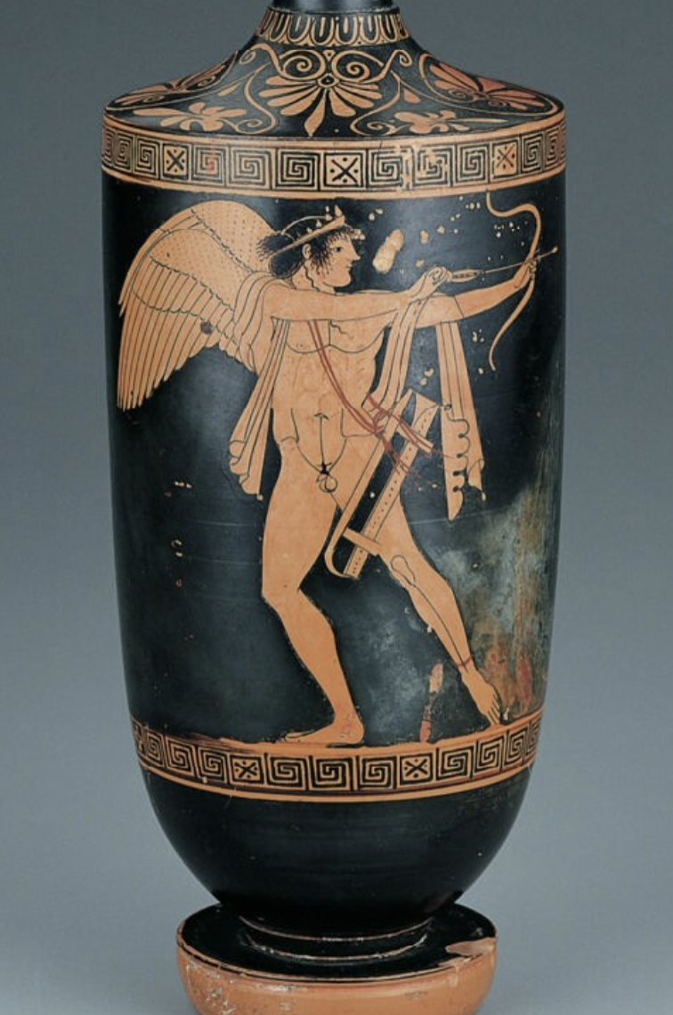
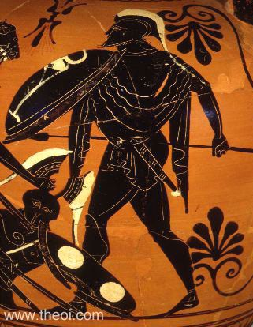
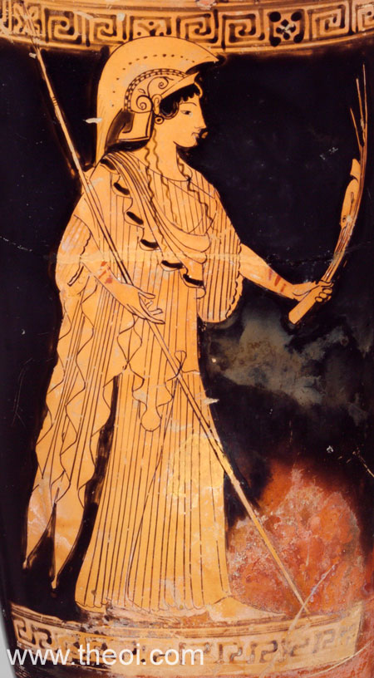
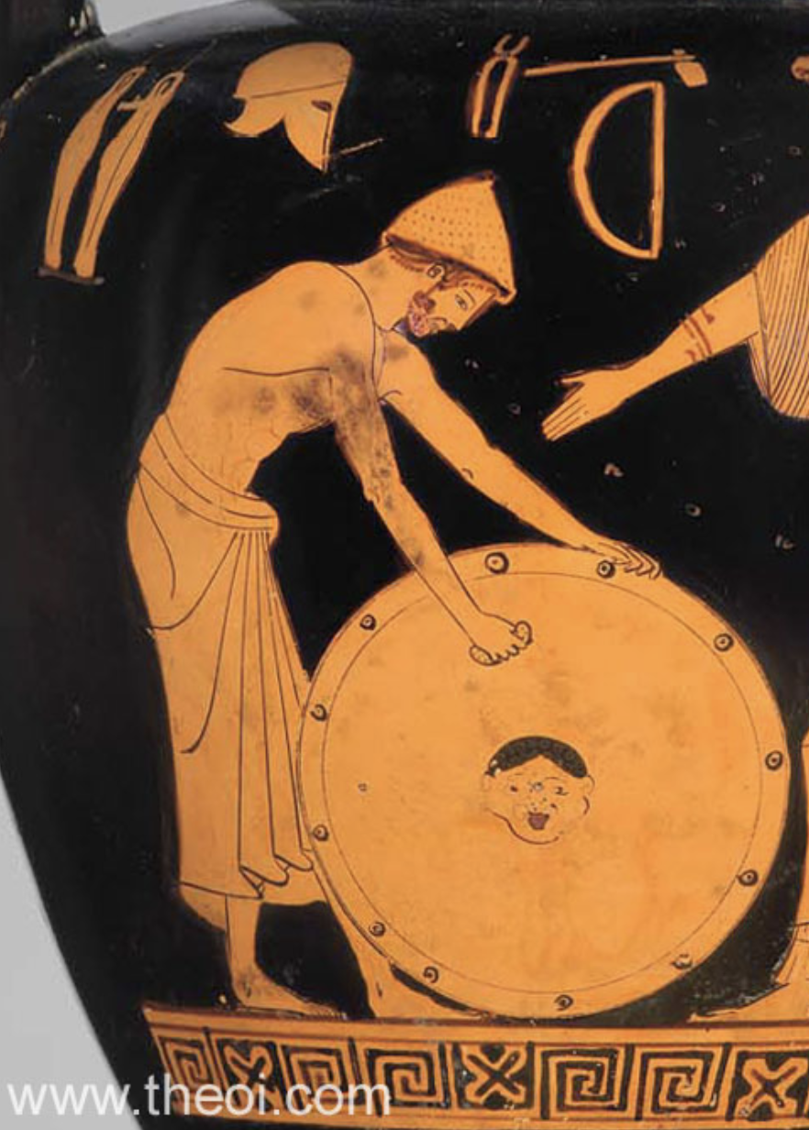
Attributes and Epithets cont’d
Eros/Cupid
Ares/Mars
Athena/Athene/Minerva
Hephaestus/Hephaistos/Vulcan

Slide 13
Attributes and Epithets cont’d
Artemis/Diana(Greek/Roman)
  Attributes: short dress, bow and arrow, wildlife (often deer)
  Epithets: far-shooter, shooter of deer, virgin goddess
Apollo
  Attributes: laurel tree, lyre
  Epithets: far-shooter, Phoebus (“bright”), Paean (“healer”)
Muses
  Attributes: alluring, songs, singing, music, dance, associated with Apollo
  Epithets: inspiring to poets, artistic
Hermes/Mercury
  Attributes: winged sandals (talaria), traveler’s cap (petasos), herald’s staff often with twin serpents (caduceus)
  Epithets: messenger of the gods

Slide 14
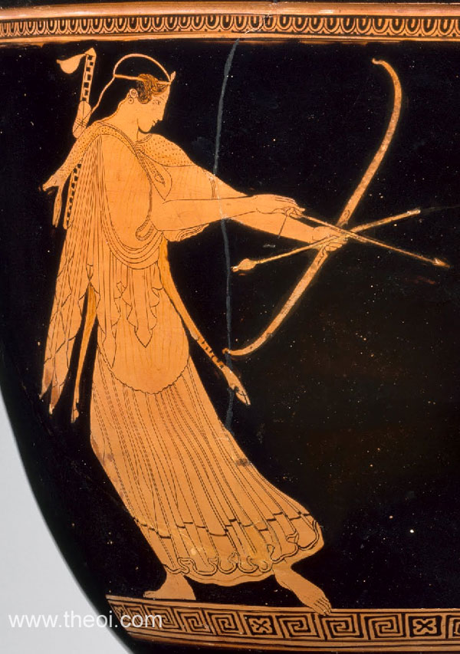
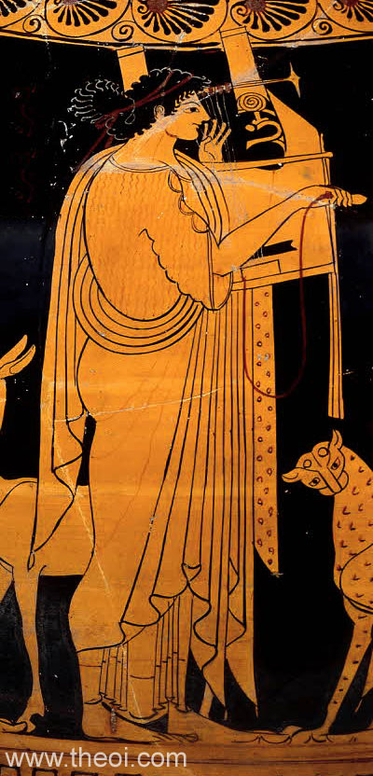
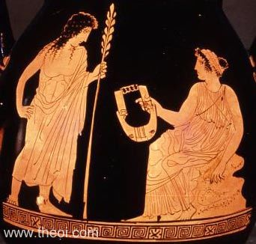
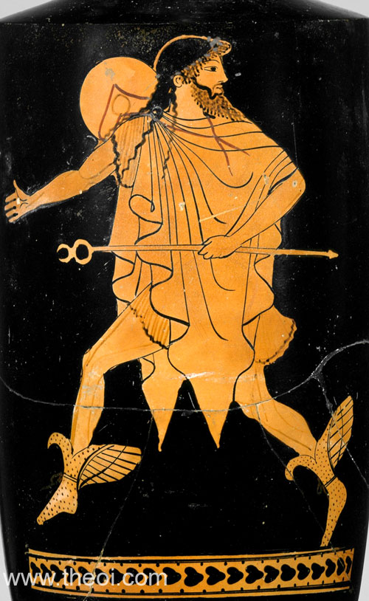
Attributes and Epithets cont’d
Artemis/Diana
Apollo
Muse (and Apollo)
Hermes/Mercury

Slide 15
Attributes and Epithets cont’d
Iris(Greek/Roman)
  Attributes: messenger, communication, rainbow
  Epithets: of the swift feet
Demeter/Ceres
  Attributes: wheat, torches, cornucopia, often shown with her daughter Persephone/Proserpina
  Epithets: goddess of harvest, mother of fields
Dionysus/Dionysos/Bacchus
  Attributes: vines, leopard skins, pinecone staff (thyrsus), often accompanied by satyrs and maenads
  Epithets: Roarer, the freer
Hades/Pluto
  Attributes: rooster, with Persephone (although not often depicted in art)
  Epithets: receiver of many, ploutos (“wealthy”)

Slide 16
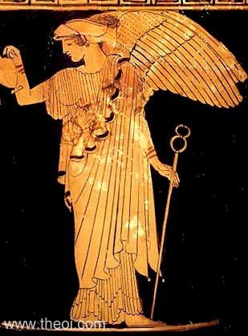
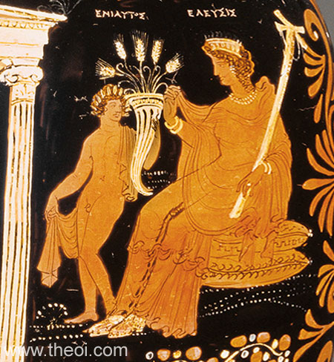
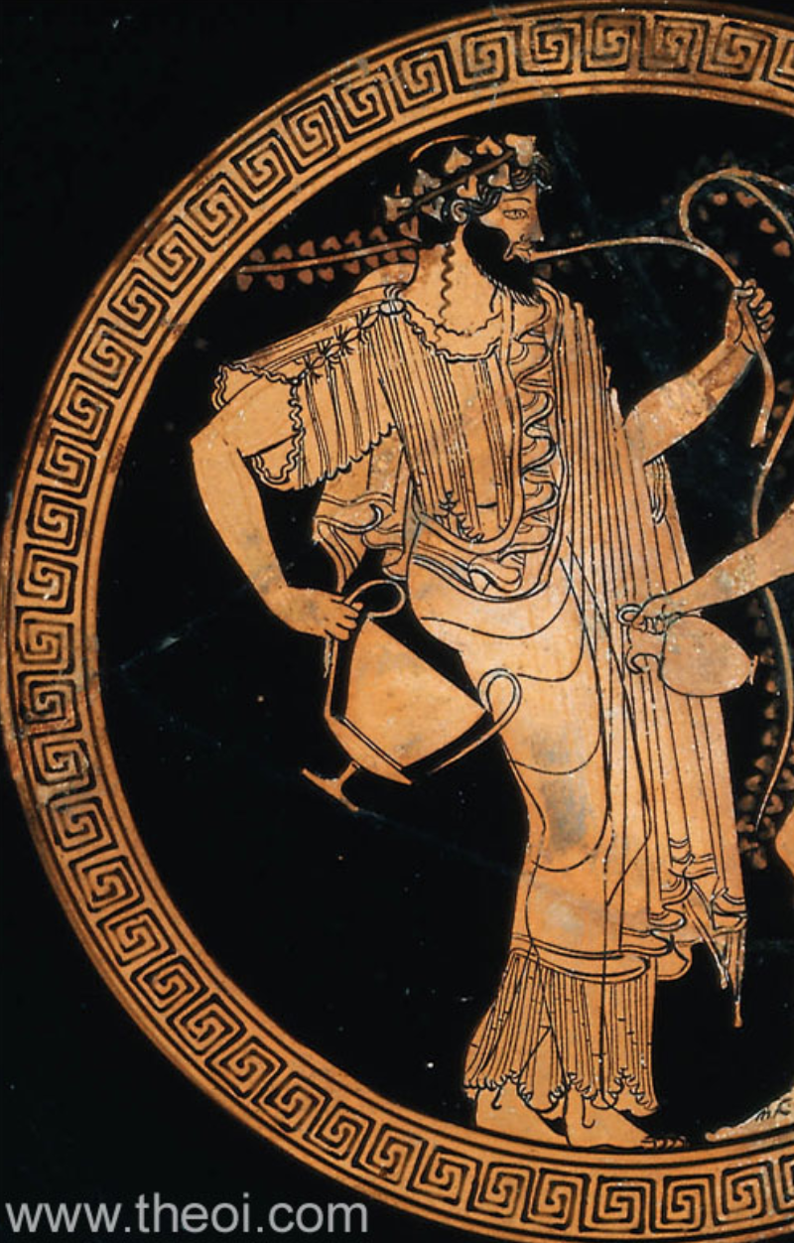
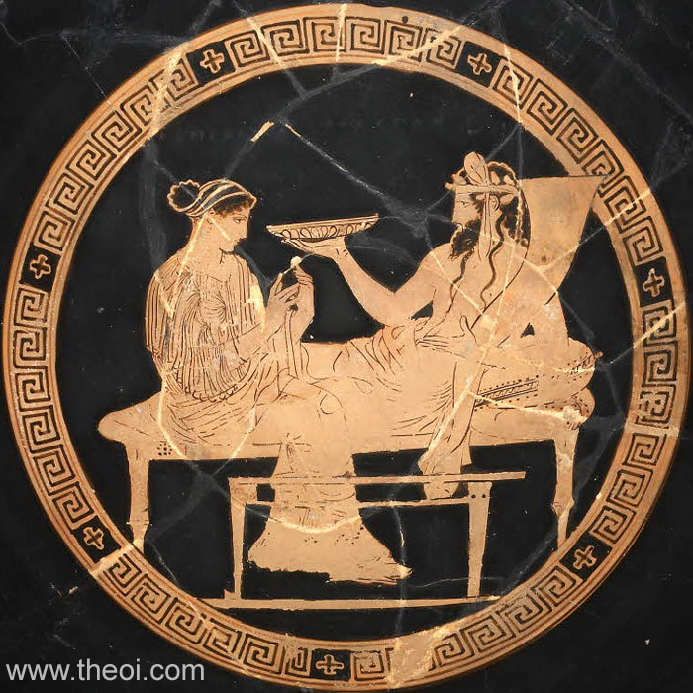
Attributes and Epithets cont’d
Hades/Pluto
Iris
Demeter/Ceres
Dionysus/
Dionysos/
Bacchus

Slide 17
The Underworld
When a mortal died, their soul (psychē) went down to Hades
Hades
  Name of the underworld as well as the god in charge of it
A cold, dark, cheerless place under the earth
River Styx
Lethe river
  lēthē, “forgetfulness”
  lethargy and lethargic

Slide 18
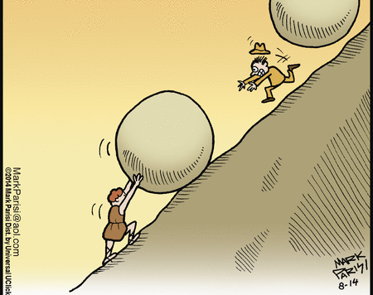
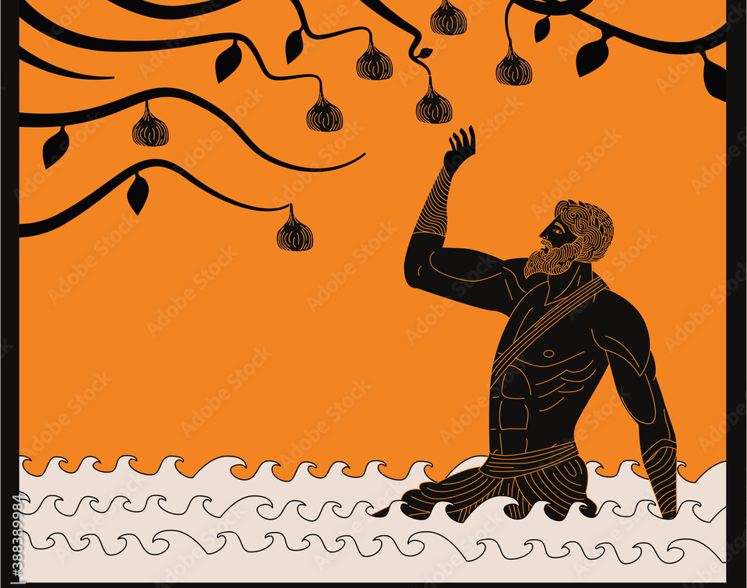
Divine Punishments
Sisyphus
Tantalus

Slide 19
Word Study — kosmos
cosmogony, the theory of the “origin of the universe”
kosmos, “universe”
gonē “offspring,” “family”
cosmography, “study of the universe”
graphē “writing”
cosmonaut, a person who travels the universe
nautēs “sailor”

Slide 20
Word Study — gē
geography, “written description of the earth”
gē
graphē “writing”
George (georgos “farmer”)
ergein “to work”
geothermal, having to do with the earth’s internal heat
thermē “heat”

Slide 21
Word Study — terra
terrain, terrestrial, terrier, and territory
terra (“land,” “earth”)
terrenus, terrestris (“belonging to the earth”)
territorium (“land around a town”)
BUT! terrify, terrorize, terrorist, terrific, and terrible
terrere (“to frighten”)

Slide 22
Word Study — Olympians
aphrodisiac, a substance that arouses sexual desire
Aphrodite
cereal, “grain”
Ceres
martial, “warlike”
Mart-, extended form of Mars

Slide 23
Word Study — Olympians cont’d
vulcanology, “the study of volcanoes”
volcano, derived from Italian, derived from Vulcan
logos, “word”
muse, “to ponder, think”
Muses
museum, a place for storing and displaying precious or interesting things; it is where people go to a muse and to seek inspiration
Muses

Slide 24
What’s Next
More mythology!!
Read, Words & Ideas, Chapter 4, pp. 85–95
Go over Word Study lists

