Slide 1
History Pt. 2
Words & Ideas, Chapter 9, pp. 238–249

Slide 2
Outline
Review of authors/historians
Timeline
Source passages
How to read the text using critical analysis
Modern day history lessons
Word study

Slide 3
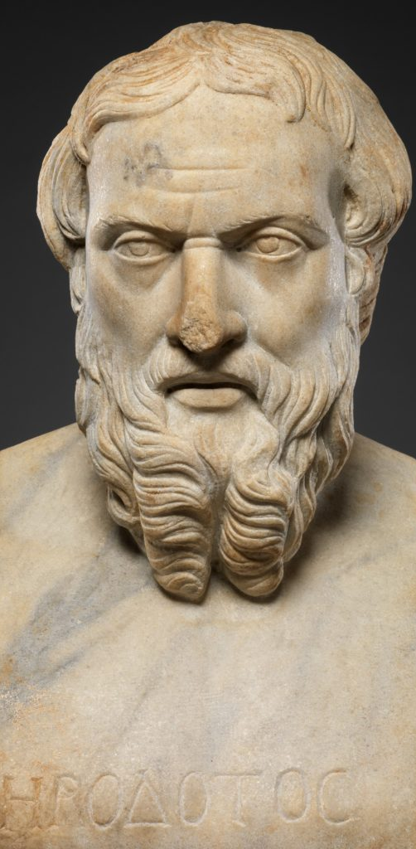
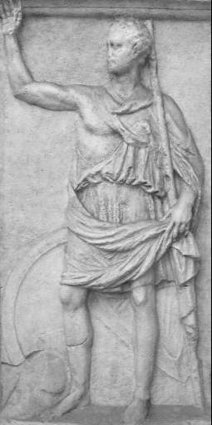
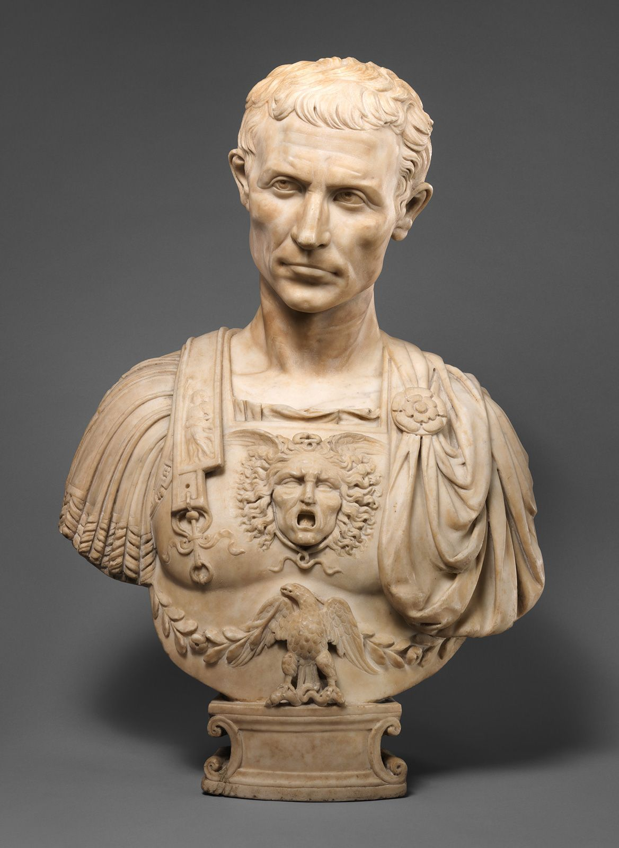
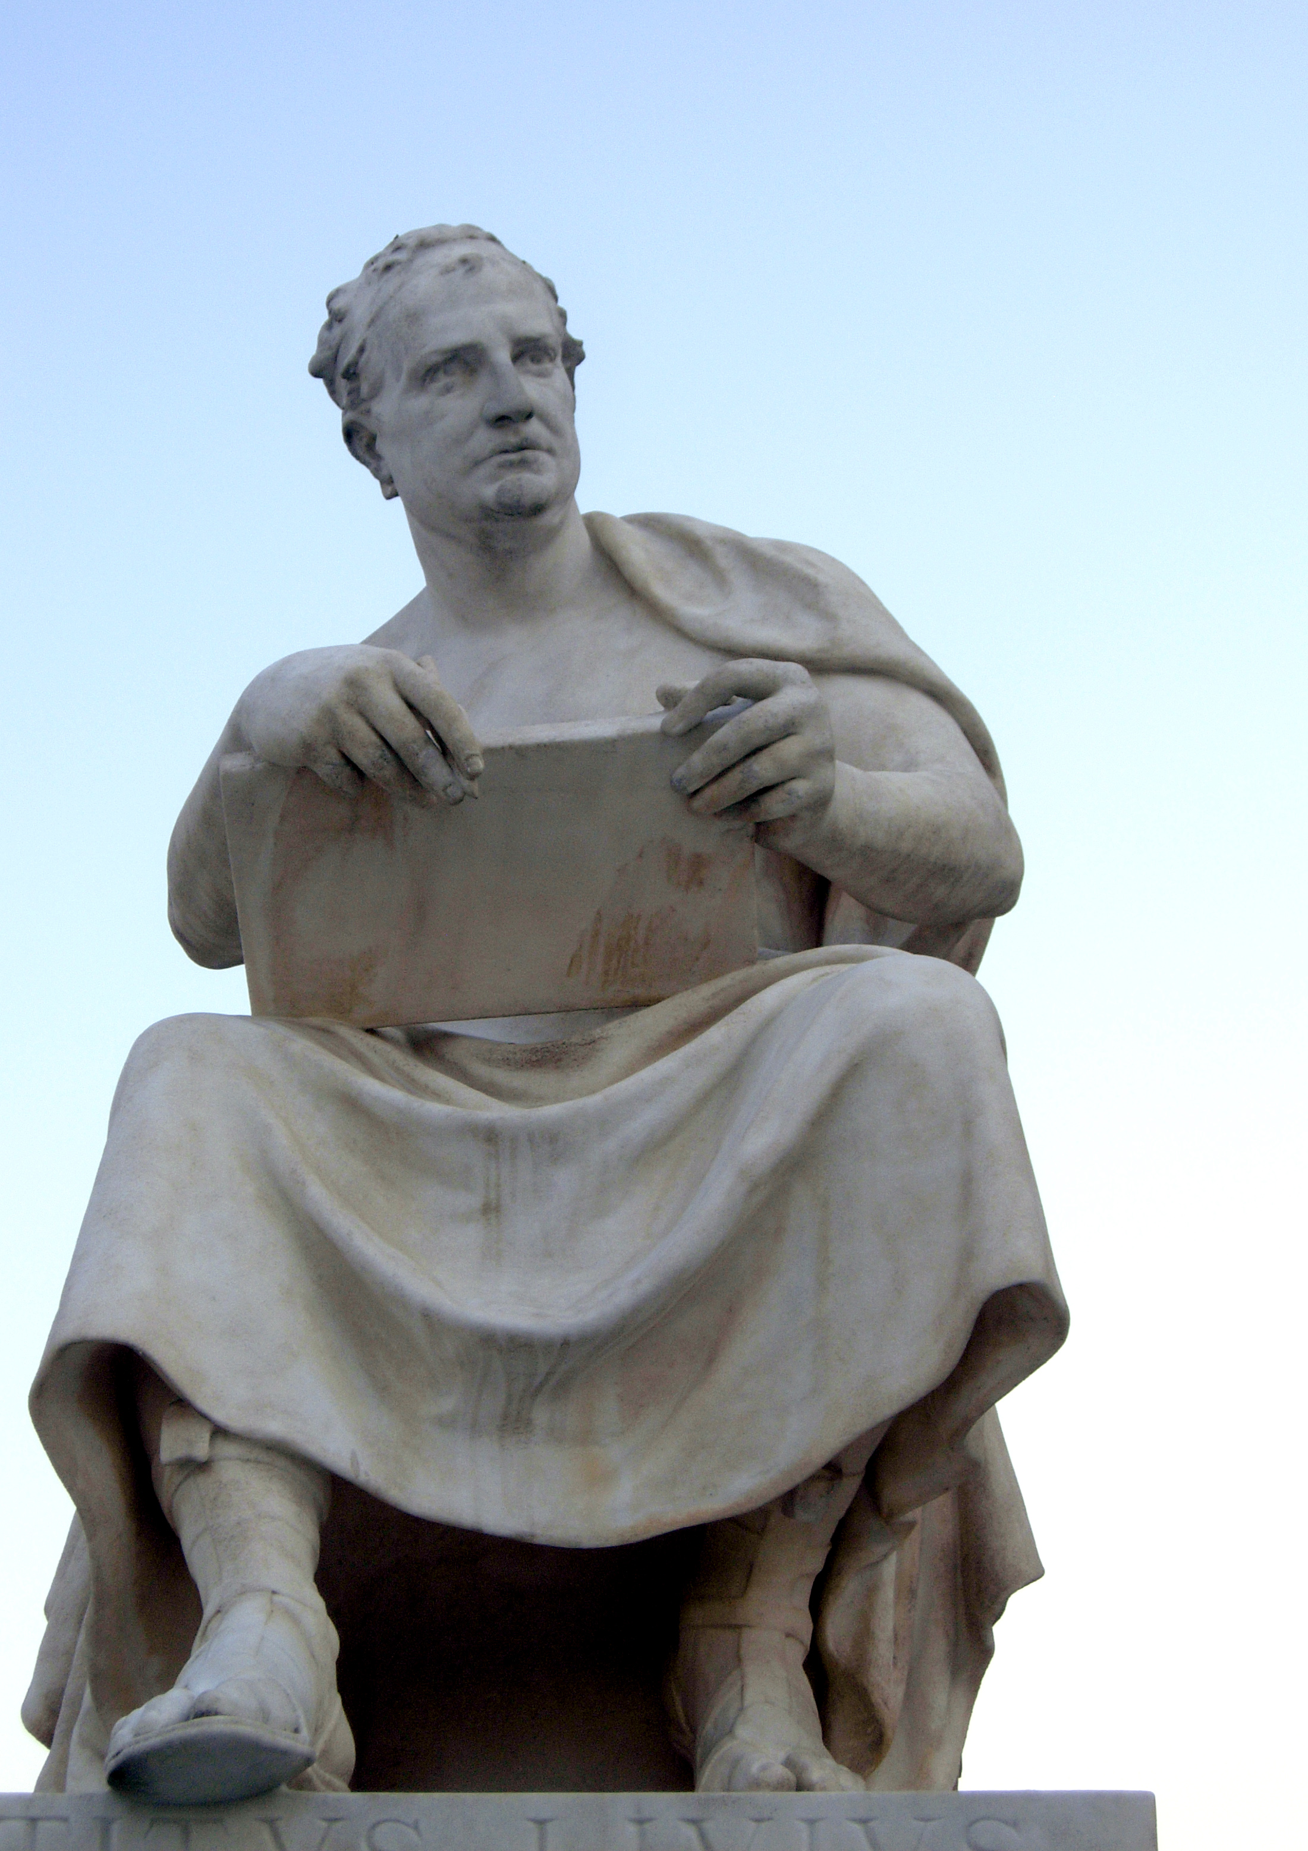
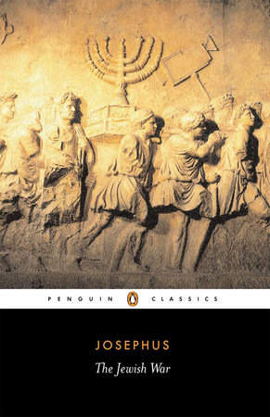
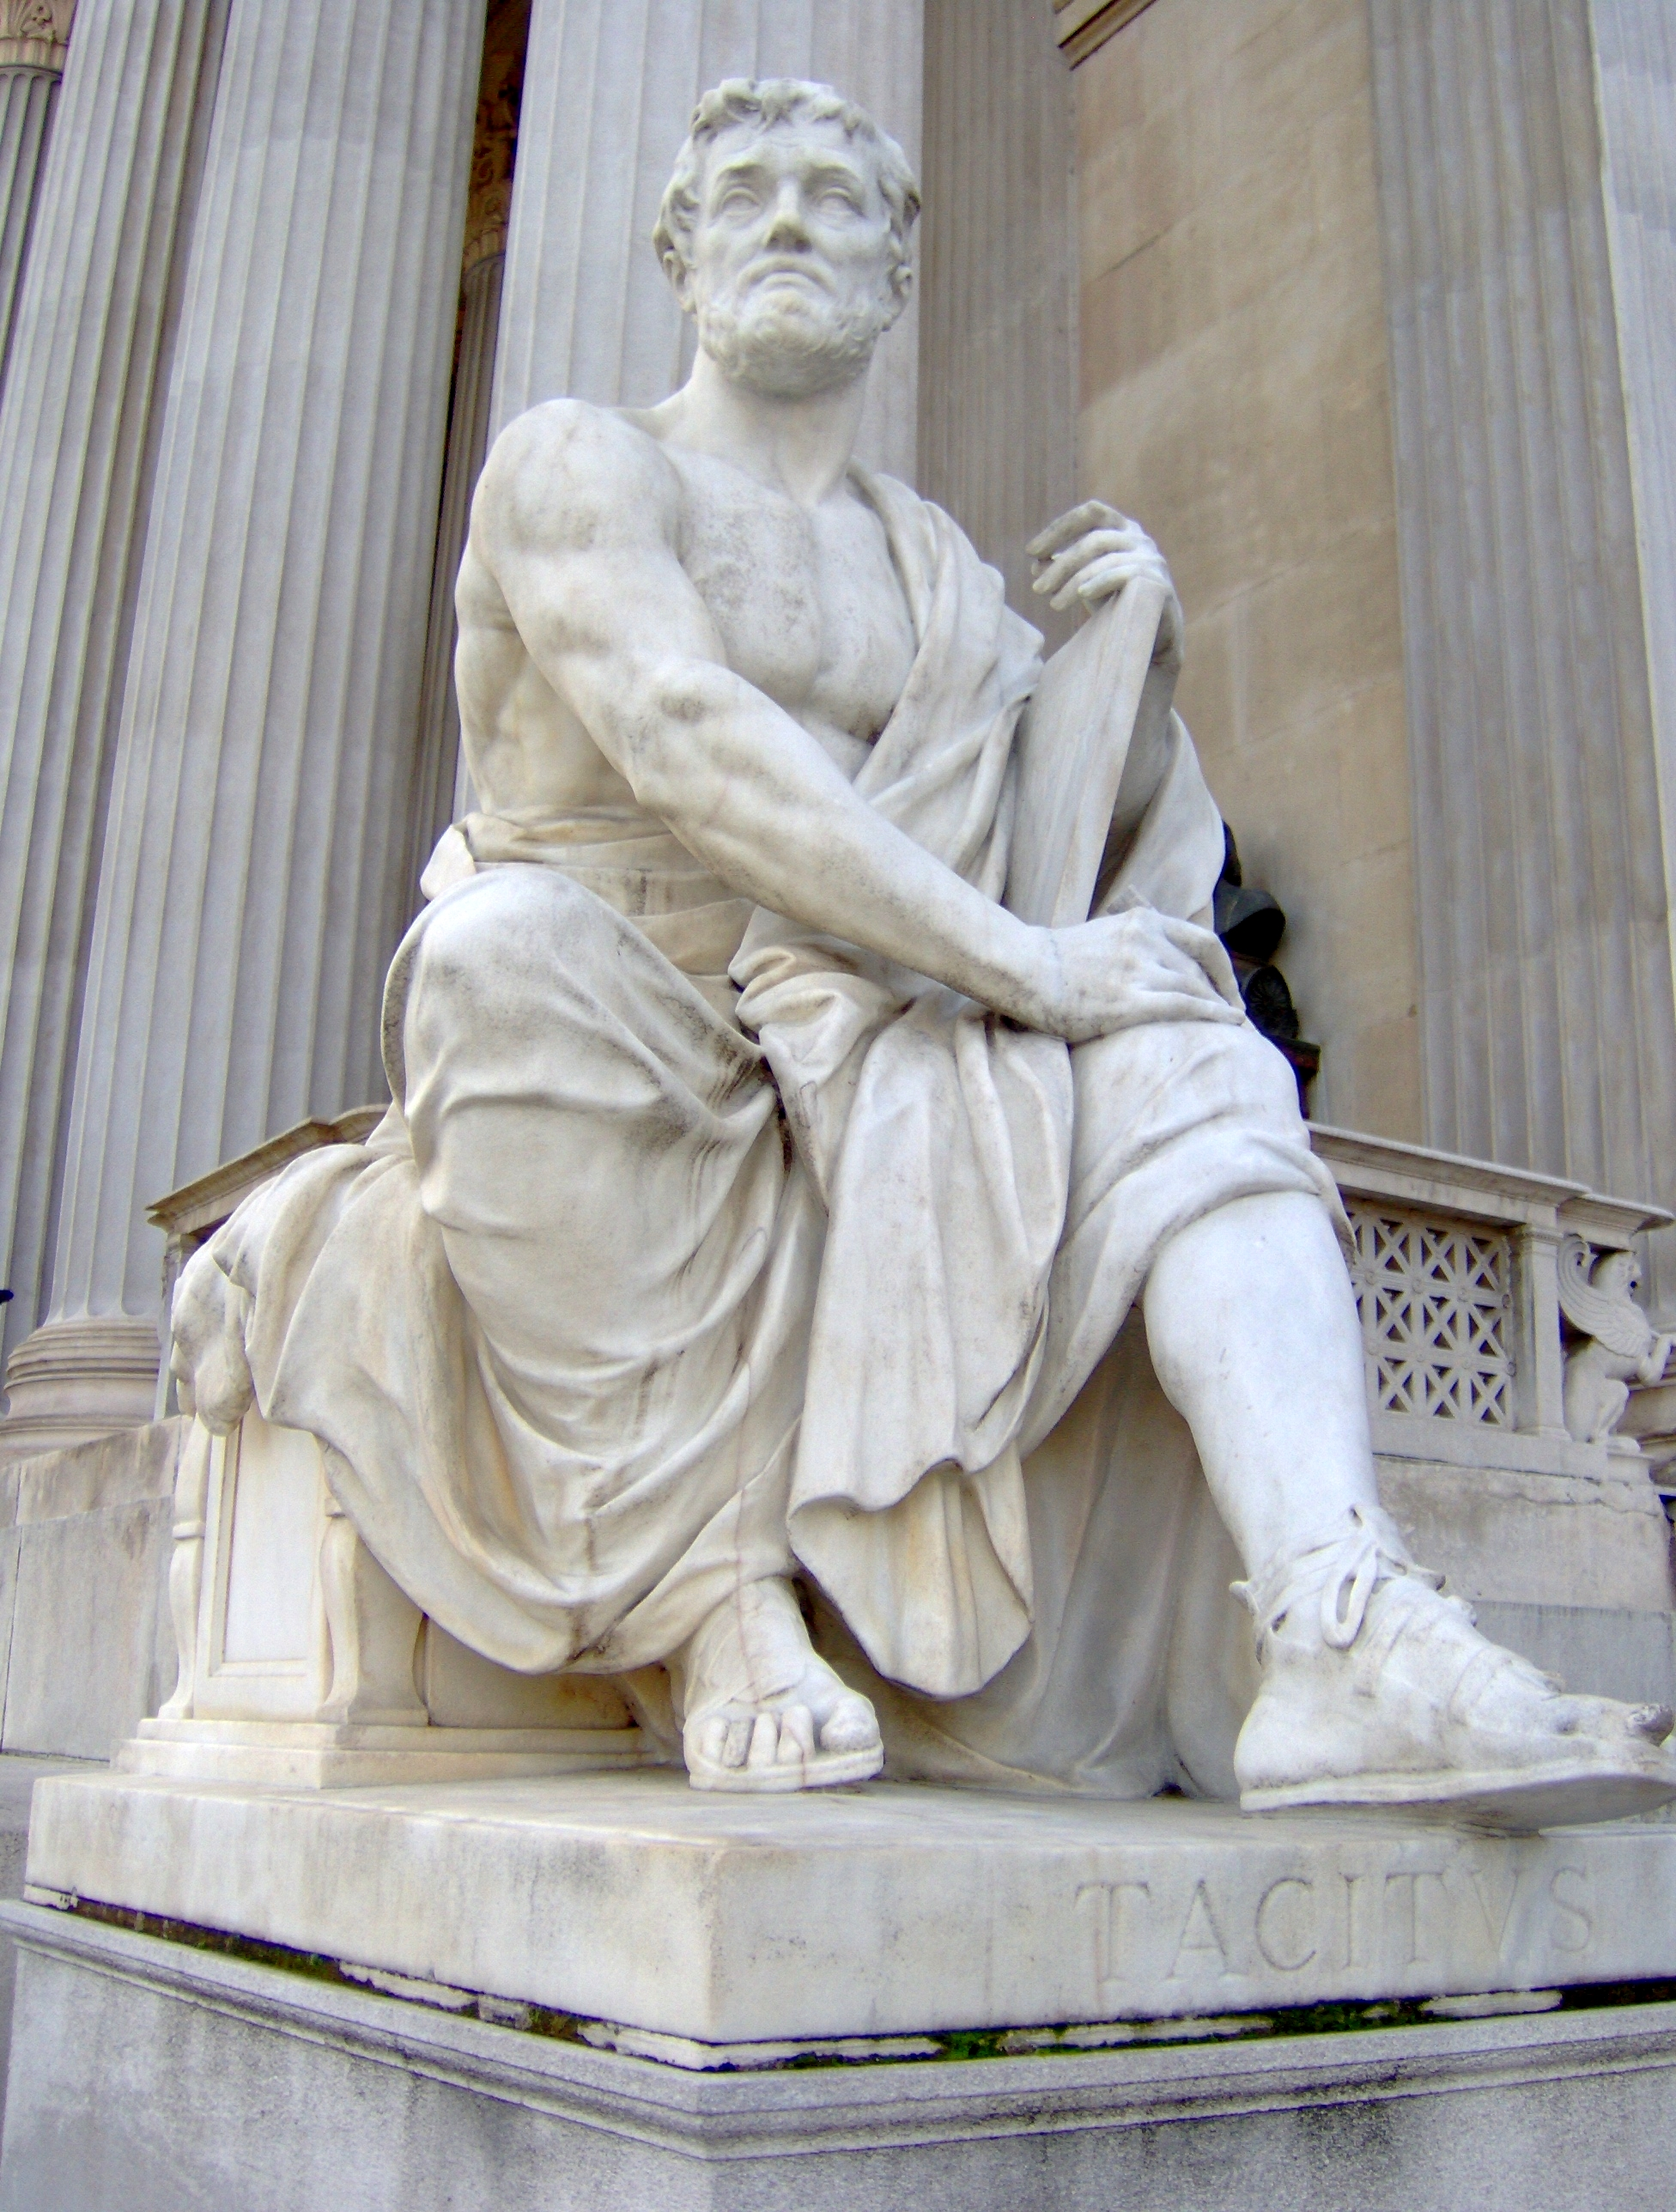
Review of Authors/Historians
Herodotus born c. 484 BCE | Polybius c. 200-118 BCE | J. Caesar c. 100-44 BCE | Livy c. 59 BCE-17 CE | F. Josephus born c. 37 CE | Tacitus c. 56-120 CE

Slide 4
What should we be looking for?
Who, what, where, when, why
Are they writing contemporaneously? Past? Distant Past?
What is the motivation/reason for their writings?
Are they using sources? What are they? Do they cite them?
Do they display bias? Personal opinions?
Personal connection to their text
Do they connect their work to others? And if so, what is the relationship between the works?

Slide 5
Herodotus, Histories preface 1.5.3
Record of the research of Herodotus of Halicarnassus
Great and marvelous achievements of Greeks and non-Greeks
Persians and Phoenicians
State things as they are
Speak about the man who was the first to commit wrongs against the Greeks

Slide 6
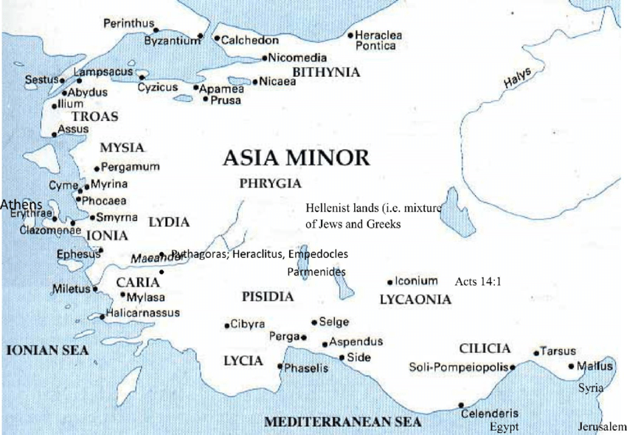
Herodotus cont’d
From Halicarnassus
Interested in a non-Greek point of view
Trying to be unbiased and state the “facts”
Personal opinion and judgement

Slide 7
Herodotus, Histories, 2.92
All these are the customs of Egyptians who dwell above the marsh country. Those who inhabit the marshes have the same customs as the rest, both in other respects, and in that each man has one wife, as in Greece. They have, besides, devised means to make their food less costly. When the river is in flood and overflows the plains, many lilies, which the Egyptians call lotus, grow in the water. They pluck these and dry them in the sun, then they crush the poppy-like centre of the plant and bake loaves of it. The root also of this lotus is eatable, and of a sweetish taste; it is round, and of the bigness of an apple. Other lilies also grow in the river, which are like roses; the fruit of these is found in a calyx springing from the root by a separate stalk, and is most like to a comb made by wasps; this produces many eatable seeds as big as an olive-stone, which are eaten both fresh and dried.

Slide 8
Polybius, Histories 3.31.2–4, 7–8, 11–13
“... Knowledge of the past [is] good but not essential” but then it is essential because no one knows the future
Difficult to determine each person’s policy and truth is often obscure
According to Polybius, what should writers and readers of history pay attention to?
Narrative, questions asked, who was there, what followed
Educational value
What use is history in the future?

Slide 9
Polybius, Histories, 1.1
Had previous chroniclers neglected to speak in praise of History in general, it might perhaps have been necessary for me to recommend everyone to choose for study and welcome such treatises as the present, since men have no more ready corrective of conduct than knowledge of the past. But all historians, one may say without exception, and in no halfhearted manner, but making this the beginning and end of their labor, have impressed on us that the soundest education and training for a life of active politics is the study of History, and that the surest and indeed the only method of learning how to bear bravely the vicissitudes of fortune, is to recall the calamities of others. Evidently therefore no one, and least of all myself, would think it his duty at this day to repeat what has been so well and so often said. For the very element of unexpectedness in the events I have chosen as my theme will be sufficient to challenge and incite everyone, young and old alike, to peruse my systematic history.

Slide 10
Julius Caesar
Gaius Julius Caesar, c.100-44 BCE
Conquest of Gaul and powerful politician
Civil war, defeated the forces led by Pompey, made perpetual dictator
Assassinated by Brutus and Cassius (Republican party)
Wrote a record of the civil war, third person
Meant to glorify his accomplishments to the Roman people

Slide 11
Caesar, De Bello Gallico, 1.11
The Helvetii had by this time led their forces over through the narrow defile and the territories of the Sequani, and had arrived at the territories of the Aedui, and were ravaging their lands. The Aedui, as they could not defend themselves and their possessions against them, send embassadors to Caesar to ask assistance, [pleading] that they had at all times so well deserved of the Roman people, that their fields ought not to have been laid waste-their children carried off into slavery-their towns stormed, almost within sight of our army. At the same time the Ambarri, the friends and kinsmen of the Aedui, apprize Caesar, that it was not easy for them, now that their fields had been devastated, to ward off the violence of the enemy from their towns: the Allobroges likewise, who had villages and possessions on the other side of the Rhone , betake themselves in flight to Caesar, and assure him that they had nothing remaining, except the soil of their land. Caesar, induced by these circumstances, decides, that he ought not to wait until the Helvetii, after destroying all the property of his allies, should arrive among the Santones.

Slide 12
Livy, From the Foundation of the City preface 6–7, 9–10
Collection of accounts on the events before the city of Rome was founded
Clearly states his opinion
What should people consider?
How people lived, values, which individuals and what skills established and increased Rome’s power
Explaining why it is beneficial to study history
Learning from your past to have a successful future
A guide to how to be a successful country, leader, etc.

Slide 13
Livy, Ab urbe condita, 2.40.1-11
p. 241 in Words & Ideas

Slide 14
Flavius Josephus
Born c. 37 CE, sent to Rome as an ambassador
Educated in the Rabbinical tradition
Became a leader in the revolt against the Roman government
Captured, but pardoned
History of the Jewish War and Jewish Antiquities (a history of the Jewish people from Adam up to his own days)

Slide 15
Flavius Josephus Passage
In class discussion

Slide 16
Tacitus, Annals 1.1
Acknowledgment from past writers, positive
False accounts because of fear under the period of Tiberius, Gaius, Claudius, and Nero
Future accounts were further influenced by the hatred of the previous times
Describing things as neutral and unbiased (to his best abilities) as there is no place for anger or partiality in history

Slide 17
Annals, 13.25
… Nero wandering through the streets of the City and its love-lairs and distractions in servile apparel, accoutred to dissemble his identity and accompanied by men who would seize things displayed for sale and inflict wounds on passers-by—such being the ignorance of his adversaries that he too received blows and presented the bruises on his face. Later—when it had become known that it was Caesar who was on the prowl, and injuries against distinguished men and women were increasing and some people, now that license was permitted, went unpunished under cover of Nero’s name, as they carried on the same behavior with their own personal groups—nighttime was passed as if in a state of captivity…

Slide 18
Thucydides, The Peloponnesian War 1.21–22
Very personal, but affirms his account is more accurate and authentic than others
Critical of past works on the subject, but does not call them out
His account should be trusted because he did a vast amount of research
Discredits other methods of historiography
Separates mythology from history (entertainment aspect)
Knowing his audience
Stating the value of his work now and in the future

Slide 19
Modern Day History Lessons
Are there any connections between how history is written and taught today to how it was recorded during antiquity?
Bias, personal opinion, judgment, which groups of people, events, places, etc.
“The Problem of Bias in US History Textbooks and Curriculum” – School of Education, American University

Slide 20
There’s always room for improvement!
Practice your critical thinking and analysis skills!
Know your author and their sources
Be aware of the language (note specific terms and phrases)
What is being said? What is being left out?
Ambiguity can be a choice
Read and re-read
Research the topic for yourself
Ask others or see what other people have to say or have said

Slide 21
Word Breakdown
Autobiography
auto- “self” (autos, from Greek)
bio- “life” (bios, from Greek)
-graphy “art or method of writing” (combining form)

Slide 22
Word Breakdown
Historian
histor- “expert” (histor, from Greek)
-ian (noun-forming suffix, agent function)

Slide 23
Word Breakdown
Memory
memor- “mindful of” (memor, from Latin)
-y (noun-forming suffix, abstract function)

Slide 24
What’s Next
Greek law and politics
Read Words & Ideas, Ch. 6, pp. 145–151

