Slide 1
Lesson 42
Indirect discourse with participle crasis

Slide 2
Indirect discourse (indirect statement)
1. After verb of saying (e.g. λέγω, ἀποκρίνομαι, φράζω, γράφω):
ὅτι ὡς + indicative [after verb of saying in secondary (past) tense, mood of verb commonly changed to optative, keeping the same aspect]
2. After φημί or verb of thinking or believing (e.g. νομίζω, πιστεύω):
subject in original direct statement is changed into accusative*, finite verb in original direct statement is changed into infinitive, keeping the same aspect
ΝΕW 3. After verb of knowing, showing, announcing, or perceiving (e.g. οἶδα, φαίνω, δηλόω, ἀγγέλλω, ἀκούω, αἰσθάνομαι, πυνθάνομαι, μανθάνω, ὁράω, βλέπω):
subject in original direct statement is changed into accusative*, finite verb in original direct statement is changed into participle, keeping the same aspect
*but if the subject of the verb introducing indirect statement is the same as the subject of the verb in the original direct speech, then the subject is either gapped or nominative is used of any pronoun or adjective agreeing with the subject

Slide 3
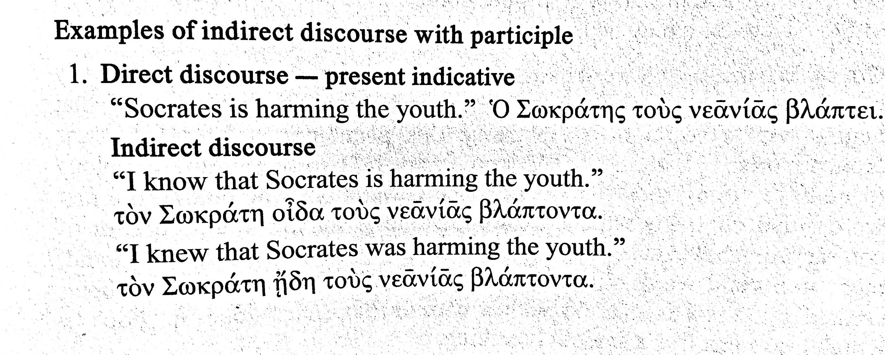

Slide 4
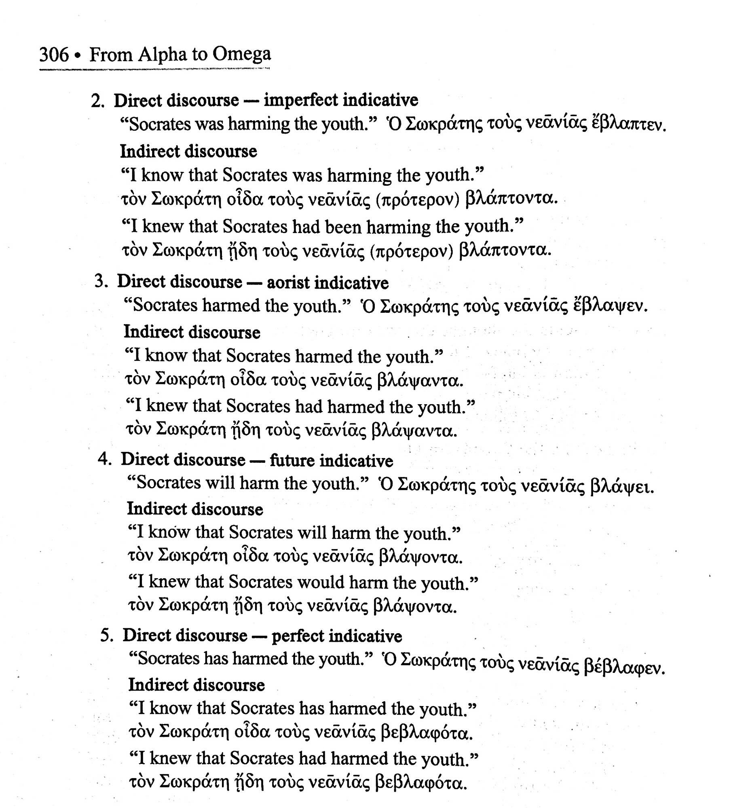

Slide 5
Further notes to indirect discourse after verbs of knowing, showing, perceiving
Using the ὅτι/ὡς + indicative [or opt. after secondary tense] construction is an option with these verbs too
when there is intellectual perception (”I heard they arrested Socrates”) rather than sense perception (“I heard Socrates talking in the jail cell”)
put another way: if sense perception is involved, the participle will generally be used. If intellectual perception is involved, either the participial or the ὅτι/ὡς construction can be used

Slide 6
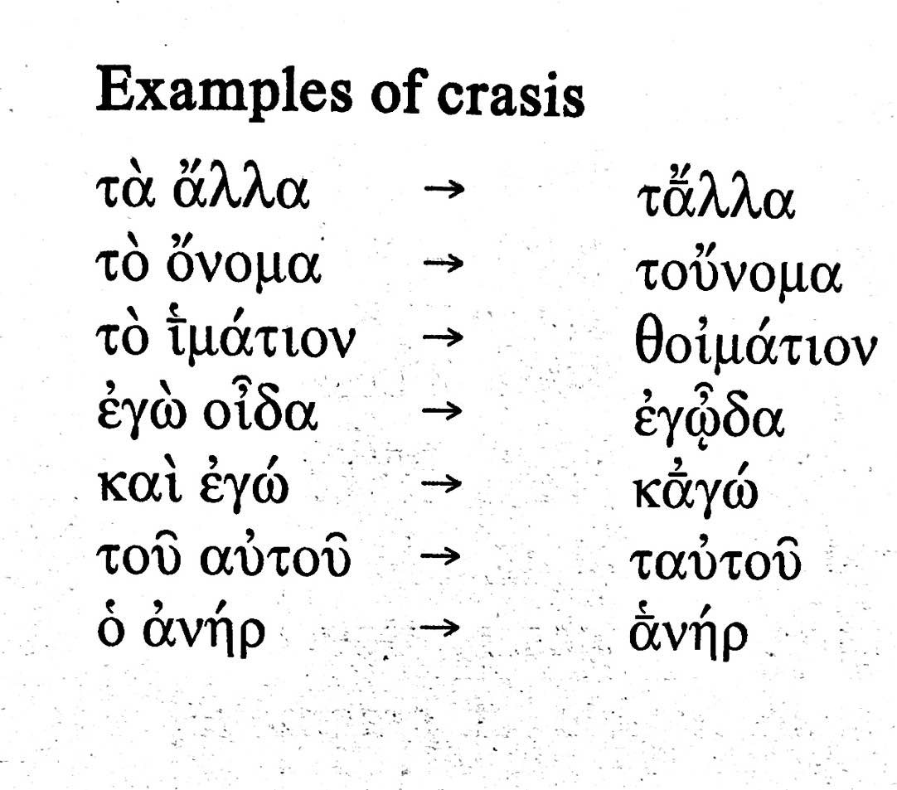
Crasis
lit. “mixing” of vowels between final vowel/diphthong of one word and initial vowel/diphthong of certain consecutive words
indication of crasis is presence of coronis sign (looks like smooth breathing sign)

