Slide 1
Lesson 44 Verbal adjectives in –τέος and -τός

Slide 2
Verbal adjectives in Greek
We have encountered the idea of a verbal noun (or gerund) in Greek: the infinitive can be used this way (e.g. “to run is fun” = “running is fun”)
A verbal adjective has characteristics of an adjective in that it describes a noun but has verbal character as well.
We have encountered one type of verbal adjective in Greek already: the participle.
e.g. ὁ φιλῶν τοὺς λόγους ῥήτωρ “the word-loving speaker” [what kind of speaker? The speaker loving words or the speaker who loves words.
In the example, the participial phrase φιλῶν τοὺς λόγους gives us more information about or describes the ῥήτωρ, and so functions like an adjective.
But it shows its verbal nature in the fact that it here takes its own direct object, τοὺς λόγους.

Slide 3
Verbal adjectives in Greek cont’d
There are other types of verbal adjectives in Greek in which the suffixes -τός, -τή, -τόν and, a development of this, -τέος, -τέα, -τέον are added to a verbal stem (usually the 6th principle part, but sometimes the 1st or the 2nd)
These have specialized meanings
1. The -τός, -τή, -τόν suffix normally gives the meaning of capability or possibility and normally conveys (but not always) a passive sense, “able to be Xed, Xable” or sometimes gives the same sense as a perfect passive participle “Xed, having been Xed”
e.g. ταῦτα τὰ ζῷα φιλητά ἐστιν ”These animals are lovable/adorable.” or ταῦτα τὰ ζῷα εὖ φιλητά ἐστιν ”These animals are well loved.”
2. The -τέος, -τέα, -τέον suffix normally conveys the idea of necessity or obligation and can be passive or active in sense depending on the construction (more later)
e.g. ταῦτα φυκτέα [formed from φεύγω] ἐστίν “These things are to be / must be avoided”

Slide 4
More on the -τέος, -τέα, -τέον type: formation
Generally formed from the 6th principal part (aorist passive stem)
e.g. παιδευτέος (“needing to be educated”) from ἐπαιδεύθην
to get stem, remove temporal augment from beginning, remove -θην from end [acc. to textbook: actually it’s *more complicated, but for now let’s think of it that way)
Thus παιδευ- remains, to which -τέος, -τέα, -τέον is added
[* really what happens is: –ην is removed, stem παιδευθ- remains. Final θ deaspirates to τ: παιδευτ-, then to this τέος is added: παιδευττέος, double ττ reduced to single τ, so παιδευτέος.]
[Advantage of this method of explanation is that it works for verbs that don’t have 6th p. part in –θην, e.g. γράφω, whose 6th p. part is ἐγράφην: remove augment and –ην from ἐγράφην to get stem γραφ-, final consonant φ deaspirates to π, then to this τέος is added: γραπτέος.
[This will also help explain how we get θυτέος from ἐτύθην, 6th p. part of θύω: remove augment and –ην from ἐτύθην to get stem τυθ-, final consonant θ deaspirates to τ, then initial consonant τ reaspirates to θ, so θυτέος.]

Slide 5
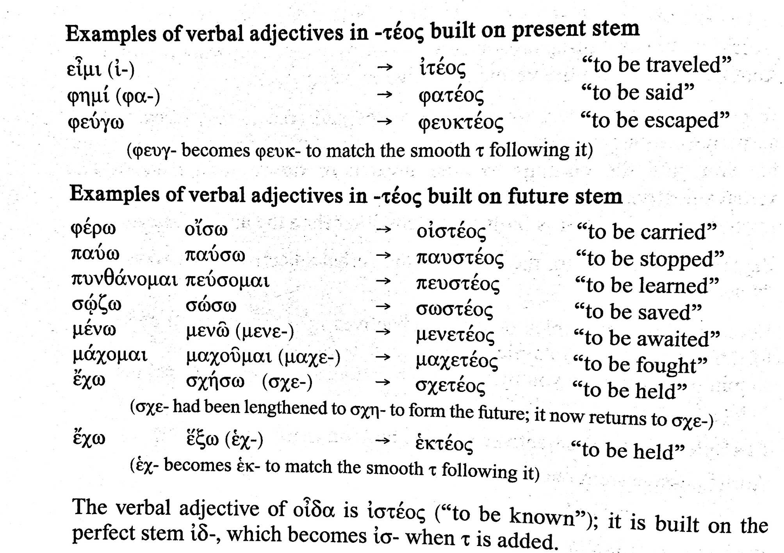
More on the -τέος, -τέα, -τέον type: verbs that use stems from 1st and 2nd p. parts

Slide 6
More on the -τέος, -τέα, -τέον type: use in constructions
used attributively, the form works as substantive, normally passive in sense: τὰ πρακτέα “the [things] to be done, the things that need to be done”
used in complement or predicate with verb to be expressed or implied, e.g οἱ παῖδες παιδευτέοι [εἰσίν]: “the kids need to be educated”

Slide 7
Two constructions using -τέος, -τέα, -τέον type as complement or predicate
1. personal construction: the form will agree with a noun, which functions as subject in expression of obligation.
the sense is passive
if it is necessary to express by whom the action should be done, the dative is used (and not ὑπό + genitive) [dative of the agent]
e.g οἱ παῖδες παιδευτέοι [εἰσίν] ἡμῖν “The kids must be / are to be educated by us.
2. impersonal construction: the form will be either neuter sing. or (less commonly) pl., there is no personal subject
the sense is active
if it is necessary to express who should do the action, the dative is used [dative of agent]
e.g. τοὺς παῖδας παιδευτέον ἐστὶν ἡμῖν lit. “There must be an educating the children for us” which is generally flipped and expressed as “We must educate the children”

