Slide 1
Lesson 46
MI-Verbs (δίδωμι, ἵστημι)

Slide 2
MI-verbs in general
in the present active show an older set of personal endings: e.g. –μι for 1st s. present active as opposed to –ω.
MI-verbs are a small group but contain some very commonly used verbs, e.g. to be, to know, to give, to stand, to put
these endings are added directly to the verb stem (which ends in a vowel) without any thematic vowel between stem and personal ending: e.g. ἵστα-μεν “we are standing, setting” vs. παιδεύ-ο-μεν.
hence they are sometimes called athematic verbs
generally speaking, these endings and their athematic nature are seen in the present, imperfect, and to some extent aorist. Other parts conjugate regularly.

Slide 3
ἵστημι, στήσω, ἔστησα (transitive) ἔστην (intransitive), ἕστηκα, ἕσταμαι, ἐστάθην “to make stand, stand”
We will concern ourselves with present active, aorist intransitive active, perfect active forms.
The other forms are conjugated regularly
ἵστημι present active is transitive (takes an object): means to stand or set something
aorist active ἔστησα (transitive) means “I stood or set something”
contrast this with ἔστην (intransitive), meaning “I stood (up) / got set” [[“got into standing position”, not “I stood” in sense of “I was standing”)
perfect active ἕστηκα means “I am standing, I stand” (lit. “have gotten into standing position and so now am standing”), so pluperfect will mean “I was standing, stood” (lit. “I was in a state of having gotten into standing position”)

Slide 4
δίδωμι, δώσω, ἔδωκα, δέδωκα, δέδομαι, ἐδόθην “to give”
future δώσω, perfects δέδωκα and δέδομαι, aorist passive ἐδόθην are all regular
we will need to look at everything formed from 1st and 3rd principle parts

Slide 5
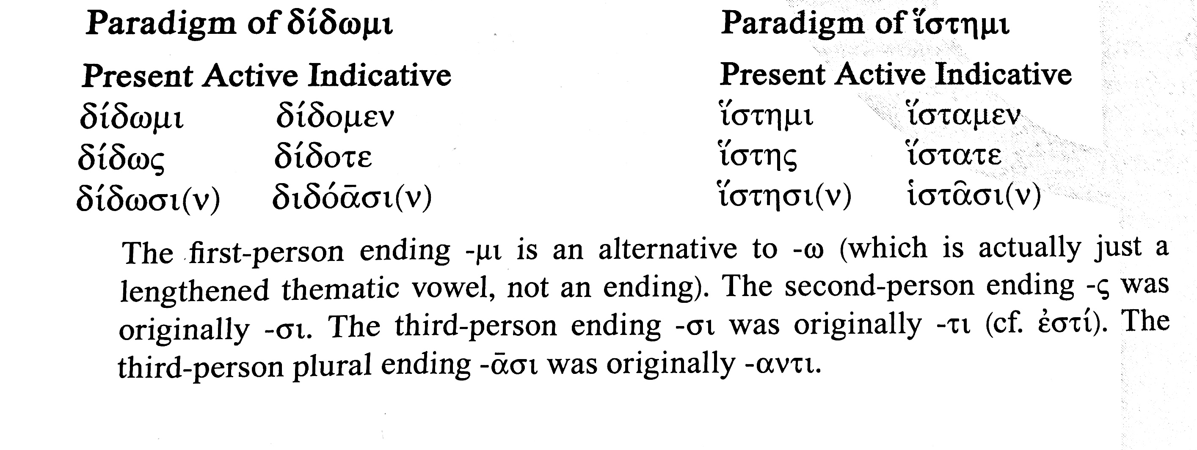
present active indicative
note both stems have present reduplication (ἵστημι originally *σίστημι)
note sing. forms use stem with long form of vowel (διδω-, ἱστη-), plurals use stem with short vowel (διδο-, ἱστα-)
note sing. endings were originally μι σι τι. Because in this dialect τ between vowels reg. becomes σ, 3rd. s. δίδωτι δίδωσι. That meant confusion with 2nd s. δίδωσι, so speakers used regular ς 2nd s. ending
note 3rd pl. originally –ντι: this ν was a sonant nasal, so could develop (as here) into a pure vowel α. In this dialect, dialect τ between vowels reg. becomes σ, so ατι became ασι

Slide 6
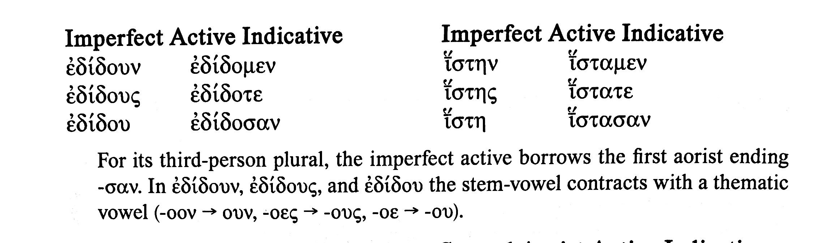
imperfect active indicative
note that ἵστημι doesn’t take ἐ augment, but lengthens initial ἰ-
note that ἵστημι observes transition between stem with long vowel (ἱστη-) for s. forms and stem with short vowel (ἱστα-) for pl.
but δίδωμι behaves irregularly, forming s. forms using thematic imperfect endings with subsequent contraction (see note in textbook above)
note that both verbs (and other MI-verbs) borrow the aor. pl. active ending –σαν (maybe to avoid confusion with 1st s. ending?)

Slide 7
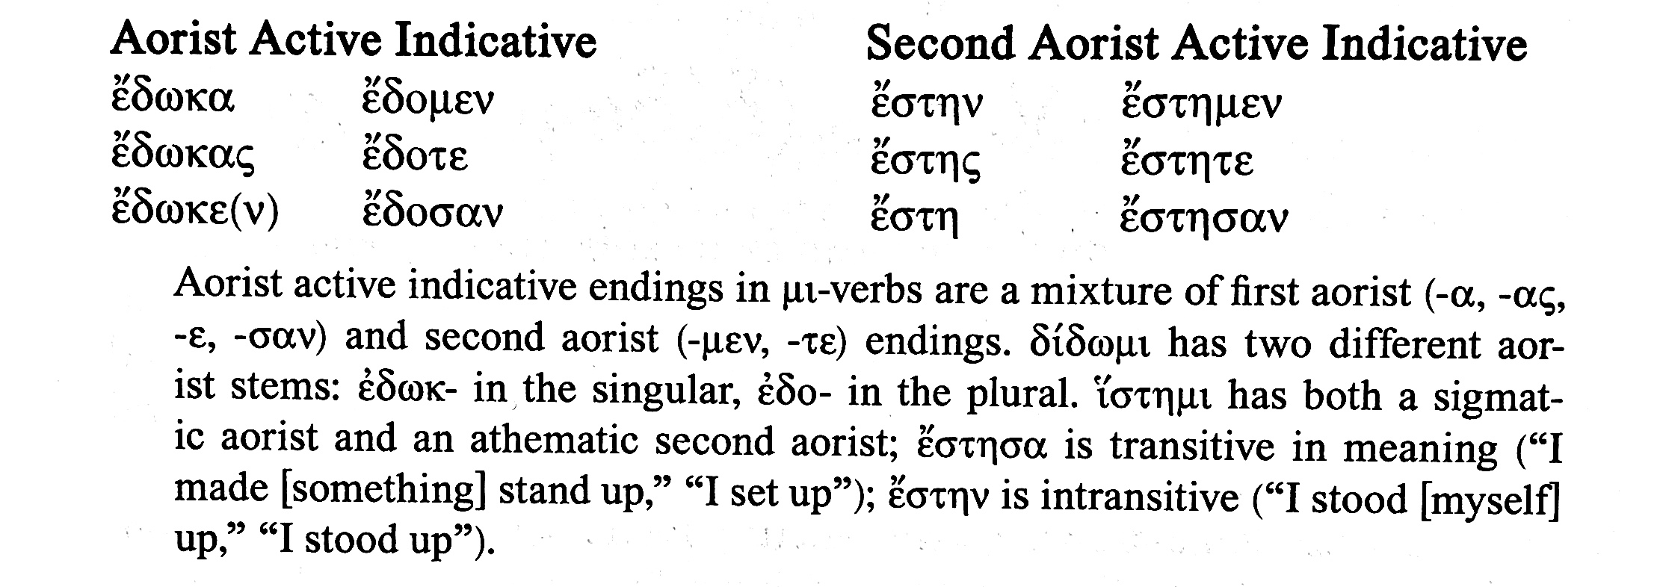
aorist active indicative
note aorist stem no longer has reduplication: δω/δο, στη
ἔστην is a so-called root aorist type, adding endings straight to stem with long vowel
see note from textbook above re significant diff. in meaning between first aorist ἔστησα (transitive) and second/strong aorist ἔστην (intransitive)
note that aorist of δίδωμι combines two different stems: see note in textbook above.

Slide 8
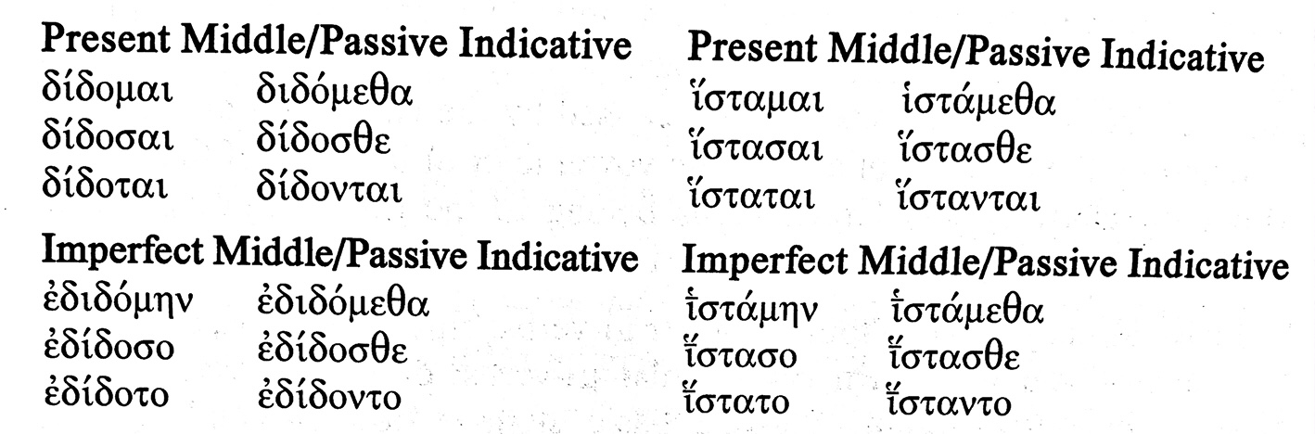
indicative present and imperf. middle/passive
note s. present endings -μαι -σαι -ται is m/p equivalent of original μι σι τι and σ in σαι doesn’t drop out as it does in regular thematic verbs (e.g. 2nd s. present m/p παιδεύῃ < παιδεύ-ε-αι < παιδεύ-ε-σαι)
note s. imperfect endings -μην -σο -το: analogous with pres. 2nd s., here the original σο is preserved and the σ doesn’t drop out as it does in regular thematic verbs (e.g. 2nd s. imperf. m/p ἐπαιδεύου < ἐπαιδεύσου)

Slide 9
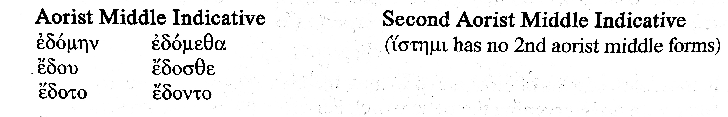
indicative aorist middle
note the aorist of δίδωμι uses stem with short vowel for both s. and pl.
note that original sigma of 2nd s. ending does drop out here

Slide 10
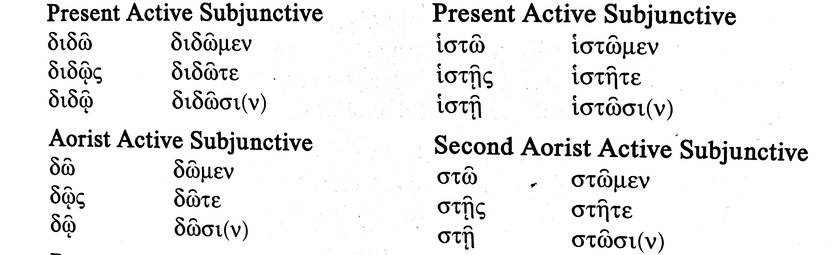
subjunctive active pres. and aor.
all forms undergo contraction of vowel in stem and lengthened thematic vowel in subjunctive ending (e.g. διδῶ < διδόω, διδῷς < διδόῃς, ἱστῶ < ἱστάω, ἱστῇς < ἱστάῃς)
note only diff. between present and aorist forms is the stem

Slide 11
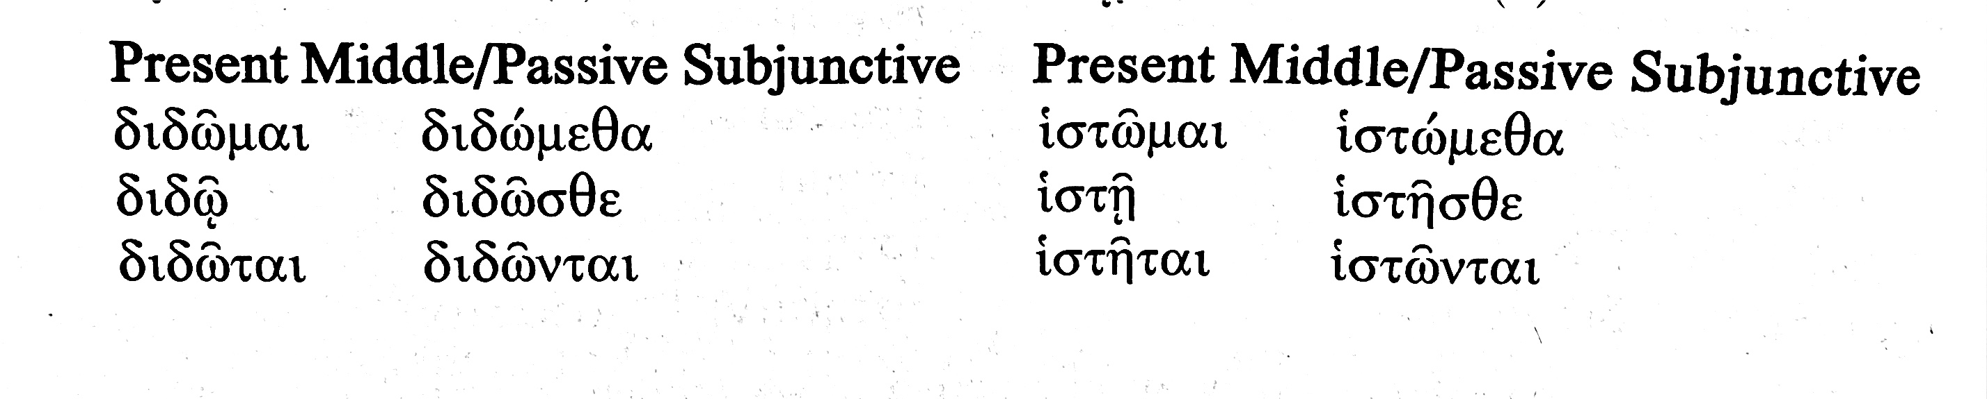
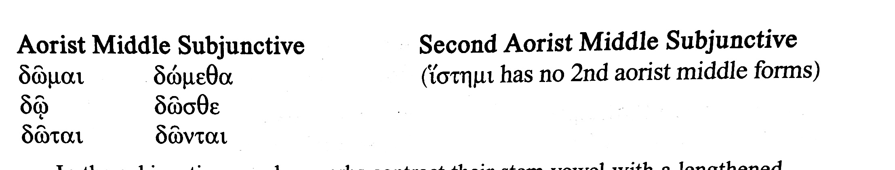
subjunctive present m/p and aorist middle

Slide 12
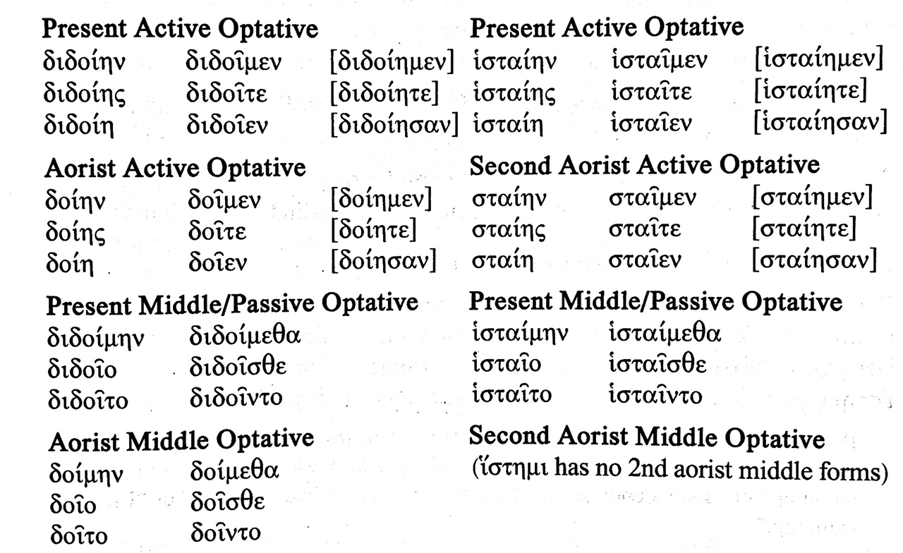
optatives, pres. act. and m/p, aor. act. and m.
note two systems of forming active optatives: either stem + ι + ending or stem + ι + η + ending. First type pref. for pl, second type pref. for sing.
middle and passive use stem + ι + ending type

Slide 13
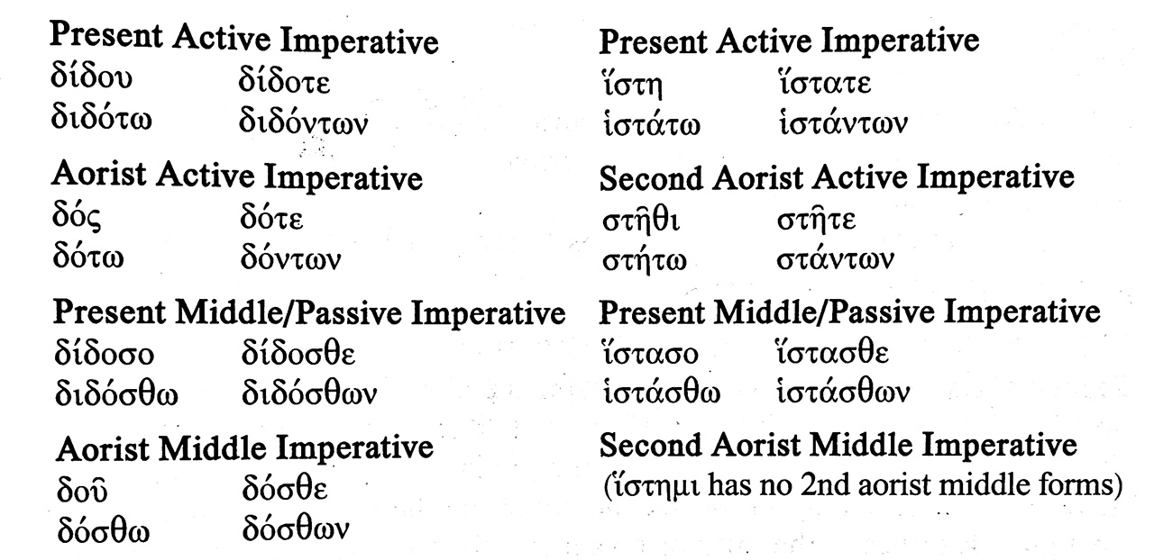
imperatives
note pres. act. 2nd s. imperative δίδου > δίδοε, while ἵστημι just uses stem with long version of vowel, ἵστη
aor. active 2nd s imperative of δίδωμι uses –ς ending, while ἵστημι uses the –θι ending (seen with aor. passive imperatives)
note that present middle/pass. imperatives preserve original –σο ending, maybe to distinguish from pres. active 2nd s. δίδου, but aorist middle δοῦ shows disappearance of intervocalic sigma.

Slide 14
Archimedes’ famous boast about what he can do with a fixed point and a lever
δός μοι ποῦ στῶ, καὶ κινήσω τὴν γῆν
lit. “Give me where I may stand and I will move the earth!”

Slide 15
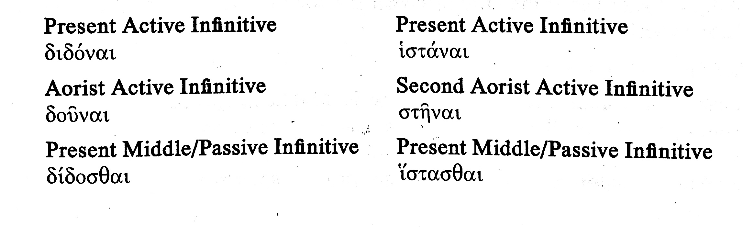
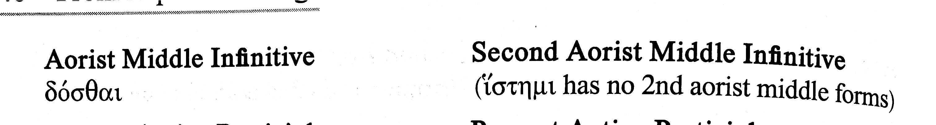
infinitives

Slide 16
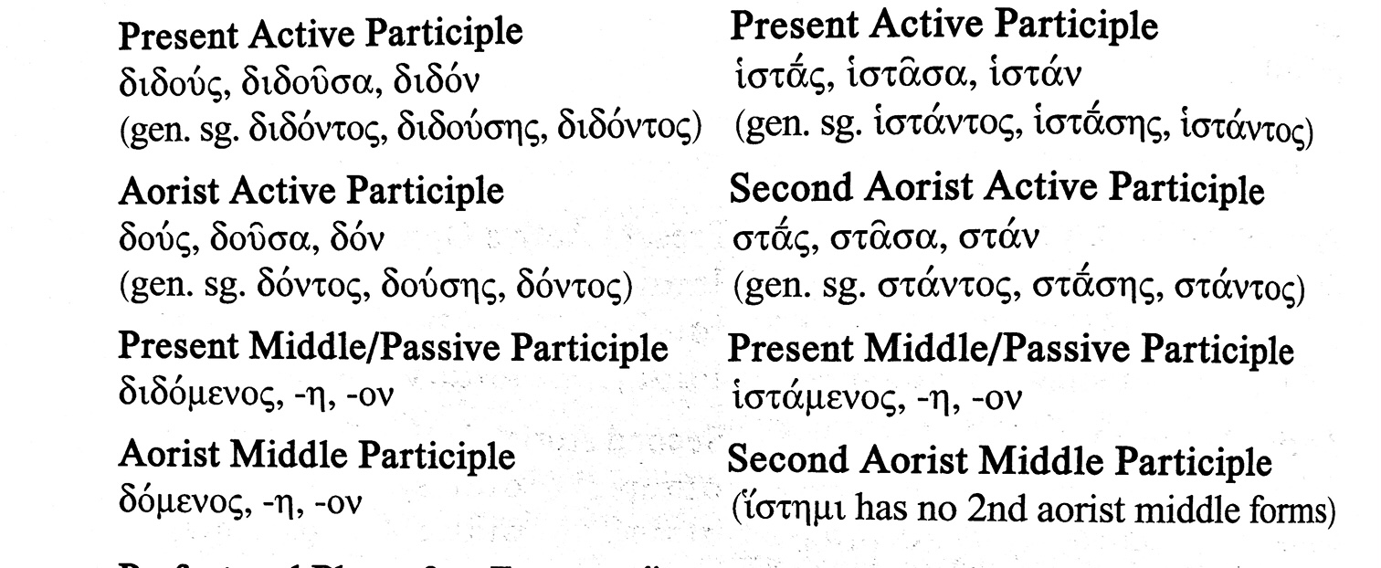
participles

Slide 17
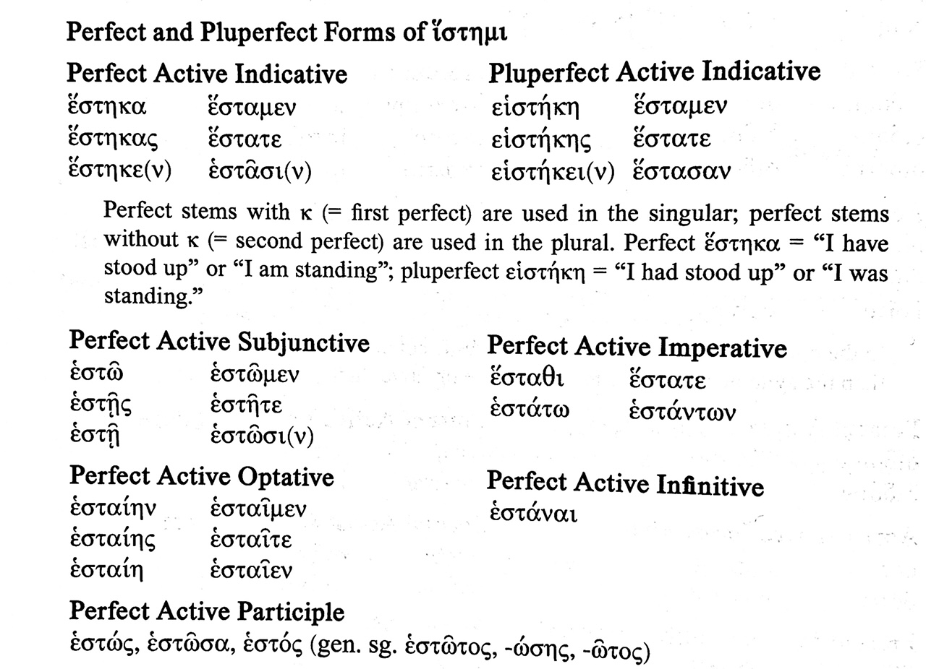
perfect and pluperfect of ἵστημι

Slide 18
A famous use of the perfect of ἵστημι: Clytemnestra appears after she has murdered her husband, Agamemnon (Aeschylus, Agamemnon, lines 1379–1380)
ἕστηκα δ᾽ ἔνθ᾽ ἔπαισ´…
οὕτω δ´ἔπραξα, καὶ τάδ᾽ οὐκ ἀρνήσομαι
I stand where I struck [him] …
So I acted, and I will not deny this

