Slide 1
Lesson 49 βαίνω, γιγνώσκω directional suffixes acc. of respect

Slide 2
βαίνω, βήσομαι, ἔβην, βέβηκα, βέβαμαι, ἐβάθην “walk, go, step”
only the aorist active, which is an athematic root aorist type, requires our attention
everything else is regular
IE root is g^{w}ā-, seen in Eng. “come”, Lat. venire

Slide 3
γιγνώσκω, γνώσομαι, ἔγνων, ἔγνωκα, ἔγνωσμαι, ἐγνώσθην “know, recognize”
only the aorist active, which is an athematic root aorist type, requires our attention
everything else is regular
IE root gnō-, seen in Eng. ”know”, Latin nosco
note that 1st p. part doesn’t mean “I know” but “I am coming to know” (process)
perfect active (4th p. part) means “I know, recognize” (result of having come to know, cf. οἶδα)
while we’re at it, compare another use of perfect to describe a present state in the verb (new this lesson): μιμνῄσκω, μνήσω, ἔμνησα, —, μέμνημαι, ἐμνήσθην
the perfect middle means “I remember” (“I have gone through the process of recalling and bringing to mind and so now I remember”).

Slide 4
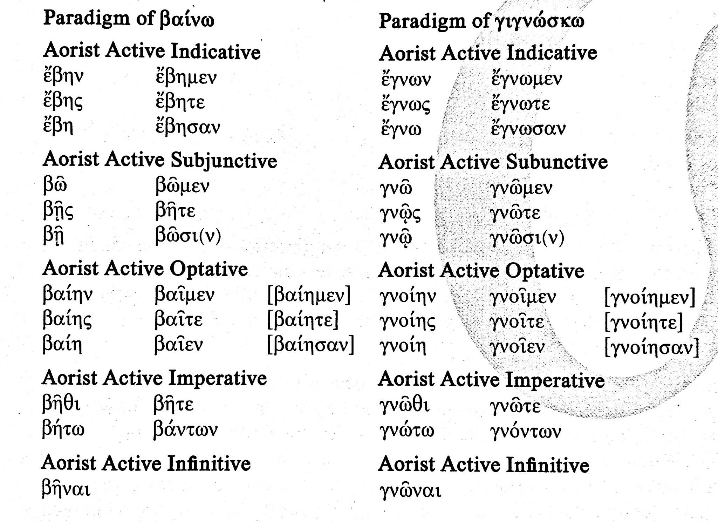
note aorist act. indic. is athematic and root aorist type (cf. ἔστην from ἵστημι): uses only βη- and γνω- stems, not βα- and γνο-
so too for infinitives and most of imperatives
everything else (subjunctive, optative, participles) uses βα-, γνο-

Slide 5
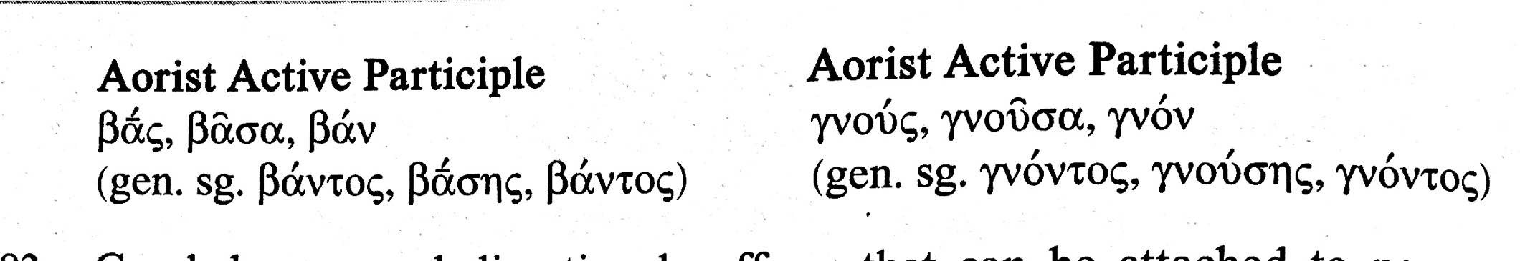
aorist active participles

Slide 6
Directional suffixes
suffixes that can be attached to noun or substantive (but in practice is only used with a selected few)
-ι, –θι, -σι(ν): show place where (locatival)
-θεν: show place from which (whence) (origin)
-δε, -ζε, -σε: show place to which (whither) (destination)

Slide 7
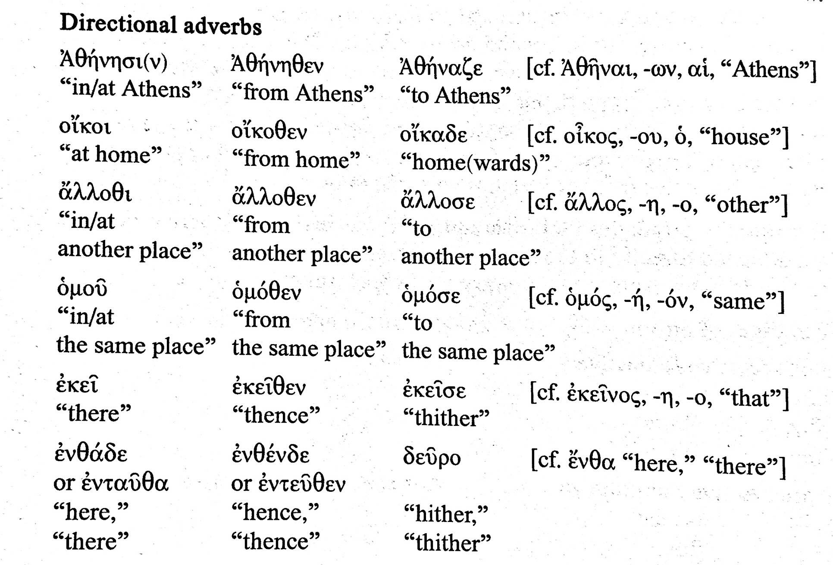
Some commonly encountered directional adverbs

Slide 8
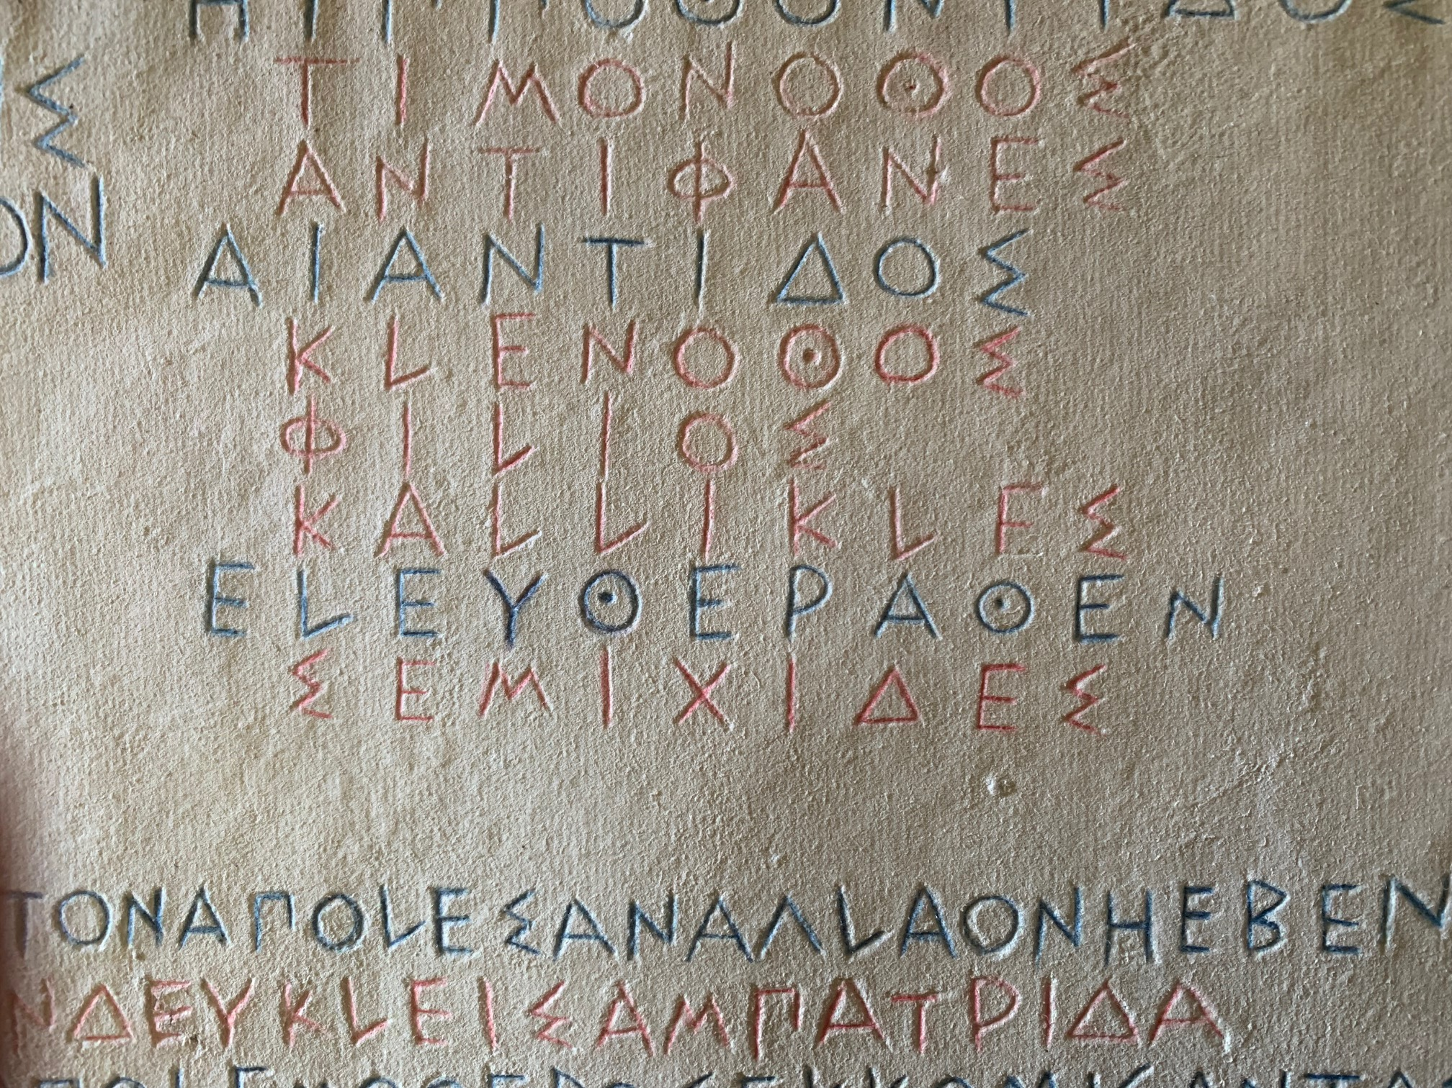
In this Athenian inscription listing some war dead, note the use of directional suffix -θεν
… ΕΛΕΥΘΕΡΑΘΕΝ
ΣΕΜΙΧΙΔΕΣ
…from Eleuthera (town in Attica)
Semikhides (name of soldier)

Slide 9
Accusative of respect
shows in what respect or aspect a quality or attribute or state is so
e.g. Sophocles, Oidipous Tyrannos, line 371 (Oedipus speaking to Tiresias, the blind prophet):
τυφλὸς τά τ’ ὦτα τόν τε νοῦν τά τ’ ὄμματ’ εἶ.
“You are blind with respect to your ears, your mind, and your eyes!”

Slide 10
Beginning of Plato’s Republic. The speaker is Socrates
κατέβην χθὲς εἰς Πειραιᾶ μετὰ Γλαύκωνος τοῦ Ἀρί- (1)
στωνος προσευξόμενός τε τῇ θεῷ καὶ ἅμα τὴν ἑορτὴν
βουλόμενος θεάσασθαι τίνα τρόπον ποιήσουσιν ἅτε νῦν
πρῶτον ἄγοντες.
I went down yesterday to Peiraieus with Glaukon, the son of Ariston, to pray to the goddess (Bendis) and also wanting to observe the festival, in what way they would do it, because they were doing it now for the first time.

Slide 11
Thucydides, 3.37.1. Kleon scolds the Athenian people for wanting to reconsider their previous decision to execute the entire adult male population of the city of Mytilene.
Πολλάκις μὲν ἤδη ἔγωγε καὶ ἄλλοτε ἔγνων δημοκρατίαν
ὅτι ἀδύνατόν ἐστιν ἑτέρων ἄρχειν, μάλιστα δ’ ἐν τῇ νῦν
ὑμετέρᾳ περὶ Μυτιληναίων μεταμελείᾳ.
Often already and on other occasions I at any rate realized that a democracy is incapable of ruling others, but especially in your current change of mind about the people of Mytilene.

Slide 12
Euripides, Heracles, lines 596-7
ὄρνιν δ’ ἰδών τιν’ οὐκ ἐν αἰσίοις ἕδραις
ἔγνων πόνον τιν’ ἐς δόμους πεπτωκότα…
Having seen some bird (omen) in not auspicious places,
I realized that some trouble had fallen upon the palace…

Slide 13
Homer, Odyssey, 1.3–4
πολλῶν δ’ ἀνθρώπων ἴδεν ἄστεα καὶ νόον ἔγνω,
πολλὰ δ’ ὅ γ’ ἐν πόντῳ πάθεν ἄλγεα ὃν κατὰ θυμόν
He saw the cities of many men and he knew their mind,
Many griefs in his spirit did he suffer on the sea.

