Slide 1
Lesson 36: Optative

Slide 2
Mood, tense, aspect, voice, person, number
Category of mood (mode)
Indicative: assertions of fact, statements, questions
Imperative: commands in 2nd and 3rd person
[Infinitive?]
[Participle?]
Subjunctive: not about assertion of fact. Independent (main clause) uses (hortatory, prohibitive, deliberative) and dependent uses (various types of subordinate clauses)
Optative: not about assertion of fact. Independent (main clause) uses (wishes, potentiality) and dependent uses (various types of subordinate clauses)

Slide 3
Optative mood
Name? From Latin opto, optare ‘to hope for’
As with subjunctive, it has more than one function
Distinguish between optative in main clause (independent use of optative) and optative in subordinate or dependent clause (we’ll come to this later).
As with subjunctive, optative has no tense*, only aspect.
possible aspects: present [incomplete, continuous], aorist [simple, once-off], perfect [completed action]
*an exception to this: there is a future optative, which is only used in one type of dependent clause [Lesson 40]

Slide 4
Optative in independent/main clause
optative of wish
wish/curse about present or future that may or may not be capable of fulfillment
e.g. εἴθε γνοῖμι “I wish I knew, if only I knew, would that I knew”
ταῦτα μὴ γένοιτο ”May these things not happen!”
particles εἴθε or εἰ γάρ can be added, but not necessary
never used with particle ἄν
potential optative
expression of potentiality/possibility
e.g. ταῦτα γνοίην ἄν ”I might/may/could/would know these things”
ταῦτα οὐκ ἂν γένοιτο ”These things could not/might not happen”
always with particle ἄν

Slide 5
How to recognize and form the optative
Subjunctive: thematic vowel lengthens, primary endings used
Optative: ι (iota) added to (short) thematic vowel, secondary ending (mostly) used

Slide 6
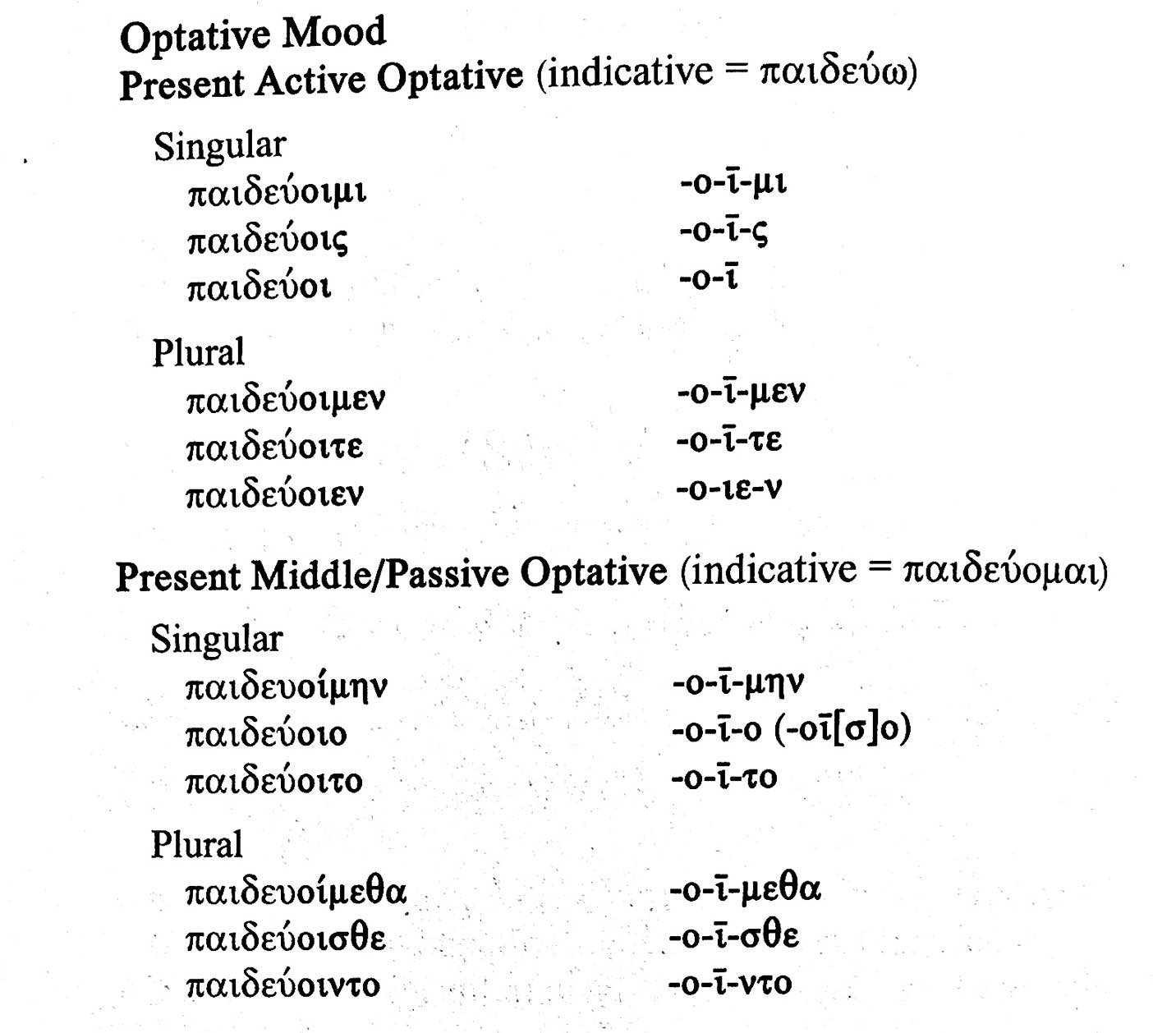
Present optative

Slide 7
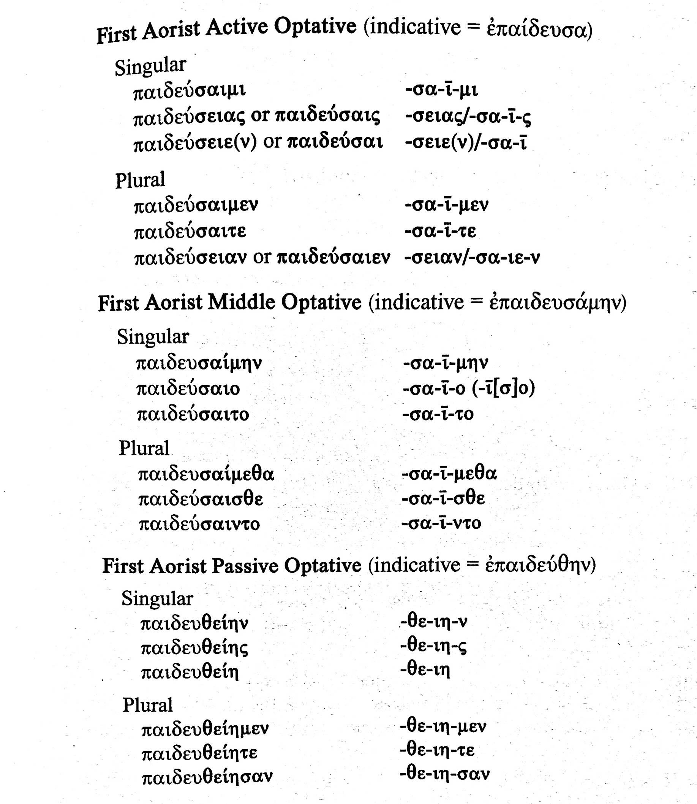
Aorist optative
Notice that unlike subjunctive, the characteristic thematic vowel of aorist (α) is used in active and middle.

Slide 8
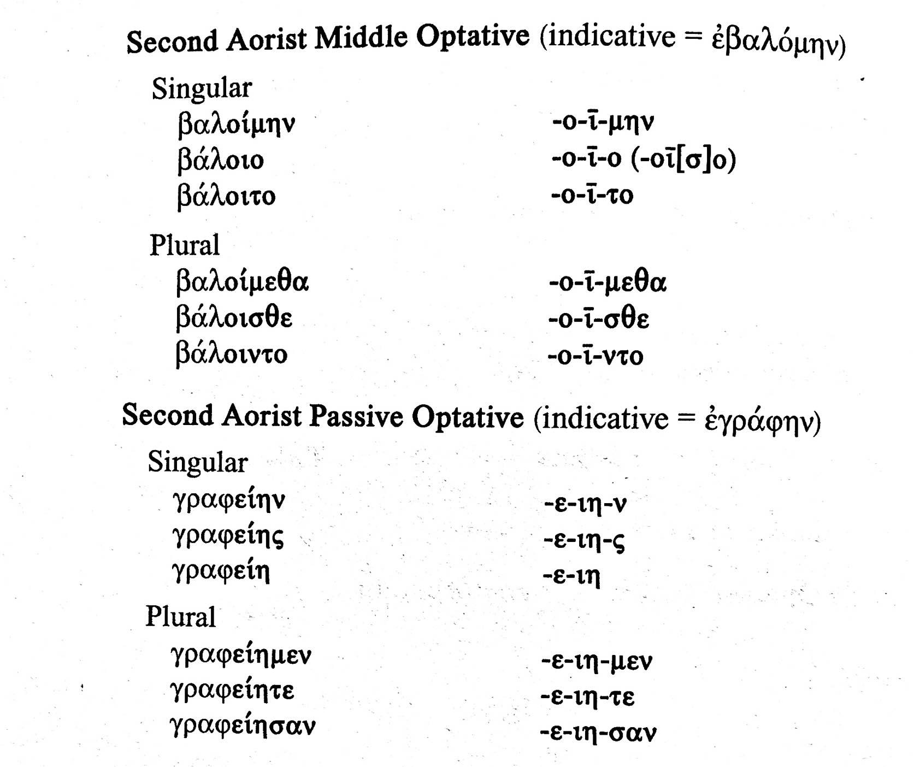
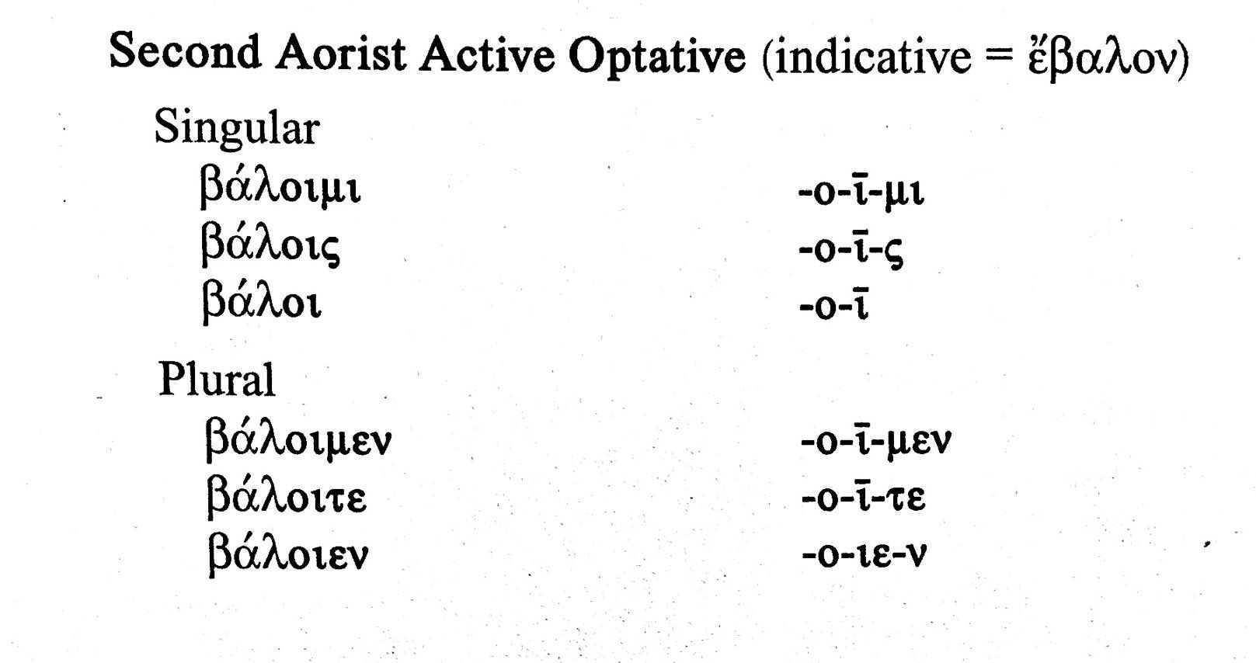
Aorist optative cont’d

Slide 9
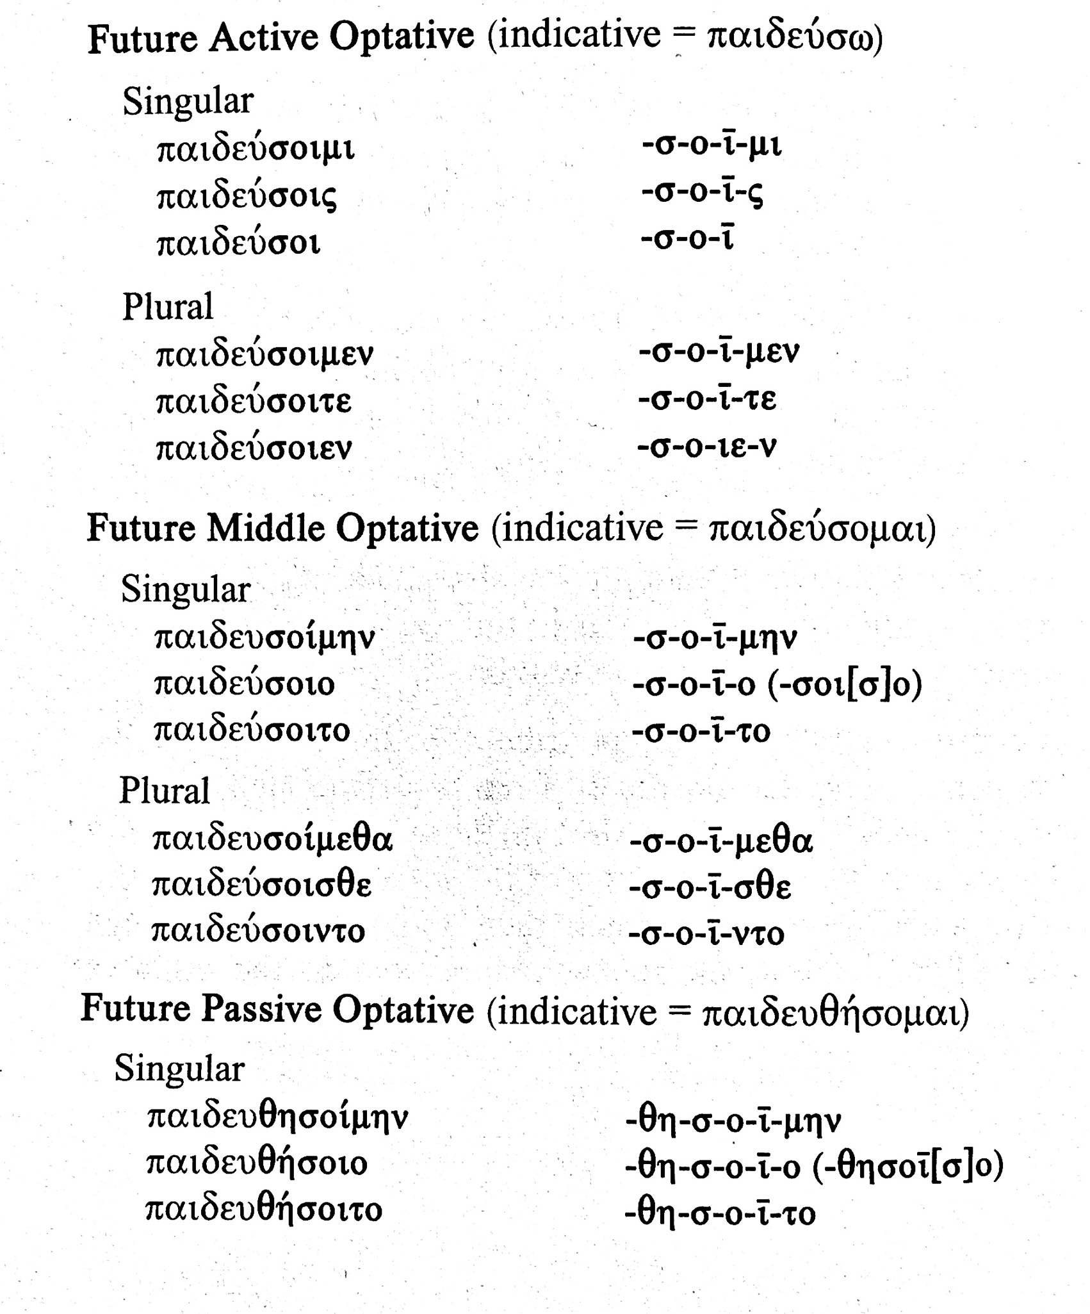
Future optative
A bit of an anomaly, only used in indirect statements to replace future indicative. We’ll get to this later.

Slide 10
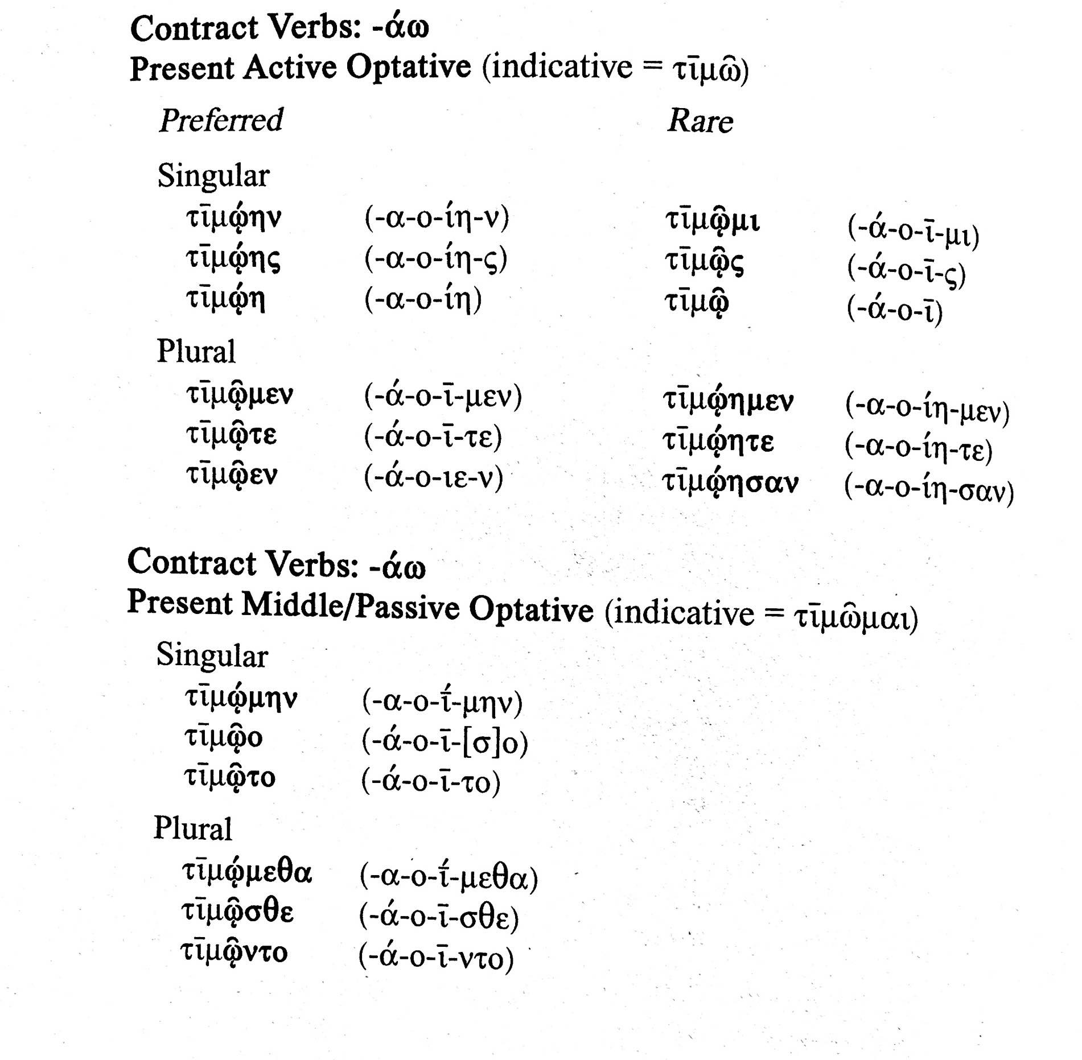
α contract optative

Slide 11
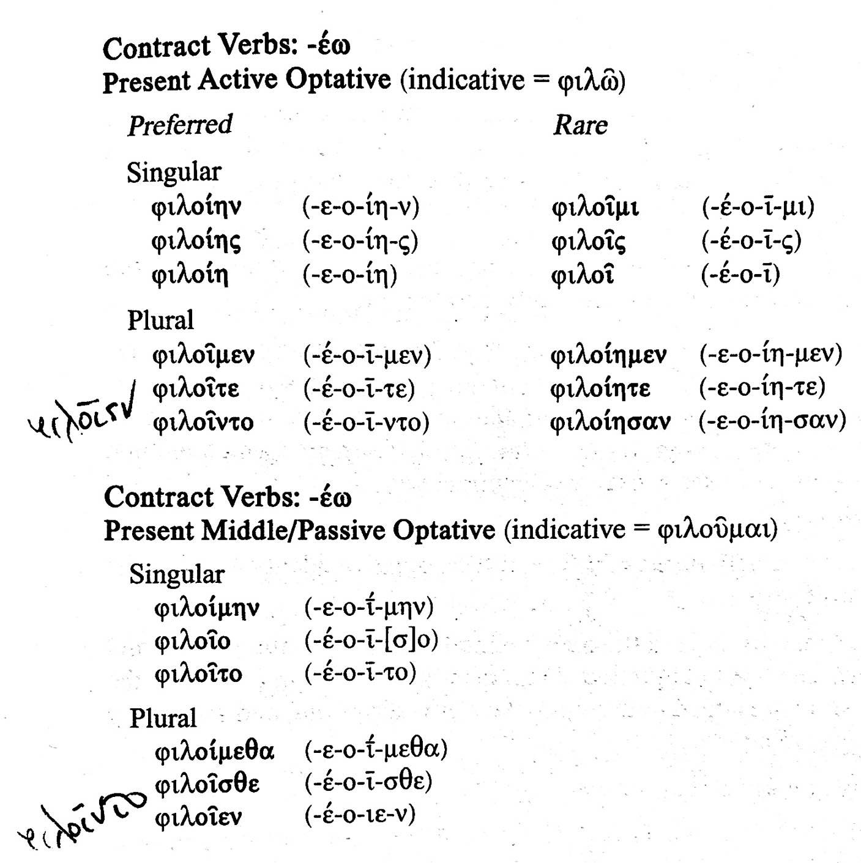
ε contract optative

Slide 12
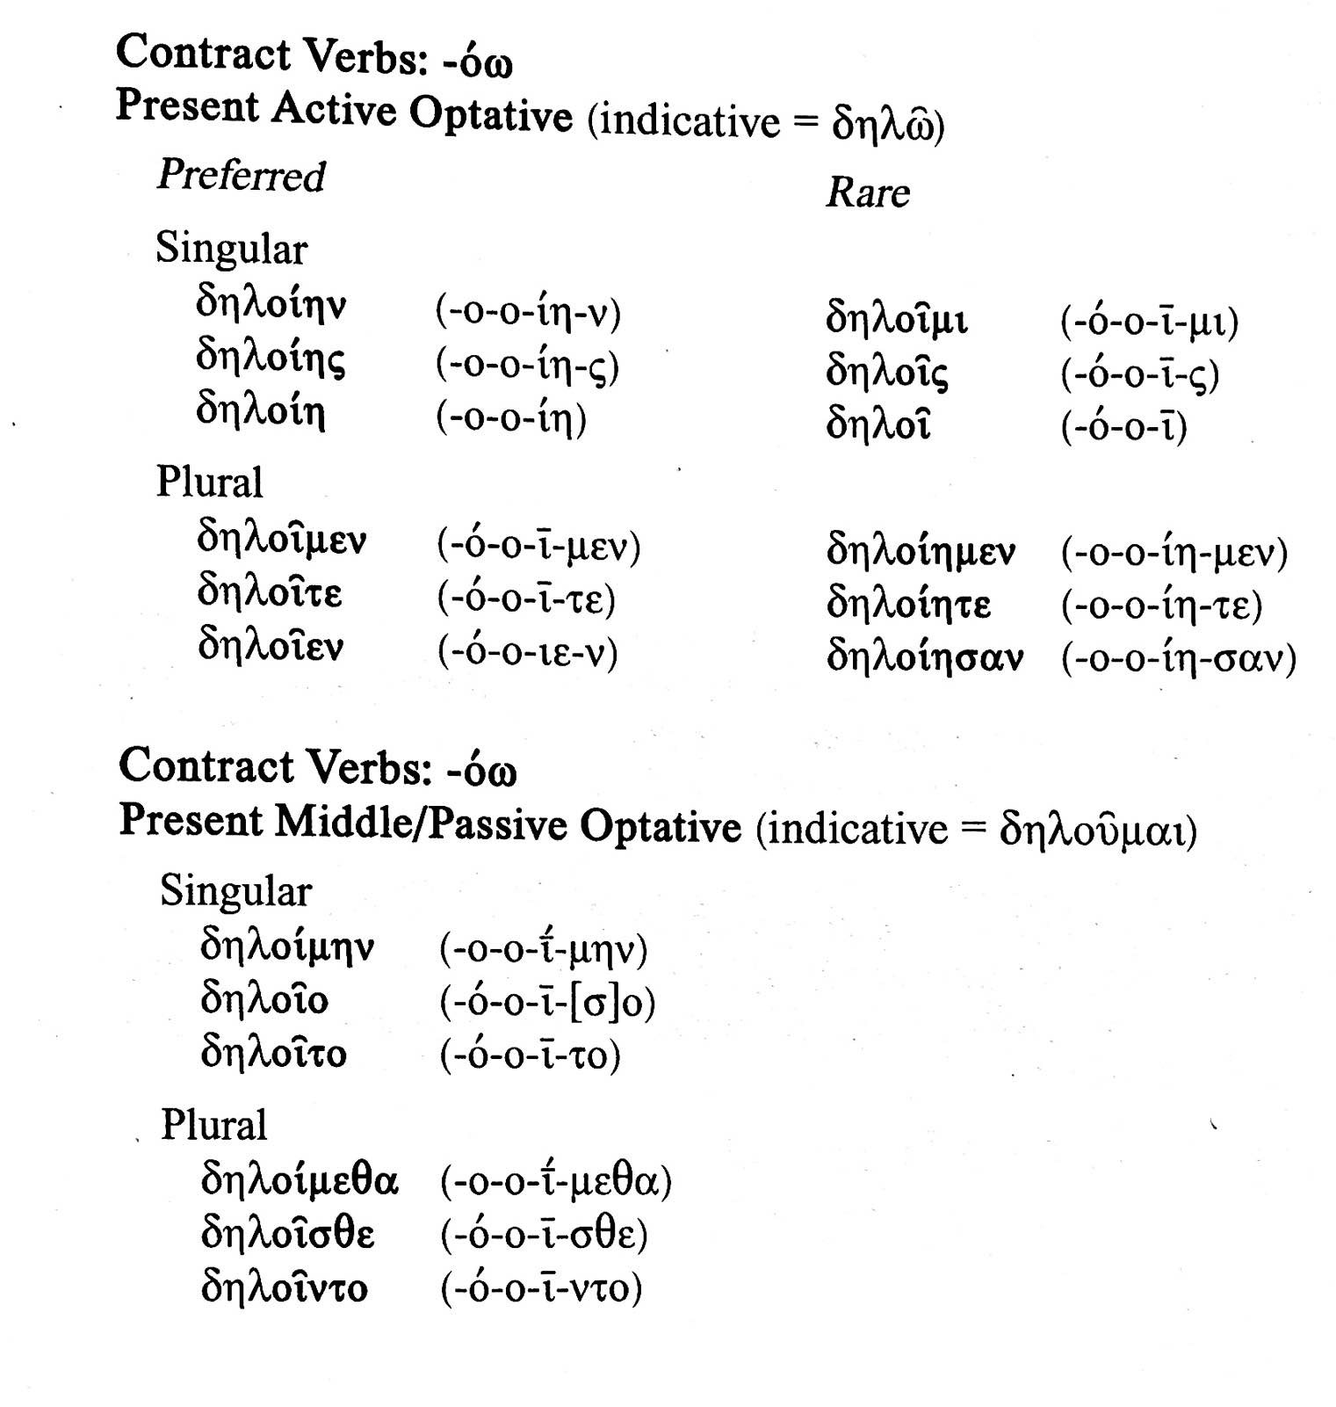
ο contract optative

Slide 13
Some passages with optatives
Theocritus (pastoral poet, 3rd c. BCE, born Syracuse), Idyll 3.
εἴθε γενοίμην ἡ βομβοῦσα μέλισσα καὶ εἰς τὸ σὸν ἄντρον ἱκοίμην.
I wish I could become the buzzing bee and come into your cave!

Slide 14
Some passages with optatives
PLATO Phil. Epigrammata {0059.039} Book 7 epigram 669 line 1
Ἀστέρας εἰσαθρεῖς, Ἀστὴρ ἐμός· εἴθε γενοίμην (1)
οὐρανός, ὡς πολλοῖς ὄμμασιν εἰς σὲ βλέπω.
You are looking at the stars, my Aster: I wish I could become the sky,
so I might look at you with many eyes.
PLATO Phil. Gorgias {0059.023} Stephanus page 469 section b line 12
ΠΩΛ. Σὺ ἄρα βούλοιο ἂν ἀδικεῖσθαι μᾶλλον ἢ ἀδικεῖν;
ΣΩ. Βουλοίμην μὲν ἂν ἔγωγε οὐδέτερα·
Polos: So would *you* wish to suffer injustice rather than commit injustice?
Socrates: I at any rate would not *want* either of these.

