Slide 1
Lesson 41 φημί Indirect Discourse with infinitive

Slide 2
φημί, φήσω, ἔφησα,—,—,—
another mi-verb! (note: only the first principal part is a mi-verb: other parts are regular, thematic verbs)
synonymous with λέγω, ‘to say’ but can have additional sense of claiming or asserting that something is the case
if indirect statement follows φημί, it does not use the ὅτι ὡς + indicative construction that λέγω and some other verbs use
instead, it uses a construction involving the infinitive (and often accusative case): more on this later

Slide 3
Present indicative active. Like εἰμί, pres. indic. of φημί is enclitic apart from 2nd s. Accent markings on other forms represent place where accent will appear if word is in front of another enclitic, but most of the time an accent will not appear.
 | sing. φη- stem (long vowel) | pl. φα- stem (short vowel)
1st | φημί | φαμέν
2nd | φῄς [orig. *φησί but changed to avoid confusion with 3rd s.; this form always has accent | φατέ
3rd | φησί(ν) [orig. *φητί, τ > σ] | φασί(ν) [orig. *φαντί]

Slide 4
Imperfect indicative active
 | sing. φη- stem (long vowel) | pl. φα- stem (short vowel)
1st | ἔφην | ἔφαμεν
2nd | ἔφησθα / ἔφης | ἔφατε
3rd | ἔφη | ἔφασαν

Slide 5
Present subjunctive active
 | sing. φα- stem | pl. φα- stem
1st | φῶ [contraction of φάω] | φῶμεν [contraction of φάωμεν]
2nd | φῇς [contraction of φάῃς] | φῆτε [contraction of φάητε]
3rd | φῇ [contraction of φάῃ] | φῶσι(ν) [contraction of φάωσι]

Slide 6
Present optative active
 | sing. φα- stem | pl. φα- stem
1st | φαίην | φαῖμεν
2nd | φαίης | φαῖτε
3rd | φαίη | φαῖεν [φαίησαν possible too]

Slide 7
Present imperative active
 | sing. φα- stem | pl. φα- stem
2nd | φαθί / φάθι | φάτε
3rd | φάτω | φάντων

Slide 8
Present infinitive active
φάναι

Slide 9
Present participle active The first set of forms are seldom used in Attic prose, but are found in poetry The second set of forms are more commonly used in Attic prose, and come from φάσκω, a frequentative form of φημί (φα- + suffix –σκ), meaning “to keep on saying, say often”
 | masc. | fem. | neut.
nom. | φάς | φᾶσα | φάν
gen. | φαντός | φάσης | φαντός
nom. | φάσκων | φάσκουσα | φάσκον
gen. | φάσκοντος | φασκούσης | φάσκοντος

Slide 10
Indirect discourse (statement) using infinitive construction
used often with verbs of thinking or believing as well as verb of saying φημί
construction works as follows:
direct statement: “ὁ Σωκράτης τοὺς νεανίας βλάπτει.”
indirect version with φημί: τὸν Σωκράτη φασὶ τοὺς νεανίας βλάπτειν
lit. “They say Socrates to harm the youth” = “They say that Socrates is harming the youth”
What’s going on? The subject of the verb of saying or believing or thinking attributes to the subject of the direct statement (Socrates) an action or state. When you talk about an action or state in its pure or abstract form, the infinitive is used (βλάπτειν ‘to harm’ is the idea of harming). So ‘they’ are attributing to Socrates the action of harming youth = they are claiming or saying he is harming the youth
Ιn practical terms, the subject (nominative) of the direct statement gets put into the accusative and the indicative (or whatever other mood is used) finite verb gets turned into an infinitive.

Slide 11
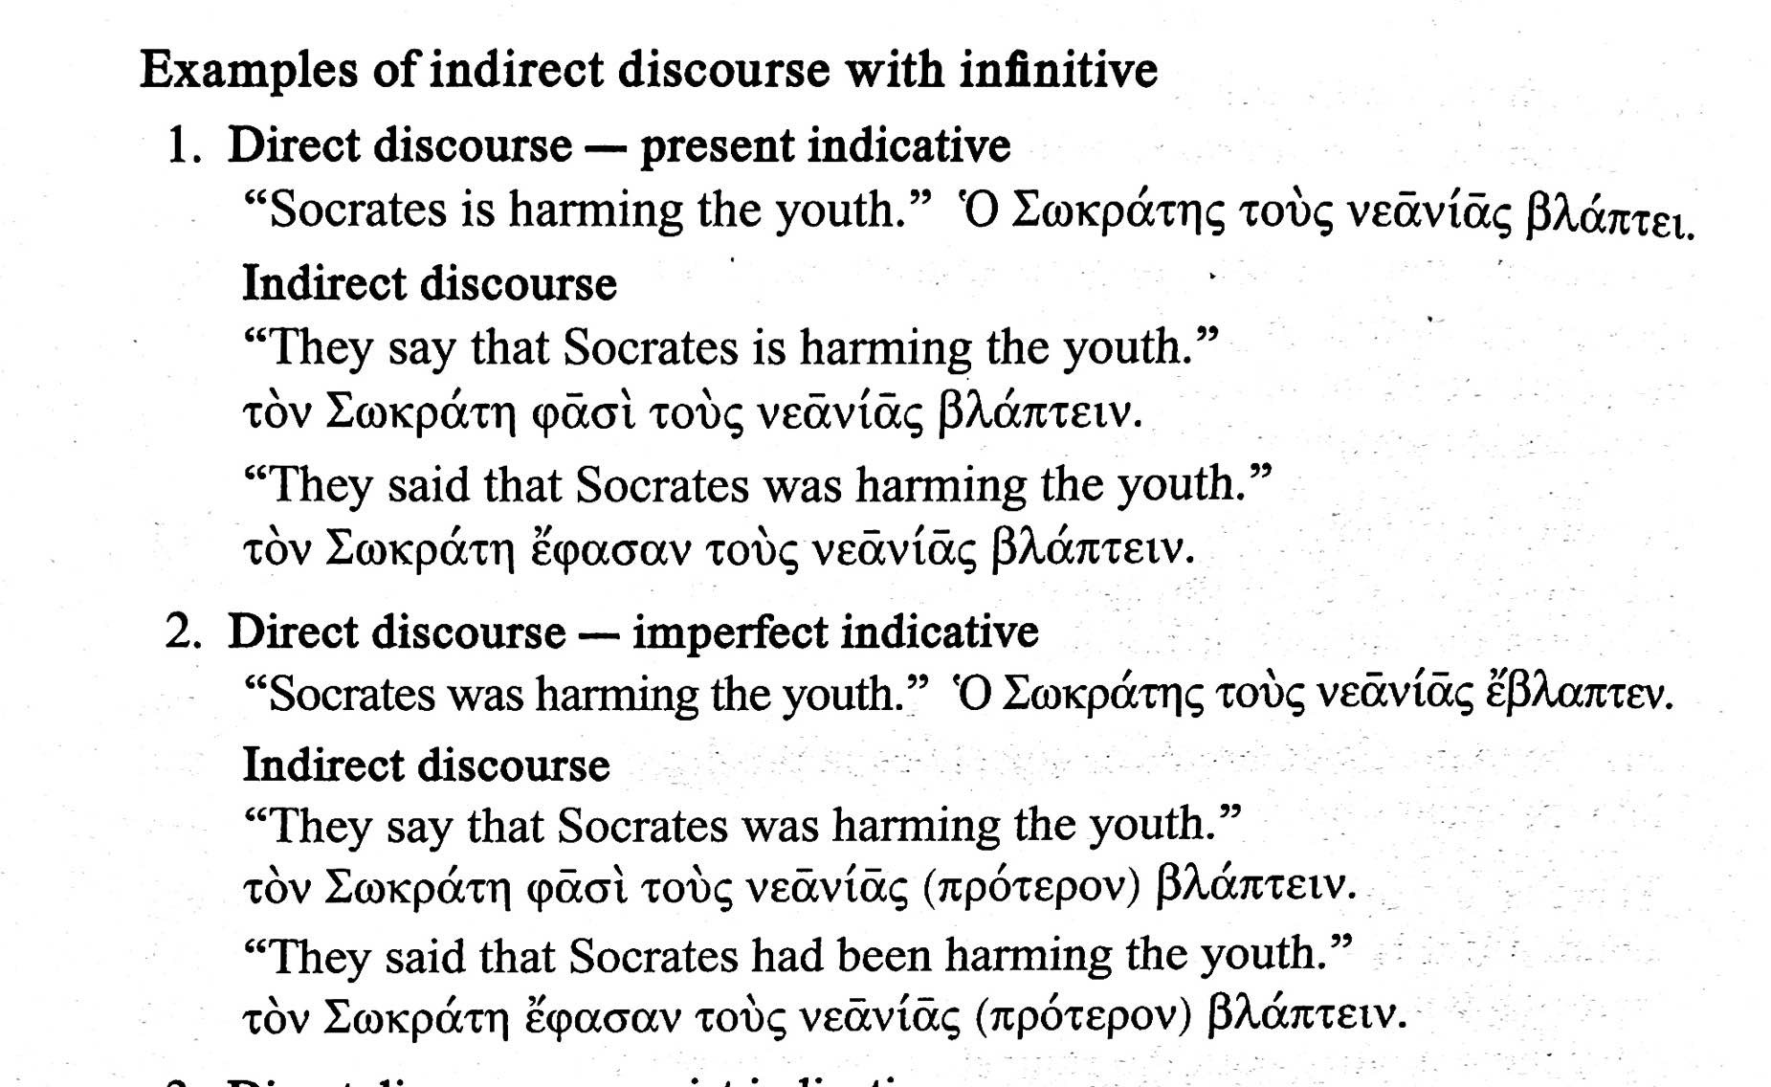
From textbook, pp. 298–299

Slide 12
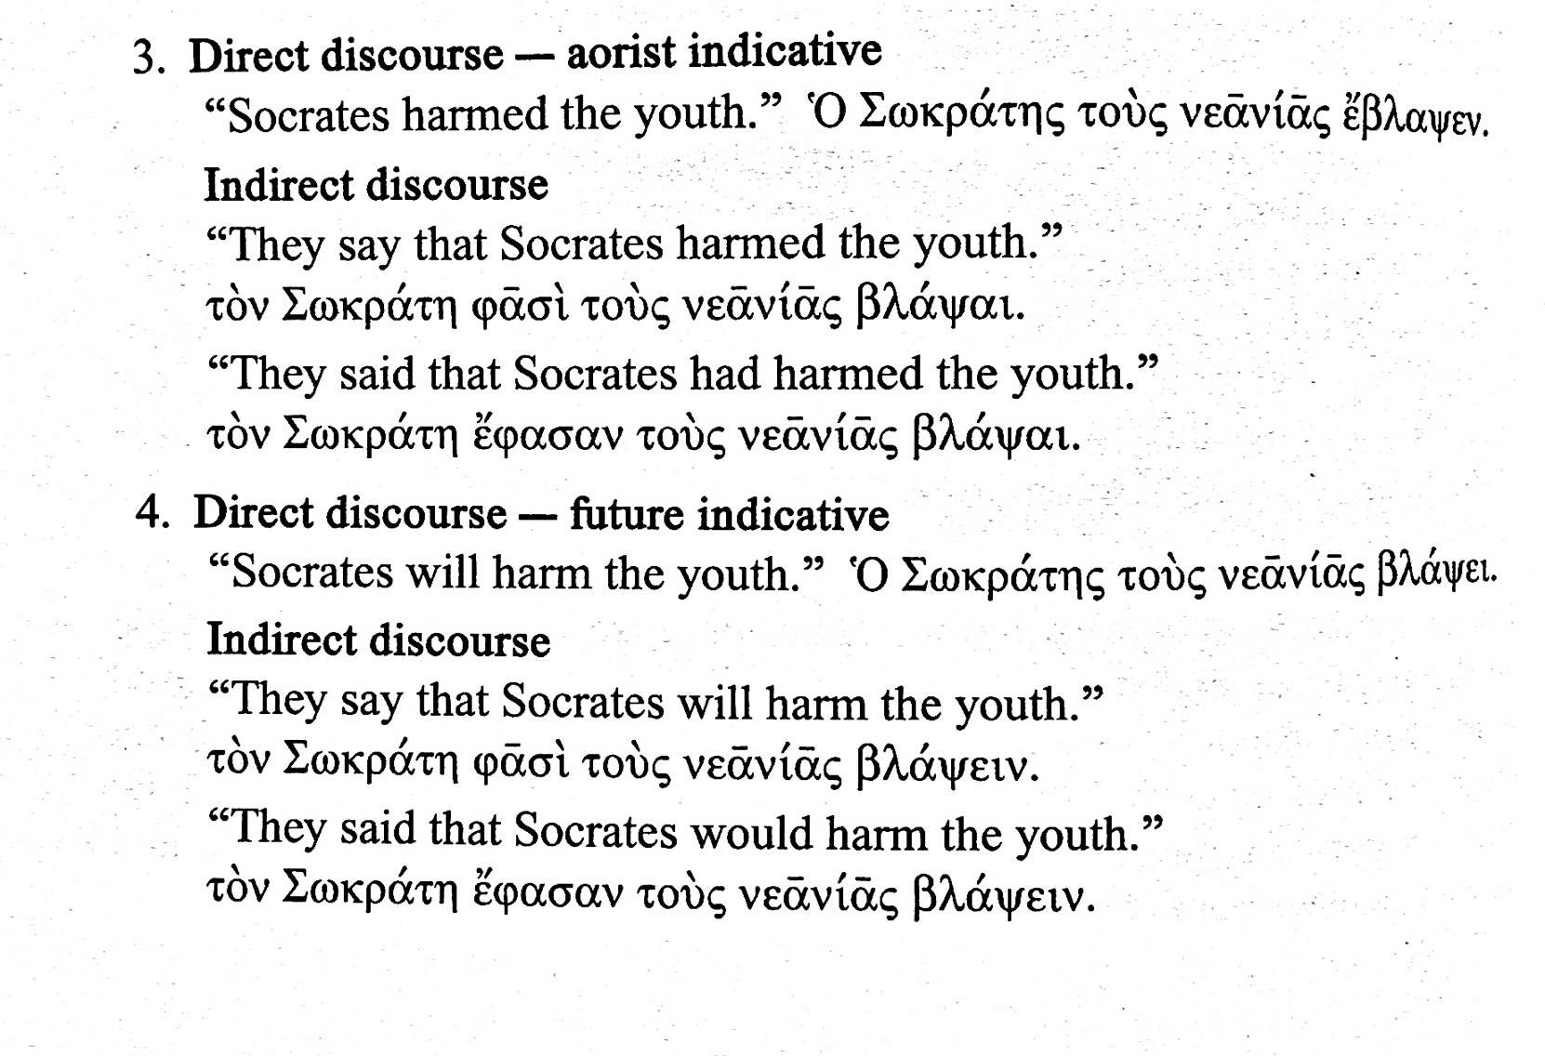
From textbook, pp. 298–299

Slide 13
From textbook, pp. 298–299

