Slide 1
Variability
The process by which a modern object can remain itself while being personalized for individual needs. This procedure can be achieved through digitization.
By Jennie, Morya, and Antoine

Slide 2
Google Filter Bubble
Google is a search engine that retrieves information from the internet that the user is trying to search for.
As the user further uses Google, it begins to adapt to the users' interests by memorizing previous searches.
It will therefore adapt and will even provide new suggestions, and advertisements that may interest you.
Google will even record your locations and return searches specific to that area.

Slide 4
The Variability of the car
A car starts as a skeleton with all the basic amenities of that car.
It can then be customized or changed, usually a company gives three or four other more luxurious options, to a person's preferences.
Even after the customization the car itself is still fundamentally the car that originally rolled off the assembly line, but exists in mnay different forms.

Slide 5
The Prius
The Prius is a perfect example of this.
It comes in four different versions the basic Prius, the Prius C, Prius v, and the Prius plug-in.
All of these versions have multiple models which have slightly different features than the basic model. For example, the Prius Plug-in Hybrid comes with Hybrid Synergy Drive, but it does not have the HUD (heads up display) of the Prius Plug-in Hybrid Advanced.
These cars are still the same car, with small changes in amenities.

Slide 6
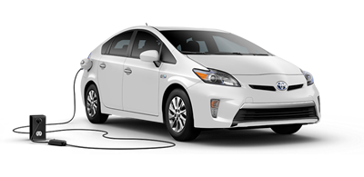
The 2012 Prius Plug-in Hybrid
All rights reserved to Toyota ©

Slide 7
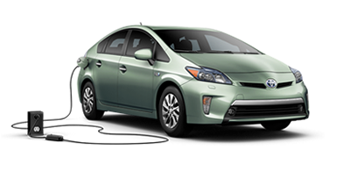
Prius Hybrid Plug-in Advanced
All rights Reserved to Toyota ©

Slide 8
iPhone
External Variability
The physical differences between the iPhone. (e.g 1st generation, 2nd generation, 3rd generation)
Internal Variability
The ability to choose how to personalize the iPhone based on the owners' lifestyle.
Autocorrect
Adapts to the owners' style of typing in comparison to others.

Slide 9
Autocorrect Experiment
Everyone type in the following phrase: "Coach Tarr and Coach Ditt want to meet us at 1."
What words are changed?

Slide 10
As Old Media
Variability as an old media function can be seen through the phenomena of multiple editions.
A book can have a first edition, a second edition, a third edition, and etc. The editions might have slight differences, but the book will fundamentally be the same.
A change in perception between new and old media is very slight, because multiple versions of objects of media have almost always existed.

Slide 12
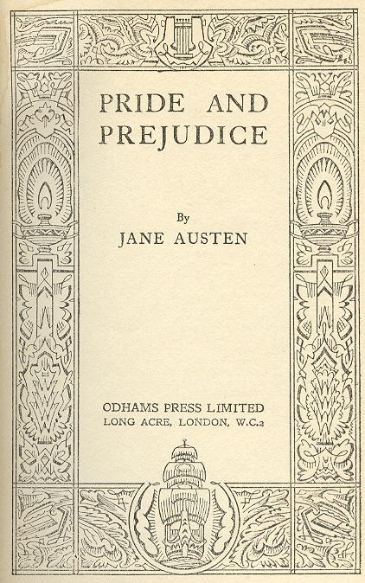

Slide 13
The End
Any Questions?
Closed Captioning Provided by Jennie, Antoine, and Morya

