Slide 1
First Year Strategies Elmore Stoutt High School
By Teacher Librarian – Dorothy Rabsatt

Slide 2
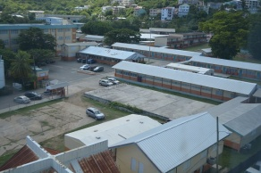

Slide 3
Strategies For Determining Current State
Survey Staff
Survey Students
Identify curriculum needs
Observe students & teachers use of facilities
Review attendance records
Analyze technology capacity

Slide 4
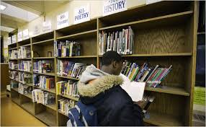
empty shelves

Slide 5
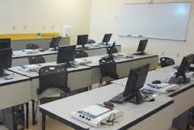
Limited computers

Slide 6
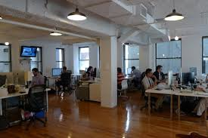
Open floor plan

Slide 7
MY Library
The learning resource center at the Elmore Stoutt High School caters to 1,300 students during the lunch breaks and before & after school. It is a one room facility with nineteen desk top computers, one photo –copier, one printer, a smart board and two large conference tables for studying and two small ones for activities. While this space fits the “learning common model” it needs to be reorganized. I am actually advocating for a new split level building so that those who according to Ray Palin are “looking for peace and quiet” can get just that.
In addition I am advocating for book fairs, grant writing and accepting physical and monetary donations to build the print and non-print collection.

Slide 8
Strategies for Moving to Vision
Form a Library Advisory Committee
(Joy Benjamin, Letitia Penn Rodgers, Mavis Abednego, TL,
Head Boy, Head Girl)
Create/review budget
Review policies (Weeding, Collection Development, Printing)
Use PTA to promote program
Promote LIT plan at staff meeting
Review technology needs

Slide 9
The mission
Let’s not be confused
To ensure that students are effective users and
producer s of information and ideas.
To ensure that students are effective users of information and ideas.
Joyce Valenza

Slide 10
Organize big 6 by month

Slide 11
big 6
Task Definition
Location & Access
Use of Information
Information Seeking Strategies
Evaluation
Synthesis

Slide 12
New Building

Slide 13
Budget
Item | Category | Type | Cost
1. | Books | Fiction | 10,000.00
2. | Books-Curriculum Support | Non-fiction | 20,000.00
3. | Equipment | Copier/Scanner | 35,000.00
4. | Subscription | On-line Resources | 7,000.00
5. | Supplies and material | Physical | 3,000.00
Total |  |  | $75,000.00

Slide 14
Collection Development
Fiction Books
Online Resources
Videos/DVD
Curriculum Support Text
Magazines/Journals

Slide 15
Additional books

Slide 16
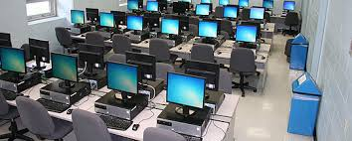
Computer lab

Slide 17
New lis program

Slide 18
New library & Information program

