Slide 1
Principles of Operation for Your Printer (and Others)

Slide 2
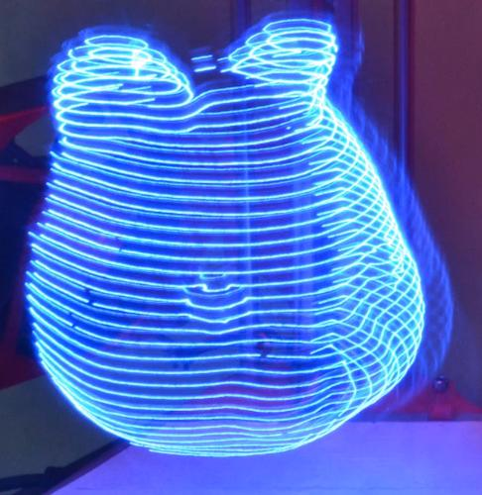
Additive Manufacturing Techniques
There are lots of techniques for 3D Printing
But nearly all of them have in
common a layer-based approach
  You print one layer at a time
    Top to bottom or bottom to top
  Depositing material in a single layer which takes the shape of the “slice” out of the overall geometry of the object that the layer intersects
  All layers together form an approximation
  of the complete geometry

Slide 3
Additive Manufacturing Techniques
All of the layer based approaches have a critical property: Throughout the process there is a plane (usually horizontal) which completely separates what has already been printed (plus the current layer) from what will be printed in the future.
  If the print mechanism stays at or beyond the “unprinted” side that plane it is guaranteed to not hit the already printed material (as is a systemic problem with subtractive approaches that do not have this property)

Slide 4
Another Common (But Not Universal) Aspect Between Technologies:
A Precision 3D Motion Platform
A precision motion platform is fairly easy to make
Several options, but most common involve use of 3 separate linear motion platforms ganged together
  Note: Most typically you have to move an entire motion platform with one of the other platforms
  (e.g., your X is moved by Z)
    Possible to avoid this,
    but there are drawbacks to those designs also

Slide 5
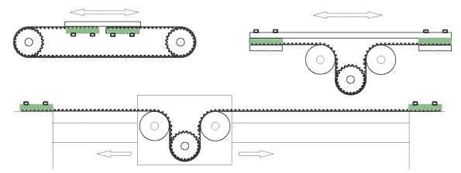
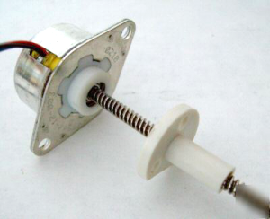
Linear Motion Platform
Also not too difficult
  Most typical are timing belt (what you have for X and Y)
  or lead screw (your Z) drives
  Ratio of motor motion to linear motion tends to be smaller for lead screw compared to belt
    Slower but more precise
Motor / Drive

Slide 6
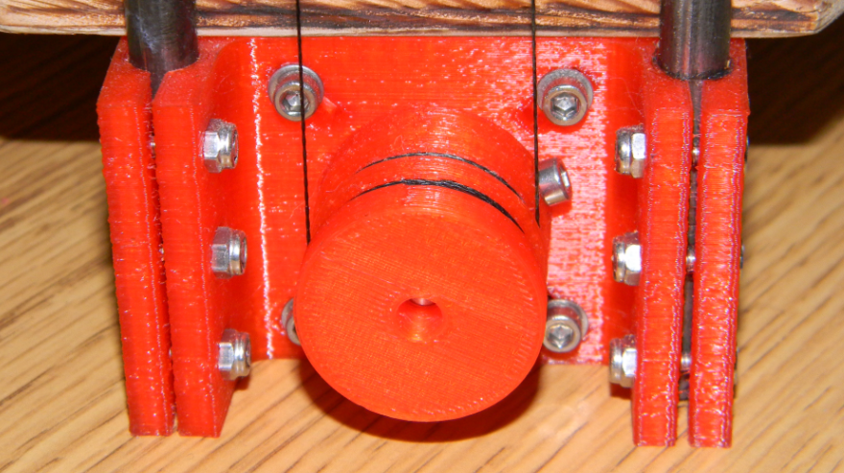
Linear Motion Platform
Related type of drive mechanism: “string” drive
Basically replace the belt with a string
(often braided HPPE fibers – high tech fishing line)
Seems like it would slip but works remarkably well
If pulled very taught
torque limit on motor
is lower, so motor
skips steps before
line slips

Slide 7
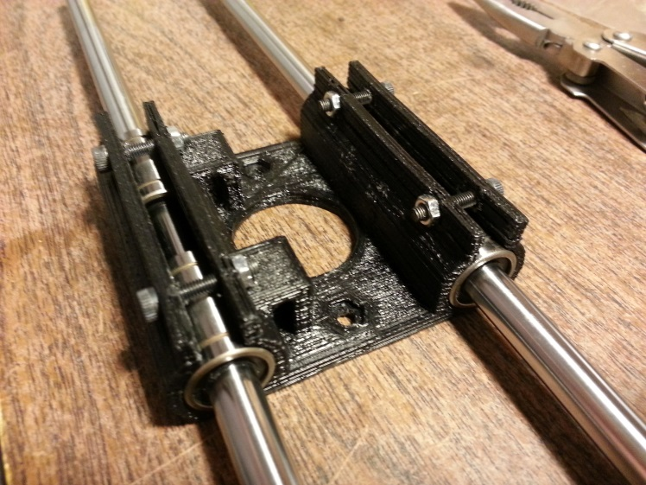
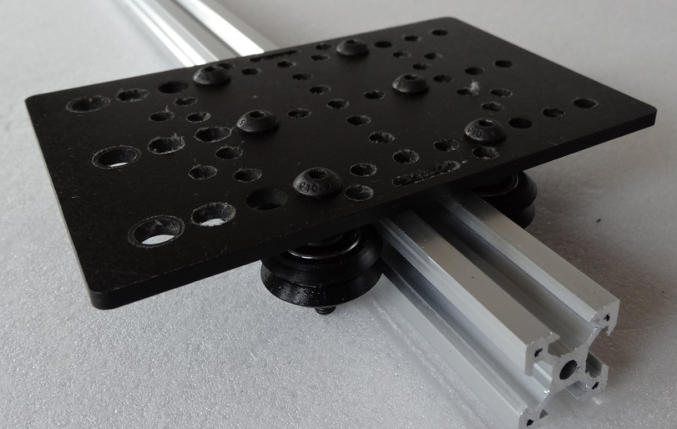
Linear Motion Platform
Also need something smooth to
bear weight and translate across
  Rods and linear bearings
  Wheels on/in “track”

Slide 8
Linear Motion Platform
Typical actuation by a stepper motor
  Open loop control
    Command a (precise) step and just assume it happened as commanded
Overall mechanism ends up simple
  Relationship between actuator & motion is simple
  Mechanism to transfer force is simple
  ➔ All the parts comparatively simple

Slide 9
Considerations in
Linear Motion Drive Mechanisms
Positional accuracy:
minimum movement & repeatability
Hard to be more accurate than min movement size
Stepper motors: typically 200 steps / rotation (1.8°)
However modern stepper drive electronics can do partial steps (balances between steps)
As much as 16 “microsteps” for each step
But these are a little less accurate
than full steps

Slide 10
Considerations in
Linear Motion Drive Mechanisms
Stepper motors: typically 200 steps / rotation (1.8°)
= 3200 µsteps / rotation
What this translates to in terms of linear motion depends on what amounts to the “gear ratio” of the drive mechanism.
Typical belt drive:
2mm tooth pitch on belt and 20 teeth on drive pulley
➔ 40mm/rotation
➔ 3200 µsteps/mm
➔ 12.5 microns/µstep
rest of mech. probably not this precise,
e.g., plastic deposition is typically ~400 microns (µm) wide
Typical lead screw: ~1-2mm/rotation so 20x more precise
(but also 20x slower)

Slide 11


Considerations in
Linear Motion Drive Mechanisms
Backlash
Originally seen in gears, but a form of it shows up in most drive mechanisms
Drive gear moves a
tiny bit before
contact tooth
begins to push
the next gear

Slide 12
Considerations in
Linear Motion Drive Mechanisms
Backlash
Originally seen in gears, but a form of it shows up in most drive mechanisms
Drive gear moves a
tiny bit before
contact tooth
begins to push
the next gear

Slide 13
Considerations in
Linear Motion Drive Mechanisms
Backlash
Originally seen in gears, but a form of it shows up in most drive mechanisms
Drive gear moves a
tiny bit before
contact tooth
begins to push
the next gear
This means the first bit of commanded motion is (sometimes) lost

Slide 14
Considerations in
Linear Motion Drive Mechanisms
Backlash
  Same thing happens for belt teeth and drive pulley teeth
  Very similar thing with threads on lead screw
With belt (and string) drive also have
the effect of stretch in the belt
Important that your belts are tight (!)
(slightly pre-stretched so first move isn’t taking up slack)
Also, can reduce this effect by slowing down
  Less velocity → less acceleration → less force

Slide 15
Considerations in
Linear Motion Drive Mechanisms
Avoiding Backlash
  Can we just make (e.g., gear teeth) exactly fit?

Slide 16
Considerations in
Linear Motion Drive Mechanisms
Avoiding Backlash
  Can we just make (e.g., gear teeth) exactly fit?
  Typically not: need space for lubrication and/or just too much wear and tear on the parts
One way to avoid is to always move in the same direction (Z-Axis does this!)

Slide 17
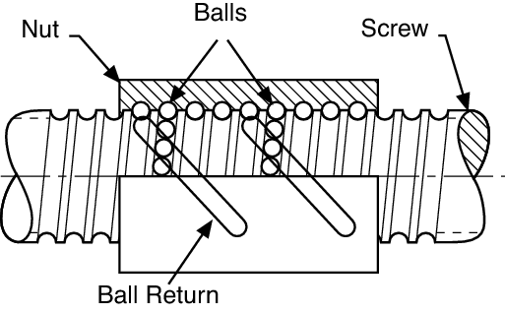
Considerations in
Linear Motion Drive Mechanisms
Avoiding Backlash
There are mechanisms to eliminate backlash
but they are complicated
(e.g., with recirculating balls in “Ball Screws”)
Mostly just try to minimize
  → Keep your belts tight
  (note they will stretch a bit over time,
  but you will have a way to tighten them)

Slide 18
Considerations in
Linear Motion Drive Mechanisms
Other issues:
Rigidity and Squareness
Does the mechanism shift/bend slightly
when it moves (e.g., rapidly)?
Is there a little “wiggle room” in mechanism?
Are the axes exactly 90° apart?
These are mostly determined by the printer design
BUT: make sure all your fasteners are fully tightened
Note: But you can be “too tight” and strip threads
Pay careful attention to bolts in stepper motors
(Hard) steel bolts in (softer) aluminum body

Slide 19
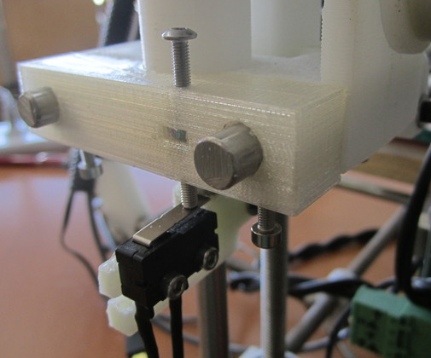
Considerations in
Linear Motion Drive Mechanisms
How do we know where we are?
With stepper motors we are counting the steps and always keep track of that (open loop control)
But when we power up (and a few other times) we may not know where we are counting from
Need a way to start: “end stops”
Homing: move towards end stop
until switch closes, then we
are at known position (e.g., 0)

Slide 20
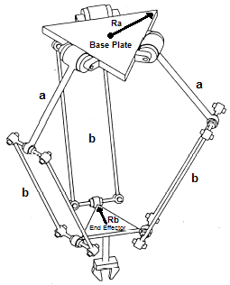
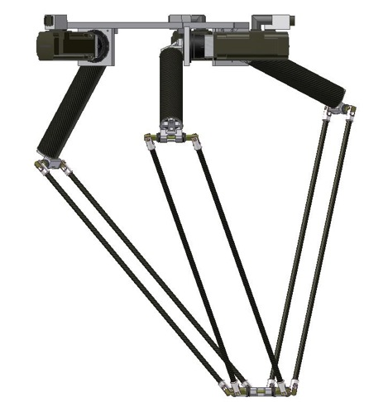
Another Kind of
3D Precision Motion Platform
Delta robot
  Three arms connected to create 3D platform
  (Video Demo: https://www.youtube.com/watch?v=v9oeOYMRvuQ)

Slide 21
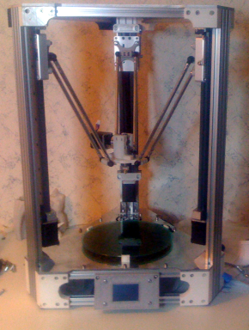
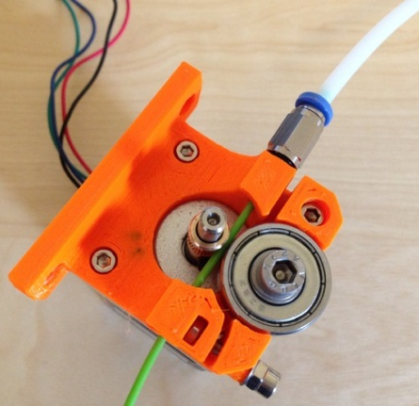
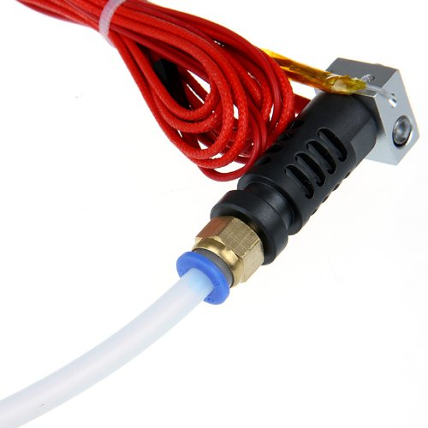
Another Kind of
3D Precision Motion Platform
Delta robot
  Can be very fast
  but can’t carry heavy loads
→ Delta Printer
  For FDM 3D printer normally separate
  filament drive (with heavy motor) from
  hot end by pushing filament down a somewhat stiff tube: “Bowden tube”

Slide 22
In addition to precision motion platform we also need a means to add/deposit material
This is where we see a lot of variations

Slide 23
Additive Manufacturing Techniques
FDM (Fused Deposition Modeling)
Your machine will be using FDM printing
  Sometimes called FFF (Fused Filament Fabrication)
  Developed by Scott Crump in the late 80’s who founded StrataSys where the idea was commercialized
Based on putting down layer via a thin bead of “melted” plastic which fuses with the layer below it
  Typically trace perimeter then
  do some pattern to (partially) fill the middle

Slide 24
FDM Has Caught on Because it’s Relatively Easy to Build
Hard part in most printing tech is
the deposition mechanism
For FDM you have two parts:
Hot end to heat and melt filament
so it can be extruded out small orifice
Feed mechanism to push filament into hot end
    Solid filament acts as a piston to push melted filament out

Slide 25
FDM Has Caught on Because it’s Relatively Easy to Build
Hard part in most printing tech is
the deposition mechanism
Mechanically simple, but…
  Note that this requires that part of the
  filament below the drive stay solid (cold zone),
  but part near the end to always be molten (hot zone)
  Actually a rather tricky thermal balance here
    Heat can creep up the shaft and melt too high
    Fast moving filament can cause solid filament
    to hit bottom

Slide 26
Other Types of Deposition for 3D Printing

Slide 27
Additive Manufacturing Techniques
Photopolymer Resin Based
Several techniques use a photopolymer resin
  Liquid resin (monomer)
  Catalyzed to bond in polymer chains by sufficiently energetic light (usually UV)
First 3D printing technique:
Stereo Lithography (SLA)
Invented by Chuck Hull in 1986
who founded 3D Systems to commercialize

Slide 28
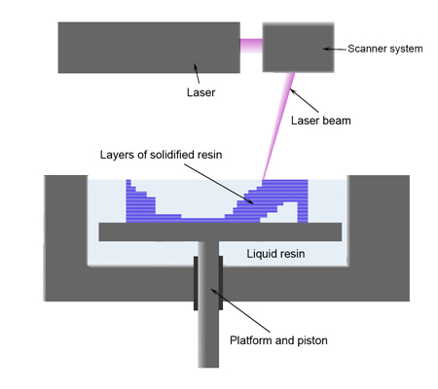
Stereo Lithography
Scanning (UV) laser traces each layer on top of vat of photopolymer resin
Platform holding part is lowered after each layer allowing a new layer of resin on top
http://youtu.be/NM55ct5KwiI?t=44s

Slide 29
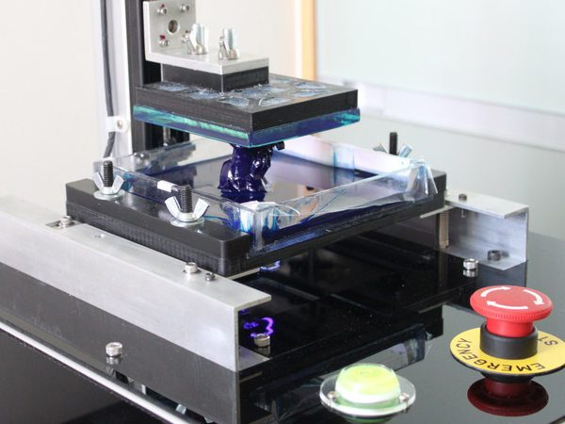
Stereo Lithography Variations
Can also print at bottom and pull part upward
Can expose a whole layer at a time
(instead of moving single point of laser around) using a projector (e.g., project a UV light image using a DLP projector)
http://youtu.be/snOErpOP5Xk?t=1m7s

Slide 30
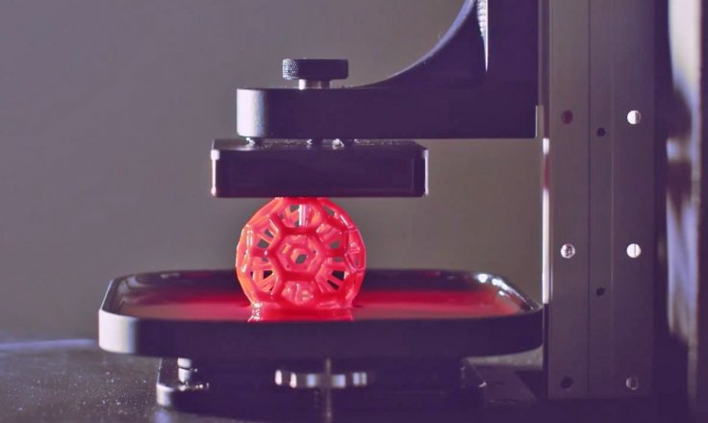
New Resin-Based Process: the Carbon3D Printer
A DLP-style photopolymer printer,
but with substantially different chemistry
Much faster prints
Essentially no detectable layers
  no anisotropic (directional) material properties
New and better materials
https://www.youtube.com/watch?v=VTJq9Z5g4Jk&t=0.1

Slide 31
Stereo Lithography
Disadvantages
  Messy
    Uncured resin is a bit toxic
  Until recently materials were pretty limited
    Somewhat brittle translucent plastic
    But starting to see new materials here (e.g., flexible)
  Intrinsically single material
    No separate support possible
But
  Can be very high resolution

Slide 32
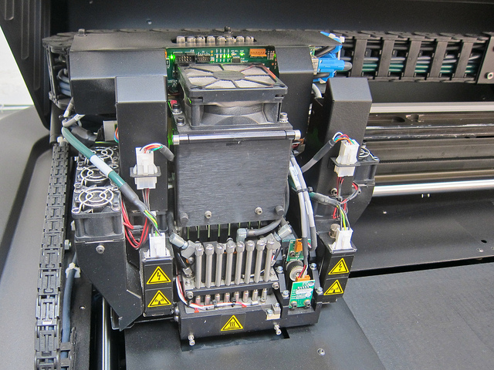
Another Resin Based Approach:
“PolyJet” (by Objet, now StrataSys)
Use inkjet printer style heads to deposit very small droplets of photopolymer resin (16µm layer height)
Immediately cure in place
with UV light
Trim layer to exact height
with cutting blades
Repeat
http://youtu.be/MVo_IAd6Rwo?t=53s

Slide 33
Another Resin Based Approach:
“PolyJet” (by Objet, now StrataSys)
Multiple print heads can print different materials
  Including rather unique ones (flexible & transparent)
  Including support material
AND mix them at the droplet level
Can generate mixed materials with varying properties
e.g., mix hard and flexible to vary stiffness at different locations within a single print
Also just started supporting mixing colored resins
Disadvantage:
Presently expensive (printer & materials)

Slide 34
Sintering Approaches
“Sintering” is fusing a powdered material
to create a solid
A number of possible materials:
  metals, ceramic, plastic, sugar
Fusing normally done with heat, often laser
  “Selective Laser Sintering” (SLS)
Print starts with a bed of powder
  Heat parts that you want to be part of result (1 layer)
  Lower part and/or put another layer of power on bed
  Repeat http://youtu.be/wD9-QEo-qDk?t=1m47s

Slide 35
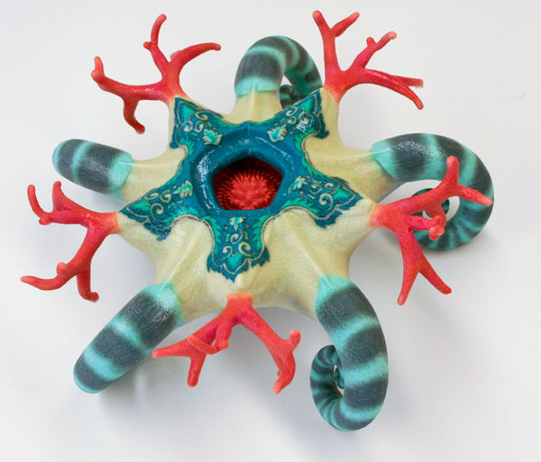
Sintering Approaches
Single material, but powder provides intrinsic support
Variation
Can also fuse by applying an adhesive
E.g., inkjet print “superglue” (at high resolution)
Z-Corp (now 3D Systems) printers do this on gypsum powder
Also inkjet colored ink into powder
  → full color result object
  http://youtu.be/BjBSoykoBNg?t=21s

Slide 36
Layered Object Manufacturing (LOM)
Cut a material in profile(s) of layer
Bond to previous layers
Repeat
Note: can leave “waste” material
in place to serve as support

Slide 37
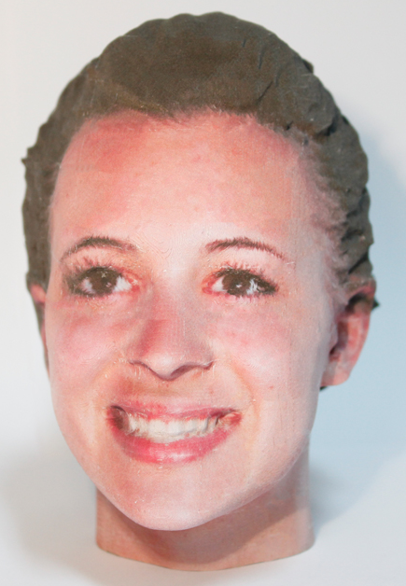
Layered Object Manufacturing (LOM)
First printers (and most common now) used paper
see: mcor technologies (http://mcortechnologies.com/)
(Video: http://youtu.be/TjDib7J3Iy4?t=1m40s)
Newest printers use inkjet on paper
first to get full color objects
Also interesting approach for metal
  Thin sheets bonded with
  ultrasonic welding (See http://goo.gl/ifu0hN)

Slide 38
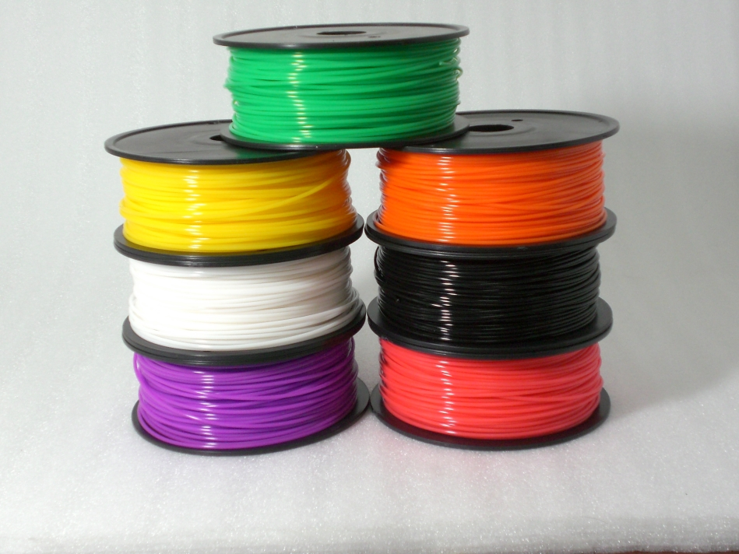
Materials for Your Printer
Print with a thermoplastic
Comes in the form of a wire-like “filament”
For your printer:
1.75mm diameter
filament
You have an allocation
of ½ Kg (½ spool)
from bulk order.

Slide 39
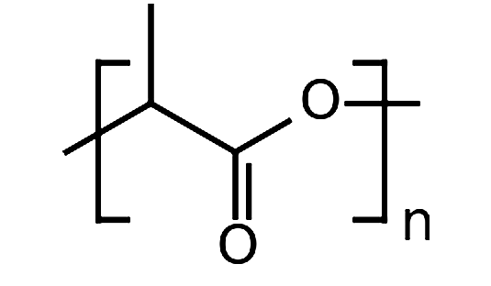
Materials for Your Printer
You will normally print in PLA
(“Polylactic Acid”)
Thermoplastic made from corn starch
  A type of polyester
  Biodegradable
  Non-toxic / biocompatible
  Quite well behaved
  Fairly “sticky”
  Comparatively low coefficient of thermal expansion
  (does not tend to warp and pull off of print bed)

Slide 40
Materials for Your Printer
One health issue to be aware of:
  All FDM 3D printing produces ultra-fine “nano-particles” (smaller than 10 nanometers)
  Health effects not fully understood, but small particles are harder for body to get out of lungs
3D printing has similar emission rates
(quantity of particles) as: cooking, burning scented candles, laser printer, burning cigarette
(see: http://spectrum.ieee.org/nanoclast/semiconductors/nanotechnology/nanoparticles-emitted-from-3d-printers-could-pose-a-risk
http://www.sciencedirect.com/science/article/pii/S1352231013005086 )
PLA particles are at least bio compatible
But should probably still use in ventilated area

Slide 41
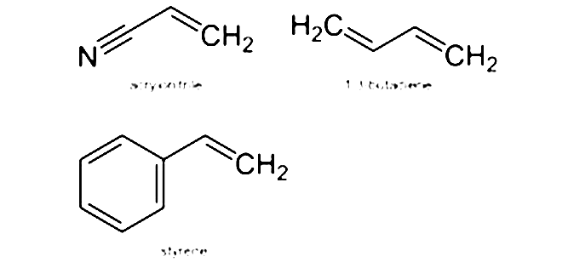
Materials for Your Printer
Other major material for this
type of printer: ABS
Acrylonitrile butadiene styrene
Better material properties than PLA
  A bit more ductile / less brittle
But harder to work with due to
higher coefficient of thermal expansion
  Uneven cooling leads to warping and pulling up from bed
  Generally need a heated print bed to work consistently

Slide 42
Materials for Your Printer
Other major material for this
type of printer: ABS
Acrylonitrile butadiene styrene
Toxicity not completely clear:
  Hardened ABS is definitely non-toxic
  Fumes during printing, not as clear
  Monomer precursors are slightly carcinogenic
  (but not normally left in the polymer)
Ventilation should definitely be used

Slide 43
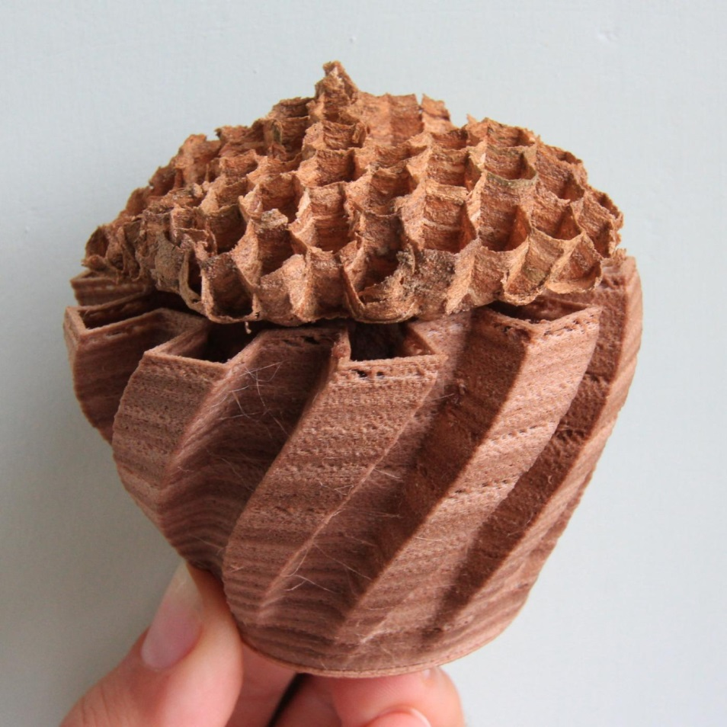
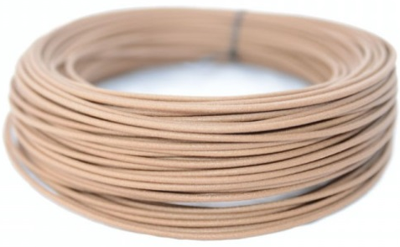
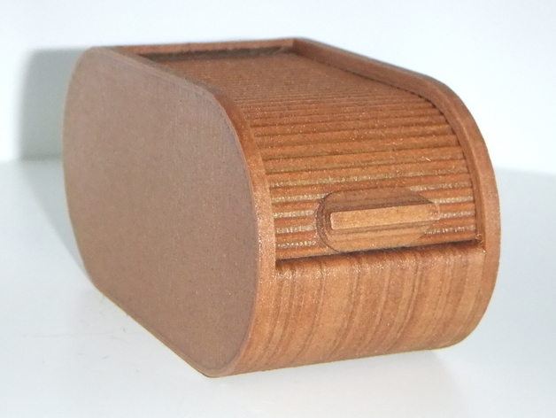
Other Available Materials:
Thermoplastics With Special Appearance
Wood (Laywoo-D3)
Wood particles embedded in a thermoplastic binder

Slide 44
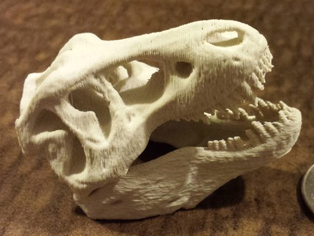
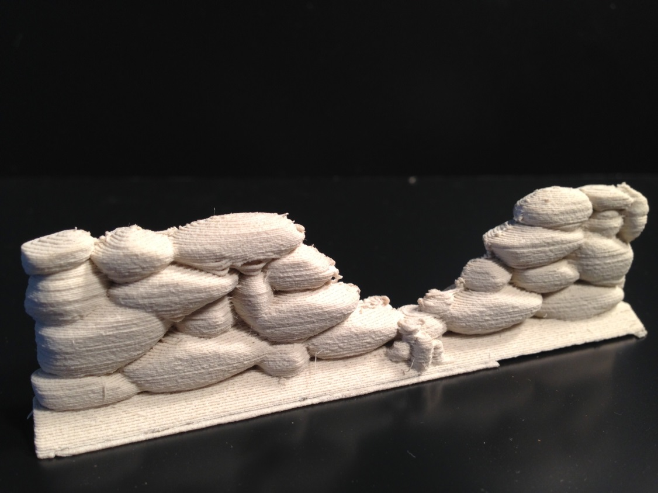
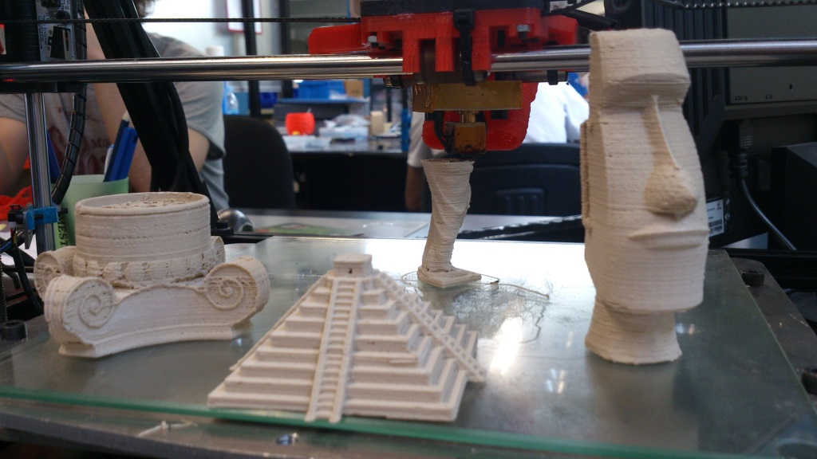
New Materials:
Thermoplastics With Special Appearance
“Stone”(ish) (LayBrick)
Really just rough surface texture

Slide 45
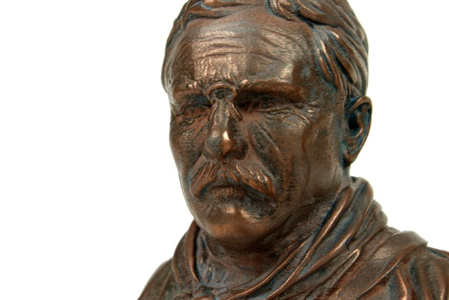
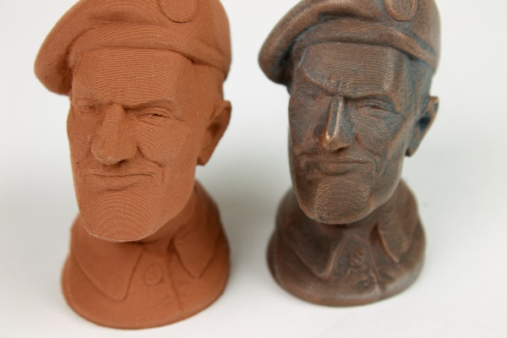
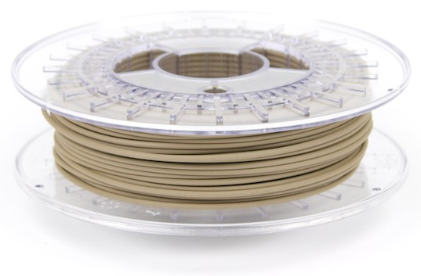
Other Materials:
Thermoplastics With Special Appearance
Bronze/copper surface appearance
(ColorFabb bonzeFill & copperFill)
Metal particles in thermoplastic
When surface is sanded
and polished
plastic goes,
metal stays

Slide 46
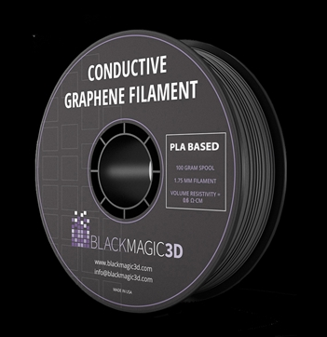
Other Materials
Conductive Filament
PLA with graphene in it
http://www.blackmagic3d.com/product-p/grphn-175.htm
Spec’d at 0.6Ω/cm
Currently very expensive
  $55 for 100g
  (Pure silver currently $61 for 100g)
Additional products about to hit the market

Slide 47
Other Thermoplastics
PVA (Poly Vinyl Alcohol)
  Dissolves in water (support material)
  Tends to be hard to work with (must be kept very dry)
Nylon
Polycarbonate
High Impact Polystyrene (HIPS)
High Tensile Polyester

Slide 48
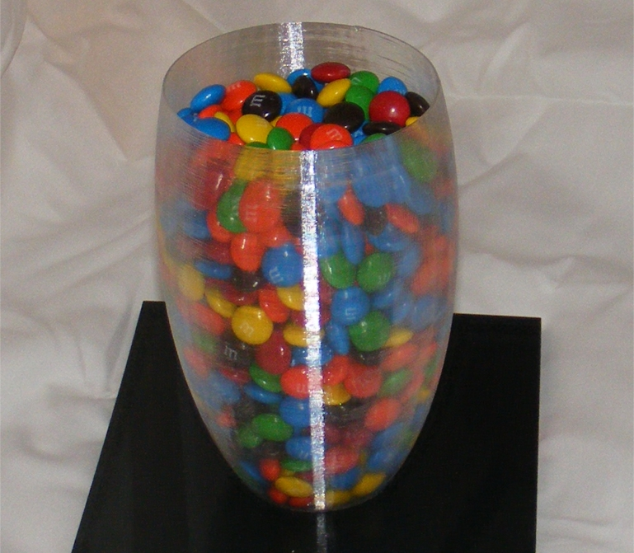
Other Materials: Transparent
  (Sort of) for FDM with T-Glase filament
  from Taulman 3D (http://taulman3d.org/)

Slide 49
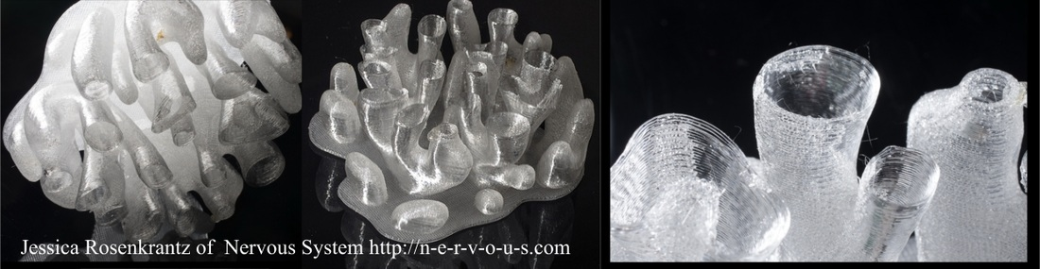
Other Materials: Transparent
  (Sort of) for FDM with T-Glase filament
  from Taulman 3D (http://taulman3d.org/)
  More typical results:

Slide 50
Other Materials: Flexible
Not everything should be made out of hard plastic
Several options for softer material
For FDM: “NinjaFlex” filament (http://www.ninjaflex3d.com/)
Must have an enclosed path from filament drive to top of hot end or it is too flexible to push through
Also doesn’t work with Bowden drive

Slide 51
Aside: Things to Look at When Considering Exotic FDM Filaments
Odor and possible toxicity :
  PLA is about the best, others at a minimum smell a bit
  and could be somewhat toxic
  Nylon is apparently particularly bad / toxic
Coefficient of thermal expansion,
but really “do you need a heated print bed?”
Temperature for extrusion
Reports of whether it’s “hard to work with”

