Slide 1
You’re getting a 3D Printer!!

Slide 2
You may be thinking this:

Slide 3
Or if you are more realistic, maybe this:

Slide 4
But keep in mind that (especially at first) it may feel more like this:

Slide 5
Preparations for Building Your 3D Printer

Slide 6
Metric Units
3D printing is pretty nearly always done using metric units (mm rather than inches)
(About the only exception is wire “gauge” [thickness])
Recall:
10mm = 1cm
1000mm = 100cm = 1 meter (also 25.4mm = 1 inch)
1 microMeter = 1µMeter = 1µM = 1 micron = 0.001mm = 1/1000th of a millimeter

Slide 7
Metric Fasteners
You will be using metric fasteners
Bolt size is written like this: M3x16
M means “metric”
3 is diameter of shaft (3mm)
16 is length of shaft (16mm)
Will also see: “M3x16x0.5”
Third number is thread pitch (0.5mm/turn)
Two possible values for each diameter, but you almost exclusively see “course” threads so we mostly ignore (and not write) this value
Head
Shaft
16mm
3mm

Slide 8
Metric Fasteners
Most of the bolts we will use have “socket” or “hex” heads
- Hex shaped hole (hence the hex wrenches)
Rather than slotted or Phillips heads
Most of your bolts have dome shaped head
“Pan” or “Button” head
A few have a cylindrical head
“Cap” head

Slide 9
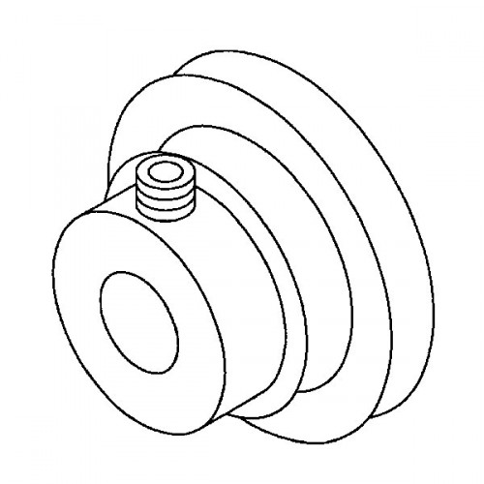
Metric Fasteners
A few of your bolts will not have a head at all
This is a “Set Screw” and is often used to secure something like a pulley to a shaft

Slide 10
Metric Fasteners
Will also have “washers”
provides more wider metal surface under bolt head
“nuts” threaded on to bolts to fasten
“t-nuts” which fit in the aluminum exxtrusion

Slide 11
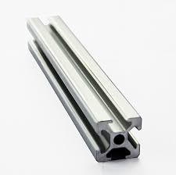
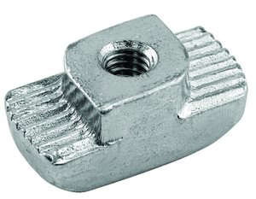
T-Slot Aluminum Extrusion
Aluminum beams (20x20mm in our kit) with slots down the sides
Special nuts (“T-Slot Nuts”) fit into those slots
And allow beams to be connected and/or things to be attached to the beams

Slide 12
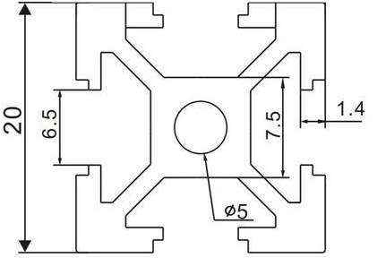
T-Slot Aluminum Extrusion
The nuts in your kit are designed to be inserted at any time
- other nuts have to be put in from the end and so you have to plan ahead
Insert these this through the slot, then turn

Slide 13
T-Slot Aluminum Extrusion
Insert these this through the slot, then turn
But note that turning bolt doesn’t always turn the nut (depends on friction), so check that it turned

Slide 14
About Your Controller Board
The control electronics for you printer is a “Melzi” http://reprap.org/wiki/Melzi

Slide 15
About Your Controller Board
Arduino program that runs the printer is a variant of the “Marlin” firmware http://reprap.org/wiki/Marlin
Quite mature and full featured (and not many bugs)
(You will get a preconfigured copy)
Works by interpreting commands sent over USB (or stored on SD card)
… but we will get into those details a bit later

Slide 16
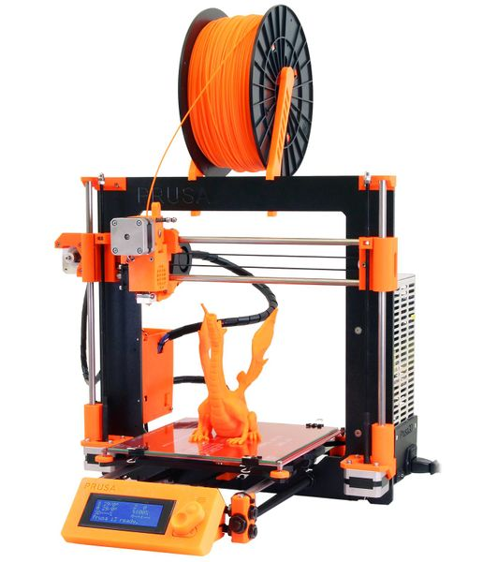
About Your Printer
Your printer is a variant of the “Prusa i3” RepRap printer design http://reprap.org/wiki/Prusa_i3
Designed by Josef Prusa who has done some of the most widely used open source designs in the RepRap community
Result of substantial design iteration

Slide 17
About Your Printer: Features
Fairly recent design all metal
extruder
Seems to work quite reliably
Occasionally need to tighten
0.4mm orifice
Heated print bed
Not needed for PLA you will be using, but allows you to print ABS and other materials with higher coefficient of thermal expansion
Large (220x220x200mm) print volume
(Added) control interface (with SD card)
So you can print without a computer attached

Slide 18
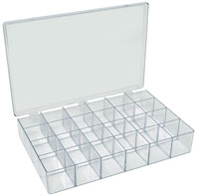
Building Plan
First step (while I’m likely still distributing printers) will be to sort and identify your parts (mostly the many fasteners)
You will want to put each separate kind of fastener in a separate plastic container and write a label to go with it (using calipers)

Slide 19
Building Plan
We will devote several weeks of in-class time to building the kits
However, that likely will not be enough time, so plan to spend time outside class as well (we will also schedule some times outside of normal class time for group building)
Based on past experience we will not be able to have the whole class proceed step-by-step through the instructions
Everyone will work at their own pace following the on-line instructions.

