Slide 1
Intensive First Year American Sign Language (ASL 134) class Summer Quarter
Instructor: Kristi Winter, MA
University of Washington
Dept. of Linguistics
ASL Program

Slide 2
Agenda:
Today:
SN Unit 1
SN Unit 1 Homework Assignment 1::1 due (pp. 4-5)
Signing Lunch at HUB, near Starbucks (12:45 – 1:30 pm)
We will meet other ASL students and teachers from different sections
Remember to turn off voice!
Thursday:
SN Unit 1
Watch video of “Intro to Deaf Community” and “Deaf President Now”.
Sample Video Assignment due (see Canvas for information on this assignment)
Monday, June 25th
Quiz #1 (ASL Facts & History, Unit 1 and Syllabus)
SN Unit 2

Slide 3
Monday’s Quiz
Read “Deaf Awareness Quiz”, syllabus, ASL Facts and History (read pages v-ix and xiv of student’s workbook), PowerPoint slides (Canvas’ Pages).
Unit 1
Cardinal Numbers 1-10
Color signs
Fingerspelling names (Fist Letters)

Slide 4
Review Survival Signs
BREAK
EMAIL
QUIZ, TEST, or EXAM
RIGHT or CORRECT
WRONG
STOP
GO AHEAD or PROCEED
GIVE-TO
SORRY

Slide 5
Review: ASL Signs (not in S.N. book)
MEANING
NICE TO MEET YOU
SUNDAY
MONDAY
TUESDAY
WEDNESDAY
THURSDAY
FRIDAY
SATURDAY
WEEK
WEEKEND
HARD
EASY

Slide 6
Review: Cardinal Numbers 11-15

Slide 7
11 12 13 14 15
Notes:
M 18
1:6, p. 29

Slide 8
Review: How Many?
ASL Structure:
__________HOW MANY?

Slide 9
Homework 1:1
Strategies for learning ASL
Build a language community.
Minimize reliance on English as you listen or converse in ASL.
Focus on meaning rather than individual signs.
Focus on the signer’s face, not on the hands for two very important reasons.
you must see both the facial expression and what is signed
it is considered rude to look away from the signers’ face while they are signing to you.
Show you understand the signer

Slide 10
Homework 1:2 (pg. 7)
Circle the Number
6
7
9
8
3
8
(Answers on page 397)
Write the Number
3
5
9
2
8
4
10
1
8
7
(Answers are given in class)

Slide 11
Homework 1:3 (pg. 13)
Circle the Letter
as
so
st
ni
si
ai
en
ta
os
oa
(Answers on page 397)
Circle the Letter 2
ao
se
sm
ti
mi
ei
on
oa
os
ea
(Answers are given in class)

Slide 12
Homework 1:3
Reading Fingerspelling (see p. 10)
Reading someone’s fingerspelling is not easy. It takes time to develop the skill. Everyone approaches fingerspelling differently. But all agree that it takes practice, practice, and more practice.
Here are a few suggestions:
work on recognizing the shape and the movement of letters and letter combinations

Slide 13
Homework 1:3
Here are a few suggestions:
work on catching the first and last letters of the word and use context (what is being discussed) to help you guess the word spelled.
don’t be timid. Ask the person to spell the word again and again – until you understand the word.

Slide 14
Homework 1:4
Andrew Foster
He spent his life dedicated to improving education for Deaf people. A teacher, pioneer, and missionary, his legacy lives on in the many schools he opened in West Africa. (pages 14-15)
https://www.youtube.com/watch?v=ij3d-GjqTyA

Slide 15
Review: Pronouns
Using the index finger to point at person(s) or object(s). It’s called Deixis (Linguistics term for “pointing at”)
I AM/ME
YOU ARE
HE, SHE, IT IS
WE ARE, US
YOU ARE (plural)
THEY ARE

Slide 16
Review: Vocabulary for WH-Word Questions
WHO
WHAT
WHERE
WHY
WHEN
HOW

Slide 17
Review: Introducing Oneself with Wh-Word Questions
Signer A: Greet, give name, and then ask for name
Signer B: Give name
A & B: Express pleasure in meeting
Be sure you :
furrow brows together and lean head forward to indicate a wh-word question.
use correct hand position to spell name
use correct orientation for the sign phrase NICE TO MEET YOU

Slide 18
ASL Signs
REMEMBER
FORGOT
NICE TO MEET YOU
FINGERSPELLING
COPY-ME
SAME-AS
DIFFERENT
SHAPE
LETTER
NUMBER
AGAIN
HOMEWORK
MEANING
ERROR

Slide 19
Homework 1.5 (pg 18)
Answers are on page 398

Slide 20
Homework 1.5 (p. 20)
List your classmates names in your book (see p. 20)

Slide 21
Classroom Exercise
(Not in SN workbook)
Eye contact. What similarity do you see in the signs eye contact, look at me, and no eye contact? What do you think it means?
Hold on. Practice using the hold on sign with your teacher or a classmate. What is a polite way of signing hold on? What about a rude or impolite way?

Slide 22
Homework 1:6 (pg. 22)
Circle the Number (Answers are on page 398)
Write the Number (Answers are given in class)
3
5
11
2
14
8
9
12
6
4
10
15
13
1
7

Slide 23
Homework 1:7 Ways of Communicating With Others (p. 23)
Signing
Gestures
Writing or typing
Third person
Lipreading and speech
Let the Deaf person know you sign
Avoid spoken English or using voice with out relaying information in ASL
Let the Deaf person set the communication mode

Slide 24
Lesson 1:7 Same or Different 2

Slide 25
Same or Different II
Review:
LETTER
NUMBER
NAME
SHAPE

Slide 26
Make up a pair for each category:
shapes, numbers, letters, and names.
For example:
• Shapes
• Numbers 6 9
• Letters ao es
• Names Mary Mary
Notes:
M 24
1:7, p. 36

Slide 27
Conversation Practice
Watch video of Unit 1 Conversation
Conversation Practice:
Find a partner and role play the situations below.
Situation 1:
You are responsible for getting the correct spelling of the names about to be printed on a program. Check the spelling of your partner’s name, but when you ask, spell the name with one incorrect letter.
Notes:
Old Unit 1

Slide 28
Conversation Practice
Watch video of Unit 1 Conversation
Conversation Practice:
Find a partner and role play the situations below.
Situation 2:
You meet a friend you haven’t seen in five years, but you are not sure of the person’s name.
Notes:
Old Unit 1

Slide 29
Where are all the “little” words like is, to, and are?
ASL is not English, neither are Japanese, Spanish and Latin.
ASL does not need separate “little” words, they are already included in each ASL sign.
E.g. THANK YOU (one ASL sign)
English required two words (verb –”to thank” and object –”you”
You need to learn how language is structured, not wondering why it isn’t like your own spoken language.

Slide 30
Classroom Exercise
Little words. Sign each phrase or sentence in ASL.
She is happy.
My name is ____.
He wants to learn ASL.
They are busy
We are____.

Slide 31
Vocabulary: Introductions
Deaf
Friend
Hard of hearing
Hearing
To introduce
To meet
Meeting
My
Nice
Nice to meet you
To want

Slide 32
Dialogue
Signer A: Hi! How are you?
Signer B: I’m fine. How are you?
Signer A: I’m good. I’m _______. I’m Deaf
Signer B: Hi, my name is ______. I’m hearing.
FYI – Use deixis (pointing at) instead of the sign MY when signing “My name is…”

Slide 33
Identifying Gender
Notes:
PERSON

Slide 34
Basic Color

Slide 35
Basic Color
Which handshapes are initialized?

Slide 36
Basic Clothing and Appearance

Slide 37
Notes:
Slide 69
What is everybody wearing?
What does each do during the day?
What kind of weather is outside?
What are you wearing today?
How is the weather where you are?
What would you wear if it were cold?
Master ASL! Level One, Unit Seven (page 280)

Slide 38
Notes:
Slide 70
What is each person wearing?
Where is each person going?
What is the reporter asking?
What will the woman do at the gym?
Why are they standing on the street?
When will each person get home?
Master ASL! Level One, Unit Seven (page 285)

Slide 39
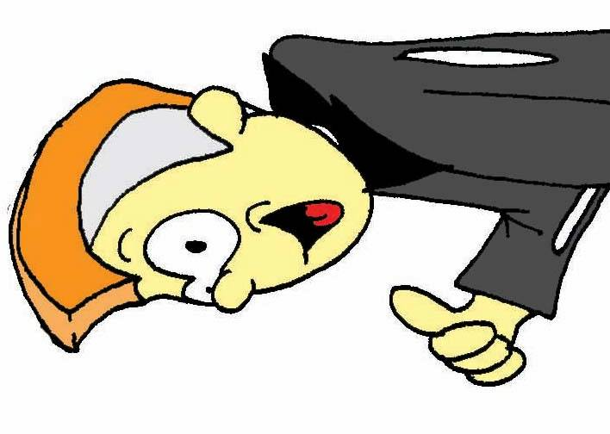
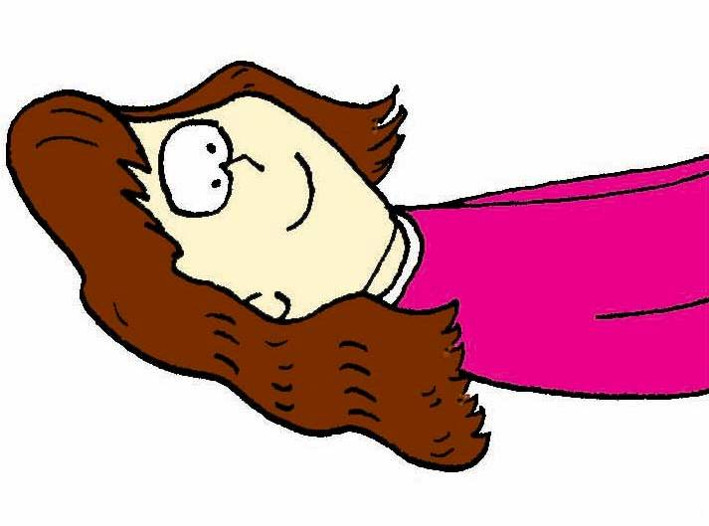
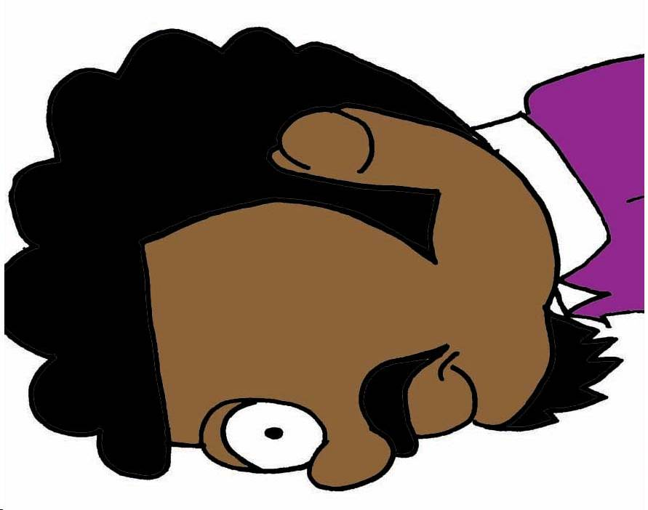
Notes:
Slide 72
What does each person look like?
What would you do to each hairstyle?
Do you like Mohawks?
What is your hair like?
What kind of jobs do they have?
Will they change their hairstyles?
Master ASL! Level One, Unit Eight (page 302)

Slide 40
Breakaway
Game
Sign your number and someone else’s number. The person with the second number signs their number and someone else’s number, and so on.

Slide 41
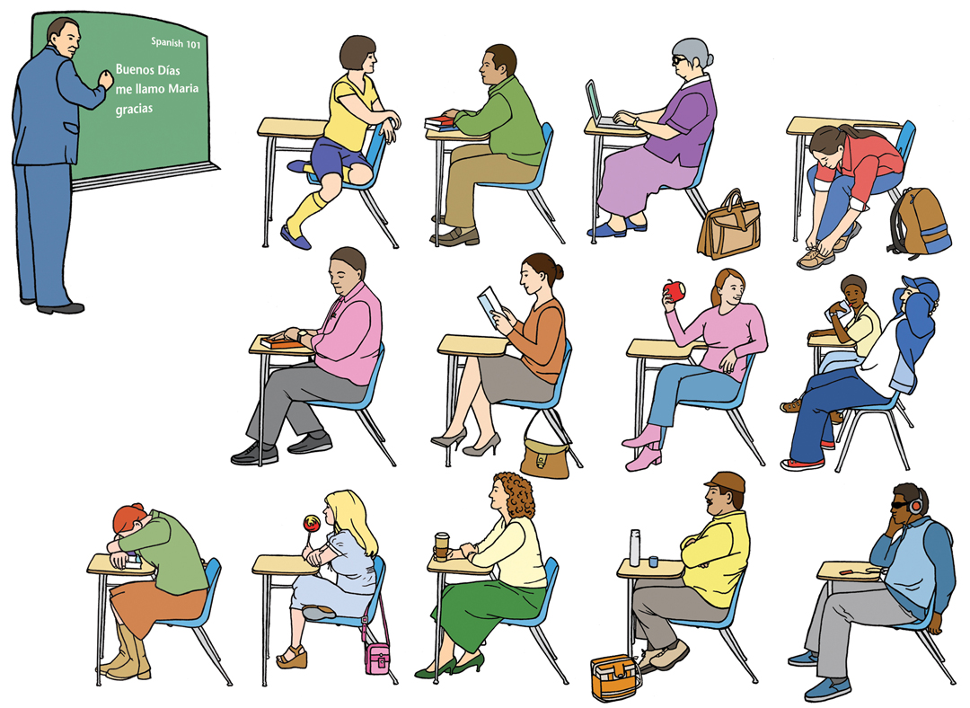
The Classroom
Notes:
M 39
2:1, p. 88, p. 93

Slide 42
Identifying Basic Clothing and Hair
Signer A: Spell a name, ask whose name it is
Signer B: Identify who (raise brows):
• gender
• brief description
• point out and glance
A: Glance and nod
B: Affirm (nod)
Notes:
M 26
1:8, p. 43

Slide 43
Lesson 1:8 Asking Who
Look at each student and see if you know their name. If you are not sure, ask that person.
Notes:
M 25
1:8, p. 40

Slide 44
Signer A: Spell a name, ask whose name it is
Signer B: Identify who (raise brows):
• gender
• brief description
• point out and glance
A: Glance and nod
B: Affirm (nod)
Notes:
M 26
1:8, p. 43

Slide 45
Did You Realize?
The hands on the statue of Abraham Lincoln at the Lincoln Memorial in Washington DC appear to spell out the initials A and L. Legend has it that Daniel Chester French, the famed sculptor, was influenced by his earlier bronze sculpture found on the Gallaudet University campus of Thomas Hopkins Gallaudet teaching a Deaf girl whose hand is forming the letter of her first name, Alice.

Slide 47
Deaf Cultural Behaviors
Getting Attention:
Handwave
Shoulder Tap

Slide 48
Deaf Cultural Behaviors
Voices
Using your voice to talk to another hearing individual instead of signing when a Deaf person is near is considered rude. Develop the habit of always signing when you know a Deaf person is in the same room with you. This way, everybody has equal access to what is being communicated.
If you must speak to a hearing person who doesn’t know ASL, then tell your Deaf friend or teacher that first, before speaking. You may be surprised to learn that most Deaf people know when hearing people are talking, even if someone is whispering. How so? Remember, Deaf people rely on their vision far more than hearing people do! Your teacher may remind you to turn off voice if you’re being rude in class.
Zinza, Jason E. (2006) Master ASL! Sign Media, Inc. Burtonsville, MD

Slide 49
Grammar Notes
Yes/No Questions in ASL
an expression that shows you are asking a yes/no question.
Keep the eyebrows raised until you’ve completed signing the question.
Examples
I’m going to the bathroom.
Am I going to the bathroom?

Slide 50
Grammar Notes
Yes/No Questions in ASL
Are you learning ASL?
Are you hearing?
Do you want to learn ASL?
Do you want to meet my friend?

Slide 51
Grammar Notes
Yes/No Questions in ASL
Work with a partner and ask him/her each question. Your partner will respond according to the information in bold. Switch roles and repeat.
Is he/she paying attention? (Yes, he/she is paying attention)
Are you sick? (No, I’m fine.)
Do they want to learn ASL? (Yes, they want to learn ASL)
Are you sleepy? (Yes, I am sleepy)
Are you Deaf? (No, I am hearing)

Slide 52
Facial Expressions & Non-Manual Signals
Non-Manual Signals (NMS) are the various parts to a sign that are not signed on the hands.
NMS or Facial Expressions - convey your tone of “voice” while you sign. Your facial expressions should match the meaning and content of what you’re signing so if you’re signing I am happy, then look happy!
Zinza, Jason E. (2006) Master ASL! Sign Media, Inc. Burtonsville, MD.

Slide 53
Using Non-Manual Signals (NMS)
Sign YES NMS-head nod
Sign NO NMS-head shake
Using the correct NMS while signing each sentence in ASL:
I’m not Deaf. I’m hearing.
Yes, I’m learning how to sign.
I didn’t go to the bathroom.
They aren’t sick.
We’re not busy.
**You don’t need a separate sign for don’t or not. Just use the head shake while signing the sentence.

Slide 54
Classroom Exercise
Use the correct sign with various facial expressions to show the difference between each meaning.
I’m not afraid….afraid….terrified.
I’m not busy…..busy…..overwhelmed.
I’m not bored…..bored…..incredibly bored.
I’m not sick…..sick…..deathly ill.
I’m not stressed…..stressed…..stressed out.

Slide 55
How important is fingerspelling?
Fingerspelling is used for:
first, last, and middle names
names of places (cities, states, stores)
titles of movies and books
certain foods
for clarification when one sign has several meanings
Example: COUNTY/COUNTRY
technical terms

Slide 56
What if I make a mistake while fingerspelling?

Slide 57
3 Letter Names
Rob Ona Ian Aga
Rea Ana Mia Tia
Gus Abe Wes Sue
Ken Kim Ned Kia
Fae Eve Sue Ace

Slide 58
Fingerspelling practice for quiz.
I will fingerspell at “normal speed” which is the average speed of Deaf people.
Hint: Only the selected names from this slides and workbook will be on the quiz. No new names.
Practice all you can with speed fingerspelling and reading fingerspelling. This is why study group and practice partners are so important to your ASL skills development.

Slide 59
Homework 1:4
Andrew Foster
He spent his life dedicated to improving education for Deaf people. A teacher, pioneer, and missionary, his legacy lives on in the many schools he opened in West Africa. (pages 14-15)
https://www.youtube.com/watch?v=ij3d-GjqTyA

Slide 60
What’s for Homework?
Practice fingerspelling your first and last name until you become comfortable spelling quickly and clearly. Watch the video for examples of fingerspelling.
Homework assignments for Thursday:
Do Homework 1:7-1:8. Bring a hard copy of Homework 1:7 (pp. 23-24), and 1:8 (pp. 25-27). Do all of them. Typed and printed. Look for the ones that said “Answers are given in class” in your Signing Naturally workbook. I will show you the answers in class for you to correct your homework and then submit it to me for full points.
* Bring your workbook to class everyday. We will do some classroom exercises from this workbook.

Slide 61
Sources:
Smith, C., Lentz, E. & Mikos, K. (1988)Signing Naturally Student Workbook Level 1. DawnSignPress. San Diego, CA
Smith, C., Lentz, E., Mikos, K. (2008) Signing Naturally Units 1-6. Dawn Sign Press. San Diego, CA.
Zinza, Jason E. (2006) Master ASL! Sign Media, Inc. Burtonsville, MD.
Eastman, G. (1989) From Mime to Sign. T.J. Publishers, Inc. Silver Spring, MD.
Pictures from Microsoft Clip Arts

